Slide 1

HealthCare App
testxyz1234455662
****************************
Sign In

Slide 2

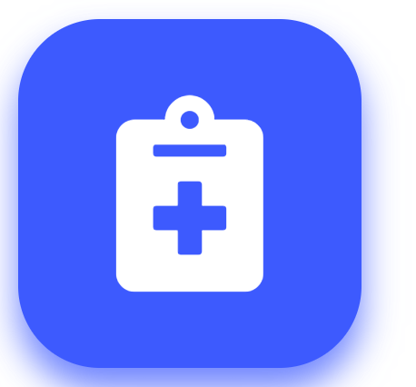
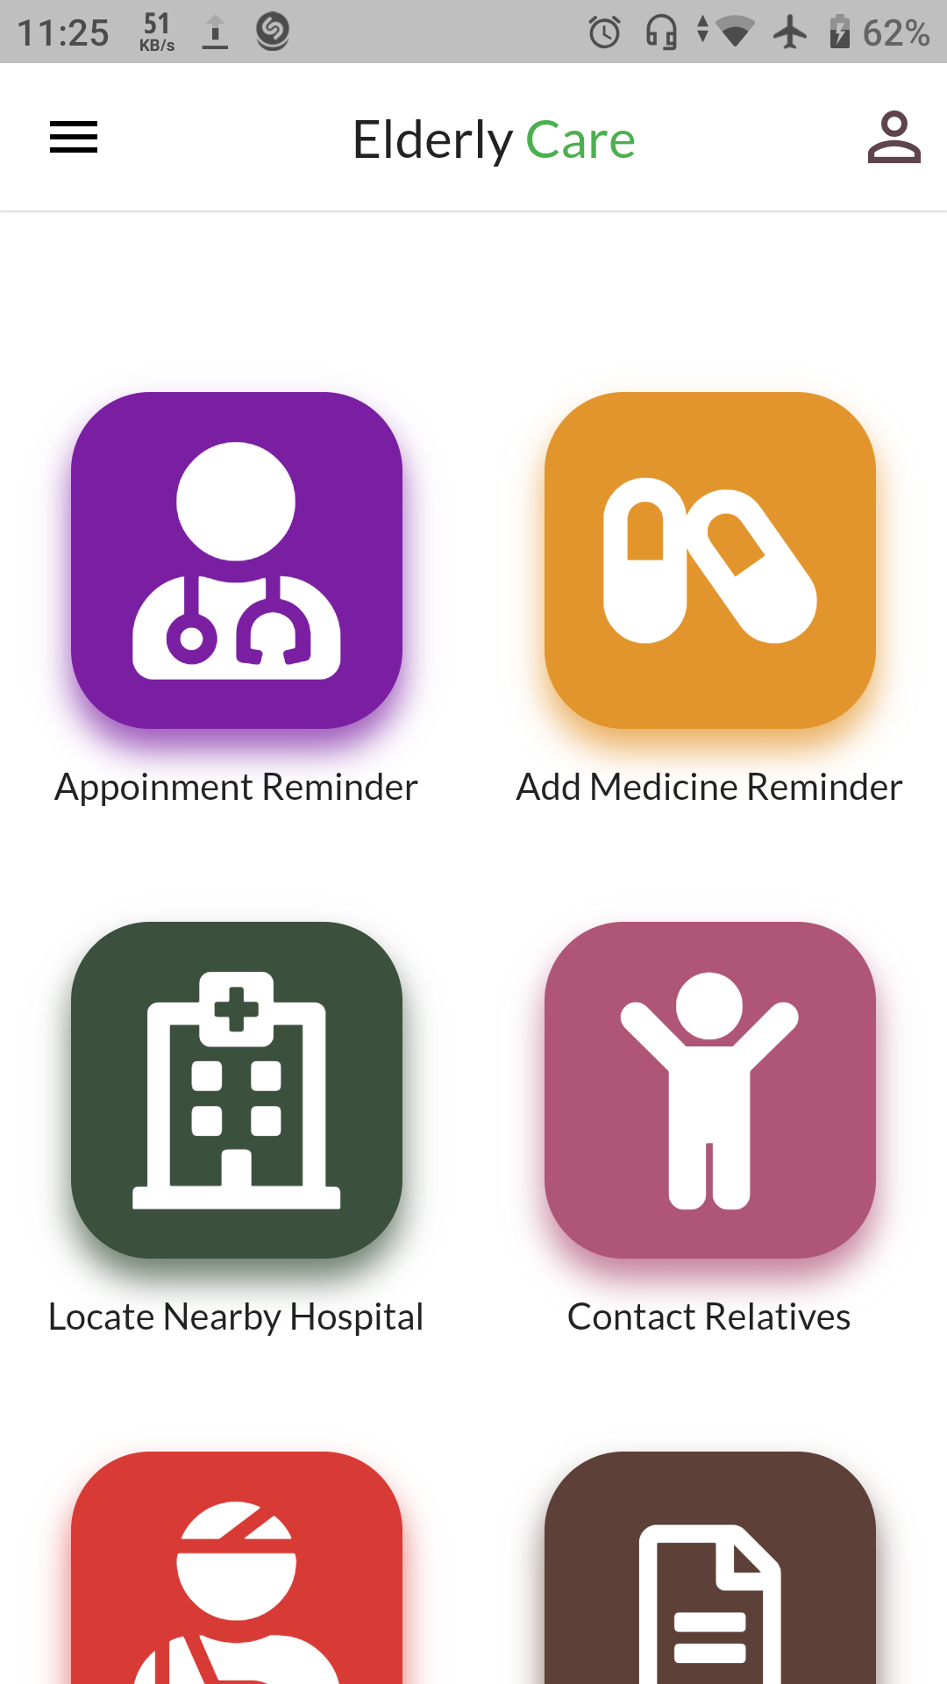
Home Page
Reminders
Medicine Store
Emergency
Situation
Exercise Record
CONSULT

Slide 3
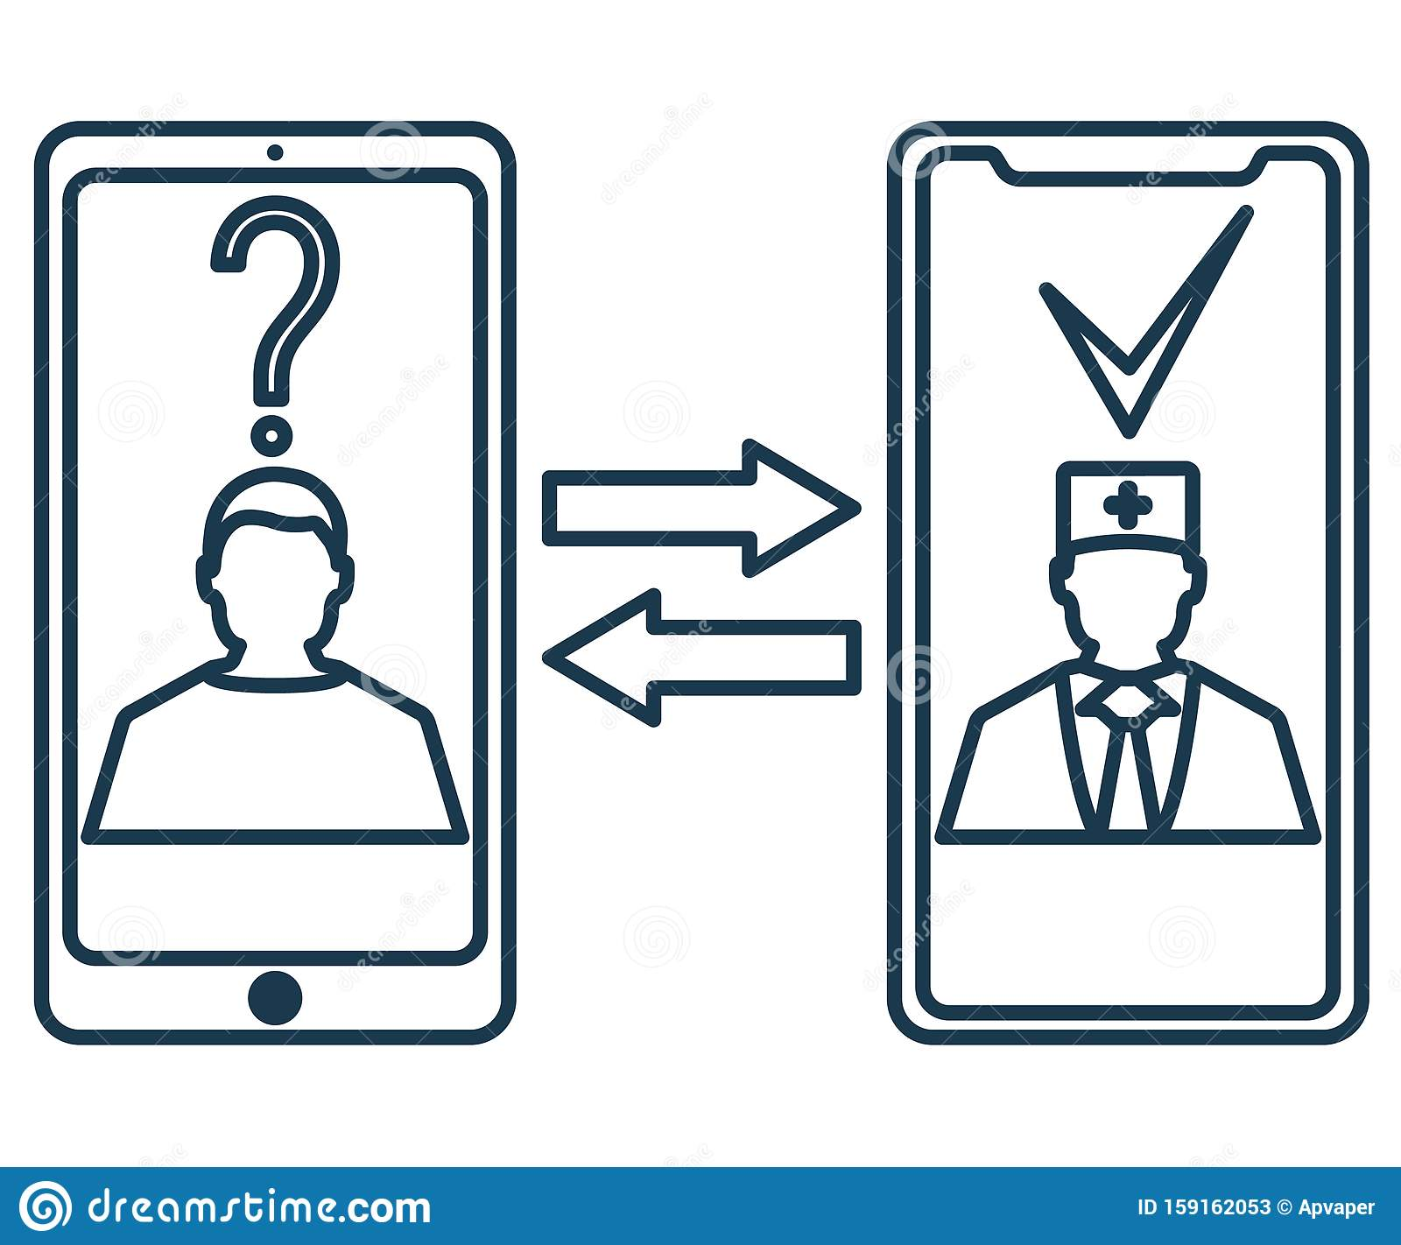


Home Page
Online consulting
Book appointment
Voice search

Slide 4

Voice Search
Please tell us about problems that you are facing currently. We will try our best to find appropriate consulting if possible!

Slide 5
Search Results
Search Results Of Your Voice Command :
1. Mr. XYZ had faced the same symptoms on 13th December 2021. Please refer to his case here.
Searching For Local Hospital(s) nearby…

Slide 6




Consulting
Voice description By The Doctor
Voice prescription
Prescription
TAGS
Consult Online
Consult Offline

Slide 7
Following Hospital(s) are found near you right now :
1. Laal Hospital , 3.6 km. Estimated Time of Arrival : 12 min.
2. Goodwill Hospital , 3.2 km. Estimated Time of Arrival : 14 min.
3. Leonardo Hospital , 5.4 km.
Estimated Time of Arrival : 19 min.
4. Humorous Hospital , 8.6 km. Estimated Time of Arrival : 25 min.
You have currently selected :
Laal Hospital
CONFIRM

Slide 8
\
HealthCare App 10.08PM
Dear customer, our HealthCare agent will call you in some time.
Home Page
Reminders
Medicine Store
Emergency
Situation
Exercise Record
CONSULT

