Slide 1
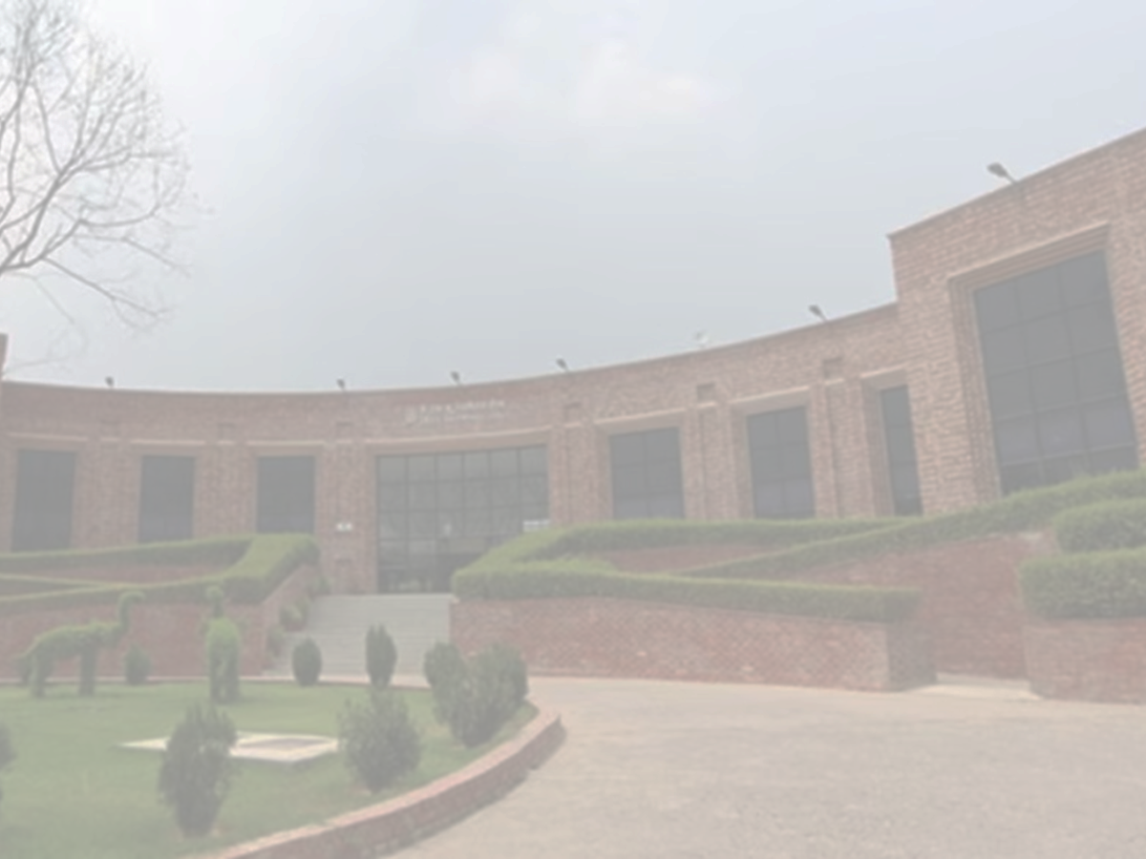





3rd International Conference on Recent Advances in Nanoscience and Nanotechnology-2025 (ICRANN-2025)
December 20-21, 2025
Organized by
Special Centre for Nanoscience (SCNS)
Jawaharlal Nehru University (JNU), New Delhi-110067
Paper ID:
Title of the Paper
Author Names:
The size of the poster is A0 (841 mm x 1190mm)
The poster layout is flexible. Authors are encouraged to design their posters based on the following content requirements.
Abstract
Introduction
Proposed Methodology
Results and Discussions
Novelty
Conclusions /Future work
Preferred font size and text:
All text in “Times New Roman”
The font size of the headings : 54 pt
The font size of the text: 36 pt

