Slide 1

WATER PIPELINE MONITORING SYSTEM Product Design Practice
NAME ​ | ROLL NO​
V.PRADEEP KUMAR​ | EDM19B018​
P.LAKSHMI VISWANADH​ | EDM19B021​
YASH KUMAR SAHU​ | CED19I039​
G.PAUL PRINCE​ | COE19B026​

Slide 2
Roadmap
Assess water quality impacts in direct and supplier operations and throughout the product life cycle (where relevant) and use this assessment to inform target-setting and develop short-term priority actions
It evaluates all chemical properties collected by the sensors, when whole product was turned on .
Here the product will be useful for external agriculture fields, house water quality testing and city monitoring system.

Slide 3
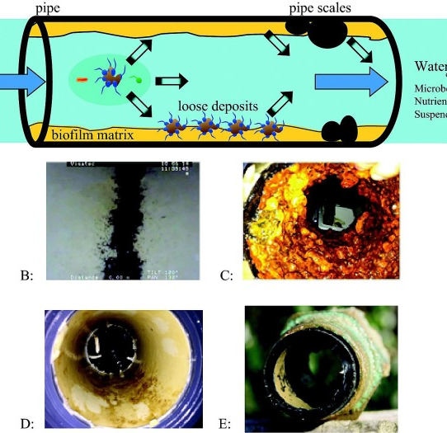
Introduction
Water pipeline networks in city’s are hard to manage manually. Real-time Monitoring and detection of water contamination, flow rate , and leaks in pipelines & purity of water are very difficult.

Slide 4
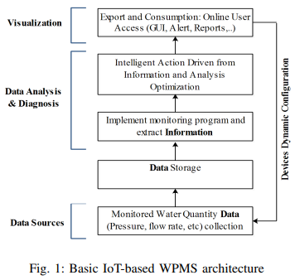
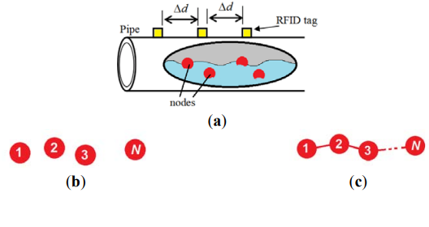
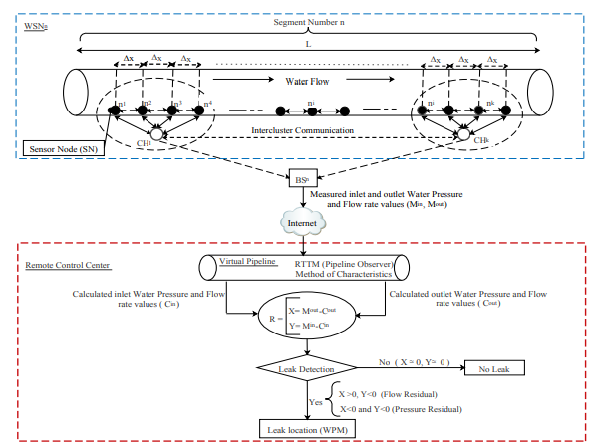
Literature
1) Hybrid Mechanism for Remote Water Pipeline Monitoring System
3) A Proposed Scalable Design and Simulation of Wireless Sensor Network-Based Long-Distance Water Pipeline Leakage Monitoring System
2) Remote Water Pipeline Monitoring System IoT-based Architecture for new Industrial era 4.0
Abstarct : Hybrid monitoring techniques are employed to offer a robust approach for leak detection that overcomes the challenges of traditional methods and to enhance the localization process. In this paper, hybrid mechanism based on Real Time Transient Modeling and Wave Propagation Method is implemented to detect and locate the position of the leak in a water pipeline
Abstarct : Internet of Things (IoT) technology based on intelligent sensors and physical objects networks is implemented to supervise the Water Distribution System and to cope with water wastage during the supply process.
Abstarct : The proposed design targets long-distance aboveground water pipelines that have special considerations for maintenance, energy consumption and cost.
Conclusion: In this paper, a scalable design and simulation of a non-real-time RFID-WSN-based long-distance aboveground water pipeline leakage monitoring system is presented. The system is based on deploying multiple mobile sensor nodes such that only one node is active for specific period of time. While a node is active, the other nodes are in sleep mode
Conclusion: In this paper, in order to guarantee a suitable water pipeline monitoring in this project, we have implemented hybrid technique that combines the RTTM method for real-time leak detection with the wave propagation method for leak
Conclusion: A proposed IoT-based Water Pipeline Monitoring System is highlighted with detailing its implemented layered architecture

Slide 5
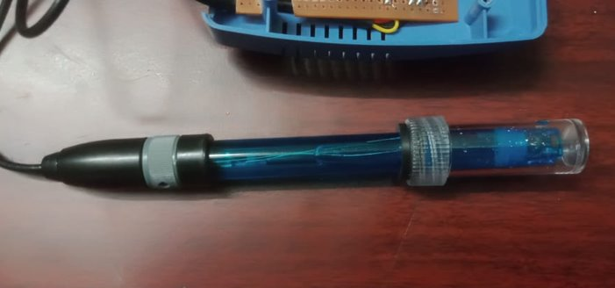
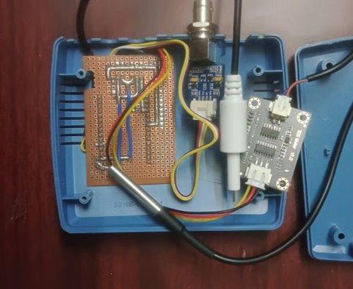
Current Contest
Our product consists of three sensors and one Esp module.
Our product was packed up with a box and interior with wiring modules .
we measured water quality can be measured by collecting water samples for laboratory analysis or by using probes which can record data at a single point in time or logged at regular intervals over an extended period.

Slide 6
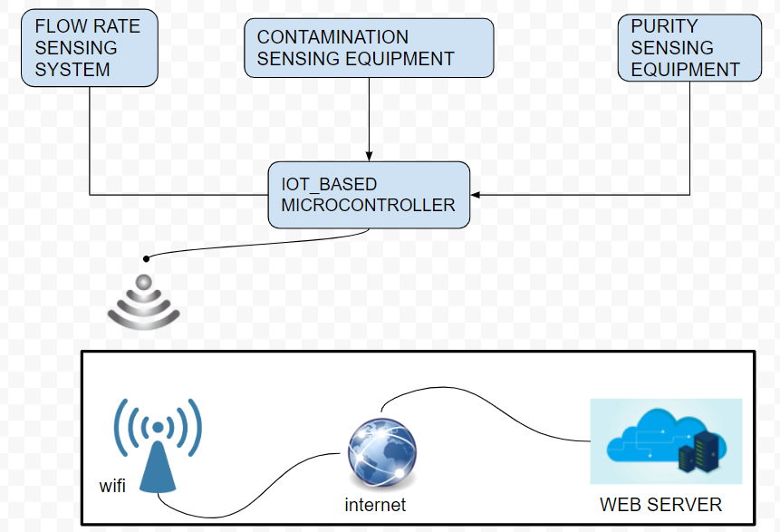
Working principle
The solution is to make an IoT-based product that monitors the water contamination, purity, pipeline pressure, and flow rate in real-time.​
The data collected from the device will update on a website. ​
By using the data available from the cloud, it is easy to manage the complex pipeline networks.

Slide 7
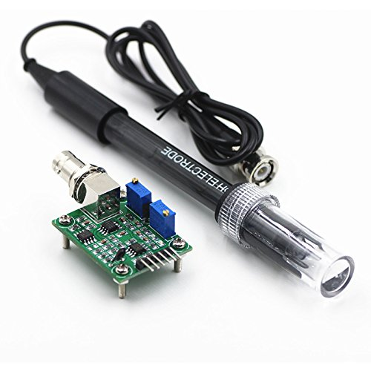
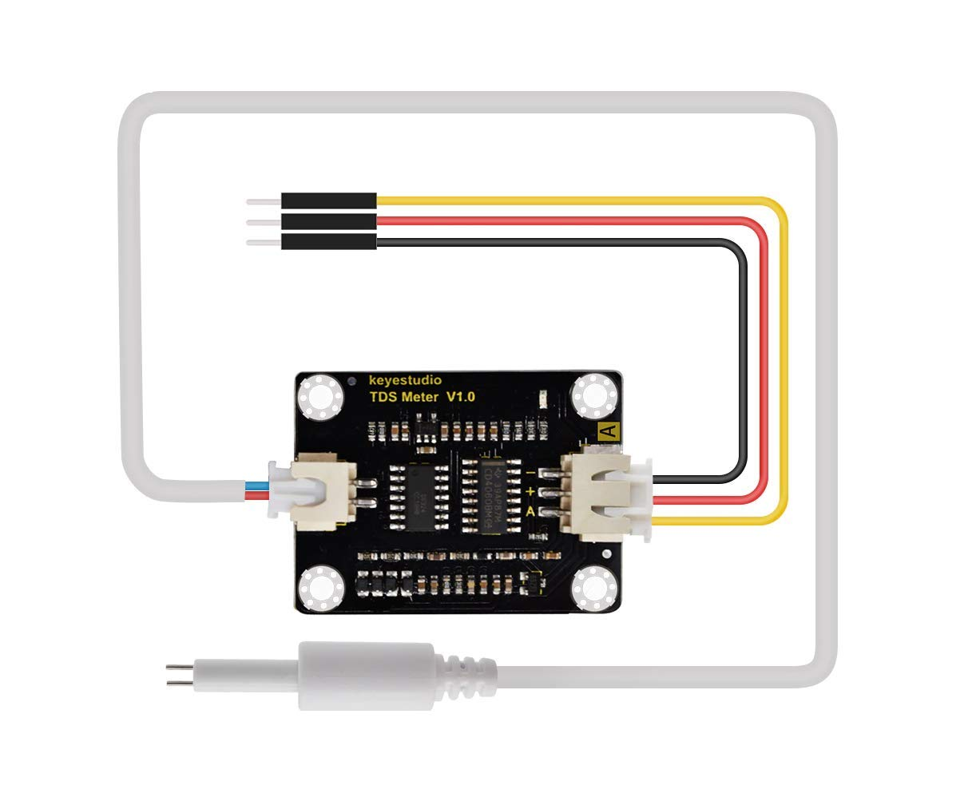
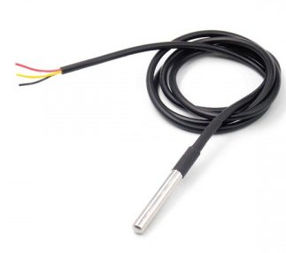
Parameters to be collected
There are a lot of parameters for judging water quality. Using multiple parameters, we can get a more accurate estimate of water quality.
Increasing the parameters will increase the use of multiple sensors and cost.
So, in our product we are using 6 parameters but only using 3 sensors, and extraction of remaining parameters were from a combination of these sensors.
SN.NO | PARAMETER | MODE OF SENSING
1) | PH | PH SENSOR
2) | TDS | TDS SENSOR & TEMP SENSOR
3) | CONDUCTIVITY | TDS(mg/L)≅EC(dS/mor umho/cm)×(0.55–0.7)
4) | HARDNESS | From tds sensor we can extract hardness
5) | SALANITY | SAR = {(PH – a)*(1 + c*EC)/b}^2
6) | CHLORINITY | SALANITY = 1.80655*Chlorinity(ppt)

Slide 8
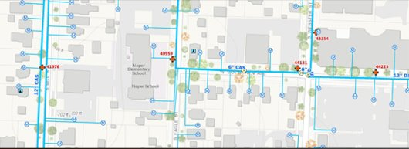
Product’s placement in a pipeline network:
The most significant challenges currently facing implementing the product in the pipeline system and placing of the product.
The function of a water pipeline system is to deliver water to all locations within the pipeline.
Here the product needs to cover the whole network and monitor the readings.
SOLUTIONS
Hence for monitoring the pipeline network we are placing our product at some junctions where it can cover whole sides of the pipeline.
Here we can see the rough sketch of pipeline network
The product was being placed at top of the pipeline ; it should be closed by using a threaded forcible cap

Slide 9
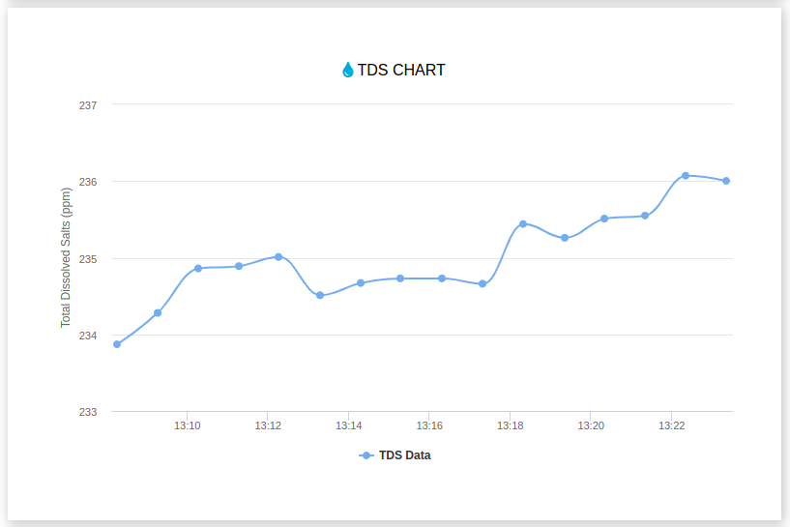
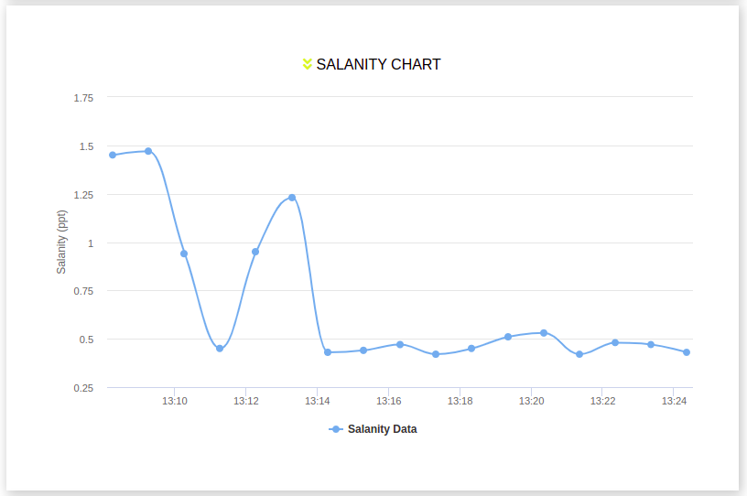
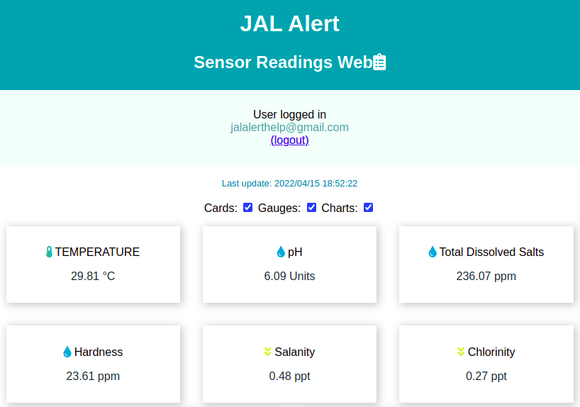
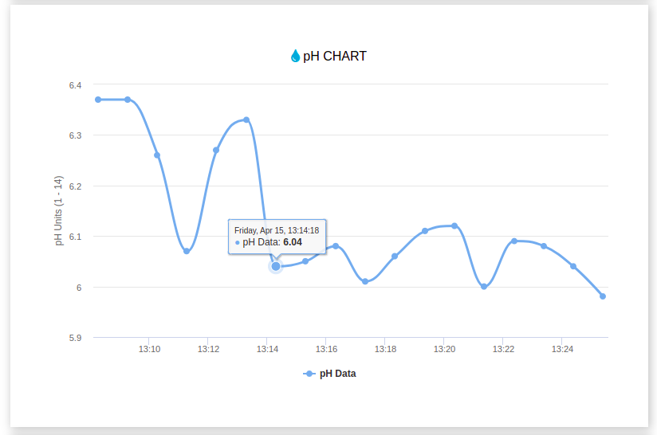
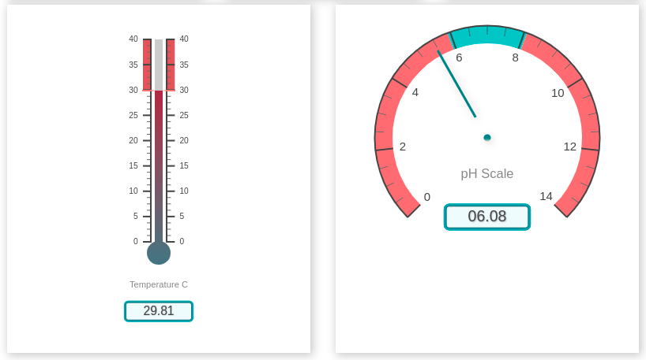
RESULTS

Slide 10
Future enhancement
Detecting the leakage in the pipeline network
Currently we are working only on managing the pipeline network, I future we can even solve some pipeline related problems with the help of product it self.
We can even extend the monitoring capabilities, beyond pipeline networks to commercial house hold , farms etc.

