Slide 1
Forest Fire Detection and Notification System
Presented By
Anish Mendhe
Ayush Mishra
Nakshatra Shindekar
Yash Kangale
Under the Guidance of
Name of Guide
Dr. B. Y. Masram

Slide 2
Contents
Introduction
Problem Statement
Literature Survey
Methodology
Work Done
References

Slide 3
Introduction
Forest fires pose a significant global challenge, particularly during the summer months. According to the Forest Survey of India, an alarming number of over 300,000 forest fires were detected between November 2020 and June 2021 alone. Moreover, the Indian State of Forest Report (ISFR) for 2019 highlights that approximately 36% of the country's forest cover is susceptible to wildfires, with around 54.4% of forests in India being exposed to occasional fires. This escalating trend in forest fires has devastating consequences, including the destruction of vegetation, habitats for wildlife, and soil quality degradation. Additionally, the emission of toxic gases and CO2 exacerbates health risks and contributes to global warming.

Slide 4
Problem Statement
Traditional fire detection methods such as Patrols, Lookout towers require constant human supervision and hence, tend to be slower and very exhaustive. Satellites Imagery provide a faster but costly alternative.
A 2-step wildfire detection system combines sensor network monitoring for real-time gas and smoke detection with camera-based image analysis to substantially decrease false positives. By utilizing MQ sensors in a Wireless Sensor Network (WSN) to detect forest fire emissions and conducting on-board image processing with the YOLOv8 Object Detection Model on a Raspberry Pi, the system effectively confirms wildfire presence, minimizing unnecessary alerts and optimizing resource utilization.

Slide 5
Literature Review
Sr no​ | Research Paper ​ | Finding​
1 | Real-time Forest Fire Detection with Wireless Sensor Networks. Liyang Yu, Neng Wang, Xiaoqiao Meng. IEEE Date of Conference:25-27 May 2009 Date Added to IEEE Xplore:30 June 2009 | Sensor Network for Forest Fire Detection. Clustering, Data Collection, Data Processing in Wireless Sensor Network.

Slide 6
Literature Review
Sr no​ | Research Paper ​ | Finding​
2 | [S. Madkar, D. Y. Sakhare, K. A. Phutane, A. P. Haral, K. B. Nikam and S. Tharunyha, "Video Based Forest Fire and Smoke Detection Using YoLo and CNN," 2022 International Conference on Power, Energy, Control and Transmission Systems (ICPECTS), Chennai, India, 2022, pp. 1-5, doi: 10.1109/ICPECTS56089.2022.10046717. | The effectiveness of YOLO and CNN architectures in detecting forest fires and smoke in video footage. The study could discuss the comparative analysis of detection accuracy, speed, and computational efficiency between the two methods.

Slide 7
Literature Review
Sr no​ | Research Paper ​ | Finding​
3 | W. Wang, Q. Huang, H. Liu, Y. Jia and Q. Chen, "Forest Fire Detection Method Based on Deep Learning," ," 2022 International Conference on Cyber-Physical Social Intelligence (ICCSI), Nanjing, China, 2022 Date Added to IEEE Xplore:23-28 2022 | Deep learning methods show promise in improving forest fire detection accuracy compared to traditional approaches. Various deep learning architectures, such as convolutional neural networks (CNNs) or recurrent neural networks (RNNs), have been successfully applied in fire detection tasks.

Slide 8
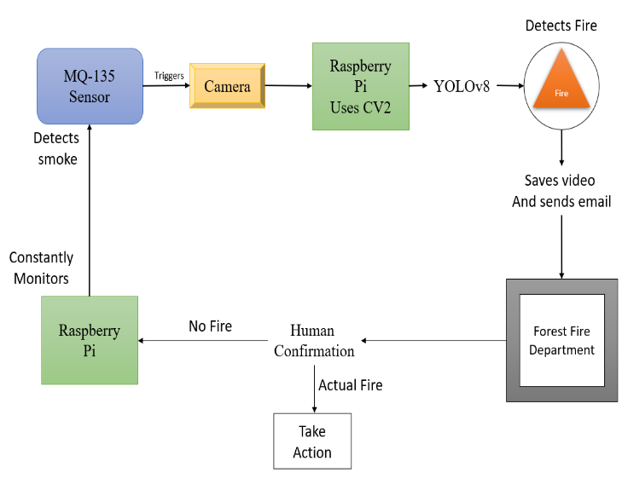
Methodology

Slide 9
Work Done
The proposed system integrates IoT and Deep Learning to enhance forest fire detection accuracy and power efficiency.
It employs MQ sensors in a Wireless Sensor Network (WSN) to detect gases and smoke generated during forest fires.
Raspberry Pi is utilized for on-board image processing using the YOLOv8 Object Detection Model, reducing memory and power consumption.
The system implements a two-step verification process, triggering the camera only after smoke detection, thus optimizing resources.
Real-time processing with YOLOv8 enables prompt alert signals to be sent to the fire department, facilitating early response to wildfires.
Raspberry Pi serves as the central base station for the wireless sensor network, coordinating data collection and processing.

Slide 10
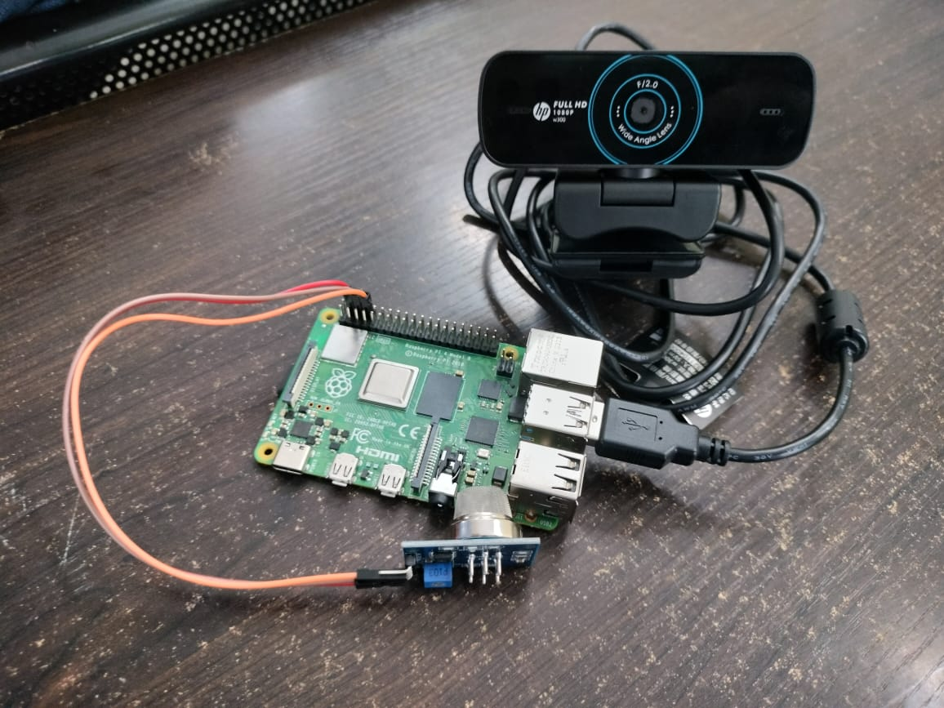
Work Done
Forest Fire detection Prototype

Slide 11
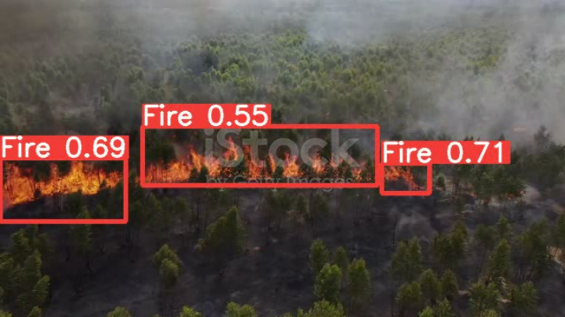
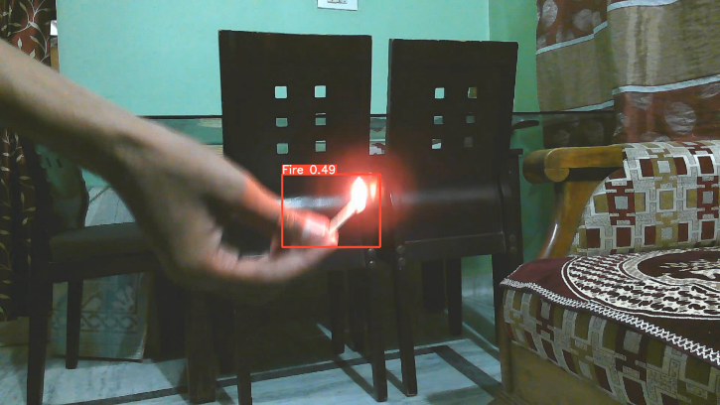
Results:
Fig2.Fire detection with 0.49 confidence value with web cam
Low Resolution stock video with different resolution value

Slide 12
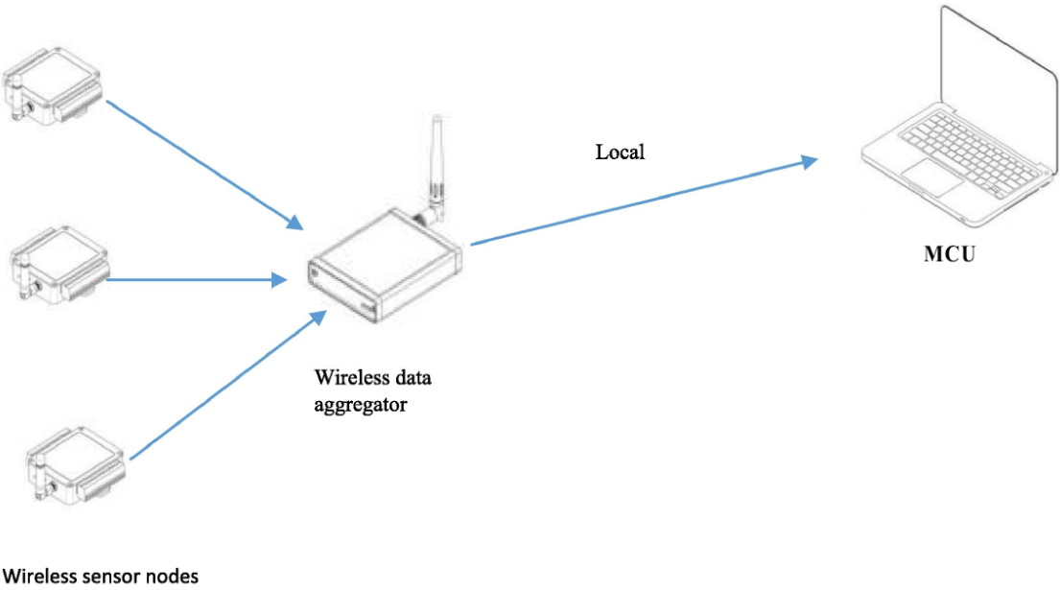
Project plan
Wireless Sensor Network

Slide 13
Project Plan
Proposal: Extension of a two-step wildfire detection system with Raspberry Pi serving as a central base station to coordinate a Wireless Sensor Network (WSN).
Integration: Incorporation of Esp8266 wireless communication nodes into the existing sensor network framework for enhanced coverage and scalability.
Data Handling: Raspberry Pi acts as the central hub for data aggregation and processing, receiving data from strategically deployed Esp8266 nodes across the forest area.
Continuous Monitoring: Utilization of MQ sensors in the WSN for real-time monitoring of gas and smoke emissions in forest regions.
Image Analysis: On-board image analysis conducted on the Raspberry Pi using the YOLOv8 Object Detection Model to confirm the presence of wildfires based on visual cues.
Objectives: Aim to improve wildfire detection accuracy, optimize resource utilization, and facilitate coordinated response actions for effective wildfire management.

Slide 14
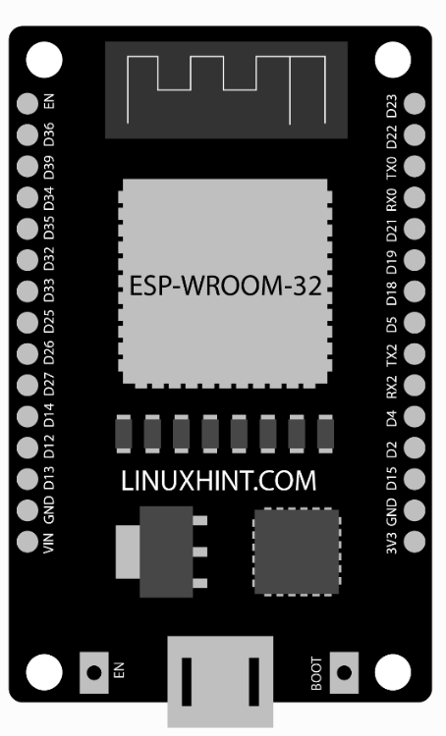
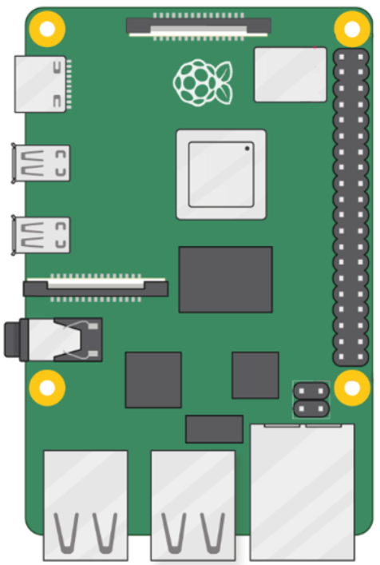
Node address: 1
Node A2: Active
Base address: A
Every 10s
Node address: 3
ESP8266

Slide 15
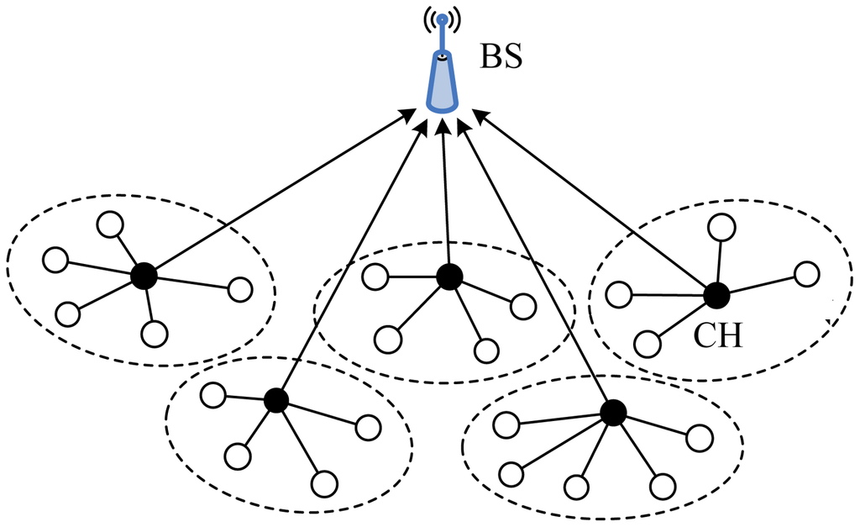
Node D3 Active
a
c
e
b
5
d
1
4
3
2

Slide 16
References
[1] D. T. Phan, K. -H. Yap, K. Garg and B. S. Han, "Vision-Based Early Fire and Smoke
Detection for Smart Factory Applications Using FFS-YOLO," 2023 IEEE 25th International
Workshop on Multimedia Signal Processing (MMSP), Poitiers, France, 2023, pp. 1-6, doi:
10.1109/MMSP59012.2023.10337640.
Vision-Based Early Fire and Smoke Detection for Smart Factory Applications Using FFS-YOLO
| IEEE Conference Publication | IEEE Xplore
[2] S. Madkar, D. Y. Sakhare, K. A. Phutane, A. P. Haral, K. B. Nikam and S. Tharunyha, "Video
Based Forest Fire and Smoke Detection Using YoLo and CNN," 2022 International Conference
On Power, Energy, Control and Transmission Systems (ICPECTS), Chennai, India, 2022, pp. 1
5, doi:10.1109/ICPECTS56089.2022.10046717. Video Based Forest Fire and Smoke
Detection Using YoLo and CNN | IEEE Conference Publication | IEEE Xplore
[3] T. Wang, R. Cao and L. Wang, "FE-YOLO: An Efficient and Lightweight Feature-Enhanced
Fire Detection Method," 2022 3rd International Conference on Electronics, Communications
And Information Technology (CECIT), Sanya, China, 2022, pp. 253-258, doi:
10.1109/CECIT58139.2022.00051.

Slide 17
THANK YOU

