Slide 1

Dharmsinh Desai University, Nadiad
Page | 1
Faculty of Technology, Department of Information Technology
B.Tech. IT Semester – VI Subject: SDP
Project Title:
Stock Market Look-up And Prediction System
NAME : KANJIYA YASH ROLL NO : IT054
NAME : KARANGIYA KULDIP ROLL NO : IT055

Slide 2

Page | 2
DHARMSINH DESAI UNIVERSITY, NADIAD
FACULTY OF TECHNOLOGY DEPARTMENT OF INFORMATION TECHNOLOGY
CERTIFICATE
This is to certify that the project entitled “Stock Market Look-Up And Prediction System” is a bonafide report of the work carried out by Kuldip Karangiya, Student ID 19ITUBS068 and Yash Kanjiya ,Student ID 19ITUOS057 of Department of Information Technology, semester VI, under the guidance and supervision for the subject Software Development Project. They were involved in Project training during the academic year 2021- 2022.
Prof. Anand D Dave,
Information Technology, Dharmsinh Desai University,
Nadiad.
Prof. Vipul Dabhi
Head of department.

Slide 3
 | Page | 3
Table of Content
Table of Content | 3
Abstract | 4
Introduction | 5
Purpose : | 5
Scope : | 5
Technologies : | 6
Tools : | 6
Software Requirement Specification | 7
Functional Requirements | 7
Design | 9
Use Case Diagram : | 13
Class Diagram : | 14
Sequence Diagram : | 15
Activity Diagram : | 11
Component Diagram : | 21
Deployment Diagram : | 22
Data Flow Diagram : | 23
Structure Chart : | 23
Implementation Details | 24
Screen-shots of the System | 26
Conclusion | 35
Limitations and Future Enhancement | 36
Reference | 37

Slide 4
Page | 4
Abstract
Stock Market systems contain real time live prices of the stocks and indexes.
Using our system users can make an account and also get the
historical prices and charts. so that users can make decisions when to buy and how much.
Users can also make triggers on the stocks.
User can also make watch-lists as he wants. User can see the information related to IPO.
Our System provides reliable price charts and also information about the company.
Our system provides information about basic fundamental data about the company.
Users can also see the market related prediction.
Users can manage portfolio and get ROI (Return of Investment) Value .

Slide 5
Page | 5
Introduction
Stock Market look-up system has 2 users which is End User and Admin.
In our system, we can provide a search option which is used for searching companies and add them to the watchlist. Users also can look into the chart and take decisions on them. Users also can get OHLC ( Open,High,Low,Close ) price of that day.User can Produce Trigger so that when price reaches to that level then system notified the user. Users can also view the company details (like current price,symbol,sectors,description,etc.. ).Users can see the stocks related prediction. Users can manage the portfolio and ROI(Return of Investment) value.
Purpose :
This document consists of all the functional and nonfunctional requirements of the Stock Market Look-up system and all the other requirement related details. This SRS document will be used as a reference and a guidance for the designer and development process ahead.
Scope :
This System can be useful to everyone who wants to see the real-time price of the US market stock and for he/she needs to register through our portal. This system is designed to help traders and investors to do research on the market at one platform. Scope of the application is global and open for all users. End Users have to provide his details ( name, email, phone_no. ) and other information which is used to notify users about triggering so that they can use this platform. Users can see the market related prediction and manage their portfolio.

Slide 6
Page | 6
Technologies :
HTML 5, CSS3
Material UI
React JS
Express JS
Node.JS
Highcharts
MongoDB
Alpaca API for getting market data
Polygon.io for getting fundamental data
Stremlite python App Framework
Sqlite3 database
Keras python library
Numpy and pandas
Tools :
Visual Studio Code with Extension for typescripting(ESLint)
Postman for testing Web Request
MongoDB compass (GUI of MongoDB)

Slide 7
Page | 7
Software Requirement Specification
Types of User
End User
Admin
Functional Requirements R.1 : Manage User
: Sign Up
Primary Actor : User
Precondition : Internet connection available
INPUT : Name, Email, Password, Phone number OUTPUT : Registration Successful
Description : User can make account through sign up.
: Login
Primary Actor : User
Precondition : User must be registered
INPUT : Email and Password
OUTPUT : Login successful and redirected to Homepage
Description : The user can login into the system.

Slide 8
Page | 8
: Forgot Password
INPUT : Click the forgot password link
OUTPUT : The user can add new password and confirm password
Description : If user forget password then they can reset password through OTP.
: Logout
INPUT : Click on Logout OUTPUT : Successfully Logged out
: Manage Stocks
: Add the Stocks on Watch-List
INPUT : Company Symbol
OUTPUT : Stocks price and name shown to the dashboard
Description : User can add the company to watchlist so that they can see all data.
: Delete the Stocks on Watch-List
INPUT : Click on Stock in Watchlist OUTPUT : Stock successfully deleted
Description : User can add stock to watchlist and Delete the stock on watchlist.
: Watch the stock prize
Precondition : NIL
INPUT : Search any Stock or Index OUTPUT : Display the Stock price

Slide 9
Page | 9
Description : The user can search any company stock.
: Watch all information about stocks
Precondition : NIL
INPUT : Company Symbol
OUTPUT : Name,Current Price,(OHLC),Sector Description
Description : The user can see all the information about stock.
: View Chart (Historical and Live)
Precondition : NIL
INPUT : Click on selected stock in watchlist OUTPUT : View chart of selected stock
Description : The user can see the historical chart of any stock.
: Computation
Precondition : NIL
INPUT : User add the invested amount and year OUTPUT : Networth and ROI
Description : User can see the profit.

Slide 10
Page | 10
: Manage Triggering
Precondition : NIL
: Put the Trigger
INPUT : Trigger price of the particular stock OUTPUT : Success/Failure message
: Update the Trigger
INPUT : Updated Trigger Price OUTPUT : Success/Failure message
: Delete the Trigger
INPUT : Triggered Stock OUTPUT : Success/Failure message
Description : The user can set alert for any stock price and update and delete the trigger. If the stock price will cross the limit then user can get instant e-mail Related to stock.
: Manage Portfolio and Market Prediction
Precondition : NIL
: Information about IPO
INPUT : Click on IPO tab
OUTPUT : Display all information related IPO
Description : User can see the all detail of IPO.
R.4.2 : Manage Portfolio
Input : Add the stock with quantity and date Output : Display the net profit of invested amount.

Slide 11
Page | 11
Description : Display the total invested amount and give the net profit value after given time range.
.
R.4.3 : Market Prediction
Precondition : NIL
INPUT : Select the Index
OUTPUT : Display the Bullish or Bearish value of price.
Description : Display the market Trade predictive chart.
: Manage Admin
: Login
INPUT : Email and Password OUTPUT : Login Successful
: View User
INPUT : Username OUTPUT : Details of End User
Description : The Admin can see the details of user through Username.

Slide 12
Page | 12
Non Functional Requirements
Performance : It is very important to know that system performs certain functions under specific conditions. Examples like speed of response, throughput, execution time and storage capacity. This system should be designed in such a way that its performance is smooth for users.
Security : It is a primary requirement of any system. It must maintain data in a secure way so that unauthorized entities do not have illegal access of the system.
Availability : System must be available to all authorized users when it is required at any time. In any abnormal situation like loss of internet connection user’s data should not be lost.
Scalability : It is a property of a system that describes the ability to handle increasing and decreasing workload. It means the ability to grow or shrink a piece of software to meet changing demands on a business. Software scalability is critical to support growth, but also to pivot during times of uncertainty and scale back operations as needed.

Slide 13
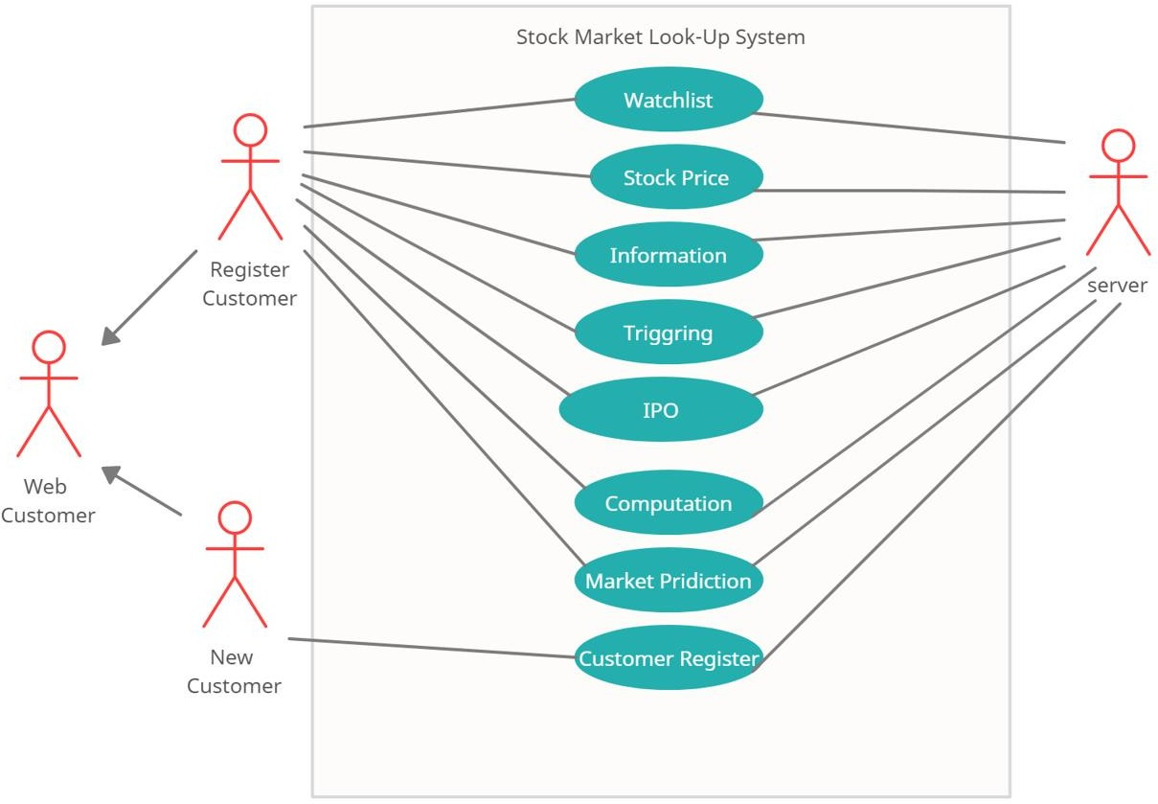
Page | 13
DESIGN :
Use Case Diagram :

Slide 14
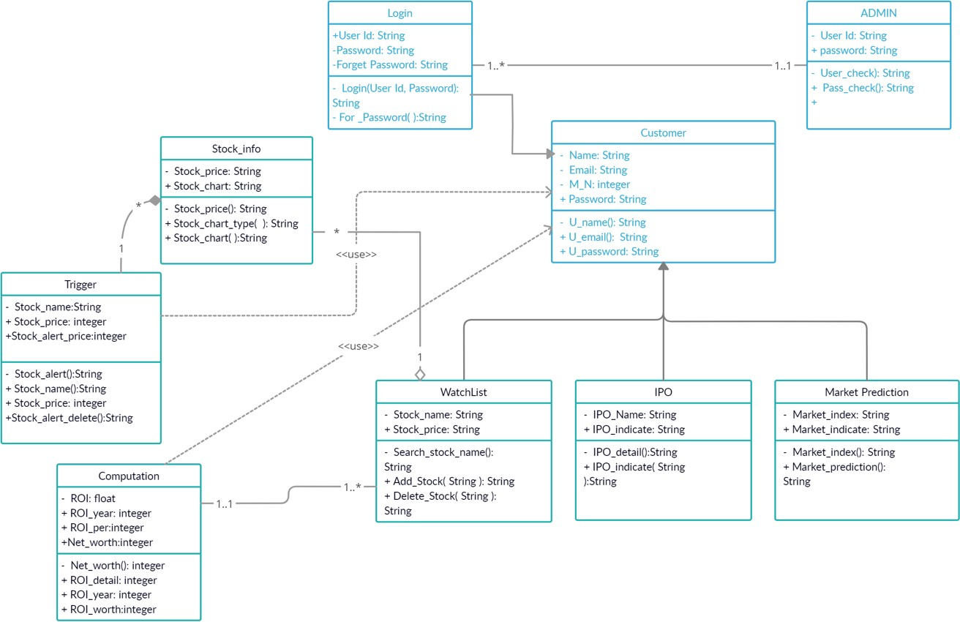
Page | 14
Class Diagram :

Slide 15
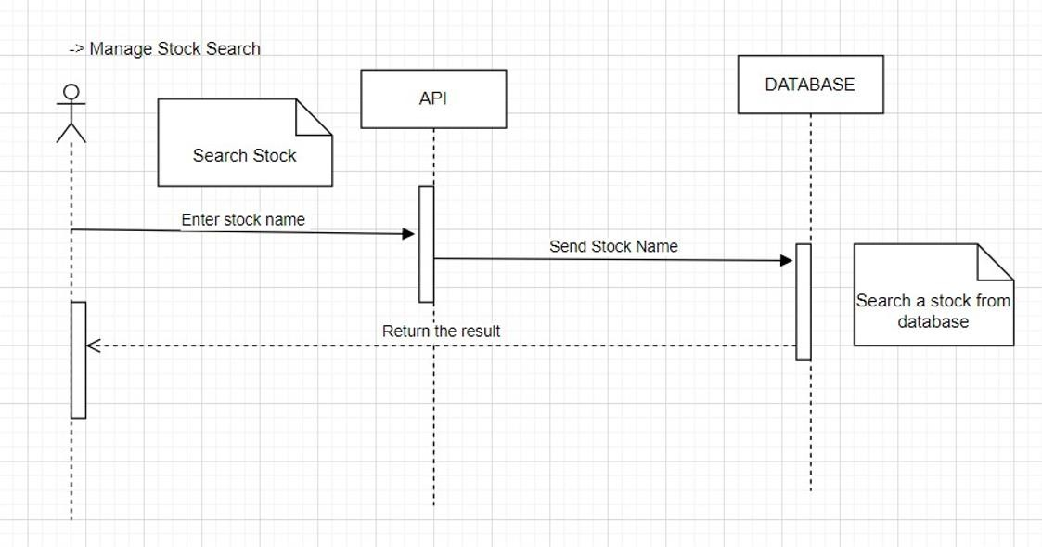
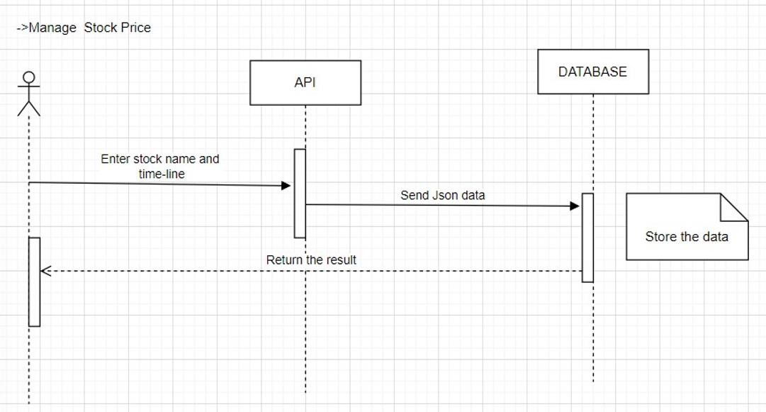
Page | 15
Sequence Diagram :

Slide 16
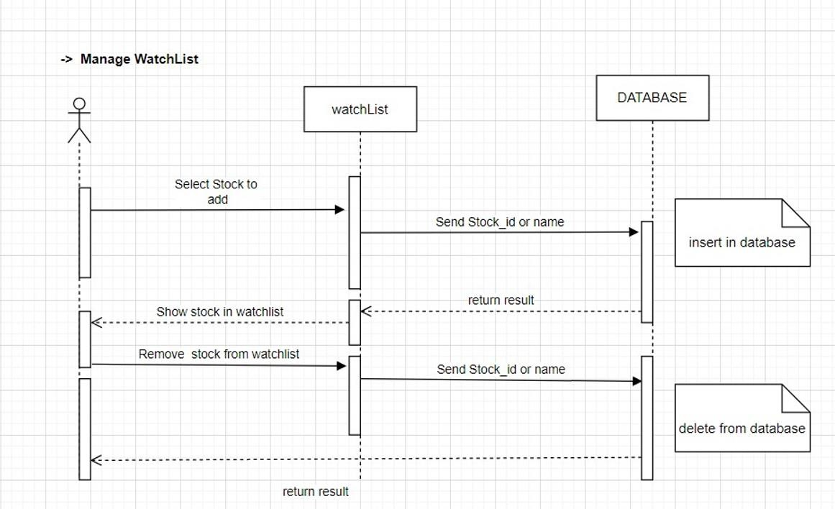
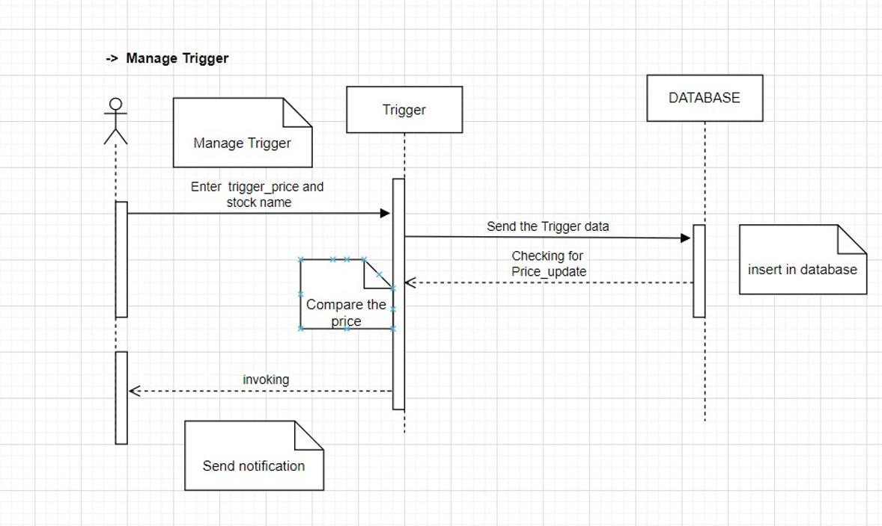
Page | 16

Slide 17
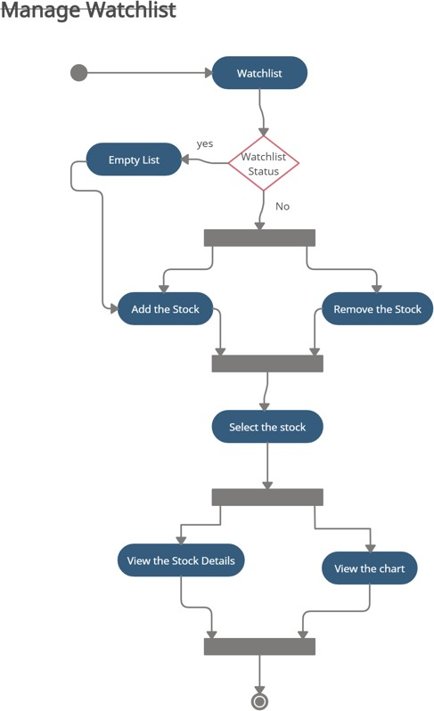
Page | 17
ACTIVITY DIAGRM :

Slide 18
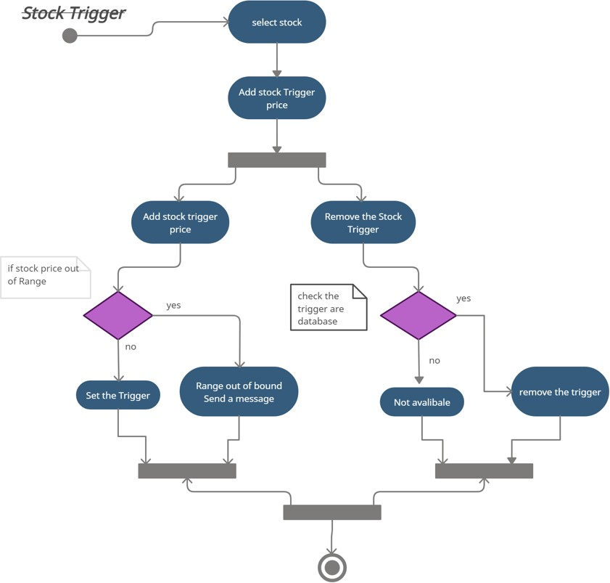
Page | 18

Slide 19
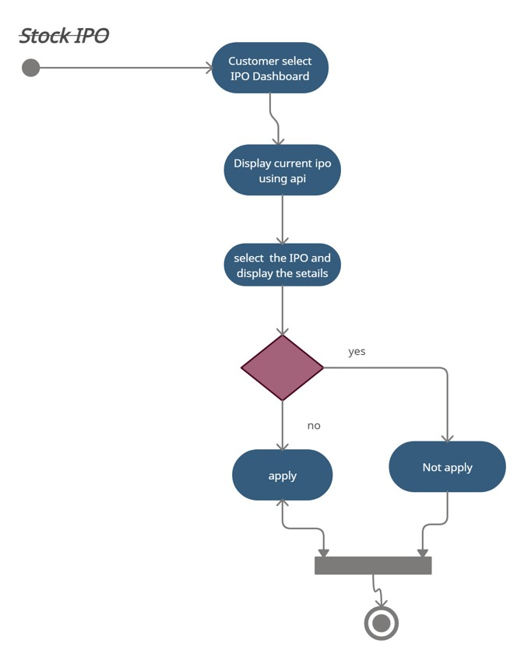
Page | 19

Slide 20
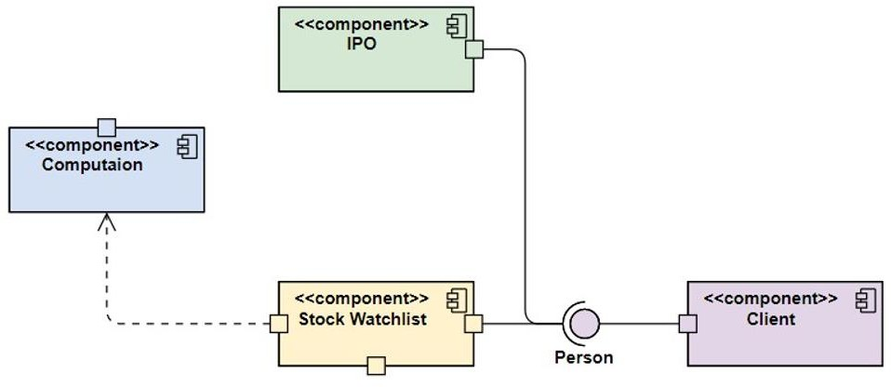
Page | 20
Component Diagram :

Slide 21
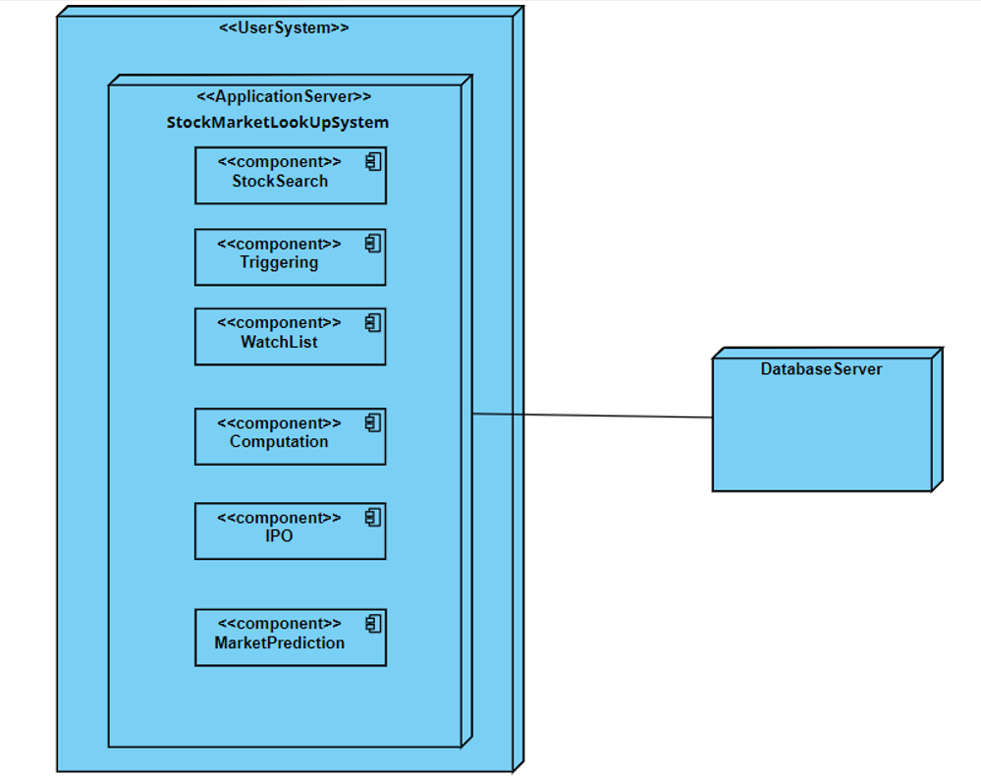
Page | 21
Deployment Diagram :

Slide 22
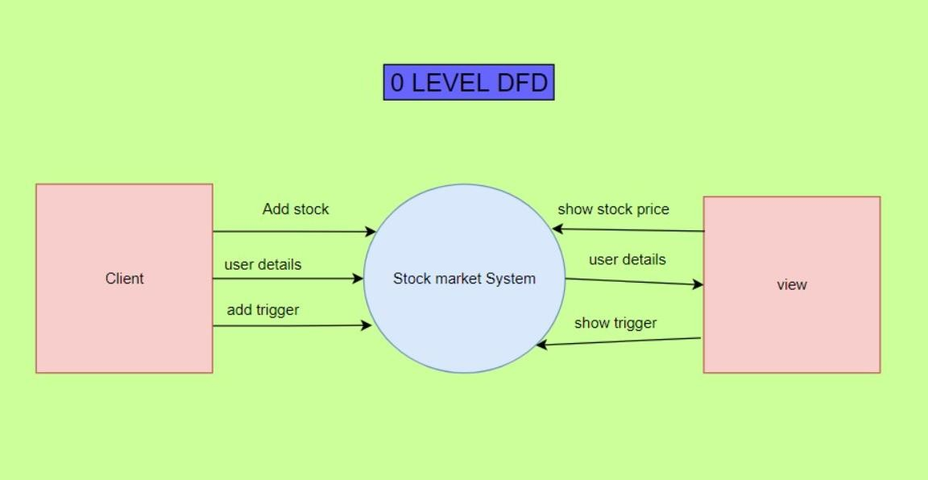
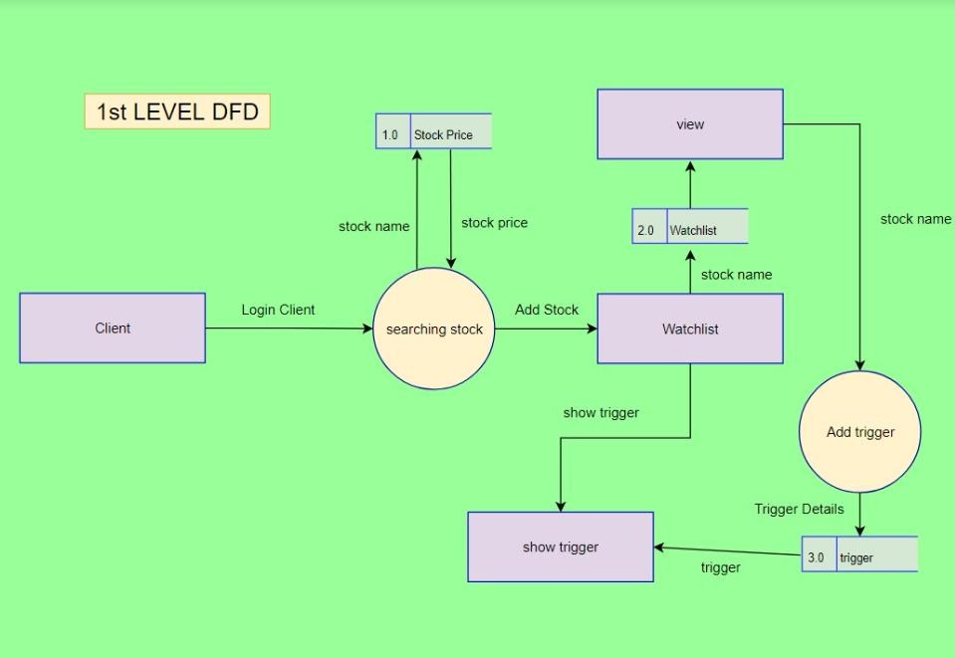
Page | 22
DFD :

Slide 23
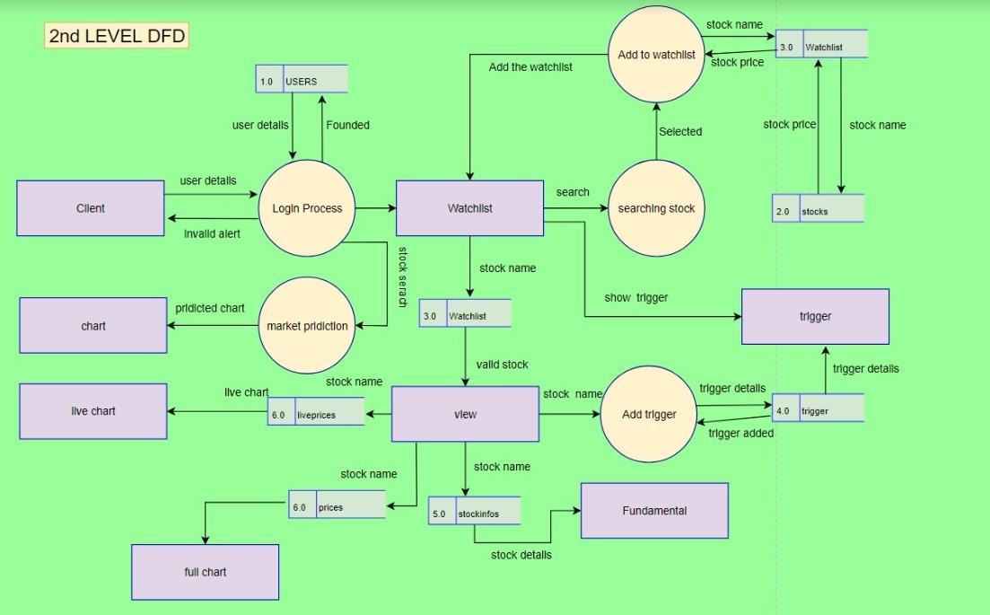
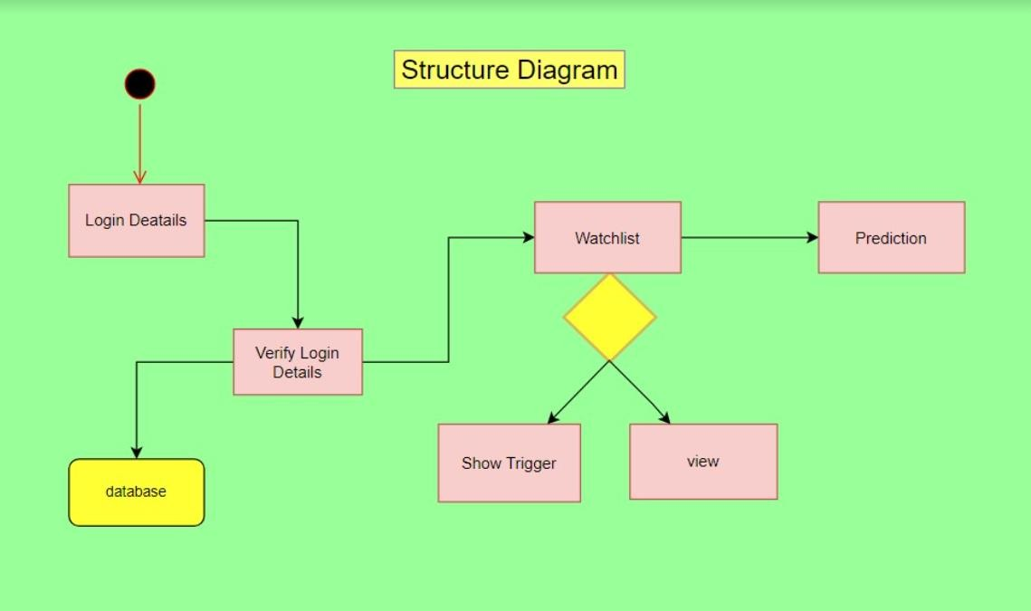
Page | 23
Structure chart :

Slide 24
Page | 24
Implementation Details
→ we have implemented a system in the MERN stack. We have used a highchart library for showing data. used Material-UI library for designing.
→ we used Alpaca api for fetching all price data and Polygon.io api for fetching Fundamental company data.
→ we have used JWT authentication for registering and login users. in that we send email & password details to the backend. so it generates the token and that token sends it to the frontend and saves it to localstorage of the browser. when we do another request then we put that token into the header of every request which is sent to the backend. so, the backend verifies it and receives the userid from that token.
→ we have a select-option bar in which users can select the stocks and it to the watchlist (limit is maximum 5 stocks)
→ stock charts show OHLC data from 1 jan,2018 to up-to date.
→ here we have used US stock market data. so the market opening time of the US market in India is 7:00 pm to 1:30 am. so, at that time we can see a live chart (Candlestick bar chart) which is updated every 1 minute.
→ we use a highcharts library which provides a wide range of charting tools. like, we can view full-screen, export chart data as image file and also .csv file, also (line,candlestick,ohlc) chart, we can set the flag & labels, draw the resistance and support line, many indicators we can apply and do technical analysis. also select the (range) 1m,3m,1y,3y data for analysis.
→we have created a IPO link where user can see all the details about IPO.
→ we can add the trigger (providing upper and lower limit). in that when current live price is going outside of this range then we mail the user about the trigger executed. no limit in adding no. of triggers.
→ we have provided only 500 stock details which are in the list of S&P 500 index. fetched data is combined from many exchanges. Clock is present in our web-app showing UTC (Universal Time) time format.
→we have used streamlit App framework for stock prediction and manage portfolio.

Slide 25
Page | 25
→In portfolio part user can see the assumed price after selected time range and get the net profit from invested amount.

Slide 26
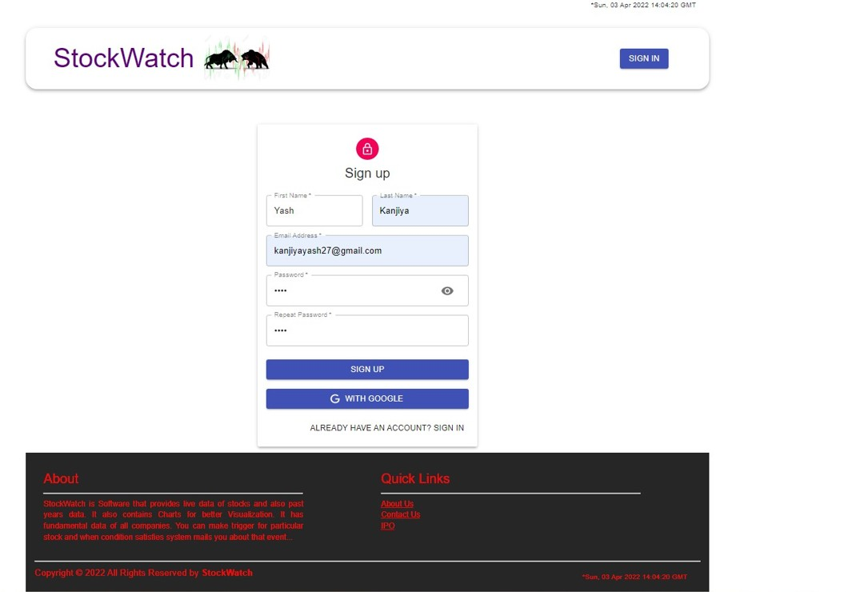
Page | 26
Screen-shots of the System :
Sign Up :

Slide 27
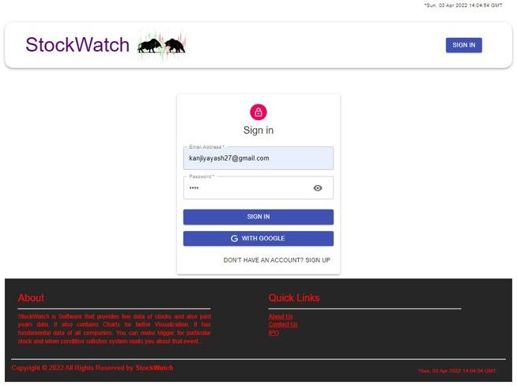
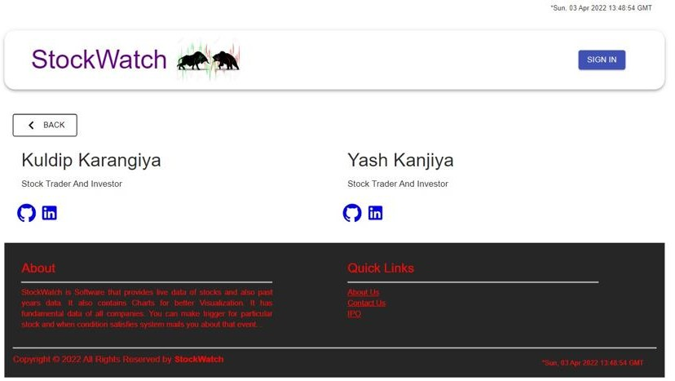
Page | 27
Log In :
About Us :

Slide 28
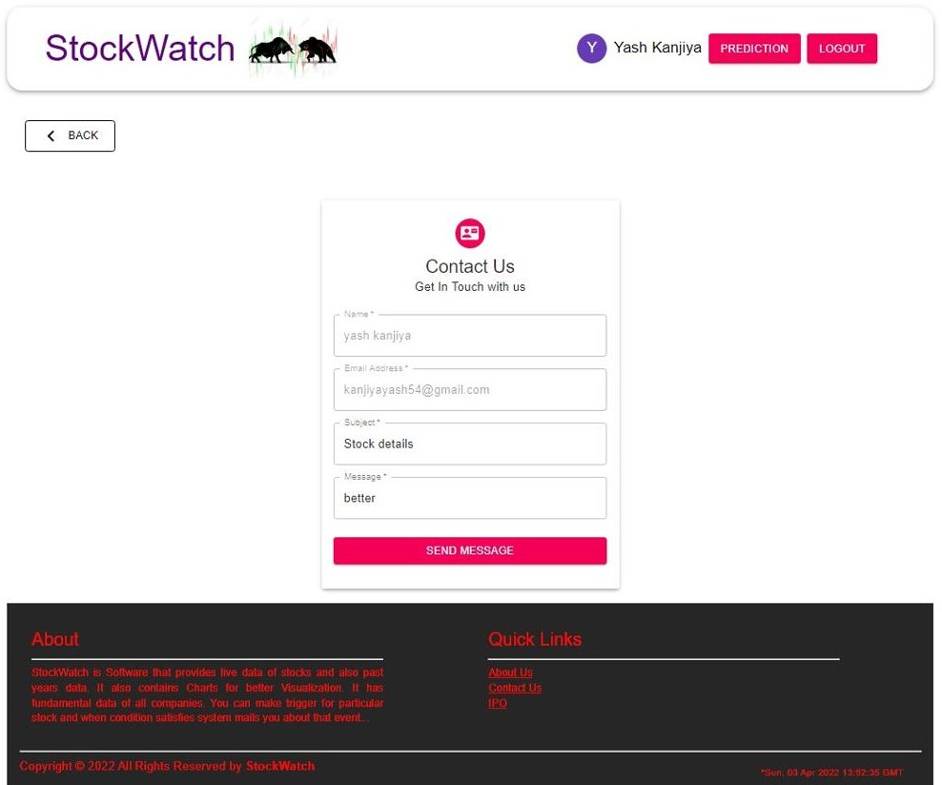
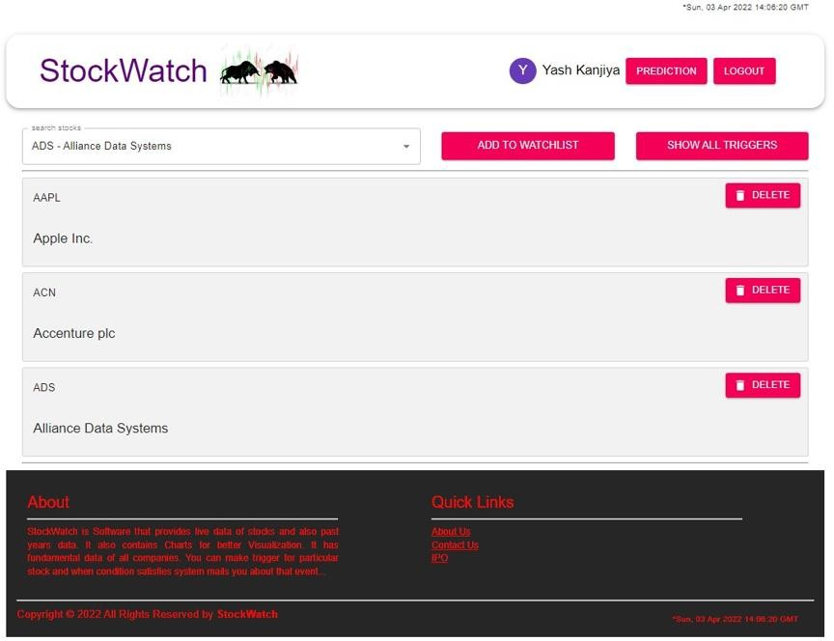
Contact Us :
Page | 28
Watchlist :

Slide 29
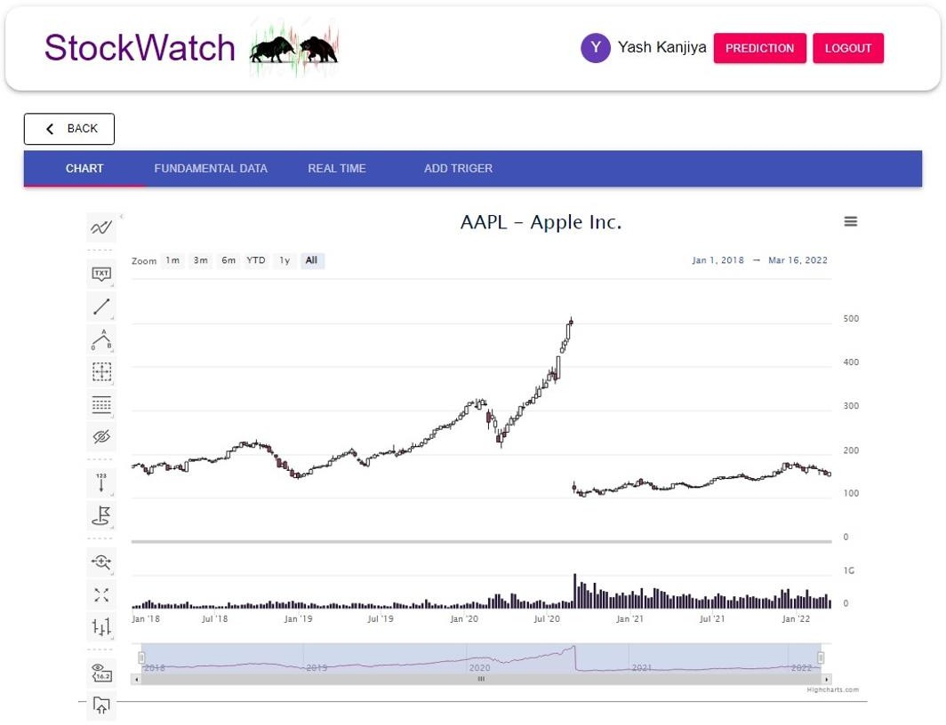
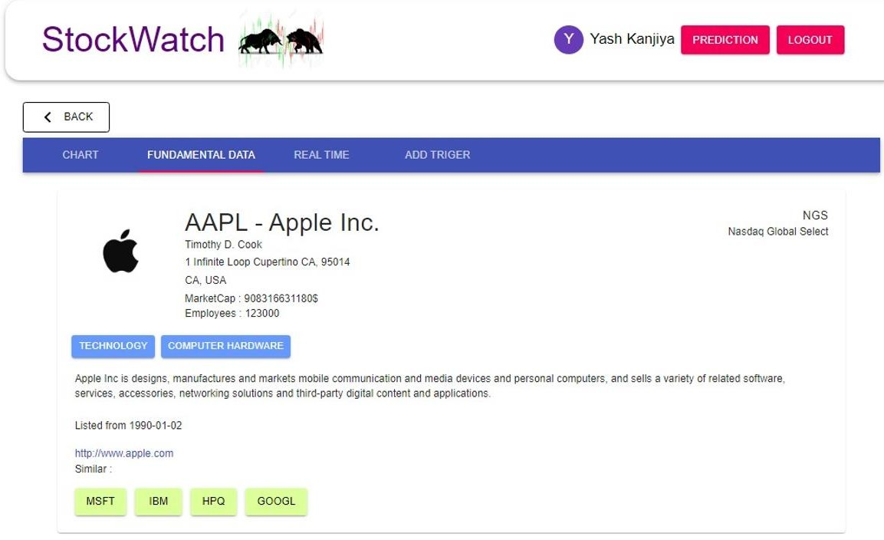
Page | 29
Chart :
Fundamental Data :

Slide 30
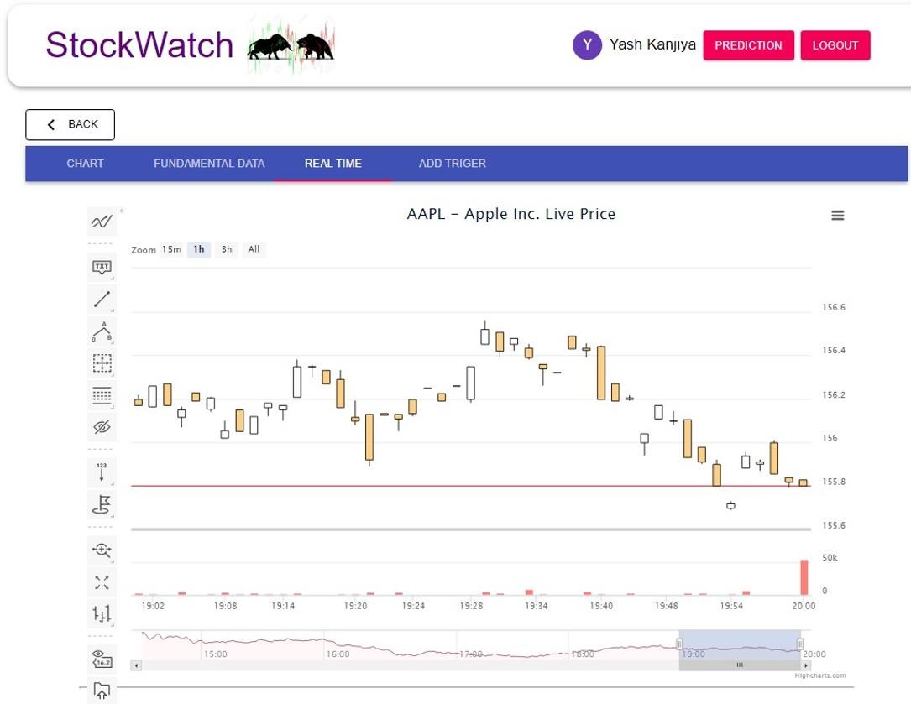
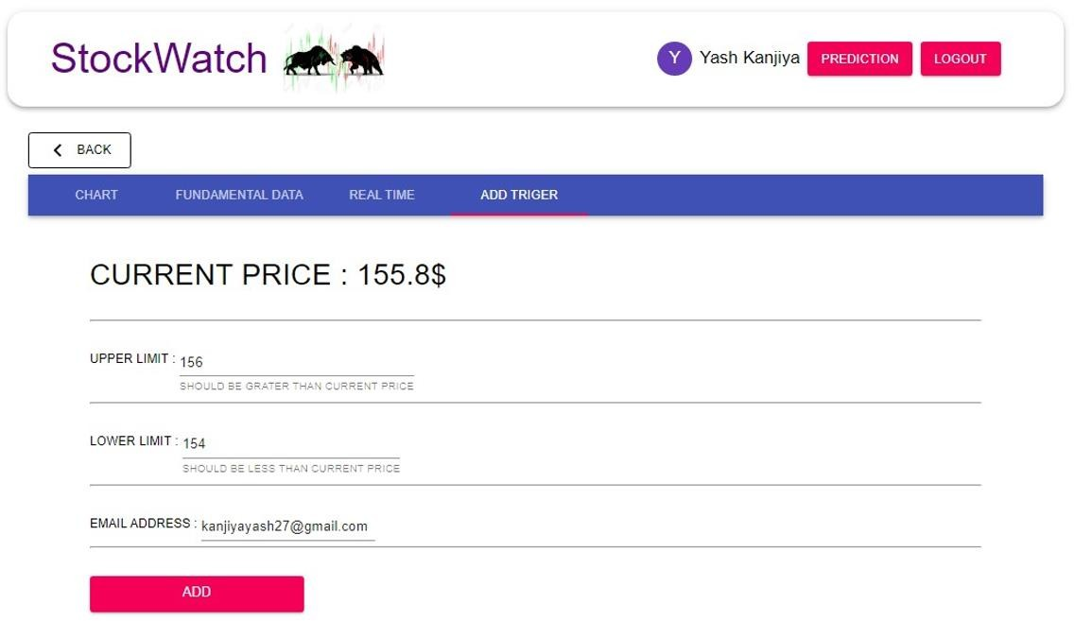
Page | 30
Real Time :
Add Trigger :

Slide 31
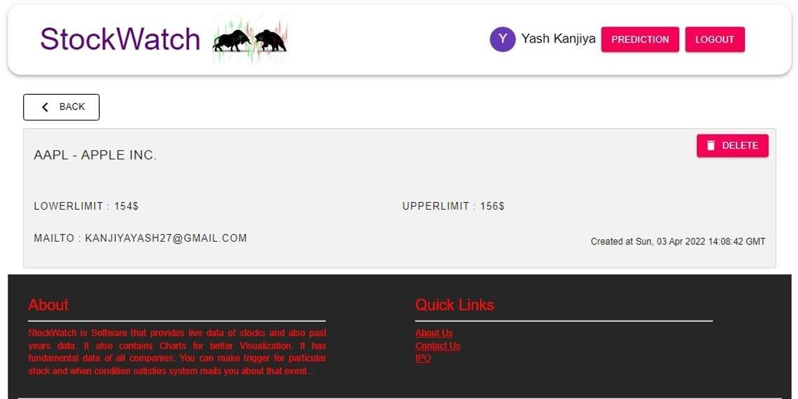
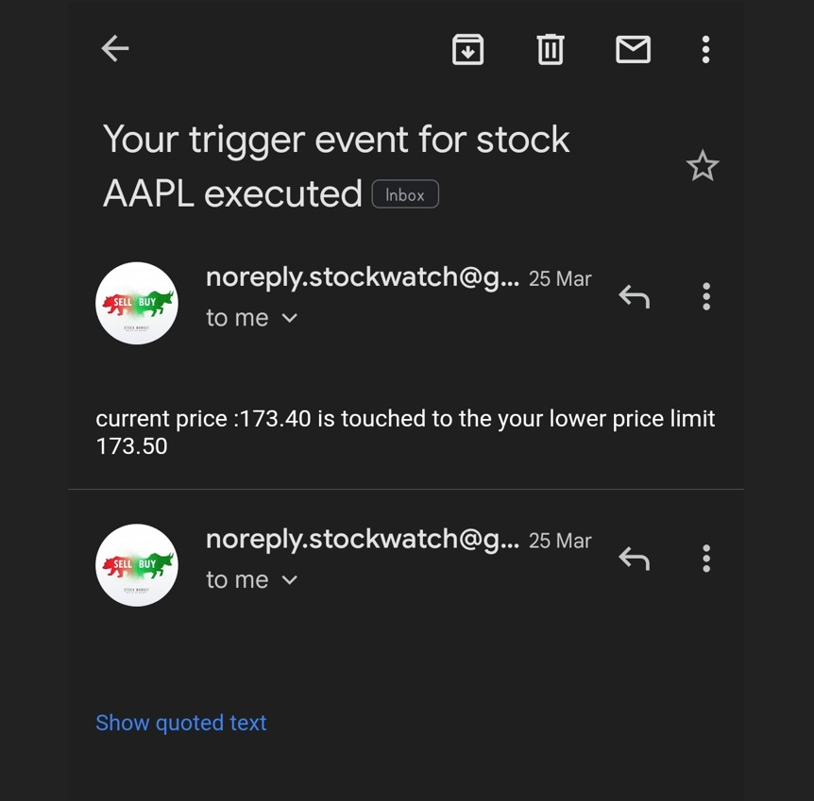
Page | 31
Show Trigger :
Mail to User :

Slide 32
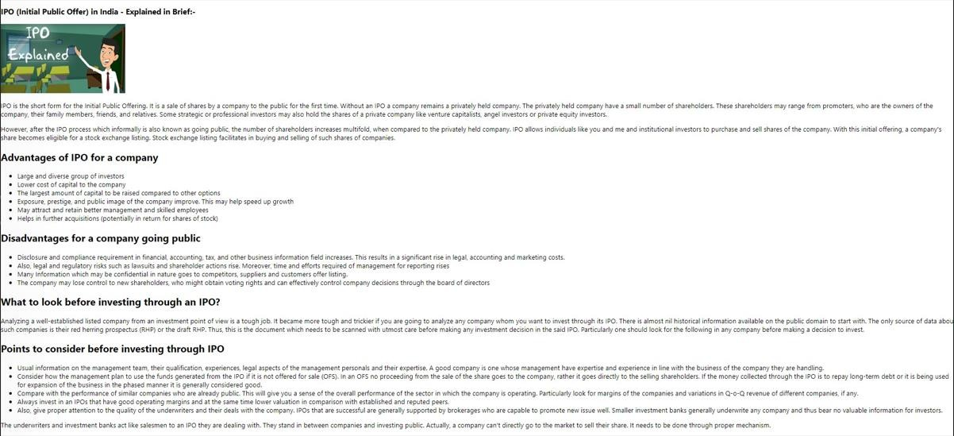
Page | 32
IPO :

Slide 33
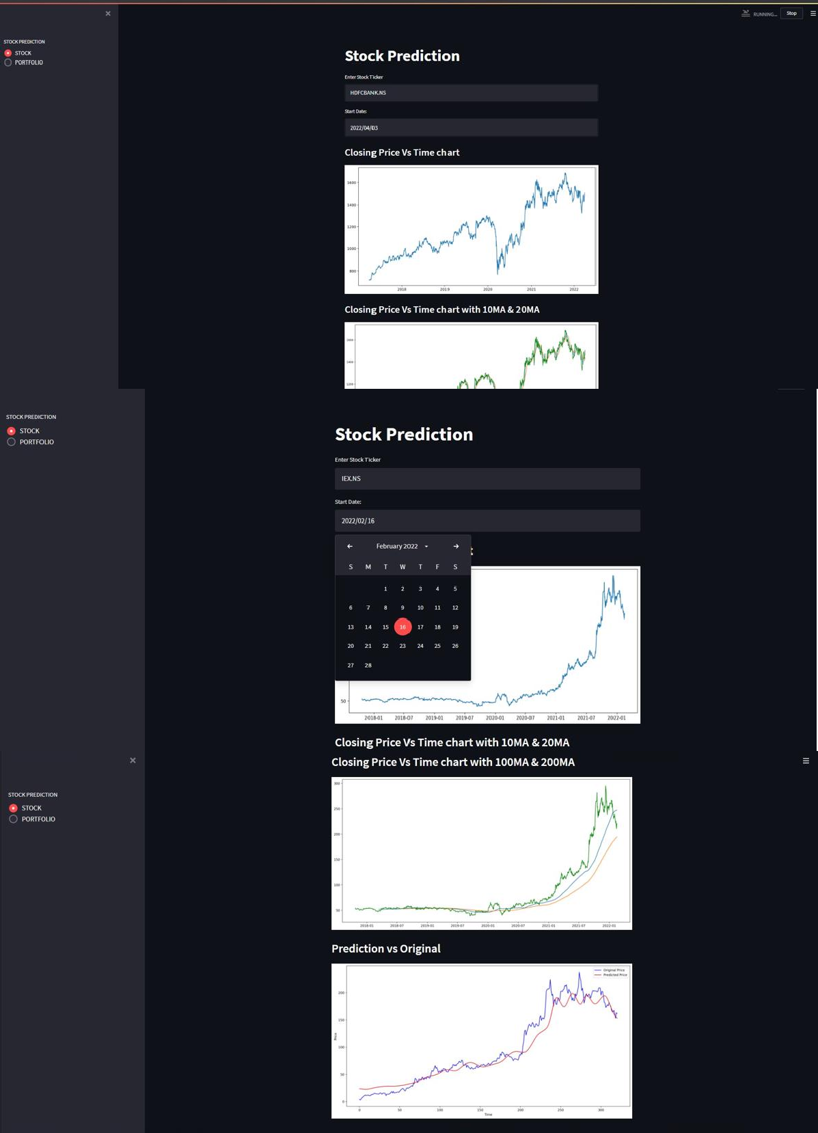
Stock Prediction :
Page | 33

Slide 34
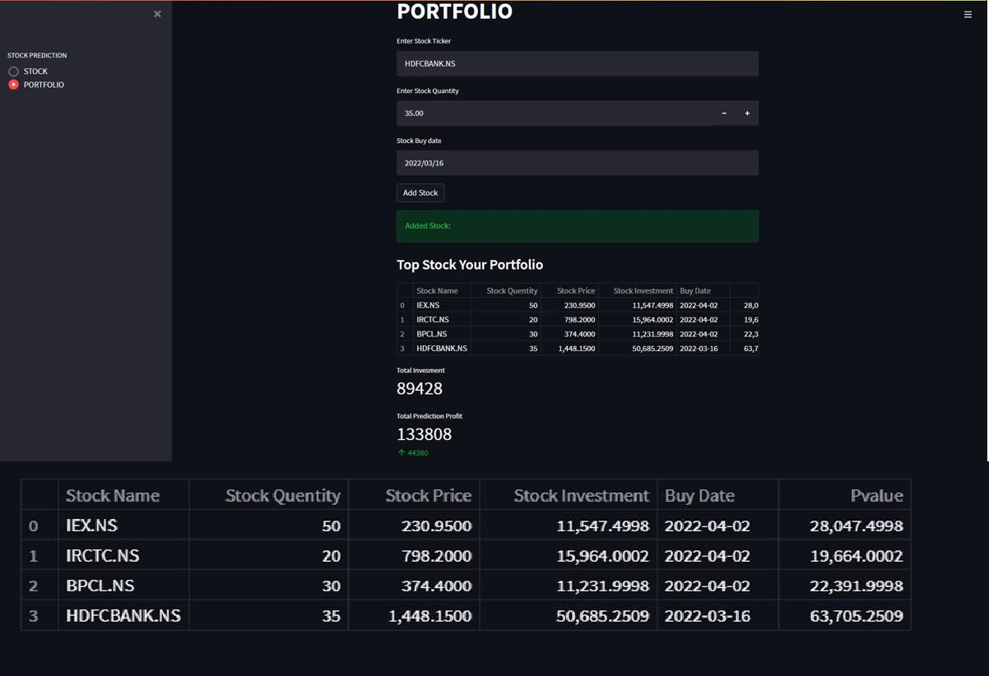
Portfolio :
Page | 34

Slide 35
Page | 35
Conclusion
→ All the main functionality of the system we have completely implemented.
→ we learn about the user registration and login and more about how JWT works and use it in Authentication and Authorization.
→ learn about how to get data from api and store it in a database and convert json objects to a good readable or maintainable format for our mongoose models. even if we have a rate limit in api calls for fetching data and manages that using javascript setInterval method.
→ learn about highchart library and its options for showing data in charts.
→ learn about cron-job which is used for cleaning and many more…
→ learn about stock prediction using streamlit app framework and keras python library and numpy and pandas for manage portfolio.
→Our App is very useful for trading quants who want to make an instant move to change their position in the market when the trigger is executed. and also users can also apply many indicators and apply technical analysis using our advanced chart and stock tools.
→ Our App is very useful for the user who wants to see the predicted value of stock price after given range(like six month, one year, etc.)
→In Our app user can see the ROI(return of investment) using predicted price.

Slide 36
Page | 36
Limitations and Future Enhancement
→ apps are limited to only a few stocks (500). we can make it adding more stocks in this web-app.
→ we can also make comparison charts between 2 to 3 stocks.
→ we can add the latest news and info about the company. so our users can also catch it and react to the market with that environment.
→ we can improve our triggering system by increasing computational power.
→ we can improve the notification system which is currently only using mail.
→In the future, we can also update the clock based on the user's local region timing.
→we can improve the accuracy predicted price.
Reference / Bibliography
https://www.youtube.com/
https://www.google.com/ https://stackoverflow.com/ https://alpaca.markets/docs/ https://polygon.io/docs/getting-started https://www.nasdaq.com/ https://docs.mongodb.com/ https://reactjs.org/tutorial/tutorial.html https://material-ui.com/ https://console.cron-job.org

