Slide 1

SQL Challenge 1
Challenge 1 - Steve's Car Showroom
By - Steeldata

Slide 2

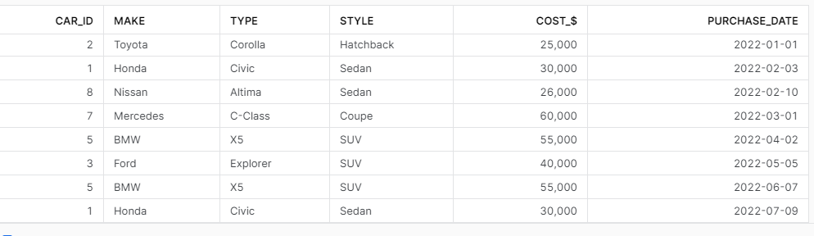
Questions
1. What are the details of all cars purchased in the year 2022?

Slide 3

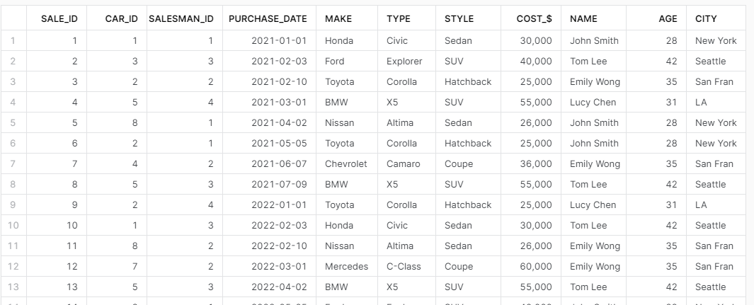
Creating Master Table For The Ease of Calculation.

Slide 4



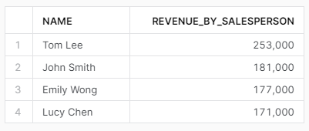
2. What is the total number of cars sold by each salesperson?
3. What is the total revenue generated by each salesperson?

Slide 5

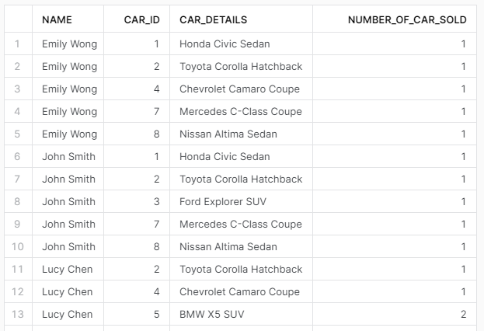

Slide 6

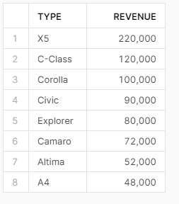



Slide 7





Slide 8



