Slide 1
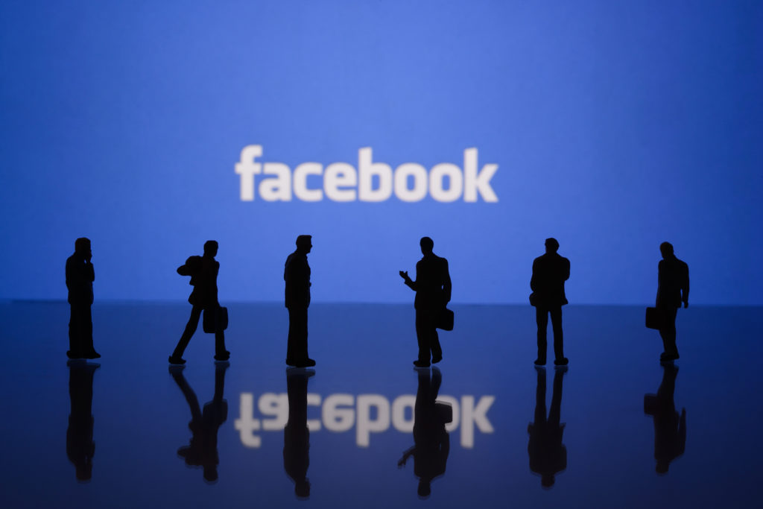



Exploratory Data Analysis
On
User Data
Guided By:
Suchit Majumdar
Presented By:
Yash Kohad

Slide 2
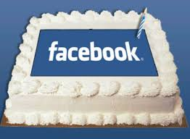
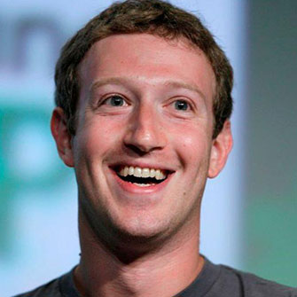
Introduction
4th Feb 2004
Facebook, a social media platform giant was founded by a Harvard sophomore named Mark Zuckerberg on 4th Feb 2004.
It is being used widely all across the world by people to exchange information, ideas, marketing, playing games and for buying/selling products also.
Most valuable companies in the world.
Over 2 billion monthly active users and still growing.
Available in over 111 languages.
Highest number of Facebook users from India and the United States, followed by Indonesia, Brazil and Mexico.

Slide 3
We shall study and analyse the Dataset of Facebook users
For:
Understanding the Distribution of Users (Age Groups, Gender, etc) and Activities of Users (Likes, Friend Requests etc).
To:
Find Trends and Hidden Patterns in the dataset and to extract meaningful information.
By:
Creating various charts and graphs (Uni-variate, Bi-variate and Multi-variate).
To:
Derive Conclusions and Actionable insights.
Which will Help Facebook :
To improve Customer’s User experience.
To stay updated with latest trends and technologies.
To retain the title for being the No. 1 Social Networking site in the World.
Expand it’s business across the world.

Slide 4
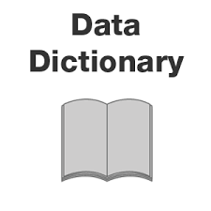
Data Dictionary Source of dataset: (https://raw.githubusercontent.com/insaid2018/Term-1/master/Data/Projects/facebook_data.csv)
Sr No. Features Description
1. userid A numeric value uniquely identifying the user.
2. age Age of the user in years.
3. dob_day Day part of the user's date of birth.
4. dob_year Year part of the user's date of birth.
5. dob_month Month part of the user's date of birth.
6. gender Gender of the user.
7. tenure Number of days since the user has been on FB.
8. friend_count Number of friends the user has.
9. friendships_initiated Number of friendships initiated by the user.
10. likes Total number of posts liked by the user.
11. likes_received Total Number of likes received by user's posts.
12. mobile_likes Number of posts liked by the user through mobile app.
13. mobile_likes_received Number of likes received by user through mobile app.
14. www_likes Number of posts liked by the user through web.
15. www_likes_received Number of likes received by user through web.

Slide 5

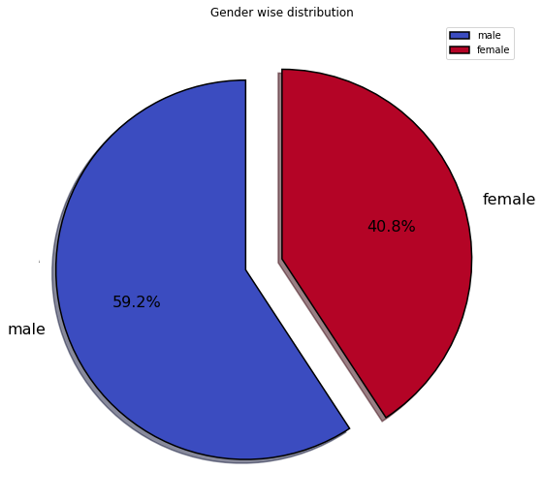
Q. To which Gender most no. of users belongs?
Male Users are high in no. than Females almost 60:40 ratio

Slide 6
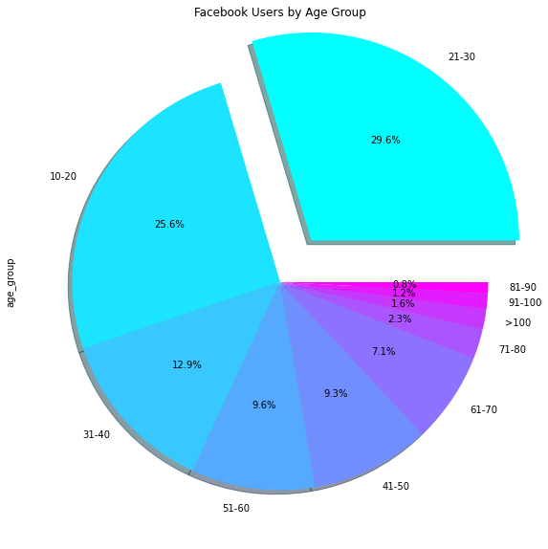
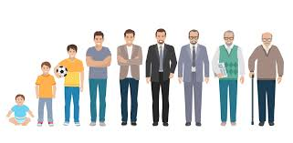
Q. Which Age-group most no. of Facebook Users belong to?
Younger generations (Age group: 21-30 years) comprises of almost 30% of our dataset

Slide 7

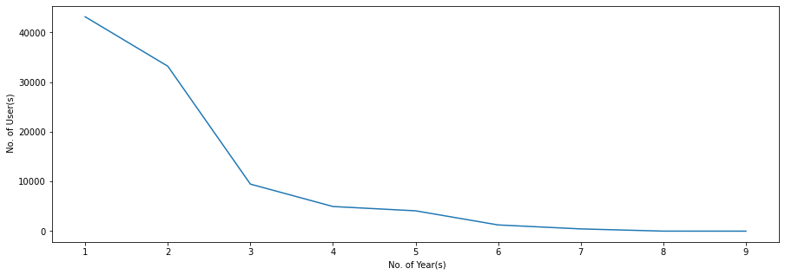
Users with their Tenures in Years
Most no. of active facebook users have a tenure of 2-3 years, it means in the recent years Facebook was able to capture a huge no. of users as compared to previous years.

Slide 8
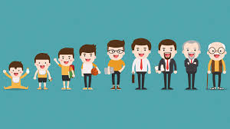
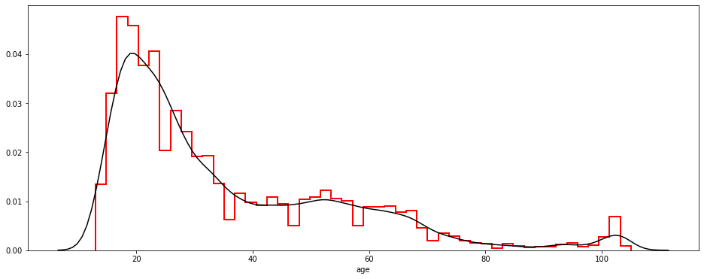
Q. How is the Age distribution of Facebook Users?
Median of Age of Users: 28 Years
Mean of Age of Users: 35.66 Years
Mean > Median, hence Age is Positively or Right skewed.

Slide 9

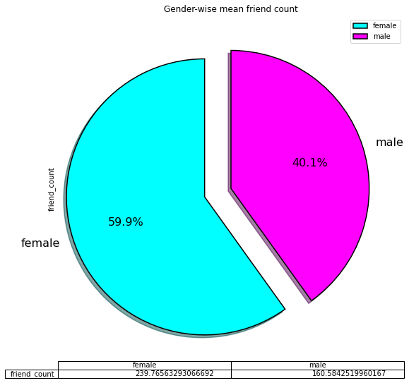
Q. Which gender has more no. of Friends?
Females have more friends by mean count than Males.

Slide 10
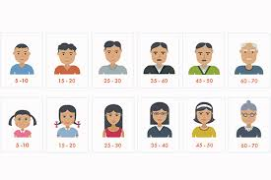
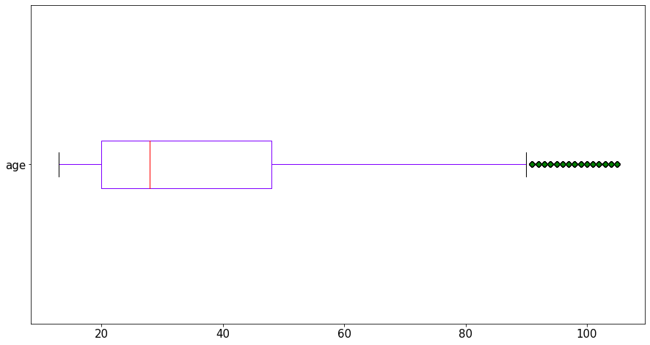
Box Plot for Age of Facebook Users
Median is around 28 years
Minimum age is 13 years
5-th percentile is 15 years
Q1 is 20 years
Median is 28 years
Q3 is 48 years
95-th percentile is 73 years
Maximum is 105 years

Slide 11
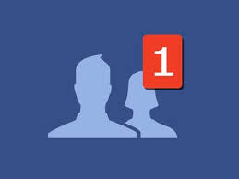
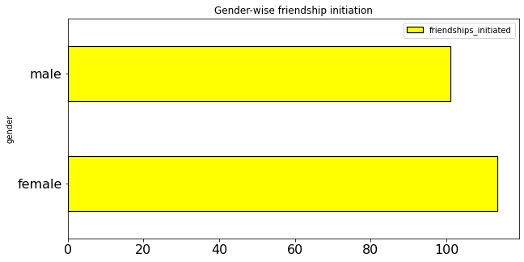
Q. Which gender initiates friendship more?
Friendship initiation by Females are slightly higher than male.

Slide 12
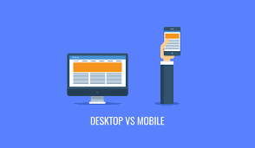
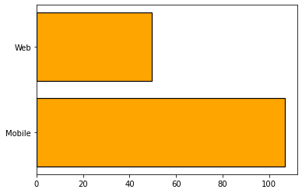
Q. Which platform is used more by users for liking posts?
Mobile platform is used more for liking posts. Web usage is less than half of mobile usage for posts liking.

Slide 13
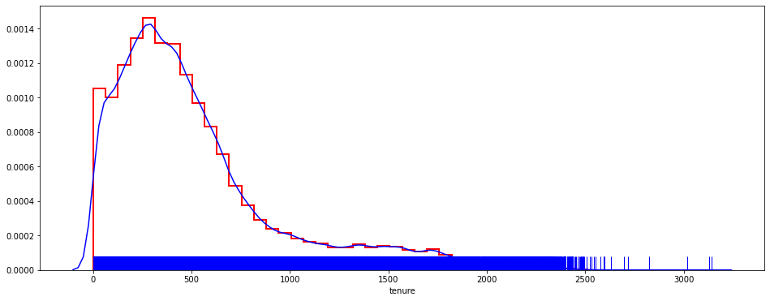

Q. What is the Tenure (in days) for most of the users and it's distribution?
Mean > Median , hence the plot is positively or right skewed
Density is less after 2500 days
Max density is around 250-500 days

Slide 14
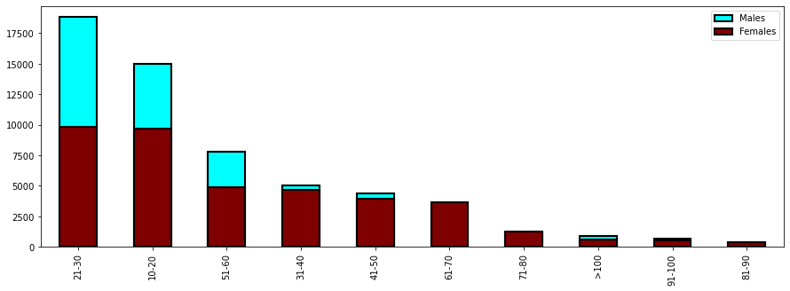

Q. Which Gender has more Users across all Age groups?
Till age 10 to 60 Males Users are more.
Females are more in age-group: 61-90

Slide 15
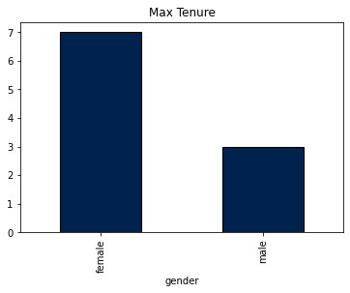

Top 10 people with Maximum Tenure
Among Top 10 Users with Max tenure 7 are Female

Slide 16

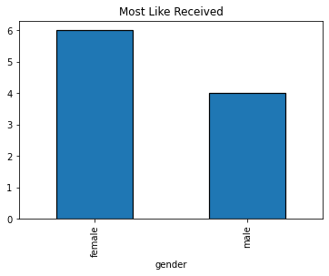
Top 10 people with most Likes received
6 out of Top 10 Users with most Likes received are Females

Slide 17
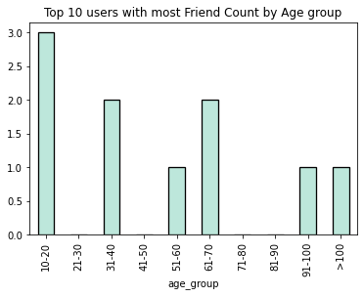

Top 10 Users with most Friends by Age group
Age group with most friend count-> 3 out of 10 users are from Age group: 10-20

Slide 18
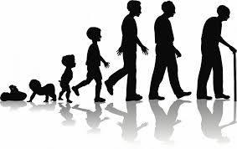
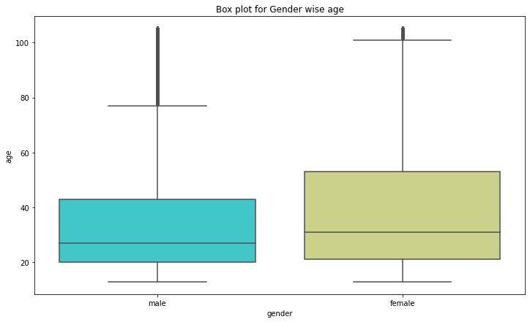
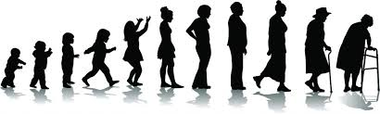
Box Plot for Gender wise Age
Median Age of Females is higher

Slide 19
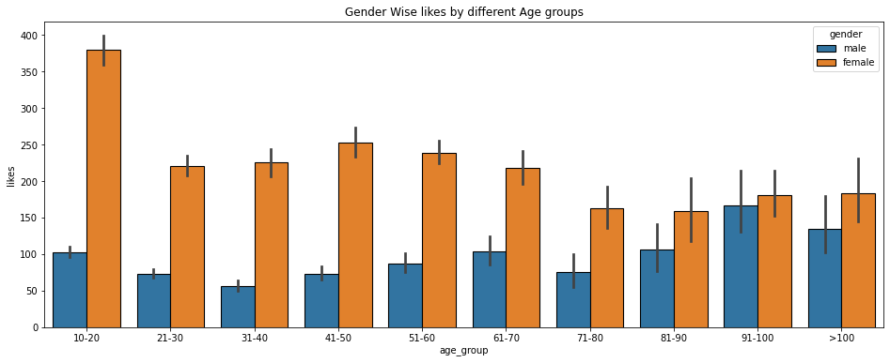

Q. Which Age group likes more posts - Gender wise.
Across all age groups, females likes more posts than male
Max no. of likes by user is in age group 10-20 by female users

Slide 20
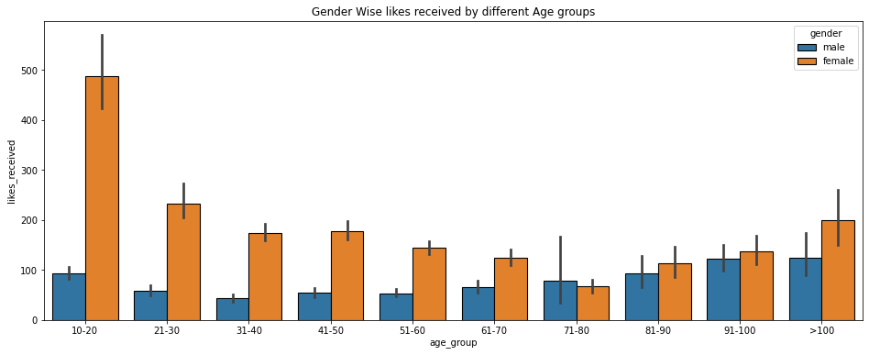

Q. Which Age group received more Likes on posts -Gender wise.
Except Age group 71-80, Females receives more Likes than Males.
Age group with Max Likes received is 10-20, again to female users.

Slide 21
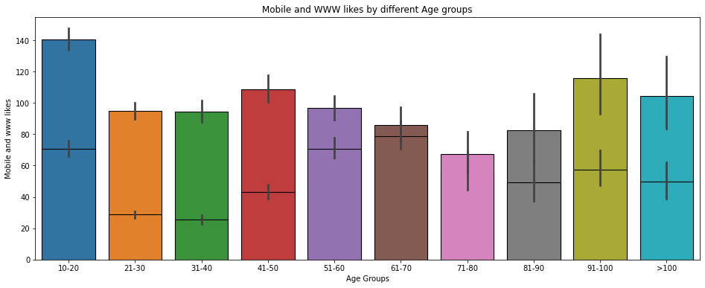

Q. Which Age group likes more posts by Mobile and Web?
Across almost all age groups mobiles likes are more than www likes.
www users are more in older age groups or teenagers as compared to age group 21-50.
Age groups 10-20 likes more posts.
Age group 71-80 likes lesser posts.
10-20 age group gives more Mobile likes.
61-70 age group gives more www likes.

Slide 22
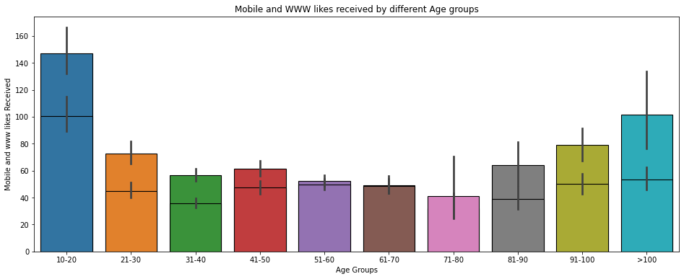

Q. Which Age group received more Likes on posts by Mobile and Web?
Across almost all age groups mobiles likes received are more than www likes received.
Age groups 10-20 receive more likes on posts.
Age groups 71-80 receive less likes on posts.
10-20 age group gets more Mobile likes and www likes.

Slide 23

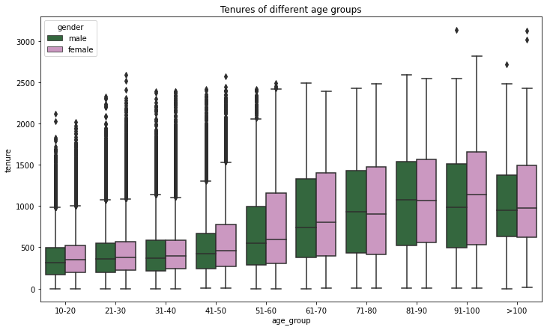
Tenure of different Age groups - Gender Wise
Tenure is higher for users with more Age as expected
Across almost all Age groups Females have more tenure than Males

Slide 24
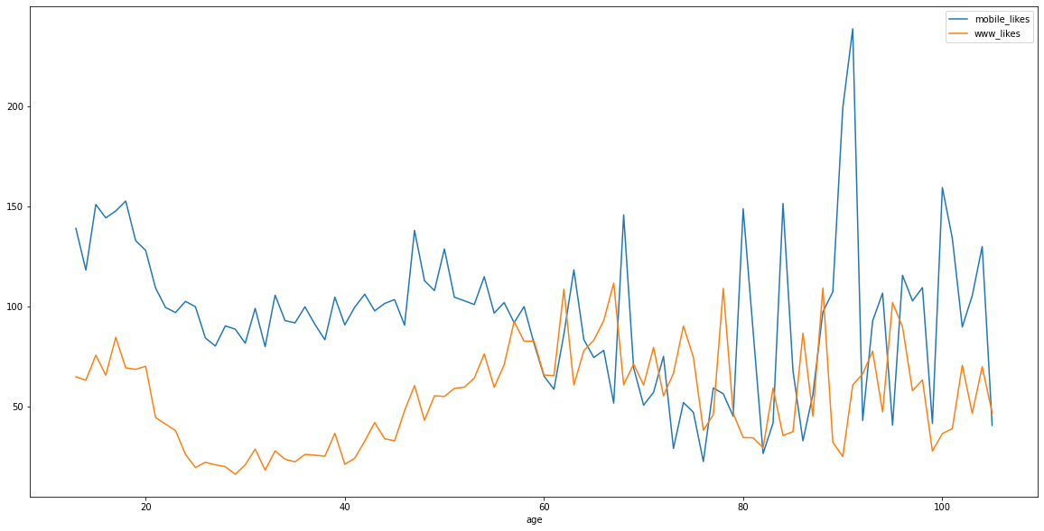
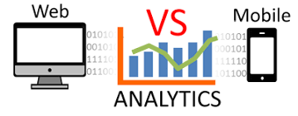
Line chart to compare trends of Mobile Likes and Web Likes by Age
Mobile likes are higher across almost all age groups than www likes

Slide 25
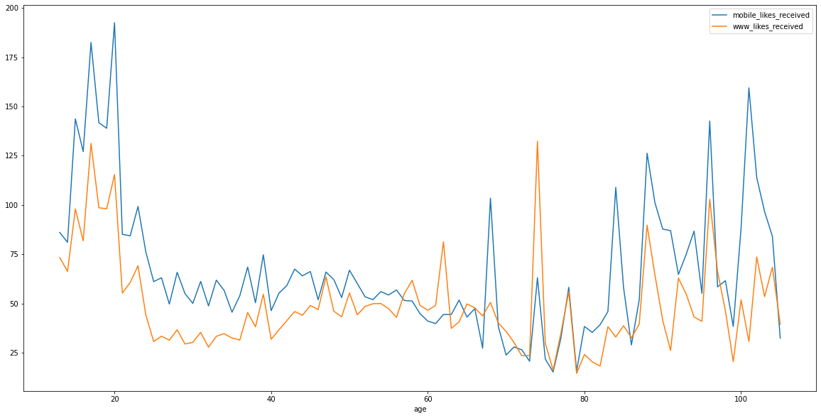

Line chart to compare trends of Mobile Likes received and Web Likes received by Age
Mobile likes received are higher across almost all age groups than www likes received

Slide 26
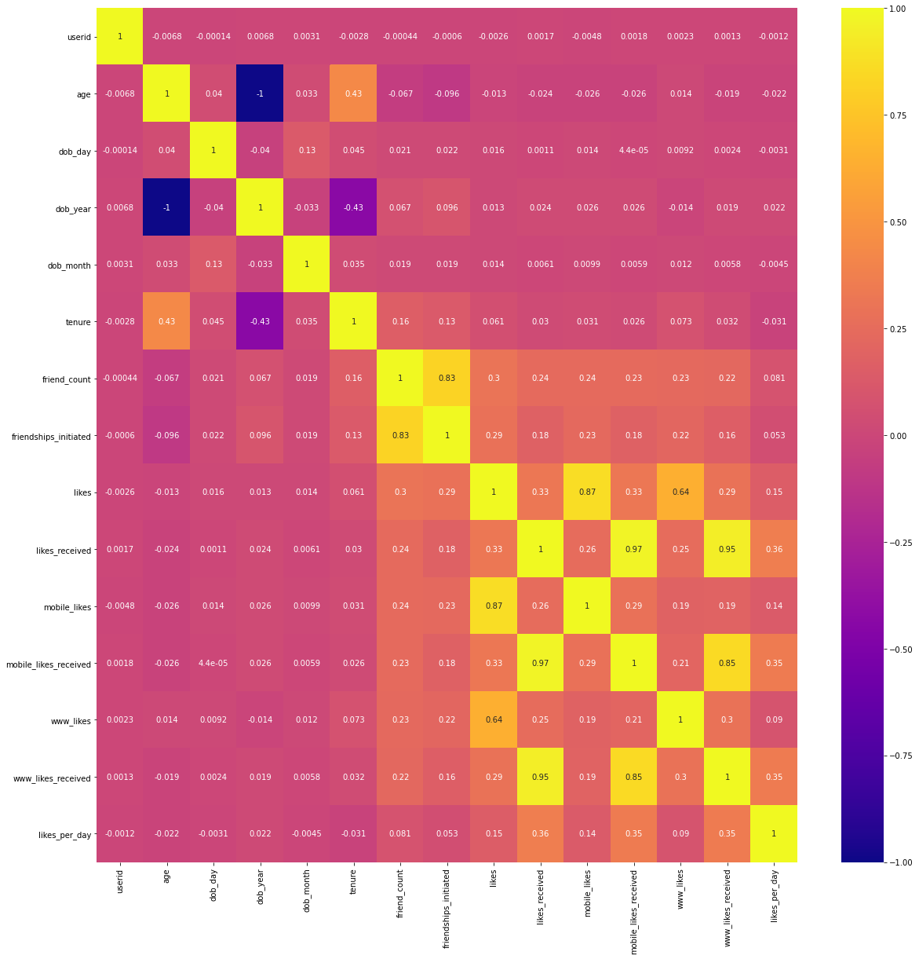
Co-Relation among all features via Heat Map
Observation:
1) Diagonals are having values as +1 as expected as anything is 100% co related to itself
2) Year of birth and Age are having -1 value as expected
3) Tenure and Age have some slightly positive co-relation
4) Friendship Initiated and friend_count have slightly negative co relation with age
5) Mobile likes received and www likes received have strong positive co relation with likes received
6) Mobile likes and likes have stronger positive co relation than www likes and likes
7) Friendship initiated and friend count have strong positive relationship
8) www likes received and mobile likes received have strong positive relation

Slide 27
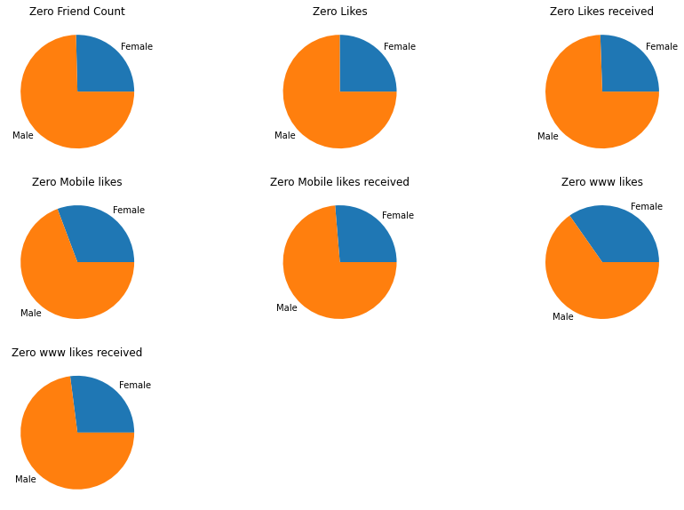

Inactive User symptoms
There are several symptoms with which we can assume that the User is not Active on facebook. Some of these are:
1) Zero Friend count
2) Zero Likes
3) Zero Likes received
4) Zero mobile likes
5) Zero mobile likes received
6) Zero www likes
7) Zero www likes received

Slide 28

Conclusions
No. of Male accounts are higher than Females.
Females are more active on Facebook in terms of Likes, Likes Received and initiating Friend requests and also have more Friends.
Although Facebook started with Web application, it’s mobile version is more popular now especially among the younger generation.
Age group with Maximum no. of users is 21-30 (almost 30%).
Age group 21-60 is comparatively less active than the teenagers and older Users.
In recent years, Facebook is able to capture a huge no. of users as compared to previous years.
There are many users which shows symptoms of being inactive like Zero friends, Zero likes, Zero Likes received etc. Lot of these users are Males(almost 75%).

Slide 29


Actionable Insights
Market more Female oriented products, as they are more Active users.
As mobile users are growing rapidly than web users especially among younger generation, make mobile app more user friendly and improve user experience so that even older generation can use mobile apps.
Max users are young generation, introduce some new products for adults and old generations by monitoring their activities so that their numbers can also increase, especially for male senior citizens.
As Males users are higher than Females, but still less active, introduce some new products and features which can keep Males engaged on Facebook likes Games, so that they can be retained as Fb users and be Active.

Slide 30


