Slide 1


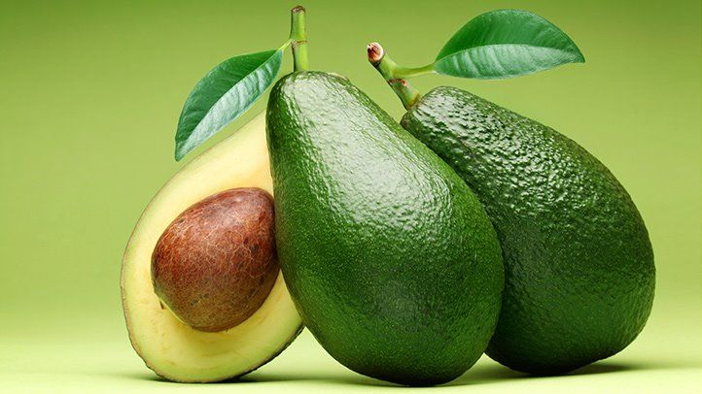




Avocado Price Prediction
Machine Learning Regression Problem
Presented by:
Yash Kohad

Slide 2

Contents
Problem Statement
Dataset and Data Description
Data Pre-processing and Cleaning
Exploratory Data Analysis (EDA)
Getting ready for ML – Dummy creation, Data Spliting and Scaling
Linear regression
Decision Tree
Random Forest
Model Evaluation Result Comparisons
Conclusion

Slide 3

Problem Statement
Avacard-corp has generations of experience sourcing, growing, packing, and shipping avocados,
They source quality fruit from over 1000 growers that’s sustainably grown across California, Mexico, Chile, and Peru.
They want to increase their supply throughout the United States and need to make sure that they are selling their products at the best possible price.
Avocado prices are increasing rapidly and almost doubled in 2019.
Due to this uncertainty in the prices, the company is not able to sell their produce at the optimal price.
Our task is to predict the optimal price of the avocado using the previous sales data of avocado according to different regions.

Slide 4

Dataset and Data Description
Features | Description
Id | Unique identity of each observation.
Date | The date of the observation
Average Price | The average price of a single avocado - target variable
Total Volume | Total number of avocados sold
4046 | Total number of avocados with PLU 4046 sold
4225 | Total number of avocados with PLU 4225 sold
4770 | Total number of avocados with PLU 4770 sold
Total Bags | Total number of bags sold.
Small Bags | Total number of small bags sold.
Large Bags | Total number of large bags sold.
X Large Bags | Total number of Extra large bags sold.
Type | Conventional or Organic
Year | The year
Region | The city or region of the observation

Slide 5

Data Pre-processing and Cleaning
No missing values or outlier in dataset.
Extracted Day Month and Year form date as below.
Gave Proper and meaningful names to columns.
Divide the 12 months into 4 season groups as below using function.
Date | Day | Month | Year
26-04-2016 | 26 | April | 2016
Month | Season
December, January, February | Winter
March, April, May | Spring
June, July, August | Summer
September, October, November | Autumn

Slide 6

Exploratory Data Analysis (EDA)

Slide 7

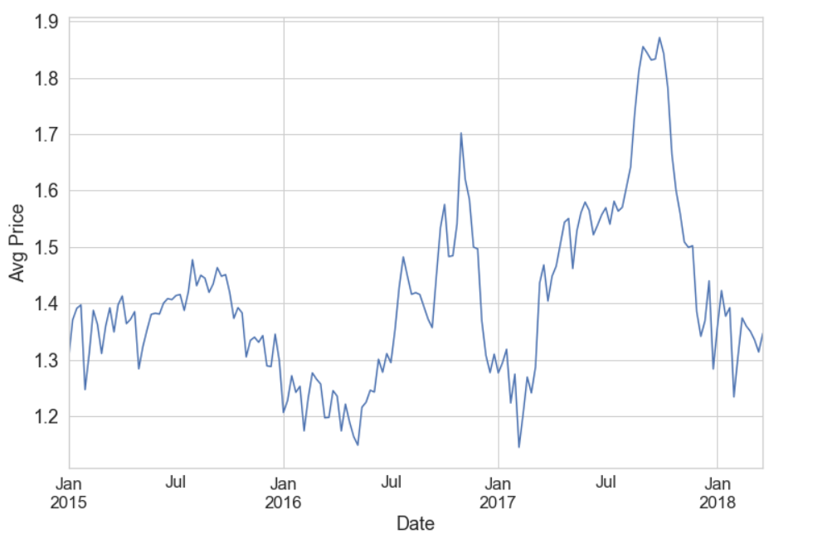
How price is distributed over the date column?

Slide 8
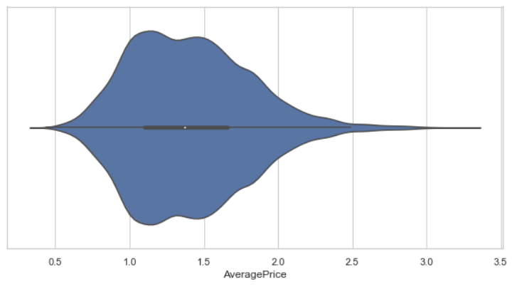
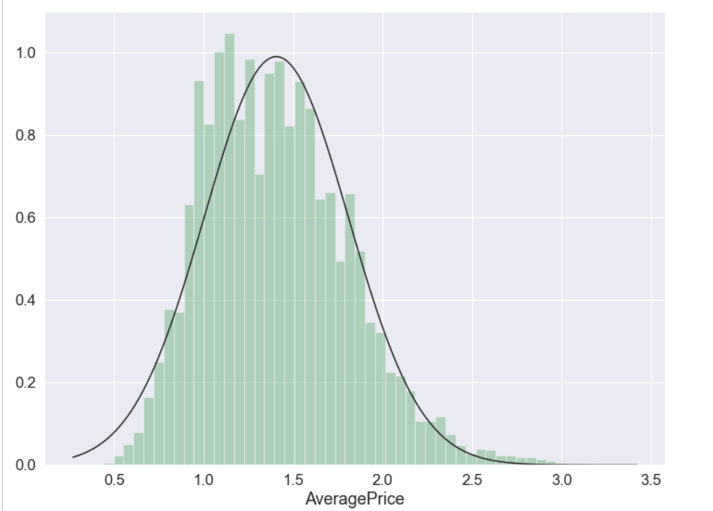
How the prices are distributed?

Slide 9
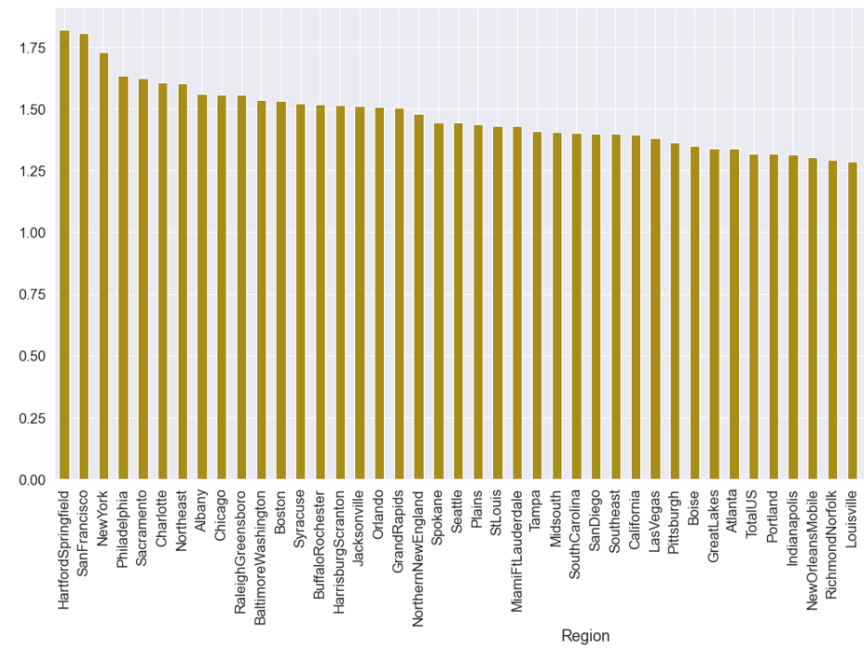
Which are the Top 5 regions where average prices are highest?

Slide 10
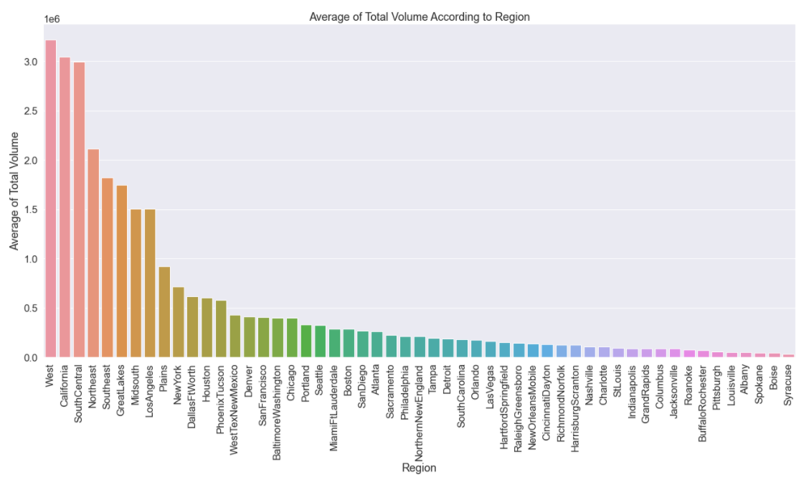
Which are Top 5 regions where average consumption of Avocado
is highest?

Slide 11
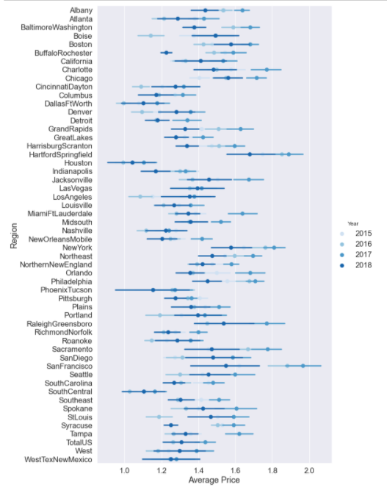
In which year and for which region was the average price of
Avocado the highest?

Slide 12
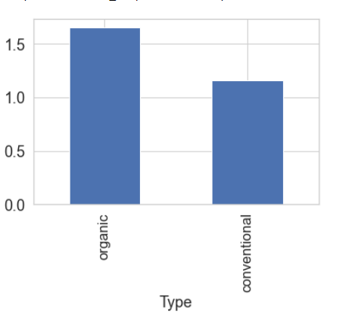
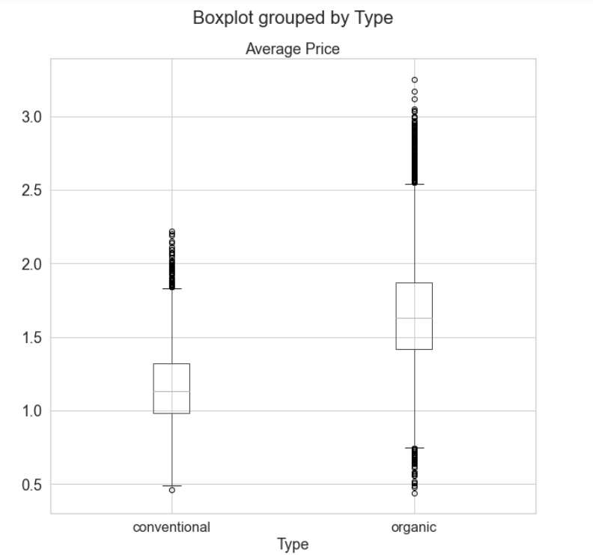
Which Avocado type is costlier in terms of average price?

Slide 13
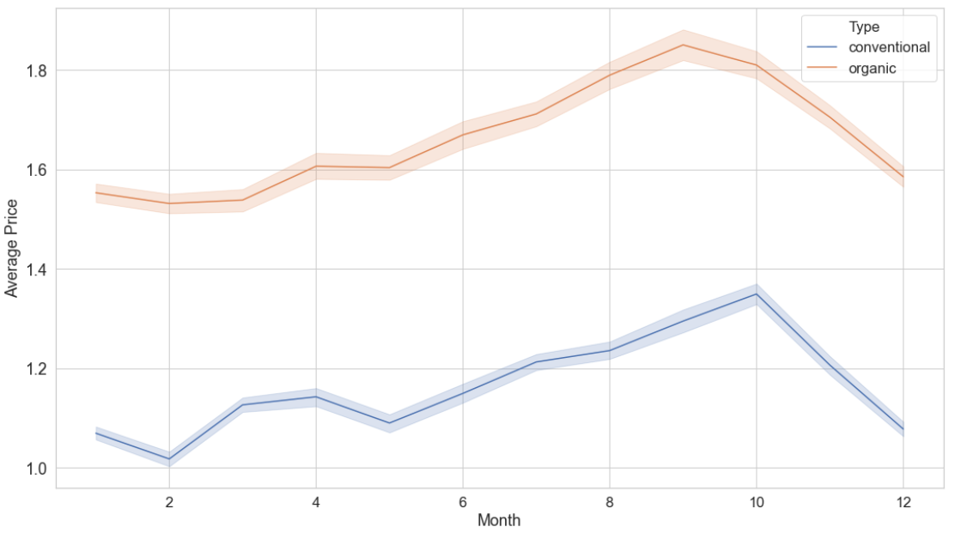
How average price is distributed over the months for Conventional
and Organic Types?

Slide 14
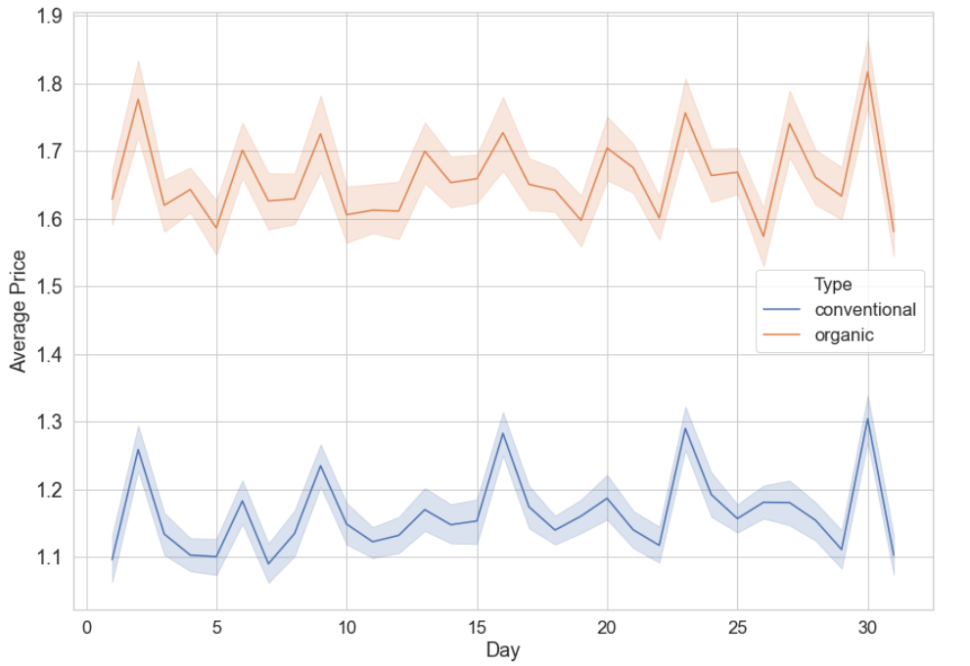
How average price is distributed over the days of months for
Conventional and Organic Types?

Slide 15
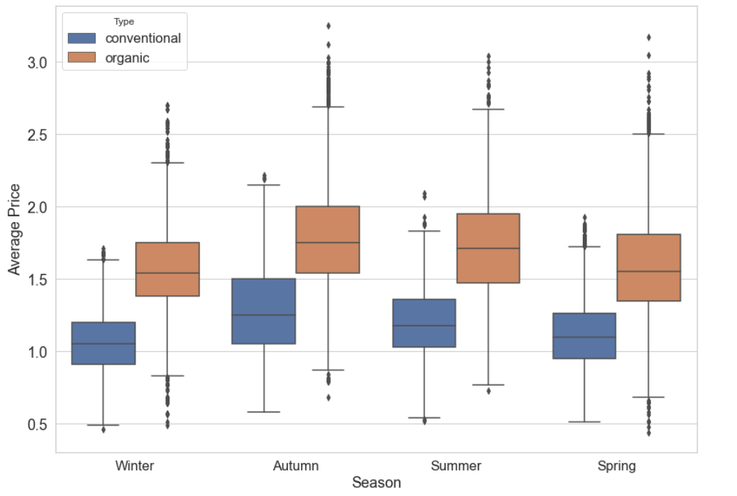
How average price is distributed over Seasons for Conventional and Organic Types?

Slide 16
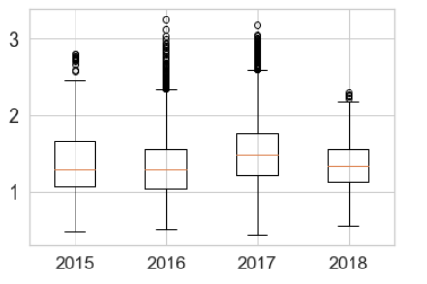
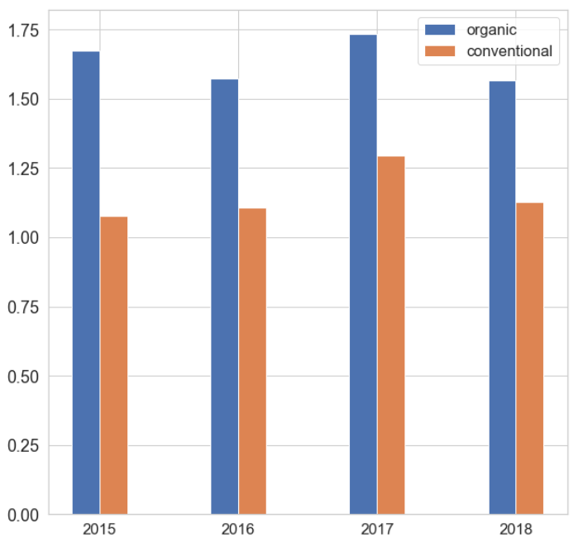
How are the average prices over years and by types?

Slide 17

EDA Conclusions
Every year, prices of Avocados are higher in Second half of year, particularly in the September-October month.
Prices are increasing year by year. Prices of Avocados are higher in Autumn season.
Most of the Avocados are in the price range 1.0 to 1.5.
Hart Ford Springfield has highest average price in year 2017. Also, in San Francisco, there was a high rise in prices in year 2016-2017.
Organic Avocados are costlier as compared to Conventional ones. But Conventional ones are high in demand may be due to low prices.
- Sales of Avocados with Price Look up code of “4225” are higher.

Slide 18

Getting ready for ML – Dummy creation, Data Splitting and Scaling
Dropping Region column.
Dummy creation of Season and Type column using One hot encoding technique.
Splitting our data into ‘X’ (Explanatory variables) and ‘y’ (Target variable)
Splitting data into Train and Test with 80:20 ratio.
Scaling all X columns of to standardize the independent features present in the data in a fixed range to handle highly varying magnitudes or values or units

Slide 19

Linear Regression
Sr No | Metric | Value
1 | Mean Absolute Error | 0.224
2 | Mean Squared Error | 0.084
3 | Root Mean Squared Error | 0.290
4 | R-Square | 0.481
5 | Adjusted R-Square | 0.479

Slide 20
Decision Tree Model 1
Sr No | Metric | Value
1 | Mean Absolute Error | 0.137
2 | Mean Squared Error | 0.045
3 | Root Mean Squared Error | 0.214
4 | R-Square | 0.717
5 | Adjusted R-Square | 0.716

Slide 21
Decision Tree Model 2
Sr No | Metric | Value
1 | Mean Absolute Error | 0.173
2 | Mean Squared Error | 0.052
3 | Root Mean Squared Error | 0.228
4 | R-Square | 0.679
5 | Adjusted R-Square | 0.677

Slide 22
Decision Tree Model 3
(using Grid Search CV)
Sr No | Metric | Value
1 | Mean Absolute Error | 0.144
2 | Mean Squared Error | 0.042
3 | Root Mean Squared Error | 0.207
4 | R-Square | 0.736
5 | Adjusted R-Square | 0.735

Slide 23
Random Forest Model 1
Sr No | Metric | Value
1 | Mean Absolute Error | 0.102
2 | Mean Squared Error | 0.021
3 | Root Mean Squared Error | 0.147
4 | R-Square | 0.8667
5 | Adjusted R-Square | 0.8663

Slide 24
Random Forest Model 2
Sr No | Metric | Value
1 | Mean Absolute Error | 0.108
2 | Mean Squared Error | 0.023
3 | Root Mean Squared Error | 0.154
4 | R-Square | 0.852
5 | Adjusted R-Square | 0.852

Slide 25
Random Forest Model 3
(using Grid Search CV)
Sr No | Metric | Value
1 | Mean Absolute Error | 0.102
2 | Mean Squared Error | 0.021
3 | Root Mean Squared Error | 0.147
4 | R-Square | 0.8667
5 | Adjusted R-Square | 0.8662

Slide 26

Model Evaluation Result Comparisons
Regression Model | Mean Absolute Error | Mean Squared Error | Root Mean Squared Error | R-Square | Adjusted R-Square
Linear Regression | 0.224 | 0.084 | 0.290 | 0.481 | 0.479
Decision Tree Model 1 | 0.137 | 0.045 | 0.214 | 0.717 | 0.716
Decision Tree Model 2 | 0.173 | 0.052 | 0.228 | 0.679 | 0.677
Decision Tree Model 3 (GSCV) | 0.144 | 0.042 | 0.207 | 0.736 | 0.735
Random Forest Model 1 | 0.102 | 0.021 | 0.147 | 0.8667 | 0.8663
Random Forest Model 2 | 0.108 | 0.023 | 0.154 | 0.852 | 0.852
Random Forest Model 3 (GSCV) | 0.102 | 0.021 | 0.147 | 0.8667 | 0.8662

Slide 27

Conclusion
As per the Model Evaluation results section, it is clear that Random Forest Model 1 is giving the best Prediction Results.
Random Forest Model 3 is not far behind and also giving equally good prediction results compared to other models used.

Slide 28

Thank You

