Slide 1




A SYNTHETIC STORY
This is Yari
Yari runs a growing tech retailer. This synthetic story assumes $47m in annual revenue. An enterprise partner now asks her team to complete a security questionnaire before onboarding.
Today
Owner, operator, with a finance team of 5
YARI'S STORY 01
Notes:
Synthetic REGODIT-track security questionnaire story. Persona assumes USD 47m annual revenue and a team of five; these are demonstration assumptions, not validated business facts. Source design and original images retained from user-provided Mandate User ex-2.pptx, matching Mandate User ex.pdf. Image authors and rights are not independently verified; no new author attribution is asserted. Document-supported means a cited passage supports the answer, not that Mandate has independently audited operation of the security control. User confirmations retain a distinct status from document support. PRISM/GIDE implementation or endorsement is not claimed by this story.

Slide 2

An enterprise partner asks Yari's team for evidence of its security controls
Her team of 5 keeps the business running while the review adds work
The answers live across documents and conversations
1
Questionnaire arrives
The partner asks about access, backups and incident response.
2
Evidence is scattered
Policies, procedures and past answers sit in different places.
3
Missing details
Some answers still depend on Yari or the IT owner.
4
Review is delayed
Repeated questions and conflicting records slow the response.
YARI'S STORY 02
Notes:
Synthetic REGODIT-track security questionnaire story. Persona assumes USD 47m annual revenue and a team of five; these are demonstration assumptions, not validated business facts. Source design and original images retained from user-provided Mandate User ex-2.pptx, matching Mandate User ex.pdf. Image authors and rights are not independently verified; no new author attribution is asserted. Document-supported means a cited passage supports the answer, not that Mandate has independently audited operation of the security control. User confirmations retain a distinct status from document support. PRISM/GIDE implementation or endorsement is not claimed by this story.

Slide 3

THE PRESSURE BUILDS
Her team knows the business. Proving every security answer still takes time.
Policies describe intended controls. Recent messages may reveal exceptions. Her team must resolve both.
Yari's problem
Yari needs evidence she can inspect, with missing details clearly flagged. She wants to support her current team of 5.
YARI'S STORY 03
Notes:
Synthetic REGODIT-track security questionnaire story. Persona assumes USD 47m annual revenue and a team of five; these are demonstration assumptions, not validated business facts. Source design and original images retained from user-provided Mandate User ex-2.pptx, matching Mandate User ex.pdf. Image authors and rights are not independently verified; no new author attribution is asserted. Document-supported means a cited passage supports the answer, not that Mandate has independently audited operation of the security control. User confirmations retain a distinct status from document support. PRISM/GIDE implementation or endorsement is not claimed by this story.

Slide 4

ENTER MANDATE
MANDATE becomes Yari's AI security analyst
Mandate searches approved sources first, drafts answers with citations, and asks focused follow-up questions only when information is missing or contradictory.
The division of work
AI gathers the evidence. Yari's team reviews and authorizes every final answer.
YARI'S STORY 04
Notes:
Synthetic REGODIT-track security questionnaire story. Persona assumes USD 47m annual revenue and a team of five; these are demonstration assumptions, not validated business facts. Source design and original images retained from user-provided Mandate User ex-2.pptx, matching Mandate User ex.pdf. Image authors and rights are not independently verified; no new author attribution is asserted. Document-supported means a cited passage supports the answer, not that Mandate has independently audited operation of the security control. User confirmations retain a distinct status from document support. PRISM/GIDE implementation or endorsement is not claimed by this story.

Slide 5

A short conversation fills a real evidence gap
Mandate checks the documents before asking Yari for a missing detail
USER INPUT
Backups
User-confirmed
✓
Backups in place? Yari answers yes.
✓
How often? Yari confirms daily.
✓
Automated? Yari confirms yes.
✓
Saved with owner and time. Evidence pending.
YARI'S STORY 05
Notes:
Synthetic REGODIT-track security questionnaire story. Persona assumes USD 47m annual revenue and a team of five; these are demonstration assumptions, not validated business facts. Source design and original images retained from user-provided Mandate User ex-2.pptx, matching Mandate User ex.pdf. Image authors and rights are not independently verified; no new author attribution is asserted. Document-supported means a cited passage supports the answer, not that Mandate has independently audited operation of the security control. User confirmations retain a distinct status from document support. PRISM/GIDE implementation or endorsement is not claimed by this story.

Slide 6
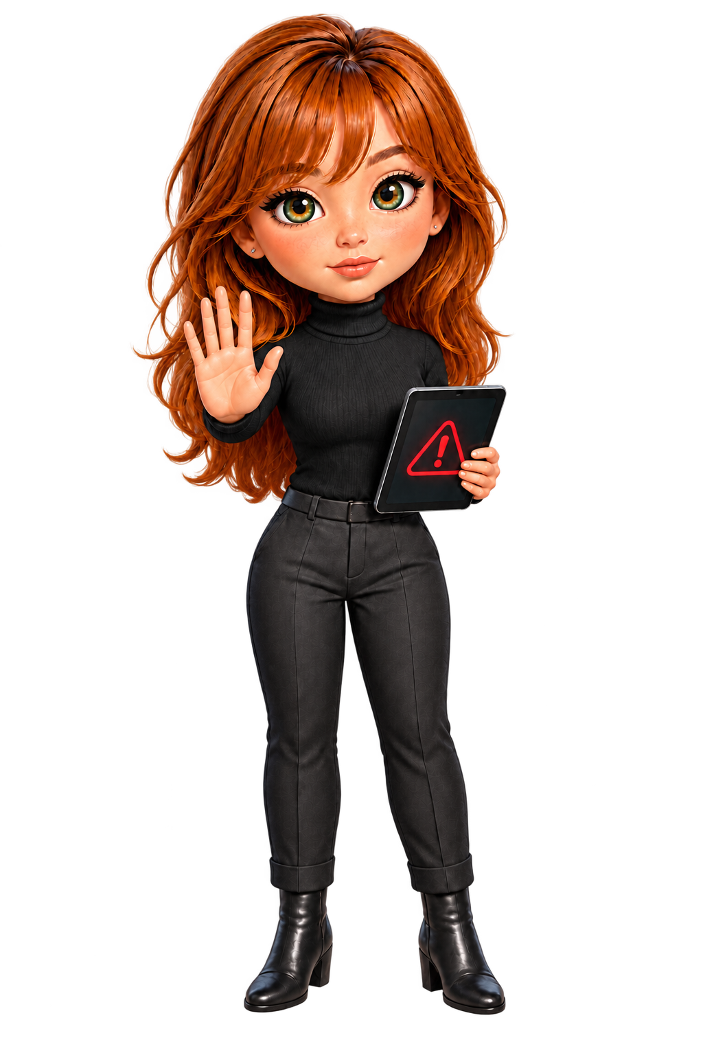
Two sources disagree about MFA coverage
Mandate keeps the answer unresolved until the owner checks the exception
CONFLICT
Review before answering
Is MFA required for all users?
The policy says MFA covers every user.
IT reports a contractor exception.
The scope remains unresolved.
Security policy
IT message
All users covered
Exception reported
YARI'S STORY 06
Notes:
Synthetic REGODIT-track security questionnaire story. Persona assumes USD 47m annual revenue and a team of five; these are demonstration assumptions, not validated business facts. Source design and original images retained from user-provided Mandate User ex-2.pptx, matching Mandate User ex.pdf. Image authors and rights are not independently verified; no new author attribution is asserted. Document-supported means a cited passage supports the answer, not that Mandate has independently audited operation of the security control. User confirmations retain a distinct status from document support. PRISM/GIDE implementation or endorsement is not claimed by this story.

Slide 7

Yari's team reviews the answer and its evidence
Every draft keeps its status. Contradictions stay open until a responsible owner resolves them.
1
Verified from documents
Linked to a specific document and passage.
2
User-confirmed
Recorded with the owner's name and time.
3
Unknown or disputed
Yari chooses what can be submitted.
YARI'S STORY 07
Notes:
Synthetic REGODIT-track security questionnaire story. Persona assumes USD 47m annual revenue and a team of five; these are demonstration assumptions, not validated business facts. Source design and original images retained from user-provided Mandate User ex-2.pptx, matching Mandate User ex.pdf. Image authors and rights are not independently verified; no new author attribution is asserted. Document-supported means a cited passage supports the answer, not that Mandate has independently audited operation of the security control. User confirmations retain a distinct status from document support. PRISM/GIDE implementation or endorsement is not claimed by this story.

Slide 8

THE OUTCOME
Yari keeps her team and owns the final security response
Mandate reduces repeated evidence collection and preserves the review trail. The pilot measures review time, citation coverage and unresolved answers. It makes no headcount or savings promise.
Human in the loop
Yari's team approves the response before export
YARI'S STORY 08
Notes:
Synthetic REGODIT-track security questionnaire story. Persona assumes USD 47m annual revenue and a team of five; these are demonstration assumptions, not validated business facts. Source design and original images retained from user-provided Mandate User ex-2.pptx, matching Mandate User ex.pdf. Image authors and rights are not independently verified; no new author attribution is asserted. Document-supported means a cited passage supports the answer, not that Mandate has independently audited operation of the security control. User confirmations retain a distinct status from document support. PRISM/GIDE implementation or endorsement is not claimed by this story.

