Slide 1

Secure OTA updates
Name | USN
Yash Mahale | 01FE19BEC265
Bharat Gunhalkar | 01FE19BEC274
Rajendra G Kanbargi | 01FE19BEC246
Spoorti Angadi | 01FE19BEC259

Slide 2

Abstract
Traditionally OEM’s used to recall the vehicles to update the firmware to introduce new features or to overcome unwanted bugs.
This process not only consumes a lot of time but a bug can spoil the reputation of OEM.
A better way to update the firmware is using OTA(over the air) updates which is reducing the dependency on the service station.
But these updates should be securely encrypted and be computationally efficient.
Therefore, an efficient system has to be designed which checks the firmware before updating onto the actual hardware/ECU.
Thus, the proposed solution adds an extra layer of security to the ECUs to make sure the updates are secure.

Slide 3
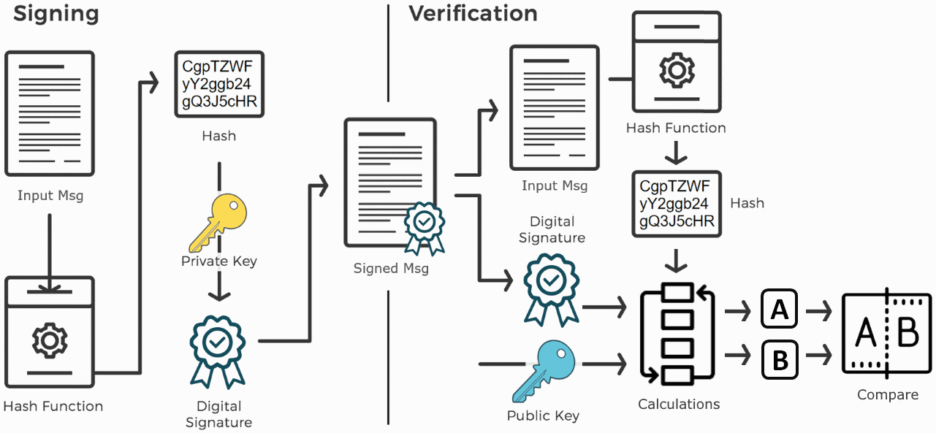
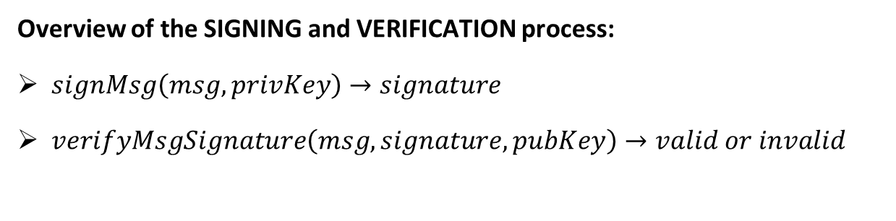
Solution
Overview of the SIGNING and VERIFICATION process:
$signMsg\left(msg, privKey\right)→signature$
$verifyMsgSignature\left(msg, signature, pubKey\right)→valid or invalid$
Image Source: https://cryptobook.nakov.com/digital-signatures

Slide 4
Solution
There are 4 main types of Digital Signature Algorithms:
RSA Signatures
DSA Signatures
ECDSA (Elliptic Curve Digital Signature Algorithm)
EdDSA (Edwards-curve Digital Signature Algorithm)
Based on various studies and trade-offs, the EdDSA Algorithm is widely used for the following reasons:
Signing and Verification is faster
Security is considered better

Slide 5
Solution
EdDSA (Edwards-curve Digital Signature Algorithm) :
The EdDSA signing algorithm generates a deterministic (not random) integer r (computed by hashing the message and the hash of the private key), then computes the signature {Rs, s}, where Rs is computed from r and s is computed from the hash of (the message + the public key derived from the private + the number r) + the private key. The signature is deterministic (the same message signed by the same key always gives the same signature).
The EdDSA signature verification algorithm involves elliptic-curve computations, based on the message (hashed together with the public key and the EC point Rs from the signature) + the public key + the number s from the signature {Rs, s}.

Slide 6
Value Addition
Considering the OTA update is downloaded to the MASTER ECU, the team intends to add an additional layer of security to the SLAVE ECUs that get updates from the MASTER ECU. SLAVE ECUs are crucial components for the vehicle's proper operation. Any update that is tampered with or corrupted has the potential to bring the entire system down. As a result, adding a layer of protection is critical.

Slide 7
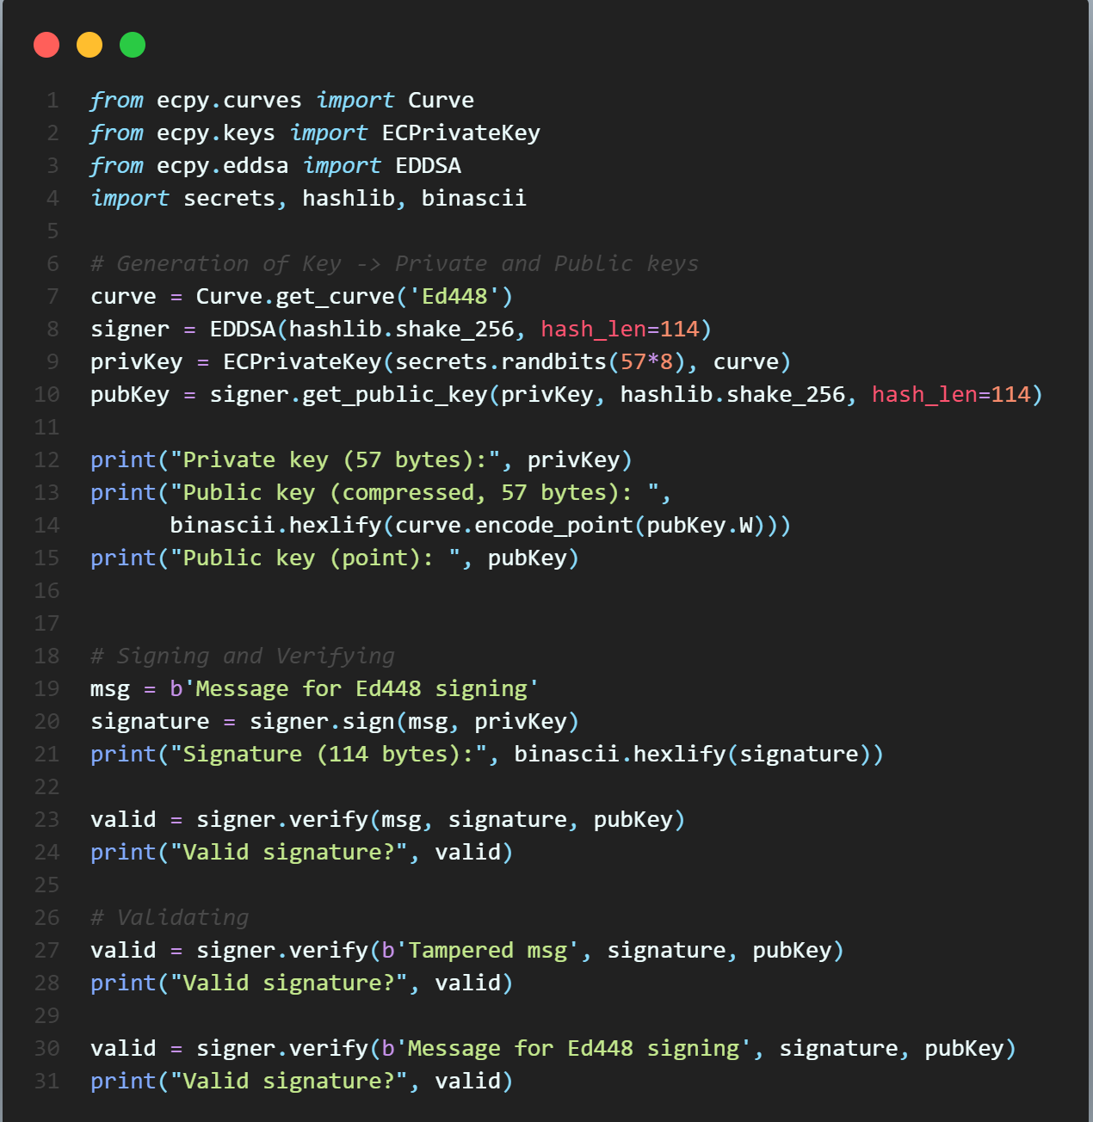
Implementation

Slide 8
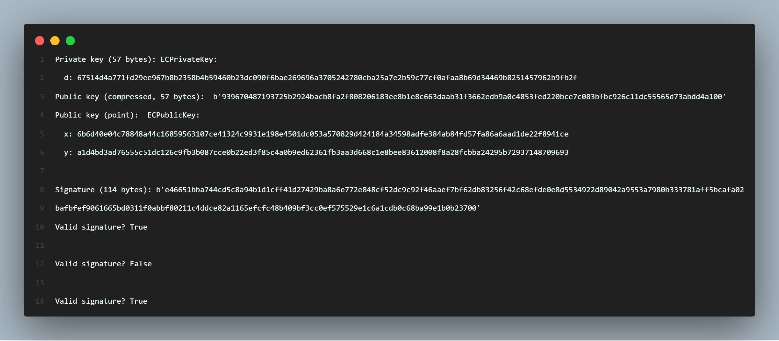
Results

