Slide 1



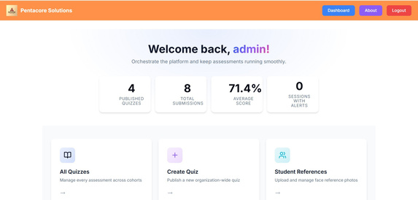
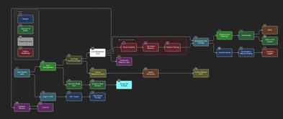
OBJECTIVE
Result
DEPARTMENT OF ARTIFICIAL INTELLIGENCE AND DATA SCIENCE
Guide: Assistant Prof. Diksha Bharawa
Students: Yash, Chetan, Aman, Shashank, Vanisha
SMART QUIZ PLATFORM
Deliver a Smart Quiz Platform that fuses intelligent assessment, AI-driven proctoring, and actionable analytics to uphold academic integrity in any modality.
Empower administrators, instructors, and learners through personalized quiz delivery, role-based access, and transparent performance insights that drive continuous improvement.
Provide a trustworthy remote testing environment by combining biometric verification, behavioral anomaly detection, and real-time alerts that deter malpractice without degrading user experience.
Establish an extensible foundation—Dockerized deployments, modular MERN architecture, and open APIs—that accelerates institutional adoption, third-party integrations, and future innovations like adaptive learning paths and LMS connectors.
Champion learner equity by pairing accessibility-first UI, code-execution sandboxes, and adaptive remediation with analytics that surface at-risk candidates early.
Components/Algorithms/Tech Stack
Applications
Verified prototype with seeded datasets demonstrating multi-role workflows, live proctoring alerts, and analytics dashboards.
Reduced manual oversight via automated violation scoring and consolidated reporting.
Positive usability feedback from demo users on clarity of dashboards and proctoring transparency.
Frontend: React 18 + Vite, Redux Toolkit, Tailwind CSS, Chart.js/Recharts, face-api.js.
Backend & Data: Node.js 18 with Express.js, MongoDB via Mongoose, Passport.js (OAuth), JWT + refresh tokens, Socket.io.
Security & Proctoring: AI facial recognition and behavior scoring, tab-switch detection, helmet, Joi validation, rate limiting.
Analytics & Automation: MongoDB aggregations, performance dashboards, exportable CSV/PDF reports, automated grading pipeline.
DevOps & QA: Docker Compose, Nginx reverse proxy option, seeded demo scripts, Jest/Vitest test suites.
Universities conducting remote midterms/finals.
Corporate compliance training and certification.
MOOC providers needing scalable, integrity-focused assessments.
Professional licensure exams with remote candidates.
K-12 institutions adopting blended or flipped classrooms.
Methodology
Flowchart/Block diagram
Conclusion
Requirement Capture: Identify stakeholder roles (admin, instructor, learner) and compliance constraints.
Architecture & Data Modeling: Design modular MVC backend with Mongoose schemas for quizzes, questions, results, proctoring events.
Secure Authentication Layer: Implement JWT with refresh tokens, OAuth, and optional 2FA; enforce RBAC middleware.
Quiz Authoring & Delivery: Build question banks, randomization, adaptive difficulty, timed/untimed modes, and code execution sandbox.
AI-Driven Proctoring: Use webcam feeds + face-api.js for facial landmarks, integrate browser event listeners for tab focus, compute violation scores.
Real-Time Monitoring & Notifications: Stream events via Socket.io dashboards for instructors and flag anomalies.
Analytics & Reporting: Aggregate results, generate insights (accuracy, time, integrity metrics), and provide export features.
Quality Assurance: Automated Jest/Vitest suites, linting, Dockerized staging, user acceptance testing with seeded personas.
Deployment: Containerized stack on Docker, configurable .env, optional cloud scaling.
Smart Quiz Platform integrates secure assessment delivery with AI proctoring and actionable analytics, aligning with contemporary research on academic integrity and adaptive learning.
Modular architecture supports future extensions (pose estimation, LMS integration) and scalability across educational contexts.
Reference
1. Meta Landys (2025). “Enhancing Online STEM Education: Impacts of Pre-Released Exam Materials and Remote Proctoring Requirements.” Online Learning Journal, 29(3). DOI: 10.24059/olj.v29i3.4743. Explores remote proctoring’s effect on performance and anxiety—useful for proctoring justification.
2. Yaqub, Mohanty & Suleiman (2023). “Proctoring Online Exam Using Eye Tracking.” In Proceedings of the 20th International Conference on Security and Cryptography. DOI: 10.5220/0012120600003555. Presents eye-tracking-based proctoring mechanics; informs AI proctoring module.
3. Rawashdeh & Rawashdeh (2023). “Online Exam Proctoring: Challenges, Timeline, and a Proposed Custom Rule-Based Online Proctoring Exam Framework.” In Future Technologies Conference 2023 (LNNS, vol. 543). DOI: 10.1007/978-3-031-47448-4_28. Offers design considerations and rule-based safeguards aligning with violation scoring.
4. INVIG-AI Team (2025). “INVIG-AI Online Exam Proctoring System.” IRJMETS, May 2025. DOI: 10.56726/irjmets75406. Describes AI-driven posture/facial analytics for integrity monitoring.
5. Jiyou & Yunfan (2022). “The Design, Implementation and Pilot Application of an Intelligent Online Proctoring System for Online Exams.” Interactive Technology and Smart Education, 19(1), 112–120. DOI: 10.1108/ITSE-12-2020-0246. Discusses intelligent proctoring architecture—parallels current system.
6. Ross et al. (2018). “Adaptive Quizzes to Increase Motivation, Engagement and Learning Outcomes.” International Journal of Educational Technology in Higher Education, 15(1). DOI: 10.1186/s41239-018-0113-2. Supports adaptive quiz bank and analytics components.

