Slide 1



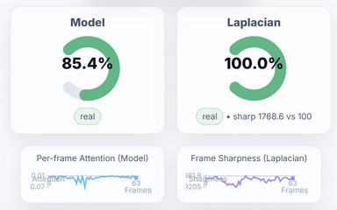
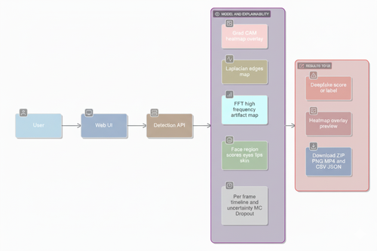
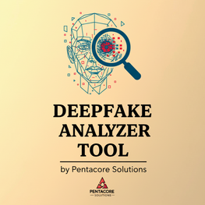
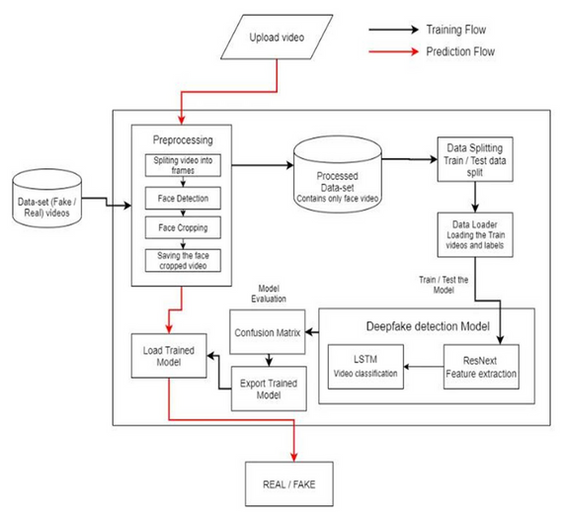
OBJECTIVE
Result
The rapid growth of AI-generated synthetic media has created opportunities for misuse in social media, politics, and entertainment. Traditional detection methods fail to adapt quickly to evolving deepfake techniques. A reliable and explainable detection platform is necessary to restore trust in digital media. Our project focuses on building a robust system that not only detects fakes but also provides explainable evidence to support decision-making. We target low-latency, high-accuracy inference for images and short videos, with robustness to compression, scaling, noise, and mild motion blur. Ensure privacy, security, and reproducibility with versioned models, hashed inputs/outputs, encrypted storage, and detailed audit logs. The platform is modular and extensible to new detectors/modalities, supports local and cloud deployment with authentication and rate limiting, and includes continuous evaluation for drift, fairness, and bias across demographics, with transparent documentation of limitations.
DEPARTMENT OF ARTIFICIAL INTELLIGENCE AND DATA SCIENCE
Guide: Assistant Prof. Diksha Bharawa
Students: Yash, Chetan, Aman, Shashank, Vanisha
Outputs: deepfake probability/labels, per-method scores, Grad-CAM overlays, optional region heatmaps.
DEEPFAKE ANALYZER TOOL
Components/Algorithms/Tech Stack
Applications
Datasets: FaceForensics++, DFDC with heavy augmentations (scaling, compression).
Backend: Python, PyTorch, OpenCV, librosa, MediaPipe.
Modeling: Transformer-based video encoder + audio branch; Grad-CAM for visual explanations.
Frontend: HTML, CSS, JavaScript with a user-friendly UI.
Deployment: Docker, Docker Compose, AWS cloud integration.
Explainability Tools: Grad-CAM, Laplacian heatmaps, A/V synchronization metrics.
Government & Law Enforcement: Verify authenticity of video evidence.
News & Media Organizations: Fact-check viral content to prevent misinformation.
Social Media Platforms: Integrate detection as part of content moderation systems.
Education: Raise awareness about deepfake threats and safe digital practices.
Commercial Use: Entertainment industry for authenticity checks, preventing misuse of celebrity likeness.
Public Safety: Protect individuals from identity theft, harassment, and reputational damage.
Methodology
Flowchart/Block diagram
Conclusion
Input: User uploads image/video.
Pre-processing: Frames and audio extracted.
Heuristic Analysis: Laplacian sharpness and edge detection for blur/fake evidence.
Deep Model: Transformer-based video encoder with audio features.
Explainability: Grad-CAM overlays, lip-sync checks, A/V sync correlation.
Output: Fake/Real classification with confidence score and visual evidence.
The system couples explainable deepfake detection with a simple UI and cloud stack, enabling trustworthy assessments, reproducible artifacts, and streamlined operations.
Reference
Grad-CAM: Selvaraju et al., 2017, https://arxiv.org/abs/1610.02391
FaceForensics++ — Rössler et al., 2019. Benchmark for facial manipulation detection. https://arxiv.org/abs/1901.08971
DFDC Dataset — Dolhansky et al., 2020. Large-scale face-swap dataset. https://arxiv.org/abs/2006.07397
[1] A. K. Singh, "Deep Learning for Deepfake Detection," Springer, pp. 1-300, 2022.
Selvaraju et al., 2016/2019. Visual explanations for deep nets. https://arxiv.org/abs/1610.02391

