Slide 1


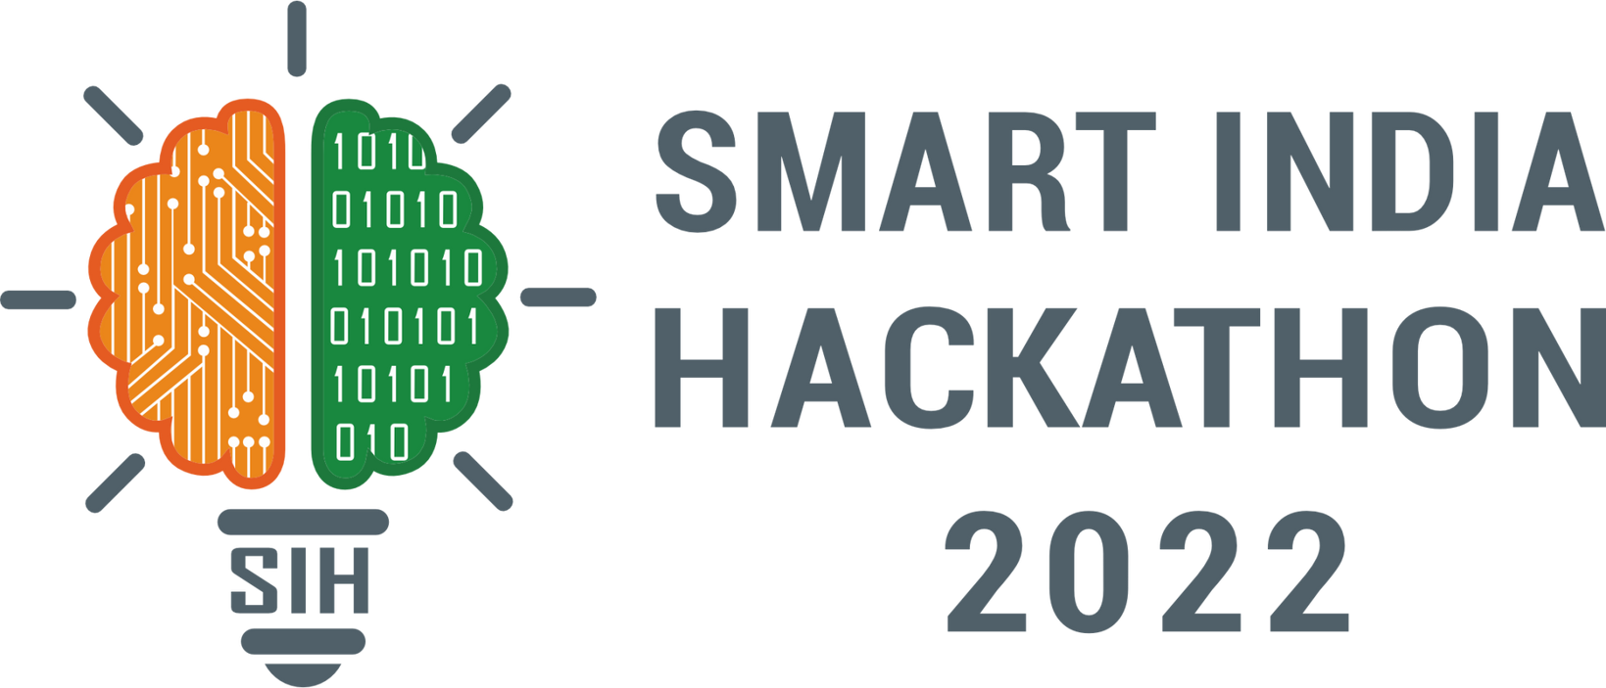
SMART INDIA HACKATHON 2024
Problem ID - SIH -1683
Problem Statement Title- Development of AI/ML based solution for detection of face-swap based deep fake videos.
Theme- Miscellaneous
PS Category- Software
Team ID-
Team Name - AuthentiSix

Slide 2
TEAM MEMBERS:-
MANI CHOURASIYA (TEAM LEADER) AI&DS 7TH SEMESTER
YASH MALVIYA AI&DS 7TH SEMESTER
LOVELY VERMA AI&DS 7TH SEMESTER
AMAN SHARMA AI&DS 7TH SEMESTER
SNEHA GUPTA AI&DS 7TH SEMESTER
CHETAN KHAPEDIA AI&DS 7TH SEMESTER

Slide 3



Development of AI/ML based solution for detection of face-swap based deep fake videos
IDEA / SOLUTION:-
Multi-Technique Detection: Combines CNNs, RNNs, LSTMs, frequency analysis, and audio-visual checks to accurately detect deep fakes.
Adversarial Training: Uses GANs to enhance the model's ability to identify evolving deep fake techniques.
Blockchain: Ensures content authenticity and integrity.
Hybrid Model: Integrates multiple analyses for robust detection
Problem Resolutions:-
Comprehensive and Accurate: Provides through, precise detection by analyzing videos from multiple angles.
Adaptive: Remains effective against new deep fake methods.
Unique Value Prepositions (UVP):-
Integrated Approach: Merges various advanced techniques and blockchain for a unique and forward-looking solution.
Future-Proof: The solution is designed to stay effective as deep fake technology evolves, making it a forward-looking tool in digital content authentication
@SIH Idea submission- 2024
2
Notes:
2

Slide 4
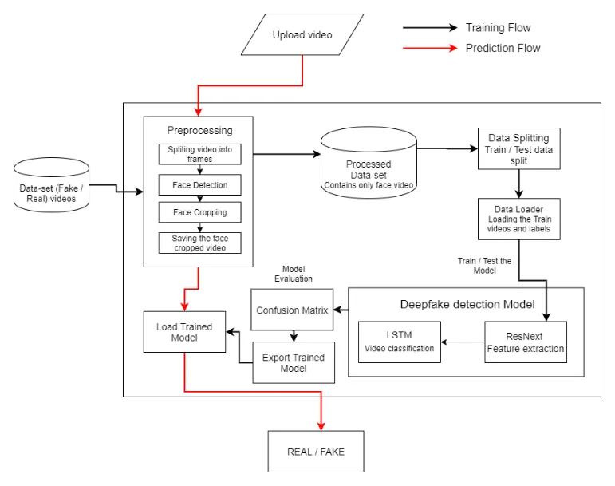
TECHNICAL APPROACH
Process Flow Architecture
Model Development-Python
Libraries Used-
OpenCV, TenserFlow, Librosa
Pandas, Numpy, Gradio.
Algorithms:- CNN, RNN, LSTM Networks, Capsule Networks, Generative Adversarial Networks (GANs), Audio-Visual Analysis, Blockchain Technology, Frequency Domain Analysis, Biometric Verification Hybrid Models.
Database:- MYSQL
@SIH Idea submission- 2024
3
Notes:
3

Slide 5
FEASIBILITY AND VIABILITY
Feasibility Analysis
Technically feasible : using techniques like CNNs, RNNs, and GANs.
High user demand for deep fake detection tools
Potential for Accuracy
Potential Challenges and Risks
Rapidly evolving deep fake technologies
Privacy concerns with sensitive content
Strategies for overcoming these challenges
Extensive testing to reduce false positives/negatives
@SIH Idea submission- 2024
4
Notes:
4

Slide 6
IMPACT AND BENEFITS
Potential Impact on the Target Audience
•Enhanced Trust in digital media
•Content moderation and regulation
•Commercial and Entertainment Sectors
Benefits of the Solution
• Cost efficient
• Education value
• Preventing Identity Theft
@SIH Idea submission-2024
5
Notes:
5

Slide 7
RESEARCH AND REFERENCES
RESEARCH PAPER. REFERNCE:-
Rana, M. S., Nobi, M. N., Murali, B., & Sung, A. H. Deepfake detection: A systematic literature review. IEEE Access, 10,(2002)
Dolhansky, B., Bitton, J., Pflaum, B., Lu, J., Howes, R., Wang, M., & Ferrer, C. C. The deepfake detection challenge (dfdc) dataset. arXiv preprint arXiv:2006.07397.(2020)
BOOKS REFERNCE:-
[1] A. K. Singh, "Deep Learning for Deepfake Detection," Springer, pp. 1-300, 2022.
@SIH Idea submission- 2024
6
Notes:
6

Slide 8


