Slide 1







IBM Data Analyst Final Project
Yash Movaliya
10th July,2024

Slide 2



OUTLINE
Executive Summary
Introduction
Methodology
Results
Visualization – Charts
Dashboard
Discussion
Findings & Implications
Conclusion
Appendix

Slide 3

EXECUTIVE SUMMARY
Contextualization and data analysis.
Methodology
Data gathering
Data analysis
Data visualization
Presentation of graphs showing result
Discussion of findings and final conclusions

Slide 4

INTRODUCTION
This presentation utilized data from the 2019 Stack Overflow survey, IBM's website, and GitHub job postings to showcase current and future trends in technology skills.
The findings represent insights from approximately 90,000 respondents within the developer community.
Provides insights into the top 10 programming languages and databases currently in use

Slide 5

METHODOLOGY
Data collection and explore the content
Data Wrangling
Data Analysis
Data Visualization
Distribution and comparison of data
Dashboard

Slide 6
RESULTS

Slide 7
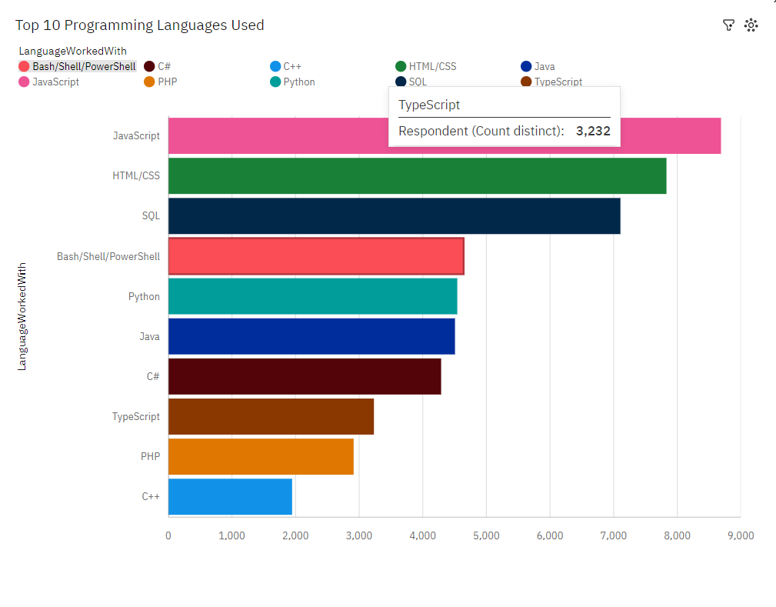
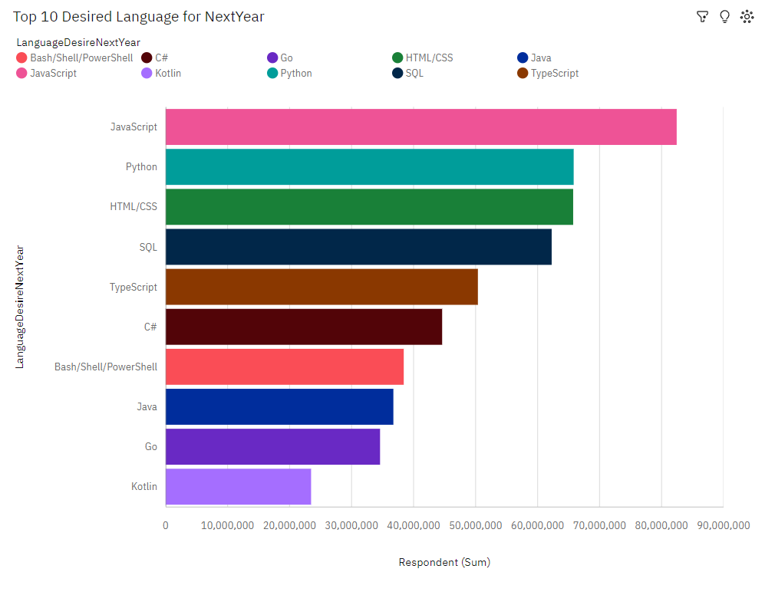
PROGRAMMING LANGUAGE TRENDS
Current Year
Next Year

Slide 8
PROGRAMMING LANGUAGE TRENDS - FINDINGS & IMPLICATIONS
Findings
JavaScript keeps going as a leading language
Python and TypeScript are fast growing languages
Implications
Developer migrating from JavaScript to TypeScript

Slide 9
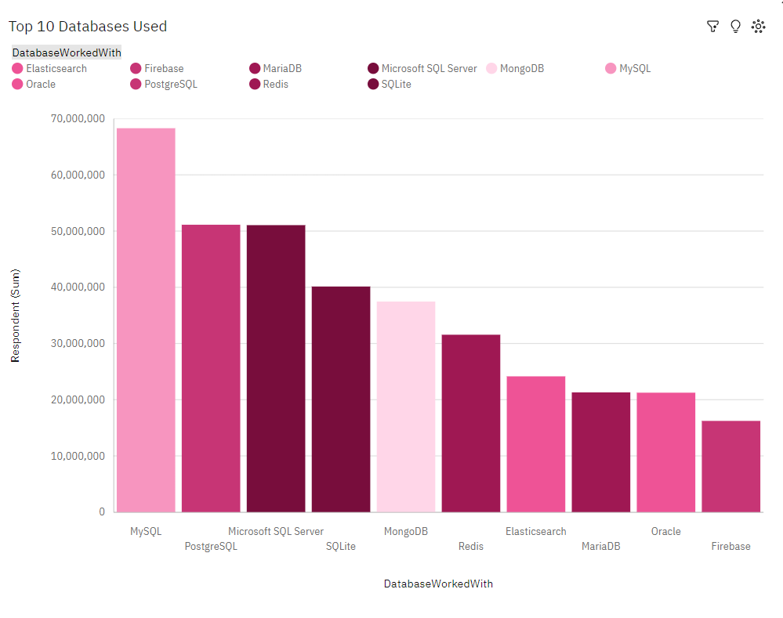
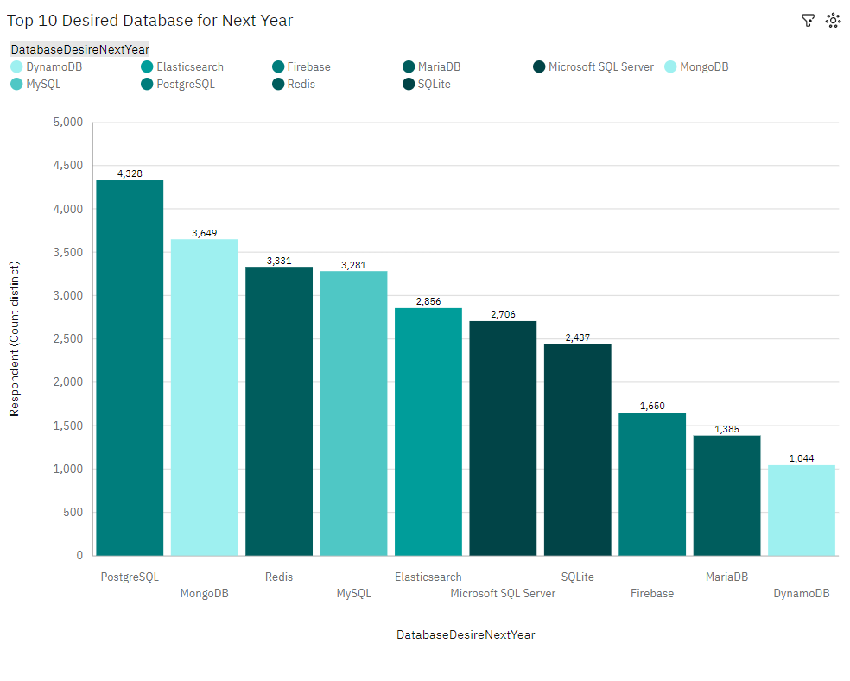
DATABASE TRENDS
Current Year
Next Year

Slide 10
DATABASE TRENDS - FINDINGS & IMPLICATIONS
Findings
PostgreSQL and MongoDB are getting popular
MySQL is being constant choice
Implications
Lack of interest in MS SQL Server and SQLite

Slide 11

DASHBOARD
https://github.com/YashMovaliya/IBM-Final-Project

Slide 12
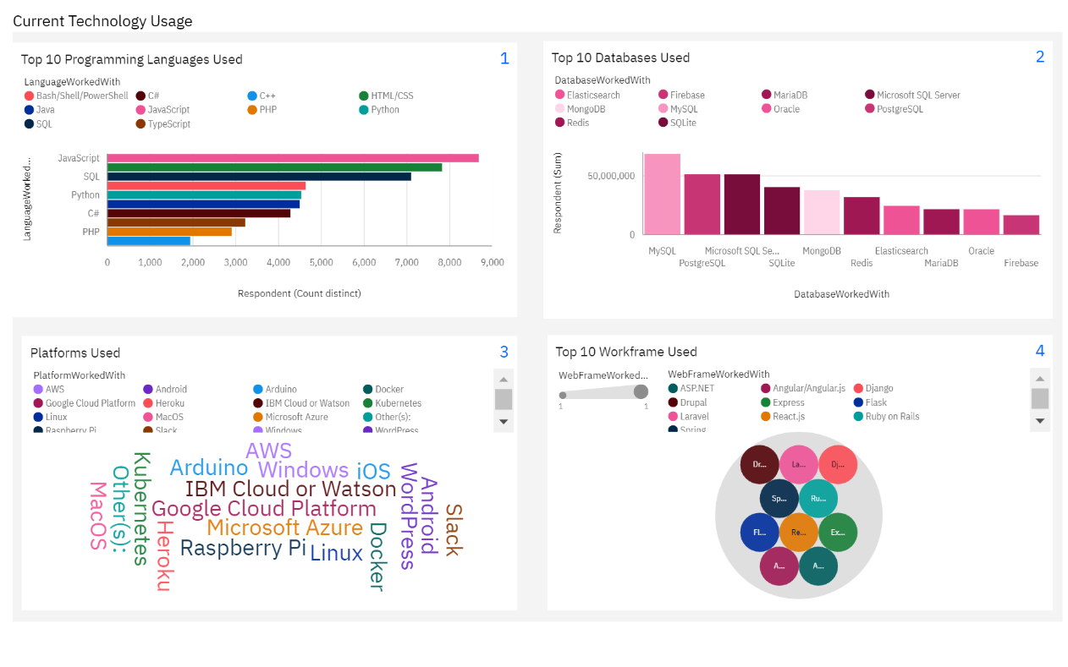
DASHBOARD TAB 1

Slide 13
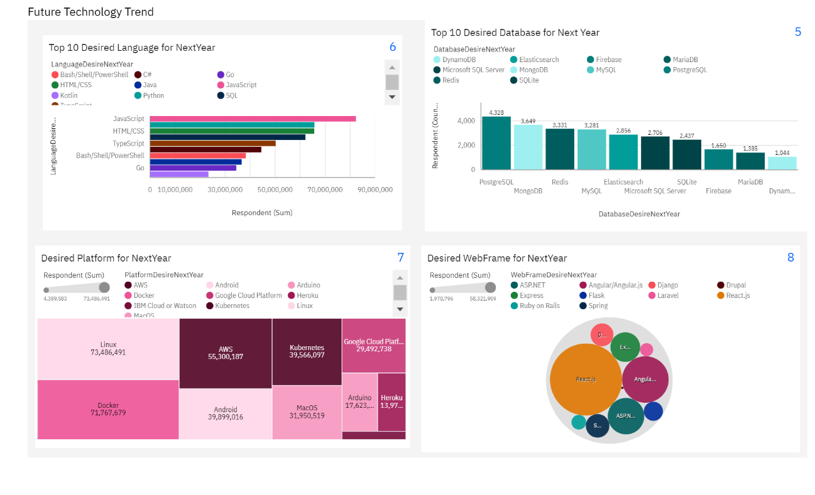
DASHBOARD TAB 2

Slide 14
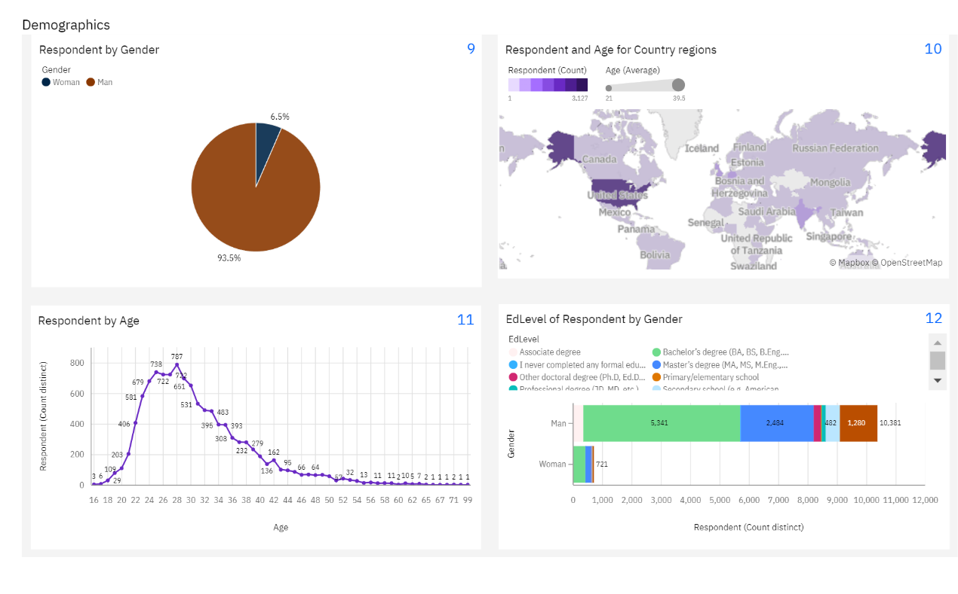
DASHBOARD TAB 3

Slide 15
DISCUSSION

Slide 16
OVERALL FINDINGS & IMPLICATIONS
Findings
JavaScript is a widely used language and TypeScript is getting popular
Over 90% of developers are young male
Implications
Young developers without post graduation on its majority
JavaScript and TypeScript frameworks attracting more developers.

Slide 17

CONCLUSION
Increasing women's participation in STEM is crucial to closing the significant gender gap in this field.
There should be more tech job available in developing countries.
Having knowledge of popular trends of different tools and technologies as a developer is demanding.

Slide 18

APPENDIX

Slide 19
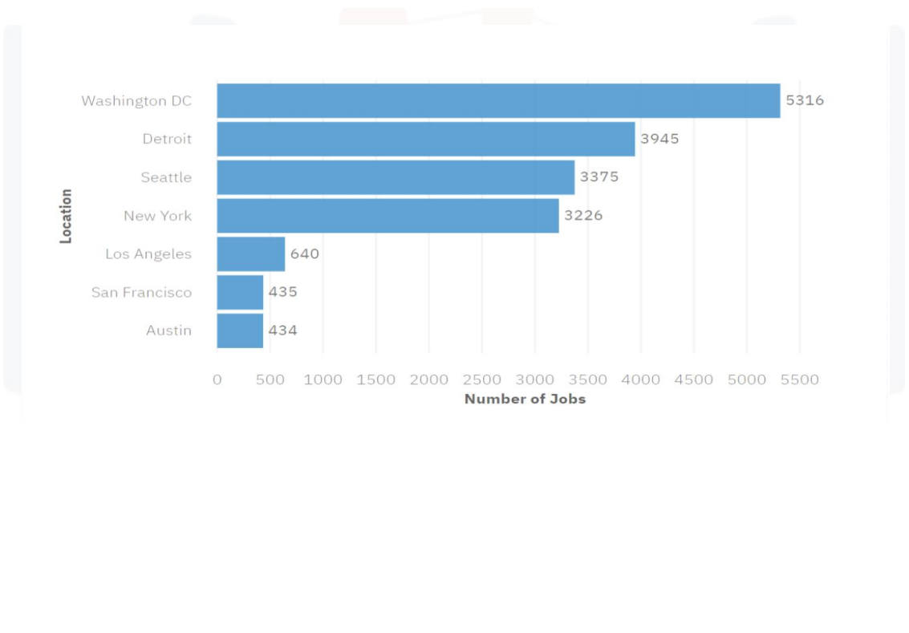
JOB POSTINGS

Slide 20
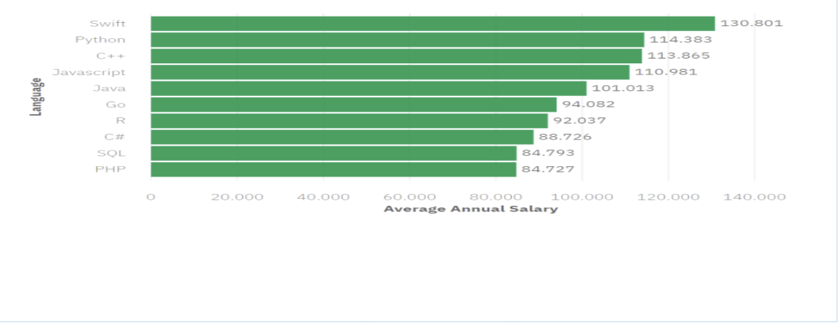
POPULAR LANGUAGES

