Slide 1
INVESTMENT ASSIGNMENT SUBMISSION
Name: Yash Naik
Submission Date:21/09/2020

Slide 2
Analysing investment trends
Observed all the necessary datasets and summarized them.
Merged two datasets companies and funding round on unique key Permalink and named that dataset as Master frame.
Data cleansing of master frame.(Treating missing values,dropping unnecessary columns,converting funding amount into million dollars)
Merged the masterframe and sector details datasets to observe the sector wise analysis.
Analysed which type of funding round is best for investment,how much amount is raised in the particular type of funding,which country has the highest English speaking population,which country is the best to invest in,which sector has the highest number of investments,How much amount is invested in particular company,How much amount is invested in particular sectors,how much amount is invested in particular countries.
From the detailed analysis we are able to find preferred funding round type,preferred country,preferred sector to invest in.

Slide 3
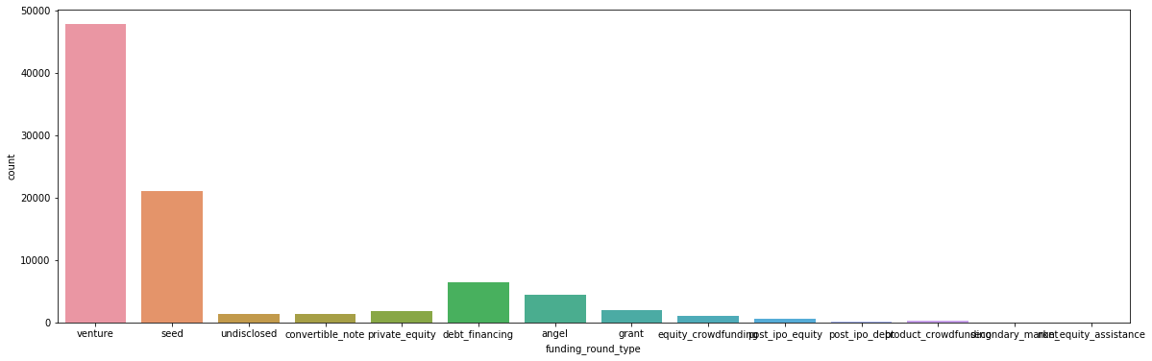
Funding Round Type Analysis

Slide 4
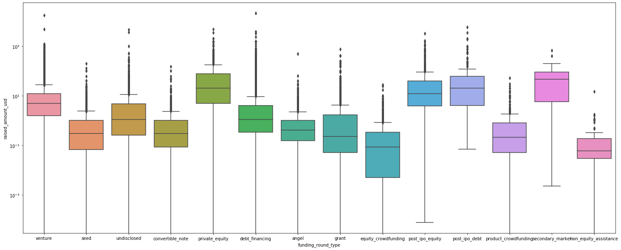
Average funding amount of venture type is 11.2 million USD
Average funding amount of angel type is 0.97 million USD
Average funding amount of seed type is 0.74 million USD
Average funding amount of private equity type 73.9 million USD
→ Investment has to be between 8 to 15 million USD So Venture is the best investment type.

Slide 5
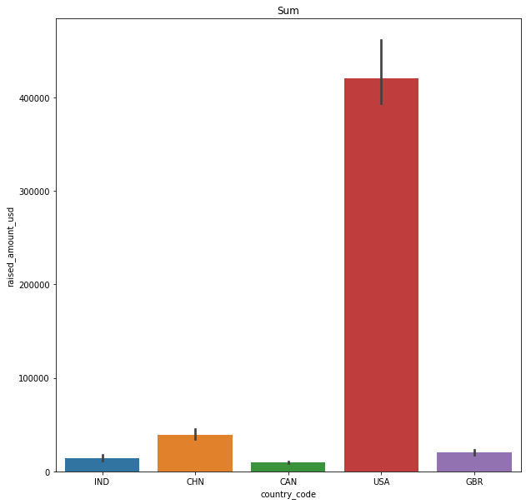
Top Countries Analysis

Slide 6
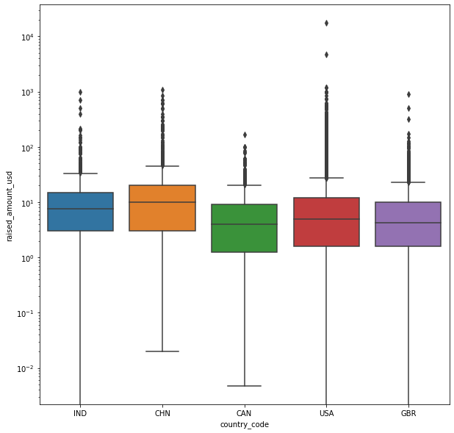
→ USA, GBR and IND are the top three English speaking countries.Because China is not an English speaking country.
→ Investors are investing more in USA,GBR and IND.

Slide 7
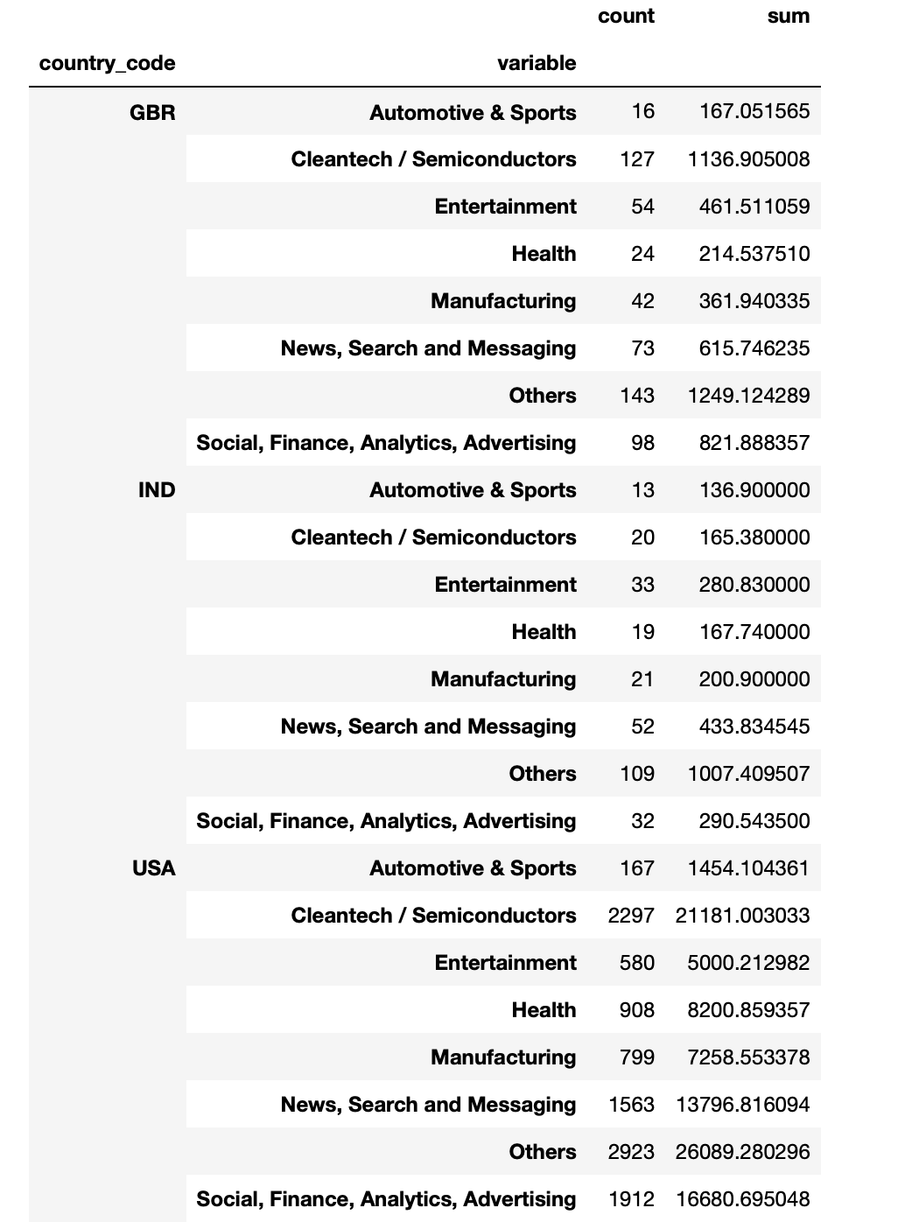
Top Sectors Analysis

Slide 8
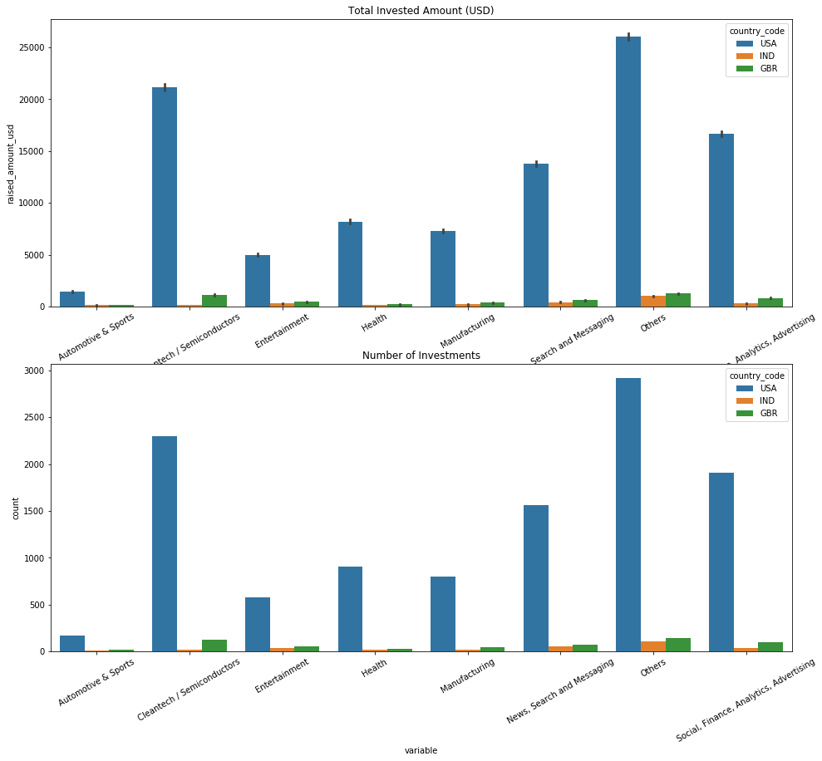
The top country in terms of the number of investments and the total amount invested is the USA.
The sectors 'Others', 'Social, Finance, Analytics and Advertising' and 'Cleantech/Semiconductors' are the most heavily invested ones.

