Slide 1
Sales_Insight

Slide 2
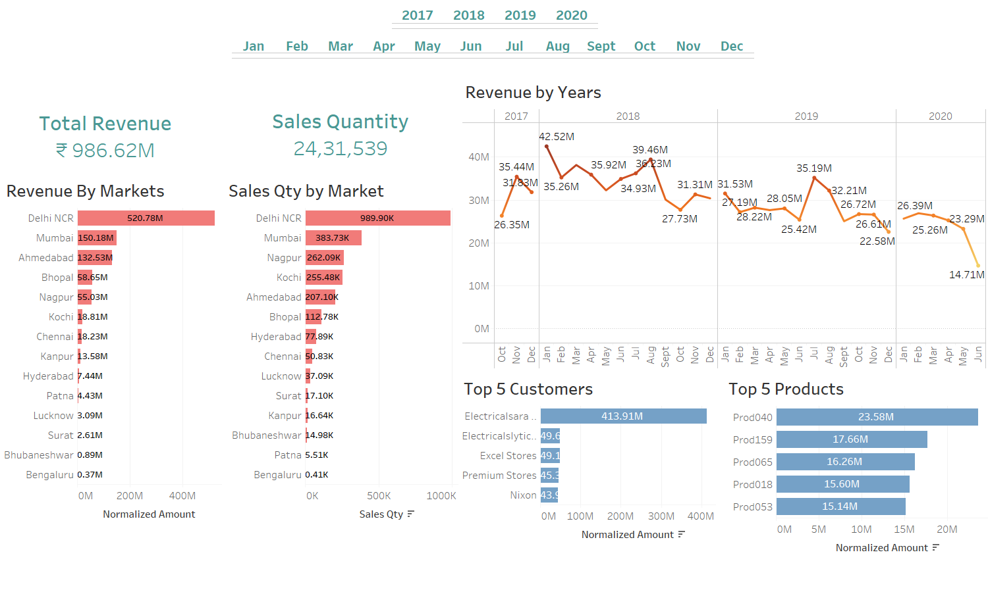

Slide 3
