Slide 1
PREDICTING PRICE OF USED CAR AREA: DATA MINING

Slide 2
PROJECT
We will be predicting the costs of used cars given the data collected from various sources and distributed across various locations in India.
FEATURES:
Name: The brand and model of the car.
Location: The location in which the car is being sold or is available for purchase.
Year: The year or edition of the model.
Kilometers_Driven: The total kilometres driven in the car by the previous owner(s) in KM.
Fuel_Type: The type of fuel used by the car.
Transmission: The type of transmission used by the car.
Owner_Type: Whether the ownership is First-hand, Second hand or other.
Mileage: The standard mileage offered by the car company in kmpl or km/kg
Engine: The displacement volume of the engine in cc.
Power: The maximum power of the engine in bhp.
Seats: The number of seats in the car.
Price: The price of the used car in INR Lakhs.

Slide 3
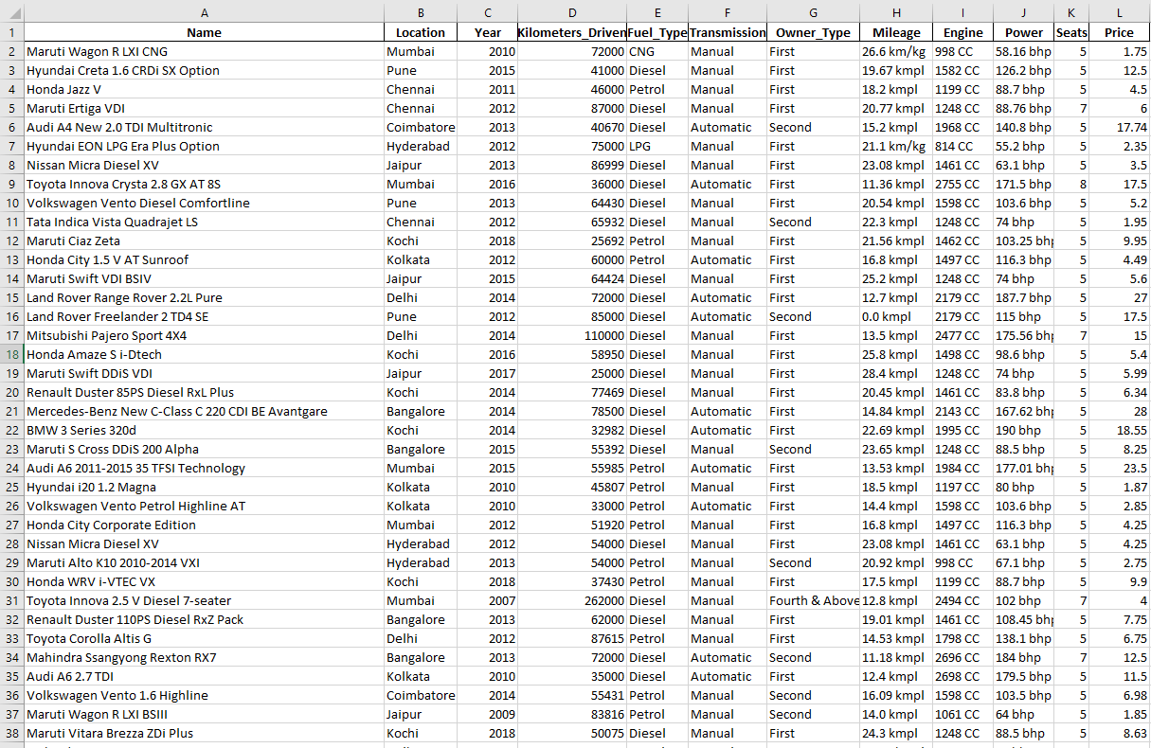
TRAINING DATA

Slide 4
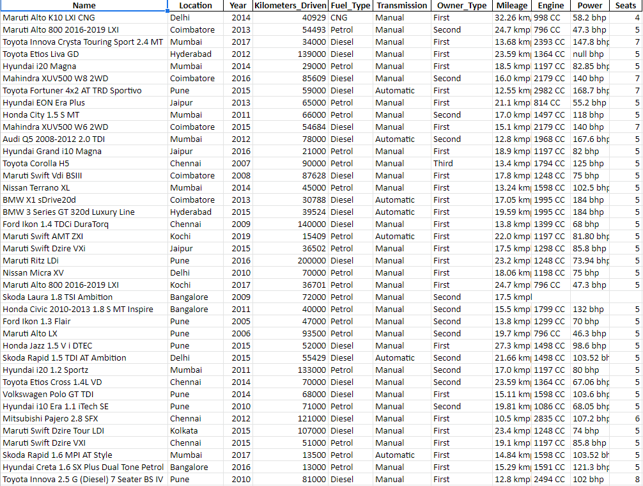
TESTING DATA

Slide 5
DATA ANALYSIS
1
Using python libraries such as : Pandas, Numpy, Matplotlib, Seaborn

Slide 6

Data Pre-Processing
We will remove all the duplicate rows from the data.
( NO DUPLICATED DATA PRESENT)

Slide 7
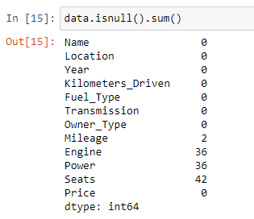
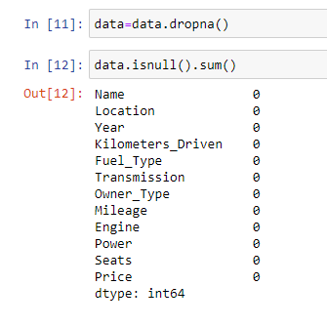
We will remove all the rows having missing or null data.
2 + 36 + 36 + 42 = 116 null values

Slide 8
We will make Mileage, Engine , Power into purely float values by removing
o “Kmpl” from Mileage
o “CC” from Engine
o “bhp” from Power
We will subtract 2000 from Year feature to make analysis simple
We will split Name column into Brand and Model column

Slide 9
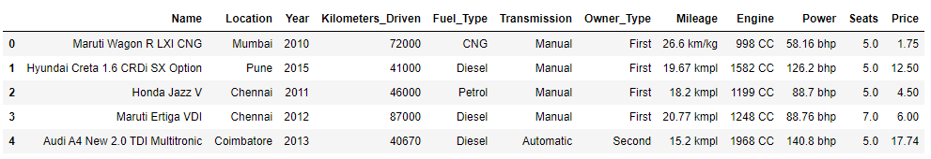
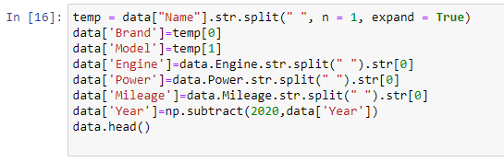
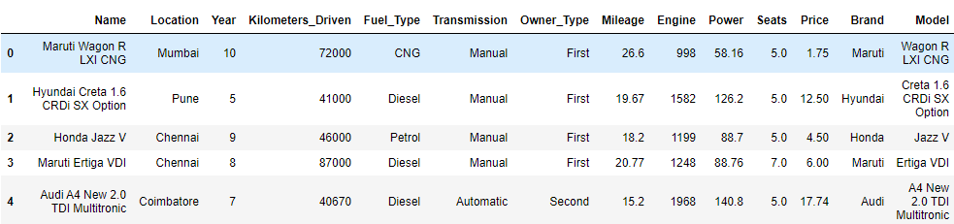

Slide 10
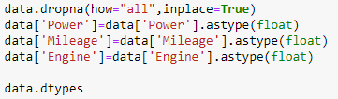
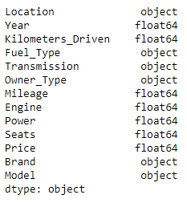

Slide 11
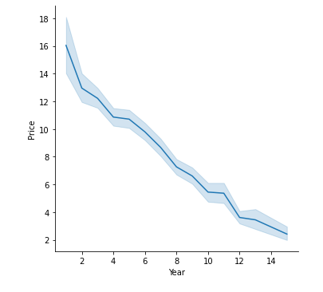
Graphical Analysis
Though the curve is not perfectly linear, it can be seen that when the car is new (bought in recent years), it has a higher market value.

Slide 12
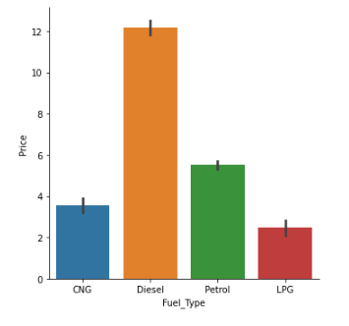
The above graph clearly states the fact that diesel cars are more preferred than petrol cars. Thus, price of used cars follows the order: diesel>petrol>CNG>LPG . This might be because:
Petrol and Diesel have high engine capacity.
Though CNG and LPG gives higher mileage, they are not safer and require high maintenance.
Cost of petrol is high and diesel index is little complex and thus a little costlier than petrol engine.

Slide 13
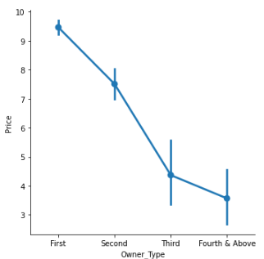
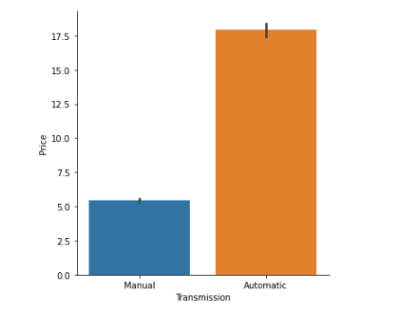

clearly, new car is having higher price than second hand car
Price of automated transmission is higher than manual, again for obvious reasons

Slide 14
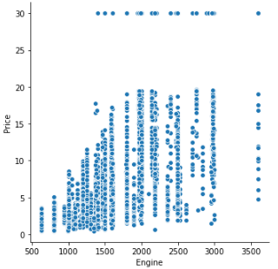
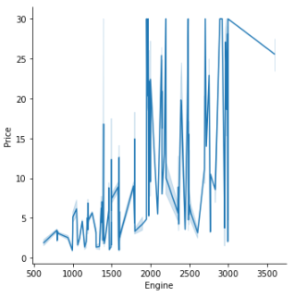
The dots are not perfectly forming a pattern, but more or less, it seems more the capacity of the engine, more price of the car.

Slide 15
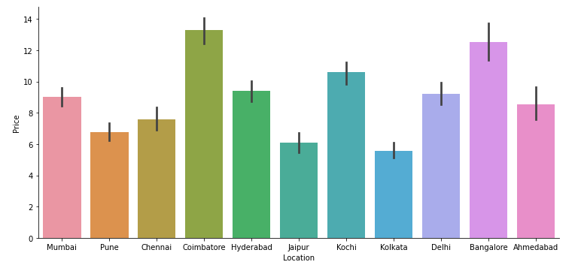
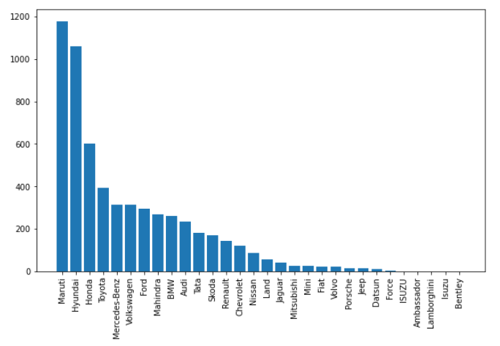
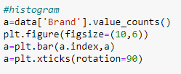


Slide 16
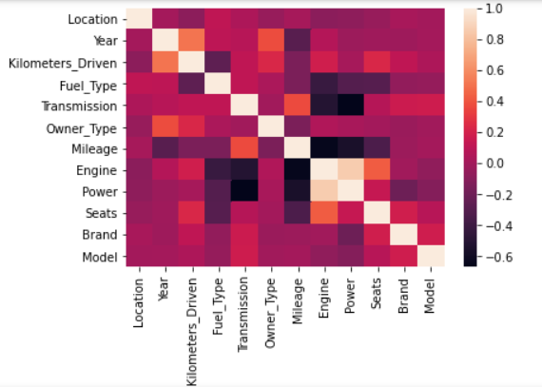
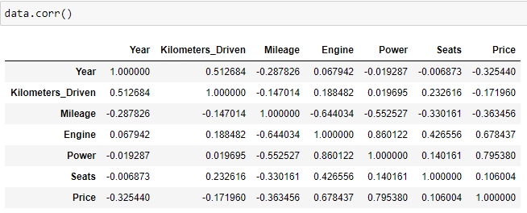
HEAT MAP SHOWING RELATION BETWEEN DIFFERENT FEATURES

Slide 17
Model Implementation
2

Slide 18
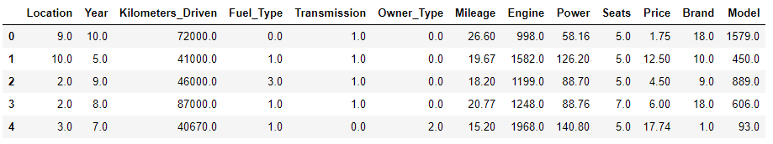
First, we will convert all the named features into numbers so that we can implement them into our model.
FOR EXAMPLE :
Owner_Type | First | Second | Third | Fourth & Above values
Owner_Type | 0.00 | 1.00 | 2.00 | 3.00
{ 'Brand' ,'Location', 'Fuel_Type', 'Transmission' ,'Owner_Type', 'Model', 'Engine', 'Power' }

Slide 19
• Now we will slip our data into Test and Training Data So, that we can test our DATA accuracy on a different Models.
• Now we will split all The data into 2 parts x,y
o x : containing all the features
o y : containing Price
• Now, we pass or Data into Different Models

Slide 20
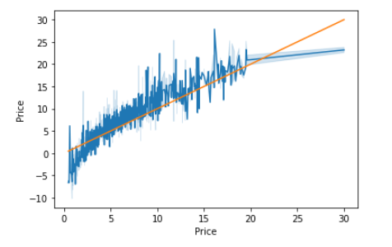
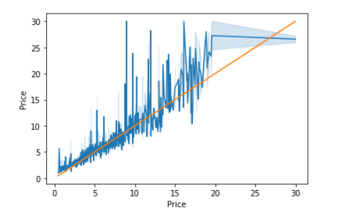
Linear Regression
KNeighborsRegressor
Accuracy: 77.8822979113963%
Accuracy: 88.38561409866529%

Slide 21
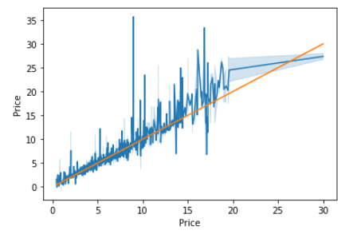
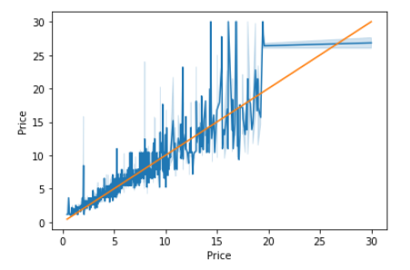
Support Vector Regression
DecisionTreeRegressor
Accuracy: 89.98166490143245%
Accuracy: 84.47259346148451%

Slide 22
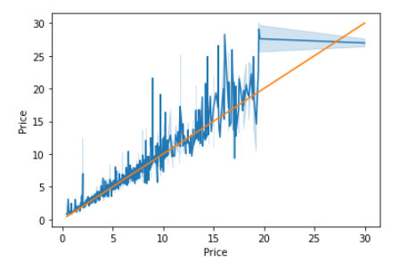
RandomForestRegressor
Accuracy: 91.48808418027862%
We will use this model

Slide 23
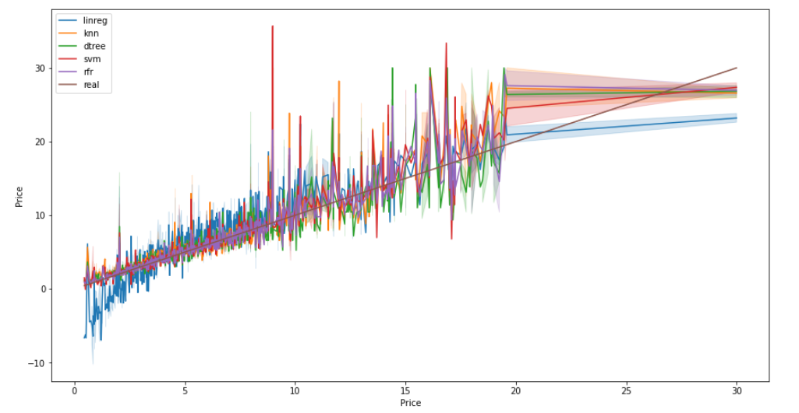
ALL MODEL COMPARISON

Slide 24
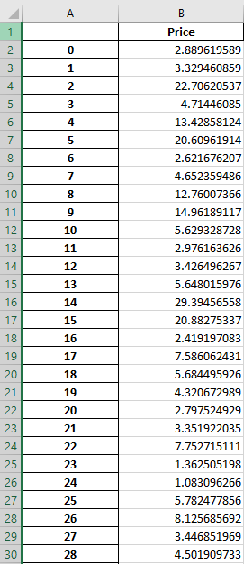
After selecting the model
we will pre-process our test data similar to the training data.
Then ,we will feed this data to our model and we will create Predict excel file in which we will predict the data.

Slide 25
REFERENCES
Sameerchand Pudaruth , “Predicting the Price of Used Cars using Machine Learning Techniques”, International Journal of Information & Computation Technology Volume 4, Number 7
Nabarun Pal , “How much is my car worth? A methodology for
predicting used cars prices using Random Forest”, Future of Information and Communications Conference (FICC) 2018
Ozer Celik1*, U. Omer Osmanoglu , “Prediction of The Prices of Second-Hand Cars ” , European Journal of Science and Technology No. 16, pp. 77-83, August 2019

Slide 26
Thanks!
Project members
Yash Nishal 2K19/CO/441
Yanshul Narotra 2K19/CO/440

