Slide 1
SKLearn.Metrics
An Overview of Modules

Slide 2
Topics
Classification Metrics
Regression Metrics
Pairwise Metrics
Plotting

Slide 3
Classification Metrics
Classification algorithms are used to predict/classify data into groups like male-female, etc.
metrics.auc
metrics.confusion_matrix
metrics.precision_score
metrics.average_precision_score
metrics.recall_score
metrics.precision_recall_curve
metrics.f1_score
metrics.accuracy_score
metrics.roc_curve
metrics.roc_auc_score

Slide 4
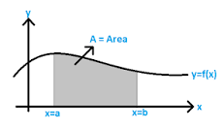
metrics.auc(x, y) - calculate Area Under Curve :
This acts like performing definite integral between two points (x and y coordinates)
metrics.hamming_loss(actual_label, prediction_label):
Compute fraction of wrong labels to total number of labels
Higher hamming loss score means more correct predictions (highest is 1).

Slide 5

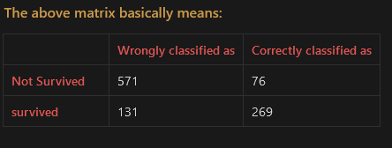
Confusion matrix
Classify the estimated values into four sections:
True Positives - (actual=1; predicted=1)
True negatives - (actual =0; predicted=0)
False negatives - (actual =1; predicted=0)
False positives - (actual=0, predicted=1)
First parameter (actual_labels) is the actual data
Second parameter (predicted_labels) is the predicted data generated by the learning model(s)
The Function would then classify these data and return a 2x2 matrix.
Eg: We created a dataframe y_train which contained actual values of people survival, and then generated a random forest based on it which was labelled as predictions.
confusion_matrix(y_train,predictions)

Slide 6
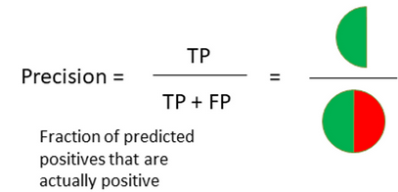
Precision score
Used to test accuracy of predicted values
Following is how precision is predicted:
precision_score(actual_label, predicted_label, pos_label=<value>)
pos_label is used to configure the operation.
If set to ‘1’ it would mean that the function would expect only positive values from the dataset.
If it is ‘0’, the function could expect negative values from the dataset.
But in order to get actual accuracy of data, we use recall.
metrics.average_precision_score(y_true, y_score) returns weighted mean of precisions observed at each threshold, where an increased recall from previous threshold is used as weight.

Slide 7
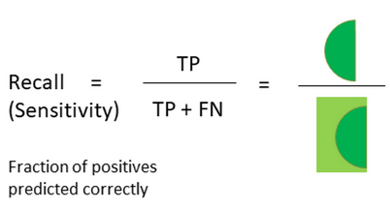
Recall score
Recall is used to validate the actual score (also known as sensitivity).
Following is how recall is calculated:
recall_score(actual_label, predicted_labels, pos_value=<value>)
pos_label is used to configure the operation.
If set to ‘1’ it would mean that the function would expect only positive values from the dataset.
If it is ‘0’, the function could expect negative values from the dataset.

Slide 8
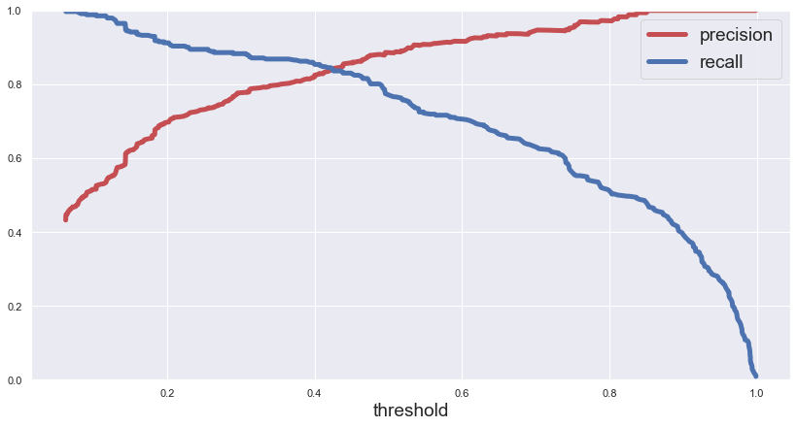
Precision Recall Curve
precision_recall_curve(actual_label, probability_label) is used for understanding of data where precision and recall take place in terms of a threshold.
This function can be applied if the datasets are imbalanced.
The Learning model can classify dataset values into one group if the threshold limit is crossed,
Else, the dataset values would be classified to a different group.
Eg: the RandomForest model could include a threshold value for a dataset of group of people which would survive once the threshold limit is crossed. If the threshold is not reached, the individual won’t survive
credits: murilogustileni

Slide 9
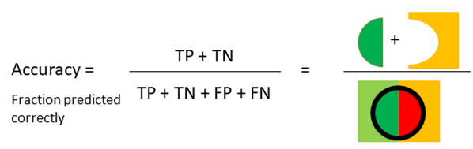
Accuracy score
Used to measure model performance in terms of True positives and true negatives
Following is how accuracy is calculated:
metrics.accuracy_score(y_true, y_pred)
Sometimes accuracy might not always be a good solution as for some cases it might become important to track both sides of a ratio.
Hence, recall becomes important in such cases.

Slide 10
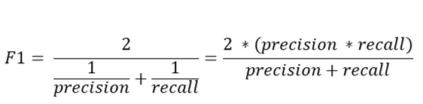
F1 score
F1 Score is basically a combination of Recall and Precision values.
It is used when accuracy of data is unbalanced.
Following is how F1 Score is calculated:
f1_score(actual_labels, prediction_labels, pos_label=<value>)
pos_label is used to configure the operation.
If set to ‘1’ it would mean that the function would expect only positive values from the dataset.
If it is ‘0’, the function could expect negative values from the dataset.

Slide 11
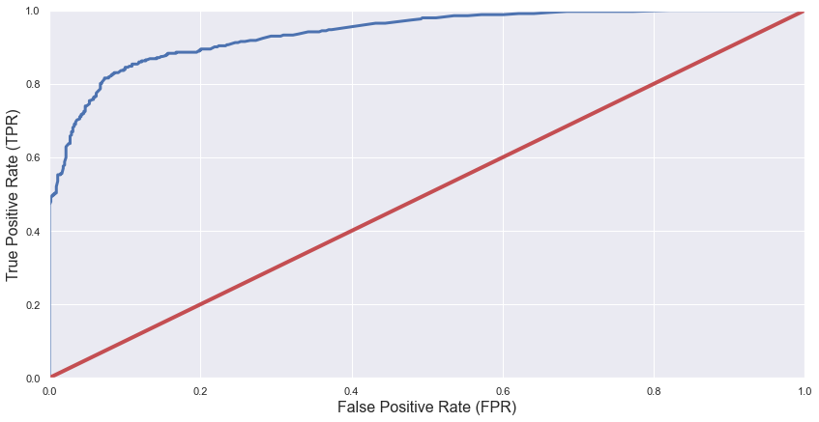
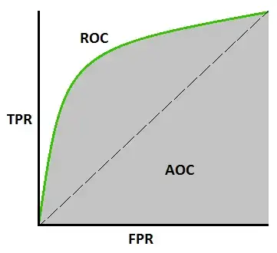
ROC Curve and ROC AUC Score
ROC (Receiver Operating Characteristics) curve (roc_curve) is used to understand a balance between True positives and False positives.
The function roc_curve accepts two parameters: actual_labels and predicted_probabilities.
The Graph would return Threshold values at different values of True positives and False positives.
An important note to consider is that we should use roc_curve only when the datasets are balanced.
roc_auc_score tells how capable the model is to classify the data, at different threshold values.
A good amount of classification would appear near 1, and the opposite if the curve resides near 0
ROC curve
ROC-AUC-Curve

Slide 12
Regression Metrics
Plotting
Regression Algorithms are used to predict continuous values like salary, age, etc.
metrics.mean_absolute_error
metrics.mean_squared_error
metrics.r2_score
API for creating data visualization
metrics.plot_confusion_matrix
metrics.plot_precision_recall_curve
metrics.plot_roc_curve

Slide 13
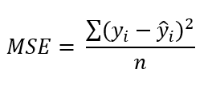
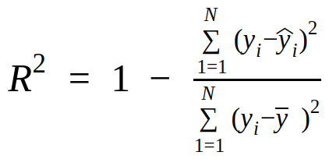
MAE, MSE and R²
Mean Absolute Error (MAE): mean_absolute_error(actual_label, prediction_label)
Used to calculate prediction error of a Model linearly.
Formula: (actual_value) - (predicted_value)
Mean Squared Error (MSE): mean_squared_error(actual_label, prediction_label)
Measure the amount of errors quadratically.
([(i-th predicted_value) - (i-th predicted_value)]**2 ) / (Number of observations)
Coefficient of Determination R² : r2_score(actual_label, prediction_label)
Tells how well the predicted data matches/approximates the real data.

Slide 14
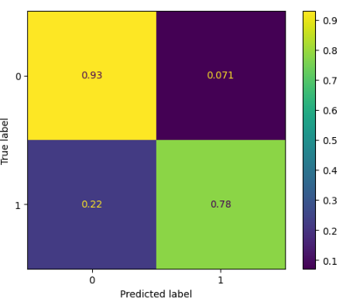
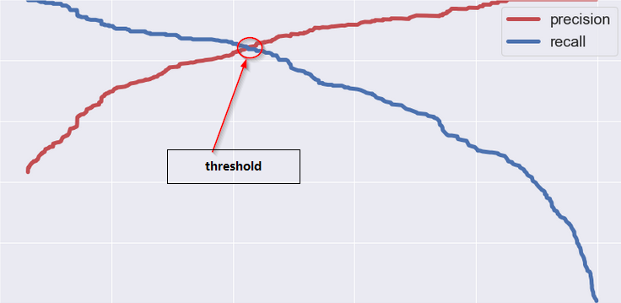
Plotting
Metrics.plot_confusion_matrix
(modelData, ActualDataX, ActualDataY, normalize =’true’)
Plot a Heatmap of Predicted values, Actual data
The rows and columns are divided into TP, FP, TN and FN.
Metrics.plot_precision_recall_curve
(modelData, ActualDataX, ActualDataY )
Plot the Precision-Recall Curve
Metrics.plot_roc_curve
(modelData, ActualDataX, ActualDataY)
Plot ROC-Curve
credits: Link

Slide 15
Pairwise Metrics
Provides a safe way to take distance matrix as input and Also perform pairwise distance between two Arrays.
pairwise.cosine_distances
pairwise.euclidean_distances, pairwise.nan_euclidean_distances
pairwise.distance_metrics
pairwise.haversine_distances
pairwise.manhattan_distances

Slide 16
pairwise.cosine_distances(X, Y): how similar the data objects are irrespective of their size
Takes two inputs as Array-like matrices and compute the cosine distances
Formula: cos(x,y) = (x * y) / (abs(x) * abs(y)
pairwise.euclidean_distances(X, Y): distance between two points on a graph plot
Takes two inputs as Array-like matrices
Formula : 2√(a²+b²)
pairwise.nan_euclidean_distances : used during presence of missing values
pairwise.distance_metrics() : return valid metrics for pairwise_distances
pairwise.haversine_distances(X, Y): Angular distance between two points on a sphere
pairwise.manhattan_distances(X, Y): Distance between two points measured axes at right angles.

