Slide 1
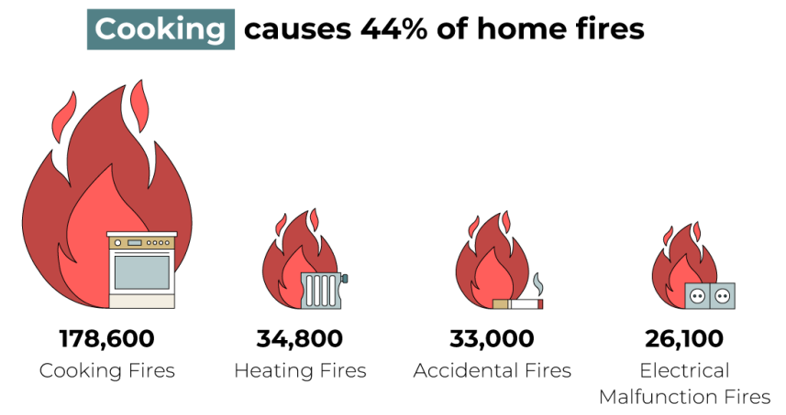


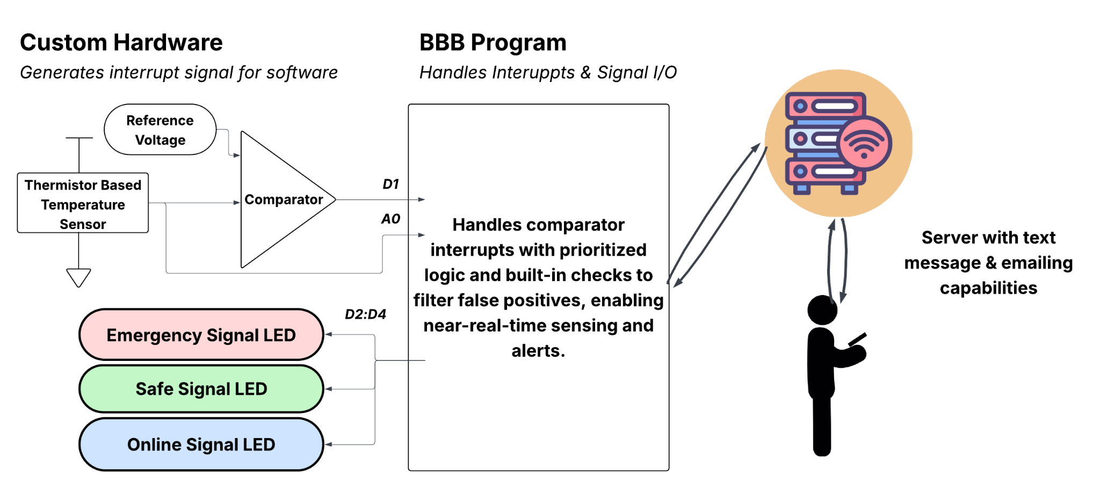
SafeStoves: A embedded wireless stove monitoring system
A stand-alone device that you place near your stove
Key Objectives
Real-time sensing: The system must react immediately during emergency conditions, so we use interrupt-driven detection to guarantee timely responses under RTOS behavior.
Low-power operation: To extend battery life, the sensing hardware triggers the MPU only when needed, allowing the main processor to stay in sleep mode instead of running continuously.
Safe fallback behavior: If the sensor hardware, driver, or interrupt fails, the MPU should fail gracefully instead of missing a critical event.

Slide 2
SafeStoves: A embedded wireless stove monitoring system
Userspace Program
Thread
Thread
Thread
mySignalLed.ko
Handles LED-Indicator Control
myTempSensor_comp.ko
Manages temperature sensor interrupts
LCD Data Display Module
(In lieu of wireless server)
Custom Hardware
Custom Hardware

Slide 3
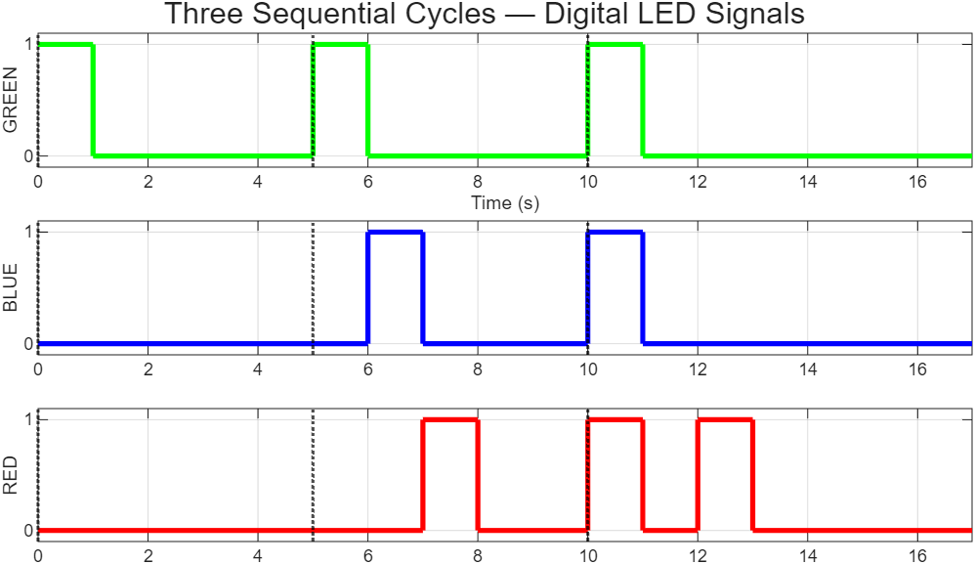
SafeStoves: A embedded wireless stove monitoring system
LED Provides Information even when the system is not connected to the server.
Cycle 1
Cycle 2
Cycle 3
 | Server Status | Stove Status | Temperature Status
Cycle 1 | Connected | Off | Safe
Cycle 2 | Connected | On | High Temp.
Cycle 3 τ_{duty} → 4 sec | Disconnected | Off | High Temp.
τ_{pulse}
τ_{pulse} and τ_{duty} are adjustable can be set via Kernel Module
τ_{duty}
Start of Cycle

Slide 4
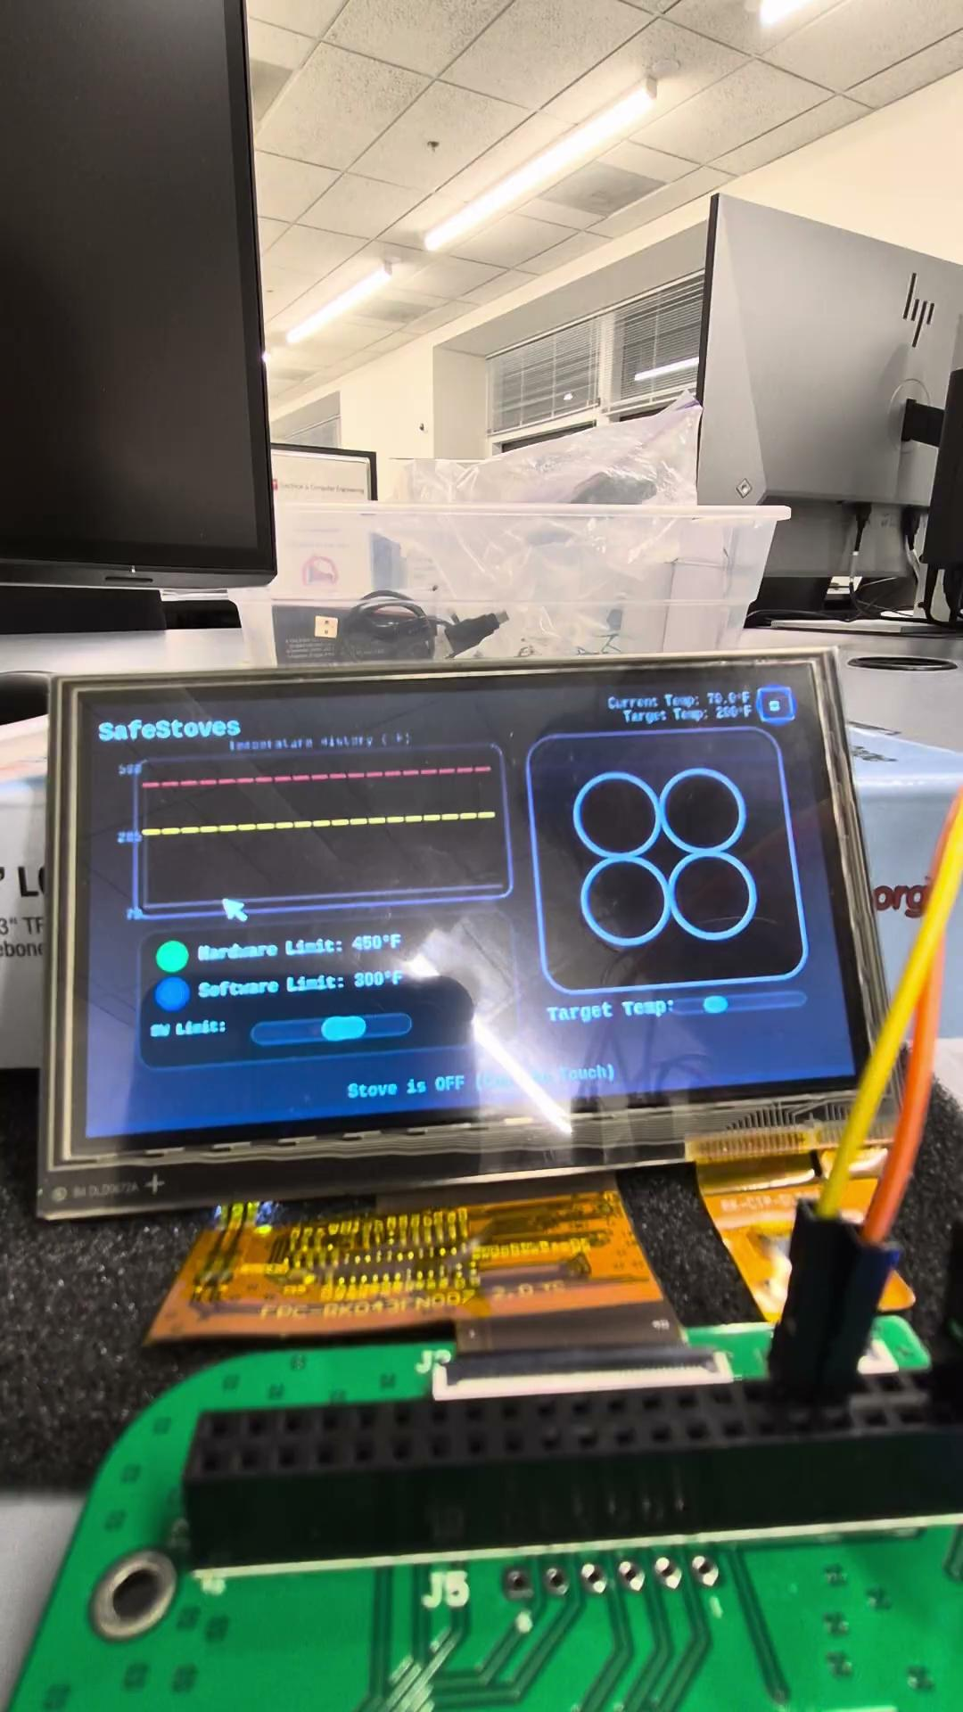
SafeStoves: A embedded wireless stove monitoring system
Project Demo Video

