Slide 1
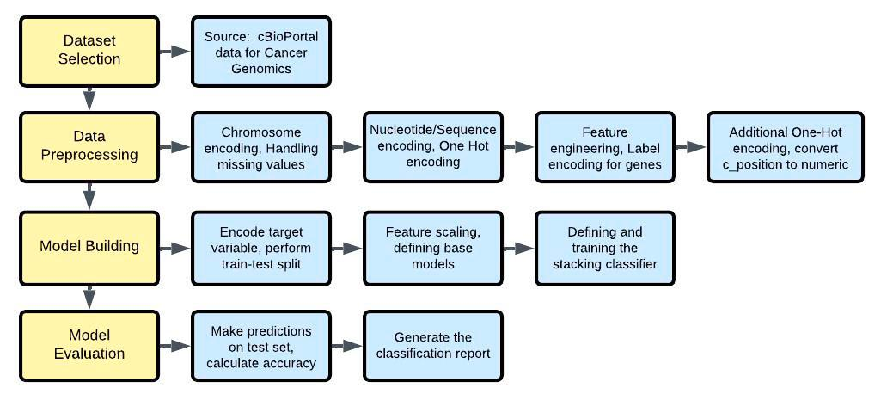
Ensemble Methods for High-Performance Classification
A Study on Adult Soft Tissue Sarcomas

Slide 2
Introduction
The study "Classification of Sarcoma Based on Genomic Data Using Machine Learning Models" focuses on developing a machine learning-based system to classify sarcoma based on genomic data.
This research aims to improve the accuracy of cancer classification, which is crucial in medical diagnosis and treatment planning.

Slide 3
Introduction (contd.)
The main objective of this study is to evaluate the effectiveness of different machine learning models, such as Support Vector Machine, KNN, Random Forest, XGBoost, and Light GBM, in classifying sarcoma types.
The research involves extensive testing and validation procedures to guarantee the correctness and dependability of the findings.
This includes splitting preprocessed data into training (80%) and testing (20%) sets, maintaining the distribution of sarcoma types.

Slide 4
Introduction (contd.)
The study provides a framework for similar works to follow, suggesting that the methodology employed in this study can be extended to encompass data cleaning procedures, feature extraction elements, and the design of stacking super classifiers.
This structure may be adapted for other tasks involving cancer classification or genomic data analysis.

Slide 5
Introduction (contd.)
The research contributes to the field by offering a comparison of different machine learning models and their performance evaluation metrics, as shown in Fig.

Slide 6
Key Topics and
This scientific document delves into the development of a Machine Learning-based system for cancer classification, specifically focusing on sarcoma types.
The main topic covered in this study is the proposed architecture, which involves a stacking process to minimize loss functions.
A crucial aspect of this approach is data splitting, where 80% of the preprocessed data is allocated for training and 20% for testing purposes.

Slide 7
Key Topics and (contd.)
also explores various machine learning algorithms, including XGBoost, LightGBM, Random Forest, Support Vector Machine, KNN, and their performance evaluation metrics.
The results are presented in a bar chart (Fig.
3), showcasing the effectiveness of each model in terms of accuracy, precision, and recall.
Additionally, the study discusses the importance of test cases, which provide a systematic way to assess different facets of the research and identify potential problems.

Slide 8
Key Topics and (contd.)
The methodology employed in this study can be extended to encompass data cleaning procedures, feature extraction elements, and the design of stacking super classifiers.
This structure may be adapted for other tasks where cancer classification is the primary objective or similar problems involving genomic data analysis.

Slide 9
Key Topics and (contd.)
The study's emphasis on validation through extensive testing and statistical analysis contributes to its credibility and reliability, ensuring that it can withstand criticism and make a significant contribution to the field.

Slide 10
Methods and Approaches
The study employs various methodologies and techniques in its approach to machine learning-based system development.
A detailed workflow diagram is presented, illustrating the step-by-step process undertaken by the researchers (Fig 1).
This involves data splitting, where preprocessed data is divided into training (80%) and testing (20%) sets, maintaining the distribution of sarcoma types.

Slide 11
Methods and Approaches (contd.)
Subsequently, base classifier training is conducted using XGBoost, LightGBM, and Random Forest algorithms, with 5-fold cross-validation employed to generate out-of-fold predictions.
The study compares different models, including tree-based classifiers and Artificial Neural Networks, which produced noteworthy results (Table 1).
The researchers also discuss the use of confusion matrices, highlighting various mutation types and their corresponding indices (Table 2).

Slide 12
Methods and Approaches (contd.)
This comprehensive approach enables the development of a robust machine learning-based system capable of accurately identifying patterns in complex medical information.
By leveraging these methodologies, the study showcases the potential for machine learning models to revolutionize medicine, facilitating early disease detection, personalized treatment plans, and improved patient outcomes.

Slide 13
Methods and Approaches (contd.)
The researchers emphasize that their methodology can be adapted and extended for various applications, including cancer classification and genomic data analysis.
By incorporating data cleaning procedures, feature extraction elements, and a stacking super classifier design, the study provides a framework for future research in this domain.

Slide 14
Methods and Approaches (contd.)
The authors' vision is to harness machine learning's potential to transform medical practices, ultimately saving more lives through early disease detection and personalized treatment plans.

Slide 15
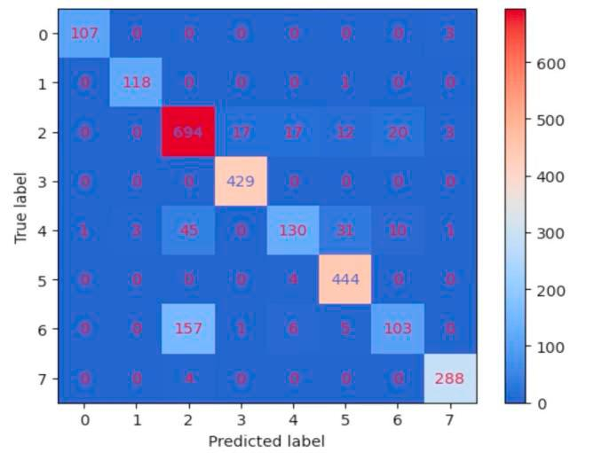
Findings
The primary findings of this study are presented through various results and statistical analysis.
A key outcome is the comparison of different machine learning models, including Support Vector Machine, KNN, Random Forest, Xgboost, and Light GBM, as shown in Fig.
The bar chart displays performance evaluation metrics such as accuracy, precision, and recall for each model, with tree-based classifiers producing the best results followed by Artificial Neural Networks.

Slide 16
Findings (contd.)
These outcomes are further supported by the statistical analysis presented in Table 1, which compares the models against specific metrics.
While some models showed noteworthy results, others were found to be less effective.
The study's findings also emphasize the importance of feature engineering in genomic data analysis.

Slide 17
Findings (contd.)
The authors describe various data preprocessing techniques, including converting chromosome numbers to numerical representation, encoding mutation positions, segmenting copy number data into discrete categories, and normalizing expression values.
These procedures enable the development of accurate machine learning models that can identify complex patterns in medical information, ultimately leading to improved patient outcomes.

Slide 18
Important Statistics Data
The analysis of genomic data in the context of sarcoma diagnosis and treatment is hindered by its immense dimensionality and complexity.
To address this challenge, machine learning (ML) models are employed to identify patterns that conventional statistical techniques may miss.
These ML models can be trained to recognize complex relationships within genetic information, enabling more precise classification systems.

Slide 19
Important Statistics Data (contd.)
A key aspect of the analysis involves preprocessing the genomic data, which includes converting chromosome numbers into numerical representations and encoding mutation positions in coding sequences.
The data is then split into training (80%) and testing (20%) sets, maintaining the distribution of sarcoma types, to ensure that the models are not overfitting to a particular subset of patients.

Slide 20
Important Statistics Data (contd.)
Specifically, 5-fold cross-validation is used to generate out-of-fold predictions for each base classifier.
The analysis also incorporates clinical data, including patient outcomes based on their clinical features.
This integrated approach allows for a comprehensive understanding of the molecular characteristics associated with sarcomas, which could lead to new insights into tumor heterogeneity and treatment opportunities.

Slide 21
Important Statistics Data (contd.)
The results highlight the potential of ML models in identifying complex patterns within large-scale genomic datasets, paving the way for more accurate diagnosis and targeted therapies.

Slide 22
Applications and Use
The findings and methods presented in this study have significant practical applications in real-world contexts.
Machine learning models, such as Support Vector Machines, Random Forests, and Deep Learning Networks, have been shown to be highly effective in identifying complex patterns in medical data, including genetic information, patient history, and clinical images.

Slide 23
Applications and Use (contd.)
These algorithms can successfully detect patterns that may seem enigmatic to humans, making it feasible to diagnose diseases at an early stage.
The use of machine learning models has the potential to revolutionize various areas in medicine by enabling the creation of more precise and complex classification systems.

Slide 24
Applications and Use (contd.)
These models can be taught to identify specific genetic markers associated with sarcoma, which can lead to improved diagnostic procedures and more effective treatment plans personalized to individual patients.
Furthermore, machine learning models have been found to outperform traditional statistical techniques in identifying patterns in medical data.

Slide 25
Applications and Use (contd.)
The study highlights the potential of machine learning models to disrupt many areas in medicine by providing a viable method for creating accurate and complex classification systems that take into account genetic information.
The results presented in Table 1 demonstrate that tree-based classifiers and Artificial Neural Networks produced the best results, followed by other models such as Support Vector Machines and Random Forests.

Slide 26
Applications and Use (contd.)
These findings have significant implications for the development of more precise diagnostic procedures and personalized treatment plans, ultimately leading to improved patient outcomes and increased chances of saving lives.

Slide 27
Challenges and Limitations
The research acknowledges several limitations and challenges that hinder its progress and applicability.
One of the significant constraints is the management of high-dimensional genomic data, which poses difficulties in selecting relevant features consistently.
This issue is further compounded by the risk of models performing well on training data but poorly on unseen data, particularly when sample sizes are limited.

Slide 28
Challenges and Limitations (contd.)
Another challenge identified in the study is the inconsistency in model building procedures and evaluation metrics across different studies, thereby hindering reproducibility.
Additionally, the analysis highlights that the integration of genomic data is severely hampered by its enormous dimensionality and complexity.

Slide 29
Challenges and Limitations (contd.)
To address these challenges, machine learning models can be employed to handle large-scale genomic datasets and identify patterns that conventional statistical techniques might miss.
The study also notes that certain mutations, such as "silent" and "missense mutations," pose a major problem in clinical oncology due to their aggressiveness and multifariousness.

Slide 30
Challenges and Limitations (contd.)
Furthermore, the analysis emphasizes the need for data normalization through standard scaling to ensure comparability of numerical features.
These limitations and challenges underscore the complexity of genomic data analysis and the need for further investigation and development to overcome these obstacles.

Slide 31
Future Scope Recommendations
Future research in machine learning and meta-learning is essential to address several challenges identified in the study.
These challenges include managing high-dimensional genomic data, selecting relevant features consistently, and mitigating the risk of models performing well on training data but poorly on unseen data.
Additionally, inconsistent model building procedures and evaluation metrics across studies hinder reproducibility.

Slide 32
Future Scope Recommendations (contd.)
To overcome these challenges, researchers suggest investigating new approaches for handling high-dimensional data and developing more robust model selection methods.
They also propose exploring meta-level learning techniques, such as the meta-level learning technique employed by Jaber Juntu et al., which can be more effective in achieving improved classification than existing methods.

Slide 33
Future Scope Recommendations (contd.)
Furthermore, researchers highlight the potential of machine learning models to disrupt various areas in medicine, including disease detection and personalized treatment planning.
The study's findings emphasize the need for further experimentation with different datasets to support these new approaches and techniques.

Slide 34
Future Scope Recommendations (contd.)
This would enable researchers to advance the field of meta-learning and strategies for combining classifiers, ultimately leading to improved classification accuracy and better decision-making processes in medicine.
By addressing these challenges and exploring new methodologies, researchers can unlock the full potential of machine learning and its applications in various fields, including medicine.

Slide 35
Conclusion
The study provides valuable insights into the development and evaluation of machine learning-based systems for sarcoma classification.
A key takeaway from this research is that tree-based classifiers, such as XGBoost and LightGBM, tend to produce the best results in comparison with other models.
This is evident from Table 1, which presents the performance metrics of various models on the task of sarcoma classification.

Slide 36
Conclusion (contd.)
Furthermore, the study highlights the potential of machine learning models in identifying complex patterns in high-dimensional genomic data that conventional statistical techniques might miss.
These models can be trained to forecast outcomes based on these patterns, making them a viable method for creating more precise and accurate classification systems.
The use of 5-fold cross-validation and out-of-fold predictions (as shown in Fig.
1) adds robustness to the model evaluation process.

Slide 37
Conclusion (contd.)
The study also emphasizes the need for further investigation into several key areas, including managing high-dimensional genomic data, selecting relevant features consistently, and ensuring that models perform well on unseen data.
Additionally, there is a pressing need for standardizing model building procedures and evaluation metrics across studies to enhance reproducibility in this field.

Slide 38
Conclusion (contd.)
These conclusions underscore the significance of this research and highlight its potential contributions to the advancement of machine learning-based systems for sarcoma classification.

