Slide 1
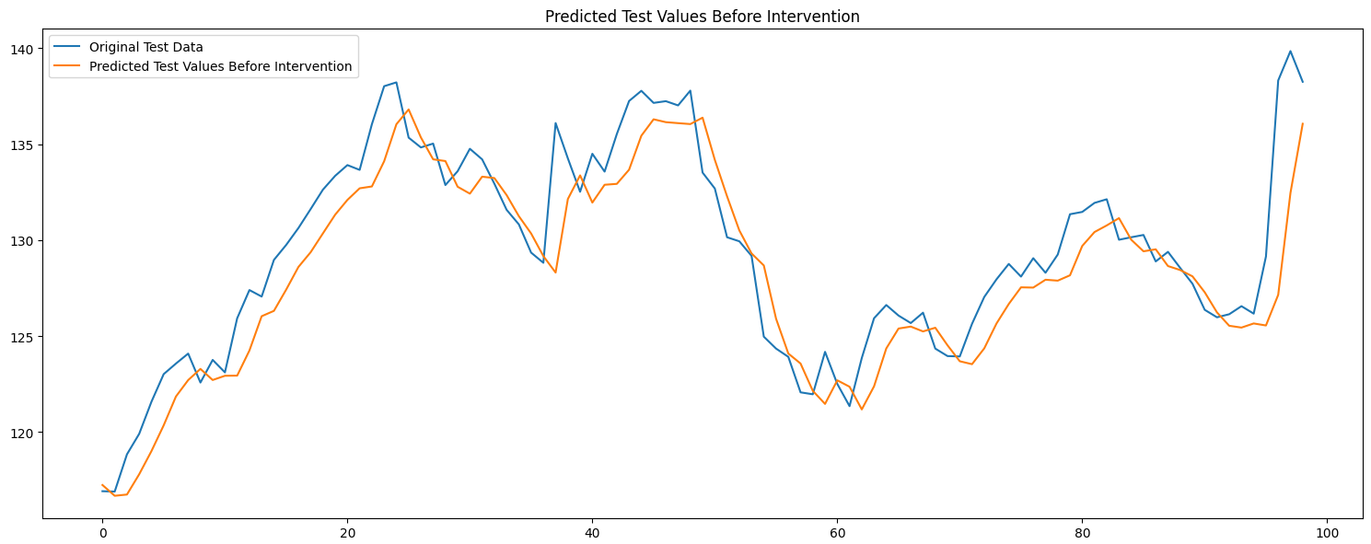
Intervention Analysis for Predicting Stock Market using Deep Learning Algorithms and Time Series Analysis
A Study on Time Series Analysis and Deep Learning

Slide 2
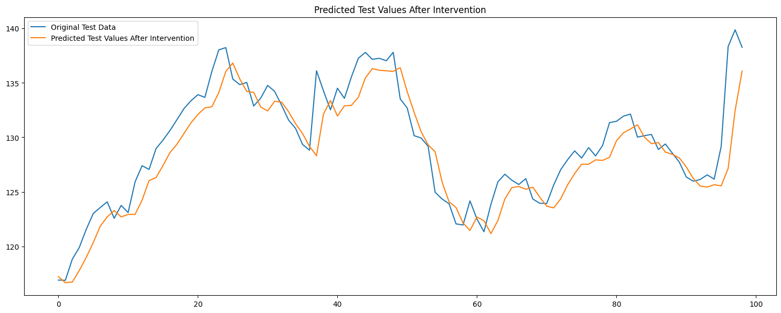
Introduction
The study by Hendri Prabowo et al.
examines the framework's ability to provide meaningful insights or predictions in markets beyond those it was specifically designed for, particularly focusing on the COVID-19 pandemic's impact on stock market conditions in various countries such as China, the United States, South Korea, and Indonesia.
This research aims to fill a gap in understanding how global crises like pandemics affect financial markets.

Slide 3
Introduction (contd.)
The study cites related work by M Nabipour et al., who investigated the dynamics of stock price forecasting using machine learning methodologies on data from the Tehran Market during the pandemic.
By applying statistical and machine learning techniques, including tree-based methods such as random forests, bagging, boosting, and decision trees, this research seeks to gain a deeper understanding of how global crises impact financial markets.

Slide 4
Introduction (contd.)
The study's focus is on intervention analysis, where the approach uses six different models on datasets from Tesla and IBM stocks to determine which model provides the most accurate output before and after an intervention point.
The goal of this investigation is to contribute to the development of more effective methods for predicting stock price variations throughout global crises like pandemics.

Slide 5
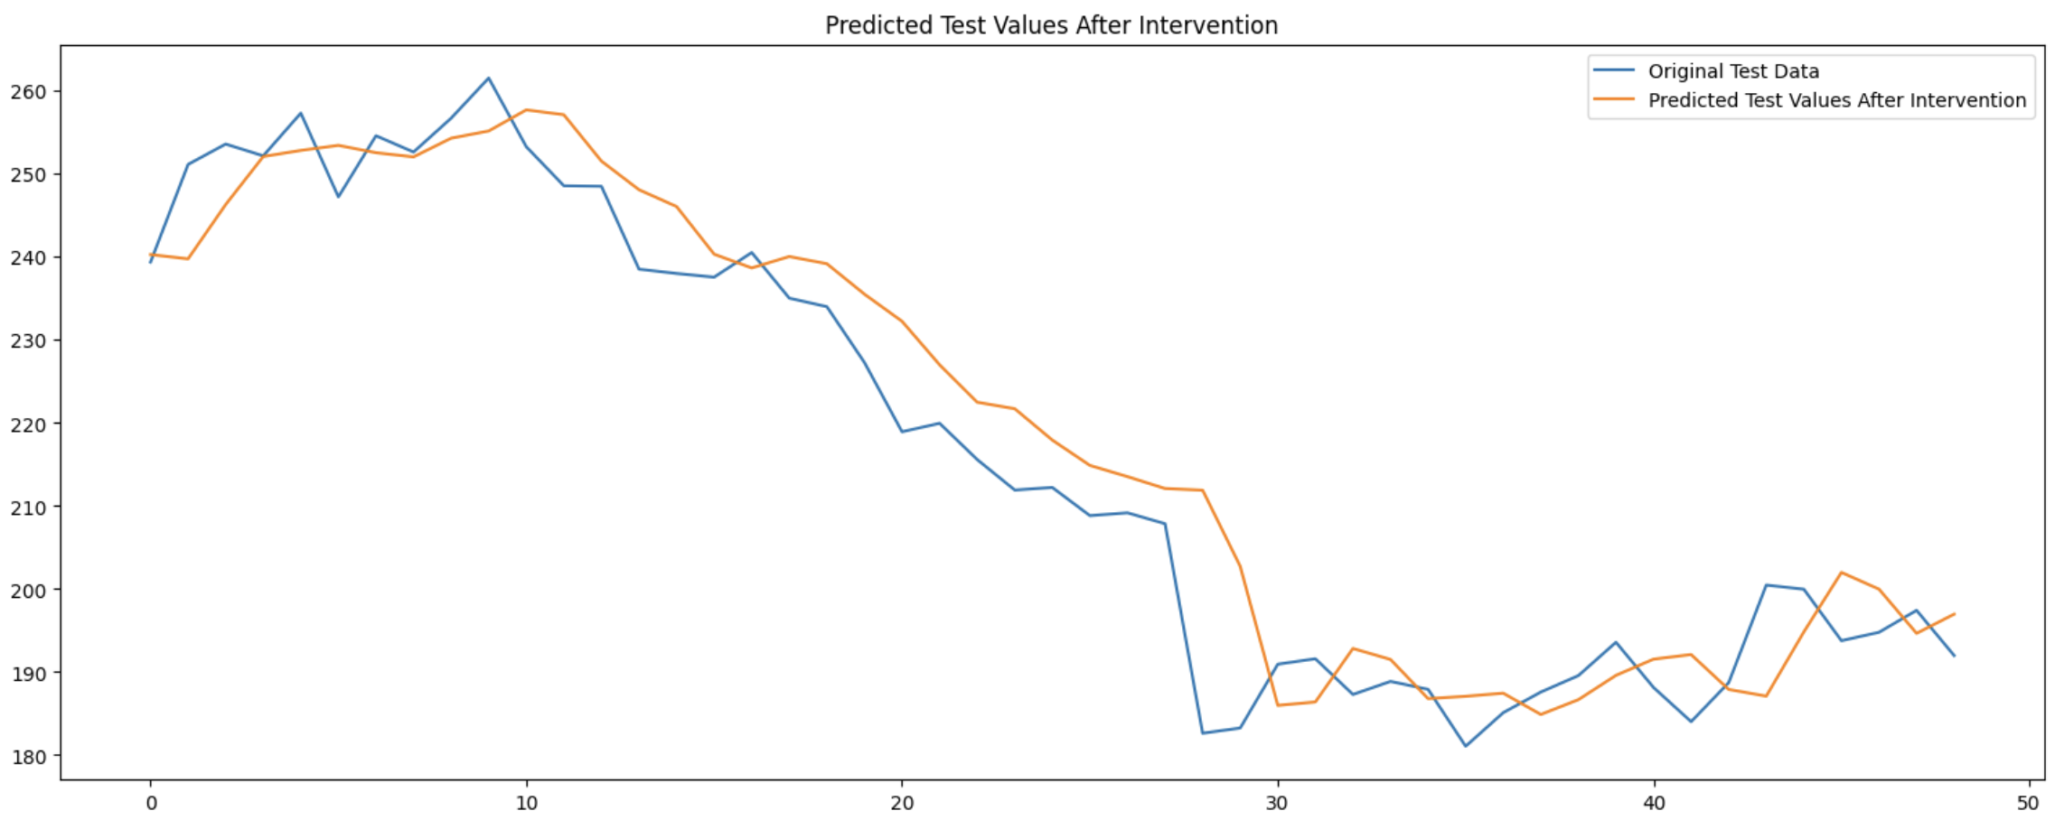
Key Topics and
The main topics covered in this scientific document revolve around the impact of global crises, specifically the COVID-19 pandemic, on financial markets.
This is exemplified through a study that explores the effects of the pandemic on stock prices in various countries, including China, the United States, South Korea, and Indonesia.
delves into the importance of statistical and machine learning methodologies in understanding these effects.

Slide 6
Key Topics and (contd.)
It highlights the use of techniques such as random forests, bagging, boosting, and decision trees to analyze financial data.
Moreover, it discusses the application of advanced algorithms, including ARIMA models for stock price forecasting, which can help predict market trends more accurately.
Furthermore, touches upon the potential for using sentiment analysis and intervention points recognized through historical data to improve investment strategies.

Slide 7
Key Topics and (contd.)
It also mentions the integration of news, social media posts, and other sentiment data to enhance the model's prediction power.
However, it notes that this framework has limitations, particularly in its ability to provide meaningful insights or predictions outside the specific markets for which it was designed.

Slide 8
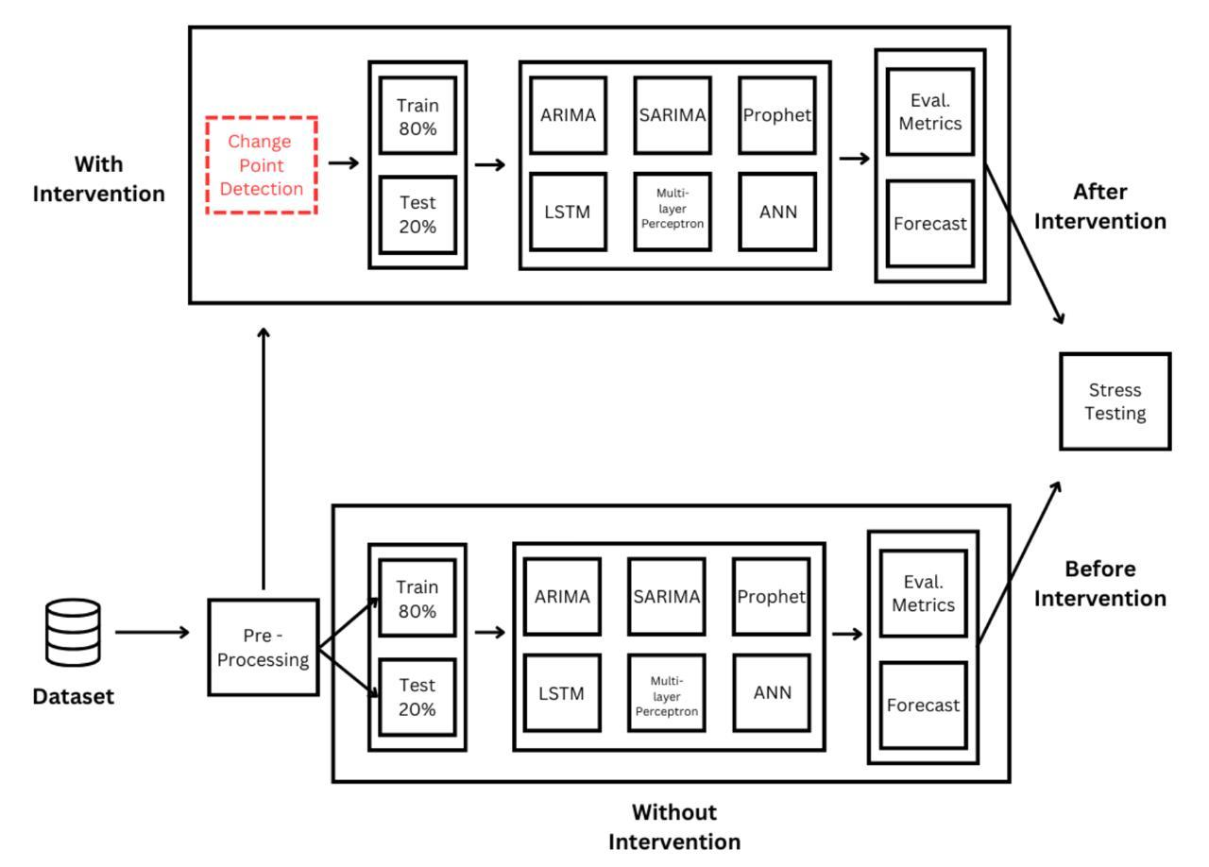
Methods and Approaches
The proposed approach involves the use of six different models on a dataset consisting of Tesla and IBM stocks.
Intervention analysis is employed to determine which model yields the most accurate output before and after an intervention point.
This approach aims to address the challenges faced by classical Time Series Analysis techniques, such as generalization and computation on real-world data.

Slide 9
Methods and Approaches (contd.)
The methodology involves using various metrics, including Mean Absolute Error (MAE), Mean Square Error (MSE), Root Mean Square Error (RMSE), and Mean Absolute Percentage Error (MAPE) to evaluate the performance of the models.
The use of these evaluation metrics is crucial in determining the best model for predicting stock market behavior.
The approach also incorporates a graphical representation, as shown in Fig.
1, which provides an overview of the proposed methodology.

Slide 10
Methods and Approaches (contd.)
Experimental design involves splitting the dataset into two sets: training and testing.
The training set comprises 80% of the data, while the testing set consists of the remaining 20%.
Intervention analysis is performed on both datasets to identify the most accurate model for predicting stock market behavior before and after intervention points.

Slide 11
Methods and Approaches (contd.)
This approach demonstrates a clear understanding of the complexities involved in stock market prediction and highlights the potential benefits of incorporating intervention analysis into predictive frameworks.

Slide 12
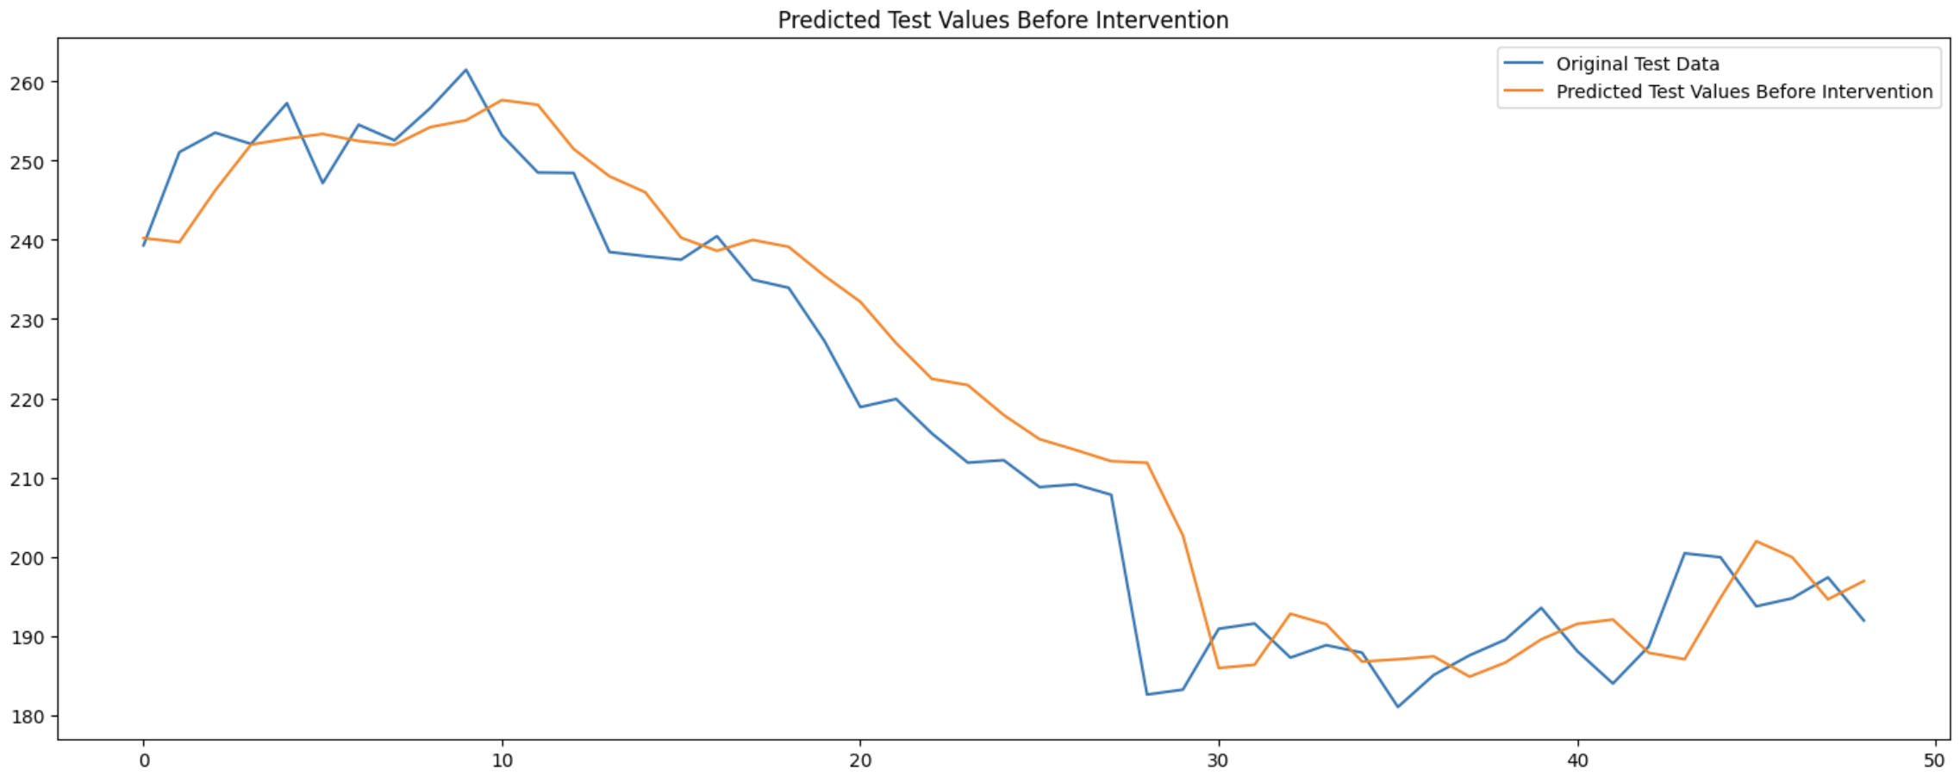
Findings
The primary results presented in this document involve the application of various models to predict stock prices, specifically on the Tesla dataset spanning 2023-2024.
A key aspect of this study is the intervention analysis, where the data is divided into three segments with detected change points using a sliding window method.
The PROPHET model and RNN with Intervention Analysis were employed to forecast stock prices before and after these interventions.

Slide 13
Findings (contd.)
Evaluation metrics such as Mean Square Error (MSE), Root Mean Square Error (RMSE), and Mean Absolute Error (MAE) were calculated for both models to determine their accuracy.
These results provide insight into the effectiveness of each model in predicting stock price changes.
The findings suggest that the RNN with Intervention Analysis outperforms PROPHET in terms of prediction accuracy, as indicated by lower error values across various metrics.

Slide 14
Findings (contd.)
This discovery has significant implications for investors and financial analysts seeking to make informed decisions based on reliable market predictions.

Slide 15
Important Statistics Data
various quantitative data and metrics to evaluate the performance of different models in predicting stock market values.
For instance, the hybrid model of Autoregressive Integrated Moving Average (ARIMA) proposed by Daiyou Xiao et al.
uses the Root Mean Square Error (RMSE) as a metric for evaluating its performance.
Specifically, the RMSE is denoted by σ, indicating the average error between predicted and actual stock values.

Slide 16
Important Statistics Data (contd.)
In addition to RMSE, also mentions the use of Mean Absolute Error (MAE) as another evaluation metric.
The MAE is represented by t, signifying the absolute difference between predicted and actual values.
These metrics are used to assess the performance of the models before and after intervention using sliding window method for change point detection.
The dataset used in this study includes features such as Open, Low, High, Close, Adj Close, and Volume, collected from a legitimate source.

Slide 17
Important Statistics Data (contd.)
The data collection process involves multiple variables and their relationships over time, which are analyzed to identify shifts in behavior or patterns following the implementation of an intervention.

Slide 18
Applications and Use
The research presented in this study has several practical applications and implementations, particularly in the field of stock market analysis.
One of the key contributions is the development of hybrid models that integrate different methodologies, such as Autoregressive Integrated Moving Average (ARIMA) and Long Short-Term Memory (LSTM) networks, to improve predictive capabilities.

Slide 19
Applications and Use (contd.)
This approach addresses the limitations of traditional Time Series Analysis techniques, which struggle with generalization and computation on real-world data.
The study also sheds light on how Chinese stock prices behave in response to macroeconomic factors, providing valuable insights for investors and policymakers.
The researchers' use of intervention analysis allows them to examine the impact of specific events or policies on stock market behavior, enabling more informed decision-making.

Slide 20
Applications and Use (contd.)
Furthermore, the hybrid models developed in this research can be applied to other markets and systems, making it a versatile tool for various industries.
The practical applications of this research are not limited to finance alone; its methodology can also be extended to other fields where time series data is analyzed, such as weather forecasting or traffic management.

Slide 21
Applications and Use (contd.)
By integrating linear and non-linear methodologies, the researchers aim to provide more accurate predictions and better understanding of complex systems, ultimately contributing to improved decision-making in various real-world contexts.

Slide 22
Challenges and Limitations
The proposed research framework and intervention analysis methods are not without their limitations.
One major constraint is the lack of generalizability of the results to other markets beyond those specifically studied.
This limitation could hinder the framework's ability to provide meaningful insights or predictions in markets where it was not designed to operate.

Slide 23
Challenges and Limitations (contd.)
The researchers acknowledge that the COVID-19 pandemic's impact on stock market conditions in China, the United States, South Korea, and Indonesia might not be representative of other markets.
Furthermore, the study highlights the difficulties associated with evaluating the performance of intervention analysis models.

Slide 24
Challenges and Limitations (contd.)
For instance, the results of such an analysis are often dependent on the specific model used, and it is unclear whether alternative models would have produced better outcomes in the same conditions.
This raises concerns about the reliability and robustness of the framework's predictions.
Additionally, the researchers note that their study may not fully capture the complexities of market dynamics, particularly those driven by unanticipated events or external factors.

Slide 25
Challenges and Limitations (contd.)
They suggest that incorporating intervention-aware predictive models, such as Q Net, could help address these limitations and provide a more comprehensive understanding of market trends.
However, this approach would require careful consideration of the model's parameters and potential biases.

Slide 26
Future Scope Recommendations
Future research in the area of stock price prediction using deep learning models and intervention analysis methods has significant potential to improve the accuracy and adaptability of investment strategies.
One suggestion for future research is to further investigate the limitations of the proposed framework, particularly its inability to provide meaningful insights or predictions in markets beyond those for which it was specifically designed.

Slide 27
Future Scope Recommendations (contd.)
This limitation could hinder its ability to allocate investments based on sentiment analysis and intervention points recognized through historical data.
To address this limitation, researchers can explore the use of advanced natural language processing (NLP) algorithms to incorporate news, social media posts, and other sentiment data into the model.

Slide 28
Future Scope Recommendations (contd.)
This has the potential to improve the model's prediction power and enable more adaptive and responsive investment strategies that capitalize on market sentiment shifts and regulatory interventions.
For instance, studies such as Xiao, Daiyou & Su, Jinxia (2022) have demonstrated the effectiveness of using deep learning and autoregressive integrated moving average methods in stock price time series prediction.

Slide 29
Future Scope Recommendations (contd.)
As researchers continue to refine and improve these models, they may also consider incorporating additional data sources or features to enhance their predictive capabilities.
By doing so, they can develop more robust and accurate tools for investment decision-making, ultimately contributing to the development of more efficient and effective financial markets.

Slide 30
Conclusion
The analysis presented in this study sheds light on the behavior of Chinese stock prices and their relationships with macroeconomic variables over time.
A key contribution of the research is the development of a framework that integrates linear and non-linear methodologies, such as AN decomposition and ARMA/LSTM models, to provide more accurate predictions and insights into market dynamics.

Slide 31
Conclusion (contd.)
This approach has been shown to outperform traditional methods in identifying shifts in stock price behavior and providing meaningful estimates of stock values.
The study's findings have significant implications for understanding the impact of macroeconomic variables on stock prices, particularly in the context of emerging markets such as China.

Slide 32
Conclusion (contd.)
The research also highlights the limitations of applying these models to other markets without proper generalizability, underscoring the need for further research in this area.
However, the framework developed in this study has been shown to be effective in providing valuable insights and predictions for Chinese stock prices.

Slide 33
Conclusion (contd.)
The significance of this research lies in its ability to provide a more comprehensive understanding of stock market dynamics, which can inform investment decisions and policy-making.
By integrating multiple methodologies and analyzing large datasets, the researchers have provided a robust framework that can be applied to real-world problems.

Slide 34
Conclusion (contd.)
Furthermore, the study's findings highlight the potential benefits of using hybrid models that combine traditional and machine learning techniques to improve forecasting accuracy and provide more nuanced insights into market behavior.

