Slide 1
Ensemble Methods for High-Performance Classification
A Study on Adult Soft Tissue Sarcomas

Slide 2
Introduction
Genetic data is highly complex, making ensemble methods useful for prediction..
The focus of this research is on classifying adult soft tissue sarcomas using genetic data.
The study evaluates the performance of various machine learning models, including Support Vector Machine (SVM), K-Nearest Neighbors (KNN), Random Forest, XGBoost, Light GBM, and a stacking classifier.

Slide 3
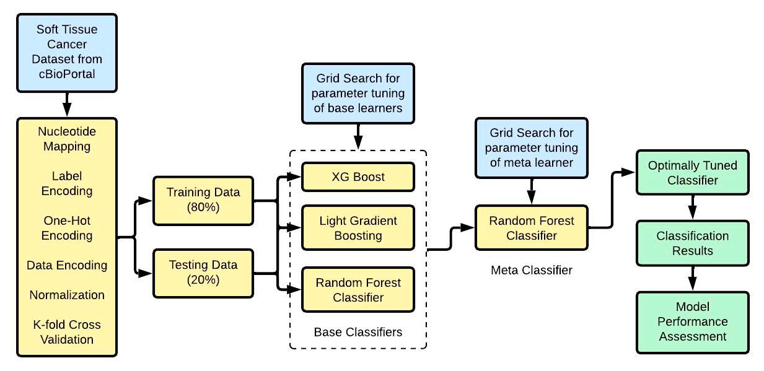
Key Topics and
Research Objectives: The paper aims to investigate the application of machine learning methods for sarcoma genomic classification, exploring various algorithms such as support vector machines (SVM), random forests, and deep learning networks.
Machine Learning (ML) Models: The author explains that ML models can handle complex genomic datasets and identify patterns that conventional statistical techniques may miss.

Slide 4
Key Topics and (contd.)
Soft Tissue Tumors: A brief introduction to soft tissue tumors, their types, and challenges in diagnosis and prognosis.
Machine Learning Applications in Medical Diagnostics: An explanation of how machine learning algorithms have been applied in medical sciences, including tumor classification and prediction.
an introduction to a research paper on using machine learning techniques for sarcoma genomic classification.

Slide 5
Key Topics and (contd.)
a comprehensive introduction to the topic and sets the stage for the proposed research..
Advances in Genomic Technology: Recent advancements in genomic technology have generated large amounts of data, which can be leveraged to improve understanding of sarcoma biology and development of more precise classification systems.

Slide 6
Key Topics and (contd.)
Genomic Classification Techniques: A discussion on the potential of genomic classification approaches for improving understanding of biological basis for histological diagnoses.
These models can be trained to predict outcomes based on genetic information

Slide 7
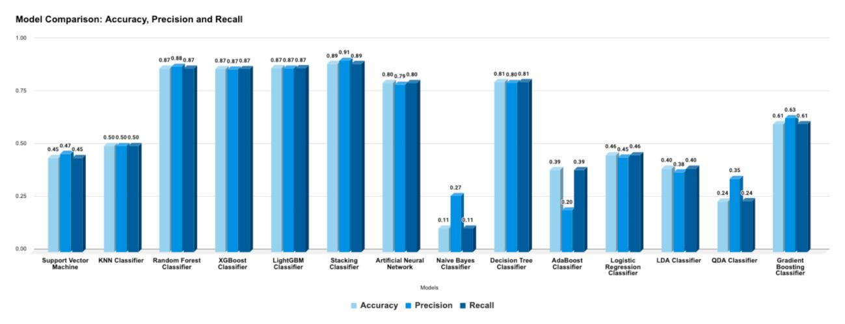
Methods and Approaches
an academic paper on the application of machine learning techniques in the genomic classification of sarcoma, a type of cancer that affects soft tissue.
Methodology: The paper explores the application of machine learning (ML) algorithms in genomic data analysis to improve the understanding of biological diversity and underlying mechanisms of sarcomas.
It highlights the need for more precise and individualized treatment plans based on genetic information.

Slide 8
Methods and Approaches (contd.)
They also present a comparative analysis of different ML algorithms, highlighting their strengths and limitations in terms of performance and complexity.
Literature Review: The authors conduct a comprehensive literature review on three key areas: soft tissue tumors, machine learning applications in medical diagnostics, and genomic classification techniques.
Therefore, there is a need for more accurate and objective approaches to categorize these tumors.

Slide 9
Methods and Approaches (contd.)
Methodologies and Results: The authors analyze various metrics, including accuracy, sensitivity, specificity, and classification error.
Conclusion: The paper concludes that machine learning techniques have the potential to improve sarcoma classification and diagnosis by leveraging genomic data.
They highlight current advancements, methodologies, and potential areas for further research.

Slide 10
Methods and Approaches (contd.)
It considers various ML techniques, including supervised learning methods such as Support Vector Machines (SVM), Random Forests, and Deep Learning Networks.
provides a comprehensive overview of the research area, including its background, methodology, literature review, objective, methodologies and results, and conclusion..
: Background: The traditional classification of sarcomas relies heavily on histopathological examination, which can be subjective and prone to errors

Slide 11
Findings
Histopathological examination is subjective and prone to errors, making accurate classification crucial for effective treatment.
Machine learning models can accurately classify sarcoma subtypes based on genomic profiles.
Machine learning models can identify complex patterns in genomic data and predict outcomes more accurately than conventional statistical techniques.
Genomic data integration improves understanding of biological diversity and underlying mechanisms of sarcomas.

Slide 12
Findings (contd.)
Stacking classifier outperforms other models with an accuracy of over 89-91%.
Tree-based classifiers and Artificial Neural Networks produce the best results.
, results, or conclusions: Key Findings: 1.
Precision medicine powered by genomics has the potential to improve treatment plans and prognosis assessments for sarcoma patients..
The study aims to create more accurate categorization frameworks for sarcoma using machine learning techniques

Slide 13
Important Statistics Data
Data quality: The accuracy of machine learning models depends on the quality and availability of genomic data.
Precision medicine: The research aims to demonstrate the potential of precision medicine powered by genomics in the treatment of sarcoma.
Interpretability: Machine learning models can be complex, making it challenging to interpret their results and identify potential biases.

Slide 14
Important Statistics Data (contd.)
Literature review: The research includes a comprehensive literature survey of existing studies on soft tissue tumors, machine learning applications in medical diagnostics, and genomic classification techniques.
Traditional classification methods are subjective and prone to mistakes.
Background: Sarcomas are a type of cancer that arises in soft tissues such as muscles, tendons, and blood vessels.

Slide 15
Important Statistics Data (contd.)
Overall, the proposed research has the potential to make significant contributions to the field of sarcoma diagnosis and treatment, but careful consideration of these limitations is essential to ensure the success of the project..
Objective: The research aims to investigate how machine learning techniques can be applied to the genomic classification of sarcoma, with a focus on improving accuracy and efficiency.

Slide 16
Important Statistics Data (contd.)
a research proposal or a dissertation on the application of machine learning techniques in the genomic classification of sarcoma.
Methodology: The author plans to use various machine learning algorithms, including supervised learning techniques such as support vector machines (SVM), random forests, and deep learning networks.
Problem statement: Current diagnostic methods for sarcomas have limitations, including subjectivity and potential errors.

Slide 17
Important Statistics Data (contd.)
Improved accuracy: Machine learning models can potentially identify complex patterns in genomic data that may not be detectable using conventional statistical techniques.
Enhanced understanding: The integration of machine learning techniques with genomic data can lead to a better comprehension of the biological basis for histological diagnoses, enabling more precise treatment plans and prognosis assessments.

Slide 18
Important Statistics Data (contd.)
Clinical validation: The proposed research will require clinical validation to ensure that the developed models are effective in real-world settings

Slide 19
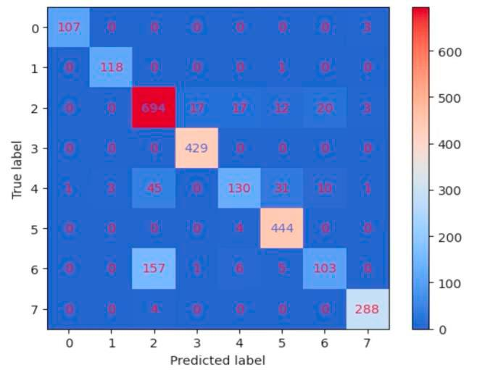
Applications and Use
Comparison of Models: A comparison is made between various models, including Support Vector Machine, KNN, Random Forest, XGBoost, Light GBM, Naive Bayes, AdaBoost, and QDA, with the stacking classifier showing superior performance.
Investigating the impact of hyperparameter tuning on the performance of different models.
Examining the characteristics of the genetic data used in this study to understand why certain models perform better than others..

Slide 20
Applications and Use (contd.)
a technical document discussing various machine learning models and their performance on a specific dataset related to genetic data.
: Exploring other models or ensemble methods that could potentially perform even better than the stacking classifier.
Stacking Classifier: The stacking classifier is shown to perform better than other models, with an accuracy of over 89-91% in comparison to other models such as Naive Bayes, AdaBoost, and QDA which have lower performance scores

Slide 21
Challenges and Limitations
The proposed work aims to demonstrate how ML models can be incorporated into clinical workflows and improve patient outcomes.
Main Points 1.
Recent advancements in genomic technology have generated large amounts of data, which can be analyzed using machine learning models to identify complex patterns and predict outcomes.
Background: Soft tissue tumors are abnormal growths in the body's soft tissues, which can be benign or malignant.

Slide 22
Challenges and Limitations (contd.)
Genomic Classification: Genomic data, including DNA sequencing, RNA expression patterns, and epigenetic markers, can be integrated with machine learning models to develop more accurate classification systems.
Objectives: The paper aims to investigate how machine learning methods can be applied to the genomic classification of sarcoma and improve on current diagnostic procedures.

Slide 23
Challenges and Limitations (contd.)
Integration of machine learning models with clinical workflows may lead to more individualized treatment plans and improved patient outcomes.
Traditional methods of histopathological examination can be subjective and prone to errors.
Machine learning models can be trained to identify complex patterns in genomic data and predict outcomes based on those patterns.
Accurate diagnosis is crucial for effective treatment.
Accurate classification of soft tissue tumors is crucial for effective treatment.

Slide 24
Challenges and Limitations (contd.)
Tree-based classifiers produced the best results followed by Artificial Neural Networks (ANNs).
Machine Learning Applications: Machine learning algorithms, such as support vector machines (SVM), random forests, and deep learning networks, can be used to improve the accuracy of tumor classification and prediction.
a lengthy text on the topic of machine learning in cancer diagnosis, specifically soft tissue sarcomas.

Slide 25
Challenges and Limitations (contd.)
Machine learning techniques, combined with genomic data, can improve the accuracy of tumor classification and prediction.
Key Findings 1.

Slide 26
Future Scope Recommendations
Improving Data Quality: Enhance data cleaning, integration, normalization, and data wrangling to improve model performance.
Precision Medicine: Develop more individualized treatment plans and accurate prognosis assessments using precision medicine powered by genomics.
Optimizing Hyperparameters: Utilize grid search techniques to optimize hyperparameters for both base and meta-classifiers.
Future Directions and Recommendations: 1.

Slide 27
Future Scope Recommendations (contd.)
Undersampling and Oversampling: Employ these techniques to address class imbalance issues and improve model performance.
Analyze the potential benefits of incorporating histopathological examination data into machine learning models.
Recommendations for Future Research: 1.
Integrating Genomic Data: Combine genomic data with machine learning models to identify complex patterns and improve sarcoma classification.

Slide 28
Future Scope Recommendations (contd.)
Investigate the integration of machine learning techniques with genomic data for more precise sarcoma classification.
Explore the application of deep learning networks in sarcoma classification.
Ensemble Learning Methods: Combine several base models into one stacking classifier to achieve better accuracy.
Develop more accurate and objective approaches to categorize sarcomas using machine learning algorithms.

Slide 29
Conclusion
Conclusion: This study explores the application of machine learning techniques for genomic classification of sarcomas.
By leveraging machine learning techniques, it is possible to develop more accurate and individualized treatment plans.
A rich dataset was used to preprocess and analyze various types of data, including genomic, transcriptomic, epigenomic, proteomic information.
This approach outperformed other models, such as Support Vector Machine, KNN, Random Forest, Xgboost, and Light GBM.

Slide 30
Conclusion (contd.)
The dataset was preprocessed using feature engineering, selection, and encoding to handle class imbalance and normalize the data.
The findings of this research have significant implications for the diagnosis and treatment of sarcomas.
The study also highlights the potential of precision medicine powered by genomics in the treatment of sarcoma..
The study employed a stacking classifier that combined predictions from base classifiers, achieving high accuracy (over 89%) in classification tasks

