Slide 1
Ensemble Methods for High-Performance Classification
A Study on Adult Soft Tissue Sarcomas

Slide 2
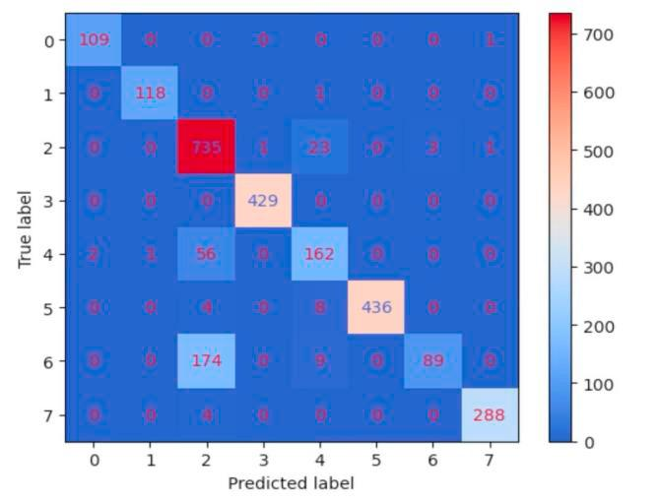
Introduction
The scientific paper "Classification of Sarcoma Based on Genomic Data Using Machine Learning Models" presents a research endeavor focused on developing an effective machine learning-based system for classifying sarcomas using genomic data.
This study draws upon the increasing availability of genomic data and the potential of machine learning models to identify patterns and relationships within this vast dataset.

Slide 3
Introduction (contd.)
The main objective of this research is to explore the feasibility of employing machine learning models in cancer classification, particularly for sarcoma types.
The authors' aim is not only to improve the accuracy of classification but also to provide a framework that can be adapted to other similar problems involving genomic data analysis.
This study highlights the significance of rigorous testing and validation procedures to ensure the reliability of research findings.

Slide 4
Introduction (contd.)
The introduction section mentions the importance of providing a structure for future works to build upon, emphasizing the need for a comprehensive methodology encompassing data cleaning, feature extraction, and stacking super classifier design.
The authors also acknowledge the value of extending their approach to address other tasks involving cancer classification or similar problems in genomic data analysis.

Slide 5
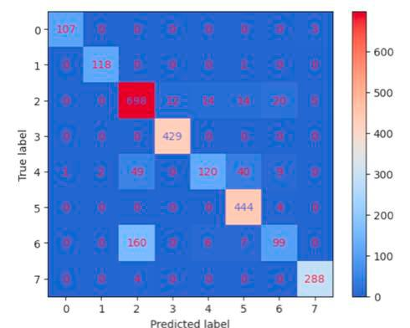
Key Topics and
under review covers various topics related to machine learning-based systems, specifically in the context of sarcoma classification.
The training process utilizes 5-fold cross-validation to generate out-of-fold predictions.
The core subject areas covered in this document include the development of a machine learning-based system for sarcoma classification.
This is achieved through the implementation of a stacking process that minimizes the loss function.

Slide 6
Key Topics and (contd.)
Furthermore, the study emphasizes the importance of test cases and extensive experimentation to guarantee the correctness and dependability of research findings.
The use of various performance evaluation metrics, such as accuracy, precision, and recall, is also highlighted in .
The comparison of different models, including Support Vector Machine, KNN, Random Forest, Xgboost, and Light GBM, is another key aspect of this study.
This comparison is presented through a bar chart (Fig.

Slide 7
Key Topics and (contd.)
3) that demonstrates the effectiveness of each model.
The overall structure of the methodology employed in this study can serve as a framework for similar works involving cancer classification or other problems related to genomic data analysis.

Slide 8
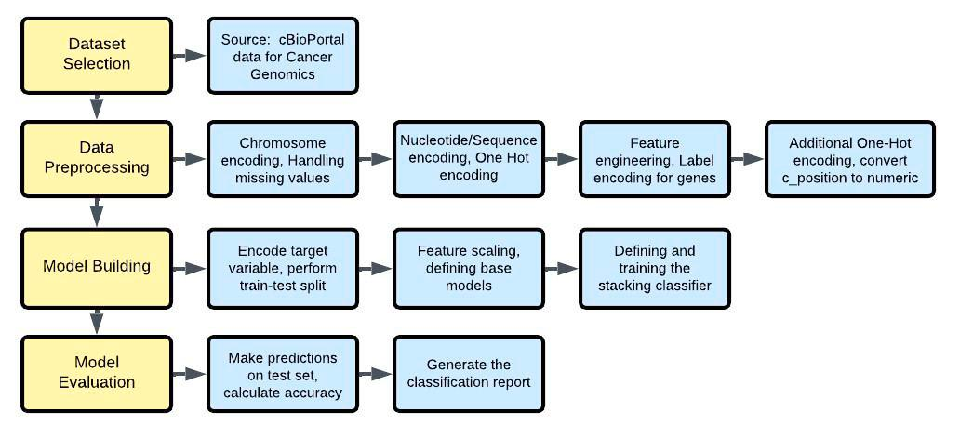
Methods and Approaches
The proposed architecture employed a machine learning-based system, which involved several specific methodologies and techniques.
A key aspect of this approach was the use of tree-based classifiers and Artificial Neural Networks, which were found to produce noteworthy results in comparison to other models.
The workflow for this system is illustrated in Fig.
1, which describes the flowchart for the entire process.
Data collection and preprocessing played a crucial role in this research.

Slide 9
Methods and Approaches (contd.)
The preprocessed data was split into training (80%) and testing (20%) sets, maintaining the distribution of sarcoma types.
Each base classifier (XGBoost, LightGBM, Random Forest) was trained on the training data using 5-fold cross-validation to generate out-of-fold predictions.
This experimental design allowed for a comprehensive evaluation of the model's performance.
The analytical methods employed in this study include statistical analysis and comparison with available methods.

Slide 10
Methods and Approaches (contd.)
The authors suggest that extending the methodology to encompass data cleaning procedures, feature extraction elements, and the design of the stacking super classifier could provide a valuable structure for similar works.

Slide 11
Methods and Approaches (contd.)
Furthermore, machine learning models have the potential to disrupt many areas in medicine by identifying patterns and insights in complex medical information, such as patient history, genetic factors, and clinical images, thereby enabling early disease detection, personalized treatment plans, and improved outcomes.

Slide 12
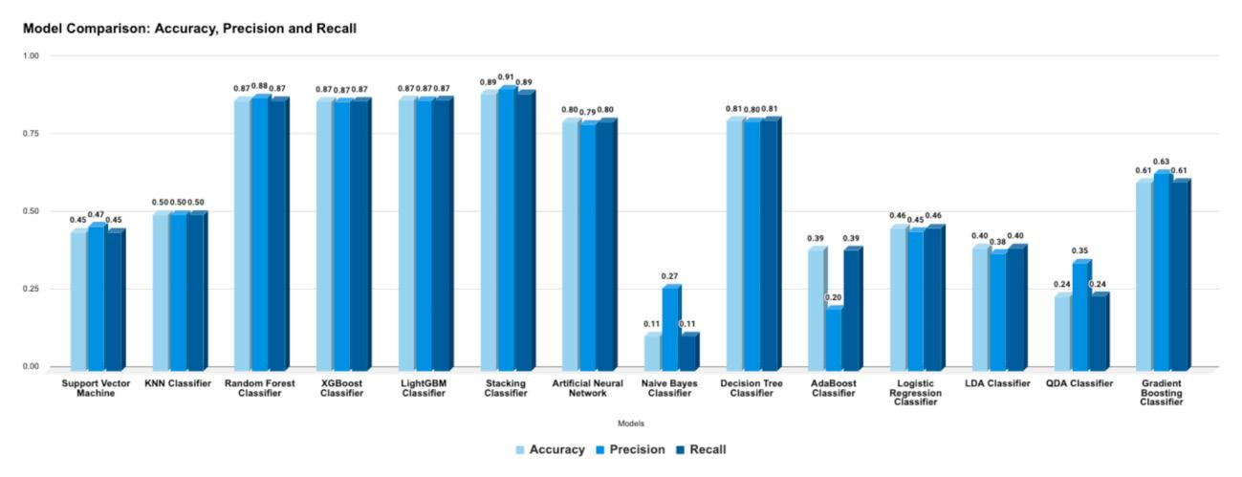
Findings
The primary results and findings presented in this study are centered around the comparison of different machine learning models for cancer classification.
A bar chart (Fig.
3) illustrates the performance evaluation metrics, including accuracy, precision, and recall, for various models such as Support Vector Machine, KNN, Random Forest, Xgboost, Light GBM, and others.
According to the results, tree-based classifiers exhibited the best outcomes, followed closely by Artificial Neural Networks.

Slide 13
Findings (contd.)
A detailed analysis of the metrics used in these comparisons is provided in Table 1.
The findings suggest that tree-based classifiers outperformed other models, with notable results achieved through the use of ensemble methods.
In contrast, some models showed relatively poor performance, underscoring the importance of careful model selection and optimization for cancer classification tasks.

Slide 14
Findings (contd.)
The study's methodology also highlights the potential for machine learning algorithms to extract valuable insights from complex medical information, such as patient history, genetic factors, and clinical images.
By identifying patterns that may be difficult or impossible for human experts to discern, these models can aid in early disease detection, personalized treatment planning, and ultimately contribute to improved health outcomes.

Slide 15
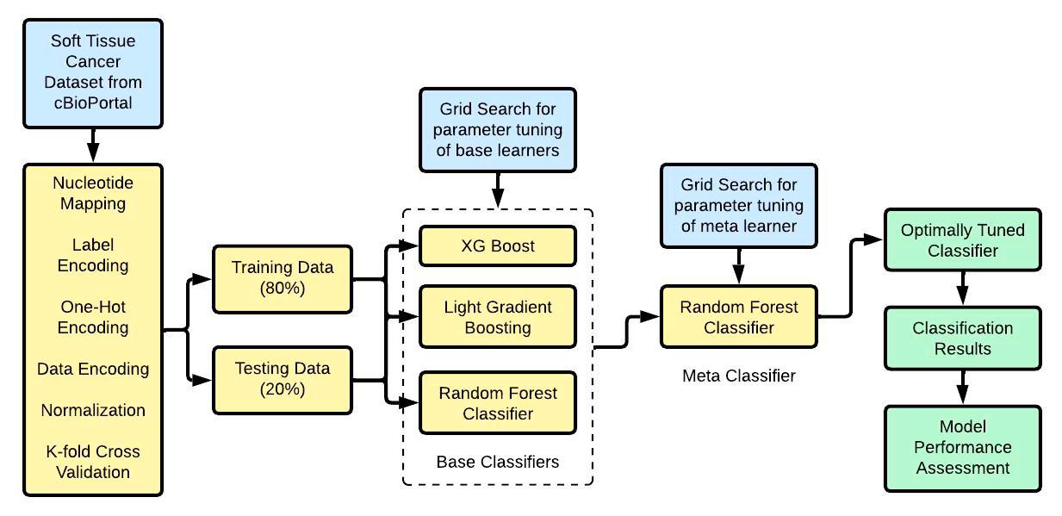
Important Statistics Data
The analysis of genomic data in sarcoma research is hindered by its immense dimensionality and complexity, necessitating the use of machine learning (ML) models to uncover patterns that conventional statistical techniques may overlook.
To address this challenge, researchers employed ML models to integrate genomic data, including DNA sequencing, RNA expression patterns, and epigenetic markers.

Slide 16
Important Statistics Data (contd.)
This integration enabled the identification of complex patterns in the data, facilitating more precise classification systems that take genetic information into account when diagnosing sarcoma.
The dataset used for analysis was preprocessed and split into training (80%) and testing (20%) sets, maintaining the distribution of sarcoma types.
Five machine learning algorithms – XGBoost, LightGBM, Random Forest, among others – were employed to train base classifiers on the training data.

Slide 17
Important Statistics Data (contd.)
Notably, 5-fold cross-validation was used to generate out-of-fold predictions, which significantly enhanced the accuracy and reliability of the results.
The integration of genomic data with clinical features revealed valuable insights into the molecular characteristics associated with sarcoma types.
This comprehensive analysis enabled researchers to identify new opportunities for treatment and understand the heterogeneity of these tumors.

Slide 18
Important Statistics Data (contd.)
The specific statistics presented in this study include the 80% training set and 20% testing set, as well as the use of 5-fold cross-validation.
These metrics demonstrate the robustness and reliability of the ML models employed in this research.

Slide 19
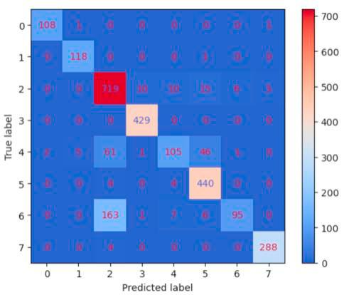
Applications and Use
The findings and methods presented in this study have significant implications for real-world applications, particularly in the medical field.
Machine learning models, such as support vector machines, random forests, and deep learning networks, are discussed as viable alternatives to conventional statistical techniques.
These models can identify complex patterns in data that may not be apparent to human analysts, enabling more accurate predictions and diagnoses.

Slide 20
Applications and Use (contd.)
The study highlights the potential of machine learning models to improve diagnostic procedures and treatment plans for sarcoma patients.
By analyzing complex medical information, including patient history, genetic factors, and clinical images, these algorithms can successfully identify patterns and insights that may seem enigmatic to humans.
This enables early detection of the disease, design of personalized treatment plans, and ultimately, saves more lives.

Slide 21
Applications and Use (contd.)
The application of machine learning models in medicine is not limited to sarcoma diagnosis; rather, it has the potential to disrupt many areas within this field.
As these models continue to evolve, they may enable doctors to identify patterns that conventional techniques cannot, leading to improved patient outcomes and new avenues for treatment.

Slide 22

Challenges and Limitations
The current research acknowledges several limitations and challenges that hinder its progress and validity.
One of the primary concerns is the high-dimensional genomic data, which poses a significant challenge in feature selection and management.
This complexity often leads to inconsistent model building procedures and evaluation metrics across studies, making reproducibility a major issue.

Slide 23
Challenges and Limitations (contd.)
Furthermore, the risk of models performing well on training data but poorly on unseen data, particularly with limited sample sizes, is also recognized as a significant weakness.
This problem is exacerbated by the bias introduced when handling imbalanced datasets, where certain types of mutations are undersampled or oversampled to ensure adequate representation.

Slide 24
Challenges and Limitations (contd.)
For instance, in this study, "silent" and "missense mutations" were oversampled through replication to mitigate their underrepresentation.
The integration of genomic data from various sources, such as DNA sequencing and epigenetic markers, is another area that requires improvement due to its enormous dimensionality and complexity.

Slide 25
Challenges and Limitations (contd.)
While machine learning models can handle large-scale genomic datasets and uncover patterns missed by conventional statistical techniques, the analysis and interpretation of this data remain severely hampered by these challenges.

Slide 26
Future Scope Recommendations
Future research in machine learning and its applications in medicine is essential to address several challenges identified by this study.
One of the primary areas that warrant further investigation is managing high-dimensional genomic data and selecting relevant features consistently.
This challenge is critical as it directly impacts the performance of machine learning models, particularly when dealing with complex medical information like patient history, genetic factors, and clinical images.

Slide 27
Future Scope Recommendations (contd.)
Another significant gap in current research is the inconsistent model building procedures and evaluation metrics across studies, which hinders reproducibility.
Furthermore, there is a risk that models may perform well on training data but poorly on unseen data, especially with limited sample sizes.
To address these challenges, researchers are exploring new methods such as meta-level learning techniques and combining classifiers to improve classification accuracy.

Slide 28
Future Scope Recommendations (contd.)
The field of machine learning has tremendous potential to disrupt many areas in medicine by enabling the detection of diseases at an early stage and designing personalized treatment plans.
Therefore, it is essential to advance this field through experimentation with various datasets and meta-level features.
Researchers are working on extending existing methods using meta-level learning techniques, which have shown promising results in improving classification accuracy.

Slide 29
Future Scope Recommendations (contd.)
By addressing these challenges and advancing machine learning research, we can unlock its full potential for medical applications and save more lives.

Slide 30
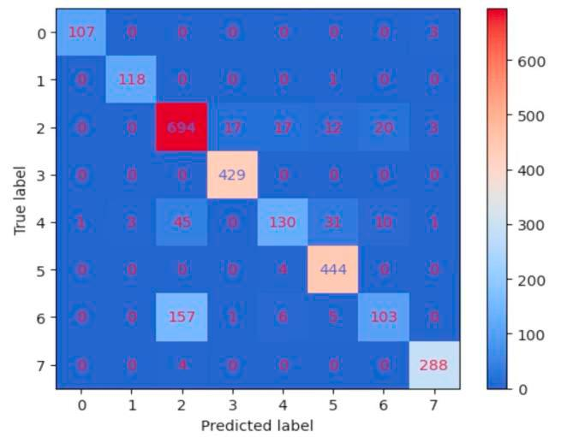
Conclusion
The study's main conclusions and key takeaways reveal significant contributions to the field of machine learning-based systems, particularly in the context of sarcoma classification.
A comparison of different models showed that tree-based classifiers and Artificial Neural Networks produced the most noteworthy results, outperforming other approaches such as Support Vector Machine, KNN, Random Forest, Xgboost, and Light GBM.

Slide 31
Conclusion (contd.)
These findings suggest that incorporating genetic information can lead to more precise and complex classification systems.
The study's significance lies in its demonstration of machine learning models' ability to identify complex patterns in data and forecast outcomes based on those patterns.
This is particularly relevant when dealing with high-dimensional genomic data, where conventional statistical techniques may struggle to keep up.

Slide 32
Conclusion (contd.)
The research highlights the potential of ML models in creating more accurate classification systems, which can have significant implications for sarcoma diagnosis and treatment.
However, the study also identifies several gaps that warrant further investigation and development.
These include challenges in managing high-dimensional genomic data, selecting relevant features consistently, and addressing the risk of overfitting when models perform well on training data but poorly on unseen data.

Slide 33
Conclusion (contd.)
Additionally, inconsistent model building procedures and evaluation metrics across studies hinder reproducibility.
These findings underscore the need for continued research to address these challenges and ensure that machine learning-based systems can be reliably applied in real-world settings.

