Slide 1
Classification of Sarcoma Based on Genomic Data Using Machine Learning Models
This paper proposes a machine-learnt classification approach for soft tissue sarcoma based on genomics data.
Automated summary of Sarcoma.pdf

Slide 2
Overview
01 Introduction
02 Key Topics
03 Methodology
04 Findings & Results
05 Key Statistics
06 Applications
07 Challenges & Limitations
08 Future Scope
09 Conclusion
Classification of Sarcoma Based on Genomic Data Using Machine Learning Models
2

Slide 3
Introduction
Sarcomas are a broad category of cancerous tumors originating from connective tissues.
Sarcomas are extremely rare, making up about 1% of adults and 15% of pediatric malignancies.
Due to their aggressiveness and multifariousness, sarcomas pose a major problem in clinical oncology.
Classification of Sarcoma Based on Genomic Data Using Machine Learning Models
3
Notes:
Sarcomas are a rare and complex type of cancer that affects connective tissues. They are aggressive and difficult to diagnose, making them a significant challenge in clinical oncology. The rarity and complexity of sarcomas highlight the need for more accurate and objective approaches to classification and diagnosis.

Slide 4
Key Topics
Machine learning models can identify complex patterns in genomic data and forecast outcomes.
The proposed work investigates how machine learning methods can be applied to the genomic classification of sarcoma.
The dataset is made up of 206 adult SOFT tissues sarcomas samples and represents six major types.
Classification of Sarcoma Based on Genomic Data Using Machine Learning Models
4
Notes:
This paper focuses on the application of machine learning to sarcoma classification. The authors aim to improve diagnostic procedures by leveraging genomic data. They use a variety of machine learning algorithms, including support vector machines, random forests, and deep learning networks. The dataset used is a rich source of information, comprising genomic alterations, transcriptomic data, epigenomic data, proteomic data, and clinical data. The authors' approach has the potential to improve our understanding of sarcoma heterogeneity and identify new opportunities for treatment.

Slide 5
Methodology
The study employs the adult soft tissue sarcomas data set available in cBioPortal database.
Machine learning algorithms used include support vector machines (SVM), random forests, and deep learning networks.
The approach involves exploratory data analysis, dimensionality reduction, and various clustering along with machine learning techniques.
Classification of Sarcoma Based on Genomic Data Using Machine Learning Models
5
Notes:
The methodology involves using a specific dataset from cBioPortal to train machine learning models. These models include SVM, random forests, and deep learning networks. The approach also involves exploratory data analysis and dimensionality reduction to prepare the data for classification.

Slide 6
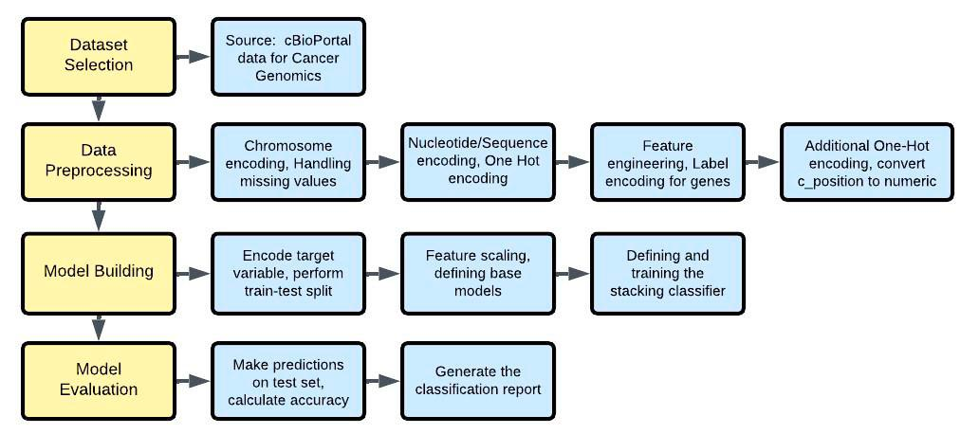
Flowchart of Machine Learning-based system
Fig. 1: Flowchart of Machine Learning-based system
Classification of Sarcoma Based on Genomic Data Using Machine Learning Models
6
Notes:
The image is a flowchart that outlines a process or system, with various steps and decision points connected by arrows, and it appears to be related to a scientific or technical field, possibly involving data analysis, machine learning, or a similar process.

Slide 7
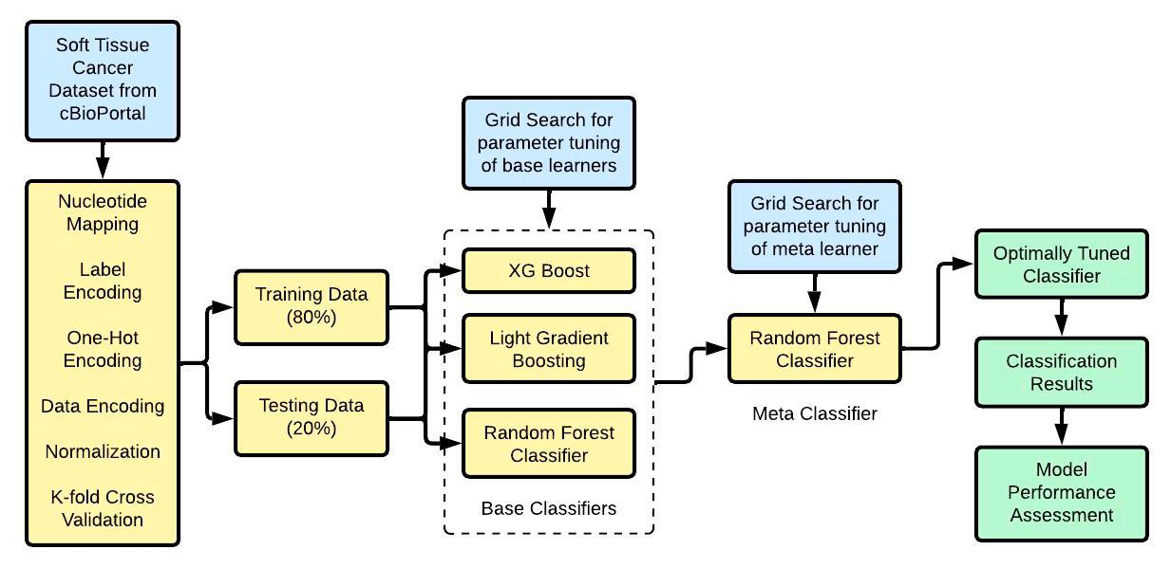
Proposed Model: Stacking Classifier
Fig. 2: Proposed Model: Stacking Classifier
Classification of Sarcoma Based on Genomic Data Using Machine Learning Models
7
Notes:
The image is a flowchart that outlines a process for cancer research, including steps such as searching for base learners, optimizing the training data, and testing the model on a validation set. The flowchart also includes a section for data encoding and a separate section for model classification. It is a visual representation of a scientific or technical process, with boxes and arrows connecting the different steps.

Slide 8
Findings & Results
5-fold cross-validation is used to generate out-of-fold predictions.
XG Boost achieved excellent performance in classifying Frameshift Mutations (107/110 correct), Inframe Mutations (118/119 correct), and Variants (28/292 correct).
LightGBM showed a similar pattern to XGBoost, with slightly better performance on Missense Mutations (715 correct vs 698 for XGBoost).
Classification of Sarcoma Based on Genomic Data Using Machine Learning Models
8
Notes:
The study employed a stacking super classifier with XGBoost, LightGBM, and Random Forest, achieving high accuracy and precision. The models demonstrated strong performance in classifying various types of mutations, including Frameshift, Inframe, and Variants. The results provide a baseline for future studies and can be used in conjunction with modern deployment tools for cancer classification.

Slide 9
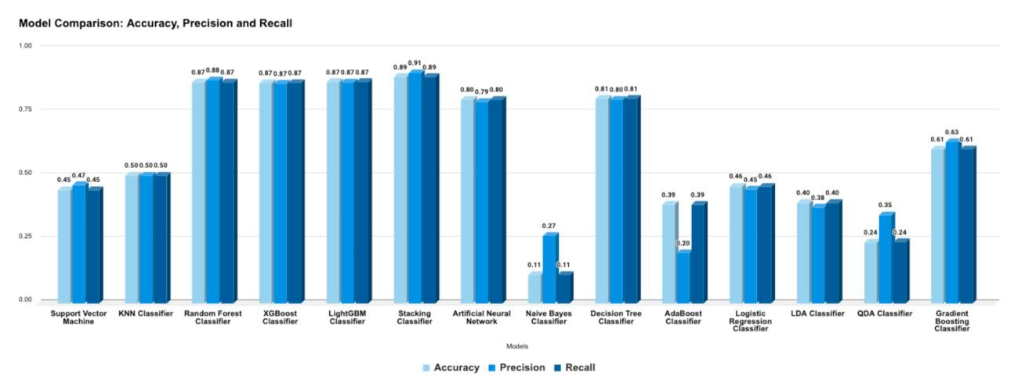
Comparison of Effectiveness of Different Models
Fig. 3: Comparison of Effectiveness of Different Models
Classification of Sarcoma Based on Genomic Data Using Machine Learning Models
9

Slide 10
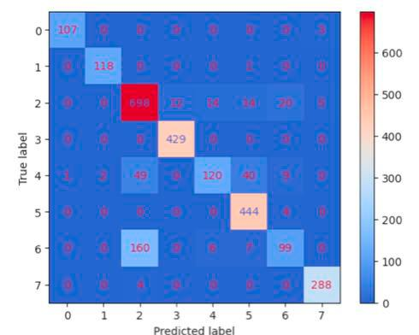
Confusion Matrix for XG Boost
Fig. 4. Confusion Matrix for XG Boost
Classification of Sarcoma Based on Genomic Data Using Machine Learning Models
10

Slide 11
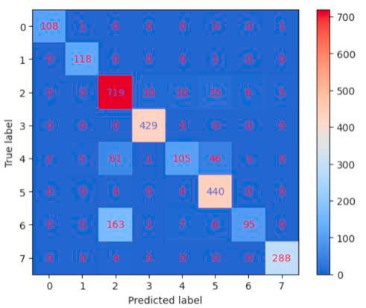
Confusion Matrix for Random Forest
Fig. 6: Confusion Matrix for Random Forest
Classification of Sarcoma Based on Genomic Data Using Machine Learning Models
11

Slide 12
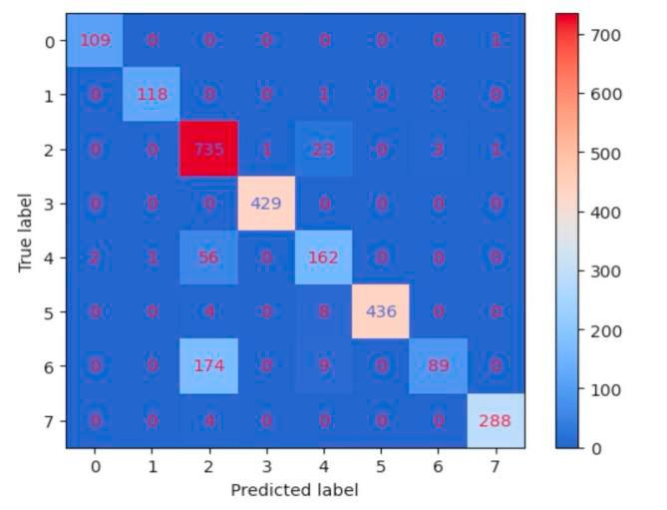
Confusion Matrix for Stacking Classifier
Fig. 7: Confusion Matrix for Stacking Classifier
Classification of Sarcoma Based on Genomic Data Using Machine Learning Models
12

Slide 13
Key Statistics
89 to 91%: Accuracy of the stacking classifier in predicting sarcoma subtypes.
50% mark: Performance scores of Naive Bayes, AdaBoost, and QDA models.
801 samples: Dataset used in the study, consisting of four cancer types.
Classification of Sarcoma Based on Genomic Data Using Machine Learning Models
13
Notes:
The stacking classifier outperformed other models, achieving high accuracy rates. The performance of other models, such as Naive Bayes and AdaBoost, was significantly lower. The dataset used in the study consisted of 801 samples from four different cancer types.

Slide 14
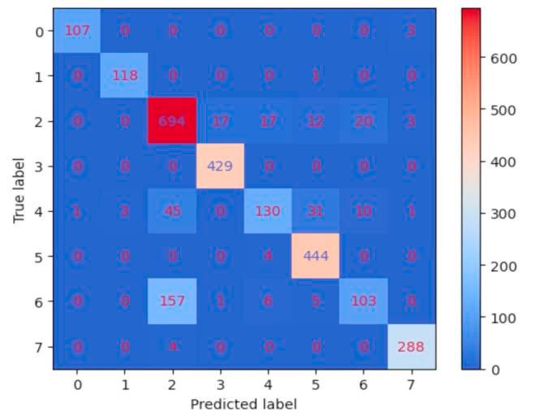
Confusion Matrix for Light Gradient-Boosting Machine
Fig. 5: Confusion Matrix for Light Gradient-Boosting Machine
Classification of Sarcoma Based on Genomic Data Using Machine Learning Models
14

Slide 15
Applications
Machine learning models can be incorporated into clinical workflows for sarcoma diagnosis.
Precision medicine powered by genomics can be applied in the treatment of sarcoma.
A unified solution for cancer classification based on genomic profiles can be developed for Pan-Cancer applications.
Classification of Sarcoma Based on Genomic Data Using Machine Learning Models
15
Notes:
This work has the potential to change cancer diagnosis forever by providing more accurate classification and personalized treatment modalities. The proposed framework can be applied to other rare complex cancers, and the models can be used in clinical settings to improve diagnosis and treatment. Further research is needed to refine the approach and ensure reliability, but the possibilities for impact are significant.

Slide 16
Challenges & Limitations
Challenges in managing high-dimensional genomic data and selecting relevant features consistently.
Risk of models performing well on training data but poorly on unseen data, especially with limited sample sizes.
Inconsistent model building procedures and evaluation metrics across studies, hindering reproducibility.
Classification of Sarcoma Based on Genomic Data Using Machine Learning Models
16
Notes:
The proposed study acknowledges several limitations and open challenges in sarcoma classification. Managing high-dimensional genomic data and selecting relevant features consistently is a significant challenge. Additionally, models may perform well on training data but poorly on unseen data, especially with limited sample sizes. Inconsistent model building procedures and evaluation metrics across studies also hinder reproducibility. These challenges highlight the need for further research and development in this area.

Slide 17
Future Scope
External validation will test the models' generalizability against independent datasets from various clinical settings.
The approach will be refined to better identify and classify rare sarcoma subtypes.
Further research in Pan-Cancer applications will help develop a unified solution for cancer classification based on genomic profiles.
Classification of Sarcoma Based on Genomic Data Using Machine Learning Models
17
Notes:
The authors propose to take their research to the next level by testing the models' performance in real-world settings, refining their approach to better handle rare cases, and exploring its potential applications in Pan-Cancer classification. This will involve collecting and analyzing data from different clinical settings to assess the models' generalizability and consistency. By doing so, they aim to improve the accuracy and reliability of their models and ultimately contribute to more effective cancer diagnosis and treatment.

Slide 18
Conclusion
The proposed model achieved the highest overall accuracy in sarcoma classification.
The Stacking Classifier outperformed individual models in handling class imbalance.
The model's success demonstrates the effectiveness of computational methods in genomic data analysis.
Classification of Sarcoma Based on Genomic Data Using Machine Learning Models
18
Notes:
The proposed model's high accuracy and ability to handle class imbalance make it a valuable tool for sarcoma diagnosis. The Stacking Classifier's performance highlights its potential for improving diagnostic accuracy. This research contributes to the field of precision oncology by providing a more accurate and efficient method for sarcoma classification.

Slide 19
Thank you
Questions & discussion

