Slide 1
Intervention Analysis for Predicting Stock Market using Deep Learning Algorithms and Time Series Analysis
This paper compares Time Series Analysis and Deep Learning for stock market prediction.
Automated summary of Stock_Market_Prediction.pdf

Slide 2
Overview
01 Introduction
02 Methodology
03 Findings & Results
04 Key Statistics
05 Applications
06 Challenges & Limitations
07 Future Scope
08 Conclusion
Intervention Analysis for Predicting Stock Market using Deep Learning Algorithms and Ti…
2

Slide 3
Introduction
Stock market prediction is challenging due to its intricate and volatile nature.
Classical Time Series Analysis techniques struggle with generalization and computation on real-world data.
Deep Learning (DL) models, specifically Recurrent Neural Networks (RNN), can improve prediction capacities.
Intervention Analysis for Predicting Stock Market using Deep Learning Algorithms and Ti…
3
Notes:
The stock market's complexity and volatility pose significant challenges for traditional prediction methods. As a result, financial institutions and investors face difficulties in managing risk exposure. This research aims to address this issue by comparing Time Series Analysis with Deep Learning augmented by intervention analysis, with the goal of improving stock price prediction.

Slide 4
Methodology
The dataset of Tesla and IBM stocks was collected from a legitimate source.
The data was divided into training and testing groups using an 80/20 split for model fitting.
The proposed approach uses 6 different models, including RNN, to predict stock values.
Intervention Analysis for Predicting Stock Market using Deep Learning Algorithms and Ti…
4
Notes:
The methodology involves collecting a dataset of Tesla and IBM stocks, which is then divided into training and testing groups. The proposed approach uses six different models, including Recurrent Neural Network (RNN), to predict stock values. The models are evaluated using metrics such as Mean Square Error (MSE), Root Mean Square Error (RMSE), and Mean Absolute Error (MAE).

Slide 5
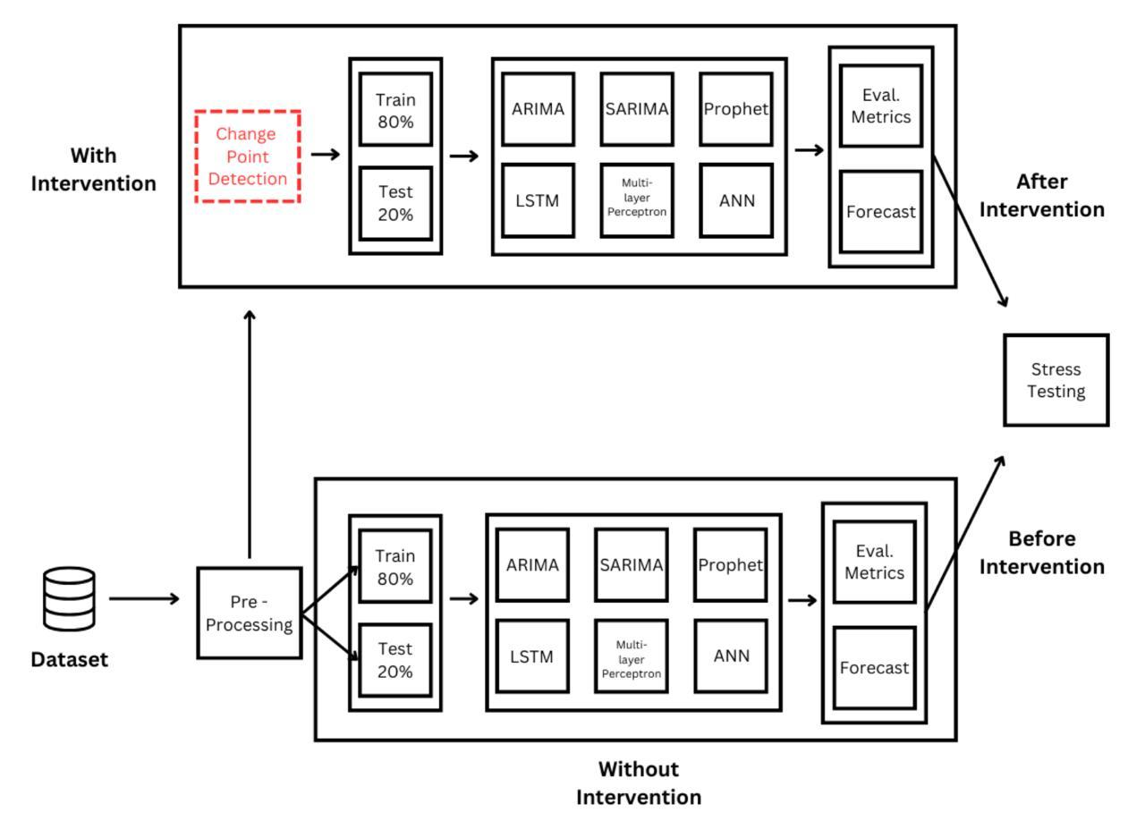
A graphical representation of the approach
Fig. 1. A graphical representation of the approach
Intervention Analysis for Predicting Stock Market using Deep Learning Algorithms and Ti…
5

Slide 6
Findings & Results
LSTM produced the most accurate findings out of the rest in their study.
The Proximal Policy Optimisation (PPO) method is the most effective, outperforming Deep Q-learning (DQN) and Soft Actor Critic (SAC).
The results show a widespread fall in stock prices following the COVID-19 outbreak, with differing effects in different nations.
Intervention Analysis for Predicting Stock Market using Deep Learning Algorithms and Ti…
6
Notes:
The study found that LSTM was the most accurate model, while PPO outperformed other reinforcement learning methods. The COVID-19 outbreak had a significant impact on stock prices, with varying effects across different countries. These findings highlight the importance of considering global crises in financial market analysis.

Slide 7
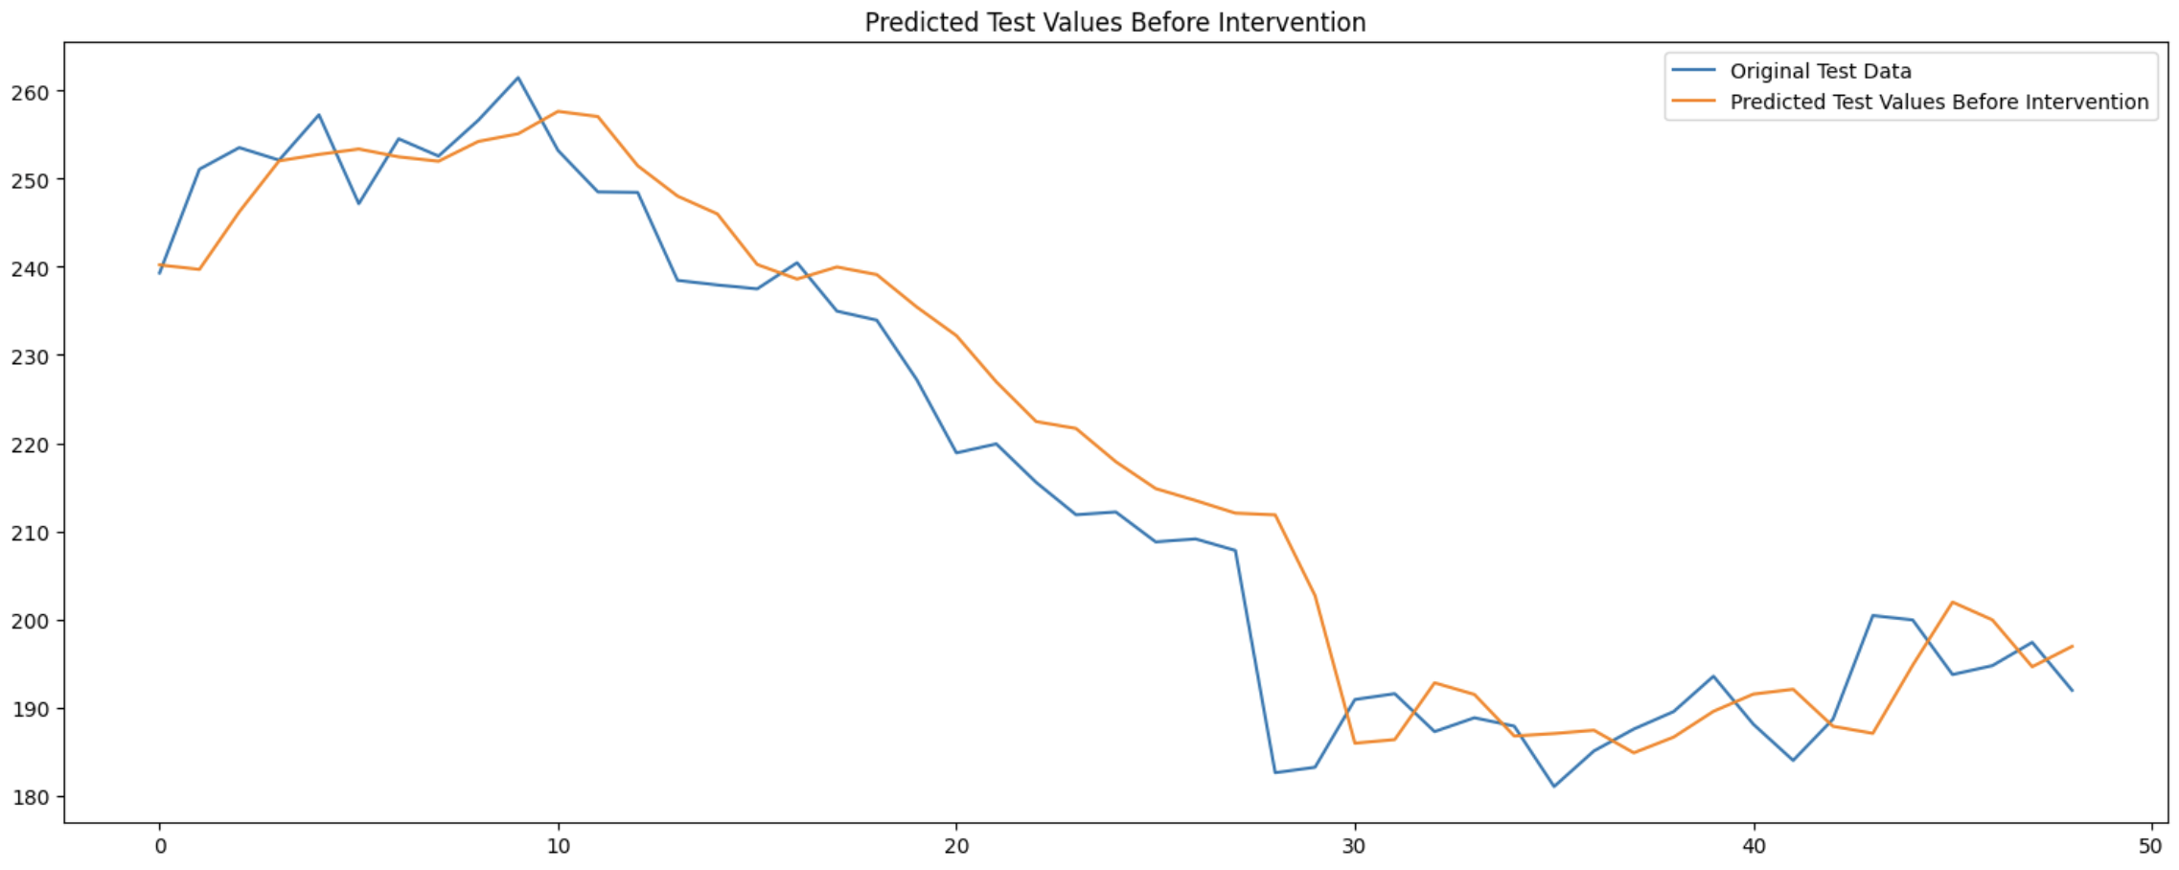
Graph denoting forecasting before intervention
Fig. 4. Graph denoting forecasting before intervention
Intervention Analysis for Predicting Stock Market using Deep Learning Algorithms and Ti…
7

Slide 8
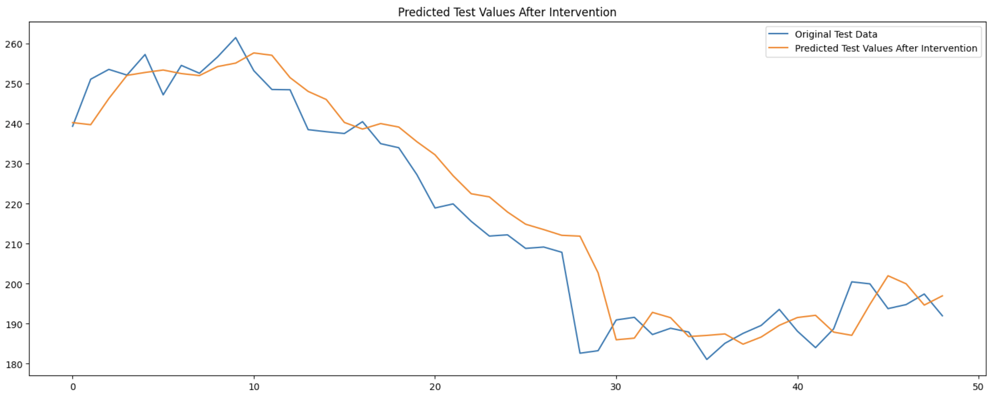
Graph denoting forecasting after intervention
Fig. 5. Graph denoting forecasting after intervention
Intervention Analysis for Predicting Stock Market using Deep Learning Algorithms and Ti…
8
Notes:
Line chart of Predicted vs Actual

Slide 9
Key Statistics
80/20 split is used to divide the dataset into training and testing groups.
6 different models are used in the proposed approach, including MLP with Intervention Analysis.
Mean Square Error (MSE), Root Mean Square Error (RMSE), and Mean Absolute Error (MAE) are used as evaluation metrics.
Intervention Analysis for Predicting Stock Market using Deep Learning Algorithms and Ti…
9
Notes:
The proposed approach uses a combination of machine learning models and intervention analysis to improve forecasting accuracy. The dataset is divided into training and testing groups using an 80/20 split. The evaluation metrics used are MSE, RMSE, and MAE, which measure the difference between predicted and actual values.

Slide 10
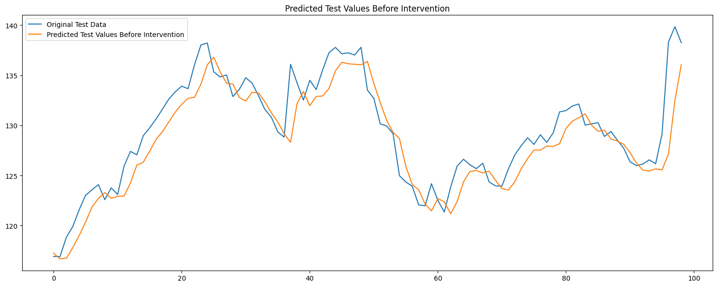
Graph denoting forecasting before intervention
Fig. 2. Graph denoting forecasting before intervention
Intervention Analysis for Predicting Stock Market using Deep Learning Algorithms and Ti…
10

Slide 11
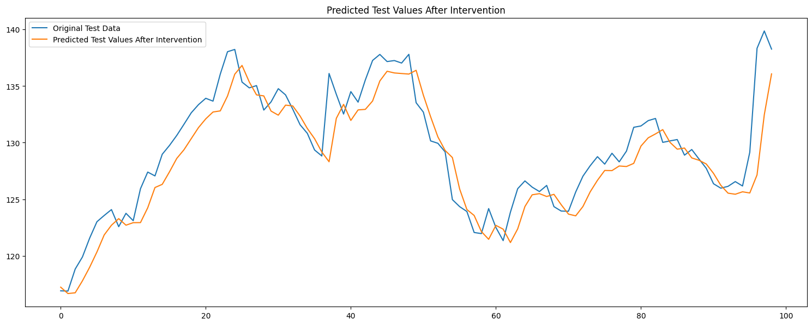
Graph denoting forecasting after intervention
Fig. 3. Graph denoting forecasting after intervention
Intervention Analysis for Predicting Stock Market using Deep Learning Algorithms and Ti…
11

Slide 12
Applications
Intervention analysis can be applied to capture real-world complexities associated with unexpected market dynamics.
Advanced recurrent neural network topologies, such as long short-term memory (LSTM) networks, can improve temporal modelling.
Intervention Analysis for Predicting Stock Market using Deep Learning Algorithms and Ti…
12
Notes:
The proposed approach can be applied to various stock markets, including IBM, by using a combination of Time Series Analysis and Deep Learning. The use of intervention analysis can help capture unexpected market dynamics, leading to more accurate predictions. The framework can be made more generalizable to other markets by adopting advanced recurrent neural network topologies, such as LSTM networks.

Slide 13
Challenges & Limitations
Predicting stock prices is a difficult endeavour because the markets are unpredictable.
Precise value estimates require the understanding of stock values in terms of movements that are derived from historical data.
The stock market is intricate and volatile, posing challenges for classical Time Series Analysis techniques.
Intervention Analysis for Predicting Stock Market using Deep Learning Algorithms and Ti…
13
Notes:
The speaker should highlight the complexity and unpredictability of the stock market, making it challenging to develop accurate predictive models. The limitations of classical Time Series Analysis techniques should be emphasized, as well as the need for new methods like intervention analysis and Deep Learning to improve prediction capacities.

Slide 14
Future Scope
The authors plan to integrate the Q Network (Q Net) with intervention-awareness into their predictive models.
They will explore the use of the RNN model to handle nonlinear dynamics in stock price prediction.
The researchers aim to improve the performance of their models by leveraging historical trends and consecutive patterns.
Intervention Analysis for Predicting Stock Market using Deep Learning Algorithms and Ti…
14
Notes:
The authors propose to build upon their previous work by integrating the Q Network with intervention-awareness. This will enable their models to capture sudden changes influenced by external factors. By leveraging the RNN model's ability to handle nonlinear dynamics, they hope to improve the accuracy of their predictions. The researchers also plan to explore the use of historical trends and consecutive patterns to further enhance their models' performance.

Slide 15
Conclusion
Deep Learning models, specifically Recurrent Neural Network (RNN), performed better than other models.
RNN outperformed other models on Mean Squared Error (MSE) for Tesla and IBM data.
The study's main goal was to determine the parameters for the ARIMA model and evaluate its performance.
Intervention Analysis for Predicting Stock Market using Deep Learning Algorithms and Ti…
15
Notes:
The study demonstrates the effectiveness of Deep Learning models, particularly RNN, in predicting stock prices. The results show that RNN outperformed other models on MSE for Tesla and IBM data. The study also aimed to determine the parameters for the ARIMA model and evaluate its performance, contributing to the development of more accurate stock price prediction models.

Slide 16
Thank you
Questions & discussion

