Slide 1

DAO2: Overcoming Overall Storage Overflow in Intermittently Connected Sensor Networks
-Under the guidance of Dr. Bin Tang
Yeswanth Saidu Sai Polu

Slide 2
Introduction
Data generated from intermittently connected sensor networks therefore must be stored inside the network for some unpredictable period before uploading opportunities become available.
Some sensor nodes are constantly generating sensory data and have depleted their own storages. We refer to sensor nodes with depleted storage spaces while still generating data as data nodes.
The newly generated data that can no longer be stored at data nodes is called overflow data
Dr. Bin Tang proposed a new algorithm study “DA02:Data Aggregation for Overall storage Overflow” to study about Overall Storage Overflow in Intermittently Connected Sensor Networks.

Slide 3
Problem statement
To provide a modify the existing algorithm while considering each node has limited amount of energy.
The main sub problems to be solved are:
Generate the sensor network with data nodes and storage nodes
Convert the sensor network to aggregation network, using shortest path algo.
Decide number of initiators and number of aggregators

Slide 4
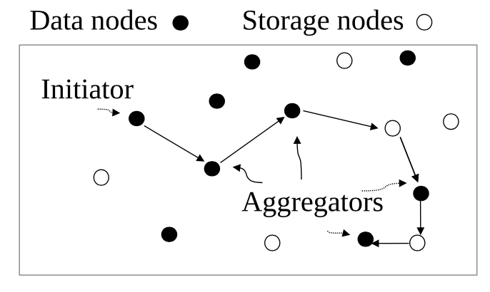
Illustration of DAO²
Initiators send their overflow data to visit other data nodes in multi-hop manner.
When a data node receives the data, it aggregates its own over-flow data and becomes an Aggregator.
This continues until enough aggregators are visited such that that total size of the overflow data after aggregation equals to or is slightly less than total available storage in the network.

Slide 5
Some Questions:
Why not use bellman-ford over Dijkstra?
Can we implement Ant colony optimization algorithm?
What kind of aggregation is done to the data?
Why does the aggregation only occur once?

Slide 6
Thank you ☺

