Slide 1



CAR CRASH REPORT ANALYSIS
CNST6308 / Data Analysis In Construction Management
Under the guidance of
Dr. Lu Gao
College of Technology
University of Houston – Main Campus
Submitted By: Group - 40

Slide 2
AGENDA
1
Abstract
2
Introduction
3
Literature review
4
Data analysis
5
Modelling & preprocessing
6
Conclusion and future work
7
References
PAGE 2

Slide 3
ABSTRACT:
Vehicles are one of the most important and as well as dangerous means of transportation, yet they pose significant risks. This project aims to predict the severity of injury type in crash information by examining data from Missouri state. The analysis focuses on injury trends and how they relate to the use of safety devices in vehicles. With the projected increase in population over the years, the number of automobiles on the road is expected to rise, leading to more accidents.
However, the growing usage of electronic vehicles will undoubtedly affect these trends. The target variable in this study is Injury Type, while the feature variables are safety devices, driver age, gender, county, location, damage, and disposition. To predict injury type accurately, a model must take all these factors into account. This project employs various machine learning models for analysis, including Naive Bayes classification, Decision Tree, Random Forest, K-Nearest Neighbors, and Multi-Layered Perceptron. The best model is chosen to predict the injury type for future events. To evaluate the model's performance, we used the accuracy score as a metric. The accuracy score reflects the ratio of correct predictions to the total number of predictions, with the highest accuracy value showing the best approach developed. Machine learning models enable the identification of valuable patterns through the processing of multiple classification parameters.
PAGE 3

Slide 4
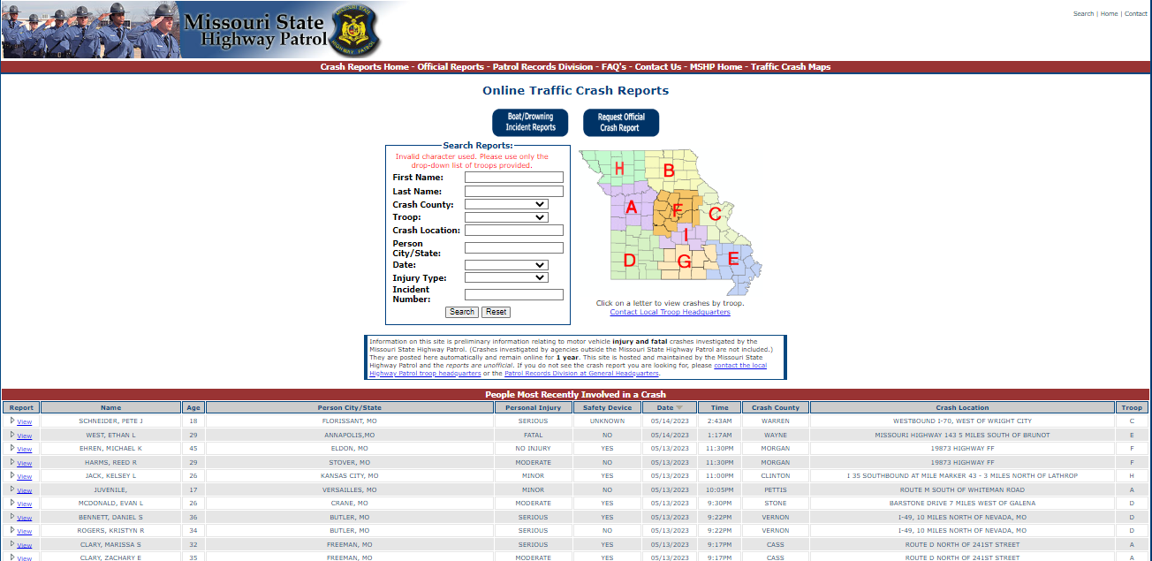
Website to extract the data.
PAGE 4

Slide 5
INTRODUCTION:
Vehicle “crashes” are the leading cause of death and injury in the United States. 2.5 million people are injured. Vehicle crashes have a devastating effect on not only the one involved in the accident, but it will also affect their families. Road safety campaigns and interventions have been introduced to reduce the number of road accidents, such as promoting the use of seat belts, enforcing speed limits, and improving road infrastructure. However, more efforts are needed to address this problem effectively.
Machine Learning models have shown great potential in predicting and analyzing road accidents. In recent years, the application of Machine Learning algorithms to road safety has gained traction, as it can help identify the most influential factors that contribute to road accidents. With the development of more advanced Machine Learning algorithms, it is expected that road safety interventions will become more effective and lead to a reduction in the number of road accidents.
Machine Learning algorithms can process many classification parameters and can obtain useful patterns. It can process huge amounts of data efficiently and can be scalable. In computer science and related fields, artificial neural networks are computational models that simulate the central nervous system of the animal allowing the machine to learn and identify information like the human brain. Many factors contribute to vehicle crashes. This study advances the methodology of crash severity research by conducting an empirical investigation
PAGE 5

Slide 6
LITERATURE REVIEW:
From "Motor vehicle fatalities during Memorial Day weekends, 1981–2016" : (Tang, et al.,1981)
They compared the Memorial Day weekends to accidents that occurred during the non-holiday periods. The paper considered the days, weeks, years, age, sex, and role of a driver, passenger, or pedestrian. 35% of the accidents have occurred during holiday weekends compared to non-holiday. Memorial Monday recorded the highest number of accidents during the holidays.
From "Paving the Way for Autonomous and Connected Vehicle Technologies in the Motor Carrier Industry." (Bernard, et al.,2018)
The main aim of the report is potential safety issues and the need for infrastructure needed for the mass adoption of autonomous vehicles and CV (Connected Technologies in motorcycles. The paper has shown the benefits of these technologies like driver shortages, and mitigating driving errors.
From "Investigation of Gender Differences in Large-Truck Crash Injury Severity in Missouri.“ (Bernard, et al.,2018),
The dataset has been taken from the Missouri State Highway Patrol STARS database and has the following variables road conditions, weather conditions, contributing circumstances, and crash injury severity. CHAID decision tree models have been applied to the crash data.
PAGE 6

Slide 7
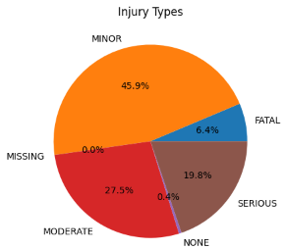
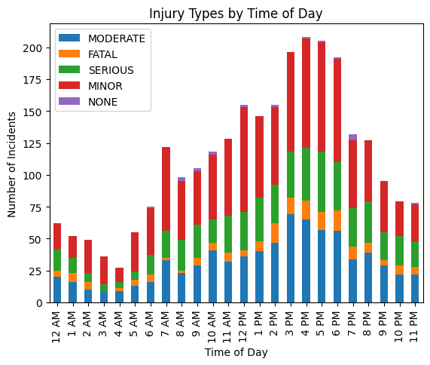
DATA ANALYSIS
As our primary focus is to analyze and predict severity of injury, we classified this data into different visual representations for enhanced analysis. We used stack bar, heatmap and pie-chart to represent these injury types, as you can see in the below figures. Injury figure illustrates the distribution of various injury types. Upon analysis, it becomes apparent that a significant proportion of drivers experience minor injuries, while the occurrence of fatal injuries is comparatively low, with a percentage of only 6.5. Approximately 28.5% of drivers suffer from moderate injuries. Stacked bar has observations made upon analyzing the stacked bar chart depicting the timings of various types of injuries. It was observed that the occurrence of minor injuries was relatively low after midnight. On the other hand, a significant number of moderate injuries were recorded after 3 PM, which gradually decreased as the day progressed and approached 9 PM.
Injury Distribution
Stacked bar: Injury Type vs Time
PAGE 7

Slide 8
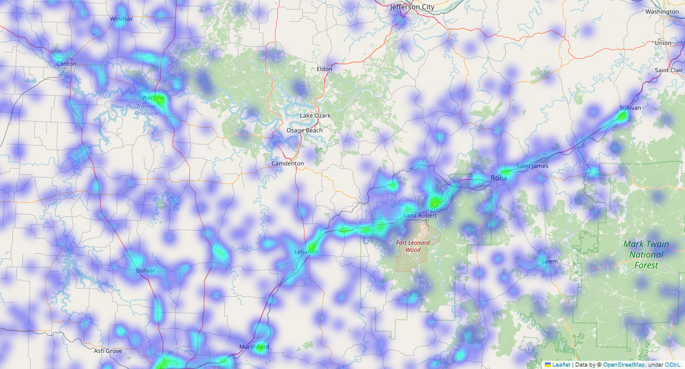
DATA ANALYSIS (continued)
Following these observations, we use co-ordinates data in dataset to map each other and assess the data for counties and places where the crashes happen. Key take-away from this observation is to know the location where the crashes happen frequently, so we can implement necessary measures to mitigate these incidents. We use heatmap to pinpoint the exact location of incident using co-ordinates recorded in the crash incident. Figure depicts the incidents that took place in a particular area.
Heatmap: Place of Incident using Latitude and Longitude in dataset.
PAGE 8

Slide 9
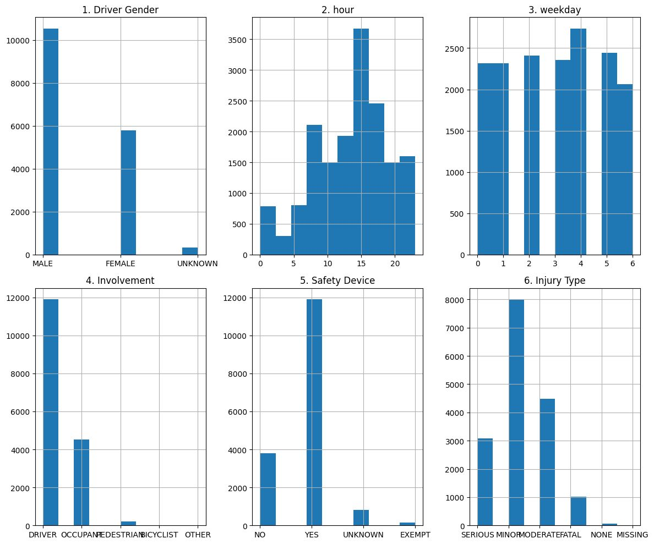
DATA ANALYSIS (continued)
Visual Representation of statistics mapped to injury type with other factors are displayed below
Heatmap: Place of Incident using Latitude and Longitude in dataset.
PAGE 9

Slide 10
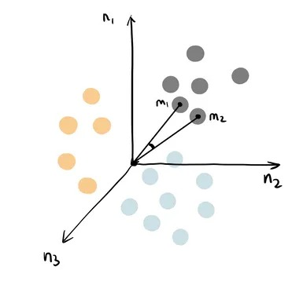
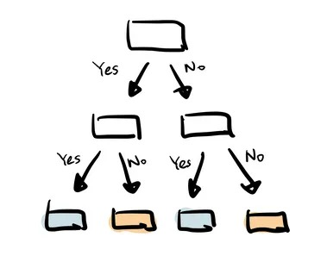
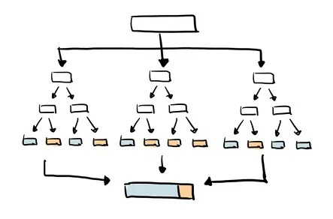
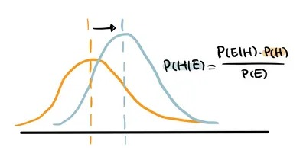
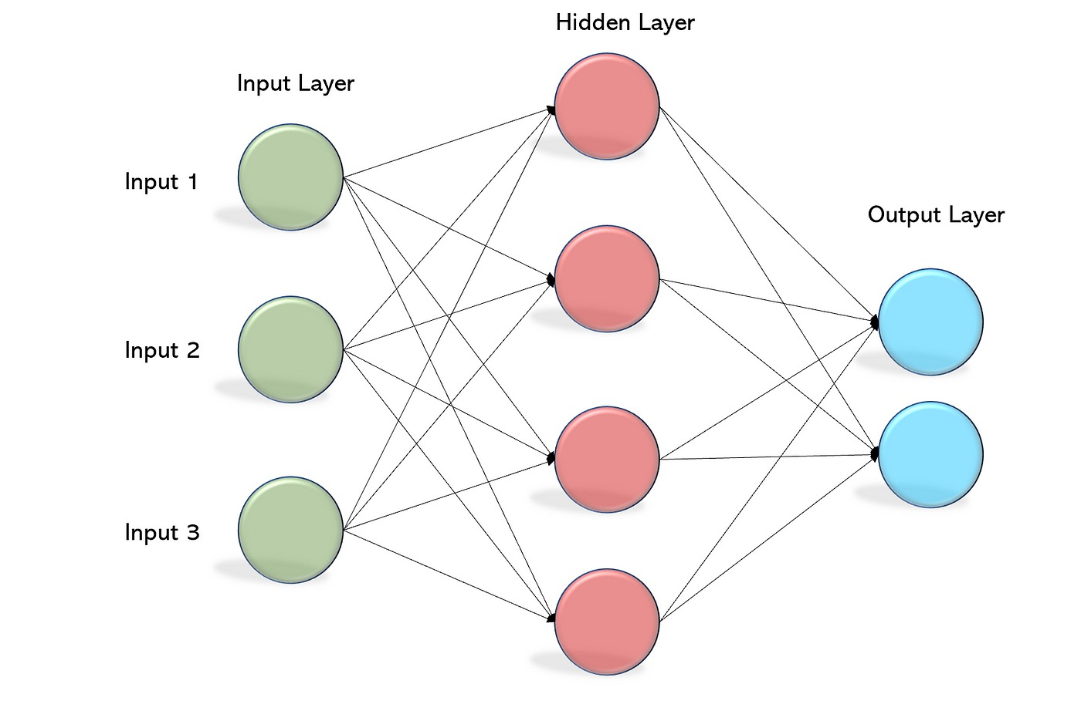
CLASSIFICATION ALGORITHMS
We implemented 5 classification machine learning models as listed below with the figures respectively from left to right
Naive Bayes Classification
K-Nearest Neighbors (KNN) Classification
Decision Tree Classification
Random Forest Classification
Neural Network Model - Multi-layer Perceptron Classifier
PAGE 10

Slide 11
SKLearn
Scikit-learn, or SKLearn for short, is a popular Python library for machine learning.
It provides a range of tools for building machine learning models, including algorithms for classification.
SKLearn is built on top of other popular scientific computing libraries in Python, such as NumPy, SciPy, and Matplotlib.
It provides many useful tools for preprocessing and feature selection, such as scaling, normalization, and evaluating model performance.
Overall, SKLearn is an important library for working with machine learning in Python.
PAGE 11

Slide 12
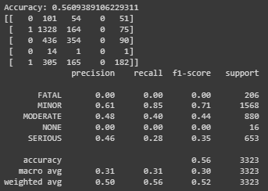
MODELLING
Model evaluation metrics are used to assess the performance and effectiveness of machine learning models. These metrics provide objective measurements of how well a model is performing in terms of accuracy, precision, recall, F1 score. Classification Models Metrics are listed below
Confusion Matrix
Accuracy
Precision
Recall (Sensitivity or True Positive Rate)
F1 Score.
Accuracy in this project, evaluate the performance of each model and choose the best model with highest accuracy. Example of confusion matrix is displayed to get crisp idea
PAGE 12

Slide 13
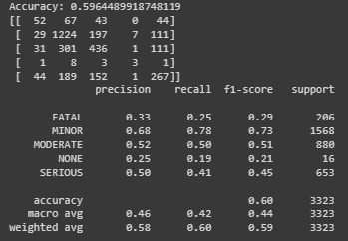
MODELLING (Result)
We implemented 5 classification machine learning models as listed below.
Naive Bayes Classification
K-Nearest Neighbors (KNN) Classification
Decision Tree Classification
Random Forest Classification
Neural Network Model - Multi-layer Perceptron Classifier.
The model with best accuracy is MLP classifier (Neural Network approach) with 60% of accurate performance on generated dataset.
PAGE 13

Slide 14
CONCLUSION AND FUTURE WORK:
In conclusion, vehicle crashes remain a significant concern, causing numerous injuries and fatalities worldwide. The analysis focused on predicting injury types based on trained models using random forest, logistic regression, and support vector classification. By leveraging the data extracted from the Missouri website, these models can provide valuable insights into the likelihood and severity of injuries in car crashes. Such predictions can aid in improving emergency response protocols, implementing effective safety measures, and ultimately reducing the impact of vehicle accidents. These advancements in modeling techniques can enhance our understanding of the factors contributing to crash severity and assist in developing targeted interventions and preventive measures.
In addition to the current analysis, there is a wide scope for future studies in the field of predicting injury types in vehicle crashes. One potential avenue for further exploration is the integration of real-time data sources, such as sensor data from vehicles and traffic surveillance systems, to enhance the accuracy and timeliness of predictions. Additionally, incorporating advanced machine learning techniques, such as deep learning algorithms and ensemble methods, may further improve the predictive performance of the models. Furthermore, exploring the impact of external factors like weather conditions, road infrastructure, and driver behavior on crash severity could provide valuable insights into comprehensive risk assessment and accident prevention strategies. Continued research in this domain has the potential to contribute significantly to the field of road safety and make a tangible difference in reducing the number and severity of injuries caused by vehicle crashes.
PAGE 14

Slide 15
REFERENCES
Tang, Y., Ratnapradipa, K.L., Xiang, H. et al. Motor vehicle fatalities during Memorial Day weekends, 1981–2016. BMC Res Notes 13, 7 (2020). https://doi.org/10.1186/s13104-019-4881-0
Bernard Bracy, Jill M ; Bao, Ken ; Mundy, Ray A, "Paving the Way for Autonomous and Connected Vehicle Technologies in the Motor Carrier Industry" (2018). https://rosap.ntl.bts.gov/view/dot/36103
Bernard Bracy, Jill M , Mondy, Christopher, "Investigation of Gender Differences in Large-Truck Crash Injury Severity in Missouri" (2018). https://rosap.ntl.bts.gov/view/dot/36224
Bernard, Jill Marie, "An Application of Data Analytics to Outcomes of Missouri Motor Vehicle Crashes" (2015). Dissertations. 168. https://irl.umsl.edu/dissertation/168
[1]https://github.com/IndiraBobburi/accident-severity-prediction/blob/master/Team4_Project_Report.pdf
[2]https://github.com/theDefiBat/ROAD-ACCIDENTS-PREDICTION-AND-CLASSIFICATION/blob/master/report/4-Final-Report-3-aw.pdf
[3] https://www.frontiersin.org/articles/10.3389/fbuil.2022.860805/full
[4] https://www.txdot.gov/data-maps/crash-reports-records/crash-data-analysis-statistics.html
PAGE 15

Slide 16
GROUP 40 - TEAM MEMBERS:
S.NO | NAME | UH ID
1 | YASWANTH CHOWDARY PAVULURI | 2183774
2 | SAI ASISH SAMINENI | 2088595
3 | VISWESWARARAO VEERAMACHANENI | 2201644
4 | SAI PRANEETH SENIGAPALLI | 2199053
PAGE 16

Slide 17
THANK YOU
PAGE 17

