Slide 1
Indian Institute of Information Technology, Una
AnyChat: Local Retrieval-Augmented Generation
Presented by: Yash Rana
(25MTCS017)

Slide 2
Outline
Introduction
What is RAG?
Core Technologies (FAISS & LangChain)
Impact of Top-K
What is AnyChat?
Target Use Cases
How it Works Architecture
Process Flowchart
Evaluation Results
Future Scope
Conclusion

Slide 3
Introduction
The Problem: Standard LLMs lack specific, or real-time data and can suffer from regular "hallucinations".
The Traditional Block: Fine-tuning base models on custom data is computationally expensive, slow, and permanently bakes rigid memory into the model.
The Modern Solution: Injecting private, targeted context into the model's working memory at runtime, guiding the model dynamically without altering its core weights.

Slide 4
What is RAG?
RAG stands for Retrieval-Augmented Generation.
Retrieval: Searching a localized, private database for information mathematically relevant to the user's prompt.
Augmentation: Fusing those retrieved data chunks into the LLM's system prompt invisibly.
Generation: Instructing the LLM to formulate an answer *only* based explicitly on that context.
Benefit: Eliminates hallucination by forcing the model to cite its contextual sources.

Slide 5
What is FAISS?
Facebook AI Similarity Search.
An extremely optimized, open-source library built for the rapid similarity search and clustering of dense vectors.
When documents are broken down into coordinates (embeddings) indicating their semantic definition, FAISS instantly locates which data coordinates are geometrically closest to the question being asked.

Slide 6
What 'K' Does
In vector retrieval, Top-K represents the *number of nearest neighbor chunks* fetched from the FAISS index.
Low K (e.g., 2): Highly strict and focused. Guarantees tight accuracy but risks missing the broader, overarching context.
High K (e.g., 8+): Gives the model a massive amount of surrounding context. Risks confusing the LLM with loosely related, noisy details.
The Key: Balancing K is crucial to optimizing RAG accuracy limits dependent upon LLM context window sizes.

Slide 7
What is LangChain?
LangChain is a framework used to build applications that combine LLMs with external data sources.
Provides the standard, robust connective architecture for:
  Document Loading (PDFs, Web crawling pipelines).
  Text Splitting (Recursive chunking algorithms).
  Can implement routing across multiple retrievers.
  Streamlined LLM chain prompting protocols.

Slide 8
What is AnyChat?
A locally-run, RAG web application built with a modern "NotebookLM" inspired application.
Accepts multi-modal text injections: Seamlessly integrates PDFs, DOCX, TXT, and dynamic Website URLs recursively.
Completely local: Uses CPU embeddings via `sentence-transformers` and the compact `TinyLlama` model, guaranteeing zero data leakage to cloud providers.

Slide 9
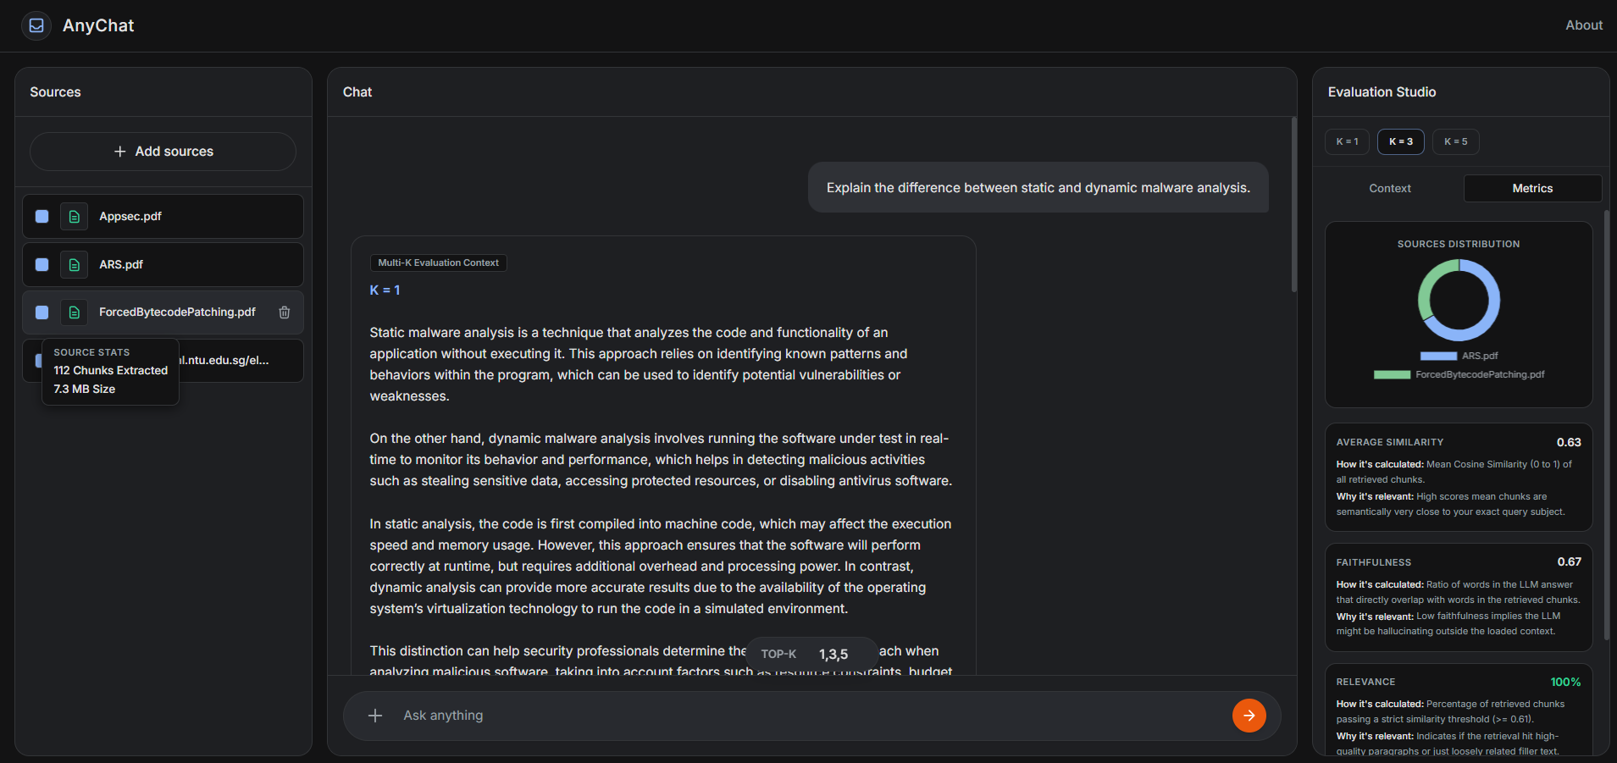
AnyChat Screenshots:

Slide 10
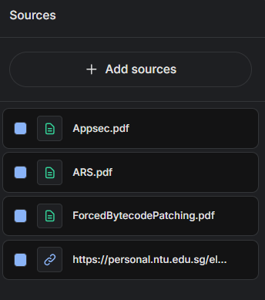
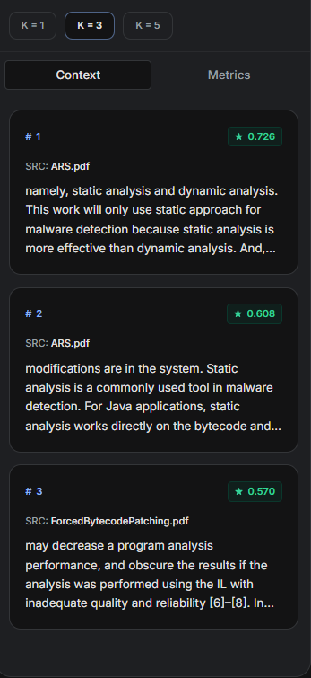
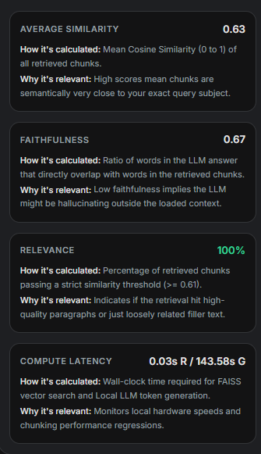
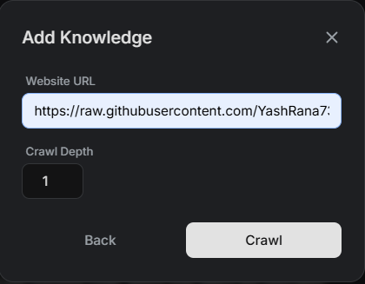
AnyChat Features:

Slide 11
How Does It Work?
Ingestion: Documents and web links are processed and split into chunks using LangChain of exactly 750 characters.
Embedding: Those string chunks are mapped into semantic multidimensional vectors via the `all-MiniLM-L6` transformer.
Organization: FAISS plots the knowledge base in memory, allowing users to toggle specific sources active or inactive.
Inference: The selected Top-K chunks are injected alongside the user query to the local `TinyLlama` instance to compile an intelligent, cited reply.

Slide 12
What It Can Be Used For
Academic/Research: Rapidly processing large PDF textbooks logically for specific citations without reading 500 pages.
Development/Engineering: Feeding complex API documentation URLs into an agent for instant coding context.
Legal/Enterprise: Chatting securely with sensitive, confidential documents knowing the firewall remains uncompromised.

Slide 13
Flowchart
User Query
Embedding Model
Vector Created
FAISS DB
Matched Context
Prompt Fusion
TinyLlama
Final Answer

Slide 14
Evaluation Metrics
Avg Similarity: The average mathematical "closeness" between your question and the retrieved chunks. High scores (0.7+) mean the system found very relevant text.
Faithfulness (Groundedness): Measures how much of the answer is actually based on the context. It detects "Hallucination"—higher scores mean the model isn't making things up.
Relevance The percentage of retrieved chunks that exceeded the system's "utility threshold". 100% means every piece of info pulled was high-quality.
Gen Latency: The total time taken (in seconds) for the model to "think" and generate the final text reply on your local machine.

Slide 15
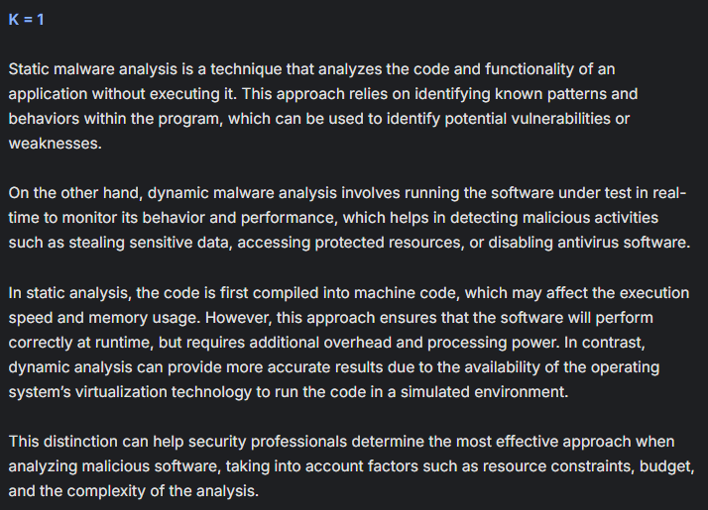
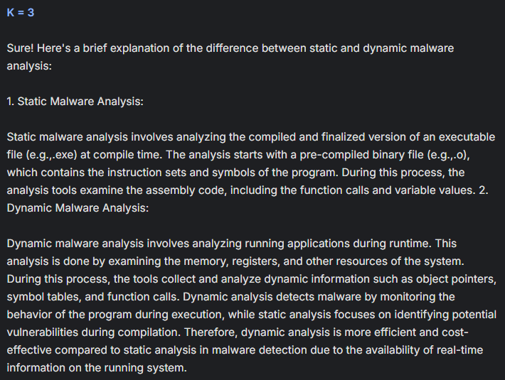
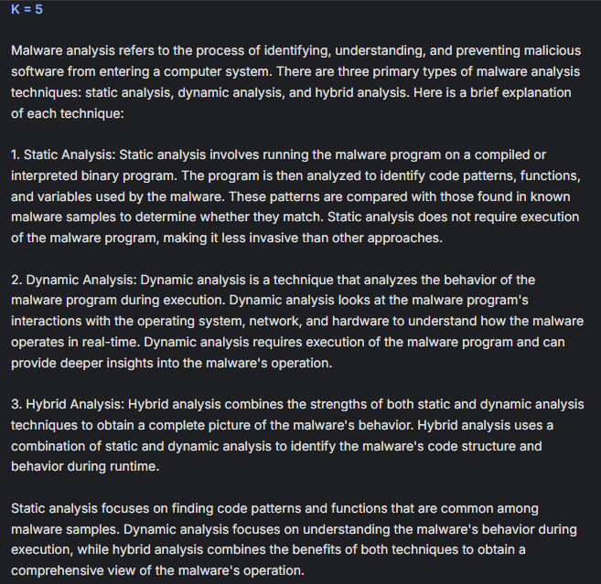
RESULTS AND ANALYSIS
Query: Explain the difference between static and dynamic malware analysis.

Slide 16
Evaluation Metrics
Avg Similarity: The average mathematical "closeness" between your question and the retrieved chunks. High scores (0.7+) mean the system found very relevant text.
Faithfulness (Groundedness): Measures how much of the answer is actually based on the context. It detects "Hallucination"—higher scores mean the model isn't making things up.
Relevance The percentage of retrieved chunks that exceeded the system's "utility threshold". 100% means every piece of info pulled was high-quality.
Gen Latency: The total time taken (in seconds) for the model to "think" and generate the final text reply on your local machine.

Slide 17
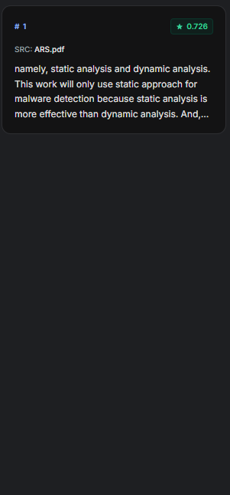
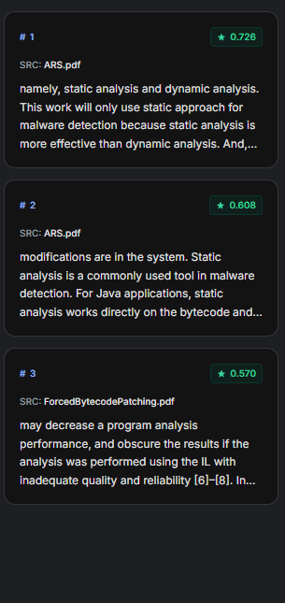
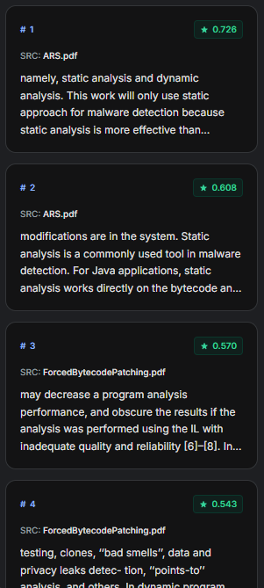
RESULTS AND ANALYSIS
K=1
K=3
K=5
Chunks Usage

Slide 18
RESULTS AND ANALYSIS
Similarity Decreases
As K increases (1 → 5), similarity drops (0.73 → 0.68) because less relevant documents are also included.
Better Coverage with Higher K
Higher K retrieves more information, so it reduces the chance of missing important details—but may add some irrelevant content.
Latency Stays Similar
Response time doesn’t change much because the main limitation is CPU processing, not the number of documents.
Best Value of K
K = 3 or 4 gives a good balance between accuracy and completeness.

Slide 19
RESULTS AND ANALYSIS
Metric | K = 1 | K = 3 | K = 5
Avg Similarity | 0.73 | 0.70 | 0.68
Faithfulness | 0.83 | 0.78 | 0.81
Relevance | 100% | 100% | 100%
Gen Latency (s) | 230.53 | 229.71 | 235.24

Slide 20
Thank You

