Slide 1
Retail Business Performance & Profitability Analysis
Prepared by Yash Rathore

Slide 2
Objective
• Analyze sales and profit data from the Superstore dataset
• Identify high-performing and underperforming product categories
• Understand regional sales trends and inventory dynamics
• Provide actionable business recommendations

Slide 3
Dataset Overview
• Source: Kaggle - Superstore Sales Dataset
• Records: ~10,000
• Key Columns: Order Date, Ship Date, Sales, Profit, Category, Sub-Category, Region, Segment, Discount, Quantity
• Time Range: [Insert year range after checking dataset]

Slide 4
Tools & Methodology
• Tools: Python (Pandas, Seaborn, Matplotlib)
• Steps Followed:
1. Data cleaning and preprocessing
2. Hypothesis formulation
3. Exploratory Data Analysis (EDA)
4. Visualization of key metrics
5. Business insights and recommendations

Slide 5
Gather and clean the data
Once you have defined the problem or question, you need to gather the data you'll need to analyze.
This could involve collecting data from various sources or accessing existing data sets. You'll also need to clean the data to ensure it's accurate, complete, and consistent.

Slide 6
Explore the data
Once you have your data, you'll need to explore it to get a sense of what it contains.
This might involve creating visualizations, calculating basic statistics, or conducting other exploratory analysis techniques.

Slide 7
Formulate hypotheses
1. Some products have the higher profit margin compared to other categories.
2. Some region has the highest sales.
3. Sales are higher during certain months of the year.
4. Profit is higher on weekend than on weekdays.

Slide 8
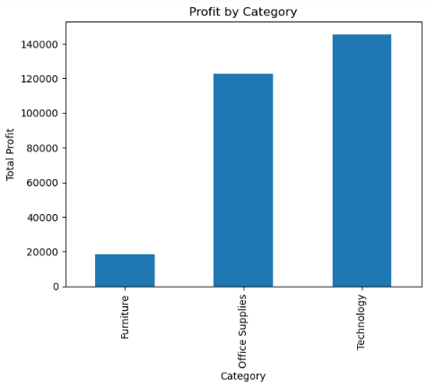
Test the hypotheses
Hypothesis 1: Some products have the higher profit margin compared to other categories.
The hypothesis proved that technology products have the highest profit margin of the three categories.

Slide 9
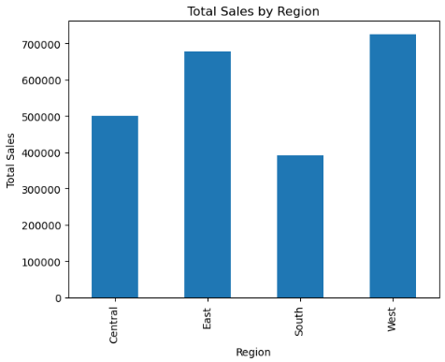
Test the hypotheses
Hypothesis 2: Some region has the highest sales.
The hypothesis proved that the west region has the highest sales.

Slide 10
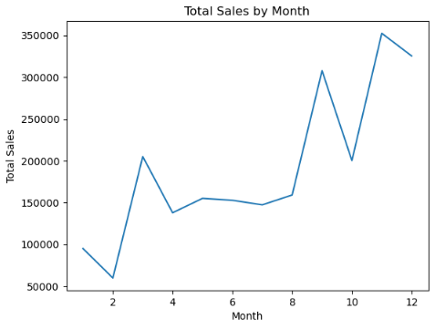
Test the hypotheses
Hypothesis 3: Sales are higher during certain months of the year.
Our Hypothesis is supported as sales are higher during certain months of the year.

Slide 11
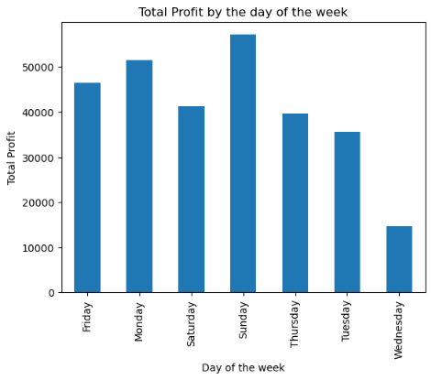
Test the hypotheses
Hypothesis 4: Profit is higher on weekend than on weekdays.
The hypothesis is supported as company's profit is higher on weekend compared to weekdays.

Slide 12
Key Insights
• Technology is the most profitable category
• The West is the top-performing region in terms of sales
• Q4 shows highest sales volume
• Profit is higher on weekend compared to weekdays.

Slide 13
Recommendations
• Focus marketing on high-profit categories
• Run promotional campaigns during high-sales months

Slide 14
Conclusion
• Data-driven insights can guide strategic decisions
• Clear profit patterns by category and region
• Inventory and time-based factors significantly impact business outcomes

