Slide 1
Superstore Sales Dashboard
Created using Tableau
By – Yash Rathore

Slide 2
Dataset Overview & KPIs
Dataset: Superstore Dataset from Kaggle
KPIs and Charts Used:
Total Sales
Total Profit
Sales Over Time
Profit Over Time
Sales by Region
Top Sub-Category by Sales
Top States by Profit
Sales Over the States
Category Sales %

Slide 3
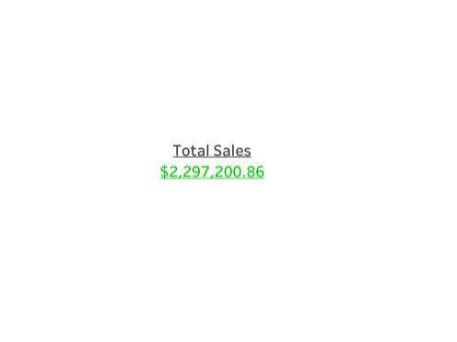
Total Sales
Displays the overall revenue generated from all orders. A quick snapshot of the company's gross performance.

Slide 4

Total Profit
Represents total earnings after deducting costs. Helps assess overall business profitability.

Slide 5
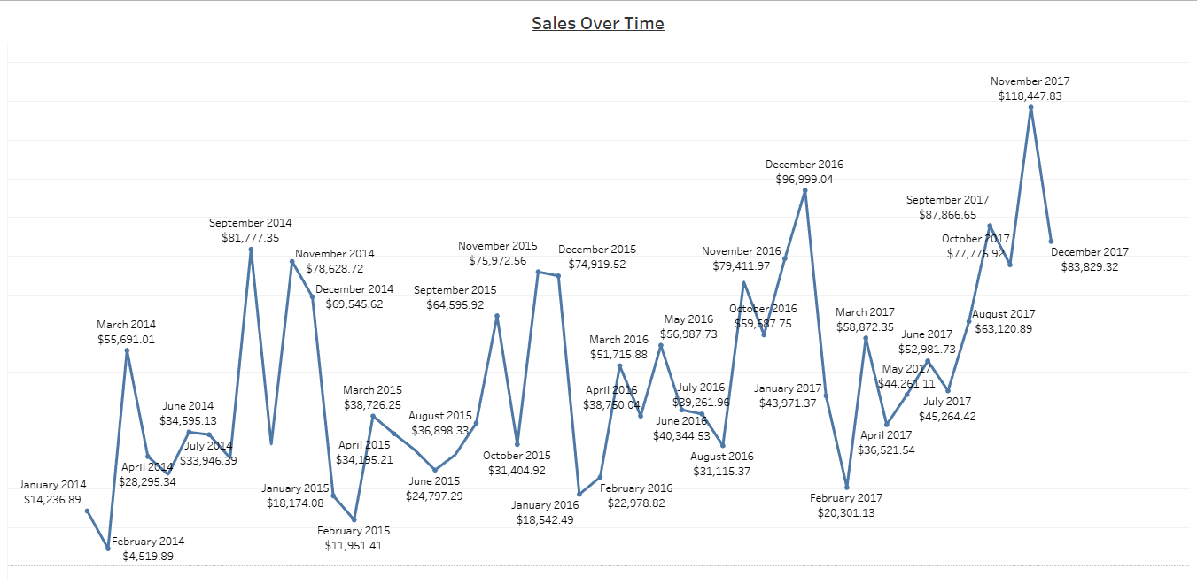
Sales Over Time
Shows how sales have changed over time, helping identify seasonal trends and growth patterns.

Slide 6
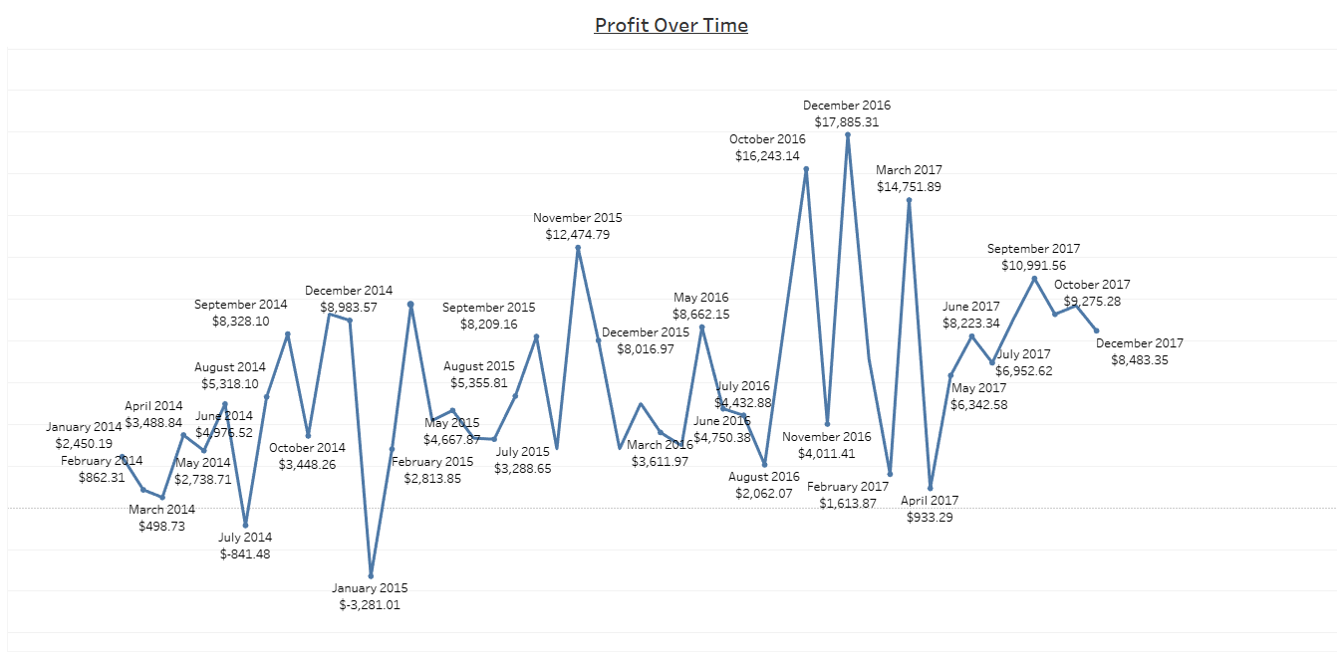
Profit Over Time
Tracks profit fluctuations over time, offering insights into profitability trends and periods of high or low margins.

Slide 7
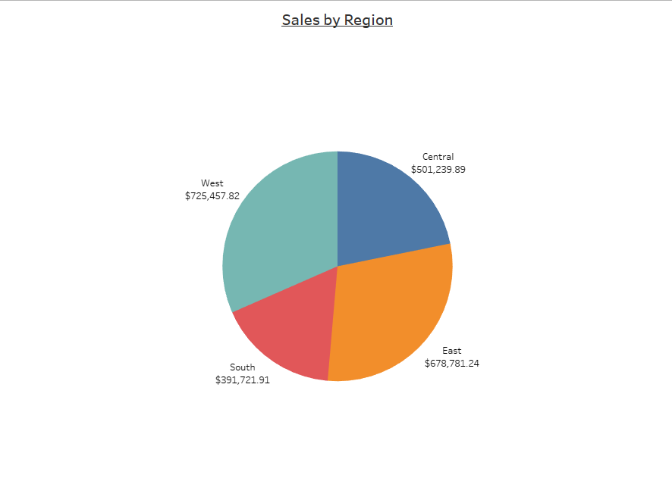
Sales by Region
Breaks down total sales by region. Useful to compare geographic performance and discover key contributing areas.

Slide 8
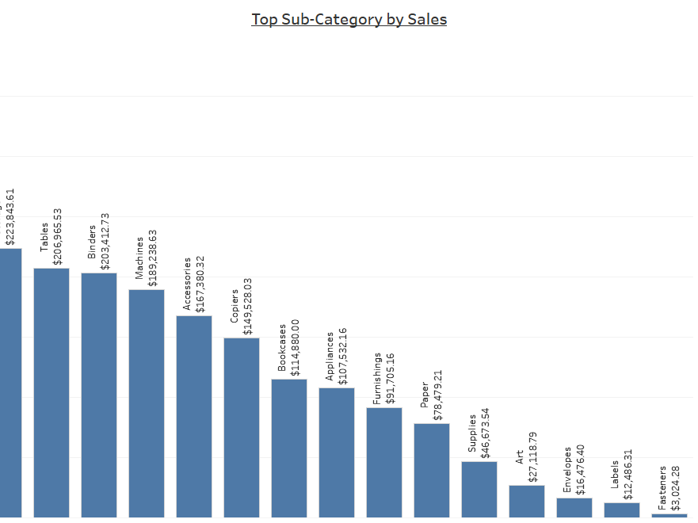
Top Sub-Category by Sales
Highlights the best-selling product sub-categories. Aids in identifying high-performing product segments.

Slide 9
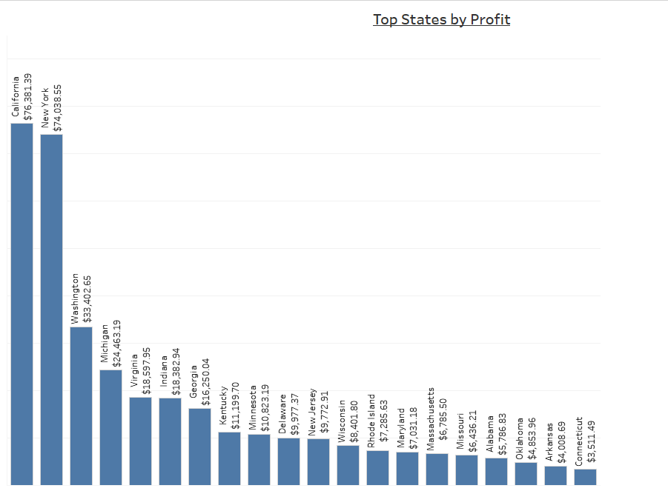
Top States by Profit
Ranks states based on profit generated. Helps pinpoint the most profitable markets.

Slide 10
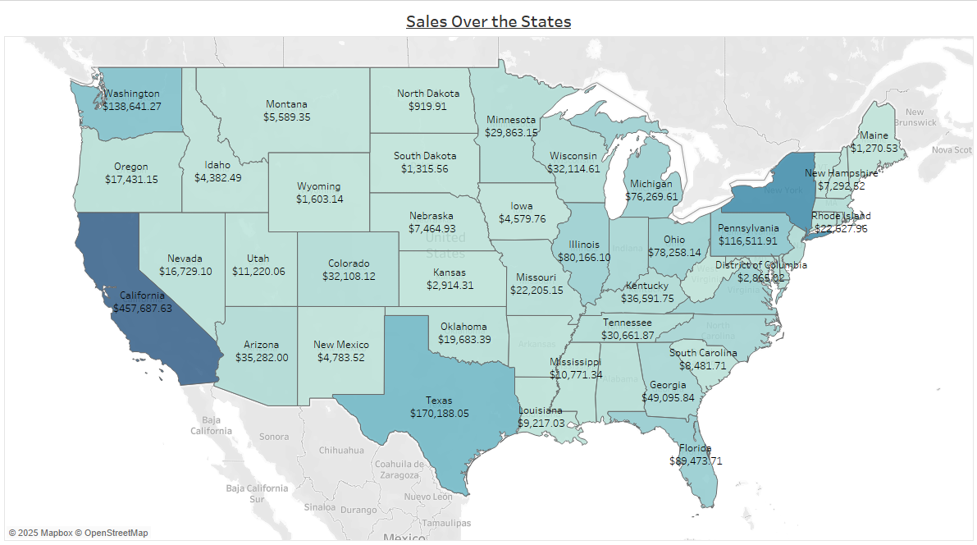
Sales Over the States
A geographical heatmap showing sales distribution across different states. Great for spotting regional opportunities

Slide 11
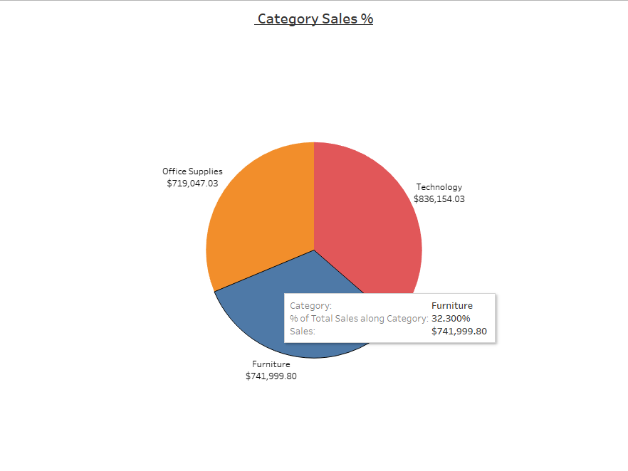
Category Sales %
Displays the proportion of total sales contributed by each main product category (Furniture, Office Supplies, Technology).

Slide 12
Interactive Elements Included in the Dashboard
Year Filter:
A drop-down filter allows users to view Sales and Profit data by specific year(s).
Makes it easy to compare performance year-over-year.
Chart Filters (Cross-filtering)
Every chart on the dashboard acts as a filter.
Clicking on a bar, pie slice, or state highlights relevant data across all other visuals.
This improves data exploration and storytelling.
Navigation Button
A custom navigation button lets users switch views or focus on specific visuals.
It links directly to the Sales Over the States map, enabling location-specific insights.
Download to PDF Button
Allows users to export the dashboard or selected sheets as a PDF.
Useful for saving reports or sharing snapshots offline.

Slide 13
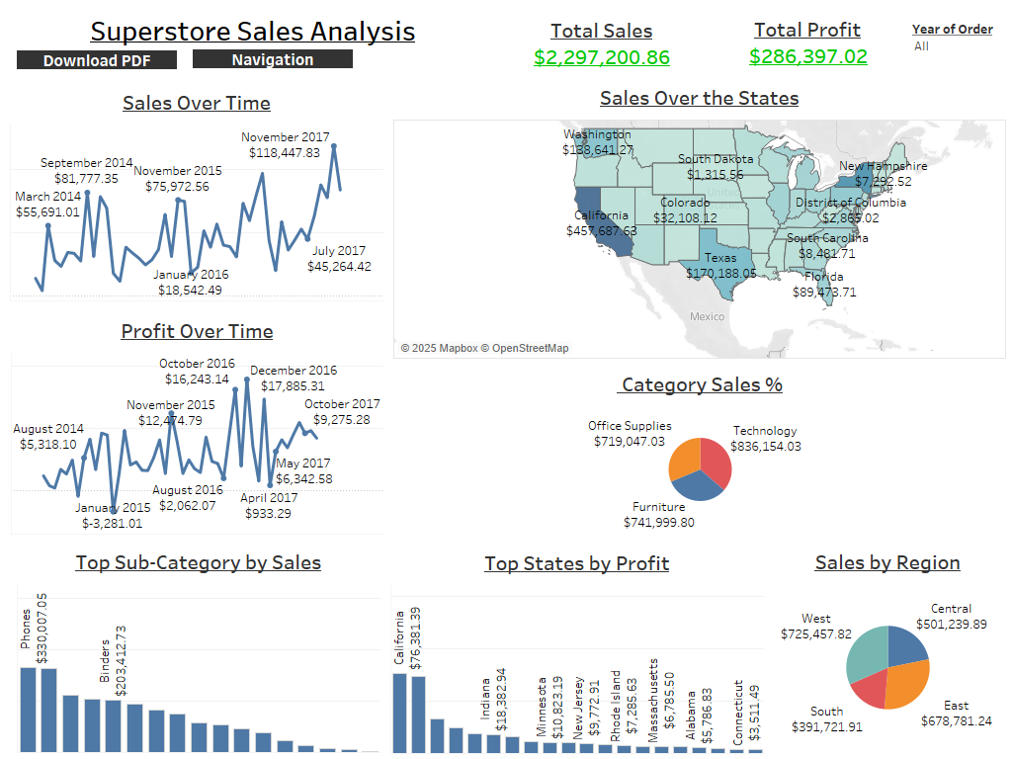
Dashboard Snapshot

