Slide 1
1
Introduction to Information Systems

Slide 2
Why Should I Study Information Systems?
Overview of Computer-Based Information Systems
How Does IT Impact Organizations?
Importance of Information Systems to Society

Slide 3
Identify the reasons why being an informed user of information systems is important in today’s world.
Describe the various types of computer-based information systems in an organization.
Discuss ways in which information technology can affect managers and non-managerial workers.

Slide 4
Identify positive and negative societal effects of the increased use of information technology.

Slide 5

1.1
Why Should I Study Information Systems
The Informed User – You!
IT Offers Career Opportunities
Managing Information Resources
Notes:
Information Technology (IT): any computer-based tool that people use to work with information and to support the information and information-processing needs of an organization.
Information System (IS): collects, processes, stores, analyzes, and disseminates information for a specific purpose.
Informed User: A person knowledgeable about information systems and information technology

Slide 6
Reasons Why You Should Be An Informed User…
You will benefit more from your organization’s IT applications because you will understand what is “behind” those applications.
Your input can enhance your organization’s IT applications.
As you enter the workforce you can assist in selecting the IT applications your organization will use.

Slide 7
Reasons Why You Should Be An Informed User (con’t)…
You will aware of both new information technologies and rapid developments in existing technologies.
You will understand how using IT can improve your organization’s performance.
If you are entrepreneurial minded, you can use IT to start your own business.

Slide 8

IT Offers Career Opportunities
Chief Information Officer (CIO)
Substantial Demand for IT Staff
Programmers
Business Analysts
System Analysts
Designers
$115,000 is the median salary for IS Managers (US Dept of Labor)
Notes:
CIO: The executive who is in charge of the IS function

Slide 9
Managing Information Resources
Managing information systems (IS) is difficult and complex
Contributing Factors:
Strategic value of IS’s
Acquiring, operating, and maintaining IS’s is very expensive
Evolution of the IS Function
Notes:
Evolution of the IS Function….
Traditional Functions of the MIS Department:
• Managing systems development and systems project management
• Managing computer operations, including the computer center
• Staffing, training, and developing IS skills
• Providing technical services
• Infrastructure planning, development, and control
New (Consultative) Functions of the MIS Department
• Initiating and designing specific strategic information systems
• Incorporating the Internet and electronic commerce into the business
• Managing system integration including the Internet, intranets, and extranets
• Educating the non-MIS managers about IT
• Educating the MIS staff about the business
• Partnering with business-unit executives
• Managing outsourcing
• Proactively using business and technical knowledge to seed innovative ideas about IT
• Creating business alliances with business partners

Slide 10
’S ABOUT Using I.S.
Information Technology Supports Students in Computer Department
Describe how VESIT Computer Department manages its information resources to provide information to students.
What are the advantages of central management of information systems in Department.
What are the disadvantages of central management of information systems in the Department?

Slide 11
1.2
Overview of Computer-Based IS’s
Data – Information – Knowledge
Computer-Based Information System (CBIS)
Types of Computer-Based Information Systems (CBIS)
Notes:
Computer-Based Information Systems (CBIS): an information system that uses computer technology to perform some or all of the its intended tasks.

Slide 12
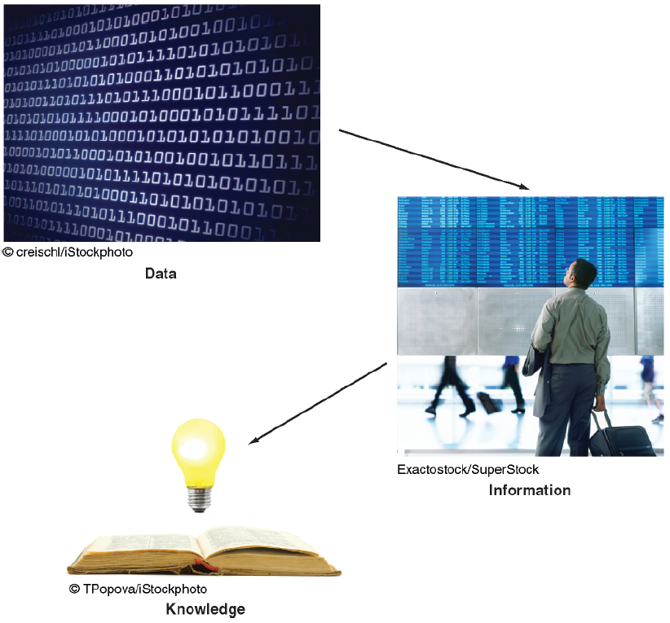
Data – Information – Knowledge

Slide 13
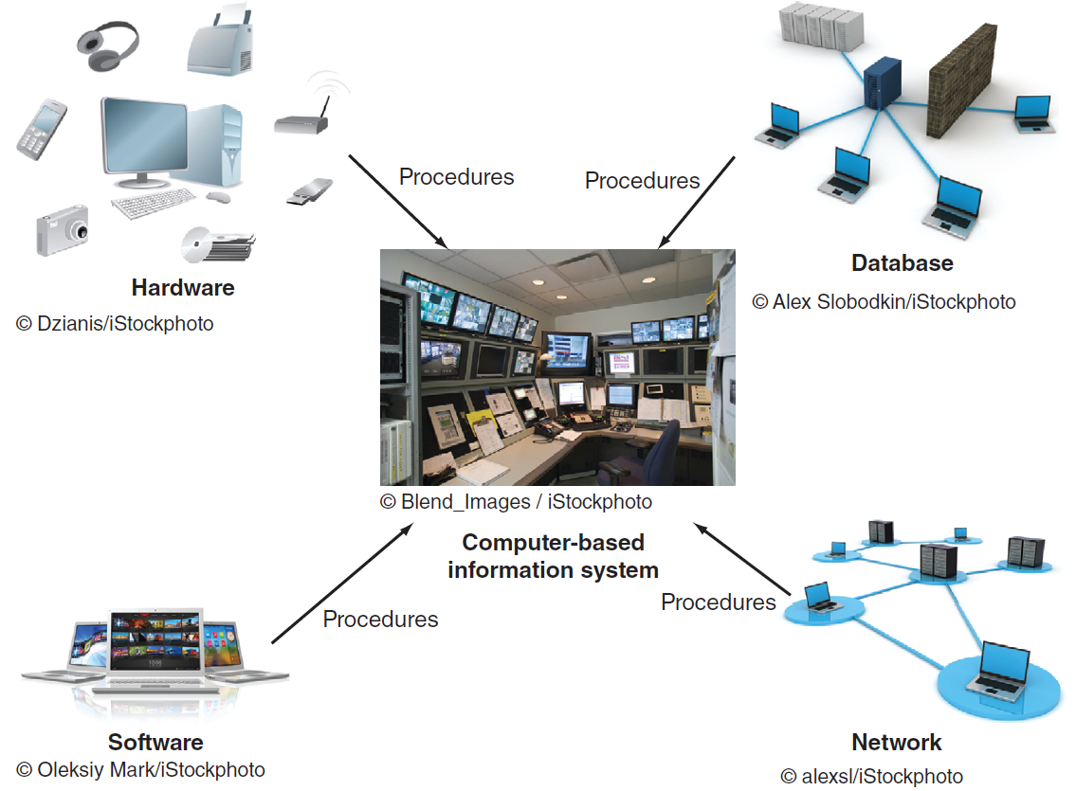
Data versus Information versus Knowledge
Notes:
Data Items: an elementary description of things, events, activities, and transactions that are recorded, classified, and stored but are not organized to convey any specific meaning.
Information: refers to data that have been organized so that they have meaning and value to the recipient.
Knowledge: consists of data and/or information that have been organized and processed to convey understanding, experience, accumulated learning, and expertise as they apply to a current business problem.

Slide 14
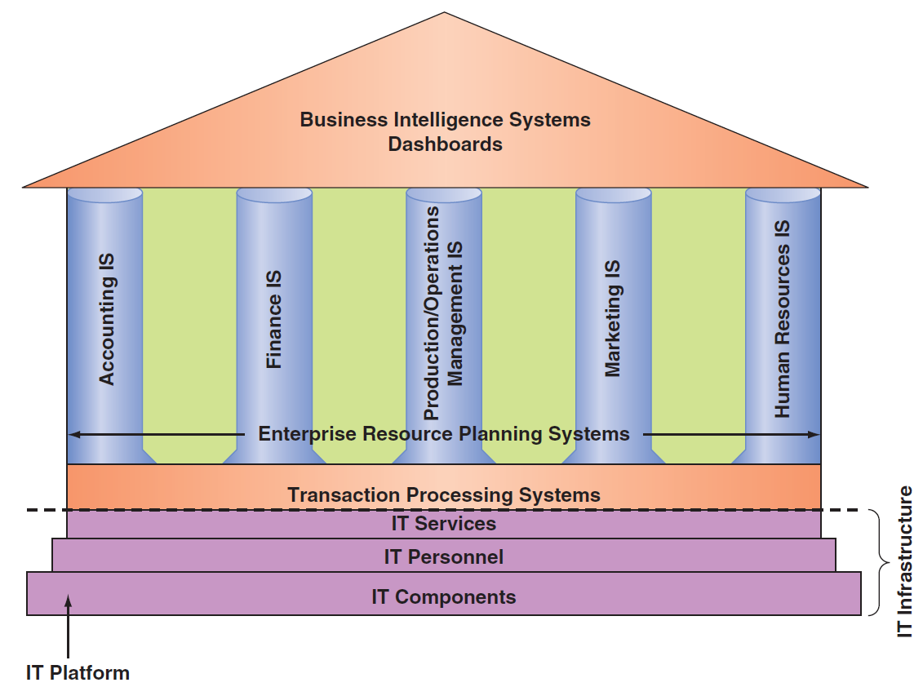
Computer-Based Information Systems (CBIS)
Notes:
IT Components: Hardware, Software, a database, a network, procedures, and people.
IT Services: IT Personnel use IT Components to develop IS’s, oversee security & risk, and manage data.
IT Infrastructure: The IT components and IT services.
Application: A program designed to support a specific task or business process.
Functional Area Information Systems (FAIS) : a collection of application programs in a single department or functional area.

Slide 15
Components of a CBIS
Hardware
Software
Database
Network
Procedures
People
Notes:
Hardware: consists of devices such as the processor, monitor, keyboard, and printer.
Software: a program or collection of programs that enable the hardware to process data.
Database: a collection of related fi les or tables containing data.
Network: a connecting system (wireline or wireless) that permits different computers to share resources.
Procedures: are the instructions for combining the above components to process information and generate the desired output.
People: individuals who use the hardware and software, interface with it, or utilize its output.

Slide 16
Types of Computer Based Information Systems (CBIS)
Breadth of Support for Information Systems (IS)
Support for Organizational Employees

Slide 17
Breadth of Support for Information Systems (IS)
Functional Area Information Systems (FAIS)
Enterprise Resource Planning Systems (ERP)
Transaction Processing Systems (TPS)
Interorganizational Information Systems (IOS)
E-Commerce Systems
Notes:
Functional Area Information Systems (FAIS) : a collection of application programs in a single department or functional area.
Enterprise Resource Planning (ERP): systems are designed to correct a lack of communication among the functional area IS.
Transaction Processing System (TPS): systems that support the monitoring, collection, storage, and processing of data from the organization’s basic business transactions, each of which generates data.
Interorganizational Information systems (IOSs): Information systems that connect two or more organizations.
Electronic Commerce (e-commerce) Systems: an interorganizational information system that enable organizations to conduct transactions, called business-to-business (B2B) electronic commerce, and customers to conduct transactions with businesses, called business-to-consumer (B2C) electronic commerce.

Slide 18
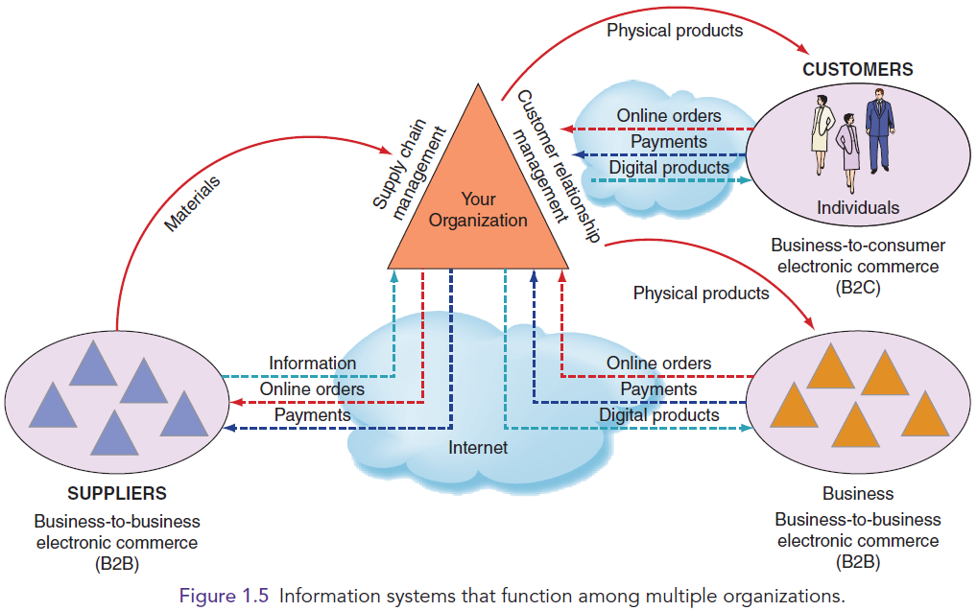
Figure 1.5: IS that function among multiple organizations

Slide 19
Support for Organizational Employees
Knowledge Workers
Office Automation Systems (OASs)
Business Intelligence (BI) Systems
Expert Systems (ES)
Dashboards
Notes:
Knowledge Workers: professional employees that are experts in a particular subject area (e.g., financial and marketing analysts, engineers, lawyers, and accountants.).
Office Automation Systems (OASs): typically support the clerical staff, lower and middle managers, and knowledge workers (e.g., word processing and desktop publishing software).
Business Intelligence (BI) Systems: systems that provide computer-based support for complex, nonroutine decisions, primarily for middle managers and knowledge workers.
Expert Systems (ES): systems that attempt to duplicate the work of human experts by applying reasoning capabilities, knowledge, and expertise within a specific domain.
Dashboards: a special form of IS that support all managers of the organization by providing rapid access to timely information and direct access to structured information in the form of reports.

Slide 20
1.3
How Does IT Impact Organizations?
IT Reduces the Number of Middle Managers
IT Change’s the Manager’s Job
Will IT Eliminate Jobs?
IT Impacts Employees at Work

Slide 21
IT Impacts Employees at Work
IT Impacts Employees’ Health and Safety
IT Provides Opportunities for People with Disabilities

Slide 22
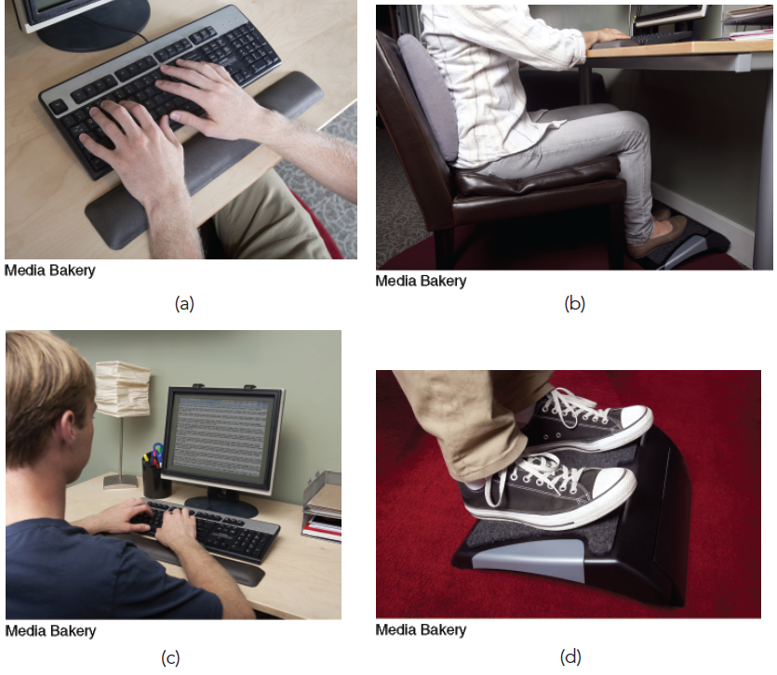
Figure 1.6: Ergonomic products protect computer users.

Slide 23
1.4
Importance of IS to Society
IT Affects Our Quality of Life
The Robot Revolution is Here Now
Improvements in Healthcare

Slide 24
’S ABOUT Self study
Different Types of Robots
Discuss some disadvantages of (a) telepresence robots, (b) autonomous cars, and (c) drones.
Would you be willing to ride in an autonomous car? Why or why not?
Which occupations are most at risk from a widespread adoption of autonomous cars? Support your answer.
Debate the privacy issues associated with domestic use of drones by law enforcement agencies.

Slide 25

’S ABOUT BUSINESS 1.3
Getting Kids in Shape
Why is Zamzee using games to help kids lose weight?
In your opinion, would Zamzee be as successful for adult weight loss? Why or why not?

Slide 26
‘s About Sign OFF
You are requested to see the google classroom for submission of class Assignemnts.
Answers should be short.
Not more than 2 Pages,
You can express with diagrams, Do not Copy your responses.

