Slide 1
3
Data and Knowledge Management

Slide 2
Managing Data
The Database Approach Big Data
Data Warehouses and Data Marts
Knowledge Management

Slide 3
Discuss ways that common challenges in managing data can be addressed using data governance.
Discuss the advantages and disadvantages of relational databases.
Define Big Data, and discuss its basic characteristics.

Slide 4
Recognize the necessary environment to successfully implement and maintain data warehouses.
Describe the benefits and challenges of implementing knowledge management systems in organizations.

Slide 5

Flurry Gathers Data from Smartphone Users
Do you feel that Flurry should be installed on your smartphone by various app makers without your consent? Why or why not? Support your answer.
What problems would Flurry encounter if someone other than the smartphone’s owner uses the device? (Hint: Note how Flurry gathers data.)
Can Flurry survive the privacy concerns that are being raised about its business model?

Slide 6
3.1
Managing Data
Difficulties of Managing Data
Data Governance

Slide 7
The Difficulties of Managing Data
The amount of data increases exponentially over time
Data are scattered throughout organizations
Data are generated from multiple sources (internal, personal, external)
New sources of data
Notes:
The amount of data increases exponentially over time
Data are scattered throughout organizations
Data are generated from multiple sources (internal, personal, external)
New sources of data (e.g., blogs, podcasts, videocasts, and RFID tags and other wireless sensors)
Data Degradation (e.g., customers move to new addresses, change their names, etc.)
Data Rot
Data security, quality, and integrity are critical
Legal requirements change frequently and differ among countries and industries
Internal Data Sources (e.g., corporate databases and company documents)
Personal Data Sources (e.g., personal thoughts, opinions, and experiences)
External Data Sources (e.g., commercial databases, government reports, and corporate Web sites).
Data Rot: refers primarily to problems with the media on which the data are stored. Over time, temperature, humidity, and exposure to light can cause physical problems with storage media and thus make it difficult to access the data.
Federal regulations:
-- Sarbanes–Oxley Act of 2002 requires that:
(1) public companies evaluate and disclose the effectiveness of their internal fi nancial controls
(2) independent auditors for these companies agree to this disclosure.

Slide 8
The Difficulties of Managing Data (continued)
Data Degradation
Data Rot
Data security, quality, and integrity are critical
Legal requirements change frequently and differ among countries & industries
Notes:
The amount of data increases exponentially over time
Data are scattered throughout organizations
Data are generated from multiple sources (internal, personal, external)
New sources of data (e.g., blogs, podcasts, videocasts, and RFID tags and other wireless sensors)
Data Degradation (e.g., customers move to new addresses, change their names, etc.)
Data Rot
Data security, quality, and integrity are critical
Legal requirements change frequently and differ among countries and industries
Internal Data Sources (e.g., corporate databases and company documents)
Personal Data Sources (e.g., personal thoughts, opinions, and experiences)
External Data Sources (e.g., commercial databases, government reports, and corporate Web sites).
Data Rot: refers primarily to problems with the media on which the data are stored. Over time, temperature, humidity, and exposure to light can cause physical problems with storage media and thus make it difficult to access the data.
Federal regulations:
-- Sarbanes–Oxley Act of 2002 requires that:
(1) public companies evaluate and disclose the effectiveness of their internal fi nancial controls
(2) independent auditors for these companies agree to this disclosure.

Slide 9

’S ABOUT BUSINESS 3.1
New York City Opens Its Data to All
What are some other creative applications addressing city problems that could be developed using NYC’s open data policy?
List some disadvantages of providing all city data in an open, accessible format.

Slide 10
Data Governance
Master Data Management
Master Data
Notes:
Data Governance: is an approach to managing information across an entire organization involving a formal set of unambiguous rules for creating, collecting, handling, and protecting its information.
Master Data Management: a strategy for data governance involving a process that spans all organizational business processes and applications providing companies with the ability to store, maintain, exchange, and synchronize a consistent, accurate, and timely for the company’s master data.
Master Data: a set of core data (e.g., customer, product, employee, vendor, geographic location, etc.) that span the enterprise information systems.

Slide 11
3.2
The Database Approach
Data File
Database Systems Minimize & Maximize Three Things
The Data Hierarchy
The Relational Database Model
Notes:
Data File: a collection of logically related records.

Slide 12
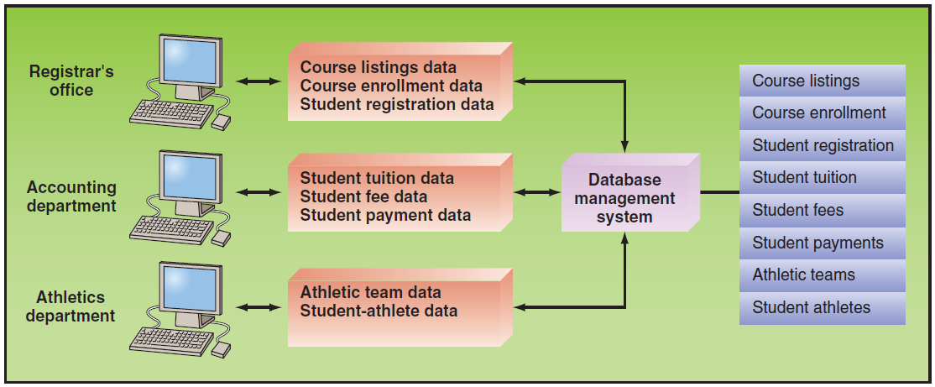
Figure 3.1: Database Management System

Slide 13
Database Management Systems (DBMS) Minimize:
Data Redundancy
Data Isolation
Data Inconsistency

Slide 14
Database Management Systems (DBMS) Maximize:
Data Security
Data Integrity
Data Independence

Slide 15
’S ABOUT BUSINESS 3.2
Google’s Knowledge Graph
Refer to the definition of a relational database. In what way can the Knowledge Graph be considered a database? Provide specific examples to support your answer.
Refer to the definition of an expert system in Plug IT In 5. Could the Knowledge Graph be considered an expert system? If so, provide a specific example to support your answer.
What are the advantages of the Knowledge Graph over traditional Google searches?

Slide 16
Data Hierarchy
Bit
Byte
Field
Record
Data File (Table)
Database
Notes:
Bit (binary digit): represents the smallest unit of data a computer can process and it consists only of a 0 or a 1.
Byte: A group of eight bits represents a single character (letter, number, or symbol).
Field: A column of data containing a logical grouping of characters into a word, a small group of words (e.g., last name, social security number, etc.).
Record: A logical grouping of related fi elds in a row (e.g., student’s name, the courses taken, the date, and the grade).
Data File: logical grouping of related records is called a data file or a table similar in appearance to a speadsheet in Excel consisting of multiple columns and multiple rows.
Database: logical grouping of related data files (aka database tables).

Slide 17
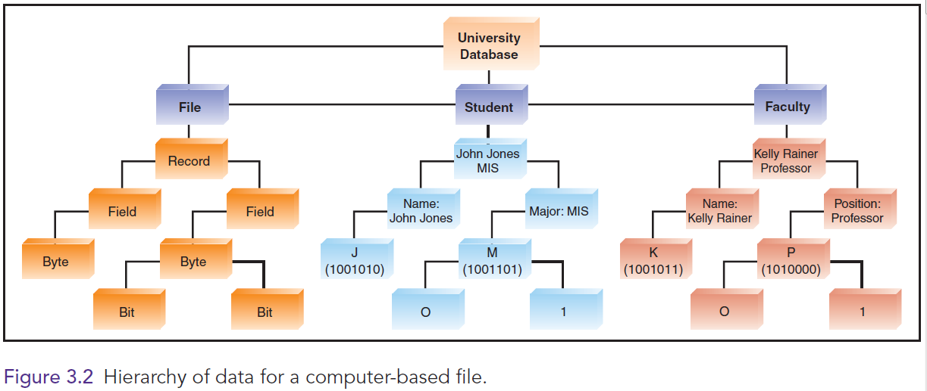
Figure 3.2: Hierarchy of Data for a Computer-Based File

Slide 18
The Relational Database Model
Database Management System (DBMS)
Relational Database Model
Data Model
Entity
Instance
Attribute
Notes:
Database Management System (DBMS): a set of programs that provide users with tools to create and manage a database.
Relational Database Model: is based on the concept of two-dimensional tables and is usually designed with a number of related tables with each of these tables contains records (listed in rows) and attributes (listed in columns).
Data Model: a diagram that represents entities in the database and their relationships.
Entity: a person, place, thing, or event (e.g., customer, an employee, or a product).
Record: generally describes an entity and an instance of an entity refers to each row in a relational table.
Attribute: each characteristic or quality of a particular entity.
Primary Key: a field in a database that uniquely identify each record so that it can be retrieved, updated, and sorted.
Secondary Key: a field that has some identifying information, but typically does not identify the record with complete accuracy and therefore cannot serve at the Primary Key.
Foreign Key: a field (or group of fields) in one table that uniquely identifies a row of another table. It is used to establish and enforce a link between two tables.

Slide 19
The Relational Database Model (continued)
Primary Key
Secondary Key
Foreign Key
Notes:
Primary Key: a field in a database that uniquely identify each record so that it can be retrieved, updated, and sorted.
Secondary Key: a field that has some identifying information, but typically does not identify the record with complete accuracy and therefore cannot serve at the Primary Key.
Foreign Key: a field (or group of fields) in one table that uniquely identifies a row of another table. It is used to establish and enforce a link between two tables.

Slide 20
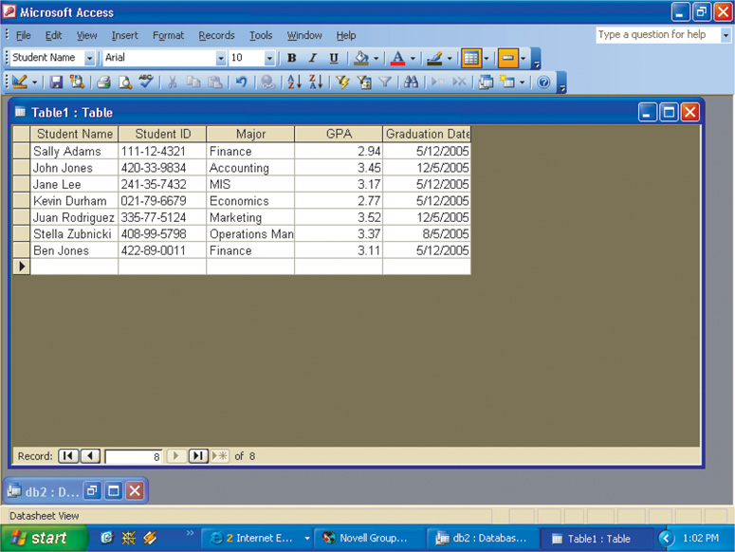
Figure 3.3: Student Database Example

Slide 21
3.3
Big Data
Defining Big Data
Characteristics of Big Data
Issues with Big Data
Managing Big Data
Putting Big Data to Use

Slide 22
Defining Big Data
Gartner (www.gartner.com)
Big Data Institute
Notes:
Gartner (www.gartner.com): defines Big Data as diverse, high volume, high-velocity information assets that require new forms of processing to enable enhanced decision making, insight discovery, and process optimization.
Big Data Institute (TBDI; www.the-bigdatainstitute.com): defines Big Data as vast datasets that:
Exhibit variety;
Include structured, unstructured, and semi-structured data;
Are generated at high velocity with an uncertain pattern;
Do not fit neatly into traditional, structured, relational databases; and
Can be captured, processed, transformed, and analyzed in a reasonable amount of time only by sophisticated information systems.

Slide 23
Defining Big Data: Gartner
Diverse, high volume, high-velocity information assets that require new forms of processing to enable enhanced decision making, insight discovery, and process optimization.
Notes:
Gartner (www.gartner.com): defines Big Data as diverse, high volume, high-velocity information assets that require new forms of processing to enable enhanced decision making, insight discovery, and process optimization.
Big Data Institute (TBDI; www.the-bigdatainstitute.com): defines Big Data as vast datasets that:
Exhibit variety;
Include structured, unstructured, and semi-structured data;
Are generated at high velocity with an uncertain pattern;
Do not fit neatly into traditional, structured, relational databases; and
Can be captured, processed, transformed, and analyzed in a reasonable amount of time only by sophisticated information systems.

Slide 24
Defining Big Data: The Big Data Institute (TBDI)
Vast Datasets that:
Exhibit variety
Include structured, unstructured, and semi-structured data
Generated at high velocity with an uncertain pattern
Do not fit neatly into traditional, structured, relational databases
Can be captured, processed, transformed, and analyzed in a reasonable amount of time only by sophisticated information systems.
Notes:
Gartner (www.gartner.com): defines Big Data as diverse, high volume, high-velocity information assets that require new forms of processing to enable enhanced decision making, insight discovery, and process optimization.
Big Data Institute (TBDI; www.the-bigdatainstitute.com): defines Big Data as vast datasets that:
Exhibit variety;
Include structured, unstructured, and semi-structured data;
Are generated at high velocity with an uncertain pattern;
Do not fit neatly into traditional, structured, relational databases; and
Can be captured, processed, transformed, and analyzed in a reasonable amount of time only by sophisticated information systems.

Slide 25
Characteristics of Big Data
Volume
Velocity
Variety
Notes:
Volume: incredible volume of data.
Velocity: The rate at which data flow into an organization is rapidly increasing and it is critical because it increases the speed of the feedback loop between a company and its customers.
Variety: Big Data formats change rapidly and can include include satellite imagery, broadcast audio streams, digital music files, Web page content.

Slide 26
Issues with Big Data
Untrusted data sources
Big Data is dirty
Big Data changes, especially in data streams
Notes:
Big Data can come from untrusted sources.
Big Data is dirty: Dirty data refers to inaccurate, incomplete, incorrect, duplicate, or erroneous data.
Big Data changes, especially in data streams: Organizations must be aware that data quality in an analysis can change, or the data itself can change, because the conditions under which the data are captured can change.

Slide 27
Managing Big Data
Big Data can reveal valuable patterns, trends, and information that were previously hidden:
tracking the spread of disease
tracking crime
detecting fraud

Slide 28
Managing Big Data (continued)
First Step:
Integrate information silos into a database environment and develop data warehouses for decision making.
Second Step:
making sense of their proliferating data.
Notes:
First Step: integrate information silos into a database environment and develop data warehouses for decision making.
Second Step: making sense of their proliferating data.
Information Silo: is an information system that does not communicate with other, related information systems in an organization.

Slide 29
Managing Big Data (continued)
Many organizations are turning to NoSQL databases to process Big Data
Notes:
Many organizations are turning to NoSQL databases (think of them as “not only SQL” (structured query language) databases) to process Big Data.
NoSQL Database: can manipulate structured as well as unstructured data and inconsistent or missing data providing an alternative for firms that have more and different kinds of data (Big Data) in addition to the traditional, structured data that fit neatly into the rows and columns of relational databases.

Slide 30
’S ABOUT BUSINESS 3.3
The MetLife Wall
Describe the problems that MetLife was experiencing with customer data before it implemented the MetLife Wall.
Describe how these problems originated.

Slide 31
Putting Big Data to Use
Making Big Data Available
Enabling Organizations to Conduct Experiments
Micro-Segmentation of Customers
Creating New Business Models
Organizations Can Analyze Far More Data
Notes:
Making Big Data Available: Making Big Data available for relevant stakeholders can help organizations gain value.
Enabling Organizations to Conduct Experiments: Big Data allows organizations to improve performance by conducting controlled experiments. For example, Amazon (and many other companies such as Google and LinkedIn) constantly experiments by offering slight different “looks” on its Web site.
Micro-Segmentation of Customers: Segmentation of a company’s customers means dividing them up into groups that share one or more characteristics.
Creating New Business Models: Companies are able to use Big Data to create new business models. For example, a commercial transportation company operated a large fleet of large, long-haul trucks. Th e company recently placed sensors on all its trucks. These sensors wirelessly communicate large amounts of information to the company, a process called telematics. Th e sensors collect data on vehicle usage (including acceleration, braking, cornering, etc.), driver performance, and vehicle maintenance. By analyzing this Big Data, the transportation company was able to improve the condition of its trucks through near-real-time analysis that proactively suggested preventive maintenance.
Organizations Can Analyze Far More Data: In some cases, organizations can even process all the data in a population relating to a particular phenomenon, meaning that they do not have to rely as much on sampling.

Slide 32
3.4
Data Warehouses and Data Marts
Describing Data Warehouses and Data Marts
A Generic Data Warehouse Environment

Slide 33
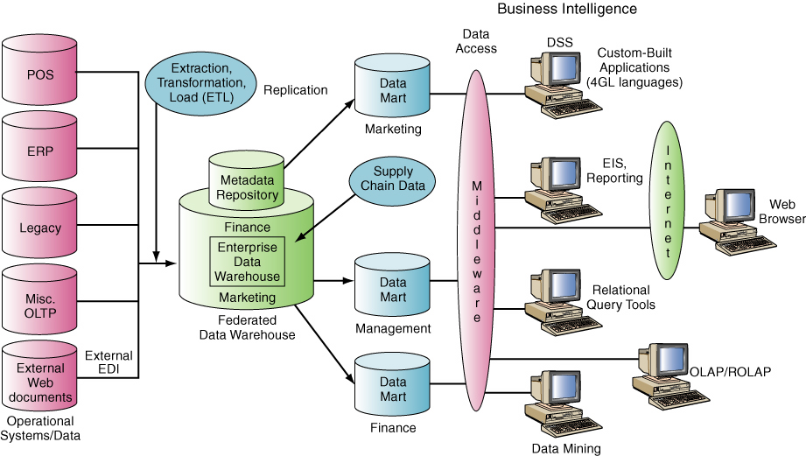
Figure 3.4: Data Warehouse Framework

Slide 34
Describing Data Warehouses and Data Marts
Organized by business dimension or Use online analytical processing (OLAP)
Integrated
Time variant
Nonvolatile
Multidimensional
Notes:
Data Warehouse: a repository of historical data that are organized by subject to support decision makers in the organization.
Data Mart: a low-cost, scaled-down version of a data warehouse that is designed for the end-user needs in a strategic business unit (SBU) or an individual department.
Basic Characteristics of Data Warehouses and Data Marts:
Organized by business dimension or subject - Data are organized by subject. For example, by customer, vendor, product, price level, and region. This arrangement differs from transactional systems, where data are organized by business process, such as order entry, inventory control, and accounts receivable.
Use online analytical processing (OLAP)
Integrated - Data are collected from multiple systems and then integrated around subjects.
Time variant - Data warehouses and data marts maintain historical data (i.e., data that include time as a variable).
Nonvolatile - Data warehouses and data marts are nonvolatile—that is, users cannot change or update the data.
Multidimensional - Typically the data warehouse or mart uses a multidimensional data structure. Recall that relational databases store data in two-dimensional tables.

Slide 35
A Generic Data Warehouse Environment
Source Systems
Data Integration
Storing the Data
Metadata
Data Quality
Governance
Users
Notes:
Source Systems: Systems that provide a source of organizational data.
Data Integration: reflects the growing number of ways that source system data can be handled. Typically organizations need to Extract, Transform, and Load (ETL) data from source system into a data warehouse or data mart.
Storing the Data: A variety of architectures can be used to store decision-support data and the most common architecture is one central enterprise data warehouse, without data marts.
Metadata: data maintained about the data within the data warehouse. (e.g., database, table, and column names; refresh schedules; and data-usage measures.
Data Quality: quality of the data in the warehouse must meet users’ needs. If it does not, users will not trust the data and ultimately will not use it. Some of the data can be improved with data-cleansing soft ware, but the better, long-term solution is to improve the quality at the source system level.
Governance: To ensure that BI is meeting their needs, organizations must implement governance to plan and control their BI activities. Governance requires that people, committees, and processes be in place.
Users: There are many potential BI users, including IT developers; frontline workers; analysts; information workers; managers and executives; and suppliers, customers, and regulators.
----------------
Common Examples of Source Systems Include:
operational/transactional systems
enterprise resource planning (ERP) systems
Web site data
third-party data (e.g., customer demographic data)
operational databases

Slide 36
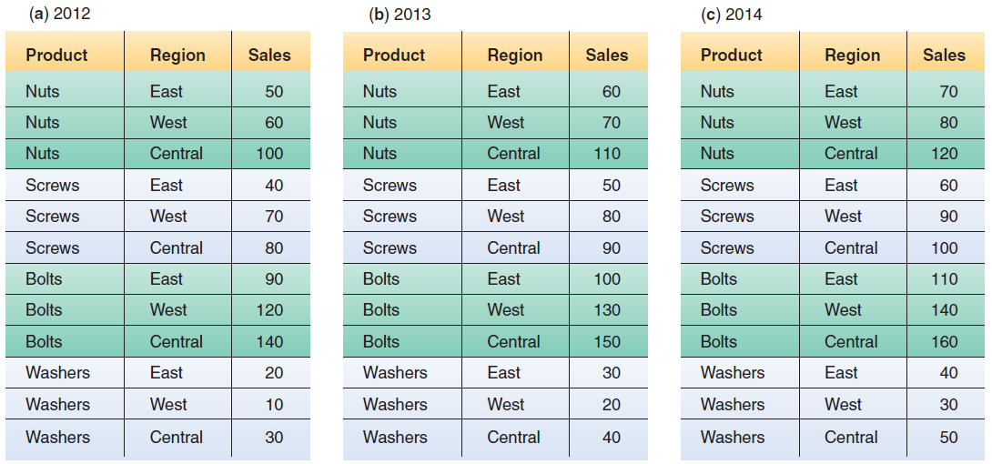
Figure 3.5: Relational Databases

Slide 37
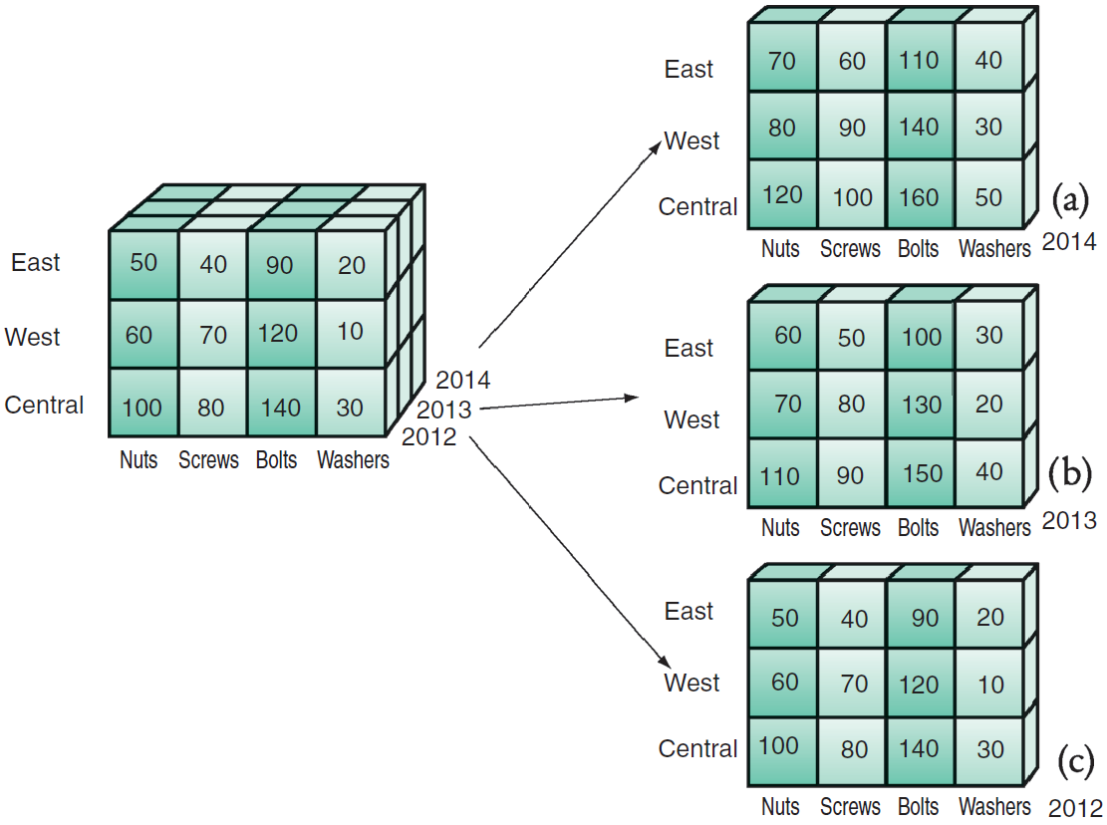
Figure 3.6: Data Cube

Slide 38
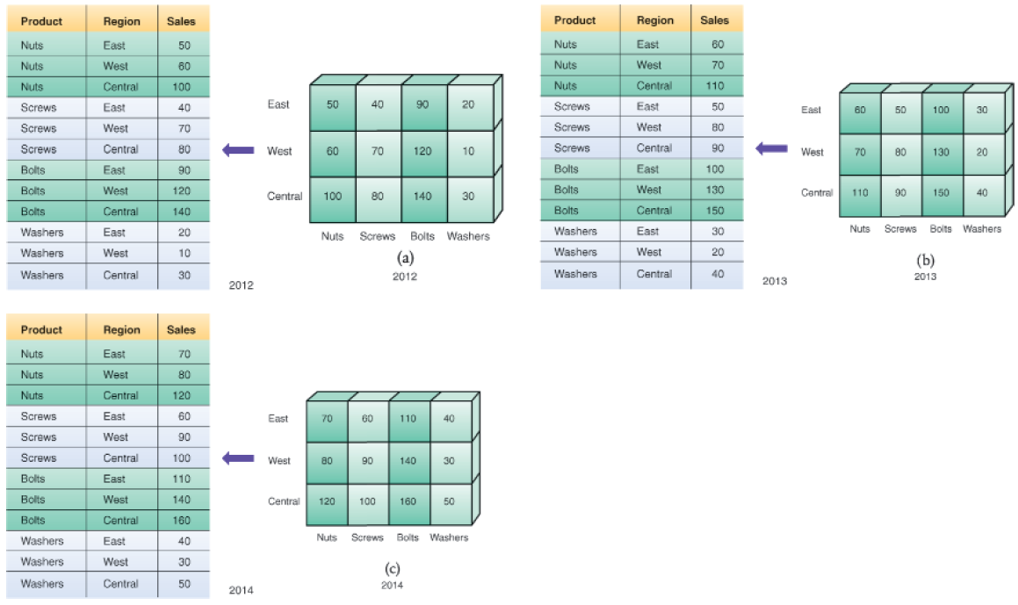
Figure 3.7: Equivalence Between Relational and Multidimensional Databases

Slide 39

’S ABOUT BUSINESS 3.4
Data Warehouse Gives Nordea Bank a Single Version of the Truth
What are other advantages (not mentioned in the case) that Nordea Bank might realize from its data warehouse?
What recommendations would you give to Nordea Bank about incorporating Big Data into their bank’s data management? Provide specific examples of what types of Big Data you think Nordea should consider.

Slide 40
3.5
Knowledge Management
Concepts and Definitions
Knowledge Management Systems
The KMS Cycle

Slide 41
Concepts and Definitions
Knowledge Management
Knowledge
Explicit and Tacit Knowledge
Knowledge Management Systems
The KMS Cycle
Notes:
Knowledge management (KM): a process that helps organizations manipulate important knowledge that comprises part of the organization’s Knowledge: information that is contextual, relevant, and useful. It is information in action. Intellectual capital (or intellectual assets) is another term for knowledge.
Explicit Knowledge: more objective, rational, and technical knowledge. In an organization, explicit knowledge consists of the policies, procedural guides, reports, products, strategies, goals, core competencies, and IT infrastructure of the enterprise.
Tacit Knowledge: the cumulative store of subjective or experiential learning. In an organization, tacit knowledge consists of an organization’s experiences, insights, expertise, know-how, trade secrets, skill sets, understanding, and learning. It is generally imprecise and costly to transfer.
Knowledge management systems (KMSs): refer to the use of modern information technologies—the Internet, intranets, extranets, databases—to systematize, enhance, and expedite intra-firm and inter-firm knowledge management. KMSs are intended to help an organization cope with turnover, rapid change, and downsizing by making the expertise of the organization’s human capital widely accessible.
------------------------------
The KMS Cycle Consists of Six Steps:
Create knowledge: Knowledge is created as people determine new ways of doing things or develop know-how. Sometimes external knowledge is brought in.
Capture knowledge: New knowledge must be identified as valuable and be represented in a reasonable way.
Refine knowledge: New knowledge must be placed in context so that it is actionable. This is where tacit qualities (human insights) must be captured along with explicit facts.
Store knowledge: Useful knowledge must then be stored in a reasonable format in a knowledge repository so that other people in the organization can access it.
Manage knowledge: Like a library, the knowledge must be kept current. It must be reviewed regularly to verify that it is relevant and accurate.
Disseminate knowledge: Knowledge must be made available in a useful format to anyone in the organization who needs it, anywhere and anytime.

Slide 42
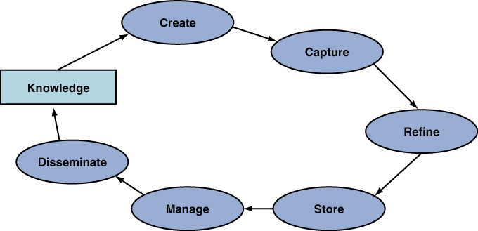
Figure 3.8: The Knowledge Management System Cycel

