Slide 1
3
Fundamentals of Relational Database Operations

Slide 2
Query Languages
Entity–Relationship Modeling
Normalization and Joins

Slide 3
Understand the process of querying a relational database.
Understand the process of entity–relationship modeling.
Understand the process of normalization and the process of joins.

Slide 4
PI3.1
Query Languages
Primary Key
Secondary Key
Foreign Key
Structured Query Language (SQL)
Query By Example (QBE)
Notes:
Primary Key: A database field (or group of fields) that uniquely identifies each record so records can be retrieved, updated, and sorted.
Secondary Key: a field within a database table that has some identifying information, but typically does not uniquely identify the record.
Foreign Key: is a field (or group of fields) within a database table that matches the primary key data value of another table. A foreign key is used to establish a relationship and enforce a link between two tables.
Structured Query Language (SQL): allows people to perform complicated searches by using relatively simple statements or keywords. It is a universal, standard query language used to interact with a database.
Query-by-Example (QBE): In QBE, the user fills out a grid or template (also known as a form) to construct a sample or a description of the data desired. Users can construct a query quickly and easily by using drag-and-drop features in a DBMS such as Microsoft Access.

Slide 5
PI3.2
Entity-Relationship Modeling
Entity Relationship Modeling
Entity Relationship Diagram (ERD)
Business Rules
Data Dictionary
Relationships (Unary, Binary, Ternary)
Notes:
Entity Relationship Modeling: an iterative process used by database professionals to plan, design, and create databases using entity–relationship (ER) diagrams as blueprints.
Entity Relationship (ER) Diagram: graphical diagrams of entities, attributes, and relationships that describe the make up of a database similar to the blueprints for a building project.
Business Rules: precise descriptions of policies, procedures, or principles in any organization that stores and uses data to generate information. Business rules are derived from a description of an organization’s operations, and help to create and enforce business processes in that organization.
Data Dictionary: provides information on each attribute, such as its name, if it is a key, part of a key, or a non-key attribute, the type of data expected (alphanumeric, numeric, dates, etc.), and valid values. Data dictionaries can also provide information on why the attribute is needed in the database; which business functions, applications, forms, and reports use the attribute; and how oft en the attribute should be updated.
Relationships: illustrates an association between entities. The degree of a relationship indicates the number of entities associated with a relationship.
Unary Relationship: exists when an association is maintained within a single entity.
Binary Relationship: exists when two entities are associated.
Ternary Relationship: exists when three entities are associated.

Slide 6
PI3.2
Entity-Relationship Modeling (Continued)
Connectivity
Cardinality
Attributes
Notes:
Connectivity: established by the business rules of a relationship and describes the relationship classification. Entity relationships may be classified as one-to-one, one-to-many, or many-to-many.
Cardinality: established by the business rules of a relationship, refers to the maximum number of times an instance of one entity can be associated with an instance in the related entity. Cardinality can be mandatory single, optional single, mandatory many, or optional many.
Attributes: Properties that describe the entities characteristics.

Slide 7



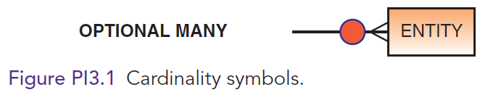
Cardinality Symbols

Slide 8
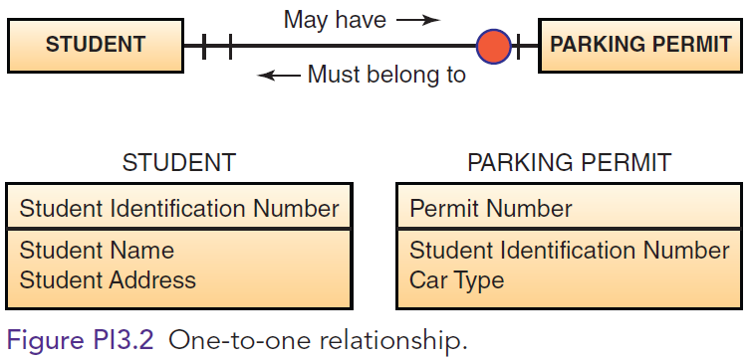
One-to-One Relationship

Slide 9
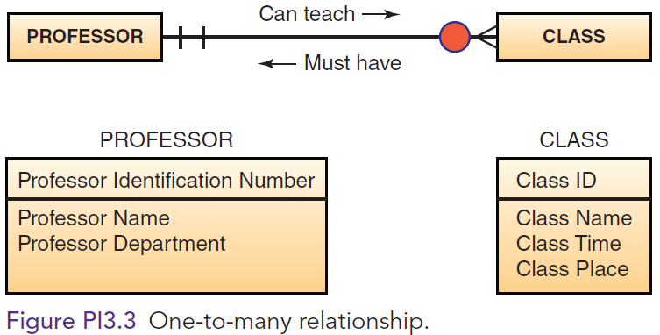
One-to-Many Relationship

Slide 10
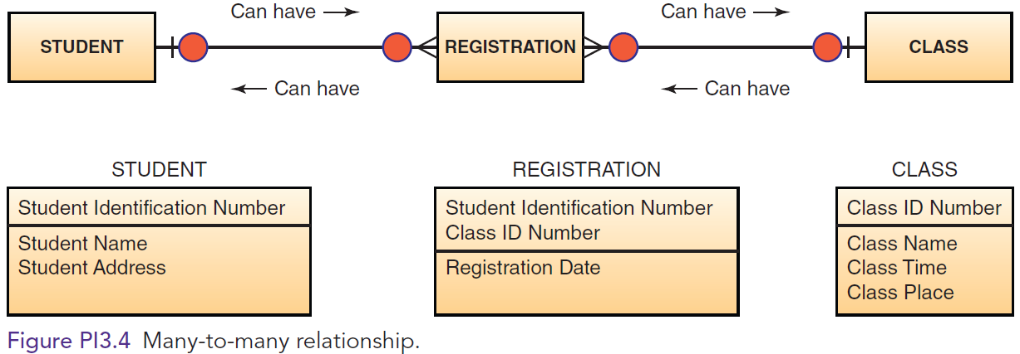
Many-to-Many Relationship

Slide 11
PI3.3
Normalization and Joins
Normalization
1st Normal Form
2nd Normal Form
3rd Normal Form
Functional Dependencies
Join Operation
Notes:
Normalization: a method for analyzing and reducing a relational database to its most streamlined form to ensure minimum redundancy, maximum data integrity, and optimal processing performance. Data normalization is a methodology for organizing attributes into tables so that redundancy among the non-key attributes is eliminated.
Functional Dependencies: define associations among the attributes and are a means of expressing that the value of one particular attribute is associated with a specific single value of another attribute.
Join Operation: combines records from two or more tables in a database to obtain information that is located in different tables.

Slide 12
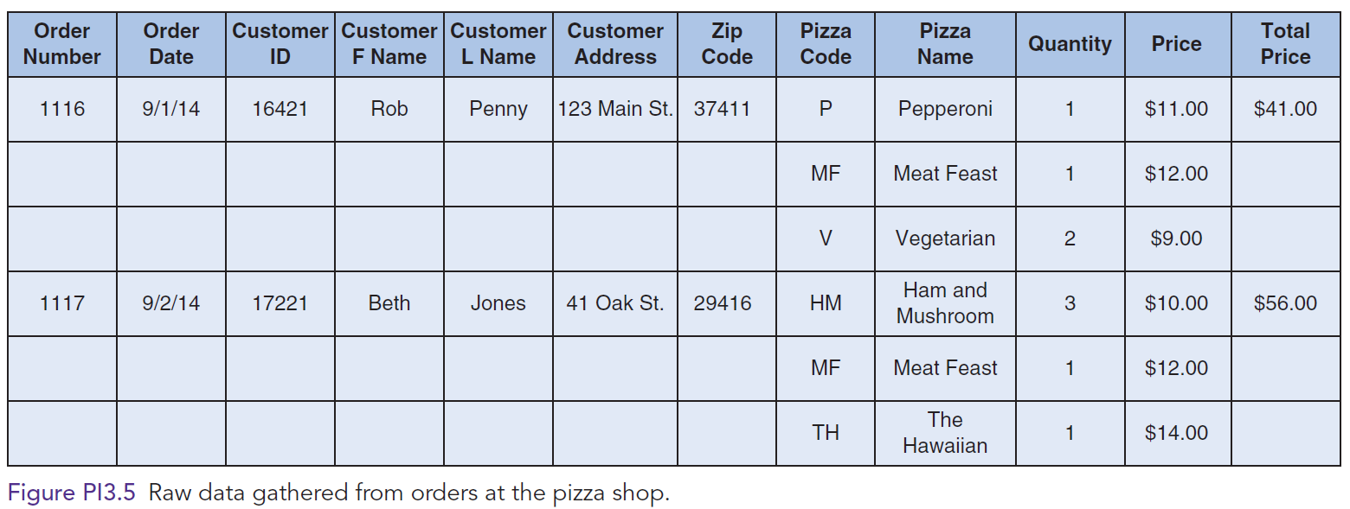
Raw Data Gathered from Pizza Shop Orders

Slide 13
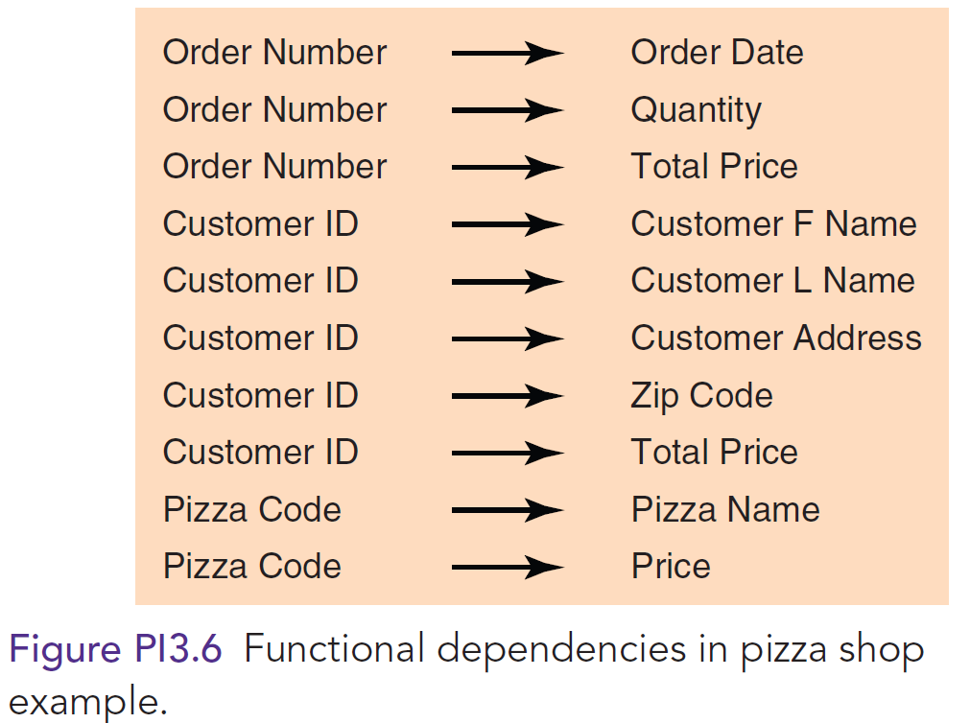
Functional Dependency from Pizza Shop

Slide 14
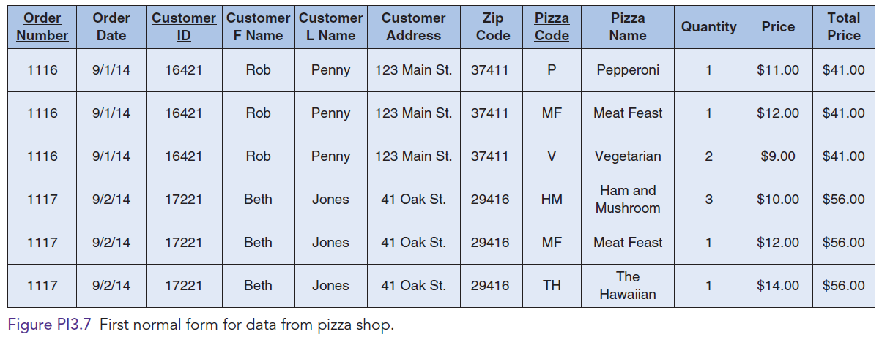
1st Normal Form for Pizza Shop Database

Slide 15
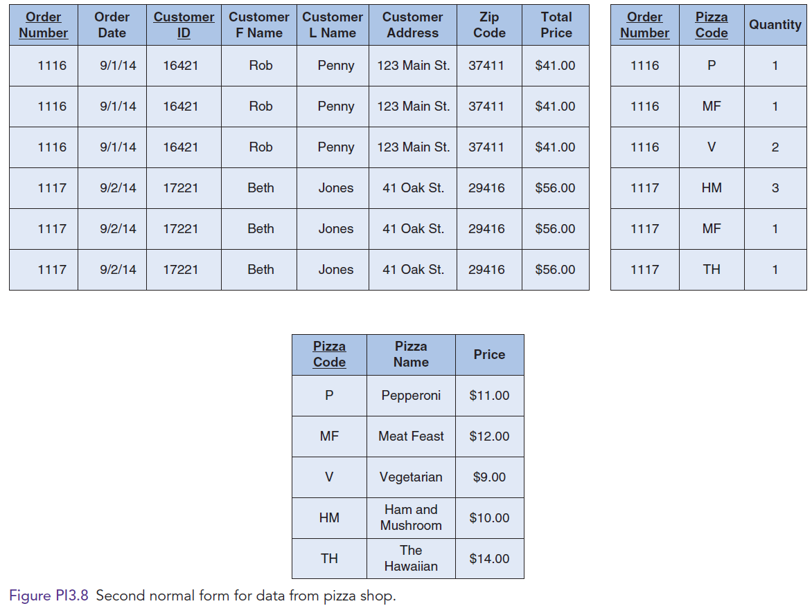
2nd Normal Form for Pizza Shop Database

Slide 16
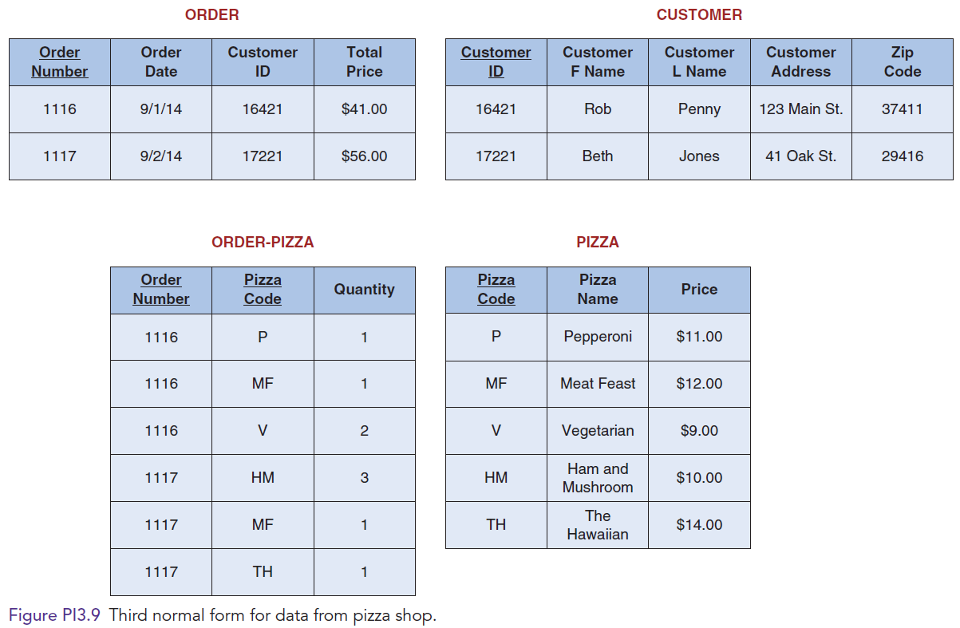
3rd Normal Form for Pizza Shop Database

Slide 17
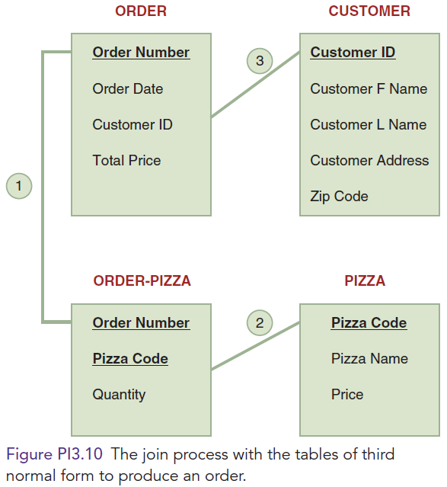
Join Process with Tables of 3rd Normal Form for Pizza Orders

