Slide 1
6
Project Management

Slide 2
Project Management for Information Systems Projects
The Project Management Process
The Project Management Body of Knowledge

Slide 3
Explain the relationship between the triple constraints on projects.
Describe the five phases of the project management process.
Review how each of the nine processes of the Project Management Body of Knowledge is necessary in order to ensure smooth project deployment.

Slide 4
Building a Natural Gas Pipeline to Hong Kong
What were the drivers of the new natural gas pipeline to Hong Kong?
Describe the key factors contributing to the success of the pipeline project.
Describe the triple constraints of Hong Kong’s pipeline project.

Slide 5
PI6.1
Project Management (PM) for IS Projects
Projects
IS Project Management
Triple Constraints of Project Management
Time
Cost
Scope
Notes:
Projects: are short-term efforts to create a specific business related outcome.
IS project management: a directed effort to plan, organize, and manage resources to bring about the successful achievement of specific IS goals.
Triple Constraints of Project Management: time, cost, and scope.
-- Time: refers to the window of opportunity in which a project must be completed to provide a benefit to the organization.
-- Cost: the actual amount of resources, including cash and labor, that an organization can commit to completing a project.
-- Scope: refers to the processes that ensure that the project includes all the work required—and only the work required—to complete the project successfully.

Slide 6
PI6.2
The Project Management (PM) Process
PM Process - Five Distinct Phases:
Project Initiation
Project Planning
Project Execution
Project Monitoring and Control
Project Completion

Slide 7
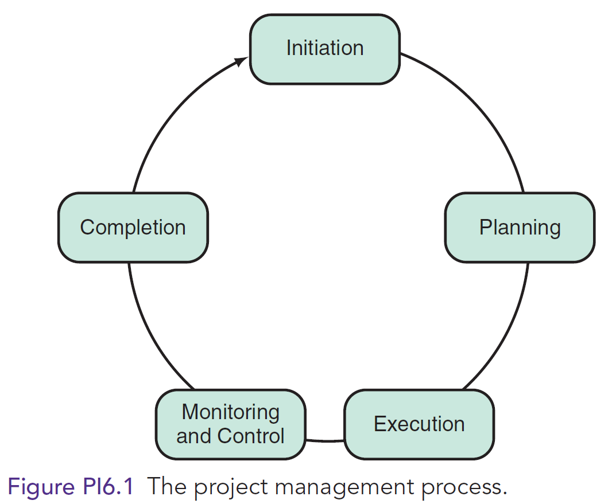
The Project Management (PM) Process

Slide 8
Phase 1: Project Initiation
Clearly define the problem the project will solve and the goals of the project
Identify and secure resources necessary for the project
Analyze the costs and benefits of the project
Identify potential risks

Slide 9
Phase 2: Project Planning
Each project objective and its associated activities must be identified and sequenced to avoid scope creep
Several tools are used for sequencing activities
Dependence diagrams
Program evaluation and review (PERT)
Critical path Method (CPM)
Gantt Chart timeline diagrams
Notes:
Scope creep: refers to uncontrolled changes in a project’s scope. This occurs when the scope of a project is not properly defined, documented, or controlled.

Slide 10
Phase 3: Project Execution
Work defined in the Planning Phase is performed coordinating people and resources to accomplish the project’s requirements.
Users may be involved in project execution (e.g., prototype evaluation)

Slide 11
Phase 4: Project Monitoring and Control
Verify the project is progressing as planned
Three Steps:
Where are we? Monitor activities
Where should we be? Compare actual project variables with the project plan
How do we get back on track? Identify corrective actions if needed

Slide 12
Phase 5: Project Completion
Project is formally accepted by the organization
All activities are finalized and all contracts are fulfilled and settled
All files are archived
All "lessons learned" are documented

Slide 13
PI6.2
The Project Management (PM) Process (Continued)
PM Failure
Enabling PM Success

Slide 14
Project Management Failure
Runaway Projects
Four Groups of Issues Causing IT Project Failures
Lack of focus & unclear objectives
Content issues
Skill Issues
Execution Issues
Notes:
Research by McKinsey and the University of Oxford suggest:
-- Half of all large IT projects (>$15 million) go far over their budgets
-- Large IT projects run 45 percent over budget, 7 percent over time, and deliver 56 percent less value than predicted
Runaway projects: Large IT projects that run so far over budget and past deadline that they must be abandoned with large. 17% of large IT projects are so bad they threaten the very existence of the organization.
Researchers found that four groups of issues caused most IT project failures:
• A lack of focus, including unclear objectives and lack of business focus
• Content issues, such as shifting requirements (e.g., scope creep) and technical complexity)
• Skill issues, such as a team not aligned with business objectives and a general lack of skills
• Execution issues, such as an unrealistic schedule and reactive planning (on the fly, as opposed to sufficient planning at the start of a project)

Slide 15
Enabling Project Management Success
Manage strategy and stakeholders
Secure critical talent
Build effective teams
Excel at project management practices
Notes:
Manage strategy and stakeholders: To avoid cost and time overruns, the team should establish a clear view of the project’s strategic value—one that goes beyond technical content. By building a robust, well-understood business case and maintaining focus on business objectives along the entire project timeline. This ensures the project aligns with the company’s business strategy and undertakes detailed analyses of stakeholder positions.
Secure critical talent: Drawing on expert help as needed, high-performance teams integrate all technical aspects of the project, including IT architecture and infrastructure, functionality trade-offs, quality assurance, migration and rollout plans, and project scope. The team should understand both business and technical concerns, which is why companies must assign a few high-performing and experienced experts for the length of the project.
Build effective teams: Project teams need a common vision, shared team processes, and a high-performance culture. Members must have a common incentive structure that is aligned with the overall project goal, in contrast with individual goals.
Excel at project management practices: Excellent project management practices include having a strategic and disciplined project management office and establishing rigorous processes for managing project requirements and change requests.

Slide 16
PI6.3
The Project Management Body of Knowledge (PMBOK)
Five Basic Process Groups
Nine Knowledge Areas

Slide 17
PMBOK: Five Basic Project Groups
Initiation
Planning
Execution
Monitoring & Control
Completion

Slide 18
PMBOK: Nine Knowledge Areas
Project Integration Management
Project Scope Management
Project Time Management
Project Cost Management
Project Quality Management
Project Human Resource Management
Notes:
1. Project Integration Management: processes required to ensure that all the project’s components are properly coordinated. Th e project plan development processes, project plan execution processes, and integrated change control processes are all included in this area of knowledge. Each process has expected inputs and outputs and change of inputs to outputs.
2. Project Scope Management: defines the processes that limit and control the work included in a project. Scope creep is a serious problem that often causes projects to go over time and over budget. These processes ensure that all the work of the project is included and properly accounted for.
3. Project Time Management: Proper sequencing is vital to timely project completion. When the amount of time needed is established, it takes excellent scheduling skills and tools to manage the activities to complete project milestones and the project itself within the allotted time. Different tools are available to assist with this process, such as Gantt charts, milestone charts, and network charts. Each tool helps managers see the big picture and stay in control of the project’s progression.
4. Project Cost Management: Resource planning and cost estimation are equally vital to time management. These two processes cannot exist independent of each other. Resource cost management is difficult to estimate and even more difficult to manage when unforeseen events take place. Early in a project, managers may project a budget range and then fine-tune it as the project progresses.
5. Project Quality Management: Quality planning, assurance, and control are included in this area. There are many quality management models to consider, such as the Deming Prize, TQM, and Six Sigma. All of these aim to help organizations produce quality products the first time they try. There are also many paradigms applicable to this area of knowledge,such as “Zero Defects” and “DTRTRTFT” (Do the right thing right the first time).
6. Project Human Resource Management: People with differing skill sets are required at various times during a project and their individual skills have to be used effectively for the project to succeed. This area of knowledge includes concepts such as staffing decisions; team management; and organizational culture, style, and structure.
7. Project Communications Management: Information must be collected, disseminated, stored, and destroyed at the appropriate time. This area of knowledge contains the processes to perform these functions. Often, organizations investigate personality styles to determine their most effective communicators. Choosing the right person to be a leader can make all the difference in the success of a project.
8. Project Risk Management: Risk management must be an integral part of any project because things do not always happen as planned. The risk management process includes identification of risks, quantitative and qualitative analyses, risk response planning, and risk monitoring.
9. Project Procurement Management: Proper funding is required for project success. The accumulated knowledge related to project procurement management encompasses processes of solicitation, selection, contractual agreements, and closeout processes.

Slide 19
PMBOK: Nine Knowledge Areas (continued)
Project Communications Management
Project Risk Management
Project Procurement Management
Notes:
7. Project Communications Management: Information must be collected, disseminated, stored, and destroyed at the appropriate time. This area of knowledge contains the processes to perform these functions. Often, organizations investigate personality styles to determine their most effective communicators. Choosing the right person to be a leader can make all the difference in the success of a project.
8. Project Risk Management: Risk management must be an integral part of any project because things do not always happen as planned. The risk management process includes identification of risks, quantitative and qualitative analyses, risk response planning, and risk monitoring.
9. Project Procurement Management: Proper funding is required for project success. The accumulated knowledge related to project procurement management encompasses processes of solicitation, selection, contractual agreements, and closeout processes.

