Slide 1
7
Protecting Your Information Assets

Slide 2
How to Protect Your Assets: The Basics
Behavioral Actions to Protect Your Information Assets
Computer-Based Actions to Protect Your Information Assets

Slide 3
Explain why it is critical that you protect your information assets.
Identify the various behavioral actions you can take to protect your information assets.
Identify the various computer-based actions you can take to protect your information assets.

Slide 4
PI7.1
How to Protect Your Assets: The Basics
Business travel
Working from home
Various activities at our favorite hotspot
Industrial strength IS security from work
Attacks on a home network
Notes:
Areas of Exposure
Business travel
Working from home
Various activities at our favorite hotspot
Industrial strength IS security from work Versus Attacks on a home network

Slide 5
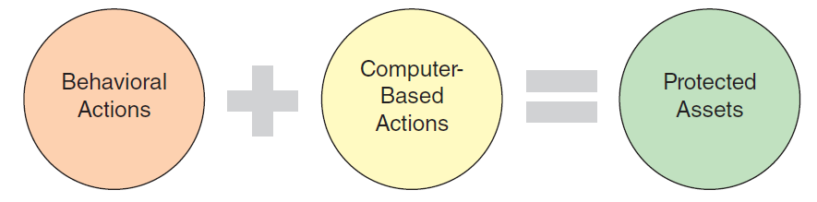
How to Protect Your Assets: The Basics
Notes:
Two types of actions to protect your information assets:
behavioral actions
computer-based actions

Slide 6
PI7.2
Behavioral Actions to Protect Your Information Assets
General Behavioral Actions
What to Do in the Event of Identity Theft
Notes:
Behavioral actions: those actions that do not specifically involve a computer.

Slide 7
General Behavioral Actions
Never provide personal information to anyone in any format
Protect your Social Security number
Use credit cards with your picture on them
Write “Photo ID Required” on the back of credit cards

Slide 8
General Behavioral Actions (Continued)
Use virtual credit cards
Pay very close attention to your credit card billing cycles
Receive your credit card bills electronically
Only use the last four digits of your credit card account when paying by check

Slide 9
General Behavioral Actions (Continued)
Limit your use of debit cards
Use secure, private mailbox/PO Box
Use a cross-cut or confetti shredder to dispose of old mail & records
Sign up for a proactive protection service (e.g., lifelock.com, trustedid.com, cardcops.com)

Slide 10
What to Do in the Event of Identity Theft
Review instructions from the Federal Trade Commission (FTC) and immediately take the actions outlined in the following slides.

Slide 11
What to Do in the Event of Identity Theft (continued)
Step 1:
Place an Initial Fraud Alert by contacting all three credit reporting agencies (Equifax, Experian, Transunion
Keep a detailed record of all communication (phone calls, letters, e-mail)

Slide 12
What to Do in the Event of Identity Theft (continued)
Step 2:
Order credit reports from all three nationwide credit reporting companies.
Keep detailed records of everything you requested and received

Slide 13
What to Do in the Event of Identity Theft (continued)
Step 3:
Create and Identity Theft Report that includes an Identity Theft Affidavit and a police report.

Slide 14
What to Do in the Event of Identity Theft (continued)
Step 4:
Regularly review your credit report.
Pay particular attention to medical benefit explanations from your insurance company.
Respond quickly to notices from the Internal Revenue Service (IRS)
Obtain legal counsel

Slide 15
PI7.3
Computer-Based Actions to Protect Your Information Assets
Determining Where People Have Visited on the Internet Using Your Computer
The Dangers of Social Networking Sites
Determining if Your Computer is Infected
Notes:
Computer-based actions: relate to safe computing.

Slide 16
PI7.3
Computer-Based Actions to Protect Your Information Assets (Continued)
Computer Actions to Prevent Malware Infections
Protecting Your Portable Devices and Information
Other Actions You Can Take On Your Computer
Protecting Your Privacy

Slide 17
PI7.3
Computer-Based Actions to Protect Your Information Assets (Continued)
Preparing for Personal Disasters
Wireless Security
Mobile Security

Slide 18
Determining Where People Have Visited on the Internet Using Your Computer
Other people who may use your home computer may not practice “Safe Computing” practices
Review the browser history
Require a password for users on your home computer

Slide 19
The Dangers of Social Networking Sites
Never post personal information about yourself or your family
Deleted photos, posts, and messages can be copied and reposted by others
Use the “Privacy Settings” to maintain control over your information

Slide 20
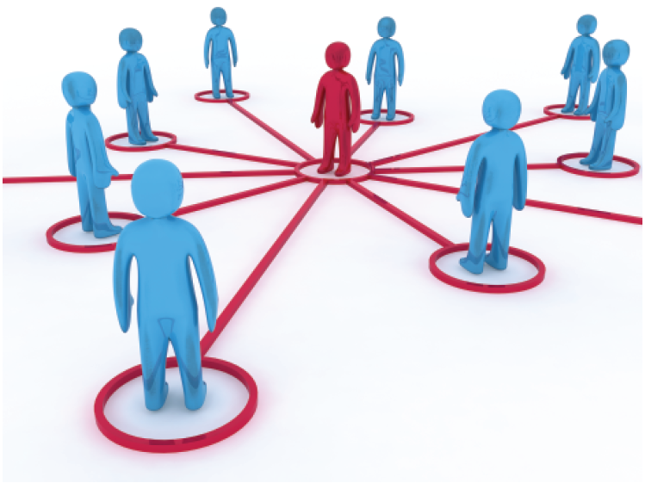
The Dangers of Social Networks
(Source: Jure Porenta / Shutterstock)

Slide 21
Determining if Your Computer is Infected
Signs that your computer system is infected with malicious software or malware
Your computer shuts down unexpectedly by itself
Your computer does not start normally

Slide 22
Determining if Your Computer is Infected (continued)
Your computer exhibits erratic behavior, displaying some or all of these characteristics:
System runs out of hard drive space (memory)
System continually runs out of main memory (RAM)
Programs take longer to load than normal
Programs act erratically
Monitor displays strange graphics or messages.
System displays a high number of error messages.
Your e-mail client automatically sends messages to all your contacts

Slide 23
Computer Actions to Prevent Malware Infections
Test Your System
Install a Security Suite on Your Computer
Install an Anti-malware Product on Your Computer
Install a Firewall on Your Computer

Slide 24
Computer Actions to Prevent Malware Infections (con’t)
Install an Antispyware Product on Your Computer
Install Monitoring Software on Your Computer
Install Content-Filtering Software on Your Computer

Slide 25
Computer Actions to Prevent Malware Infections (con’t)
Install Antispam Software on Your Computer
Manage Software Patches
Use a Browser Other Than Internet Explorer
Use an Operating System Other Than Windows

Slide 26
Protecting Your Portable Devices and Information
Keep portable devices in an inconspicuous container/carrier
Do not leave portable devices unattended in plain view
Use alarms
Two-factor authentication
Use data encryption on portable devices

Slide 27
Other Actions You Can Take On Your Computer
How to detect a worm
How to detect a Trojan Horse
How to detect fake Web Sites

Slide 28
Protecting Your Privacy
Use strong passwords
How to adjust your privacy settings on your computer
How to surf the Web anonymously
How to e-mail anonymously
Erasing your Google search history

Slide 29
Preparing for Personal Disasters
Safe deposit box for important papers
Fireproof safe at home for important documents
Regularly backup key computer files
Encrypt backup files
Backup to cloud or external drives

Slide 30
Wireless Security
Hide your Service Set Identifier (SSID)
Use encryption
Filter out media access control addresses
Limit IP Addresses
Sniff out intruders

Slide 31
Wireless Security (continued)
Using a Public Hotspot
Test your wireless network
Wireless security software

Slide 32
Mobile Security
Mobile best practices
Strong password
Encrypted backups
Autolock option
Limit location based services
Maintain software/hardware updates
Be cautious when downloading apps

