Slide 1
Data Analytics & Visualization
T.E. AI and DS - Jan 2023
Dr. M. Vijayalakshmi

Slide 2
Module 3 – Times Series Analysis
Overview of Time Series Analysis
Box-Jenkins Methodology , ARIMA Model
Autocorrelation Function (ACF)
Autoregressive Models ,Moving Average Models
ARMA and ARIMA Models
Building and Evaluating an ARIMA Model
Reasons to Choose and Cautions

Slide 3
Introduction
Since social and economic conditions are constantly changing over time, data analysts must be able to assess and predict the effects of these changes, in order to suggest the most appropriate actions to take
It is therefore required to use appropriate forecasting techniques to support business, operations, technology, research, etc.
More accurate and less biased forecasts can be one of the most effective driver of performance in many fields
Time Series Analysis, using statistical methods, allows to enhance comprehension and predictions on any quantitative variable of interest (sales, resources, financial KPIs, logistics, sensors’ measurements, etc.)

Slide 4





Applications
The fields of application of Time series Analysis are numerous: Demand Planning is one of the most common application, however, from industry to industry there are other possible uses. For instance:
Logistics & Transportation
Forecasting of shipped packages: workforce planning
Retail grocery
Forecasting of sales during promotions: optimizing warehouses
Insurance
Claims prediction: determining insurance policies
Manufacturing
Predictive Maintenance: improving operational efficiency
Energy & Utilities
Energy load forecasting: better planning and trading strategies

Slide 5
TS data vs. Cross Sectional data
A Time series is made up by dynamic data collected over time! Consider the differences between:
Cross Sectional Data
Multiple objects observed at a particular point of time
Examples: customers’ behavioral data at today’s update, companies’ account balances at the end of the last year, patients’ medical records at the end of the current month, …
Time Series Data
One single object (product, country, sensor, ..) observed over multiple equally-spaced time periods
Examples: quarterly Italian GDP of the last 10 years, weekly supermarket sales of the previous year, yesterday’s hourly temperature measurements, …

Slide 6
Examples
Time series example 1
Numbers of Doctorates Awarded in US, annual data – Engineering Vs. Education
12000
Engineering Education
9633
9897
At a glance
10000
9001
8032
8470
Annual data
7749
7864
7642 7578
8000
7186
Different
«directions»
6426
6000
6448
6561
6528
6227
6122
No big fluctuations
5288
4935
5117
4000
4670
4803
4791
2000
0
2005 2006 2007 2008 2009 2010 2011 2012 2013 2014 2015

Slide 7
Examples
Time series example 2
Monthly carbon dioxide concentration (globally averaged over marine surface sites)
410
405
At a glance
400
Monthly basis data
Regular pattern
395
Constant fluctuations
390
Average value increases year by year
385
380
1 | 3 | 5 7 | 9 | 11 | 1 | 3 | 5 7 | 9 | 11 | 1 | 3 | 5 7 | 9 | 11 | 1 | 3 | 5 7 | 9 | 11 | 1 | 3 | 5 7 | 9 | 11
 |  | 2012 |  |  |  |  | 2013 |  |  |  |  | 2014 |  |  |  |  | 2015 |  |  |  |  | 2016

Slide 8
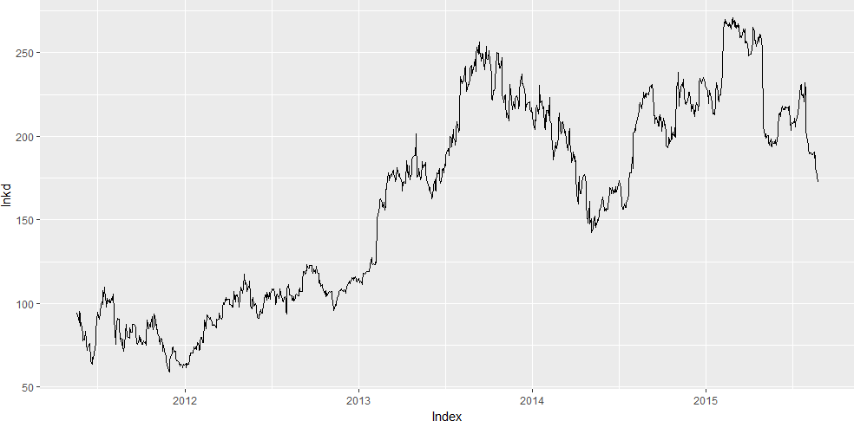
Examples
Time series example 3
LinkedIn daily stock market closing price
At a glance
Daily basis data
Very irregular dynamic
Many sudden changes

Slide 9
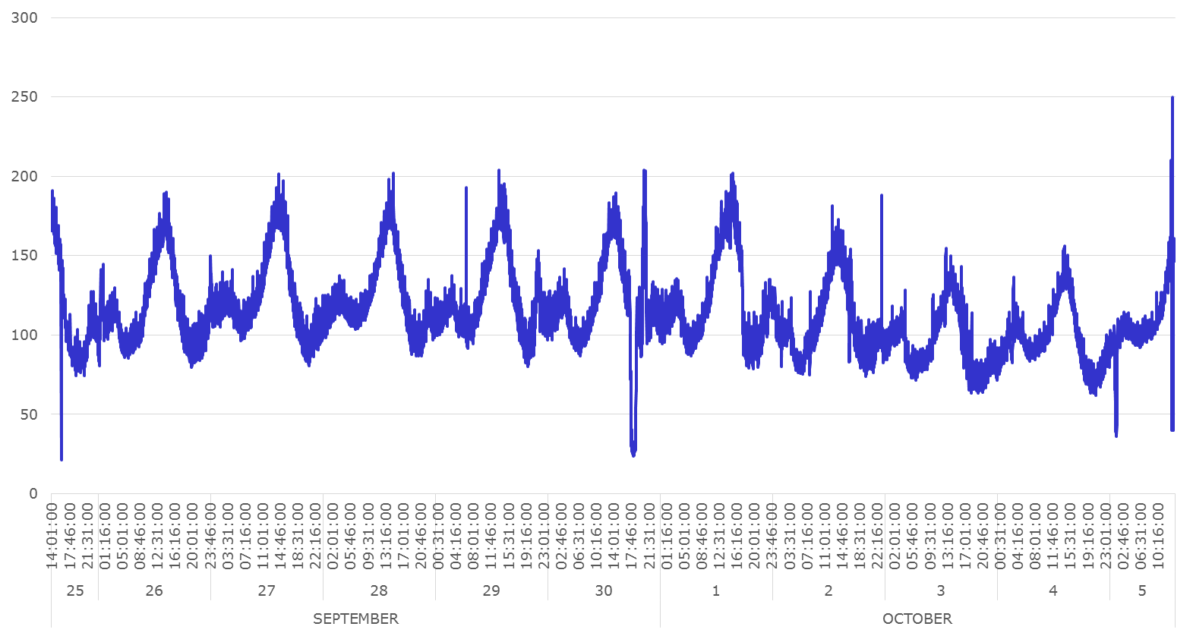
Examples
Time series example 4
Number of photos uploaded on the Instagram every minute (regional sub-sample)
At a glance
Minute basis data
Almost regular daily pattern but with some anomalies and spikes

Slide 10
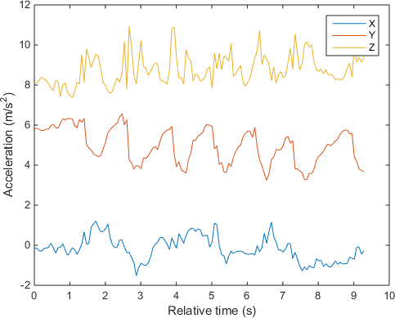
Examples
Time series example 5
Acceleration detected by a smartphone sensors during a workout session (10 seconds)
At a glance
Milliseconds basis data
Each sensor has its own dynamics

Slide 11
Significance of Time Series
TSA is the backbone for prediction and forecasting analysis, specific to time-based problem statements.
Analyzing the historical dataset and its patterns
Understanding and matching the current situation with patterns derived from the previous stage.
Understanding the factor or factors influencing certain variable(s) in different periods.

Slide 12
Use Cases
With the help of “Time Series,” we can prepare numerous time-based analyses and results.
Forecasting: Predicting any value for the future.
Segmentation: Grouping similar items together.
Classification: Classifying a set of items into given classes.
Descriptive analysis: Analysis of a given dataset to find out what is there in it.
Intervention analysis: Effect of changing a given variable on the outcome.

Slide 13
Objectives
To understand how time series works and what factors affect a certain variable(s) at different points in time.
Time series analysis will provide the consequences and insights of the given dataset’s features that change over time.
Supporting to derive the predicting the future values of the time series variable.
Assumptions: There is only one assumption in TSA, which is “stationary,” which means that the origin of time does not affect the properties of the process under the statistical factor.

Slide 14
Objectives
Summary description (graphical and numerical) of data point vs. time
Interpretation of specific series features (e.g. seasonality, trend, relationship with other series)
Forecasting (e.g. predict the series values in 𝑡 + 1, 𝑡 + 2, … , 𝑡 + 𝑘)
Hypothesis testing and Simulation (comparing different scenarios)

Slide 15
Objectives
Once someone said: «Forecasting is the art of saying what will happen in the future and then explaining why it didn’t»
Frequently true... history is full of examples of «bad forecasts», just like IBM Chairman’s famous quote in 1943: “there is a world market for maybe five computers in the future.”
The reality is that forecasting is a really tough task, and you can do really bad, just like in this cartoon..
But we can do definitely better using quantitative methods.. and common sense!
GOAL: Reduce uncertainty and improve the accuracy of our forecasts

Slide 16
Definition
General definition: “A time series is a collection of observations made sequentially through time, whose dynamics is often characterized by short/long period fluctuations (seasonality and cycles) and/or long period direction (trend)”
Such observations may be denoted by 𝒀_{𝟏} , 𝒀_{𝟐}, 𝒀_{𝟑}, … 𝒀_{𝒕}, … , 𝒀_{𝑻}
usually collected at discrete points in time Observation at time t
since data are
The interval between observations can be any time interval (seconds, minute, hours, days, weeks, months, quarters, years, etc.) and we assume that these time periods are equally spaced
One of the most distinctive characteristics of a time series is the mutual dependence between the observations, generally called SERIAL CORRELATION OR AUTOCORRELATION

Slide 17
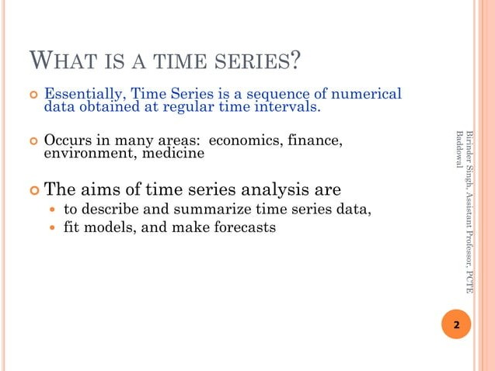

Slide 18
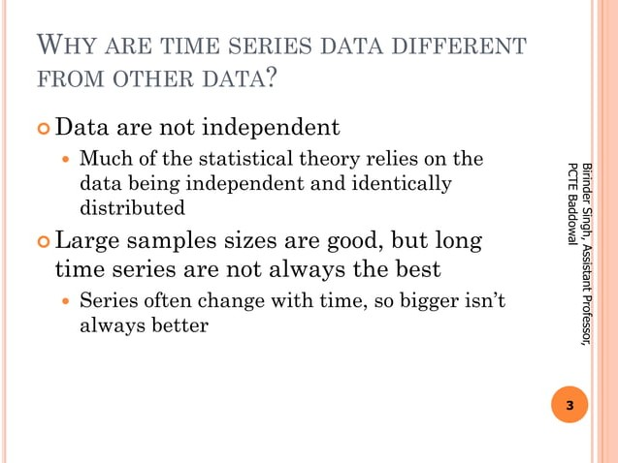

Slide 19
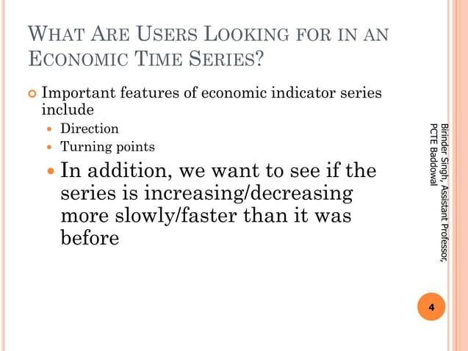

Slide 20
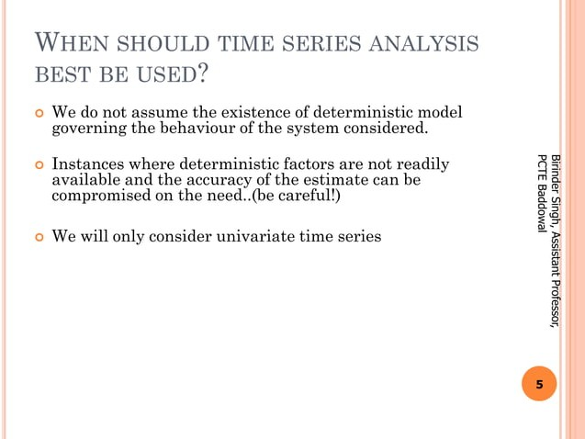

Slide 21
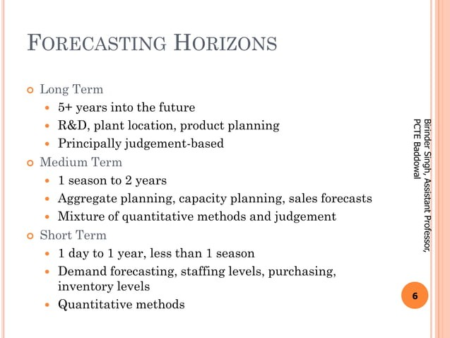

Slide 22
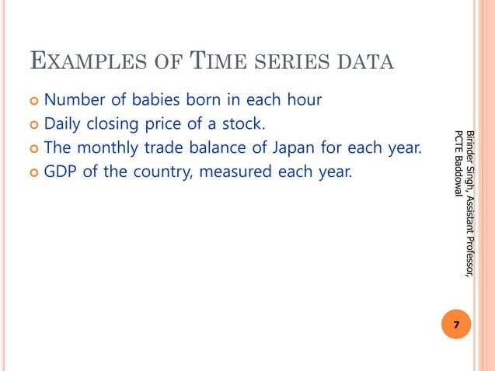

Slide 23
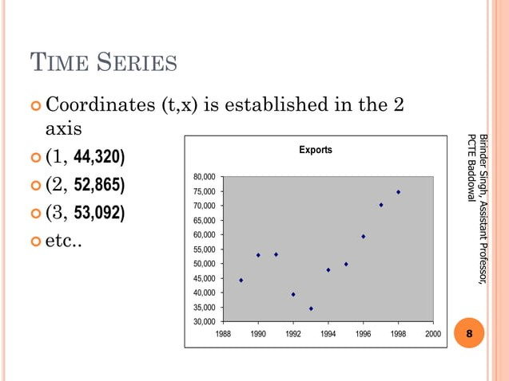

Slide 24
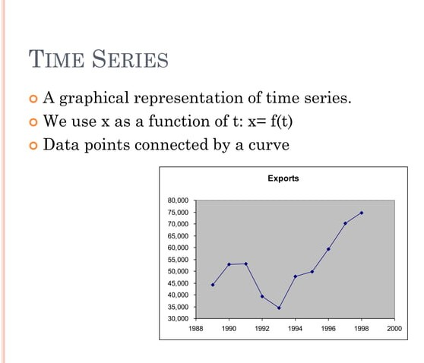

Slide 25
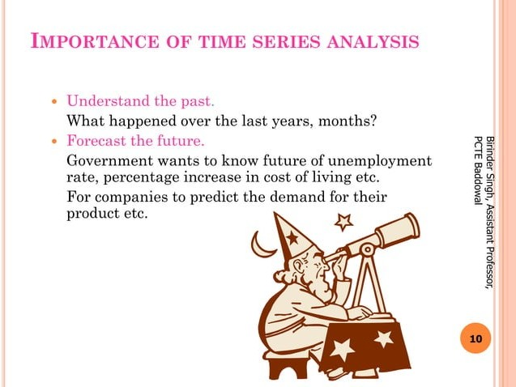

Slide 26
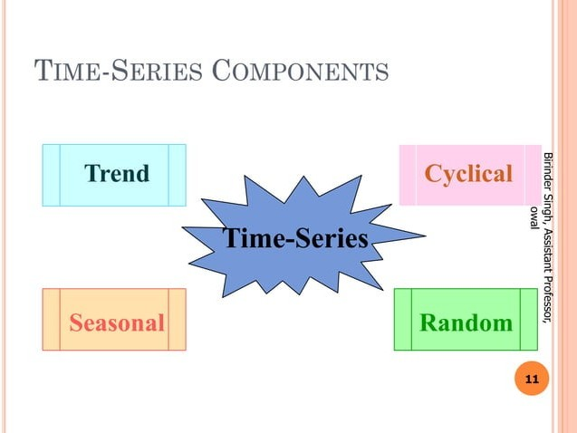

Slide 27
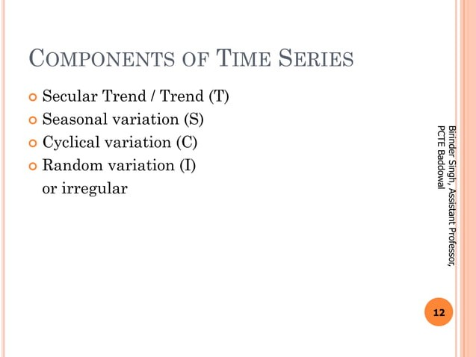

Slide 28
Time Series Components
Trend: In which there is no fixed interval and any divergence within the given dataset is a continuous timeline. The trend would be Negative or Positive or Null Trend
Seasonality: In which regular or fixed interval shifts within the dataset in a continuous timeline. Would be bell curve or saw tooth
Cyclical: In which there is no fixed interval, uncertainty in movement and its pattern
Irregularity: Unexpected situations/events/scenarios and spikes in a short time span.

Slide 29
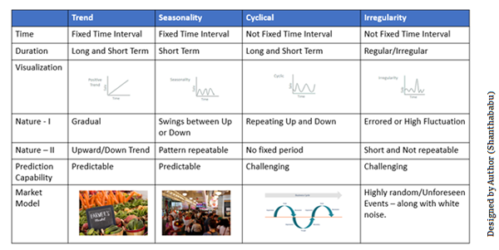

Slide 30
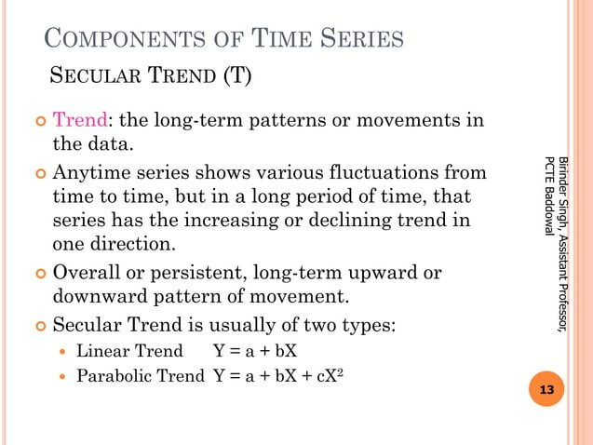

Slide 31
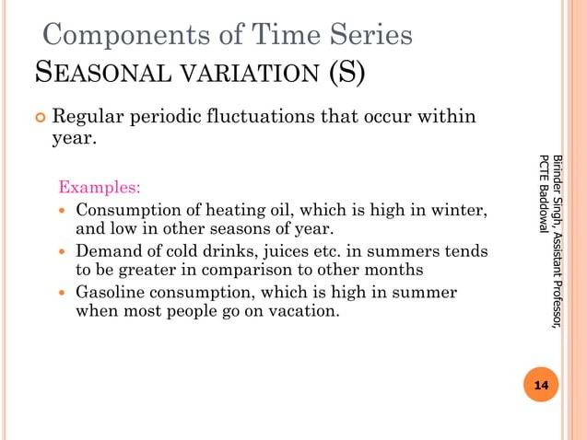

Slide 32
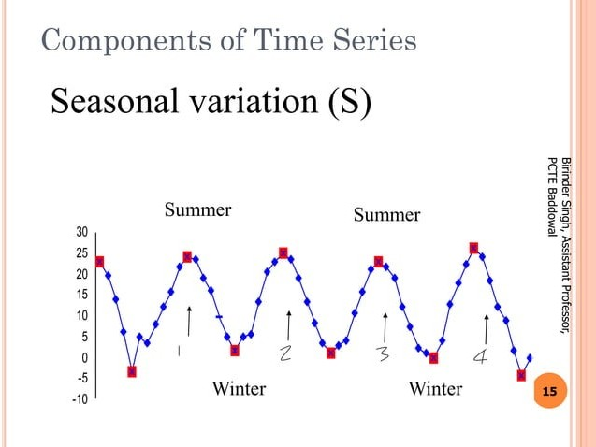

Slide 33
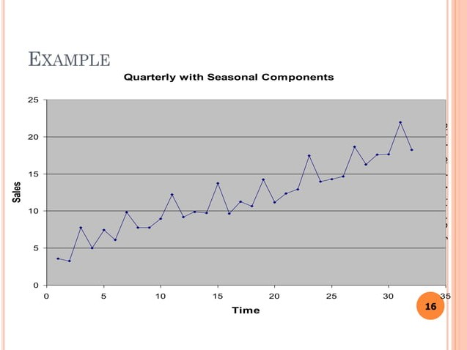

Slide 34
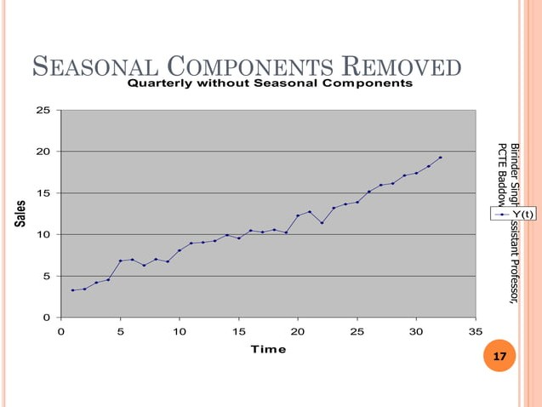

Slide 35
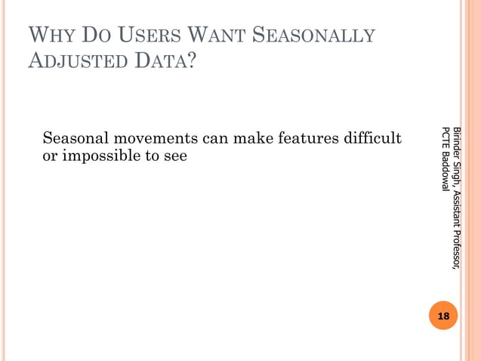

Slide 36
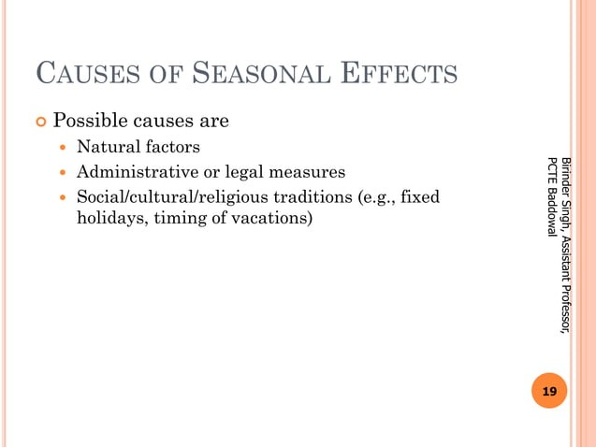

Slide 37
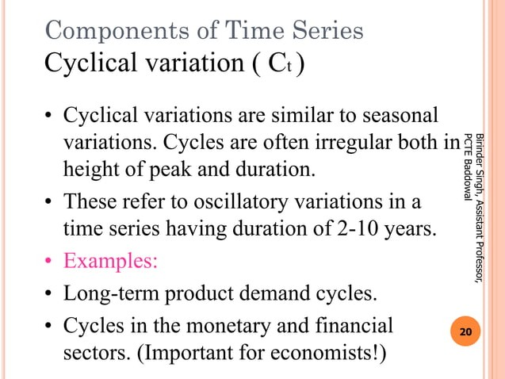

Slide 38
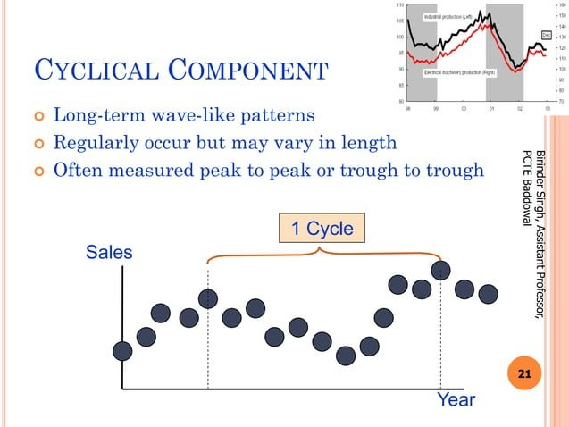

Slide 39
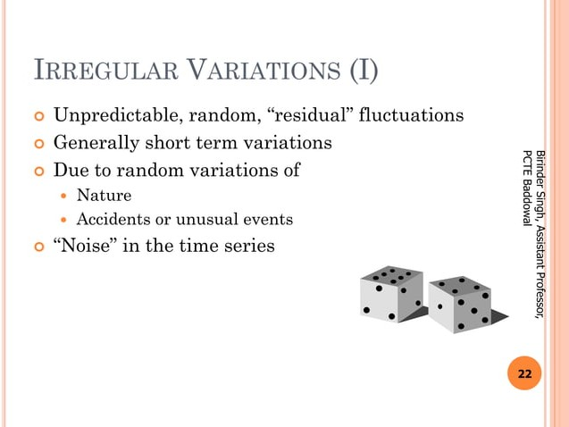

Slide 40
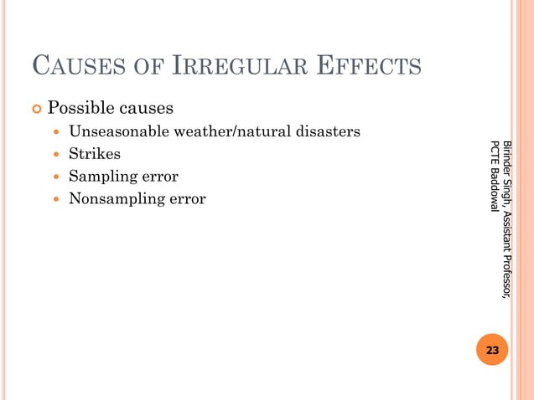

Slide 41
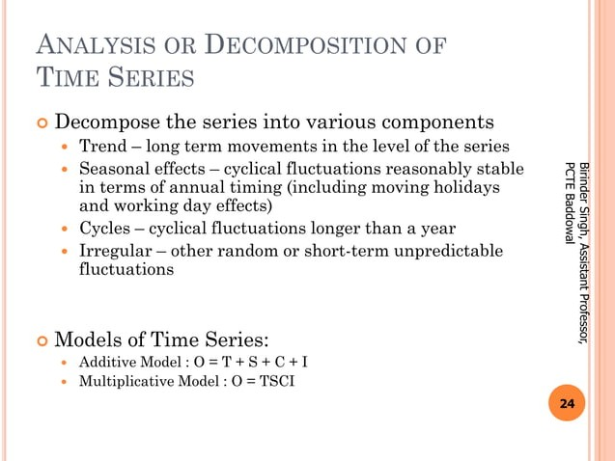

Slide 42
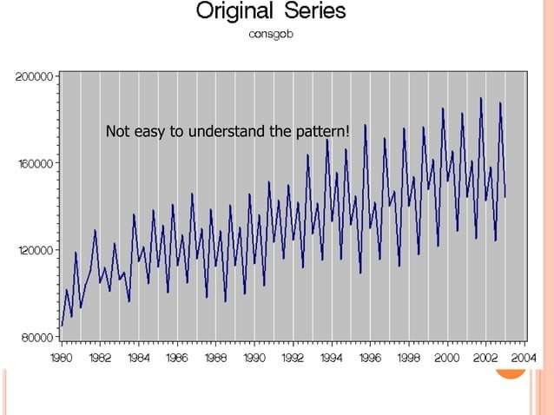

Slide 43
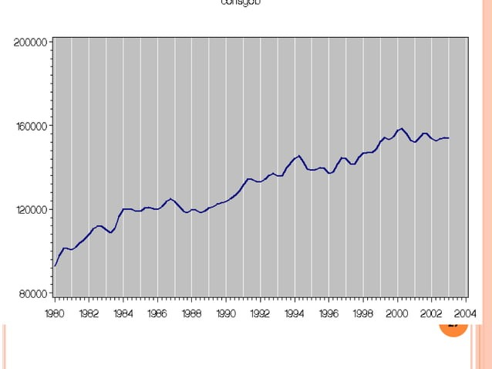

Slide 44
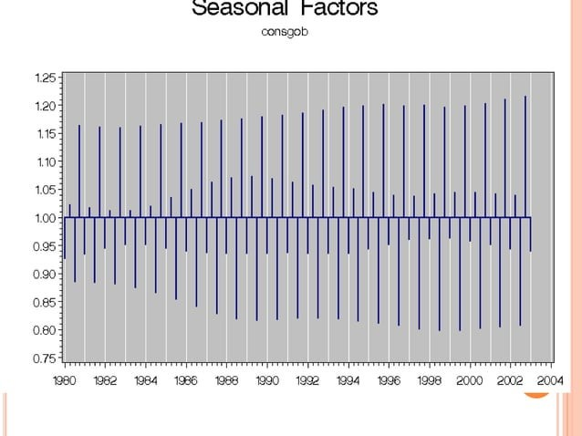

Slide 45
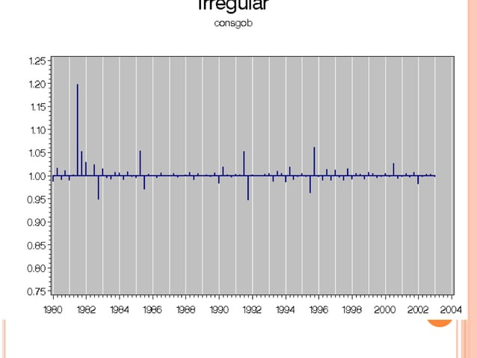

Slide 46
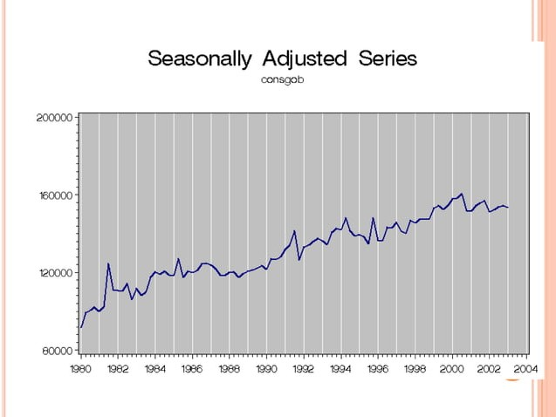

Slide 47
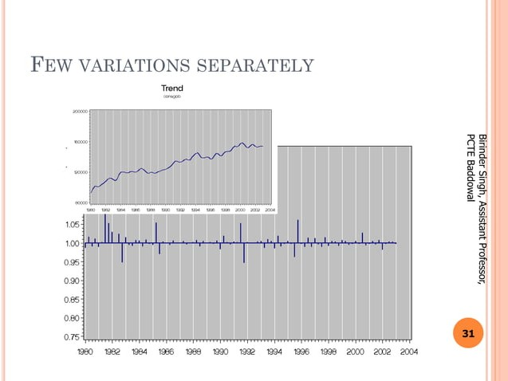

Slide 48
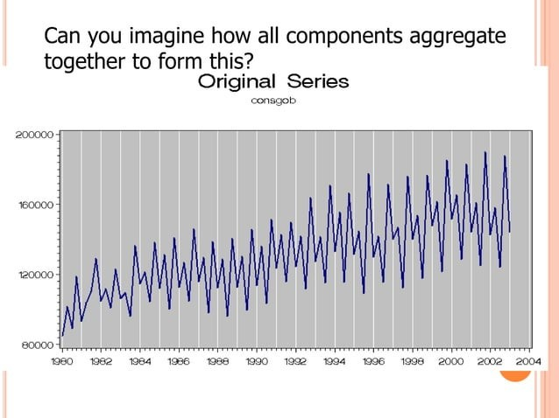

Slide 49
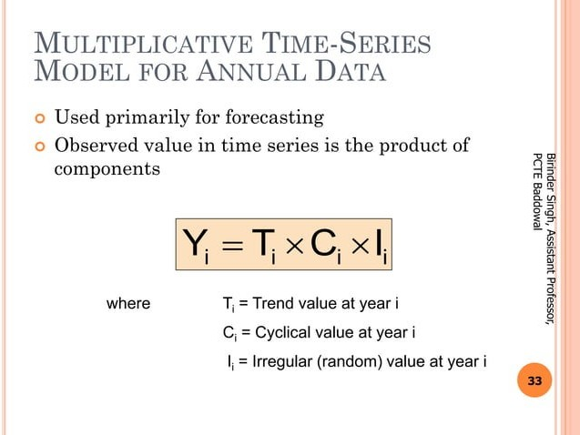

Slide 50
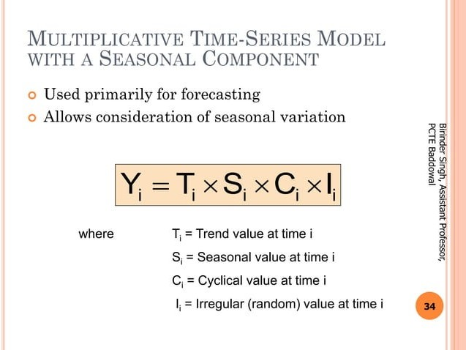

Slide 51
Types of Time Series
While discussing TS data types, there are two major types – stationary and non-stationary.
Stationary: A dataset should follow the below thumb rules without having Trend, Seasonality, Cyclical, and Irregularity components of the time series.
The mean value of them should be completely constant in the data during the analysis.
The variance should be constant with respect to the time-frame
Covariance measures the relationship between two variables.
Non- Stationary: If either the mean-variance or covariance is changing with respect to time, the dataset is called non-stationary.

Slide 52
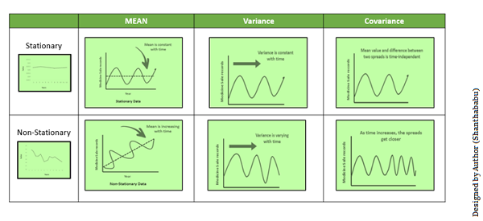

Slide 53
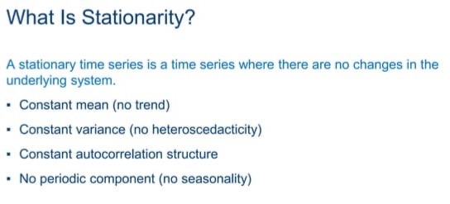

Slide 54
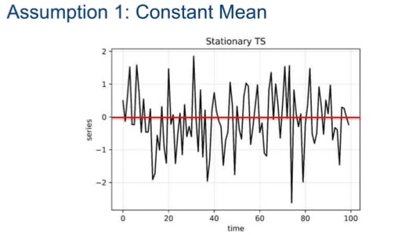

Slide 55
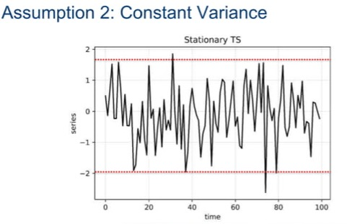

Slide 56
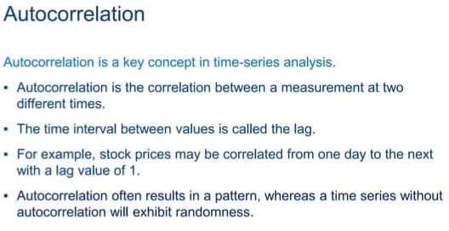

Slide 57
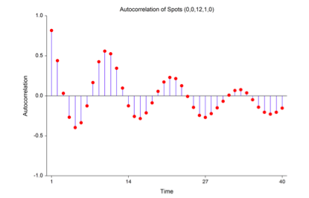

Slide 58
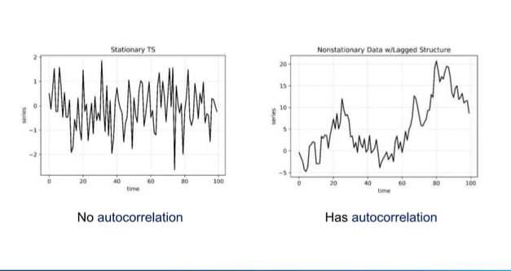

Slide 59
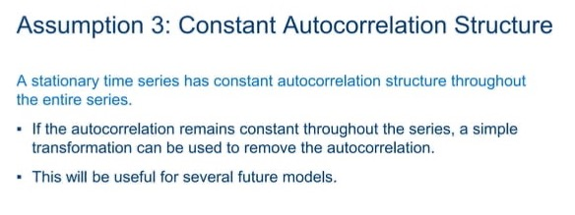

Slide 60
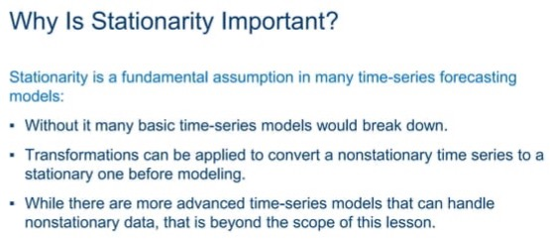

Slide 61
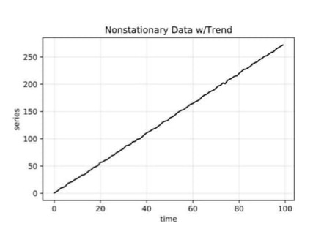

Slide 62
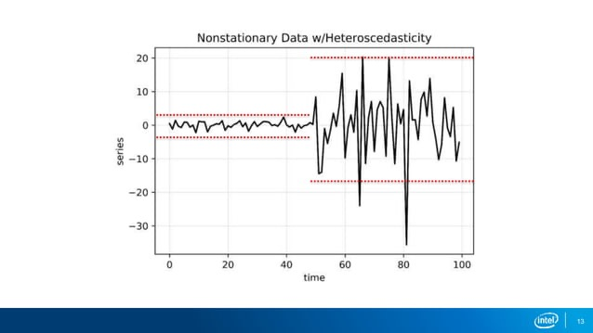

Slide 63
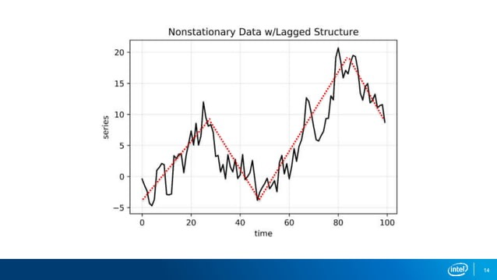

Slide 64
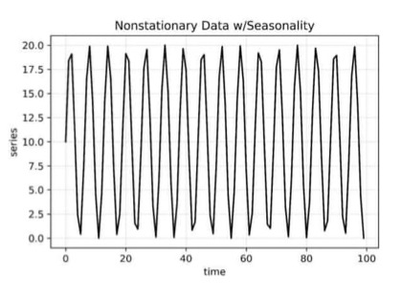
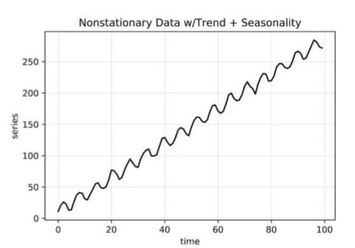

Slide 65


Slide 66


Slide 67


Slide 68


Slide 69


Slide 70


Slide 71


Slide 72


Slide 73


Slide 74



Slide 75


Slide 76
Steps for TSA
Collecting the data and cleaning it
Preparing Visualization with respect to time vs key feature
Observing the stationarity of the series
Developing charts to understand its nature.
Model building – AR, MA, ARMA and ARIMA
Extracting insights from prediction

