Slide 1
MODULE 3B
The Box-Jenkins Methodology for
ARIMA Models

Slide 2
Introduction
Autoregressive Integrated Moving Average models (ARIMA models) were popularized by George Box and Gwilym Jenkins in the early 1970s.
ARIMA models are a class of linear models that is capable of representing stationary as well as non-stationary time series.
ARIMA models do not involve independent variables in their construction. They make use of the information in the series itself to generate forecasts.

Slide 3
Introduction
ARIMA models rely heavily on autocorrelation patterns in the data.
ARIMA methodology of forecasting is different from most methods because it does not assume any particular pattern in the historical data of the series to be forecast.
It uses an interactive approach of identifying a possible model from a general class of models.
The chosen model is then checked against the historical data to see if it accurately describe the series.

Slide 4
Introduction
Recall that, a time series data is a sequence of numerical observations naturally ordered in time, such as:
Daily closing price of IBM stock
Weekly automobile production by the Pontiac division of general Motors.
Hourly temperatures at the entrance to Grand central Station.

Slide 5
Introduction
Two question of paramount importance When a forecaster examines a time series data are:
Do the data exhibit a visible pattern?
Can this be used to make meaningful forecasts?

Slide 6
Introduction
The Box-Jenkins methodology refers to a set of procedures for identifying, fitting, and checking ARIMA models with time series data. Forecasts follow directly from the form of fitted model.
The basis of BOX-Jenkins approach to modeling time series consists of three phases:
Identification
Estimation and testing
Application

Slide 7
RECALL - ACF PACF
Auto-Correlation Function (ACF)
ACF is used to indicate how similar a value is within a given time series and the previous value.
(OR) It measures the degree of the similarity between a given time series and the lagged version of that time series at the various intervals we observed.
Partial Auto-Correlation (PACF)
PACF is similar to Auto-Correlation Function and is a little challenging to understand.
It always shows the correlation of the sequence with itself with some number of time units per sequence order in which only the direct effect has been shown.
All other intermediary effects are removed from the given time series.

Slide 8
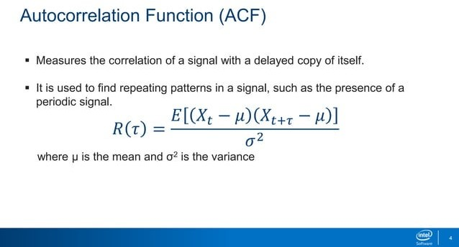
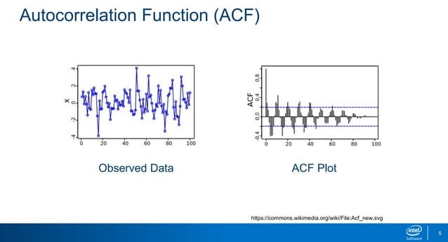

Slide 9
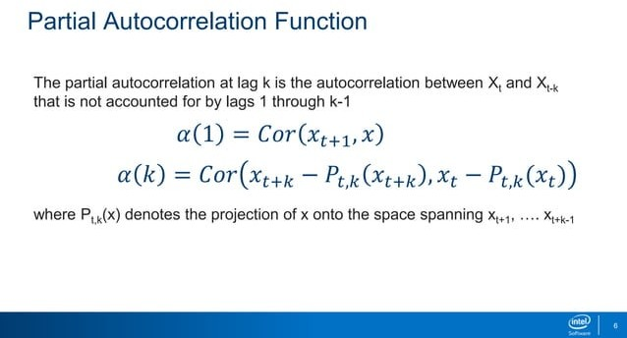

Slide 10
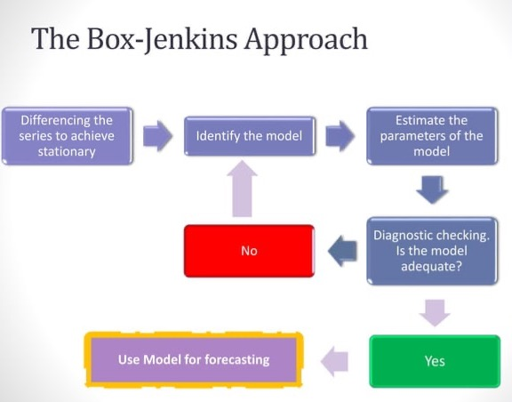

Slide 11
Introduction
Identification
Data preparation
Transform data to stabilize variance
Differencing data to obtain stationary series
Model selection
Examine data, ACF and PACF to identify potential models

Slide 12
Introduction
Estimation and testing
Estimation
Estimate parameters in potential models
Select best model using suitable criterion
Diagnostics
Check ACF/PACF of residuals
Do portmanteau test of residuals
Are the residuals white noise?
Application
Forecasting: use model to forecast

Slide 13
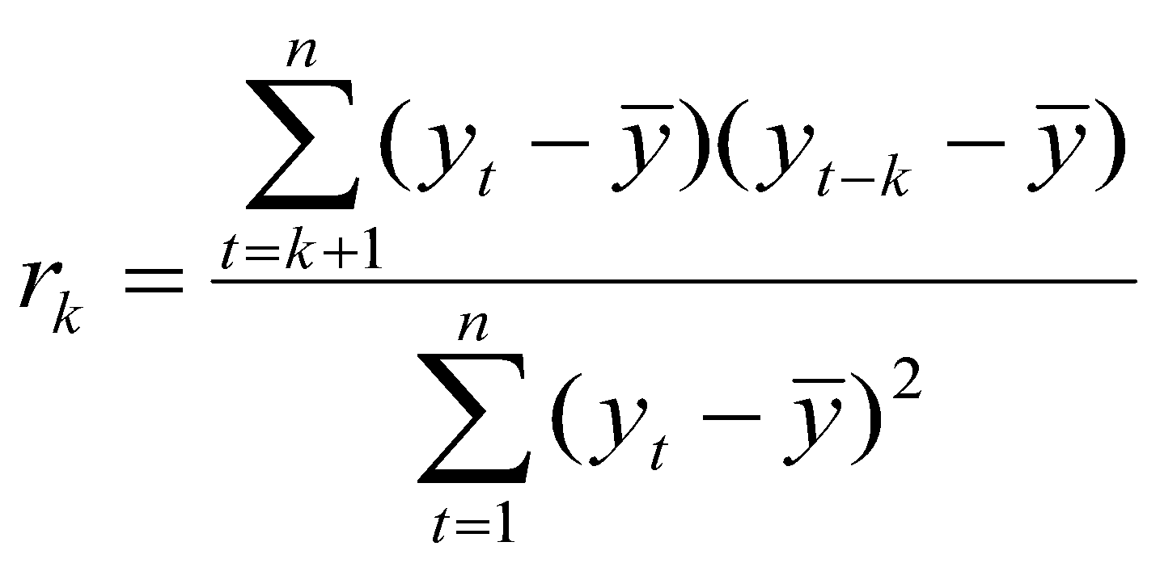
Examining correlation in time series data
The key statistic in time series analysis is the autocorrelation coefficient ( the correlation of the time series with itself, lagged 1, 2, or more periods).
Recall the autocorrelation formula:

Slide 14
Examining Correlation in Time Series Data
Recall r₁ indicates how successive values of Y relate to each other, r₂ indicates how Y values two periods apart relate to each other, and so on.
The auto correlations at lag 1, 2, …, make up the autocorrelation function or ACF.
Autocorrelation function is a valuable tool for investigating properties of an empirical time series.

Slide 15
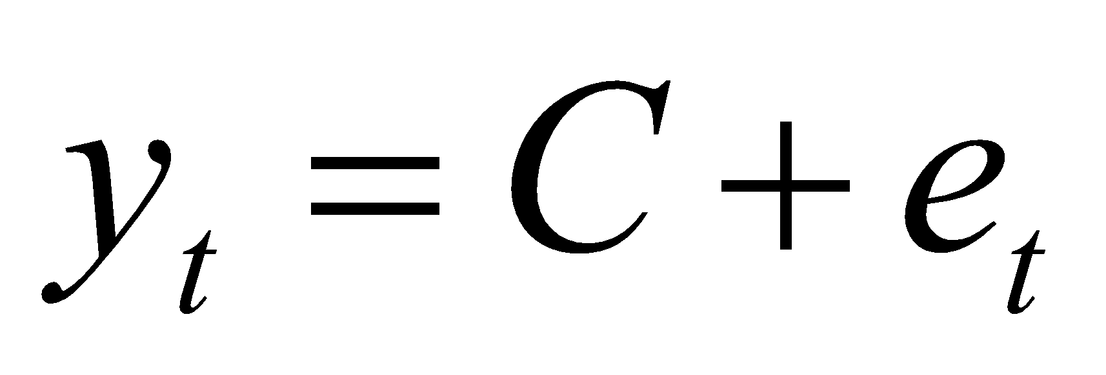
White noise model
A white noise model is a model where observations Y_{t} is made of two parts: a fixed value and an uncorrelated random error component.
For uncorrelated data (a time series which is white noise) we expect each autocorrelation to be close to zero.

Slide 16
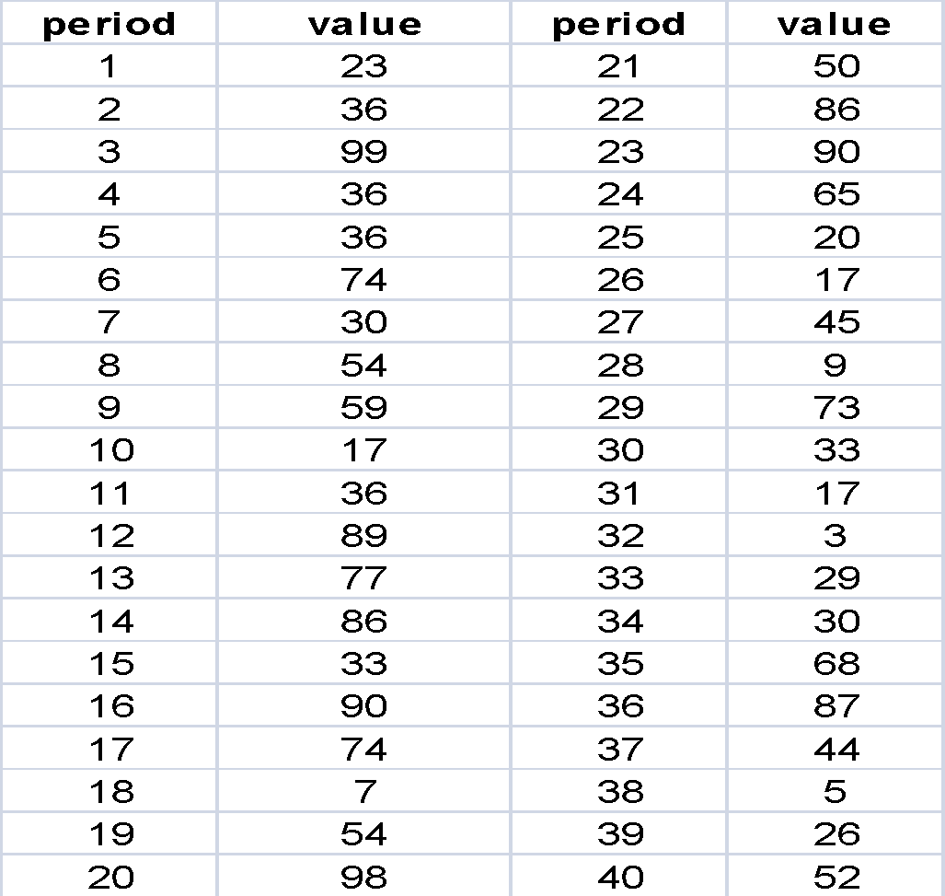
Consider the following white noise series.

Slide 17
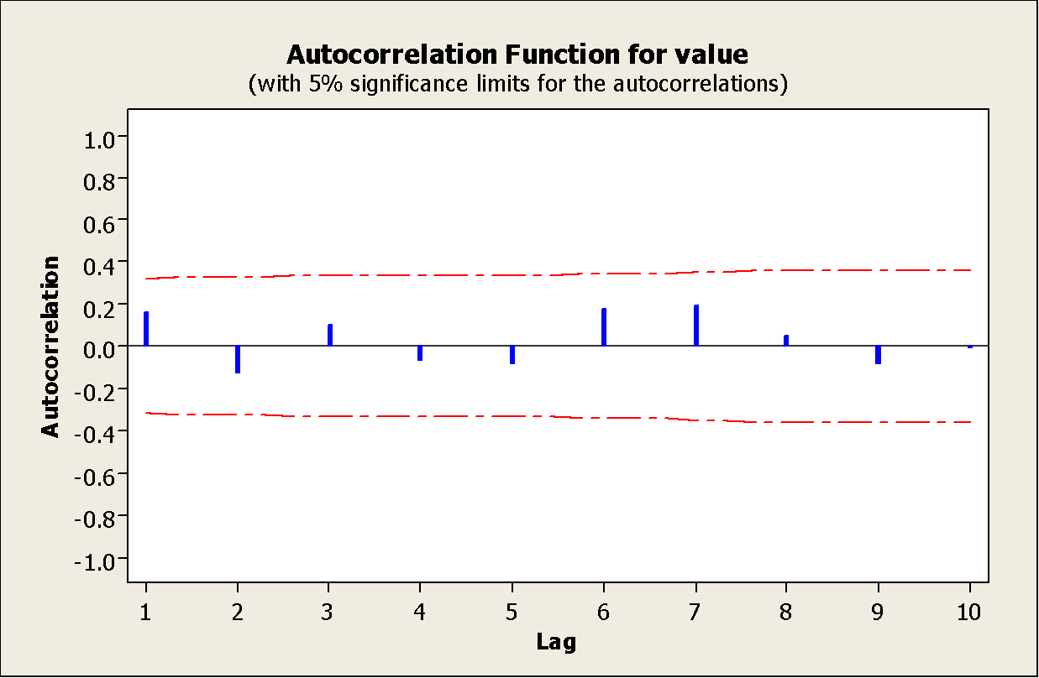
ACF for the white noise series

Slide 18
Sampling distribution of autocorrelation
The autocorrelation coefficients of white noise data have a sampling distribution that can be approximated by a normal distribution with mean zero and standard error 1/√n. where n is the number of observations in the series.
This information can be used to develop tests of hypotheses and confidence intervals for ACF.

Slide 19
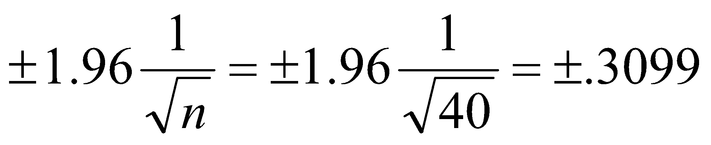
Sampling distribution of autocorrelation
For example:
For our white noise series example, we expect 95% of all sample ACF to be within:
If this is not the case then the series is not white noise.
The sampling distribution and standard error allow us to distinguish what is randomness or white noise from what is pattern.

Slide 20
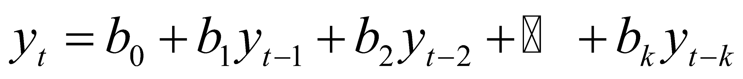
The Partial autocorrelation coefficient
Partial autocorrelations measures the degree of association between y_{t} and y_{t-k}, when the effects of other time lags 1, 2, 3, …, k-1 are removed.
The partial autocorrelation coefficient of order k is evaluated by regressing y_{t} against y_{t-1},…y_{t-k}:
α_{k} (partial autocorrelation coefficient of order k) is the estimated coefficient b_{k}.

Slide 21
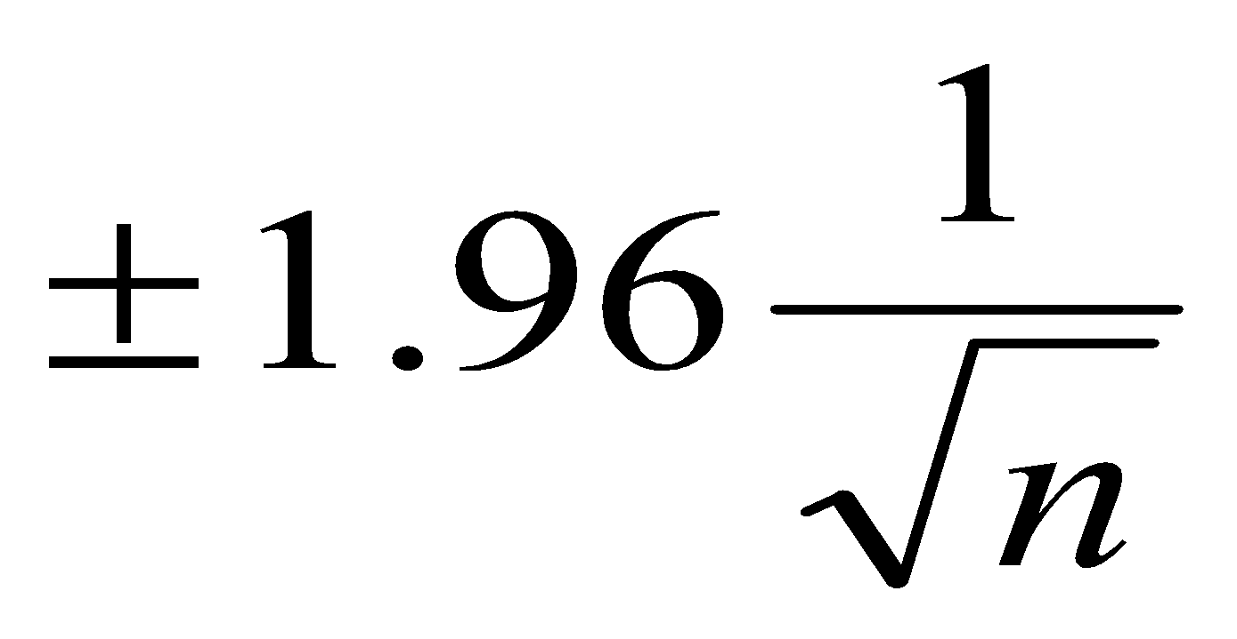
The Partial autocorrelation coefficient
The partial autocorrelation functions (PACF) should all be close to zero for a white noise series.
If the time series is white noise, the estimated PACF are approximately independent and normally distributed with a standard error 1/√n.
Therefore the same critical values of
Can be used with PACF to assess if the data are white noise.

Slide 22
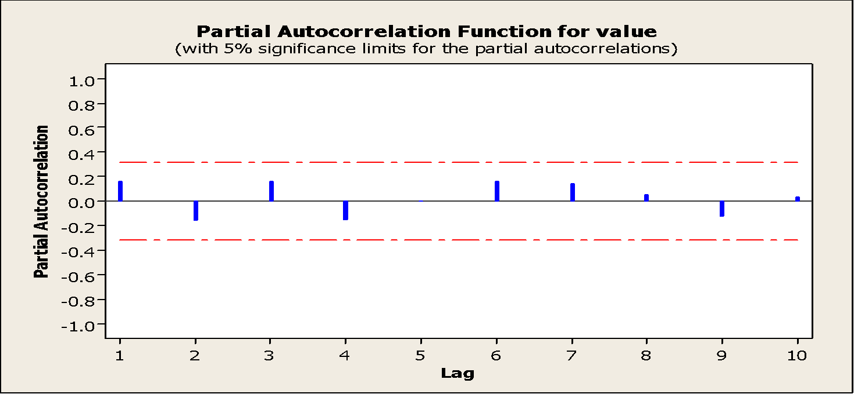
The Partial autocorrelation coefficient
It is usual to plot the partial autocorrelation function or PACF.
The PACF plot of the white noise data looks like this.

Slide 23
Examining stationarity of time series data
Stationarity means no growth or decline.
Data fluctuates around a constant mean independent of time and variance of the fluctuation remains constant over time.
Stationarity can be assessed using a time series plot:
Plot shows no change in the mean over time
No obvious change in the variance over time.

Slide 24
Examining stationarity of time series data
The autocorrelation plot can also show non-stationarity.
Significant autocorrelation for several time lags and slow decline in r_{k} indicate non-stationarity.
The following graph shows the seasonally adjusted sales for Gap stores from 1985 to 2003.

Slide 25
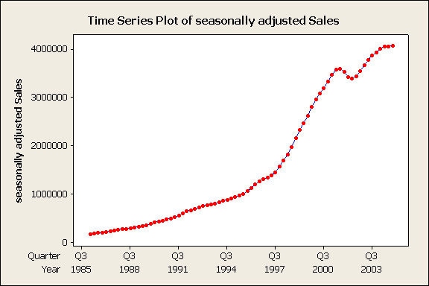
Examining stationarity of time series data
The time series plot shows that it is non-stationary in the mean.
The next slide shows the ACF plot for this data series.

Slide 26
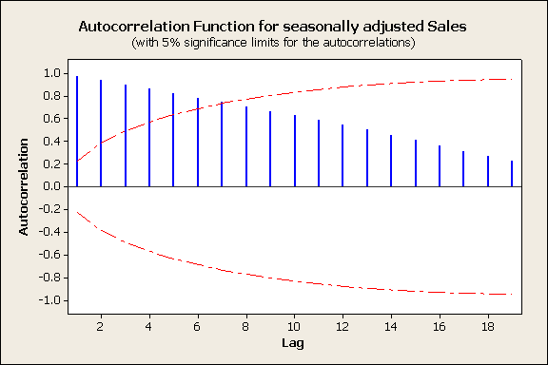
Examining stationarity of time series data
The ACF also shows a pattern typical for a non-stationary series:
Large significant ACF for the first 7 time lag
Slow decrease in the size of the autocorrelations.
The PACF is shown in the next slide.

Slide 27
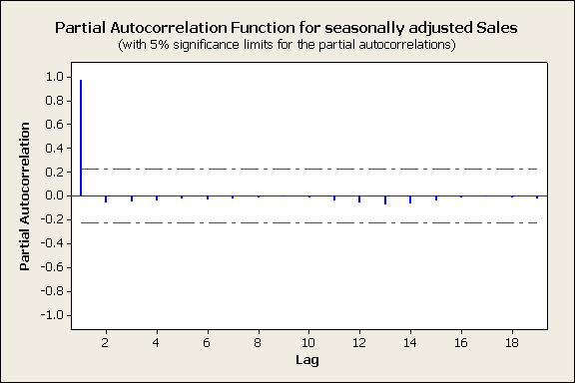
Examining stationarity of time series data
This is also typical of a non-stationary series. Partial autocorrelation at time lag 1 is close to one and the partial autocorrelation for the time lag 2 through 18 are close to zero

Slide 28
Removing non-stationarity in time series
The non-stationary pattern in a time series data needs to be removed in order that other correlation structure present in the series can be seen before proceeding with model building.
One way of removing non-stationarity is through the method of differencing.

Slide 29
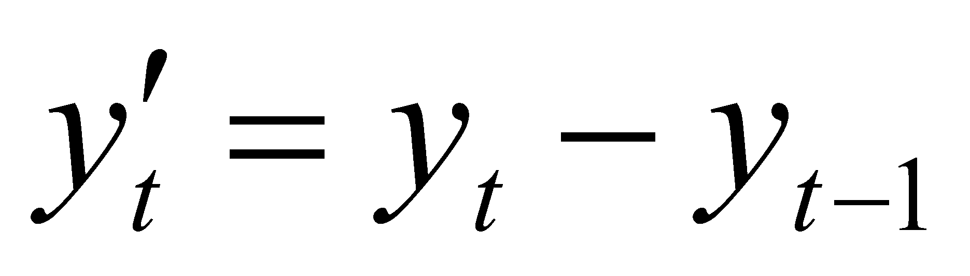
Removing non-stationarity in time series
The differenced series is defined as:
The following two slides shows the time series plot and the ACF plot of the monthly S&P 500 composite index from 1979 to 1997.

Slide 30
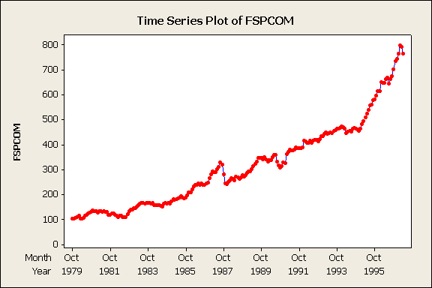
Removing non-stationarity in time series

Slide 31
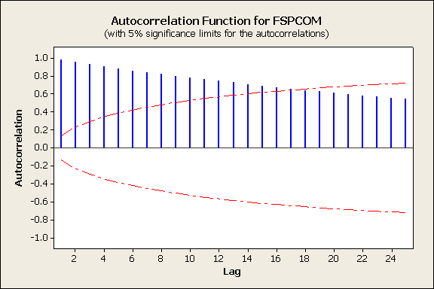
Removing non-stationarity in time series

Slide 32
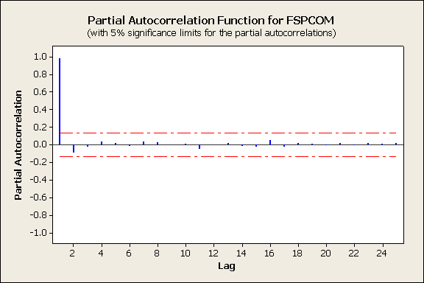
Removing non-stationarity in time series

Slide 33
Removing non-stationarity in time series
The time plot shows that it is not stationary in the mean.
The ACF and PACF plot also display a pattern typical for non-stationary pattern.
Taking the first difference of the S& P 500 composite index data represents the monthly changes in the S&P 500 composite index.

Slide 34
Removing non-stationarity in time series
The time series plot and the ACF and PACF plots indicate that the first difference has removed the growth in the time series data.
The series looks just like a white noise with almost no autocorrelation or partial autocorrelation outside the 95% limits.

Slide 35
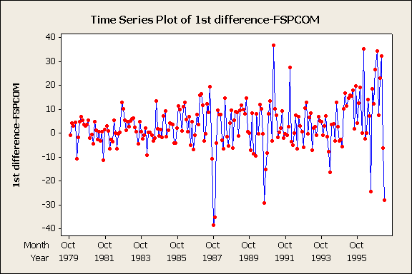
Removing non-stationarity in time series

Slide 36
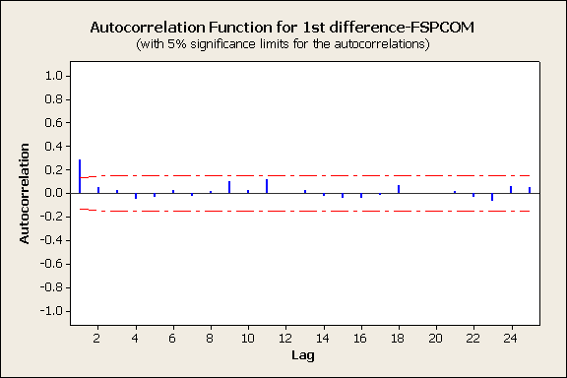
Removing non-stationarity in time series

Slide 37
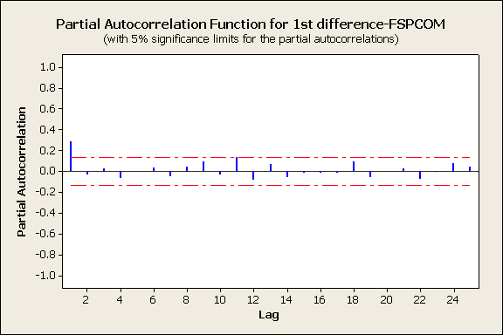
Removing non-stationarity in time series
Note that the ACF and PACF at lag 1 is outside the limits, but it is acceptable to have about 5% of spikes fall a short distance beyond the limit due to chance.

Slide 38
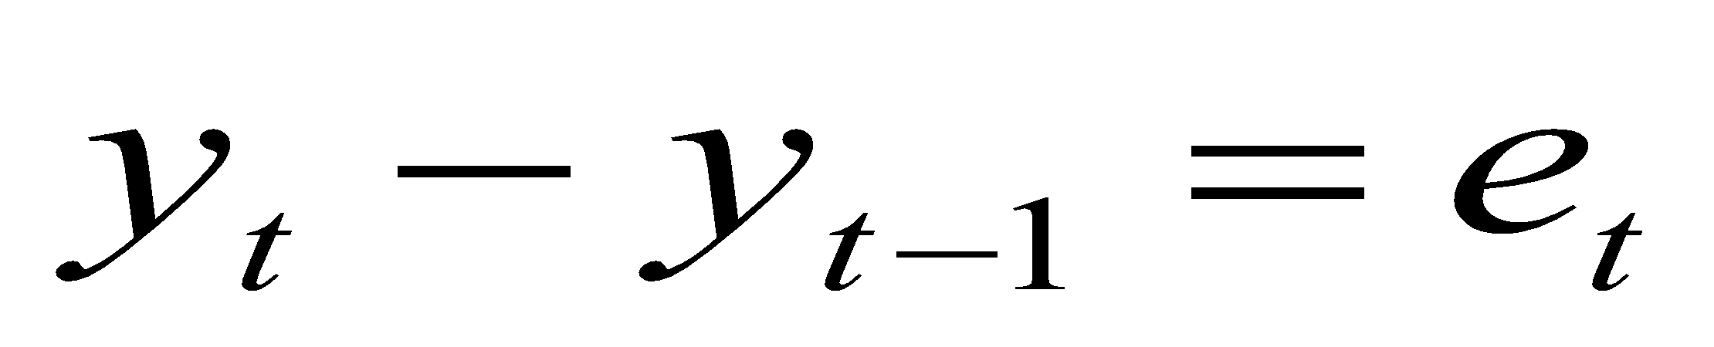
Random Walk
Let y_{t} denote the S&P 500 composite index, then the time series plot of differenced S&P 500 composite index suggests that a suitable model for the data might be
Where e_{t} is white noise.

Slide 39
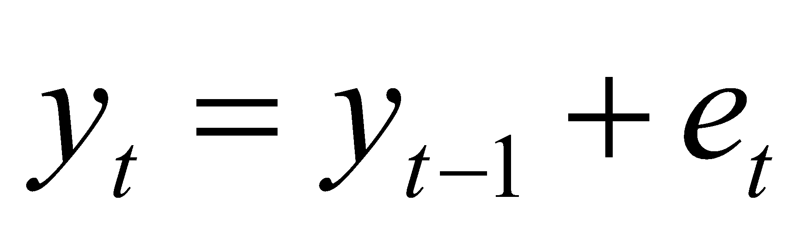
Random Walk
The equation in the previous slide can be rewritten as
This model is known as “random walk” model and it is widely used for non-stationary data.
Random walks typically have long periods of apparent trends up or down which can suddenly change direction unpredictably
They are commonly used in analyzing economic and stock price series.

Slide 40
Removing non-stationarity in time series
Taking first differencing is a very useful tool for removing non-statioanarity, but sometimes the differenced data will not appear stationary and it may be necessary to difference the data a second time.
The series of second order difference is defined:
In practice, it is almost never necessary to go beyond second order differences.

Slide 41
Differencing
In this method, we compute the difference of consecutive terms in the series.
Differencing is typically performed to get rid of the varying mean.
Mathematically, differencing can be written as:
y_{t}‘ = y_{t} – y_{(t-1)} where y_{t} is the value at a time t
In seasonal differencing, instead of calculating the difference between consecutive values, we calculate the difference between an observation and a previous observation from the same season.
For example, an observation taken on a Monday will be subtracted from an observation taken on the previous Monday. Mathematically it can be written as:
y_{t}‘ = y_{t} – y_{(t-n)} n=7

Slide 42
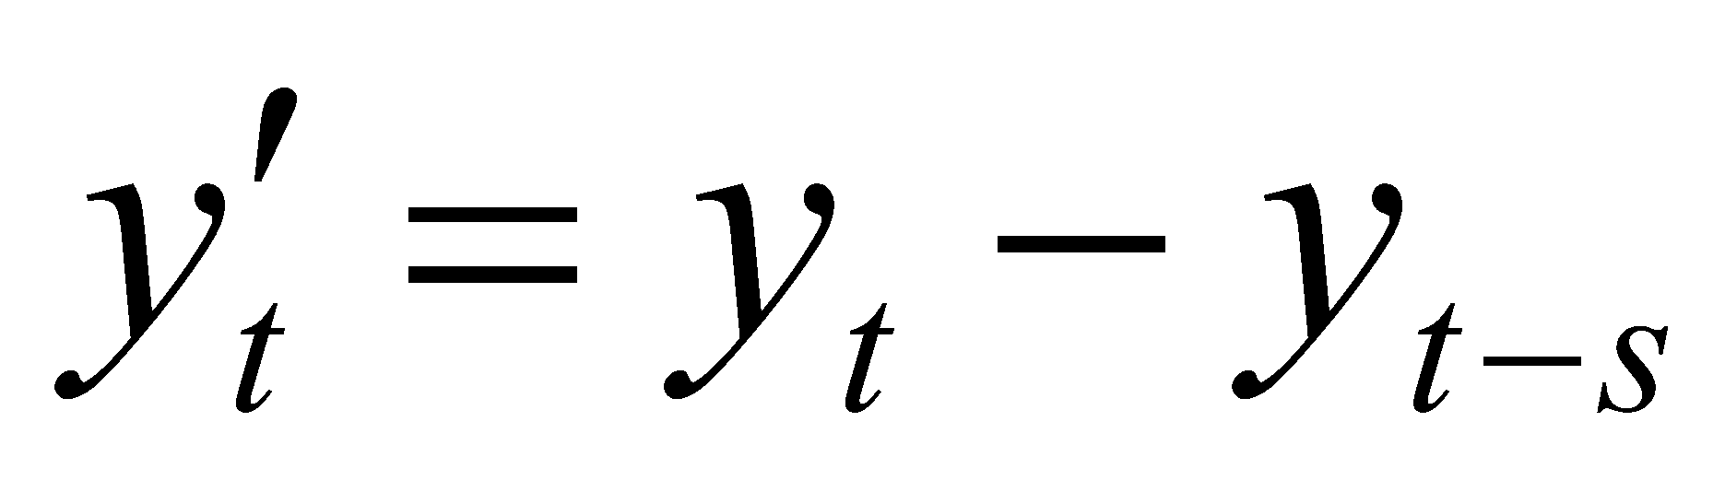
Seasonal differencing
With seasonal data which is not stationary, it is appropriate to take seasonal differences.
A seasonal difference is the difference between an observation and the corresponding observation from the previous year.
Where s is the length of the season

Slide 43
Seasonal differencing
The Gap quarterly sales is an example of a non-stationary seasonal data.
The following time series plot show a trend with a pronounced seasonal component
The auto correlations show that:
The series is non-stationary.
The series is seasonal.

Slide 44
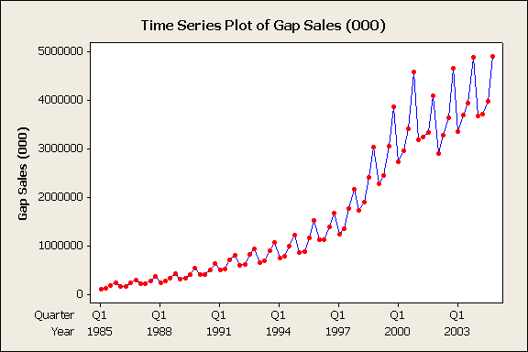
Seasonal differencing

Slide 45
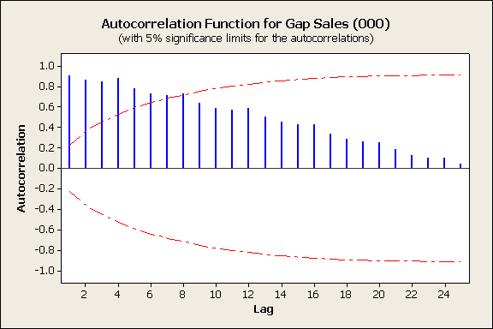
Seasonal differencing

Slide 46
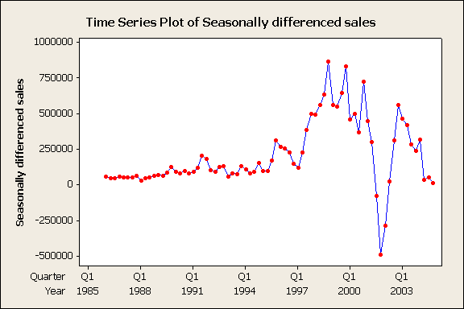
Seasonal differencing
The seasonally differenced series represents the change in sales between quarters of consecutive years.
The time series plot, ACF and PACF of the seasonally differenced Gap’s quarterly sales are in the following three slides.

Slide 47
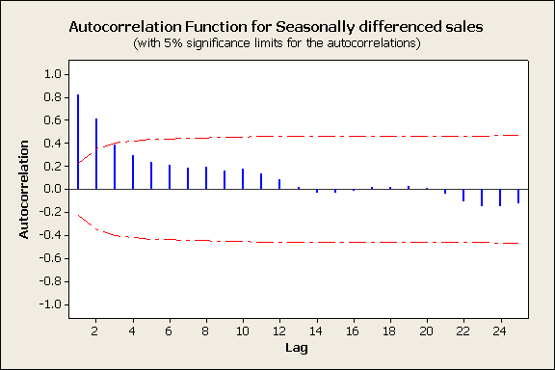
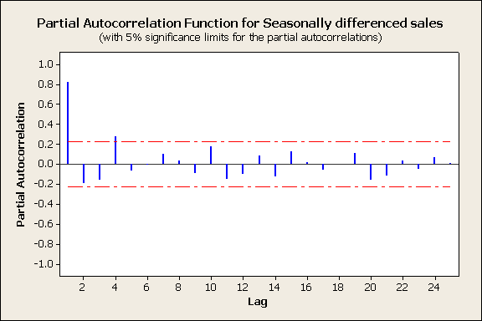
Seasonal differencing

Slide 48
Seasonal differencing
The series is now much closer to being stationary, but more than 5% of the spikes are beyond 95% critical limits and autocorrelation show gradual decline in values.
The seasonality is still present as shown by spike at time lag 4 in the PACF.
The remaining non-stationarity in the mean can be removed with a further first difference.
When both seasonal and first differences are applied, it does not make no difference which is done first.

Slide 49
Seasonal differencing
It is recommended to do the seasonal differencing first since sometimes the resulting series will be stationary and hence no need for a further first difference.
When differencing is used, it is important that the differences be interpretable.
The series resulted from first difference of seasonally differenced Gap’s quarterly sales data is reported in the following three slides.
Is the resulting series white noise?

Slide 50
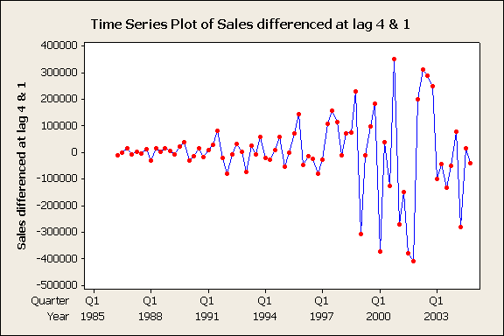
Seasonal differencing

Slide 51
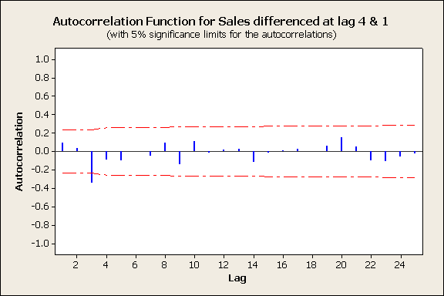
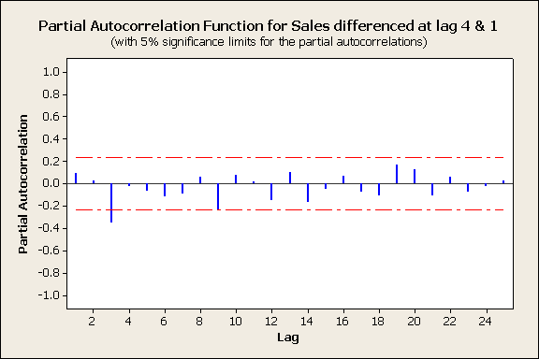
Seasonal differencing

Slide 52
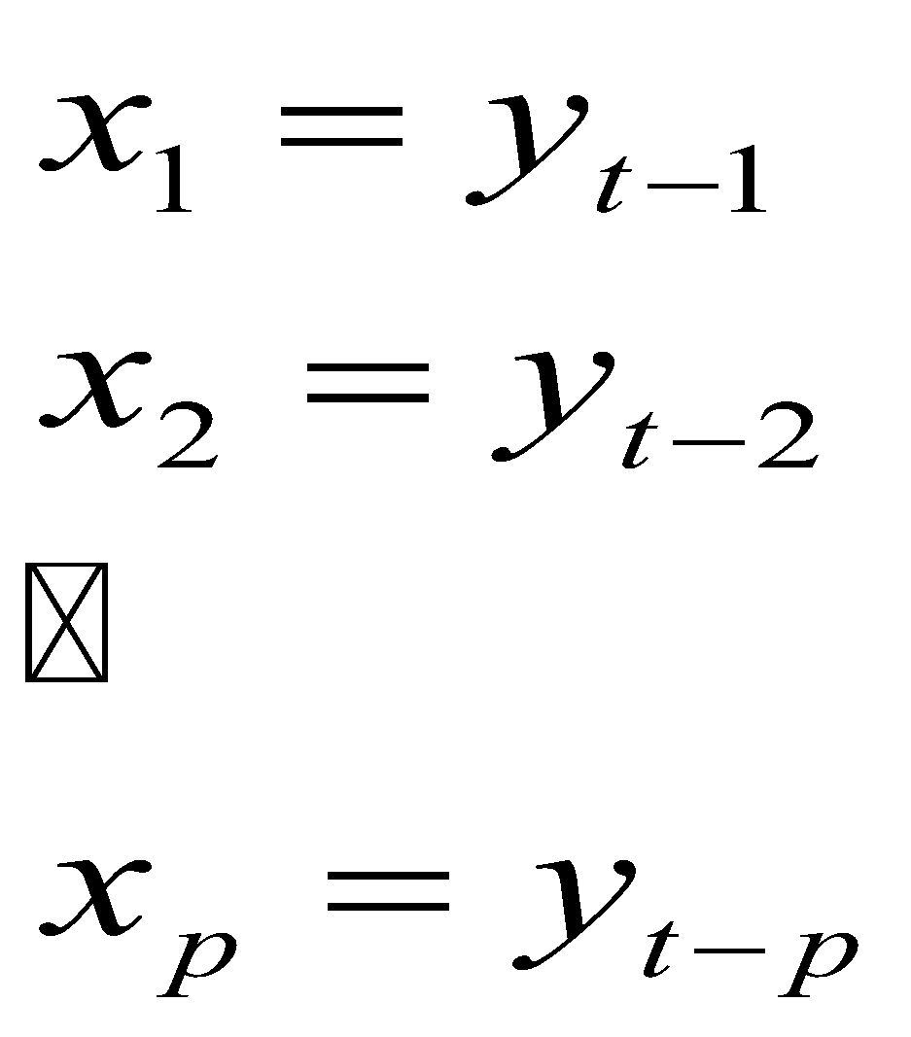
ARIMA models for time series data
Autoregression
Consider regression models of the form
Define

Slide 53
ARIMA models for time series data
Then the previous equation becomes:
The explanatory variables in this equations are time-lagged values of the variable y.
Autoregression (AR) is used to describe models of this form.
Autoregression models should be treated differently from ordinary regression models since:
The explanatory variables in the autoregression models have a built-in dependence relationship.
Determining the number of past values of y_{t} to include in the model is not always straight forward

Slide 54
ARIMA models for time series data
Moving average model
A time series model which uses past errors as explanatory variable:
is called moving average(MA) model
Note that this model is defined as a moving average of the error series, while the moving average models we discussed previously are the moving average of the observations.

Slide 55
ARIMA models for time series data
Autoregressive (AR) models can be coupled with moving average (MA) models to form a general and useful class of time series models called Autoregressive Moving Average (ARMA) models.
These can be used when the data are stationary.
This class of models can be extended to non-stationary series by allowing the differencing of the data series.
These are called Autoregressive Integrated Moving Average (ARIMA) models.
There are a large variety of ARIMA models.

Slide 56
ARIMA models for time series data
The general non-seasonal model is known as ARIMA (p, d, q):
p is the number of autoregressive terms.
d is the number of differences.
q is the number of moving average terms.
A white noise model is classified as ARIMA (0, 0, 0)
No AR part since y_{t} does not depend on y_{t-1}
There is no differencing involved.
No MA part since y_{t} does not depend on e_{t-1}

Slide 57
ARIMA models for time series data
A random walk model is classified as ARIMA (0, 1, 0)
There is no AR part.
There is no MA part.
There is one difference.
Note that if any of p, d, or q are equal to zero, the model can be written in a shorthand notation by dropping the unused part.
Example
ARIMA(2, 0, 0) = AR(2)
ARIMA (1, 0, 1) = ARMA(1, 1)

Slide 58
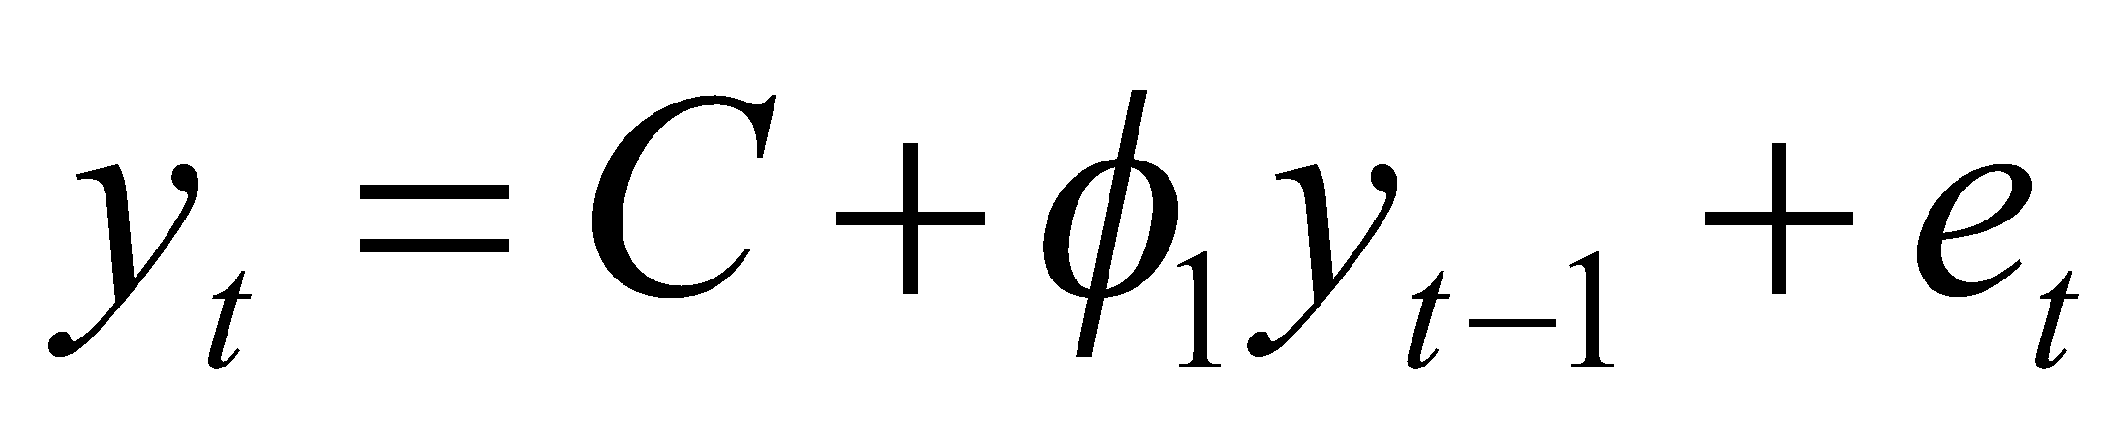
An autoregressive model of order one AR(1)
The basic form of an ARIMA (1, 0, 0) or AR(1) is:
Observation y_{t} depends on y _{t-1}
The value of autoregressive coefficient φ₁ is between –1 and 1.

Slide 59
An Autoregressive model of order one
The time plot of an AR(1) model varies with the parameter φ₁:
When φ₁= 0, y_{t} is equivalent to a white noise series.
When φ₁= 1, y_{t} is equivalent to a random walk series
For negative values of φ₁, the series tends to oscillate between positive and negative values.
The following slides show the time series, ACF and PACF plot for an ARIMA(1, 0, 0) time series data.

Slide 60
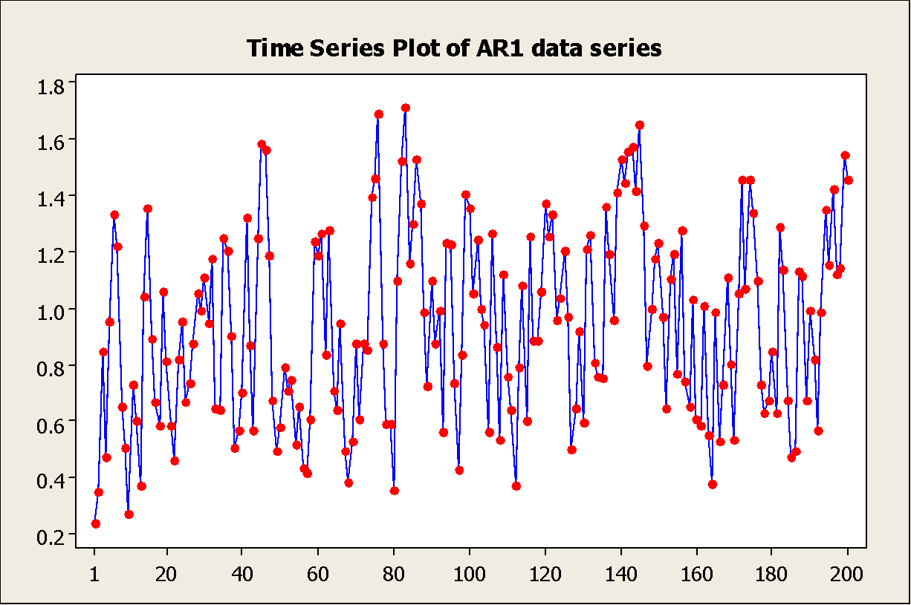
An autoregressive model of order one

Slide 61
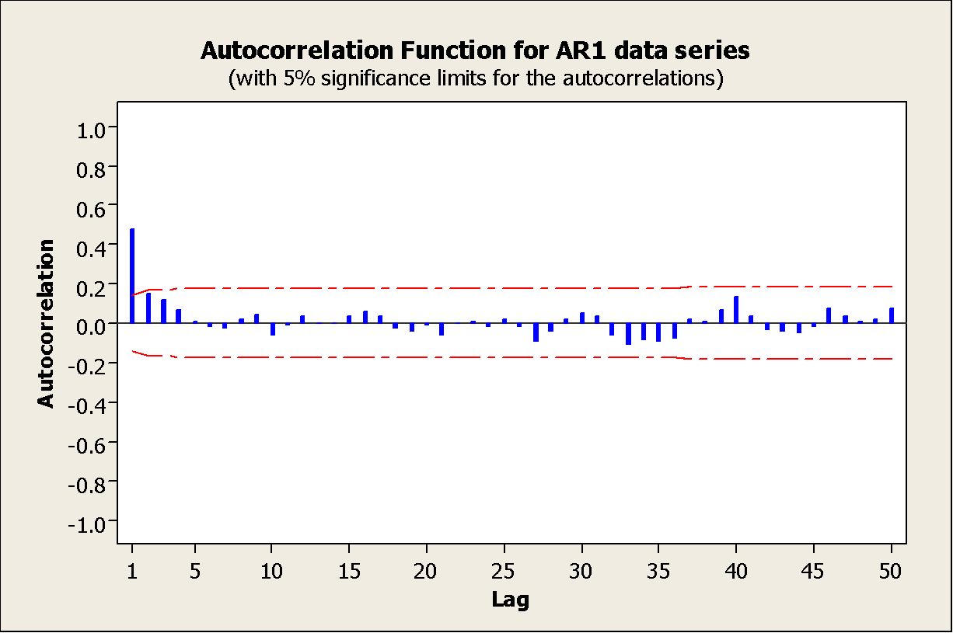
An autoregressive model of order one

Slide 62
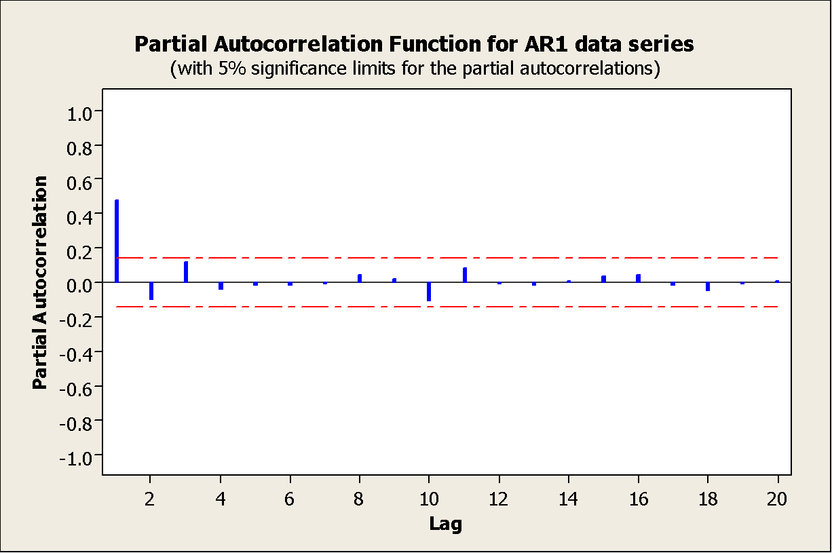
An autoregressive model of order one
The ACF and PACF can be used to identify an AR(1) model.
The autocorrelations decay exponentially.
There is a single significant partial autocorrelation.

Slide 63
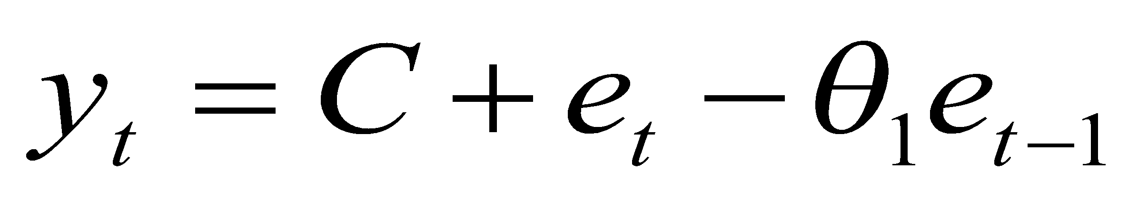
Moving Average of order one MA(1)
The general form of ARIMA (0, 0, 1) or MA(1) model is
Y_{t} depends on the error term e_{t} and on the previous error term e_{t-1} with coefficient - θ₁.
The value of θ₁ is between –1 and 1.
The following slides show an example of an MA(1) data series.

Slide 64
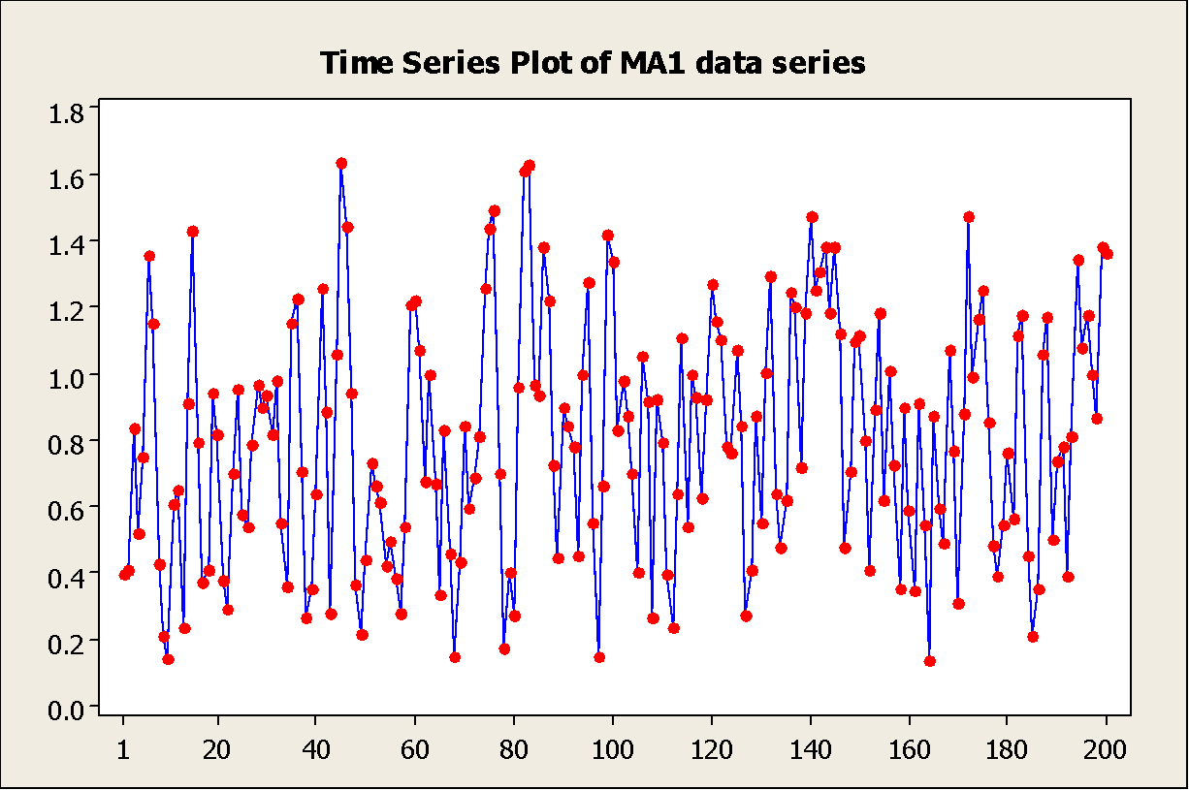
A moving average of order one MA(1)

Slide 65
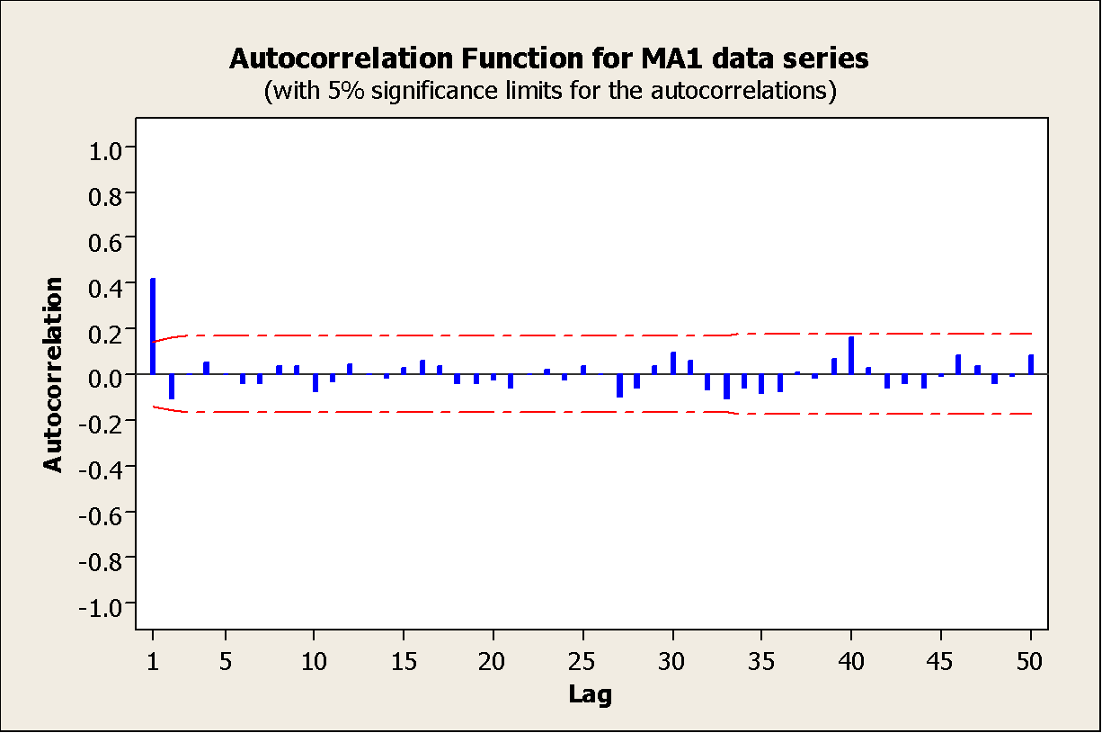
A moving average of order one MA(1)

Slide 66
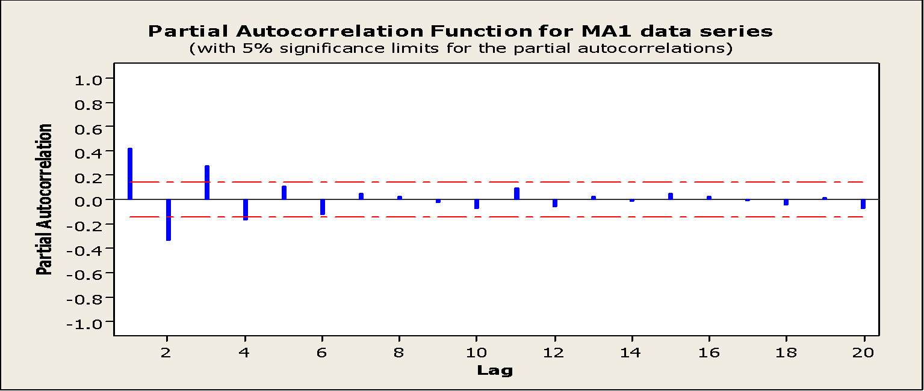
A moving average of order one MA(1)
Note that there is only 1 significant autocorrelation at time lag 1.
The partial autocorrelations decay exponentially, but because of random error components, they do not die out to zero as do the theoretical autocorrelation

Slide 67
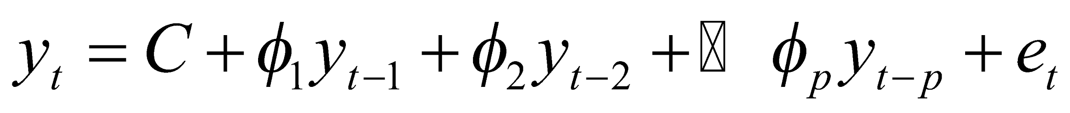
Higher order auto regressive models
A p^{th}-order AR model is defined as
C is the constant term
φ_{j} is the j^{th} auto regression parameter
e_{t} is the error term at time t.

Slide 68
Higher order auto regressive models
Restrictions on the allowable values of auto regression parameters
For p =1
-1< φ₁ < 1
For p = 2
-1< φ₂ < 1
φ₁+ φ₂ <1
φ₂- φ₁ <1

Slide 69
Higher order auto regressive models
A great variety of time series are possible with autoregressive models.
The following slides shows an AR(2) model.
Note that for AR(2) models the autocorrelations die out in a damped Sine-wave patterns.
There are exactly two significant partial autocorrelations.

Slide 70
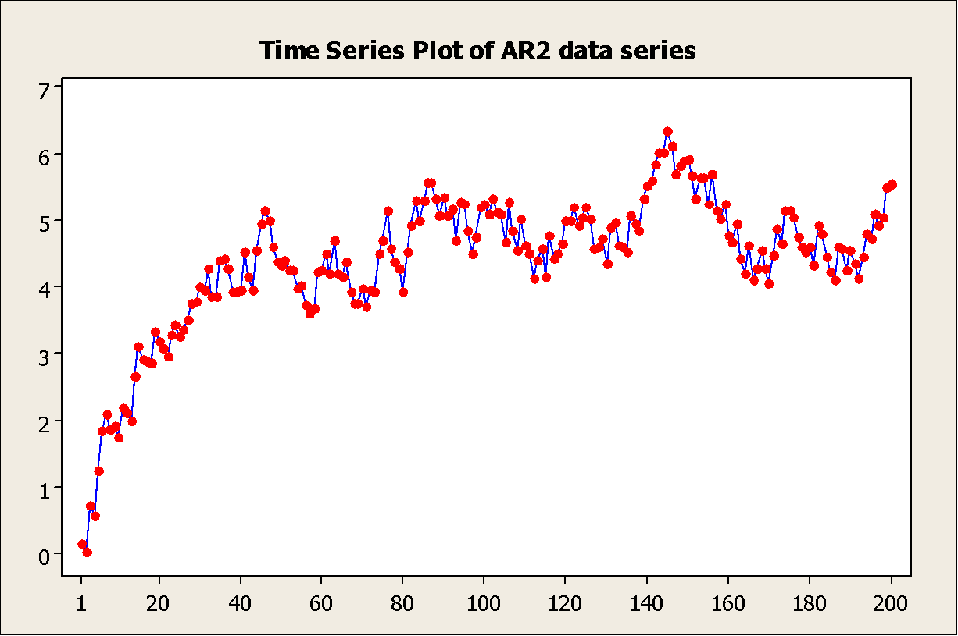
Higher order auto regressive models

Slide 71
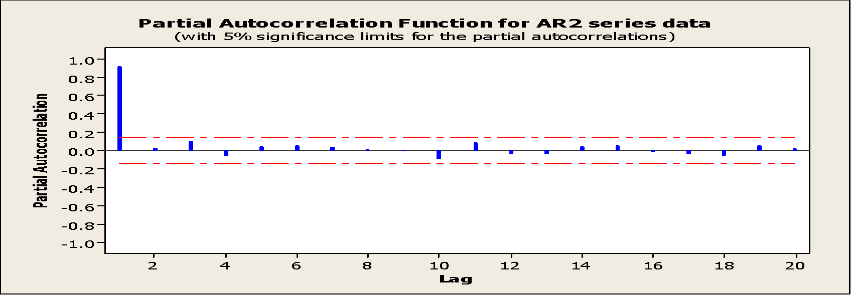
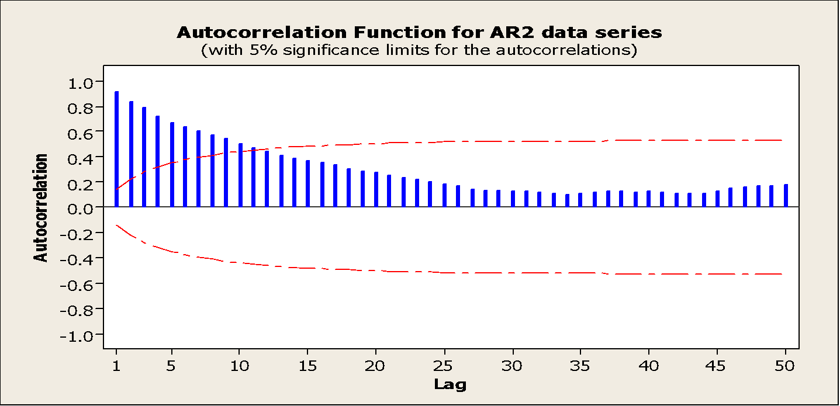
Higher order auto regressive models

Slide 72
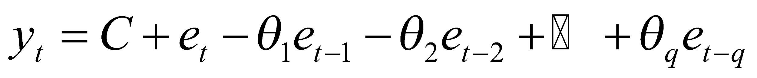
Higher order moving average models
The general MA model of order q can be written as:
C is the constant term
θ_{j} is the jth moving average parameter.
e _{t-k} is the error term at time t-k

Slide 73
Higher order moving average models
Restrictions on the allowable values of the MA parameters.
For q =1
-1 < θ₁ < 1
For q =2
-1 < θ₂ < 1
θ₁ + θ₂ < 1
θ₂ - θ₁ < 1

Slide 74
Higher order moving average models
A wide variety of time series can be produced using moving average models.
In general, the autocorrelations of an MA(q) models are zero beyond lag q
For q ≥ 2, the PACF can show exponential decay or damped sine-wave patterns.

Slide 75
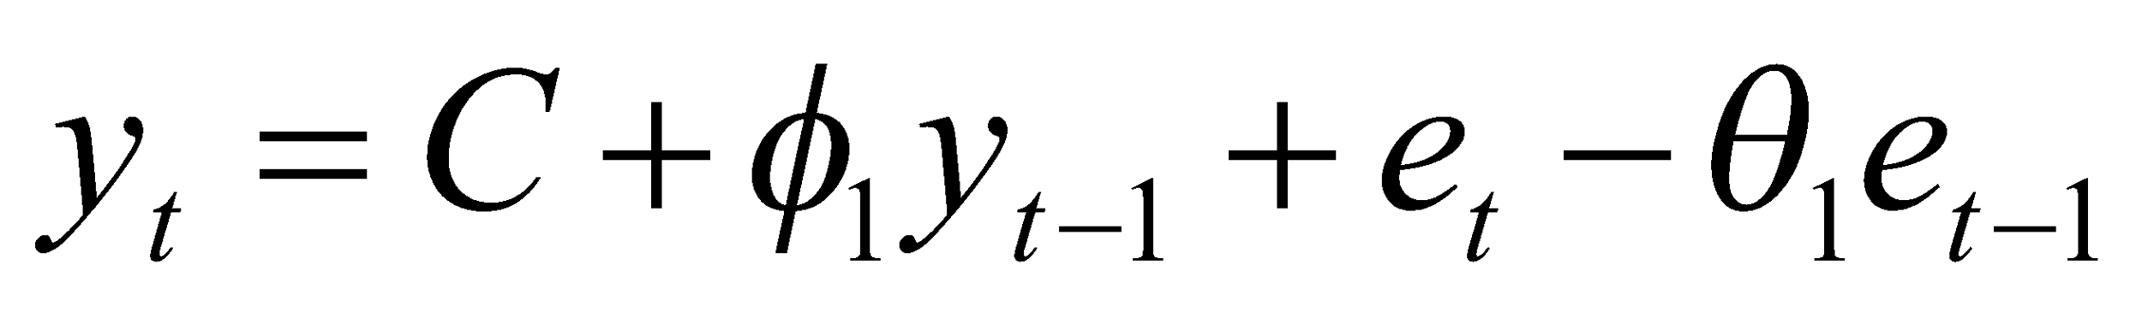
Mixtures ARMA models
Basic elements of AR and MA models can be combined to produce a great variety of models.
The following is the combination of MA(1) and AR(1) models
This is model called ARMA(1, 1) or
ARIMA (1, 0, 1)
The series is assumed stationary in the mean and in the variance.

Slide 76
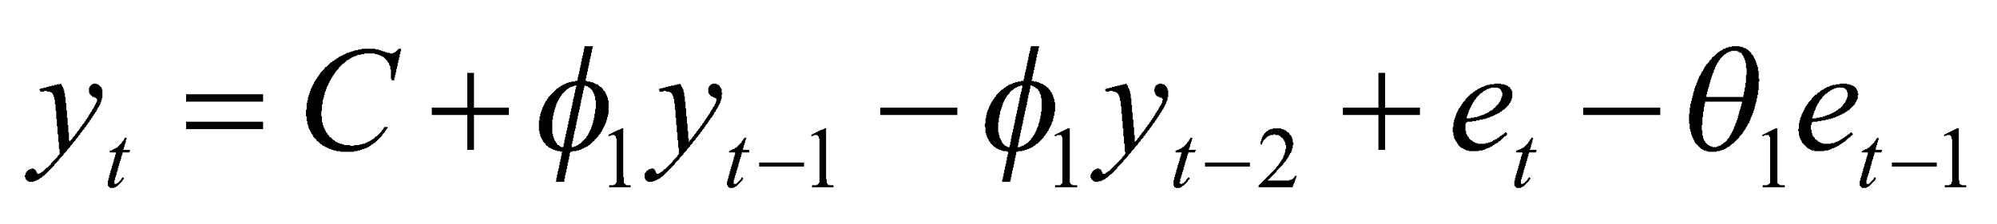
Mixtures ARIMA models
If non-stationarity is added to a mixed ARMA model, then the general ARIMA (p, d, q) is obtained.
The equation for the simplest ARIMA (1, 1, 1) is given below.

Slide 77
Mixtures ARIMA models
The general ARIMA (p, d, q) model gives a tremendous variety of patterns in the ACF and PACF, so it is not practical to state rules for identifying general ARIMA models.
In practice, it is seldom necessary to deal with values p, d, or q that are larger than 0, 1, or 2.
It is remarkable that such a small range of values for p, d, or q can cover such a large range of practical forecasting situations.

Slide 78
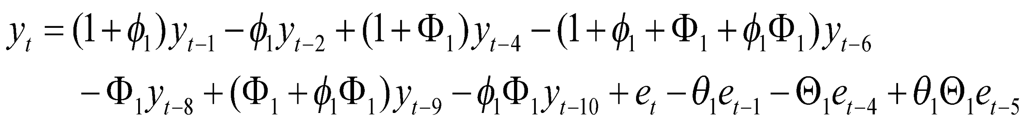
Seasonality and ARIMA models
The ARIMA models can be extended to handle seasonal components of a data series.
The general shorthand notation is
ARIMA (p, d, q)(P, D, Q)_{s}
Where s is the number of periods per season.
The general ARIMA(1,1,1)(1,1,1)₄ can be written as:
Once the coefficients φ₁, Ф₁, θ₁, and Θ₁ have been estimated from the data, the above equation can be used for forecasting.

Slide 79
Seasonality and ARIMA models
The seasonal lags of the ACF and PACF plots show the seasonal parts of an AR or MA model.
Examples:
Seasonal MA model:
ARIMA(0,0,0)(0,0,1)₁₂
will show a spike at lag 12 in the ACF but no other significant spikes.
The PACF will show exponential decay in the seasonal lags i.e. at lags 12, 24, 36,…
Seasonal AR model:
ARIMA(0,0,0)(1,0,0)₁₂
will show exponential decay in seasonal lags of the ACF.
Single significant spike at lag 12 in the PACF.

Slide 80
Implementing the model –Building Strategy
The Box –Jenkins approach uses an iterative model-building strategy that consist of:
Selecting an initial model (model identification)
Estimating the model coefficients (parameter estimation)
Analyzing the residuals (model checking)
If necessary, the initial model is modified and the process is repeated until the residual indicate no further modification is necessary.
At this point the fitted model can be used for forecasting.

Slide 81
Model identification
The following approach outlines an approach to select an appropriate model among a large variety of ARIMA models possible.
Plot the data
Identify any unusual observations
If necessary, transform the data to stabilize the variance
Check the time series plot, ACF, PACF of the data (possibly transformed) for stationarity.
IF
Time plot shows the data scattered horizontally around a constant mean
ACF and PACF to or near zero quickly
Then, the data are stationary.

Slide 82
Model identification
Use differencing to transform the data into a stationary series
For no-seasonal data take first differences
For seasonal data take second seasonal differences
Check the plots again if they appear non-stationary, take the differences of the differenced data.
When the stationarity has been achieved, check the ACF and PACF plots for any pattern remaining.

Slide 83
Model identification
There are three possibilities:
AR or MA models
No significant ACF after time lag q indicates MA(q) may be appropriate.
No significant PACF after time lag p indicates that AR(p) may be appropriate.
Seasonality is present if ACF and/or PACF at the seasonal lags are large and significant.
If no clear MA or AR model is suggested, a mixture model may be appropriate

Slide 84
Model identification
Example (1):
Non seasonal time series data.
The following example looks at the number of users logged onto an internet server over a 100 minutes period.
The time plot, ACF and PACF is reported in the following three slides.

Slide 85

Model identification

Slide 86


Model identification

Slide 87
Model identification
The gradual decline of ACF values indicates non-stationary series.
The first partial autocorrelation is very dominant and close to 1, indicating non-stationarity.
The time series plot clearly indicates non-stationarity.
We take the first differences of the data and reanalyze.

Slide 88

Model identification

Slide 89

Model identification

Slide 90

Model identification
ACF shows a mixture of exponential decay and sine-wave pattern
PACF shows three significant PACF values.
This suggests an AR(3) model.
This identifies an ARIMA(3,1,0).

Slide 91
Model identification
Example (2):
A seasonal time series.
The following example looks at the monthly industry sales (in thousands of francs) for printing and writing papers between the years 1963 and 1972.
The time plot, ACF and PACF shows a clear seasonal pattern in the data.
This is clear in the large values at time lag 12, 24 and 36.

Slide 92

Model identification

Slide 93


Model identification

Slide 94
Model identification
We take a seasonal difference and check the time plot, ACF and PACF.
The seasonally differenced data appears to be non-stationary (the plots are not shown), so we difference the data again.
the following three slides show the twice differenced series.

Slide 95

Model identification

Slide 96

Model identification

Slide 97

Model identification
The PACF shows the exponential decay in values.
The ACF shows a significant value at time lag 1.
This suggest a MA(1) model.
The ACF also shows a significant value at time lag 12
This suggest a seasonal MA(12).

Slide 98
Model identification
Therefore, the identifies model is
ARIMA (0,1,1)(0,1,1)₁₂.
This model is sometimes is called the “airline model” because it was applied to international airline data by Box and Jenkins.
It is one of the most commonly used seasonal ARIMA model.

Slide 99
Model identification
Example (3):
A seasonal data needing transformation
In this example we look at the monthly shipments of a company that manufactures pollution equipment
The time plot shows that the variability increases as the time increases. This indicate that the data is non-stationary in the variance.

Slide 100

Model identification

Slide 101
Model identification
We need to stabilize the variance before fitting an ARIMA model.
Logarithmic or power transformation of the data will make the variance stationary.
The time plot, ACF and PACF for the logged data is reported in the following three slides.

Slide 102

Model identification

Slide 103


Model identification

Slide 104
Model identification
The time plot shows that the magnitude of the fluctuations in the log-transformed data does not vary with time.
But, the logged data are clearly non-stationary.
The gradual decay of the ACF values.
To achieve stationarity, we take the first differences of the logged data.
The plots are reported in the next three slides.

Slide 105

Model identification

Slide 106


Model identification

Slide 107
Model identification
There are significant spikes at time lag 1 and 2 in the PACF, indicating an AR(2) might be appropriate.
The single significant spike at lag 12 of the PACF indicates a seasonal AR(1) component.
Therefore for the logged data a tentative model would be
ARIMA(2,1,0)(1,0,0)₁₂

Slide 108
Summary
The process of identifying an ARIMA model requires experience and good judgment.
The following guidelines can be helpful:
Make the series stationary in mean and variance
Differencing will take care of non-stationarity in the mean.
Logarithmic or power transformation will often take care of non-stationarity in the variance.

Slide 109
Summary
Consider non-seasonal aspect
The ACF and PACF of the stationary data obtained from the previous step can reveal whether MA of AR is feasible.
Exponential decay or damped sine-wave. For ACF, and spikes at lags 1 to p then cut off to zero, indicate an AR(P) model.
Spikes at lag1 to q, then cut off to zero for ACF and exponential decay or damped sine-wave for PACF indicates MA(q) model.

Slide 110
Summary
Consider seasonal aspect
Examination of ACF and PACF at the seasonal lags can help to identify AR and MA models for the seasonal aspect of the data.
For example, for quarterly data the pattern of r₄, r₈, r₁₂, r₁₆, and so on.

Slide 111
Estimating the parameters
Once a tentative model has been selected, the parameters for the model must be estimated.
The method of least squares can be used for RIMA model.
However, for models with an MA components, there is no simple formula that can be used to estimate the parameters.
Instead, an iterative method is used. This involves starting with a preliminary estimate, and refining the estimate iteratively until the sum of the squared errors is minimized.

Slide 112
Estimating the parameters
Another method of estimating the parameters is the maximum likelihood procedure.
Like least squares methods, these estimates must be found iteratively.
Maximum likelihood estimation is usually favored because it has some desirable statistical properties.
After the estimates and their standard errors are determined, t values can be constructed and interpreted in the usual way.
Parameters that are judged significantly different from zero are retained in the fitted model; parameters that are not significantly different from zero are dropped from the model.

Slide 113

Estimating the parameters
There may have been more than one plausible model identified, and we need a method to determine which of them is preferred.
Akaike’s Information Criterion (AIC)
L denotes the likelihood
m is the number of parameters estimated in the model: m = p+q+P+Q

Slide 114

Estimating the parameters
Because not all computer programs produce the AIC or the likelihood L, it is not always possible to find the AIC for a given model.
A useful approximation to the AIC is:

Slide 115
Diagnostic Checking
Before using the model for forecasting, it must be checked for adequacy.
A model is adequate if the residuals left over after fitting the model is simply white noise.
The pattern of ACF and PACF of the residuals may suggest how the model can be improved.
For example
Significant spikes at the seasonal lags suggests adding seasonal component to the chosen model
Significant spikes at small lags suggest increasing the non-seasonal AR or MA components of the model.

Slide 116
Diagnostic Checking
A portmanteau test can also be applied to the residuals as an additional test of fit.
If the portmanteau test is significant, then the model is inadequate.
In this case we need to go back and consider other ARIMA models.
Any new model will need their parameters estimated and their AIC values computed and compared with other models.
Usually, the model with the smallest AIC will have residuals which resemble white noise.
Occasionally, it might be necessary to adopt a model with not quite the smallest AIC value, but with better behaved residuals.

Slide 117
Example
The analyst for the ISC Corporation was asked to develop forecasts for the closing prices of ISC stock.
The stock has been languishing for some time with little growth, and senior management wanted some projections to discuss with the board of directors.
The ISC stock prices are plotted in the following slide.

Slide 118

Example

Slide 119
Example
The plot of the stock prices suggests the series is stationary.
The stock prices vary about a fixed level of approximately 250.
Is the Box-Jenkins methodology appropriate for this data series?
The ACF and PACF for the stock price series are reported in the following two slides.

Slide 120


Example

Slide 121
Example
The sample ACF alternate in sign and decline to zero after lag 2.
The sample PACF are similar are close to zero after time lag 2.
These are consistent with an AR(2) or ARIMA(2,0,0) model
AR(2) model is fit to the data.
WE include a constant term to allow for a nonzero level.

Slide 122
Example
The estimated coefficient φ₂ is not significant (t=1.75) at 5% level but is significant at the 10 % level.
The residual ACF and PACF are given in the following two slides.
The ACF and PACF are well within their two standard error limits.
Final Estimates of Parameters
Type Coef SE T P
AR 1 -0.3243 0.1246 -2.60 0.012
AR 2 0.2192 0.1251 1.75 0.085
Constant 284.903 6.573 43.34 0.000

Slide 123


Example

Slide 124
Example
The p-value for the Ljung-Box statistics for m = 12, 24, 36, and 48 are all large (> 5%) indicating an adequate model.
We use the model to generate forecasts for periods 66 and 67.
MS = 2808 DF = 62
Modified Box-Pierce (Ljung-Box) Chi-Square statistic
Lag 12 24 36 48
Chi-Square 6.3 13.3 18.2 29.1
DF 9 21 33 45
P-Value 0.707 0.899 0.983 0.969

Slide 125

Example
The forecasts are generated by the following equation:

Slide 126


Example
The 95% prediction limits are approximately:
The 95% prediction limits for period 66 are:

Slide 127
Final Comments
In ARIMA modeling, it is NOT good practice to include AR and MA parameters to “cover all possibilities” suggested by the sample ACF and Sample PACF.
This means, when in doubt, start with a model containing few parameters rather than many parameters. The need for additional parameters will be evident from the residual ACF and PACF.
Least square estimates of AR and MA parameters in ARIMA models tend to be highly correlated. When there are more parameters than necessary, this leads to unstable models that can produce poor forecasts.

Slide 128
Final Comments
To summarize, start with a small number of clearly justifiable parameters and add one parameter at a time as needed.
If parameters in a fitted ARIMA model are not significant, delete one parameter at a time and refit the model.
Because of high correlation among estimated parameters, it may be the case that a previously non-significant parameter becomes significant.

Slide 129
Summary of rules for identifying ARIMA models
Identifying the order of differencing and the constant:
Rule 1: If the series has positive autocorrelations out to a high number of lags (say, 10 or more), then it probably needs a higher order of differencing.
Rule 2: If the lag-1 autocorrelation is zero or negative, or the autocorrelations are all small and patternless, then the series does not need a higher order of differencing. If the lag-1 autocorrelation is -0.5 or more negative, the series may be overdifferenced. BEWARE OF OVERDIFFERENCING.
Rule 3: The optimal order of differencing is often the order of differencing at which the standard deviation is lowest. (Not always, though. Slightly too much or slightly too little differencing can also be corrected with AR or MA terms. See rules 6 and 7.)

Slide 130
Summary of rules for identifying ARIMA models
Rule 4: A model with no orders of differencing assumes that the original series is stationary (among other things, mean-reverting). A model with one order of differencing assumes that the original series has a constant average trend (e.g. a random walk or SES-type model, with or without growth). A model with two orders of total differencing assumes that the original series has a time-varying trend (e.g. a random trend or LES-type model).
Rule 5: A model with no orders of differencing normally includes a constant term (which allows for a non-zero mean value). A model with two orders of total differencing normally does not include a constant term. In a model with one order of total differencing, a constant term should be included if the series has a non-zero average trend.

Slide 131
Summary of rules for identifying ARIMA models
Identifying the numbers of AR and MA terms:
Rule 6: If the partial autocorrelation function (PACF) of the differenced series displays a sharp cutoff and/or the lag-1 autocorrelation is positive--i.e., if the series appears slightly "underdifferenced"--then consider adding one or more AR terms to the model. The lag beyond which the PACF cuts off is the indicated number of AR terms.
Rule 7: If the autocorrelation function (ACF) of the differenced series displays a sharp cutoff and/or the lag-1 autocorrelation is negative--i.e., if the series appears slightly "overdifferenced"--then consider adding an MA term to the model. The lag beyond which the ACF cuts off is the indicated number of MA terms.

Slide 132
Summary of rules for identifying ARIMA models
Rule 8: It is possible for an AR term and an MA term to cancel each other's effects, so if a mixed AR-MA model seems to fit the data, also try a model with one fewer AR term and one fewer MA term--particularly if the parameter estimates in the original model require more than 10 iterations to converge. BEWARE OF USING MULTIPLE AR TERMS AND MULTIPLE MA TERMS IN THE SAME MODEL.
Rule 9: If there is a unit root in the AR part of the model--i.e., if the sum of the AR coefficients is almost exactly 1--you should reduce the number of AR terms by one and increase the order of differencing by one.
Rule 10: If there is a unit root in the MA part of the model--i.e., if the sum of the MA coefficients is almost exactly 1--you should reduce the number of MA terms by one and reduce the order of differencing by one.
Rule 11: If the long-term forecasts* appear erratic or unstable, there may be a unit root in the AR or MA coefficients.

Slide 133
Summary of rules for identifying ARIMA models
Identifying the seasonal part of the model:
Rule 12: If the series has a strong and consistent seasonal pattern, then you must use an order of seasonal differencing (otherwise the model assumes that the seasonal pattern will fade away over time). However, never use more than one order of seasonal differencing or more than 2 orders of total differencing (seasonal+nonseasonal).
Rule 13: If the autocorrelation of the appropriately differenced series is positive at lag s, where s is the number of periods in a season, then consider adding an SAR term to the model. If the autocorrelation of the differenced series is negative at lag s, consider adding an SMA term to the model. The latter situation is likely to occur if a seasonal difference has been used, which should be done if the data has a stable and logical seasonal pattern. The former is likely to occur if a seasonal difference has not been used, which would only be appropriate if the seasonal pattern is not stable over time. You should try to avoid using more than one or two seasonal parameters (SAR+SMA) in the same model, as this is likely to lead to overfitting of the data and/or problems in estimation.

Slide 134


