Slide 1
Data Analytics & Visualization
T.E. AI and DS - Jan 2023
Dr. M. Vijayalakshmi

Slide 2
Module 4 Text Analytics
Overview of seven practices of text analytics
Application and use cases for Text mining:
extracting meaning from unstructured text
Summarizing Text.

Slide 3
Overview Text Mining
Text mining and text analytics are broad umbrella terms describing a range of technologies for analyzing and processing semistructured and unstructured text data.
The unifying theme behind each of these technologies is the need to “turn text into numbers” so powerful algorithms can be applied to large document databases.
Converting text into a structured, numerical format and applying analytical algorithms require knowing how to both use and combine techniques for handling text, ranging from individual words to documents to entire document databases.

Slide 4
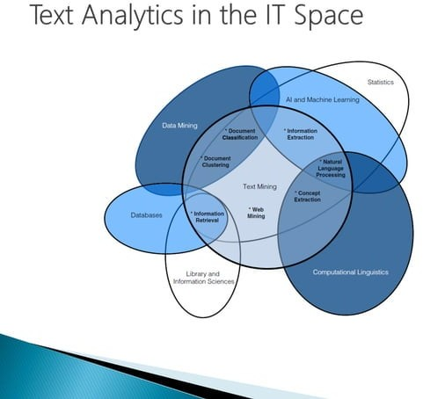
Text Mining –Related Fields

Slide 5
Seven Practice Areas or Text Analytics
Search and information retrieval
Document clustering
Document classification
Web mining
Information extraction
Natural language processing
Concept extraction

Slide 6
Seven Practice Areas or Text Analytics
Search and information retrieval (IR): Storage and retrieval of text documents, including search engines and keyword search.
Document clustering: Grouping and categorizing terms, snippets, paragraphs, or documents, using data mining clustering methods.
Document classification: Grouping and categorizing snippets, paragraphs, or documents, using data mining classification methods, based on models trained on labeled examples.
Web mining: Data and text mining on the Internet, with a specific focus on the scale and interconnectedness of the web.

Slide 7
Seven Practice Areas or Text Analytics
Information extraction (IE): Identification and extraction of relevant facts and relationships from unstructured text; the process of making structured data from unstructured and semi-structured text.
Natural language processing (NLP): Low-level language processing and understanding tasks (e.g., tagging part of speech); often used synonymously with computational linguistics.
Concept extraction: Grouping of words and phrases into semantically similar groups.

Slide 8
Five Questions to Target the Practice Areas
focus, especially the question of whether to emphasize search or information extraction – that is, finding specific words and documents versus characterizing the entire data set;
granularity, the desired level of detail of focus;
available information, emphasizing whether there is enough information to provide a pattern and look for that, or with less information, just look for anomalies;o999o
syntax versus semantics, which means deciding whether the analysis is more about what words literally mean or what they connote in context; and
Web information vs. traditional document-based text.

Slide 9
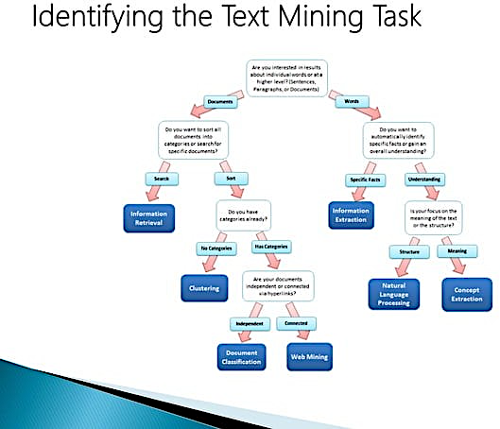
5 Questions

Slide 10
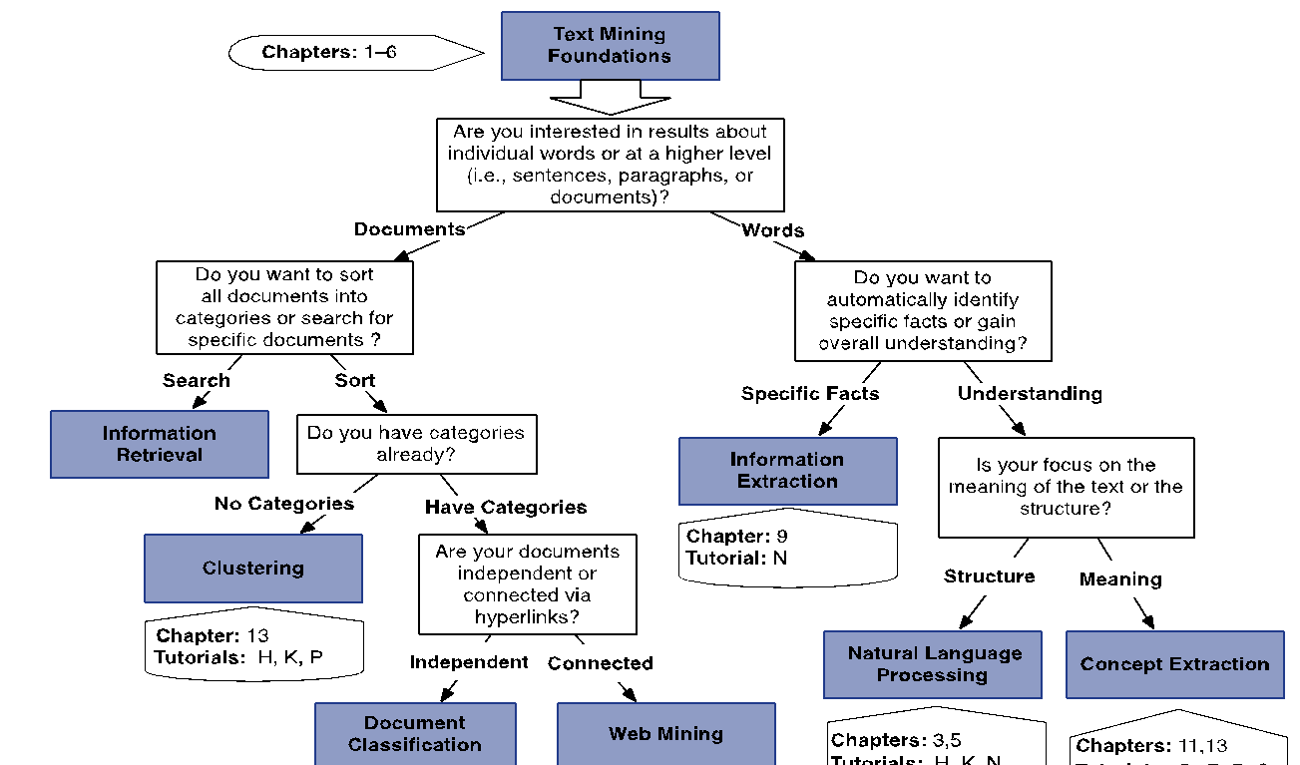

Slide 11
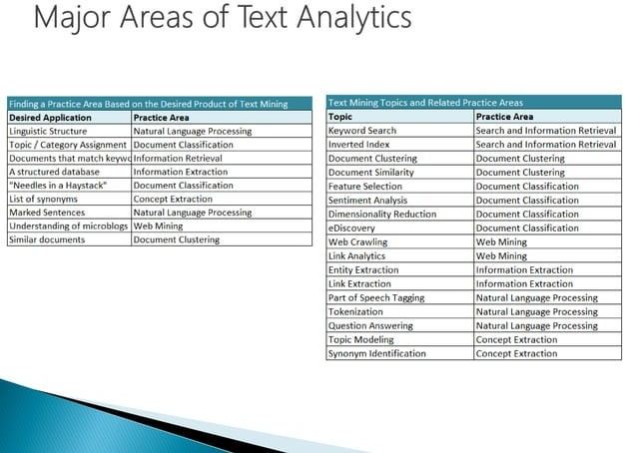

Slide 12
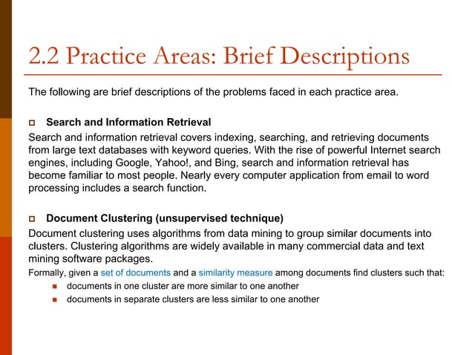
The Seven Practice Areas – Brief Description

Slide 13
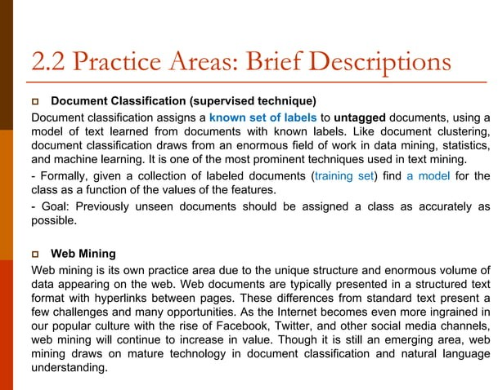
The Seven Practice Areas – Brief Description

Slide 14
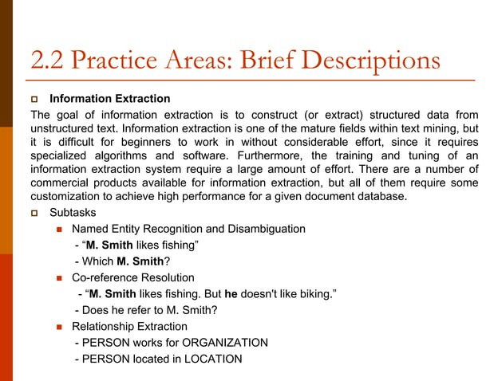
The Seven Practice Areas – Brief Description

Slide 15
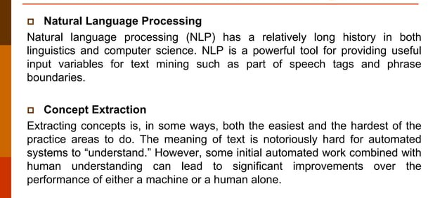
The Seven Practice Areas – Brief Description

Slide 16
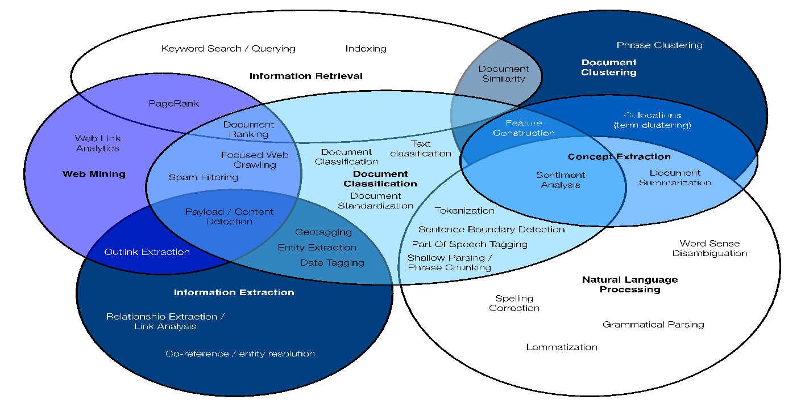
Visualizing the seven text mining practice areas (ovals) and how specific text mining tasks (labels within ovals) exist at their intersections.

Slide 17
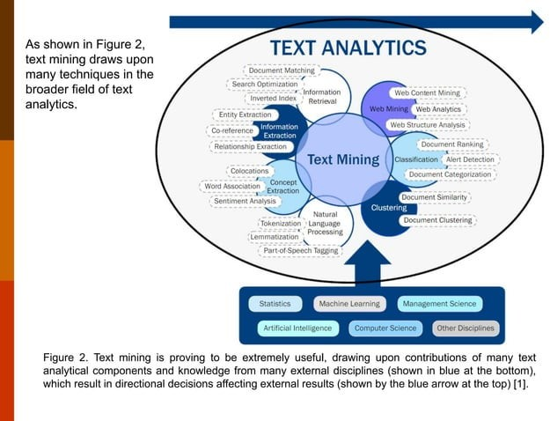

Slide 18
Use Cases - 5 Basic Text Mining Applications
Extracting meaning: This involves the extraction of meaning from unstructured data. This includes the understanding of core themes and relevant messages without actually reading the text.
Automatic text categorization: This is an excellent way of downstream processing by automatically classifying text.
Improving predictive accuracy: In predictive modelling and unsupervised modelling, it is an efficient method to achieve accuracy by combing unstructured data with structured numeric information.
Identifying specific document: This is an important task in information retrieval to efficiently extract similar or relevant documents on a particular topic.
Extracting specific information: Extracting specific information like names, geographic regions etc. is an efficient method to provide data to decision-makers.

Slide 19
Extracting “Meaning” From Unstructured Text
3 main applications
Sentiment Analysis
Topic Modeling (Trending Themes in a Stream of Text)
SUMMARIZING TEXT

Slide 20
Sentiment Analysis - Terms
Sentiment
A thought, view, or attitude, especially one based mainly on emotion instead of reason
Sentiment Analysis
aka opinion mining
use of natural language processing (NLP) and computational techniques to automate the extraction or classification of sentiment from typically unstructured text
Notes:
1. Subjective vs objective information
2. Essentially the same as other information retrieval tasks, but with some additional challenges as we will see

Slide 21
Sentiment Analysis - Motivation
Consumer information
Product reviews
Marketing
Consumer attitudes
Trends
Politics
Politicians want to know voters’ views
Voters want to know policitians’ stances and who else supports them
Social
Find like-minded individuals or communities
Notes:
Review info from blogs, newsgroups, etc
Consumer attitudes towards
-company’s products
-competitor’s products
Politics
-can form basis of policy decisions

Slide 22
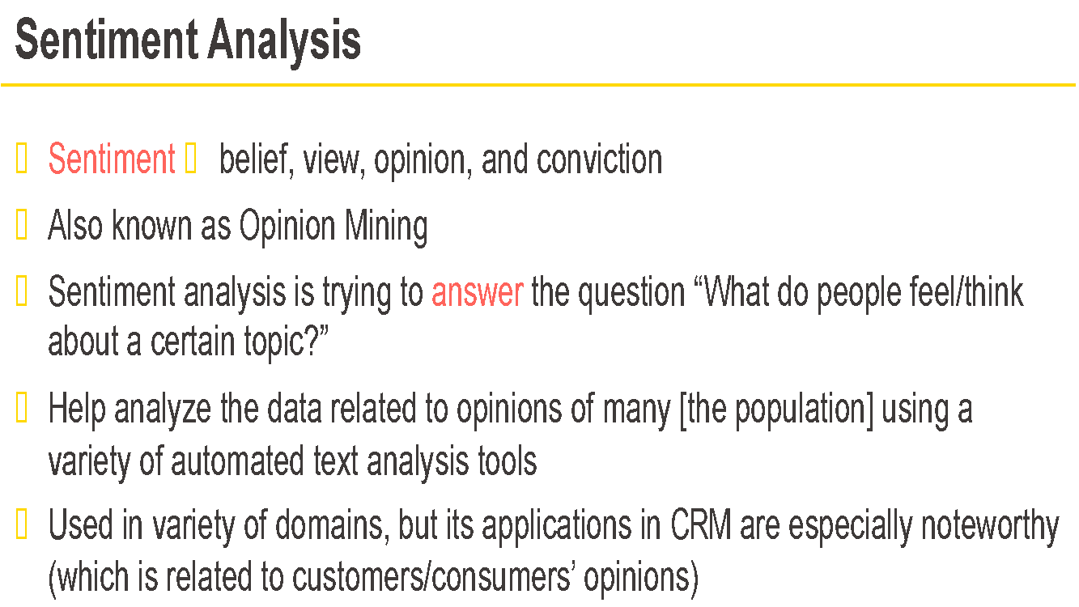

Slide 23
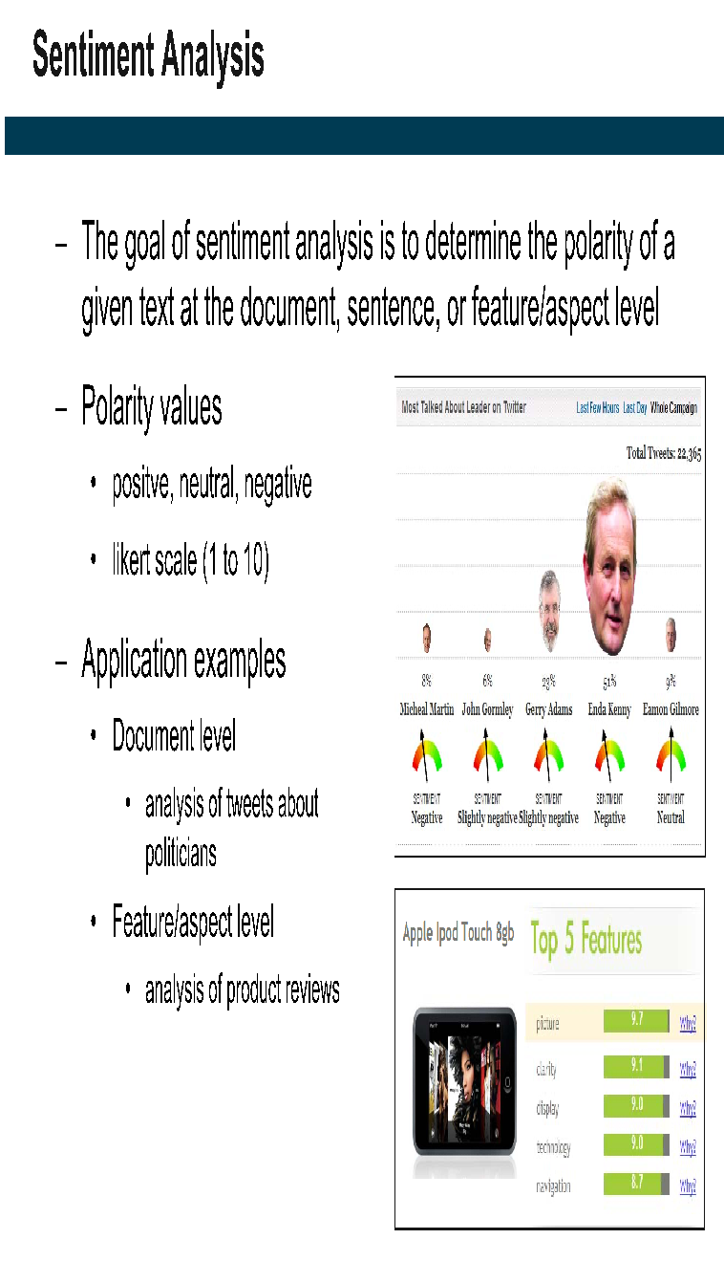

Slide 24
Trending Themes in a Stream of Text
Detecting changes, trends, and unusual events expressed in a corpus of text.
Unexpected or unusual events often are first reflected in text before they are measured numerically.
Warranty Claim Trends
Insurance Claims,
Fraud Detection
and So Forth

Slide 25
Text Summarization
Another use case of text mining is the extraction of meaning when the goal is to quickly summarize one or a few very large documents.
Extractive Summarization
Extractive methods attempt to summarize articles by identifying the important sentences or phrases from the original text and stitch together portions of the content to produce a condensed version.
These extracted sentences are then used to form the summary.
Abstractive Summarization
This technique, unlike extraction, relies on being able to paraphrase and shorten parts of a document using advanced natural language techniques.
Since abstractive machine learning algorithms can generate new phrases and sentences to capture the meaning of the source document.
When such abstraction is done correctly in deep learning problems, they can assist in overcoming grammatical inaccuracies.

Slide 26
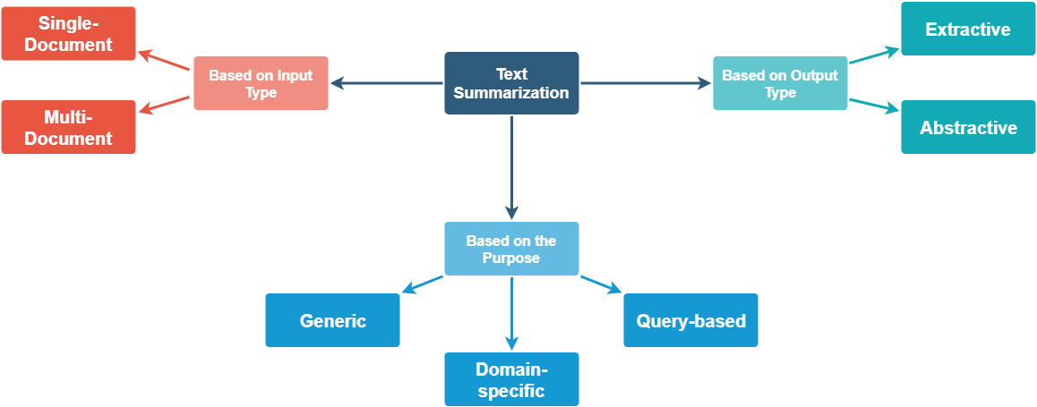
Text Summarization

Slide 27
Extractive Summarization – no new sentences
Source text: DataFlair is an online, immersive, instructor-led, self-paced technology school for students around the world. DataFlair offers lifetime support, quizzes to sharpen student’s knowledge, and various live project participation. DataFlair machine learning projects are best for students to gain practical knowledge for real-world problems.
Summary: DataFlair is an online school for students around the world. DataFlair offers lifetime support, quizzes, and live projects. DataFlair machine Learning projects are best to gain knowledge for real-world problems.

Slide 28
Abstract Summarization: New sentences
Source text: DataFlair is an online, immersive, instructor-led, self-paced technology school for students around the world. DataFlair offers lifetime support, quizzes to sharpen student’s knowledge, and various live project participation. DataFlair machine learning projects are best for students to gain practical knowledge for real-world problems.
Summary: DataFlair is an online school where students are offered various quizzes and projects including machine learning to solve real-world problems.

Slide 29
Applications
Media monitoring
Newsletters
Search marketing and SEO
Financial research
contract analysis
Social media marketing
Question answering and bot
Medical cases
Books and literature
Email overload
Science and R&D
Patent research

Slide 30
Common Approaches To Extracting Meaning
Statistical Natural Language Processing
This analysis begins with simply counting words or phrases and the frequency with which they occur in each document. Usually, various preprocessing steps are applied to the text to do the following:
Correct misspellings.
Reduce different grammatical forms of the same words to common roots (the process called stemming).
Translate foreign language text as required ( machine translation algorithms).
Build lists of abbreviations and synonyms so common abbreviations and their nonabbreviated counterparts are counted as instances of the same word.
Eliminate words that are very general in meaning and occur with high frequency across all documents (e.g., the, to, and). These words are sometimes called stopwords (or a stoplist) because they are not counted.

Slide 31
Computing Statistical Summaries for a Data Matrix of Raw Word/Term Counts
In more general terms, any text can be numericized - turned into a matrix of word (terms, phrases) counts.
At that point, the corpus of text can be represented by a data matrix, where each column represents a word or term and where each row represents a document.
What to count (words, phrases, nouns, names of locations)
How to identify automatically (algorithmically) the items to be counted (the algorithms and methods to parse text) and extract “entities,” such as simple words or phrases, terms describing locations, names, references to specific companies, or grammatical structures and syntax elementsdfor example, to determine automatically “who did what to whom”
How best to process and summarize the counts to extract efficiently information that is relevant to the specific goals of the respective project (e.g., compute word frequencies, relative word frequencies, or indices that summarize the document complexities, relevance to a search term, etc.)

Slide 32
Processing the Data Matrix
Word Frequencies across Documents
Correlations of Word Frequencies across Documents
Relating Word/Term Frequencies to Known Dimensions of Interest:
Using Dictionaries and Known Dimensions of Meaning (sentiments)
Dictionaries of Terms That Express Likes and Dislikes
Counting Expressions of Positive and Negative Sentiments
Using Statistical or Analytical Methods to Derive an Index of Positive and Negative Sentiments
Classifying Words and Phrases Based on Relevant Dimensions of Meaning

Slide 33
