Slide 1
Data Analytics & Visualization
T.E. AI and DS - Jan 2023
Dr. M. Vijayalakshmi

Slide 2
Module 6 Data analytics and visualization with Python
Essential Data Libraries for data analytics: Pandas, NumPy, SciPy.
Plotting and visualization with python: Introduction to Matplotlib, Basic Plotting with Matplotlib, Create Histogram, BarChart, Pie chart, Box Plot, violin plot using Matplotlib.
Introduction to seaborn Library, MultiplePlots, Regressionplot, regplot.

Slide 3
Python Libraries for Data Science
Many popular Python toolboxes/libraries:
NumPy
SciPy
Pandas
SciKit-Learn
Visualization libraries
matplotlib
Seaborn
and many more …
All these libraries are installed on the SCC

Slide 4

Python Libraries for Data Science
NumPy:
introduces objects for multidimensional arrays and matrices, as well as functions that allow to easily perform advanced mathematical and statistical operations on those objects
provides vectorization of mathematical operations on arrays and matrices which significantly improves the performance
many other python libraries are built on NumPy
Link: http://www.numpy.org/

Slide 5

Python Libraries for Data Science
SciPy:
collection of algorithms for linear algebra, differential equations, numerical integration, optimization, statistics and more
part of SciPy Stack
built on NumPy
Link: https://www.scipy.org/scipylib/

Slide 6

Python Libraries for Data Science
Pandas:
adds data structures and tools designed to work with table-like data (similar to Series and Data Frames in R)
provides tools for data manipulation: reshaping, merging, sorting, slicing, aggregation etc.
allows handling missing data
Link: http://pandas.pydata.org/

Slide 7

Python Libraries for Data Science
matplotlib:
python 2D plotting library which produces publication quality figures in a variety of hardcopy formats
a set of functionalities similar to those of MATLAB
line plots, scatter plots, barcharts, histograms, pie charts etc.
relatively low-level; some effort needed to create advanced visualization
Link: https://matplotlib.org/

Slide 8
Python Libraries for Data Science
Seaborn:
based on matplotlib
provides high level interface for drawing attractive statistical graphics
Similar (in style) to the popular ggplot2 library in R
Link: https://seaborn.pydata.org/

Slide 9
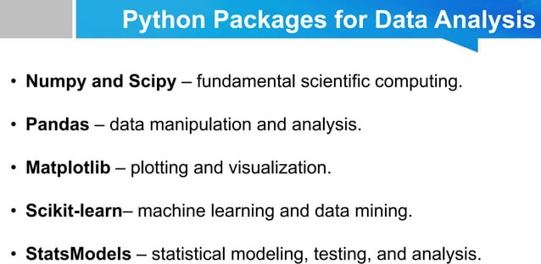

Slide 10
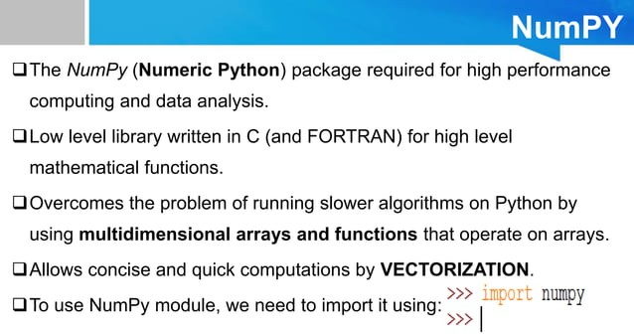

Slide 11
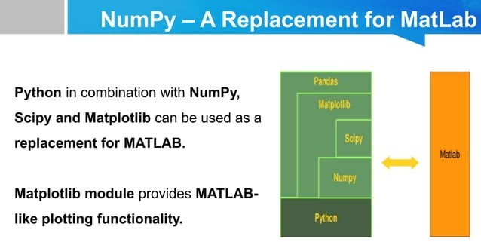

Slide 12
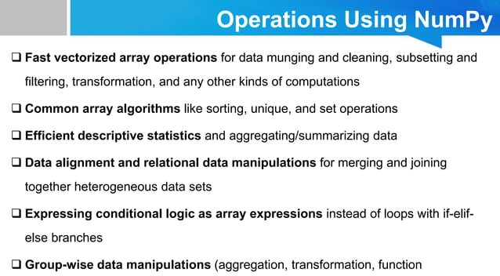

Slide 13
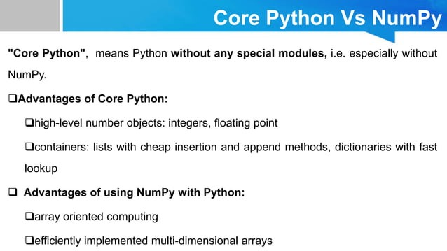

Slide 14
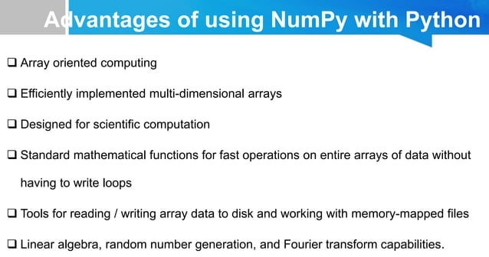

Slide 15
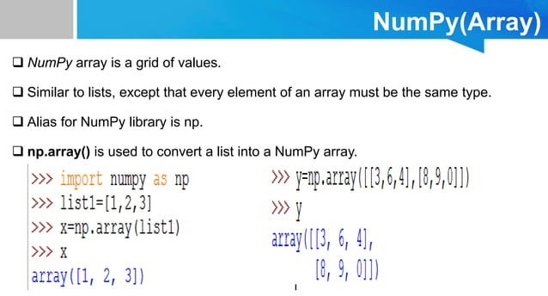

Slide 16
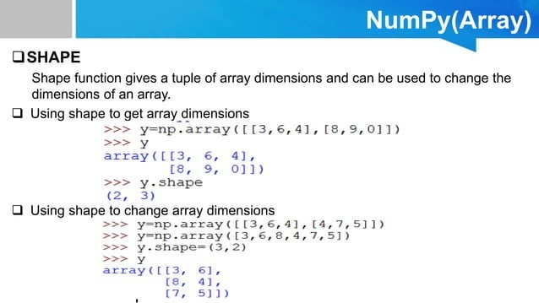

Slide 17
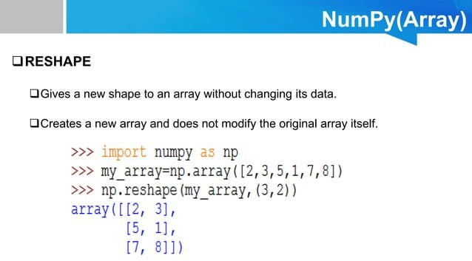

Slide 18
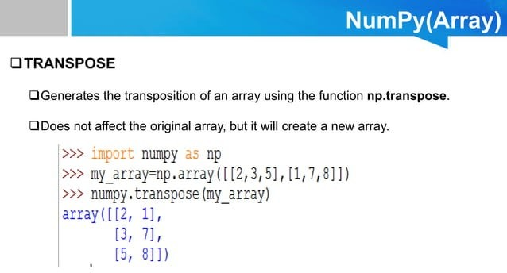

Slide 19
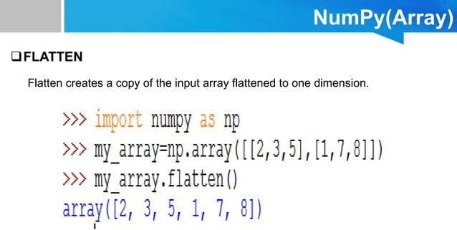

Slide 20
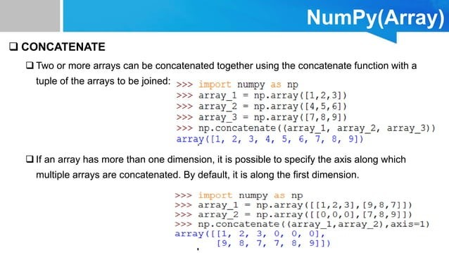

Slide 21
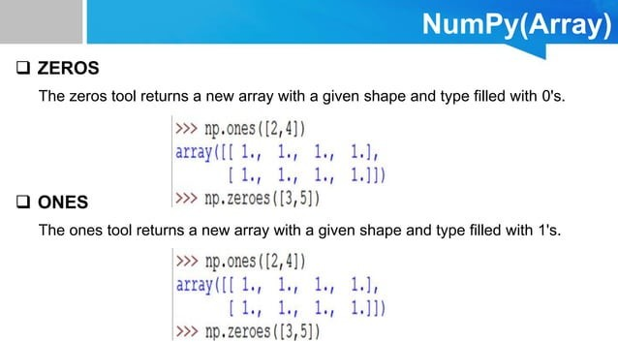

Slide 22
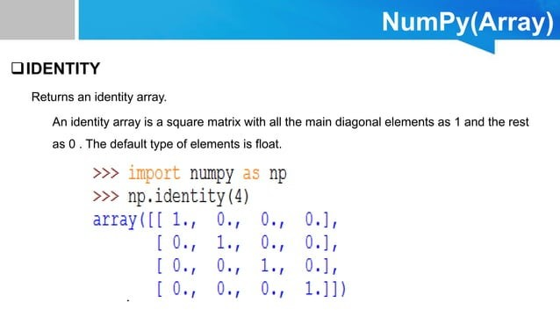

Slide 23
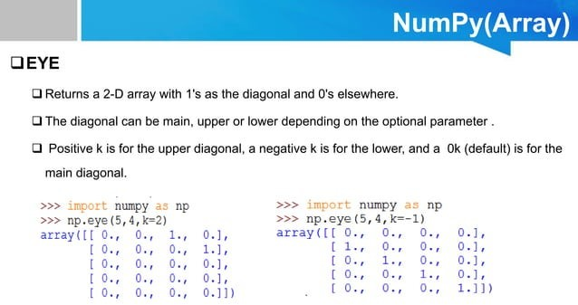

Slide 24
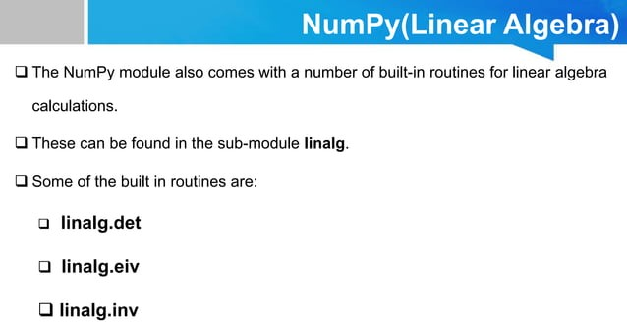

Slide 25
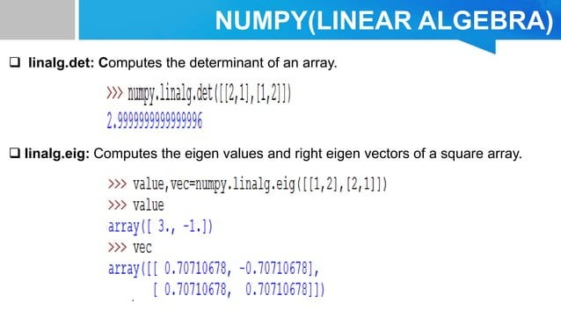

Slide 26
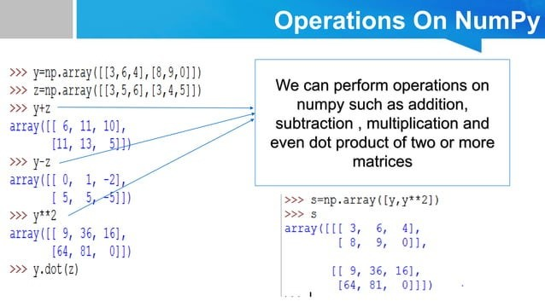

Slide 27
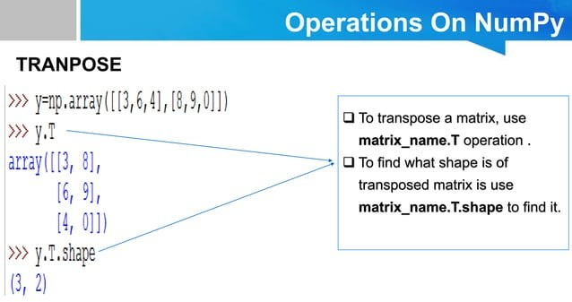

Slide 28
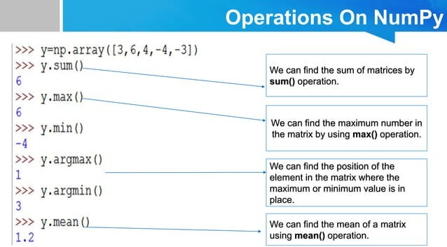

Slide 29
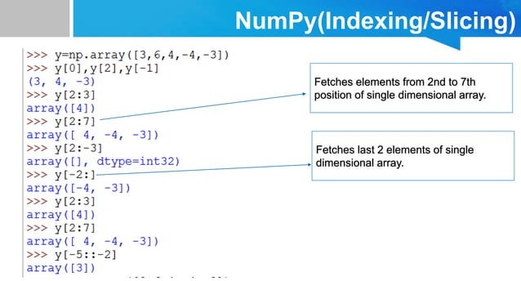

Slide 30
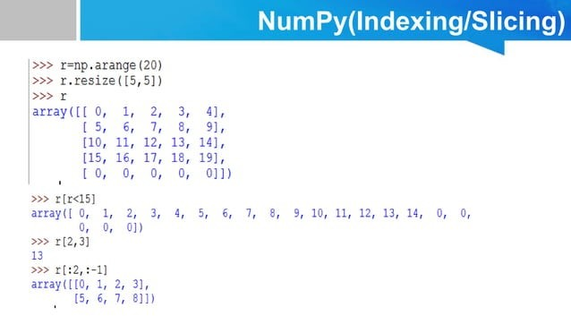

Slide 31
The NumPy ndarray: A multi-dimensional array object
The NumPy ndarray object is a fast and flexible container for large data sets in Python.
NumPy arrays are a bit like Python lists, but are still a very different beast at the same time.
Arrays enable you to store multiple items of the same data type. It is the facilities around the array object that makes NumPy so convenient for performing math and data manipulations.

Slide 32


Creating a NumPy array
One of the most common, of the many, ways to create a NumPy array is to create one from a list by passing it to the np.array() function.
In:
Out:

Slide 33
Differences between lists and ndarrays
The key difference between an array and a list is that arrays are designed to handle vectorised operations while a python lists are not.
That means, if you apply a function, it is performed on every item in the array, rather than on the whole array object.

Slide 34




Let’s suppose you want to add the number 2 to every item in the list. The intuitive way to do this is something like this:
In:
Out:
That was not possible with a list, but you can do that on an array:
In:
Out:

Slide 35
It should be noted here that, once a Numpy array is created, you cannot increase its size.
To do so, you will have to create a new array.

Slide 36


Create a 2d array from a list of list
You can pass a list of lists to create a matrix-like a 2d array.
In:
Out:

Slide 37


The dtype argument
You can specify the data-type by setting the dtype() argument.
Some of the most commonly used NumPy dtypes are: float, int, bool, str, and object.
In:
Out:

Slide 38
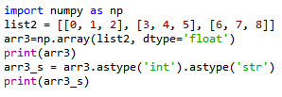
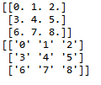
The astype argument
You can also convert it to a different data-type using the astype method.
In:
Out:
Remember that, unlike lists, all items in an array have to be of the same type.

Slide 39

dtype=‘object’
However, if you are uncertain about what data type your array will hold, or if you want to hold characters and numbers in the same array, you can set the dtype as 'object'.
In:
Out:

Slide 40

The tolist() function
You can always convert an array into a list using the tolist() command.
In:
Out:

Slide 41
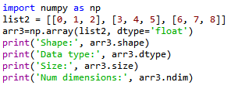

Inspecting a NumPy array
There are a range of functions built into NumPy that allow you to inspect different aspects of an array:
In:
Out:

Slide 42


Extracting specific items from an array
You can extract portions of the array using indices, much like when you’re working with lists.
Unlike lists, however, arrays can optionally accept as many parameters in the square brackets as there are number of dimensions
In:
Out:

Slide 43


Boolean indexing
A boolean index array is of the same shape as the array-to-be-filtered, but it only contains TRUE and FALSE values.
In:
Out:

Slide 44
Pandas
Pandas, like NumPy, is one of the most popular Python libraries for data analysis.
It is a high-level abstraction over low-level NumPy, which is written in pure C.
Pandas provides high-performance, easy-to-use data structures and data analysis tools.
There are two main structures used by pandas; data frames and series.

Slide 45
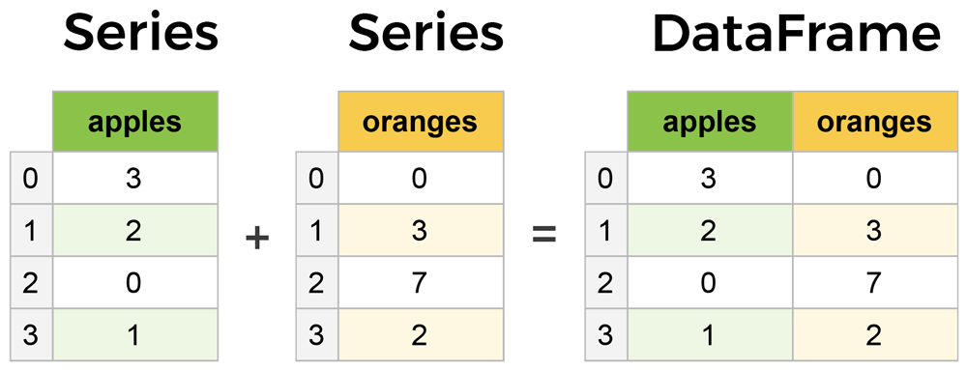
Core components of pandas: Series & DataFrames
The primary two components of pandas are the Series and DataFrame.
Series is essentially a column, and
DataFrame is a multi-dimensional table made up of a collection of Series.
DataFrames and Series are quite similar in that many operations that you can do with one you can do with the other, such as filling in null values and calculating the mean.
A Data frame is a two-dimensional data structure, i.e., data is aligned in a tabular fashion in rows and columns.
columns
Features of DataFrame
Potentially columns are of different types
Size – Mutable
Labeled axes (rows and columns)
Can Perform Arithmetic operations on rows and columns
rows

Slide 46
Types of Data Structure in Pandas
Data Structure | Dimensions | Description
Series | 1 | 1D labeled homogeneous array with immutable size
Data Frames | 2 | General 2D labeled, size mutable tabular structure with potentially heterogeneously typed columns.
Panel | 3 | General 3D labeled, size mutable array.
Series & DataFrame
Series is a one-dimensional array (1D Array) like structure with homogeneous data.
DataFrame is a two-dimensional array (2D Array) with heterogeneous data.
Panel
Panel is a three-dimensional data structure (3D Array) with heterogeneous data.
It is hard to represent the panel in graphical representation.
But a panel can be illustrated as a container of DataFrame

Slide 47
pandas.DataFrame
pandas.DataFrame(data, index , columns , dtype , copy )
data: data takes various forms like ndarray, series, map, lists, dict, constants and also another DataFrame.
index: For the row labels, that are to be used for the resulting frame, Optional, Default is np.arrange(n)if no index is passed.
columns: For column labels, the optional default syntax is - np.arrange(n). This is only true if no index is passed.
dtype: Data type of each column.
copy: This command (or whatever it is) is used for copying of data, if the default is False.
Create DataFrame
A pandas DataFrame can be created using various inputs like −
Lists
dict
Series
Numpy ndarrays
Another DataFrame

Slide 48
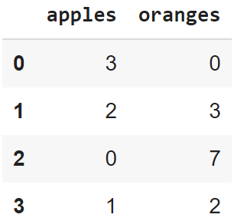
Creating a DataFrame from scratch
There are many ways to create a DataFrame from scratch, but a great option is to just use a simple dict. But first you must import pandas.
Let's say we have a fruit stand that sells apples and oranges. We want to have a column for each fruit and a row for each customer purchase. To organize this as a dictionary for pandas we could do something like:
And then pass it to the pandas DataFrame constructor:
import pandas as pd
data = { 'apples':[3, 2, 0, 1] , 'oranges':[0, 3, 7, 2] }
df = pd.DataFrame(data)

Slide 49
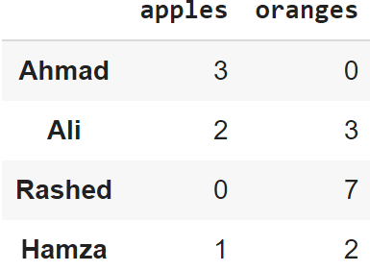
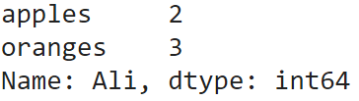
How did that work?
Each (key, value) item in data corresponds to a column in the resulting DataFrame.
The Index of this DataFrame was given to us on creation as the numbers 0-3, but we could also create our own when we initialize the DataFrame.
E.g. if you want to have customer names as the index:
df = pd.DataFrame(data, index=['Ahmad', 'Ali', 'Rashed', 'Hamza'])
So now we could locate a customer's order by using their names:
df.loc['Ali']

Slide 50
pandas.DataFrame.from_dict
pandas.DataFrame.from_dict(data, orient='columns', dtype=None, columns=None)
data : dict
Of the form {field:array-like} or {field:dict}.
orient : {‘columns’, ‘index’}, default ‘columns’
The “orientation” of the data.
If the keys of the passed dict should be the columns of the resulting DataFrame, pass ‘columns’ (default).
Otherwise if the keys should be rows, pass ‘index’.
dtype : dtype, default None
Data type to force, otherwise infer.
columns : list, default None
Column labels to use when orient='index'. Raises a ValueError if used with orient='columns'.
https://pandas.pydata.org/pandas-docs/version/0.23/generated/pandas.DataFrame.from_dict.html

Slide 51
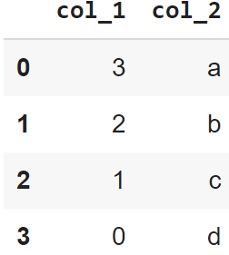
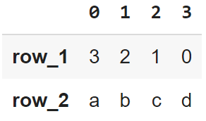
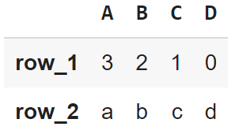
pandas’ orient keyword
data = {'col_1':[3, 2, 1, 0], 'col_2':['a','b','c','d']}
pd.DataFrame.from_dict(data)
data = {'row_1':[3, 2, 1, 0], 'row_2':['a','b','c','d']}
pd.DataFrame.from_dict(data,
orient='index')
data = {'row_1':[3, 2, 1, 0], 'row_2':['a','b','c','d']}
pd.DataFrame.from_dict(data, orient = 'index', columns = ['A','B','C','D'])

Slide 52
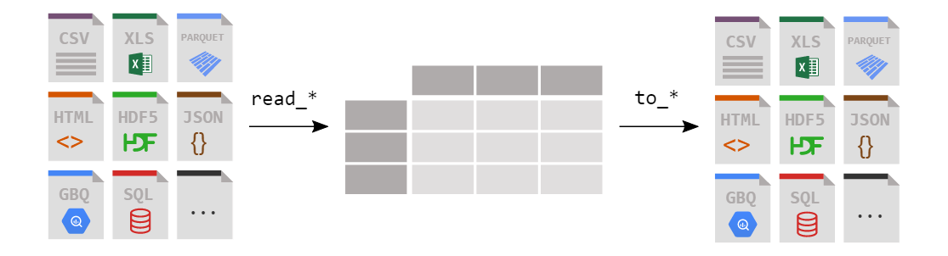
LOADING A DATAFRAME FROM FILES

Slide 53
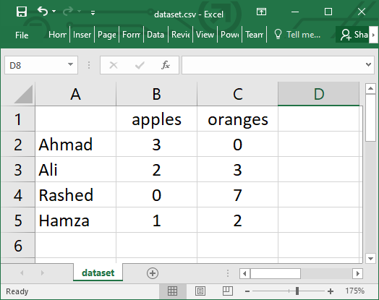
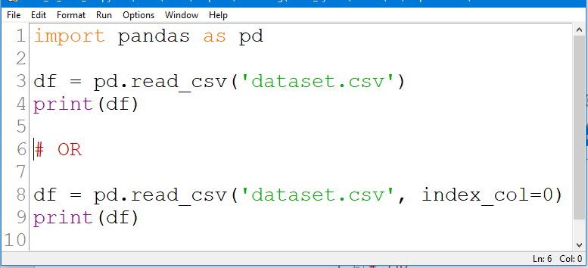
Reading data from a CSV file

Slide 54
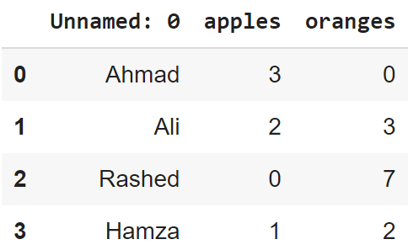
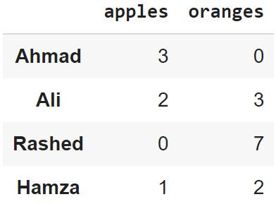
Reading data from CSVs
With CSV files, all you need is a single line to load in the data:
df = pd.read_csv('dataset.csv')
CSVs don't have indexes like our DataFrames, so all we need to do is just designate the index_col when reading:
df = pd.read_csv('dataset.csv', index_col=0)
Note: here we're setting the index to be column zero.

Slide 55
Reading data from JSON
If you have a JSON file — which is essentially a stored Python dict — pandas can read this just as easily:
df = pd.read_json('dataset.json')
Notice this time our index came with us correctly since using JSON allowed indexes to work through nesting.
Pandas will try to figure out how to create a DataFrame by analyzing structure of your JSON, and sometimes it doesn't get it right.
Often you'll need to set the orient keyword argument depending on the structure

Slide 56
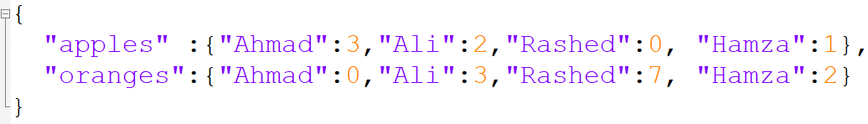
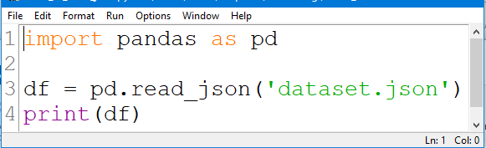
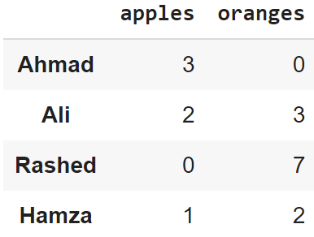
Example #1:Reading data from JSON

Slide 57
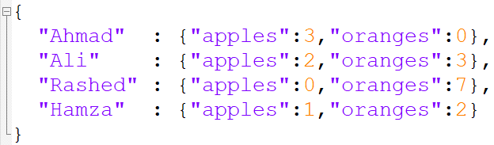
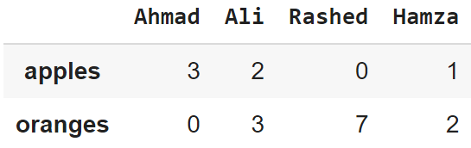
Example #2: Reading data from JSON

Slide 58
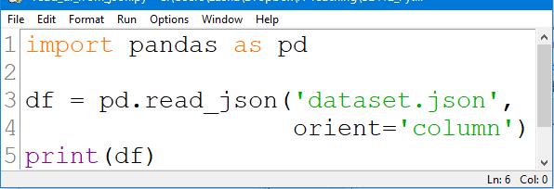
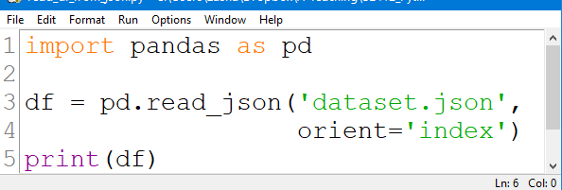
Example #3: Reading data from JSON

Slide 59
Converting back to a CSV or JSON
So after extensive work on cleaning your data, you’re now ready to save it as a file of your choice. Similar to the ways we read in data, pandas provides intuitive commands to save it:
When we save JSON and CSV files, all we have to input into those functions is our desired filename with the appropriate file extension.
df.to_csv('new_dataset.csv')
df.to_json('new_dataset.json')
df.to_sql('new_dataset', con)
Reference: https://pandas.pydata.org/pandas-docs/stable/reference/api/pandas.DataFrame.to_json.html

Slide 60
Most important DataFrame operations
DataFrames possess hundreds of methods and other operations that are crucial to any analysis.
As a beginner, you should know the operations that:
that perform simple transformations of your data and those
that provide fundamental statistical analysis on your data.

Slide 61
Loading dataset
We're loading this dataset from a CSV and designating the movie titles to be our index.
movies_df = pd.read_csv("movies.csv", index_col="title")
https://grouplens.org/datasets/movielens/

Slide 62
Viewing your data
The first thing to do when opening a new dataset is print out a few rows to keep as a visual reference. We accomplish this with .head():
.head() outputs the first five rows of your DataFrame by default, but we could also pass a number as well: movies_df.head(10) would output the top ten rows, for example.
To see the last five rows use .tail() that also accepts a number, and in this case we printing the bottom two rows.:
movies_df.head()
movies_df.tail(2)

Slide 63
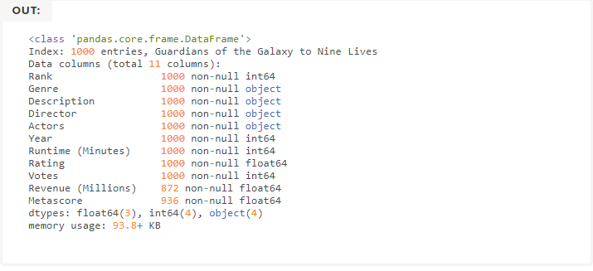

Getting info about your data
.info() should be one of the very first commands you run after loading your data
.info() provides the essential details about your dataset, such as the number of rows and columns, the number of non-null values, what type of data is in each column, and how much memory your DataFrame is using.
movies_df.info()
movies_df.shape

Slide 64


Handling duplicates
This dataset does not have duplicate rows, but it is always important to verify you aren't aggregating duplicate rows.
To demonstrate, let's simply just double up our movies DataFrame by appending it to itself:
Using append() will return a copy without affecting the original DataFrame. We are capturing this copy in temp so we aren't working with the real data.
Notice call .shape quickly proves our DataFrame rows have doubled.
temp_df = movies_df.append(movies_df)
temp_df.shape
Now we can try dropping duplicates:
temp_df = temp_df.drop_duplicates()
temp_df.shape

Slide 65
Handling duplicates
Just like append(), the drop_duplicates() method will also return a copy of your DataFrame, but this time with duplicates removed. Calling .shape confirms we're back to the 1000 rows of our original dataset.
It's a little verbose to keep assigning DataFrames to the same variable like in this example. For this reason, pandas has the inplace keyword argument on many of its methods. Using inplace=True will modify the DataFrame object in place:
Another important argument for drop_duplicates() is keep, which has three possible options:
first: (default) Drop duplicates except for the first occurrence.
last: Drop duplicates except for the last occurrence.
False: Drop all duplicates.
temp_df.drop_duplicates(inplace=True)
https://www.learndatasci.com/tutorials/python-pandas-tutorial-complete-introduction-for-beginners/

Slide 66
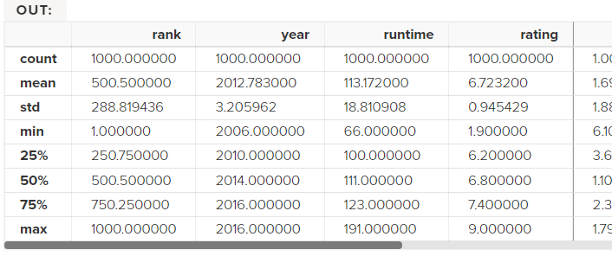
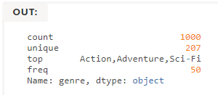
Understanding your variables
Using .describe() on an entire DataFrame we can get a summary of the distribution of continuous variables:
.describe() can also be used on a categorical variable to get the count of rows, unique count of categories, top category, and freq of top category:
This tells us that the genre column has 207 unique values, the top value is Action/Adventure/Sci-Fi, which shows up 50 times (freq).
movies_df.describe()
movies_df['genre'].describe()

Slide 67


More Examples
import pandas as pd
data = [1,2,3,10,20,30]
df = pd.DataFrame(data)
print(df)
import pandas as pd
data = {'Name' : ['AA', 'BB'], 'Age': [30,45]}
df = pd.DataFrame(data)
print(df)

Slide 68
More Examples
import pandas as pd
data = [{'a': 1, 'b': 2},{'a': 5, 'b': 10, 'c': 20}]
df = pd.DataFrame(data)
print(df)
a b c
0 1 2 NaN
1 5 10 20.0
import pandas as pd
data = [{'a': 1, 'b': 2},{'a': 5, 'b': 10, 'c': 20}]
df = pd.DataFrame(data, index=['first', 'second'])
print(df)
a b c
first 1 2 NaN
second 5 10 20.0

Slide 69
More Examples
E.g. This shows how to create a DataFrame with a list of dictionaries, row indices, and column indices.
import pandas as pd
data = [{'a': 1, 'b': 2},{'a': 5, 'b': 10, 'c': 20}]
#With two column indices, values same as dictionary keys
df1 = pd.DataFrame(data,index=['first','second'],columns=['a','b'])
#With two column indices with one index with other name
df2 = pd.DataFrame(data,index=['first','second'],columns=['a','b1'])
print(df1)
print('...........')
print(df2)
a b
first 1 2
second 5 10
...........
a b1
first 1 NaN
second 5 NaN

Slide 70
More Examples: Create a DataFrame from Dict of Series
import pandas as pd
d = {'one' : pd.Series([1, 2, 3] , index=['a', 'b', 'c']),
'two' : pd.Series([1,2, 3, 4], index=['a', 'b', 'c', 'd'])
}
df = pd.DataFrame(d)
print(df)
one two
a 1.0 1
b 2.0 2
c 3.0 3
d NaN 4

Slide 71
More Examples: Column Addition
import pandas as pd
d = {'one':pd.Series([1,2,3], index=['a','b','c']),
'two':pd.Series([1,2,3,4], index=['a','b','c','d'])
}
df = pd.DataFrame(d)
# Adding a new column to an existing DataFrame object
# with column label by passing new series
print("Adding a new column by passing as Series:")
df['three'] = pd.Series([10,20,30],index=['a','b','c'])
print(df)
print("Adding a column using an existing columns in DataFrame:")
df['four'] = df['one']+df['three']
print(df)
Adding a column using Series:
one two three
a 1.0 1 10.0
b 2.0 2 20.0
c 3.0 3 30.0
d NaN 4 NaN
Adding a column using columns:
one two three four
a 1.0 1 10.0 11.0
b 2.0 2 20.0 22.0
c 3.0 3 30.0 33.0
d NaN 4 NaN NaN

Slide 72
More Examples: Column Deletion
# Using the previous DataFrame, we will delete a column
# using del function
import pandas as pd
d = {'one' : pd.Series([1, 2, 3], index=['a', 'b', 'c']),
'two' : pd.Series([1, 2, 3, 4], index=['a', 'b', 'c', 'd']),
'three' : pd.Series([10,20,30], index=['a','b','c'])
}
df = pd.DataFrame(d)
print ("Our dataframe is:")
print(df)
# using del function
print("Deleting the first column using DEL function:")
del df['one']
print(df)
# using pop function
print("Deleting another column using POP function:")
df.pop('two')
print(df)
Our dataframe is:
one two three
a 1.0 1 10.0
b 2.0 2 20.0
c 3.0 3 30.0
d NaN 4 NaN
Deleting the first column:
two three
a 1 10.0
b 2 20.0
c 3 30.0
d 4 NaN
Deleting another column:
a 10.0
b 20.0
c 30.0
d NaN

Slide 73
More Examples: Slicing in DataFrames
import pandas as pd
d = {'one' : pd.Series([1, 2, 3], index=['a', 'b', 'c']),
'two' : pd.Series([1, 2, 3, 4], index=['a', 'b', 'c','d'])
}
df = pd.DataFrame(d)
print(df[2:4])
one two
c 3.0 3
d NaN 4

Slide 74
More Examples: Addition of rows
import pandas as pd
d = {'one' : pd.Series([1, 2, 3], index=['a', 'b', 'c']),
'two' : pd.Series([1, 2, 3, 4], index=['a', 'b', 'c','d'])
}
df = pd.DataFrame(d)
print(df)
df2 = pd.DataFrame([[5,6], [7,8]], columns = ['a', 'b'])
df = df.append(df2 )
print(df)
one two
a 1.0 1
b 2.0 2
c 3.0 3
d NaN 4
one two a b
a 1.0 1.0 NaN NaN
b 2.0 2.0 NaN NaN
c 3.0 3.0 NaN NaN
d NaN 4.0 NaN NaN
0 NaN NaN 5.0 6.0
1 NaN NaN 7.0 8.0

Slide 75
More Examples: Deletion of rows
import pandas as pd
d = {'one':pd.Series([1, 2, 3], index=['a','b','c']),
'two':pd.Series([1, 2, 3, 4], index=['a','b','c','d'])
}
df = pd.DataFrame(d)
print(df)
df2 = pd.DataFrame([[5,6], [7,8]], columns = ['a', 'b'])
df = df.append(df2 )
print(df)
df = df.drop(0)
print(df)
one two
a 1.0 1
b 2.0 2
c 3.0 3
d NaN 4
one two a b
a 1.0 1.0 NaN NaN
b 2.0 2.0 NaN NaN
c 3.0 3.0 NaN NaN
d NaN 4.0 NaN NaN
0 NaN NaN 5.0 6.0
NaN NaN 7.0 8.0
one two a b
a 1.0 1.0 NaN NaN
b 2.0 2.0 NaN NaN
c 3.0 3.0 NaN NaN
d NaN 4.0 NaN NaN
1 NaN NaN 7.0 8.0

Slide 76
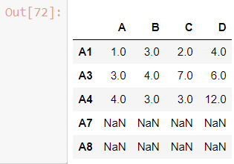
More Examples: Reindexing
Pandas dataframe.reindex_like() function return an object with matching indices to myself.
Any non-matching indexes are filled with NaN values.
import pandas as pd
# Creating the first dataframe
df1 = pd.DataFrame({"A":[1, 5, 3, 4, 2],
"B":[3, 2, 4, 3, 4],
"C":[2, 2, 7, 3, 4],
"D":[4, 3, 6, 12, 7]},
index =["A1", "A2", "A3", "A4", "A5"])
# Creating the second dataframe
df2 = pd.DataFrame({"A":[10, 11, 7, 8, 5],
"B":[21, 5, 32, 4, 6],
"C":[11, 21, 23, 7, 9],
"D":[1, 5, 3, 8, 6]},
index =["A1", "A3", "A4", "A7", "A8"])
# Print the first dataframe
print(df1)
print(df2)
# find matching indexes
df1.reindex_like(df2)

Slide 77
More Examples: Concatenating Objects (Data Frames)
import pandas as pd
df1 = pd.DataFrame({'Name':['A','B'], 'SSN':[10,20], 'marks':[90, 95] })
df2 = pd.DataFrame({'Name':['B','C'], 'SSN':[25,30], 'marks':[80, 97] })
df3 = pd.concat([df1, df2])
df3

Slide 78
Handling categorical data
There are many data that are repetitive for example gender , country , and codes are always repetitive .
Categorical variables can take on only a limited
The categorical data type is useful in the following cases −
A string variable consisting of only a few different values. Converting such a string variable to a categorical variable will save some memory.
The lexical order of a variable is not the same as the logical order (“one”, “two”, “three”).
By converting to a categorical and specifying an order on the categories, sorting and min/max will use the logical order instead of the lexical order.
As a signal to other python libraries that this column should be treated as a categorical variable (e.g. to use suitable statistical methods or plot types).

Slide 79
Other DataFrame functions
mean()
Mean(axis=0, skipna=True)
sum()
cumsum()
describe(): return summary statistics of each column
for numeric data: mean, std, max, min, 25%, 50%, 75%, etc.
For non-numeric data: count, uniq, most-frequent item, etc.
corr(): correlation between two Series, or between columns of a DataFrame
corr_with(): correlation between columns of DataFram and a series or between the columns of another DataFrame

Slide 80
Handling missing data
Filtering out missing values
from numpy import nan as NaN
data = Series([1, NaN, 2.5, NaN, 6])
print(data)
0 1.0
1 NaN
2 2.5
3 NaN
6.0
dtype: float64
print(data.notnull())
0 True
1 False
2 True
3 False
4 True
dtype: bool
print(data[data.notnull()])
0 1.0
2 2.5
4 6.0
dtype: float64
print(data.dropna())
0 1.0
2 2.5
4 6.0
dtype: float64
Notes:
s.dropna(inplace=True)

Slide 81
Handling missing data - 2
data = DataFrame([[1, 2, 3], [1, NaN, NaN], [NaN, NaN, NaN], [NaN, 4, 5]])
print(data)
0 1 2
0 1.0 2.0 3.0
1 1.0 NaN NaN
2 NaN NaN NaN
NaN 4.0 5.0
print(data.dropna())
0 1 2
0 1.0 2.0 3.0
print(data.dropna(how='all'))
0 1 2
0 1.0 2.0 3.0
1 1.0 NaN NaN
NaN 4.0 5.0
print(data.dropna(axis=1, how='all'))
0 1 2
0 1.0 2.0 3.0
1 1.0 NaN NaN
2 NaN NaN NaN
3 NaN 4.0 5.0
data[4]=NaN
print(data)
0 1 2 4
0 1.0 2.0 3.0 NaN
1 1.0 NaN NaN NaN
2 NaN NaN NaN NaN
NaN 4.0 5.0 NaN
print(data.dropna(axis=1, how='all'))
0 1 2
0 1.0 2.0 3.0
1 1.0 NaN NaN
2 NaN NaN NaN
3 NaN 4.0 5.0

Slide 82
Filling in missing data
print(data)
0 1 2 4
0 1.0 2.0 3.0 NaN
1 1.0 NaN NaN NaN
2 NaN NaN NaN NaN
NaN 4.0 5.0 NaN
print(data.fillna(0))
0 1 2 4
0 1.0 2.0 3.0 0.0
1 1.0 0.0 0.0 0.0
2 0.0 0.0 0.0 0.0
3 0.0 4.0 5.0 0.0
print(data)
0 1 2
0 1.0 2.0 3.0
1 1.0 NaN NaN
2 NaN NaN NaN
3 NaN 4.0 5.0
print(data.fillna(data.mean(skipna=True)))
0 1 2
0 1.0 2.0 3.0
1 1.0 3.0 4.0
2 1.0 3.0 4.0
3 1.0 4.0 5.0
print(data.fillna(0, inplace=True))
print(data)
0 1 2 4
0 1.0 2.0 3.0 0.0
1 1.0 0.0 0.0 0.0
2 0.0 0.0 0.0 0.0
3 0.0 4.0 5.0 0.0
replace nan with column mean
Modify the dataframe instead of returning a new object (default)

