Slide 1
Data Analytics & Visualization
T.E. AI and DS - Jan 2023
Dr. M. Vijayalakshmi

Slide 2
Module 6
Visualization with Python
Plotting and visualization with python: Introduction to Matplotlib, Basic Plotting with Matplotlib, Create Histogram, BarChart, Pie chart, Box Plot, violin plot using Matplotlib.
Introduction to seaborn Library, MultiplePlots, Regressionplot, regplot.

Slide 3
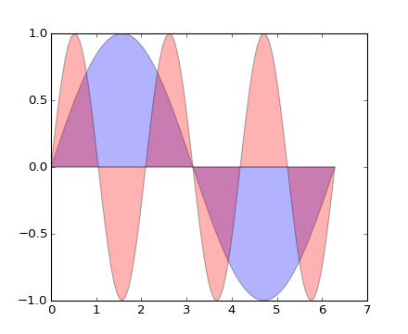
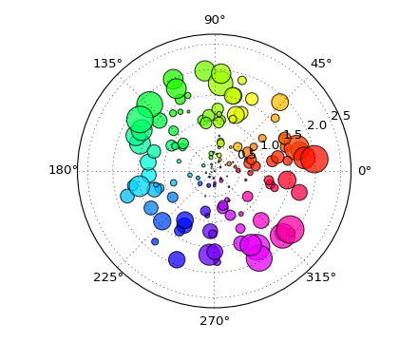
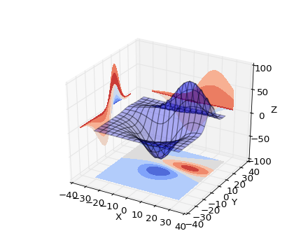
What is data visualization?
Data visualization is the graphical representation of information and data.
  Can be achieved using visual elements like figures, charts, graphs, maps, and more.
Data visualization tools provide a way to present these figures and graphs.
Often, it is essential to analyze massive amounts of information and make data-driven decisions.
  converting complex data into an easy to understand representation.

Slide 4
Matplotlib
Matplotlib is one of the most powerful tools for data visualization in Python.
Matplotlib is an incredibly powerful (and beautiful!) 2-D plotting library.
  It is easy to use and provides a huge number of examples for tackling unique problems
In order to get matplotlib into your script,
  first you need to import it, for example:
  import matplotlib.pyplot as plt
However, if it is not installed, you may need to install it:
  Easiest way to install matplotlib is using pip.
  Type the following command in the command prompt (cmd) or your Linux shell;
    pip install matplotlib
    Note that you may need to run the above cmd as an administrator

Slide 5
matplotlib
Strives to emulate MATLAB
  matplotlib.pyplot is a collection of command style functions that make matplotlib work like MATLAB.
Each pyplot function makes some change to the figure:
  e.g.,
    creates a figure,
    creates a plotting area in the figure,
    plots some lines in the plotting area,
    decorates the plot with labels, etc.
Note that various states are preserved across function calls
Whenever you plot with matplotlib, the two main code lines should be considered:
  Type of graph
    this is where you define a bar chart, line chart, etc.
  Show the graph
    this is to display the graph

Slide 6
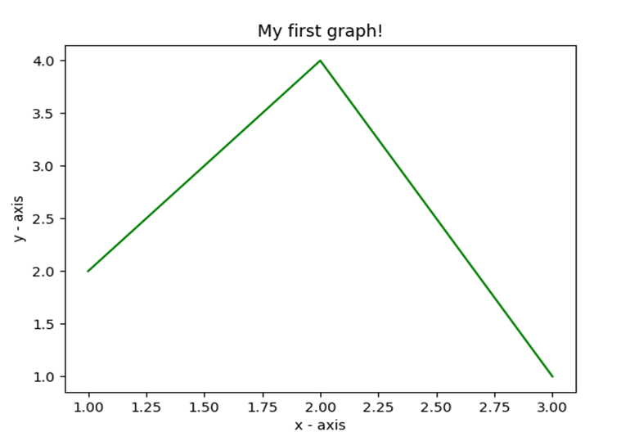
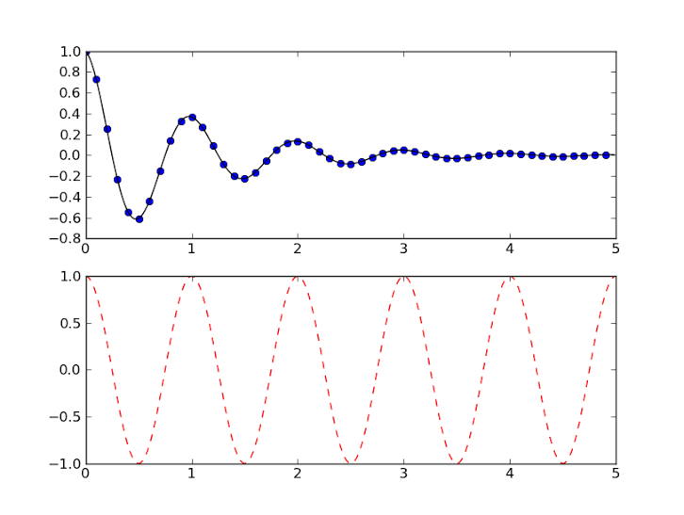
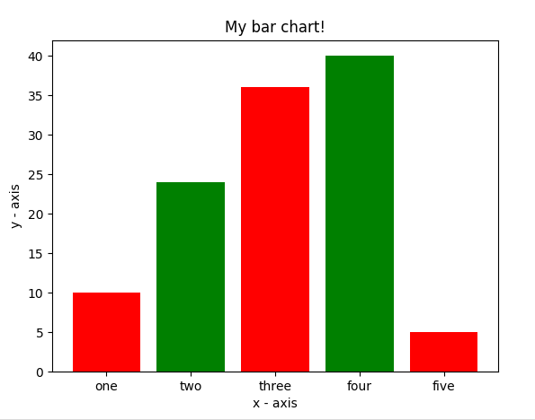
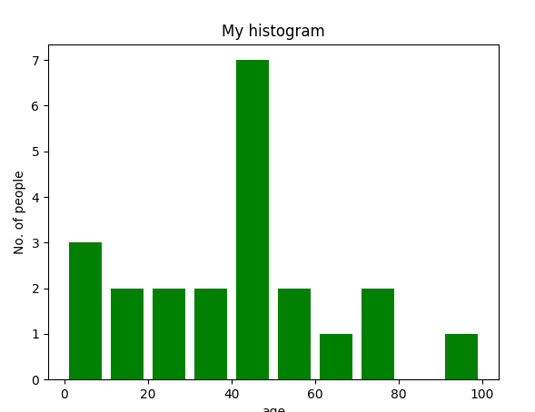
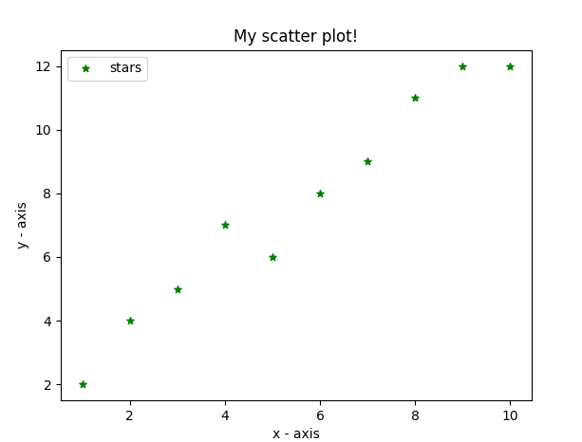
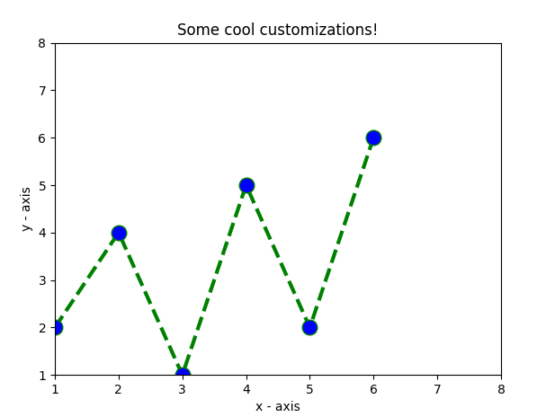
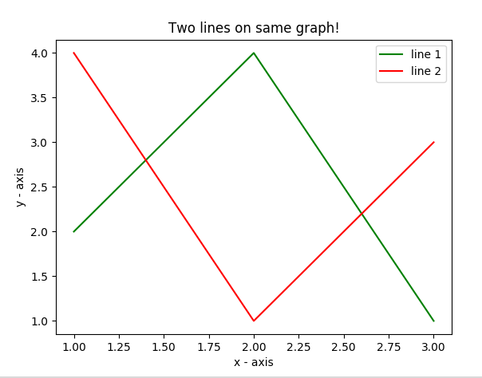
E.g. Matplotlib
Matplotlib allows you to make easy things
You can generate plots, histograms, power spectra, bar charts, errorcharts, scatterplots, etc., with just a few lines of code.

Slide 7
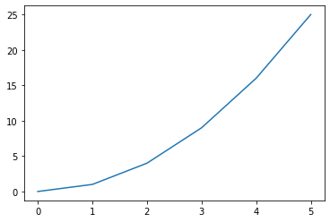
Line Graphs
import matplotlib.pyplot as plt
#create data for plotting
x_values = [0, 1, 2, 3, 4, 5 ]
y_values = [0, 1, 4, 9, 16,25]
#the default graph style for plot is a line
plt.plot(x_values, y_values)
#display the graph
plt.show()

Slide 8
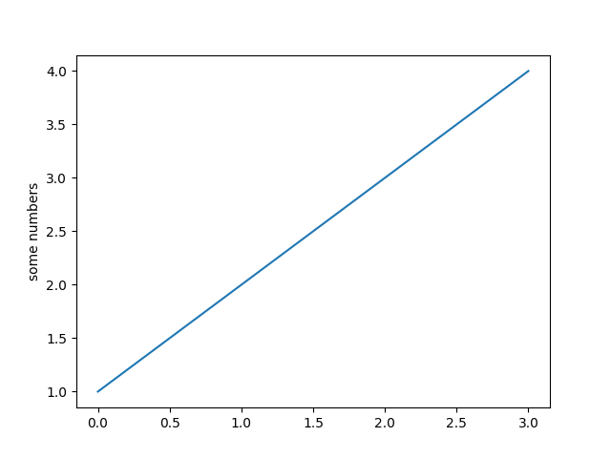
More on Line Graph
Note: if you provide a single list or array to the plot() command,
  then matplotlib assumes it is a sequence of y values, and
  automatically generates the
  x values for you.
Since python ranges start with 0,
the default x vector has the same length as y but starts with 0.
  Hence the x data are[0, 1, 2, 3].
import matplotlib.pyplot as plt
plt.plot([1, 2, 3, 4])
plt.ylabel('some numbers')
plt.show()

Slide 9
pyplot
text() : adds text in an arbitrary location
xlabel(): adds text to the x-axis
ylabel(): adds text to the y-axis
title() : adds title to the plot
clear() : removes all plots from the axes.
savefig(): saves your figure to a file
legend() : shows a legend on the plot
All methods are available on pyplot and on the axes instance generally.

Slide 10
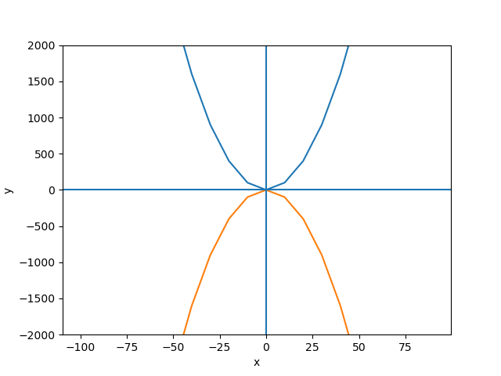
import matplotlib.pyplot as plt
y1 =[]
y2 =[]
x = range(-100,100,10)
for i in x: y1.append(i**2)
for i in x: y2.append(-i**2)
plt.plot(x, y1)
plt.plot(x, y2)
plt.xlabel("x")
plt.ylabel("y")
plt.ylim(-2000, 2000)
plt.axhline(0) # horizontal line
plt.axvline(0) # vertical line
plt.savefig("quad.png")
plt.show()
Incrementally modify the figure.
Save your figure to a file
Show it on the screen

Slide 11
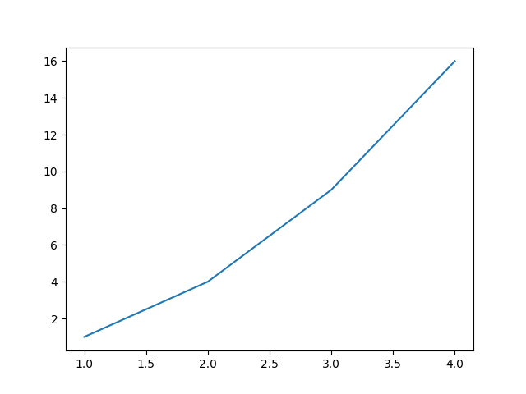
Plot
import matplotlib.pyplot as plt
x = [1, 2, 3, 4]
y = [1, 4, 9, 16]
plt.plot(x, y)
no return value?
We are operating on a “hidden” variable representing the figure.
This is a terrible, terrible trick.
Its only purpose is to pander to MATLAB users.
I’ll show you how this works in the next lecture

Slide 12

Simple line
# importing the required module
import matplotlib.pyplot as plt
# x axis values
x = [1,2,3]
# corresponding y axis values
y = [2,4,1]
# plotting the points
plt.plot(x, y)
# naming the x axis
plt.xlabel('x - axis')
# naming the y axis
plt.ylabel('y - axis')
# giving a title to my graph
plt.title('My first graph!')
# function to show the plot
plt.show()
Define the x-axis and corresponding y-axis values as lists.
Plot them on canvas using .plot() function.
Give a name to x-axis and y-axis using .xlabel() and .ylabel() functions.
Give a title to your plot using .title() function.
Finally, to view your plot, we use .show() function.

Slide 13
Simple 2 lines
import matplotlib.pyplot as plt
# line 1 points
x1 = [1,2,3]
y1 = [2,4,1]
# plotting the line 1 points
plt.plot(x1, y1, label="line 1")
# line 2 points
x2 = [1,2,3]
y2 = [4,1,3]
# plotting the line 2 points
plt.plot(x2, y2, label = "line 2")
# naming the x axis
plt.xlabel('x - axis')
# naming the y axis
plt.ylabel('y - axis')
# giving a title to my graph
plt.title('Two lines on same graph!')
# show a legend on the plot
plt.legend()
# function to show the plot
plt.show()
Here, we plot two lines on same graph. We differentiate between them by giving them a name(label) which is passed as an argument of .plot() function.
The small rectangular box giving information about type of line and its color is called legend. We can add a legend to our plot using .legend() function.

Slide 14
Customization of Plots
import matplotlib.pyplot as plt
# x axis values
x = [1,2,3,4,5,6]
# corresponding y axis values
y = [2,4,1,5,2,6]
# plotting the points
plt.plot(x, y, color='green', linestyle='dashed', linewidth = 3,
marker='o', markerfacecolor='blue', markersize=12)
# setting x and y axis range
plt.ylim(1,8)
plt.xlim(1,8)
# naming the x axis
plt.xlabel('x - axis')
# naming the y axis
plt.ylabel('y - axis')
# giving a title to my graph
plt.title('Some cool customizations!')
# function to show the plot
plt.show()

Slide 15
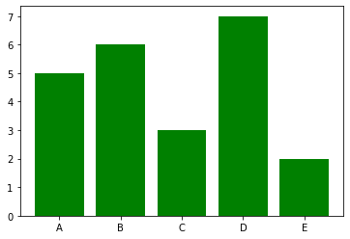
Bar graphs
import matplotlib.pyplot as plt
#Create data for plotting
values = [5, 6, 3, 7, 2]
names = ["A", "B", "C", "D", "E"]
plt.bar(names, values, color="green")
plt.show()
When using a bar graph, the change in code will be from
plt.plot() to plt.bar() changes it into a bar chart.

Slide 16
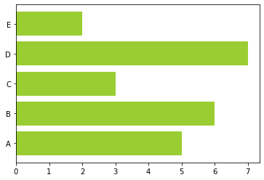
Bar graphs
We can also flip the bar graph horizontally with the following
import matplotlib.pyplot as plt
#Create data for plotting
values = [5,6,3,7,2]
names = ["A", "B", "C", "D", "E"]
# Adding an "h" after bar will flip the graph
plt.barh(names, values, color="yellowgreen")
plt.show()

Slide 17
Bar Chart
import matplotlib.pyplot as plt
# heights of bars
height = [10, 24, 36, 40, 5]
# labels for bars
names = ['one','two','three','four','five']
# plotting a bar chart
c1 =['red', 'green']
c2 =['b', 'g'] # we can use this for color
plt.bar(left, height, width=0.8, color=c1)
# naming the x-axis
plt.xlabel('x - axis')
# naming the y-axis
plt.ylabel('y - axis')
# plot title
plt.title('My bar chart!')
# function to show the plot
plt.show()
Here, we use plt.bar() function to plot a bar chart.
you can also give some name to x-axis coordinates by defining tick_labels

Slide 18
Histogram
import matplotlib.pyplot as plt
# frequencies
ages=[2,5,70,40,30,45,50,45,43,40,44,60,7,13,57,18,90,77,32,21,20,40]
# setting the ranges and no. of intervals
range = (0, 100)
bins = 10
# plotting a histogram
plt.hist(ages, bins, range, color='green',histtype='bar',rwidth=0.8)
# x-axis label
plt.xlabel('age')
# frequency label
plt.ylabel('No. of people')
# plot title
plt.title('My histogram')
# function to show the plot
plt.show()

Slide 19
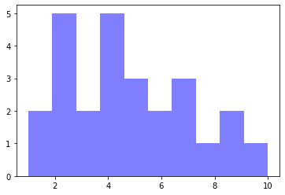
Histograms
import matplotlib.pyplot as plt
#generate fake data
x = [2,1,6,4,2,4,8,9,4,2,4,10,6,4,5,7,7,3,2,7,5,3,5,9,2,1]
#plot for a histogram
plt.hist(x, bins = 10, color='blue', alpha=0.5)
plt.show()
Looking at the code snippet, I added two new arguments:
  Bins — is an argument specific to a histogram and allows the user to customize how many bins they want.
  Alpha — is an argument that displays the level of transparency of the data points.

Slide 20
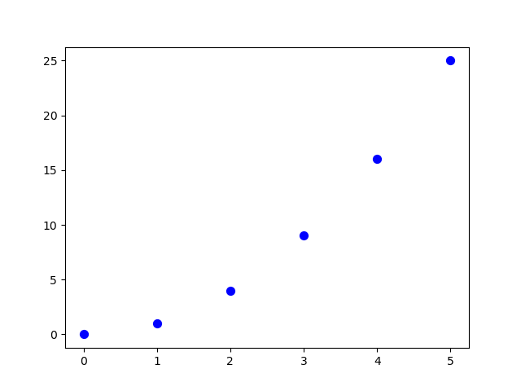
Scatter Plots
import matplotlib.pyplot as plt
#create data for plotting
x_values = [0,1,2,3,4,5]
y_values = [0,1,4,9,16,25]
plt.scatter(x_values, y_values, s=30, color=“blue")
plt.show()
Can you see the pattern? Now the code changed from plt.bar() to plt.scatter().

Slide 21
Scatter plot
import matplotlib.pyplot as plt
# x-axis values
x = [1,2,3,4,5,6,7,8,9,10]
# y-axis values
y = [2,4,5,7,6,8,9,11,12,12]
# plotting points as a scatter plot
plt.scatter(x, y, label= "stars", color="green", marker="*", s=30)
# x-axis label
plt.xlabel('x - axis')
# frequency label
plt.ylabel('y - axis')
# plot title
plt.title('My scatter plot!')
# showing legend
plt.legend()
# function to show the plot
plt.show()

Slide 22
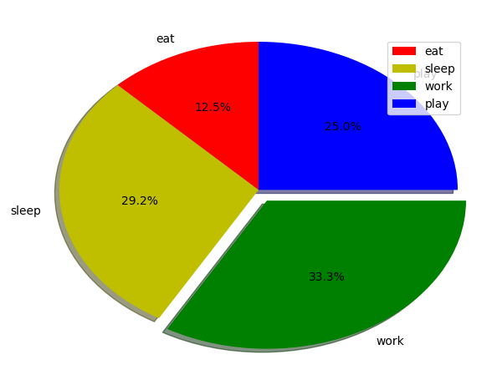
Pie-chart
import matplotlib.pyplot as plt
# defining labels
activities = ['eat', 'sleep', 'work', 'play']
# portion covered by each label
slices = [3, 7, 8, 6]
# color for each label
colors = ['r', 'y', 'g', 'b']
# plotting the pie chart
plt.pie(slices, labels = activities, colors=colors,
startangle=90, shadow = True, explode = (0, 0, 0.1, 0),
radius = 1.2, autopct = '%1.1f%%')
# plotting legend
plt.legend()
# showing the plot
plt.show()

Slide 23
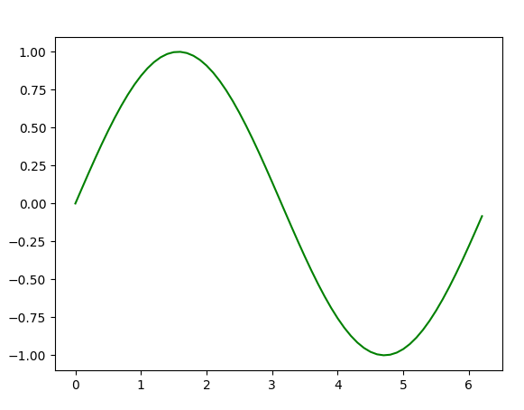
Plotting curves of given equation
# importing the required modules
import matplotlib.pyplot as plt
import numpy as np
# setting the x - coordinates
x = np.arange(0, 2*(np.pi), 0.1)
# setting the corresponding y - coordinates
y = np.sin(x)
# potting the points
plt.plot(x, y)
# function to show the plot
plt.show()
Examples taken from:
Graph Plotting in Python | Set 1

Slide 24
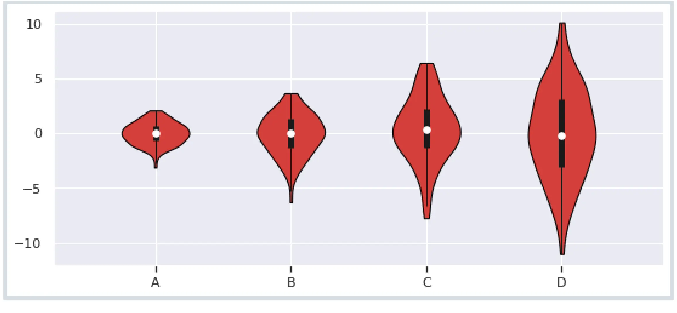
Violin Plots
What is the best way to visualize a data set such that the interquartile range, median, and probability density are captured at once?
Violin plots make this task easy by summing up these things into a single visualization. The violin plot is a superset of a box plot combined with histogram data.
A violin plot represents all data that a box plot has: a marker showing the median, a bar representing the interquartile range, and all the data points of a given set.

Slide 25
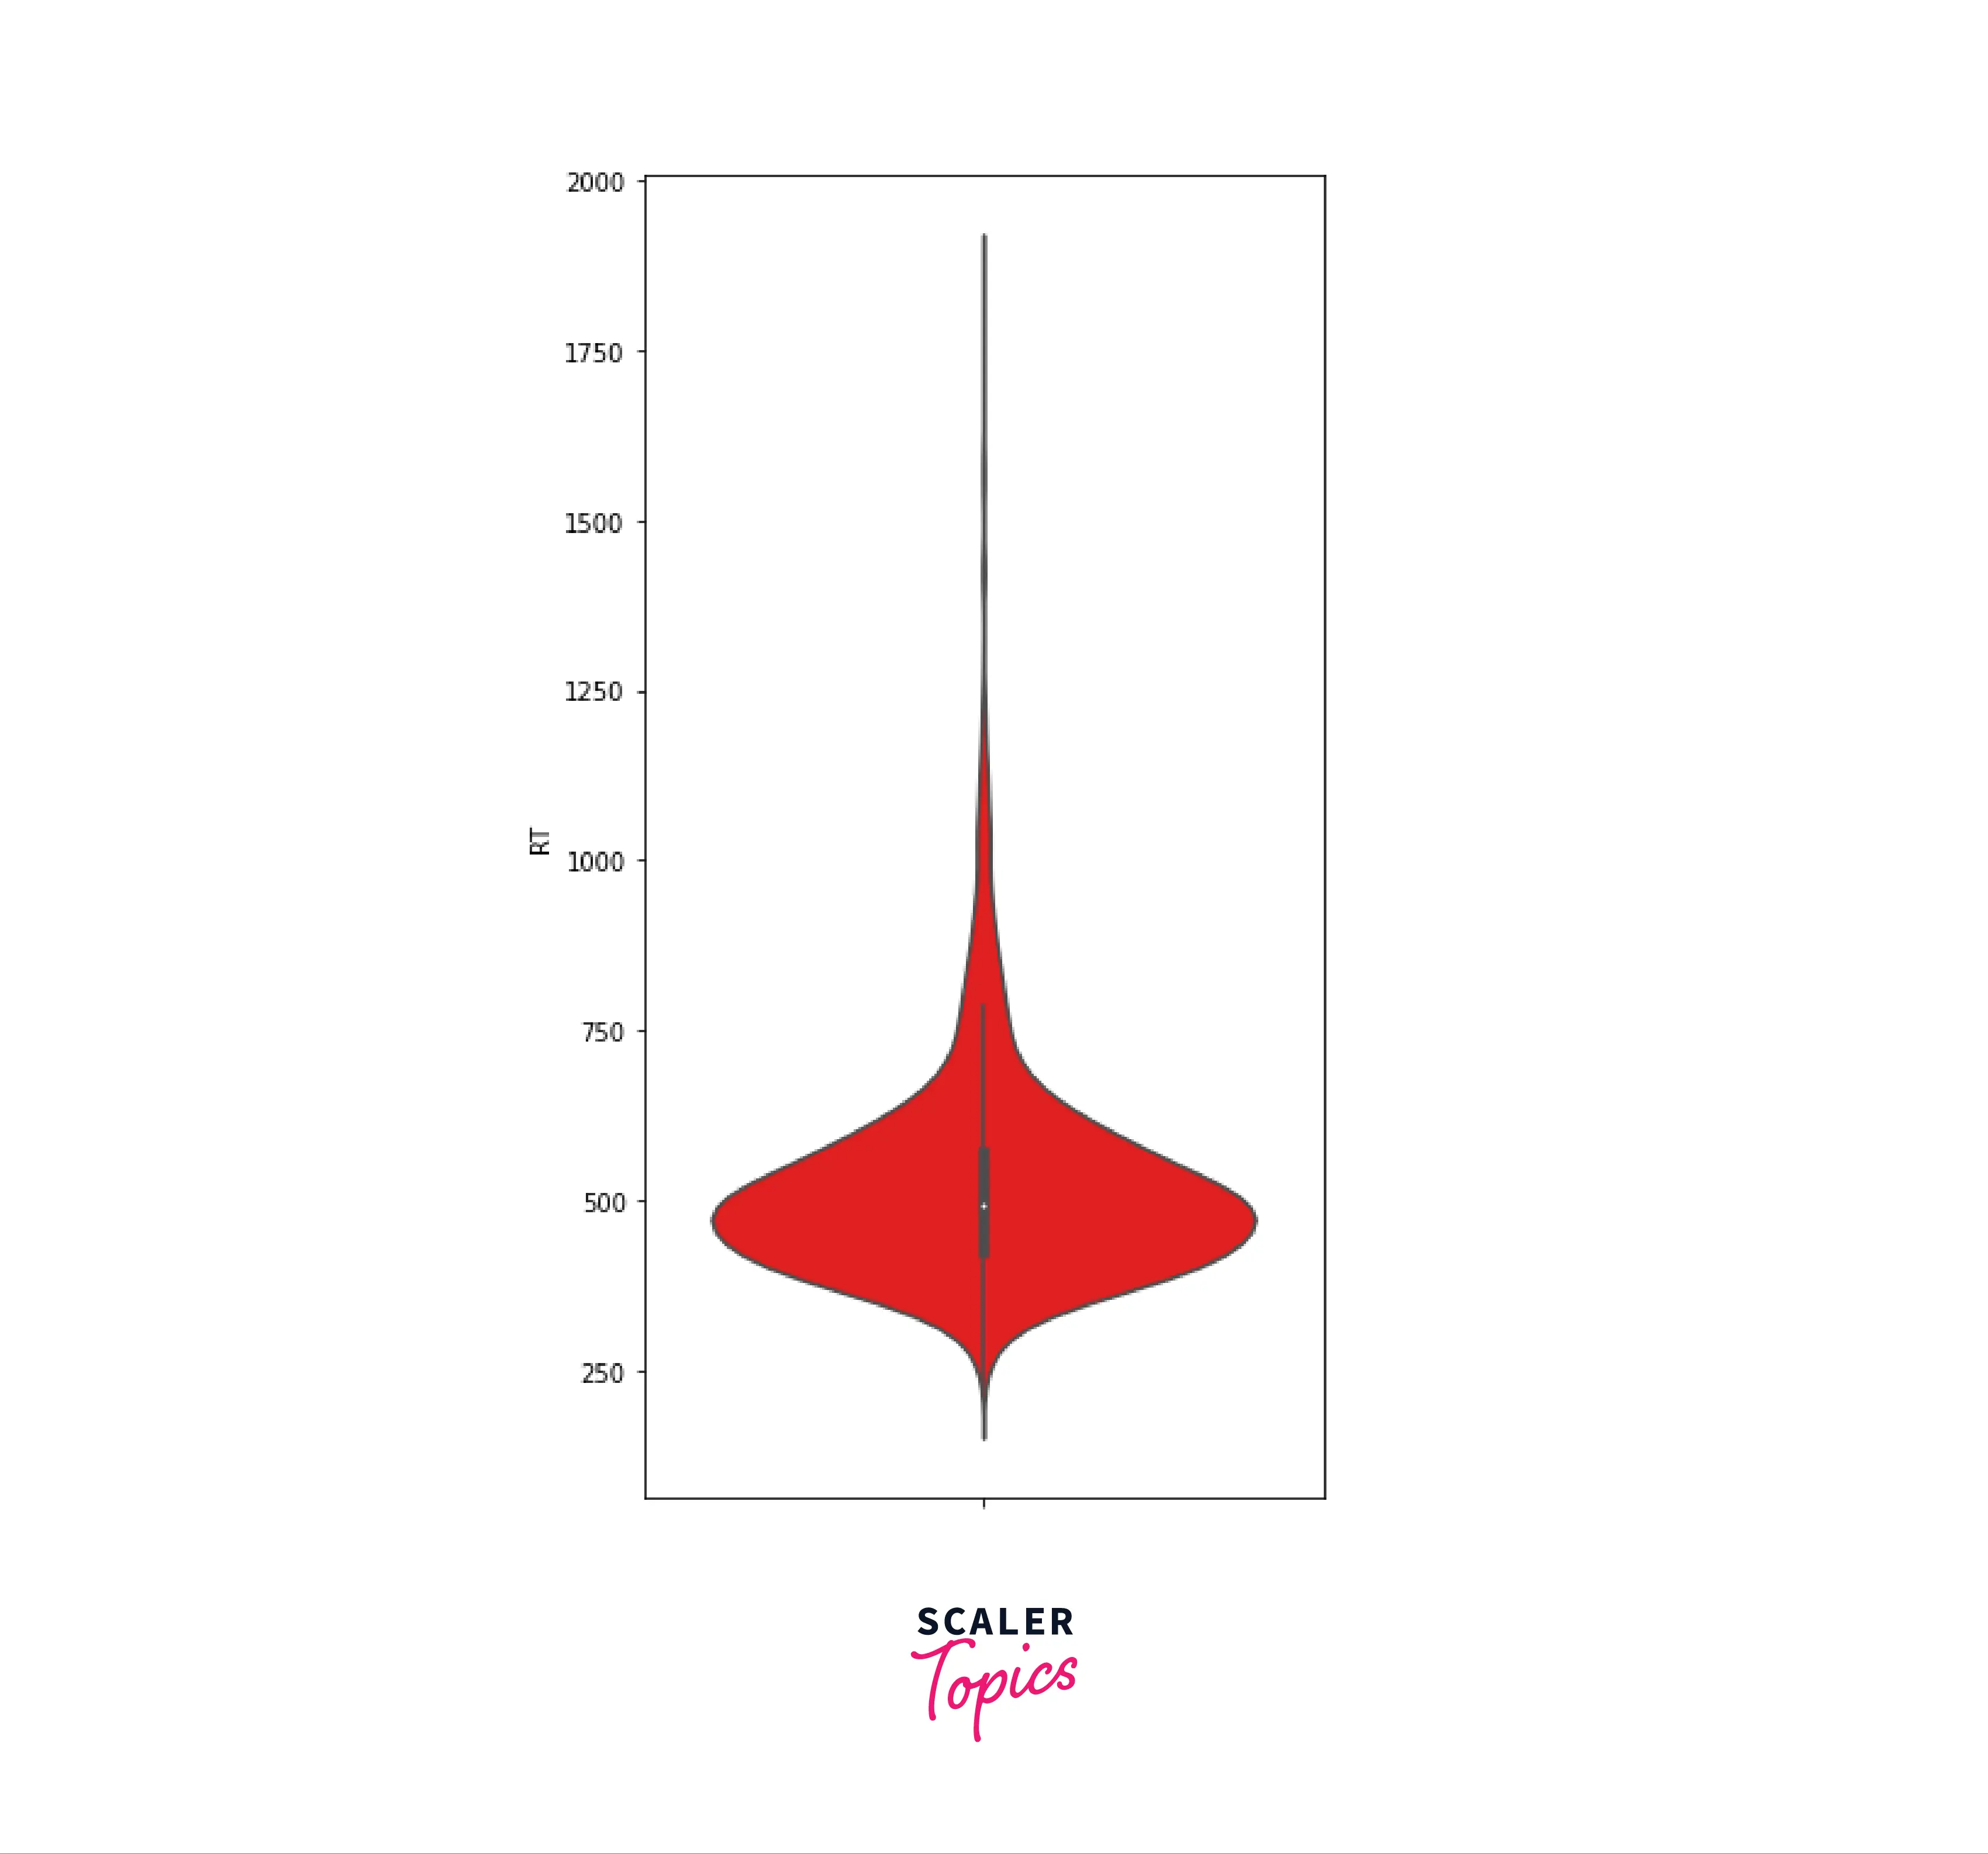
Violin Plots
A violin plot is a combination of a box plot along with a histogram.
A histogram shows the density distribution of data.
A box plot shows the mean, upper adjacent value, lower adjacent value, and interquartile data.
As seen in the figure the violin plot combines all these representations in one figure.
The Median is represented by the white dot
First Quartile is represented by the lower end of the bold bar
The Third Quartile is represented by the upper end of the bold bar
Lower Adjacent and Upper Adjacent Values are represented by the lower and upper end of the thin line
The tubular bubble represents the density distribution of the data points

Slide 26
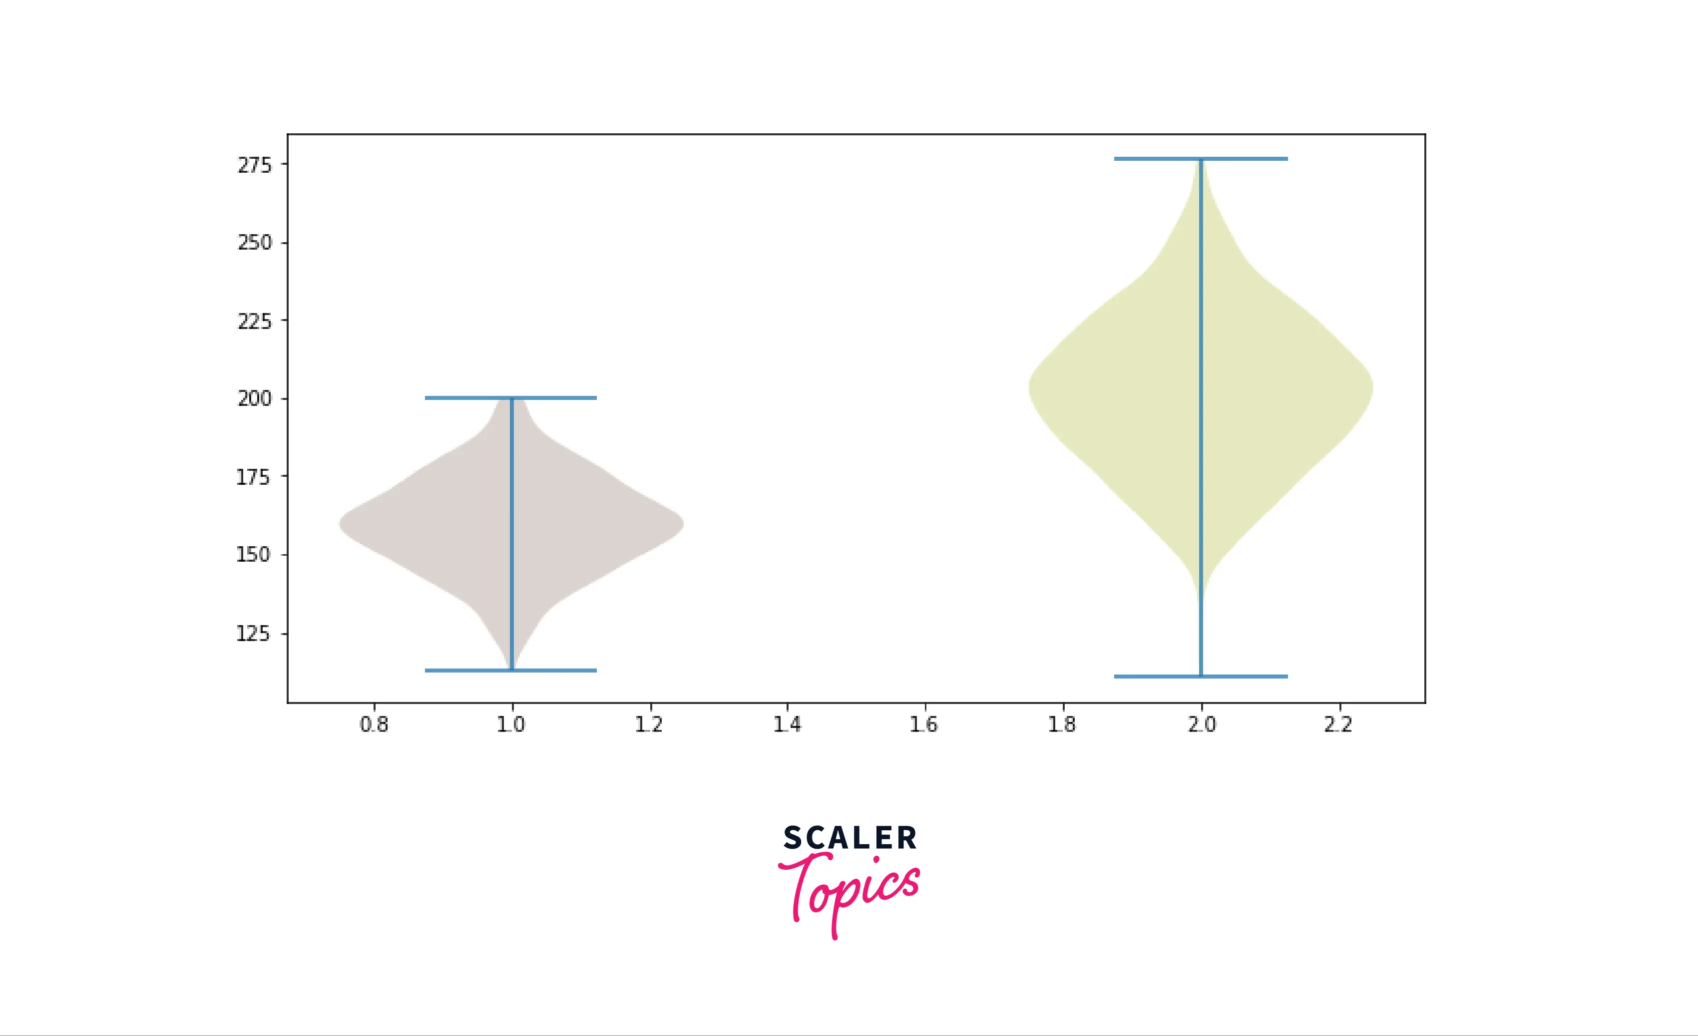
import matplotlib.pyplot as mplot
import numpy as np
np.random.seed(8)
data_set_1 = np.random.normal(160, 15, 320)
data_set_2 = np.random.normal(200, 25, 550)
set_of_Columns = [data_set_1, data_set_2]
fig = mplot.figure()
axes = fig.add_axes([0,0,1,1])
vp = axes.violinplot(set_of_Columns)
mplot.show()

Slide 27
plot a violin plot to compare two data sets, one with normal data distribution(random values) and another with uniform data distribution(consecutive values)
import numpy as np
import matplotlib.pyplot as mplot
uniform = np.arange(-2300, 2300)
normal = np.random.normal(size = 250)*800
figure, (axe1, axe2) = mplot.subplots(nrows = 1,
ncols = 2,
figsize =(12, 6),
sharey = True)
axe1.set_title('Normal Distribution')
axe1.set_ylabel('Values')
axe1.violinplot(normal)
axe2.set_title('Uniform Distribution')
axe2.violinplot(uniform)
mplot.show()

Slide 28
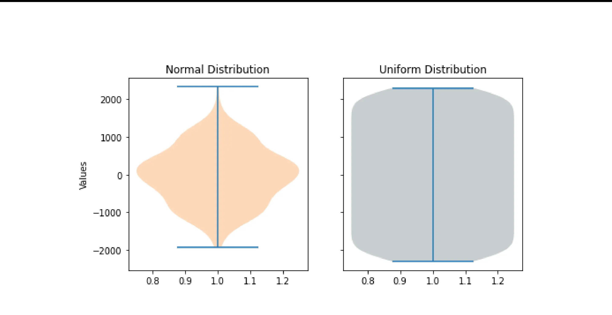

Slide 29
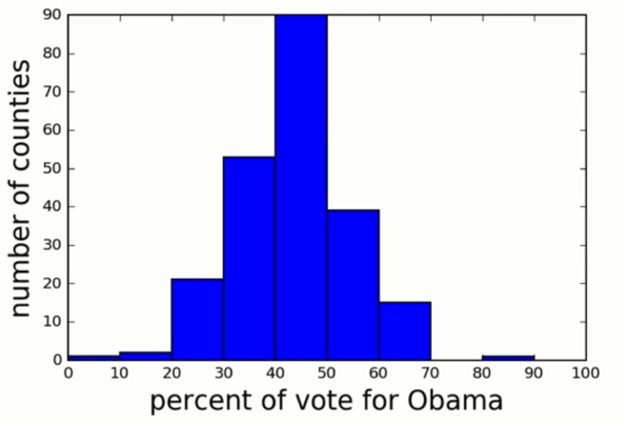
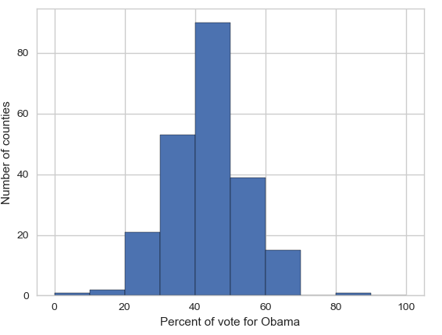
Seaborn
Matplotlib is a powerful, but sometimes unwieldy, Python library.
Seaborn provides a high-level interface to Matplotlib and makes it easier to produce graphs like the one on the right.
Some IDEs incorporate elements of this “under the hood” nowadays.

Slide 30
Benefits of Seaborn
Seaborn offers:
- Using default themes that are aesthetically pleasing.
- Setting custom colour palettes.
- Making attractive statistical plots.
- Easily and flexibly displaying distributions.
- Visualising information from matrices and DataFrames.
The last three points have led to Seaborn becoming the exploratory data analysis tool of choice for many Python users.

Slide 31
Plotting with Seaborn
One of Seaborn's greatest strengths is its diversity of plotting functions.
Most plots can be created with one line of code.
For example….

Slide 32
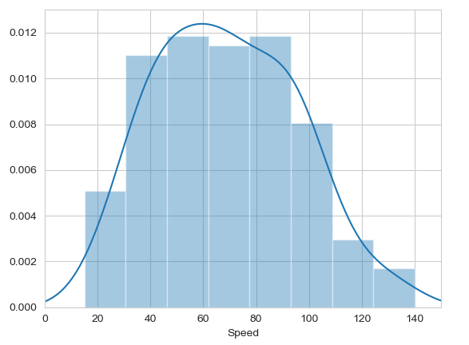

Histograms
Allow you to plot the distributions of numeric variables.

Slide 33
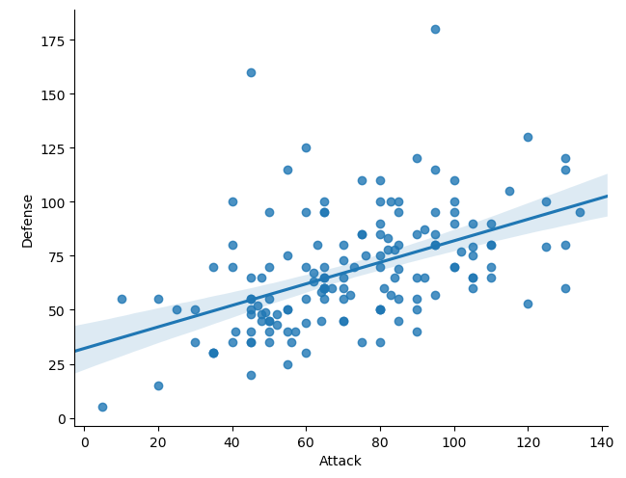
Other types of graphs: Creating a scatter plot
Name of our dataframe fed to the “data=“ command
Name of variable we want on the x-axis
Seaborn “linear model plot” function for creating a scatter graph
Name of variable we want on the y-axis

Slide 34
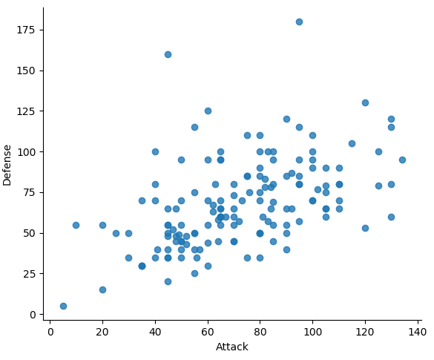
Seaborn doesn't have a dedicated scatter plot function.
We used Seaborn's function for fitting and plotting a regression line; hence lmplot()
However, Seaborn makes it easy to alter plots.
To remove the regression line, we use the fit_reg=False command

Slide 35
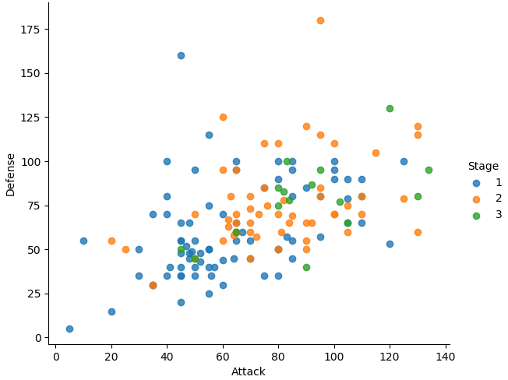

The hue function
Another useful function in Seaborn is the hue function, which enables us to use a variable to colour code our data points.

Slide 36
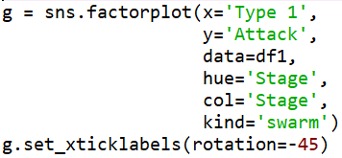
Factor plots
Make it easy to separate plots by categorical classes.
Colour by stage.
Separate by stage.
Generate using a swarmplot.
Rotate axis on x-ticks by 45 degrees.

Slide 37
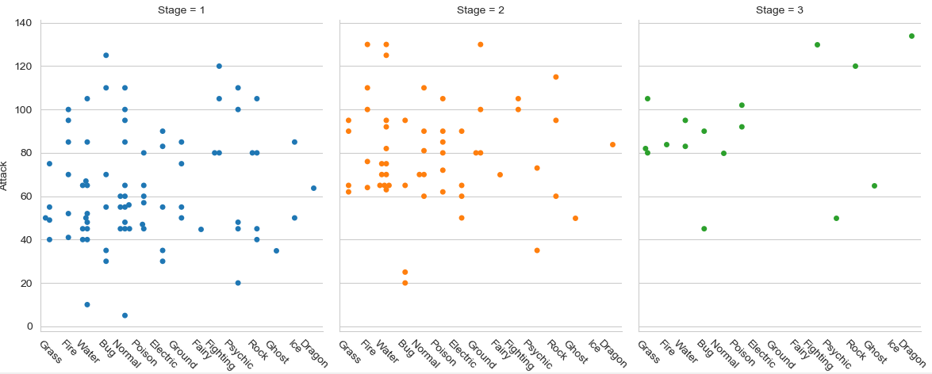

Slide 38
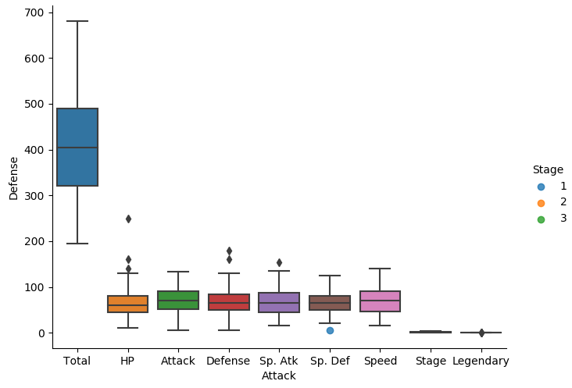

A box plot

Slide 39
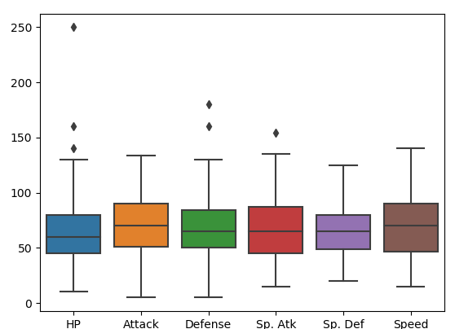
The total, stage, and legendary entries are not combat stats so we should remove them.
Pandas makes this easy to do, we just create a new dataframe
We just use Pandas’ .drop() function to create a dataframe that doesn’t include the variables we don’t want.

Slide 40
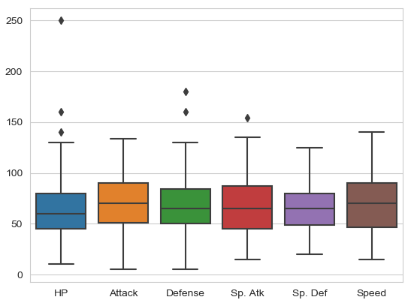

Seaborn’s theme
Seaborn has a number of themes you can use to alter the appearance of plots.
For example, we can use “whitegrid” to add grid lines to our boxplot.

Slide 41
Violin plots
Violin plots are useful alternatives to box plots.
They show the distribution of a variable through the thickness of the violin.
Here, we visualise the distribution of attack by Pokémon's primary type:

Slide 42
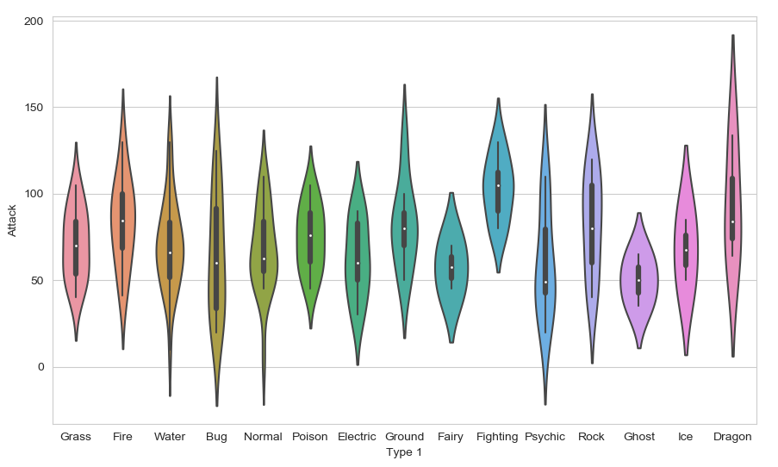
Dragon types tend to have higher Attack stats than Ghost types, but they also have greater variance. But there is something not right here….
The colours!

Slide 43
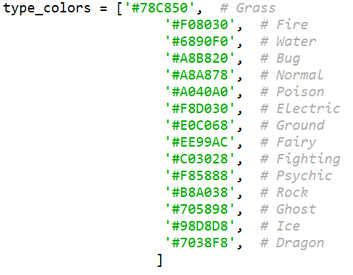
Seaborn’s colour palettes
Seaborn allows us to easily set custom colour palettes by providing it with an ordered list of colour hex values.
We first create our colours list.

Slide 44
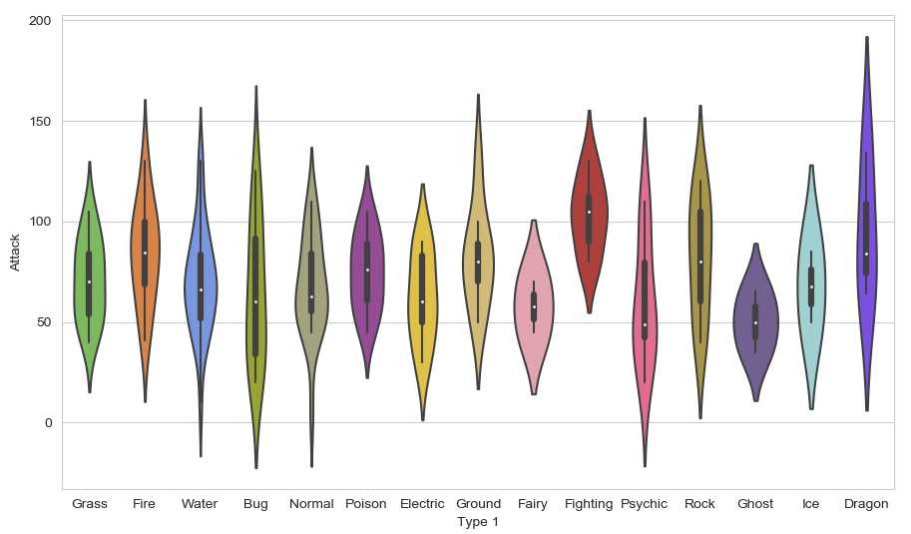
Then we just use the palette= function and feed in our colours list.

Slide 45
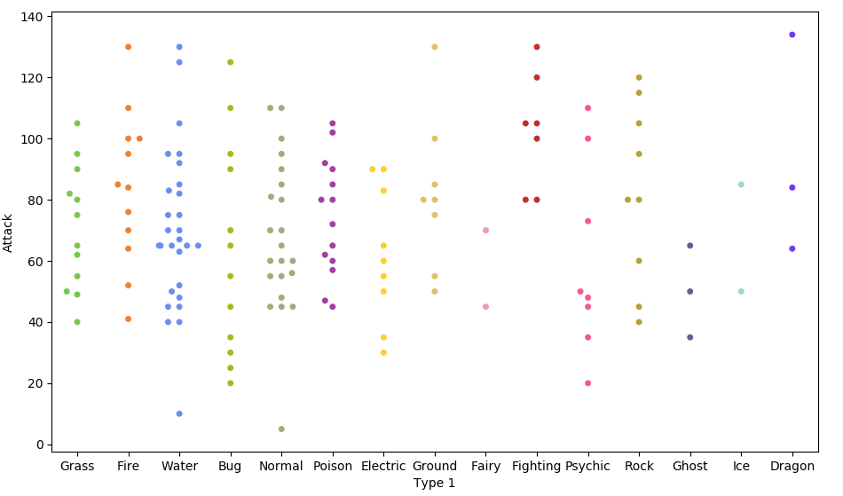

Because of the limited number of observations, we could also use a swarm plot.
Here, each data point is an observation, but data points are grouped together by the variable listed on the x-axis.

Slide 46
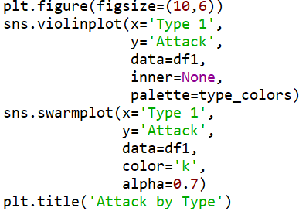
Overlapping plots
Both of these show similar information, so it might be useful to overlap them.
Set size of print canvas.
Remove bars from inside the violins
Make bars black and slightly transparent
Give the graph a title

Slide 47
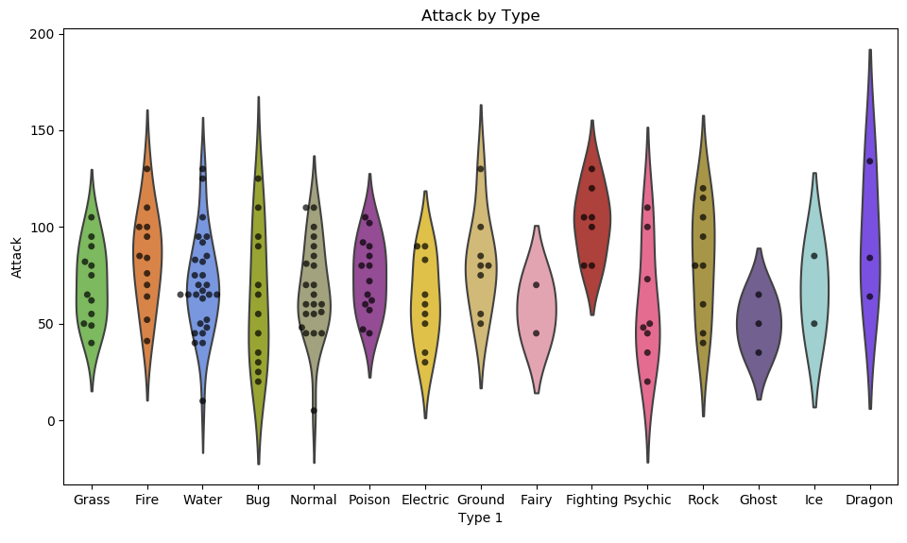

Slide 48
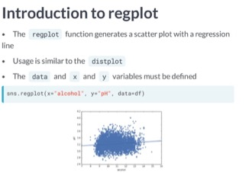

Slide 49
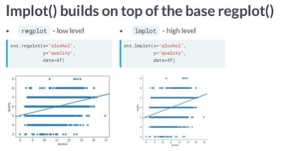

Slide 50
