Slide 1
MULTIPLE LINEAR REGRESSION
Detailed Explanation

Slide 2
MULTIPLE LINEAR REGRESSION MODELS
Introduction
Many applications of regression analysis involve situations in which there are more than one regressor variable.
A regression model that contains more than one regressor variable is called a multiple regression model.

Slide 3

MULTIPLE LINEAR REGRESSION MODELS
Introduction
For example, suppose that the effective life of a cutting tool depends on the cutting speed and the tool angle. A possible multiple regression model could be
where
Y – tool life
x₁ – cutting speed
x₂ – tool angle

Slide 4
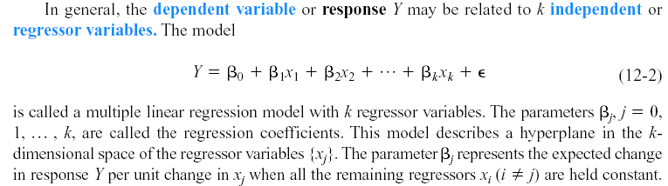
MULTIPLE LINEAR REGRESSION MODELS

Slide 5
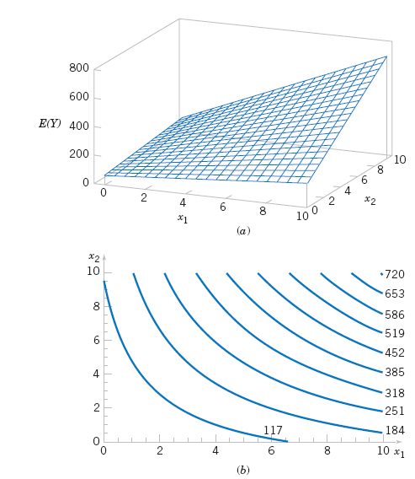
MULTIPLE LINEAR REGRESSION MODELS
Three-dimensional plot of the regression model E(Y) = 50 + 10x₁ + 7x₂ + 5x₁x₂.
(b) The contour plot

Slide 6
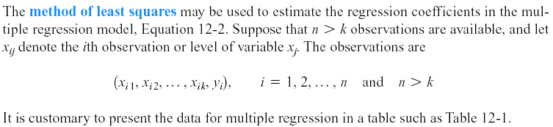
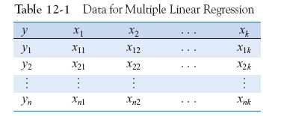
MULTIPLE LINEAR REGRESSION MODELS
Least Squares Estimation of the Parameters

Slide 7

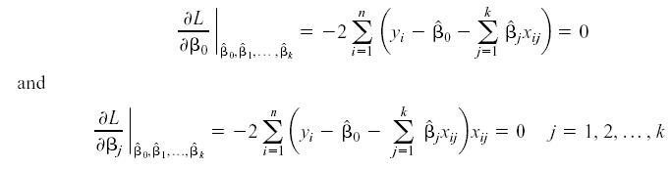
MULTIPLE LINEAR REGRESSION MODELS
Least Squares Estimation of the Parameters
The least squares function is given by
The least squares estimates must satisfy

Slide 8
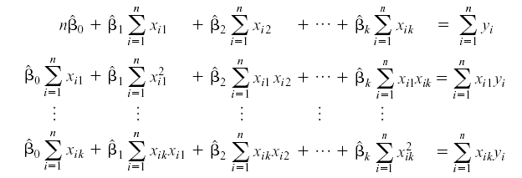
MULTIPLE LINEAR REGRESSION MODELS
Least Squares Estimation of the Parameters
The least squares normal Equations are
The solution to the normal Equations are the least squares estimators of the regression coefficients.

Slide 9
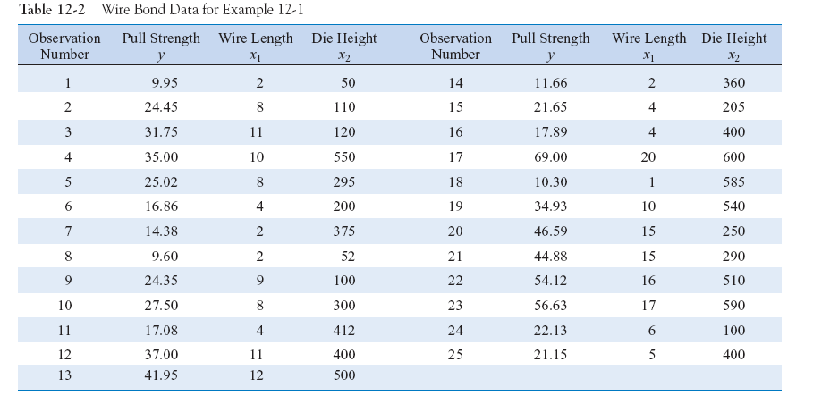

Slide 10
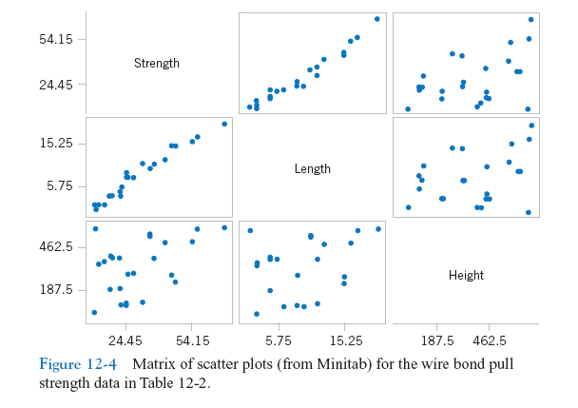

Slide 11
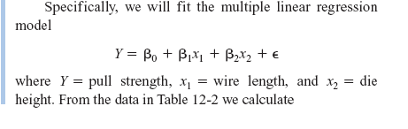
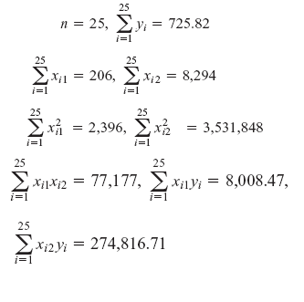
MULTIPLE LINEAR REGRESSION MODELS

Slide 12
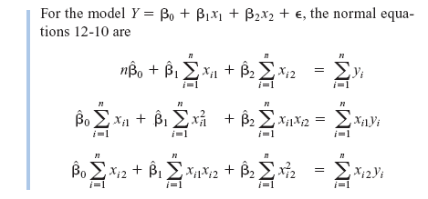
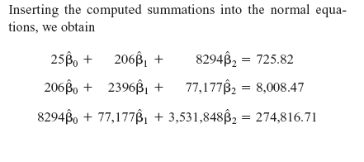

Slide 13
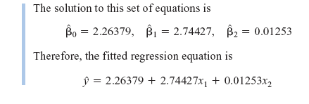
Example

Slide 14
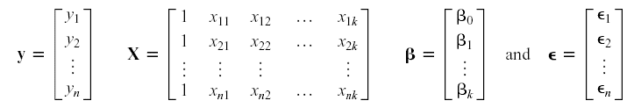
Matrix Approach to Multiple Linear Regression
Let the model relating the regressors to the response be
In matrix notation this model can be written as

Slide 15

Matrix Approach to Multiple Linear Regression
We wish to find the vector of least squares estimators that minimizes:
The resulting least squares estimate is

Slide 16
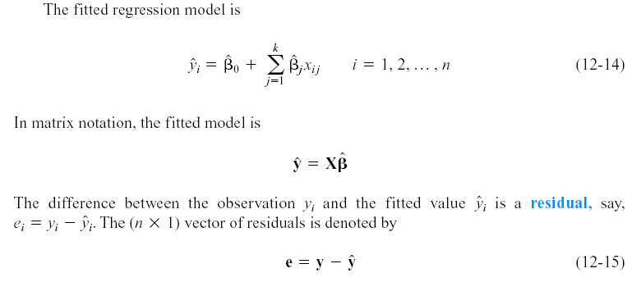
Matrix Approach to Multiple Linear Regression

Slide 17
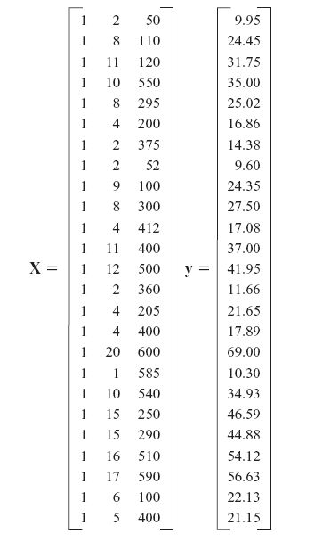
Example

Slide 18
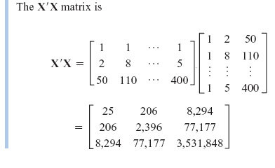
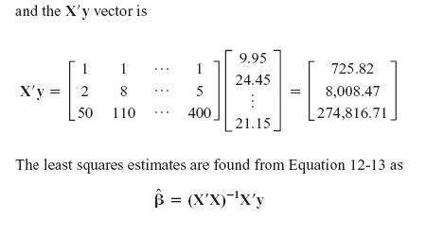
Example

Slide 19
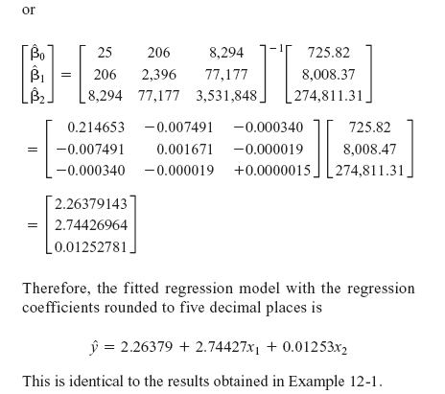
Example

Slide 20
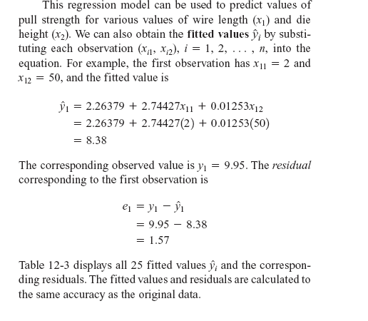
Example

Slide 21
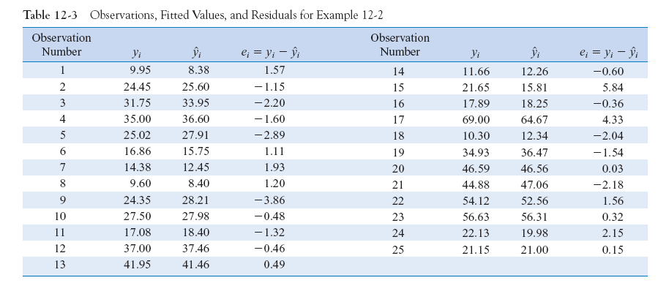

Slide 22
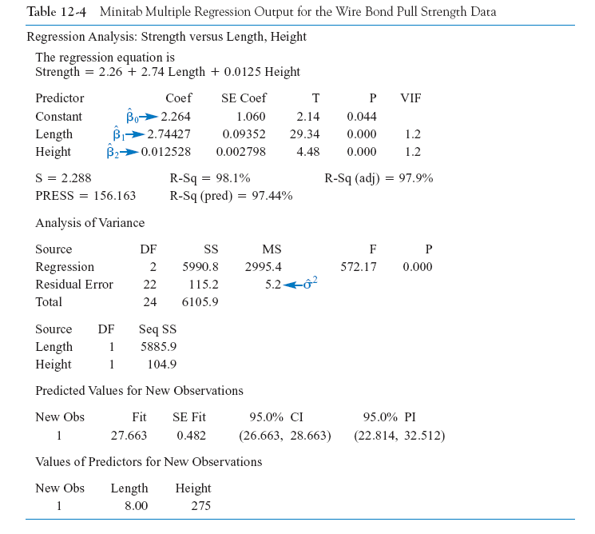

Slide 23


HYPOTHESIS TESTS IN MULTIPLE LINEAR REGRESSION
Test for Significance of Regression
The appropriate hypotheses are
The test statistic is

Slide 24
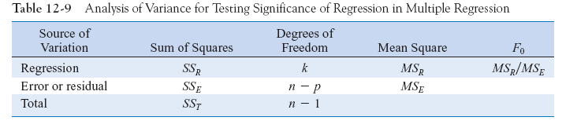
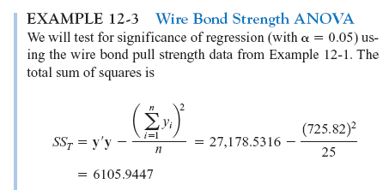
Test for Significance of Regression

Slide 25
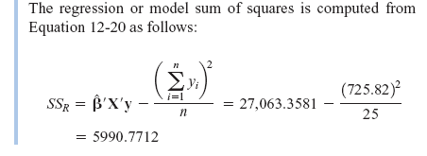

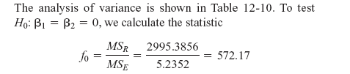
Example

Slide 26
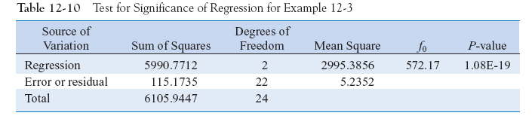
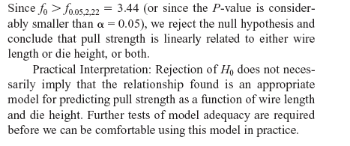

Slide 27

R² and Adjusted R²
The coefficient of multiple determination
For the wire bond pull strength data, we find that
R² = SS_{R}/SS_{T} = 5990.7712/6105.9447 = 0.9811.
Thus, the model accounts for about 98% of the variability in the pull strength response.

Slide 28

R² and Adjusted R²
The adjusted R² is
The adjusted R² statistic penalizes the analyst for adding terms to the model.
It can help guard against overfitting (including regressors that are not really useful)

Slide 29

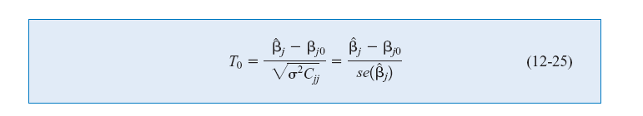
Tests on Individual Regression Coefficients and Subsets of Coefficients
The hypotheses for testing the significance of any individual regression coefficient:
The test statistic is
Reject H₀ if |t₀| > t_{α/2,n-p}.
This is called a partial or marginal test

Slide 30
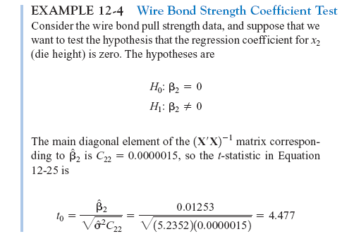
Example

Slide 31
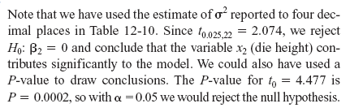
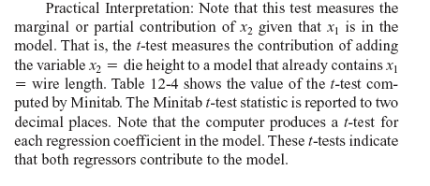
Example

Slide 32



12-2: HYPOTHESIS TESTS IN MULTIPLE LINEAR REGRESSION
The general regression significance test or the extra sum of squares method:
We wish to test the hypotheses:

Slide 33
12-2: HYPOTHESIS TESTS IN MULTIPLE LINEAR REGRESSION
A general form of the model can be written:
where X₁ represents the columns of X associated with β₁ and X₂ represents the columns of X associated with β₂

Slide 34

12-2: HYPOTHESIS TESTS IN MULTIPLE LINEAR REGRESSION
For the full model:
If H₀ is true, the reduced model is

Slide 35

12-2: HYPOTHESIS TESTS IN MULTIPLE LINEAR REGRESSION
The test statistic is:
Reject H₀ if f₀ > f_{α,r,n-p}
The test in Equation (12-32) is often referred to as a partial F-test

Slide 36
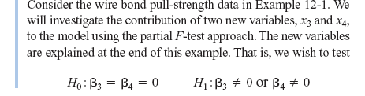
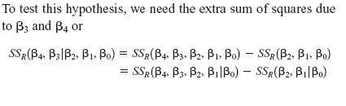
12-2: HYPOTHESIS TESTS IN MULTIPLE LINEAR REGRESSION
Example 12-6

Slide 37
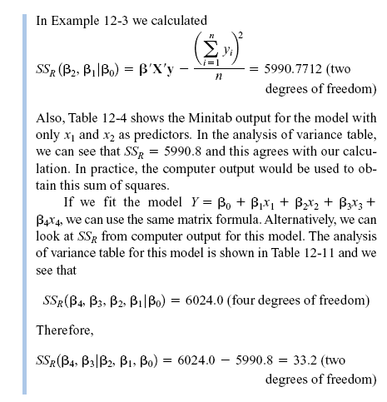
12-2: HYPOTHESIS TESTS IN MULTIPLE LINEAR REGRESSION
Example 12-6

Slide 38
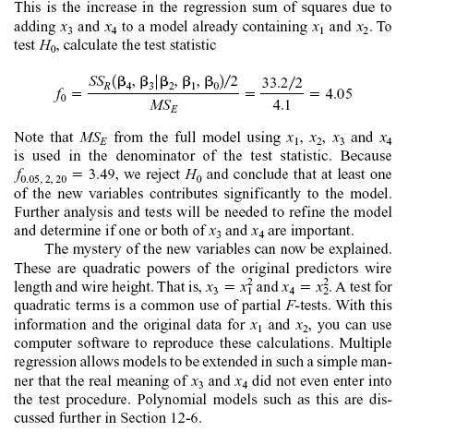
12-2: HYPOTHESIS TESTS IN MULTIPLE LINEAR REGRESSION
Example 12-6

Slide 39
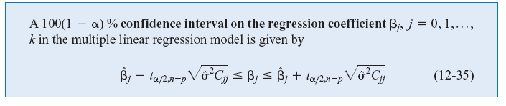
12-3: CONFIDENCE INTERVALS IN MULTIPLE LINEAR REGRESSION
12-3.1 Confidence Intervals on Individual Regression Coefficients
Definition

Slide 40
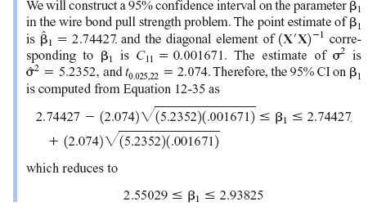
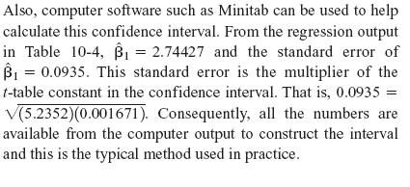
12-3: CONFIDENCE INTERVALS IN MULTIPLE LINEAR REGRESSION
Example 12-7

Slide 41


12-3: CONFIDENCE INTERVALS IN MULTIPLE LINEAR REGRESSION
12-3.2 Confidence Interval on the Mean Response
The mean response at a point x₀ is estimated by
The variance of the estimated mean response is

Slide 42
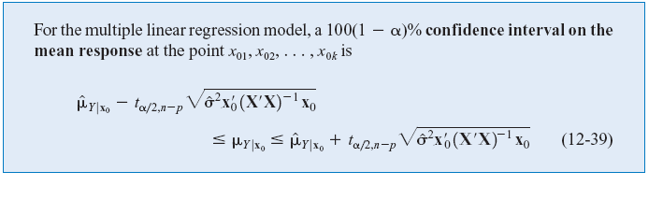
12-3: CONFIDENCE INTERVALS IN MULTIPLE LINEAR REGRESSION
12-3.2 Confidence Interval on the Mean Response
Definition

Slide 43
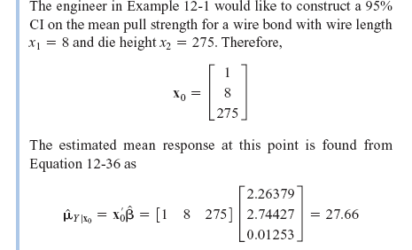
12-3: CONFIDENCE INTERVALS IN MULTIPLE LINEAR REGRESSION
Example 12-8

Slide 44
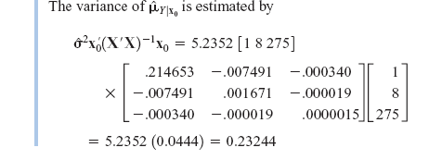
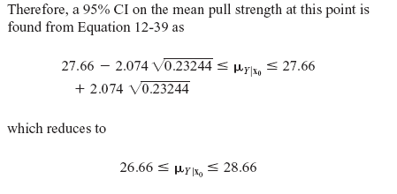
12-3: CONFIDENCE INTERVALS IN MULTIPLE LINEAR REGRESSION
Example 12-8

Slide 45
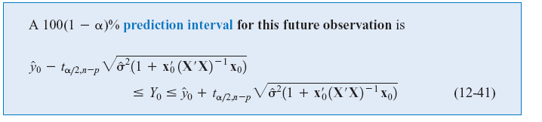
12-4: PREDICTION OF NEW OBSERVATIONS
A point estimate of the future observation Y₀ is
A 100(1-α)% prediction interval for this future observation is

Slide 46
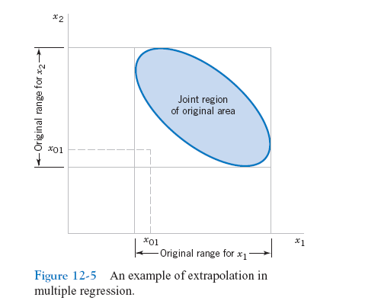
12-4: PREDICTION OF NEW OBSERVATIONS
Figure 12-5 An example of extrapolation in multiple regression

Slide 47
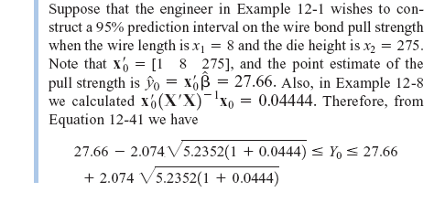
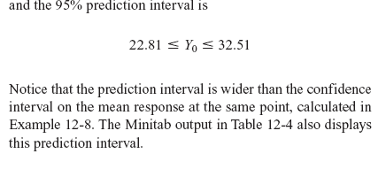
12-4: PREDICTION OF NEW OBSERVATIONS
Example 12-9

Slide 48


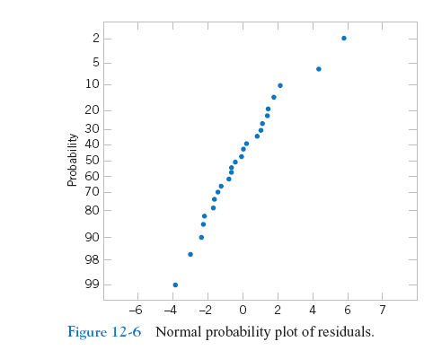
12-5: MODEL ADEQUACY CHECKING
12-5.1 Residual Analysis
Example 12-10
Figure 12-6 Normal probability plot of residuals

Slide 49
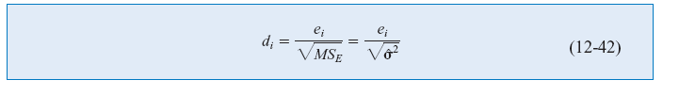
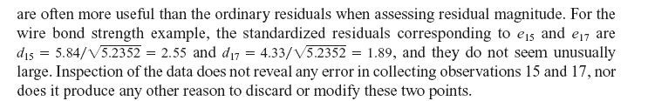
12-5: MODEL ADEQUACY CHECKING
12-5.1 Residual Analysis
Example 12-10

Slide 50


12-5: MODEL ADEQUACY CHECKING
12-5.1 Residual Analysis
Example 12-10
Figure 12-7 Plot of residuals

Slide 51

12-5: MODEL ADEQUACY CHECKING
12-5.1 Residual Analysis
Example 12-10
Figure 12-8 Plot of residuals against x₁.

Slide 52

12-5: MODEL ADEQUACY CHECKING
12-5.1 Residual Analysis
Example 12-10
Figure 12-9 Plot of residuals against x₂.

Slide 53


12-5: MODEL ADEQUACY CHECKING
12-5.1 Residual Analysis

Slide 54


12-5: MODEL ADEQUACY CHECKING
12-5.1 Residual Analysis
The variance of the ith residual is

Slide 55


12-5: MODEL ADEQUACY CHECKING
12-5.1 Residual Analysis

Slide 56

12-5: MODEL ADEQUACY CHECKING
12-5.2 Influential Observations
Figure 12-10 A point that is remote in x-space.

Slide 57


12-5: MODEL ADEQUACY CHECKING
12-5.2 Influential Observations
Cook’s distance measure

Slide 58

12-5: MODEL ADEQUACY CHECKING
Example 12-11

Slide 59

12-5: MODEL ADEQUACY CHECKING
Example 12-11

Slide 60

ASPECTS OF MULTIPLE REGRESSION MODELING
Categorical Regressors and Indicator Variables
Many problems may involve qualitative or categorical variables.
The usual method for the different levels of a qualitative variable is to use indicator variables.
For example, to introduce the effect of two different operators into a regression model, we could define an indicator variable as follows:

Slide 61

Example

Slide 62

Example

Slide 63

Example

Slide 64



Slide 65



