Slide 1
Simple Expense Tracker Application
Link to Project : https://github.com/YashSejpal/ExpenseTracker

Slide 2
Problem Statement
Create an application for simple expense tracking and management. The user should be
able to enter an expense by providing category, amount, and data.
The application should provide:
1. Total expense
2. Total expense by category
3. Expense trend
4. Highest and lowest spend category
All data can be kept in memory or in a file. A database is not necessary.

Slide 3
Approach and Design
Language Used - Java ; CLI based application
4 classes created - AuthService, Expense, ExpenseService and Main
AuthService handles the login of a user with passwordless authentication by assigning a 6 digit token at the time of registration
Expense class contains 3 instance variables - Category, Amount and Date along with a constructor to initialize them
ExpenseService contains the operations that can be selected by the user
Main class takes the inputs from the user and is the entry point of the application

Slide 4
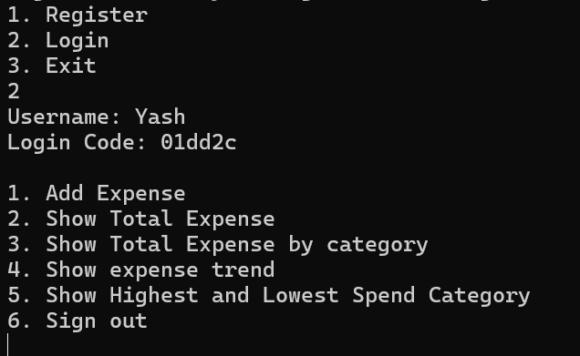
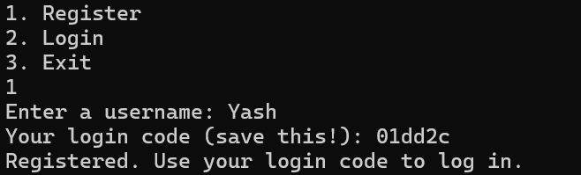
AuthService class operations
Register : For new users. On registration, a file with the name users.json is updated with the username and password. Does not allow username repetition
Login : On entering username and password, user is authenticated

Slide 5
ExpenseService class operations
The constructor initializes file name for storing expenses of every individual user as Username_expenses.json
Add Expense : Creates a JSON object and adds it to the JSONArray
Show Total Expense : Sums all expenses made by the user
Show Total Expense by Category : Returns a map that stores categories and their expenses
Show Expense Trend : Creates a line graph that plots Expense amount (y- axis) vs Date (x- axis) by using the JFreeChart class.
Show Highest and Lowest category : Uses a map to store categories and expenses, then displays the highest and lowest spend category
Sign Out : Takes you back to the Login and register menu

Slide 6
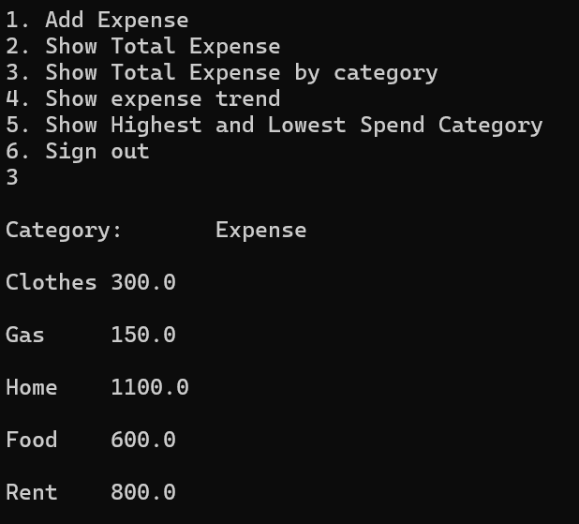
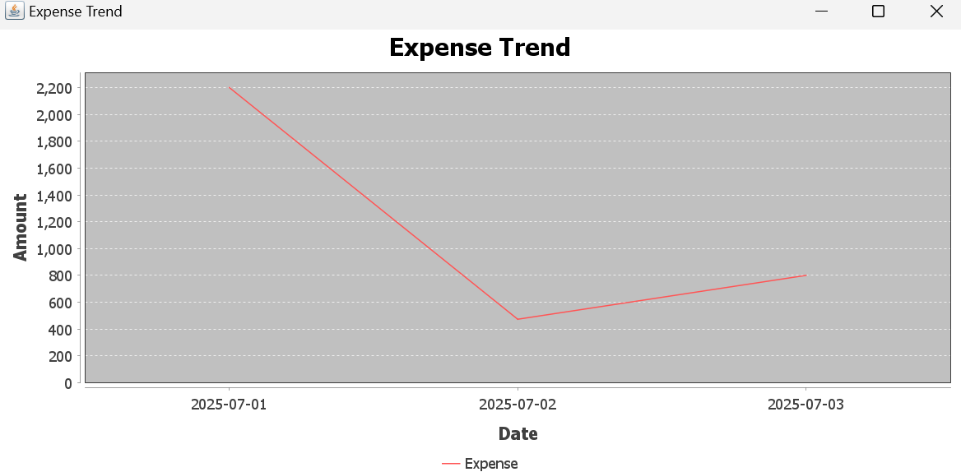
Expense Trend (line graph) made with JFreeChart class

Slide 7
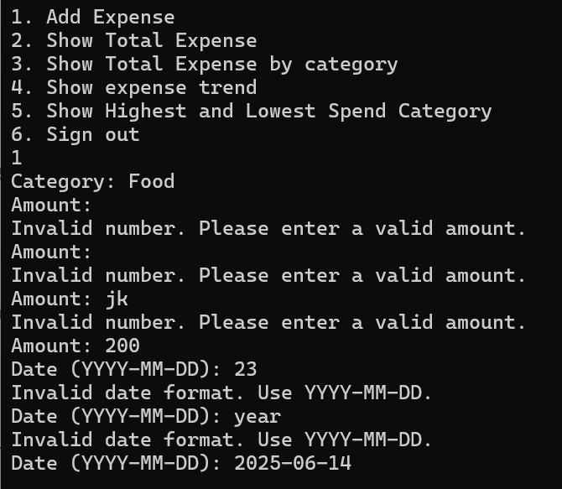
Additional features added
PASSWORDLESS AUTHENTICATION (Token based)
INPUT VALIDATION

Slide 8
Process to Run
The process is explained in the readme file : https://github.com/YashSejpal/ExpenseTracker/blob/main/README.md
It includes installing Java and Git. Then cloning the repository using git to a local directory. In the local directory, run the commands to compile and run the application.

Slide 9
Commands for compiling java code :
Commands for running the application :

Slide 10
Improvements that can be made
Add DELETE and MODIFY functions to ExpenseServices class so the user can make change existing entries.
Connect a SQL database and write queries
Add a bulk upload where expenses can be added from file
Add a User Interface for ease

Slide 11
THANK YOU

