Slide 1

Note: The data and information in this document is reflective of a hypothetical situation and client. This document is to be used for KPMG Virtual Internship purposes only.
Sprocket Central Pty Ltd
Data analytics approach
KPMG’s Lighthouse & Innovation Team – Yash Shah (Junior Consultant)

Slide 2

Note: The data and information in this document is reflective of a hypothetical situation and client. This document is to be used for KPMG Virtual Internship purposes only.
Agenda
Understanding the Data
Data Exploration
Model Development

Slide 3
Note: The data and information in this document is reflective of a hypothetical situation and client. This document is to be used for KPMG Virtual Internship purposes only.
Understanding the Datasets
Initially, three datasets were provided whose dimensions were as follows -
After assessing the quality of the datasets followed by cleaning them, we ended up with the below dimensions -
Methods like data imputation, data transformation, removing unnecessary rows and columns, and replacing missing or incorrect values with reasonable ones were applied

Slide 4
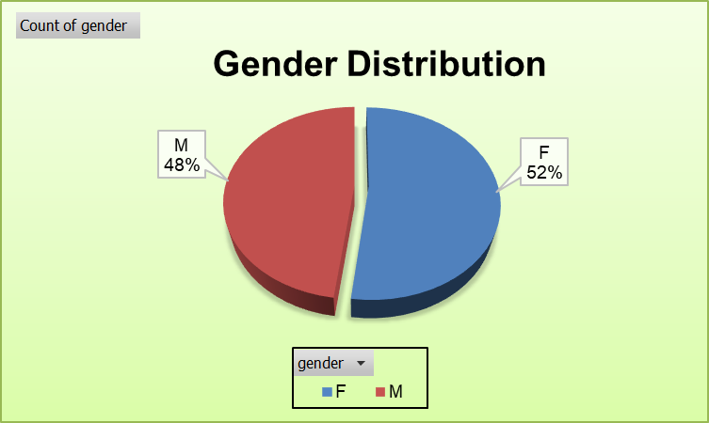
Note: The data and information in this document is reflective of a hypothetical situation and client. This document is to be used for KPMG Virtual Internship purposes only.
Data Exploration : Gender Distribution
Female customers are leading the male customers at present by 4%
The total count of females is 2038 whereas that of males is 1872

Slide 5
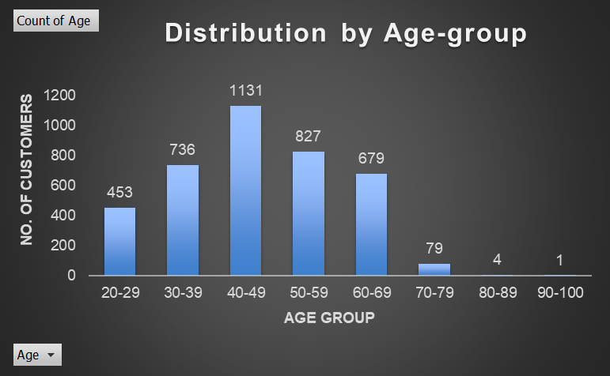
Note: The data and information in this document is reflective of a hypothetical situation and client. This document is to be used for KPMG Virtual Internship purposes only.
Data Exploration : Age Distribution
The age of the customers was derived from their date of birth
It is observed that a majority of the present customers belong to the age group 40-49 years
Followed by this, a great amount of customers are coming from the age group 50-59 and 30-39
Customers below 20 and above 79 should not be targeted due to low counts

Slide 6
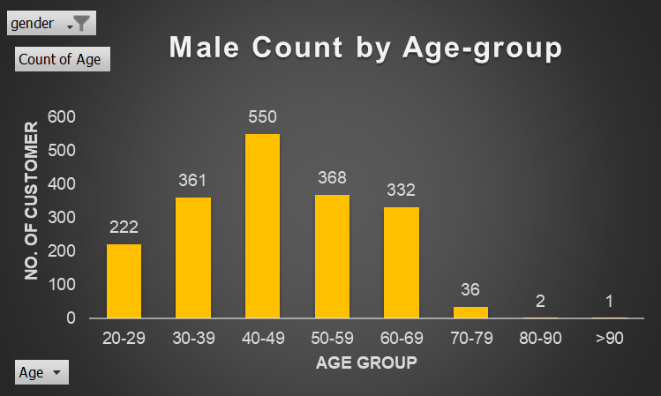
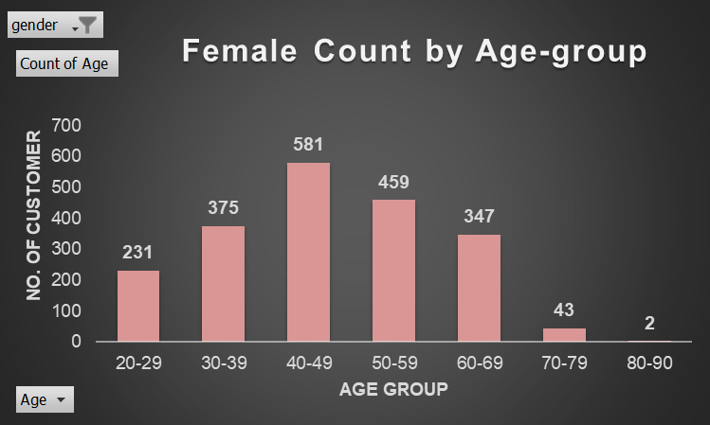
Note: The data and information in this document is reflective of a hypothetical situation and client. This document is to be used for KPMG Virtual Internship purposes only.
Data Exploration : Age Distribution
After gender-based data separating, it is discovered that customers with greater counts, irrespective of gender, primarily fall in the 40-49 age bracket
The count of female customers in this age group is slightly larger than those of male customers belonging to the same age group
Hence, female customers should be focused more at the time of marketing

Slide 7
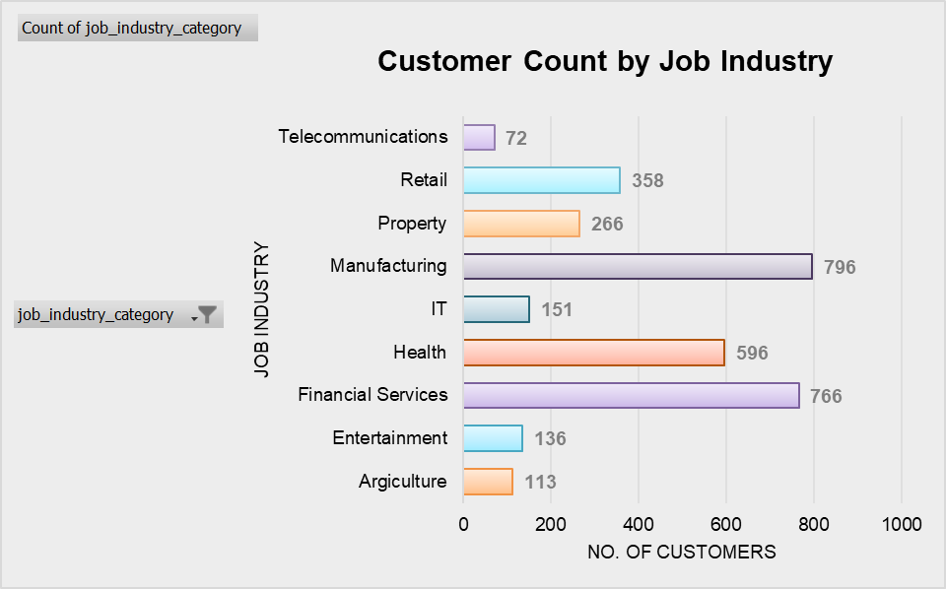
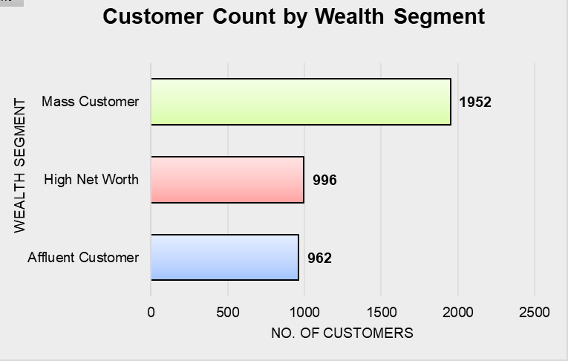
Note: The data and information in this document is reflective of a hypothetical situation and client. This document is to be used for KPMG Virtual Internship purposes only.
Data Exploration : Job Industry & Wealth Segment Distribution
Customers who are a part of the Manufacturing industry form the major basis of the business with a count of 796 followed by the Financial Services industry which sums up to 766
Mass Customers are at the top when the data is segregated based on wealth segment
To build a successful strategy, the team must concentrate on Mass customers who belong to either the manufacturing or financial services industry

Slide 8
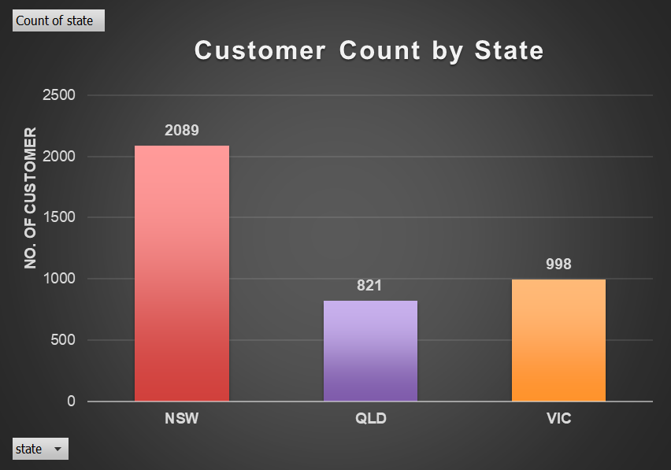
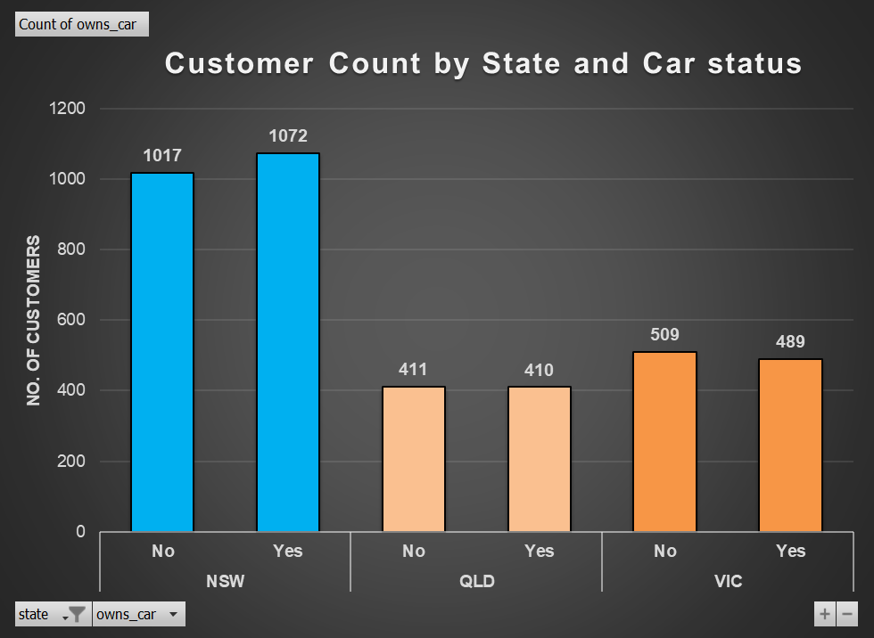
Note: The data and information in this document is reflective of a hypothetical situation and client. This document is to be used for KPMG Virtual Internship purposes only.
Data Exploration : State Distribution
New South Wales could be the potential location to conduct the marketing campaign as most customers come from this state
More number of people own car in New South Wales whereas the customers having ownership of car in other two states is nearly equal to those who do not own car
Marketing techniques can persuade more people who don't currently own an automobile to buy one. Then, QLD and VIC might also produce better outcomes

Slide 9
Note: The data and information in this document is reflective of a hypothetical situation and client. This document is to be used for KPMG Virtual Internship purposes only.
Model Development
Based on the observations, the marketing team should give priority to the following points to ensure a better return to the marketing activities conducted by them.
Customers in the age bracket 40-49
Female Clients
Customers who are a part of Manufacturing, Financial Services, and Health Industry
Mass Customers
Customers who live in New South Wales followed by Victoria

Slide 10
Note: The data and information in this document is reflective of a hypothetical situation and client. This document is to be used for KPMG Virtual Internship purposes only.
THANK YOU

