Slide 1
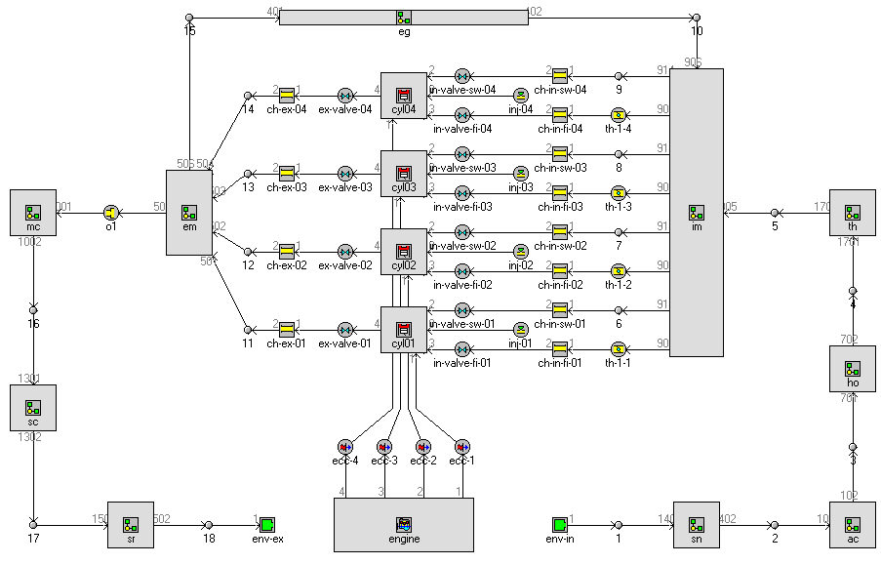
Simulation of a 2.0 L 4 cylinder engine with an isolated combustion chamber
prepared for:
Aachen, 1st of October 2015

Slide 2
GT-Power simulation
GT-Power model
The GT-Power model is based on a 2.0 L benchmark engine model
The following technics are included in the model:
HP- and LP-EGR
Turbo charger with VGT
DOC, SDPF and Slip catalyst
Controlled water cooled charged air cooler
Intake and exhaust throttle flap

Slide 3
Simulation of isolated combustion chamber
Targets, Boundary Conditions and Assumptions
Max. Power: 120 kW @ 4000 rpm
Max. Torque: 350 Nm @ 1600 – 2400 rpm
Cylinder compression ratio: 16.5
Cylinder peak pressure: 180 bar (design limit 190 bar)
Heat transfer in comparison model in the combustion chamber is reduced by different portions by varying a heat transfer multiplier (base: HTM = 1; variations from HTM = 0.2 – 0.6 during combustion and expansion phase; as extremum / for reference a HTM of 0 has been simulated)
The real isolation effect will be depending on the used material and isolation-wallthickness

Slide 4
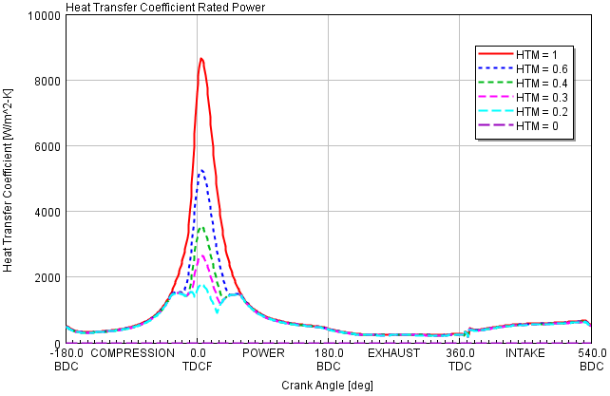
Simulation of isolated combustion chamber – Full load
HTC of rated power operating point
Remarks
Reduction of HTM during combustion and expansion
The heat transfer multiplier has been varied between 0.2 and 1 during combustion and expansion phase
For comparison the in-cylinder heat transfer has also been reduced to zero

Slide 5
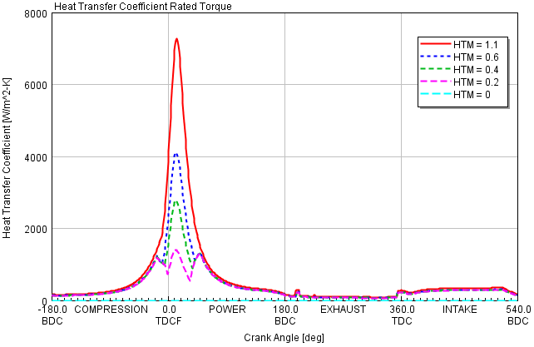
Simulation of isolated combustion chamber – Full load
HTC of rated torque operating point
Remarks
Reduction of HTM during combustion and expansion
The same procedure has been investigated at rated torque operation

Slide 6
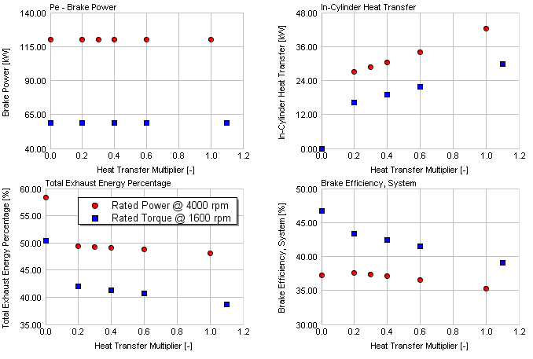
Simulation of isolated combustion chamber – Full load
Losses and efficiencies
Remarks
Due to the isolation the in-cylinder heat transfer is reduced
BMEP has been kept constant in the simulation model
Because of the higher temperatures in the combustion chamber after expansion (due to less heat transfer) the exhaust energy increases.
Less heat losses means also that less fuel is needed to generate the same BMEP – therefore brake efficiency increases, too

Slide 7
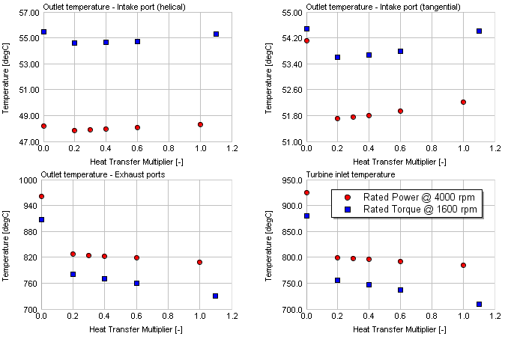
Simulation of isolated combustion chamber – Full load
Temperatures
Remarks
Due to the combustion chamber isolation the exhaust temperatures at the exhaust ports outlet and likewise the turbine inlet temperatures are for rated power up to 20 K higher than without the isolation, and up to 50 K for the rated torque operating point. But as a heat loss reduction of 80 % is more or less unrealistic, the benefit of temperature increase is little or even negligible

Slide 8
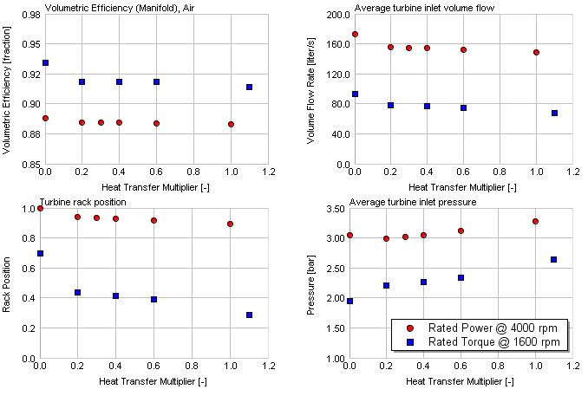
Simulation of isolated combustion chamber – Full load
Gas exchange
Remarks
Because of the higher exhaust temperatures the exhaust volume flows are slightly higher with the isolated combustion chamber
As result the turbine rack attack angle can be reduced
This reduces the back pressure before turbine
The zero HTM version of the rated power point is a kind of outlier because the max. cylinder pressure had to be reduced to keep BMEP constant (VTG is already completely open) => see also BSFC

Slide 9
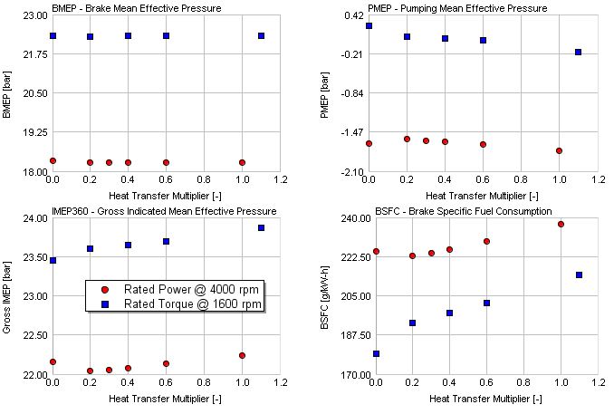
Simulation of isolated combustion chamber – Full load
Engine Performance
Remarks
Because of the lower back pressures before turbine the pumping losses can be reduced with lower in-cylinder heat transfer
This reduces the required indicated mean effective pressure of the high pressure cycle and as result the injected fuel mass
So BSFC is reduced
see also comment on slide 6
The reduction potential of BSFC is also for less isolation effect high (but it has to be kept in mind that the combustion profile was not changed in the simulation model)

Slide 10
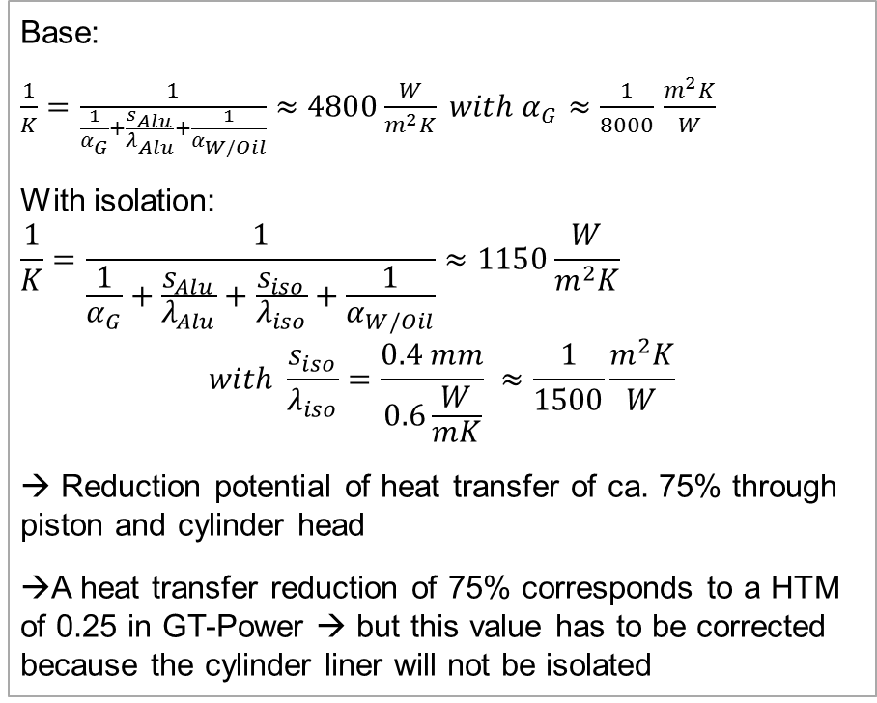
Simulation of isolated combustion chamber – Full load
Quantitative estimation of isolation effect
Remarks
Base:
$\frac{1}{K}=\frac{1}{\frac{1}{α_{G}}+\frac{s_{Alu}}{λ_{Alu}}+\frac{1}{α_{W/Oil}}}≈4800\frac{W}{m^{2}K} with α_{G}≈\frac{1}{8000}$ $\frac{m^{2}K}{W}$
With isolation:
$$\frac{1}{K}=\frac{1}{\frac{1}{α_{G}}+\frac{s_{Alu}}{λ_{Alu}}+\frac{s_{iso}}{λ_{iso}}+\frac{1}{α_{W/Oil}}}≈1150\frac{W}{m^{2}K}$$
$$with \frac{s_{iso}}{λ_{iso}}=\frac{0.4 mm}{0.6\frac{W}{mK}} ≈\frac{1}{1500}\frac{m^{2}K}{W}$$
→ Reduction potential of heat transfer of ca. 75% through piston and cylinder head
→A heat transfer reduction of 75% corresponds to a HTM of 0.25 in GT-Power → but this value has to be corrected because the cylinder liner will not be isolated
In GT-Power the heat transfer multiplier was applied for the complete combustion chamber
Therefore it has to be estimated how much heat is lost through the liner

Slide 11
Simulation of isolated combustion chamber – Full load
Quantitative estimation of isolation effect
Remarks
At the “starting” angle of -30°CA the piston position is about 8.5mm, at 60°CA it is 30mm
In total a piston stroke of 38.5mm is done
This is a percentage of 40.3% of the complete stroke.
The cylinder wall area during the isolation phase is nearly the same than the wall area of piston and cylinder head (liner wall area is 48.7% of the total area).
Assuming that the wall temperatures of cylinder head, liner and piston are the same, the following can be stated (because the heat loss is proportional to the wall area):
In GT-Power not a heat transfer reduction of 75% has to be applied, but 75% * (1-0.487) = 38.475%
The chosen HTM has to be 0.61525
The isolation is effective from approx. -30°CA to 60°CA

Slide 12
Simulation of isolated combustion chamber – Full load
Quantitative estimation of isolation effect
Remarks
The HTM of 0.61525 has to be corrected by wall temperature influence.
As the heat loss is also proportional to temperature difference and wall temperature of the liner is approx. 100K lower than piston / 50K lower than head, …
Wall temperatures of cylinder head, liner and piston are not the same
Actually the liner wall temperature is significantly lower than the head and piston wall temperature

