Slide 1

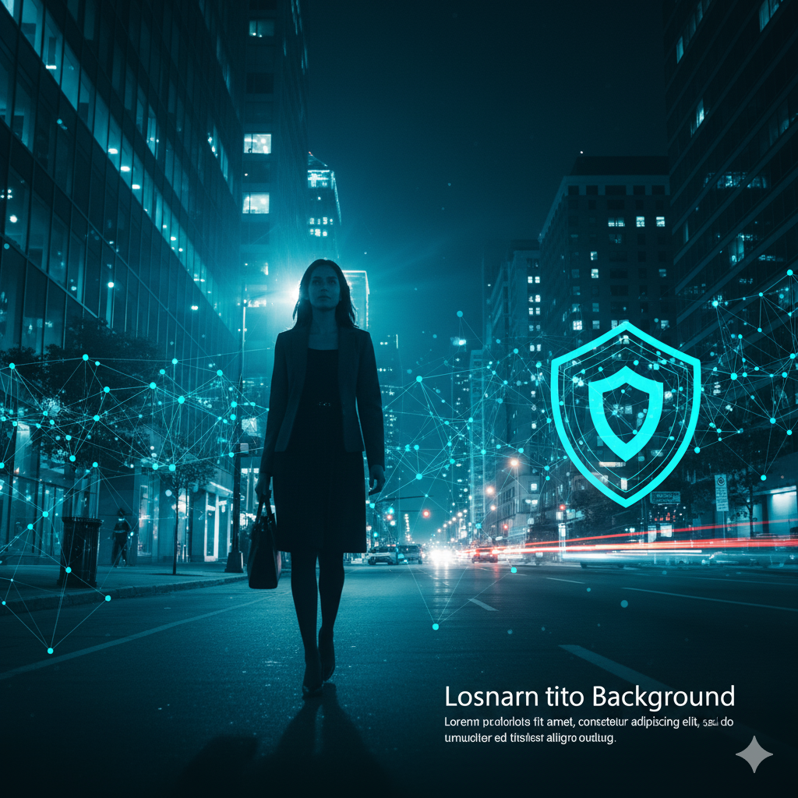

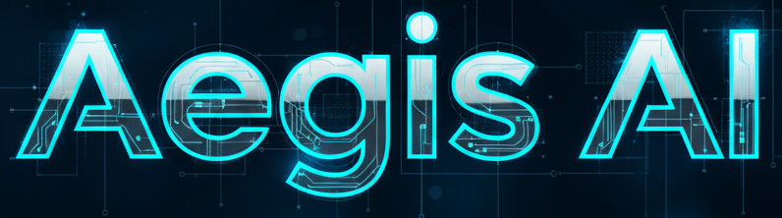
Foresight through Fortification.
Presented by:
Om Patil – 0827IT221102
Riddhi Pathak – 0827IT221120
Saloni Jain – 0827IT221128
Sarthak Kacholiya – 0827IT221132
Guided by:
Prof. Mahendra Verma

Slide 2

CONTENT
Introduction
1.1 Overview
1.2 Purpose
Literature Review
Problem Statement
Proposed Solution
Objectives
Theoretical Analysis
6.1 Block Diagram
6.2 Hardware Requirements
6.3 Software Requirements
Applications
REFERENCES

Slide 3
Introduction
1.1 Overview
Introducing a smart, real-time security system designed to prevent crimes against women.
Addresses the critical need for advanced surveillance and analytical solutions.
A promising, modern approach to enhance public safety.
Focuses on real-time threat detection, not just post-incident analysis.
1.2 Purpose
To create safer environments by providing law enforcement with early warnings of potential threats.
Proactive Threat Detection: Identifies unusual patterns and anomalies.
Early Alert System: Generates alerts to pre-empt potential incidents.
Data-Driven Insights: Offers valuable data on public safety trends and gender distribution.

Slide 4
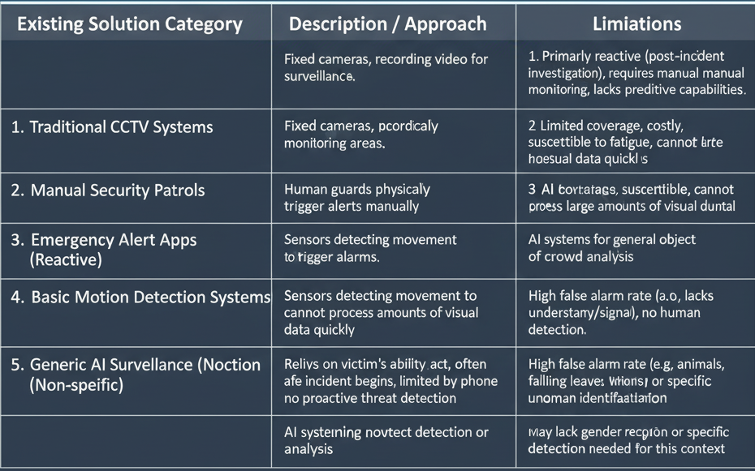
2. Literature Review

Slide 5

3. Problem Statement
The increasing rate of crimes against women in urban areas.
Existing systems are reactive, not preventive. They help with post-incident evidence gathering but do little to stop the crime in the moment.
There is a need for a promising, intelligent approach to address these issues through technology that can monitor, analyze, and alert in real-time.

Slide 6
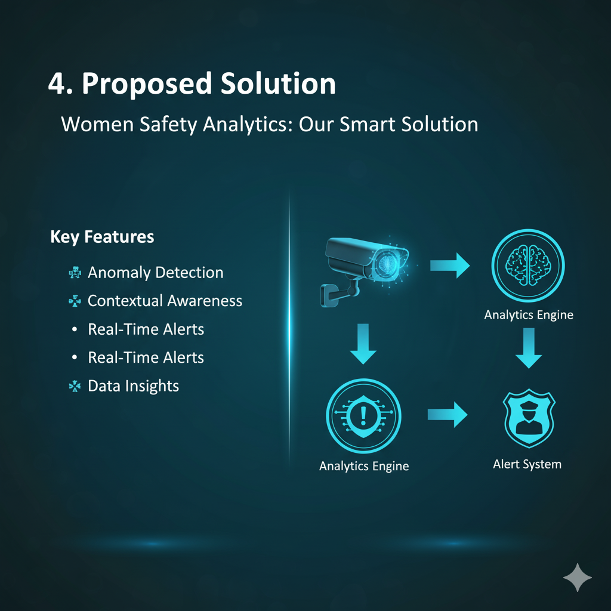
4. Proposed Solution
A software system that uses advanced analytics and real-time monitoring to create safer public environments for women
Anomaly Detection: Identifies unusual behaviors or gestures (e.g., aggression, loitering) that may indicate a threat.
Contextual Awareness: Recognizes specific high-risk patterns, such as a lone woman in a deserted area.
Real-Time Alerts: Instantly notifies law enforcement to intervene.
Data Insights: Continuously monitors gender distribution in specific locations to inform security planning.

Slide 7

5. Objectives
To develop and deploy a real-time threat detection software.
To effectively assist law enforcement in preventing crimes against women.
To improve public safety and foster a secure atmosphere.
To provide actionable insights into gender distribution and potential threats in specific locations.

Slide 8
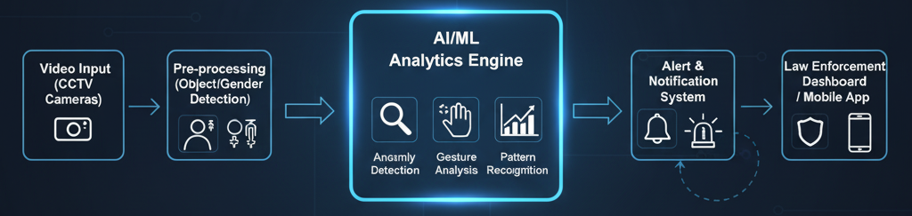
6. Theoretical Analysis
6.1 Block Diagram
A visual representation of the system's components and their interactions.

Slide 9
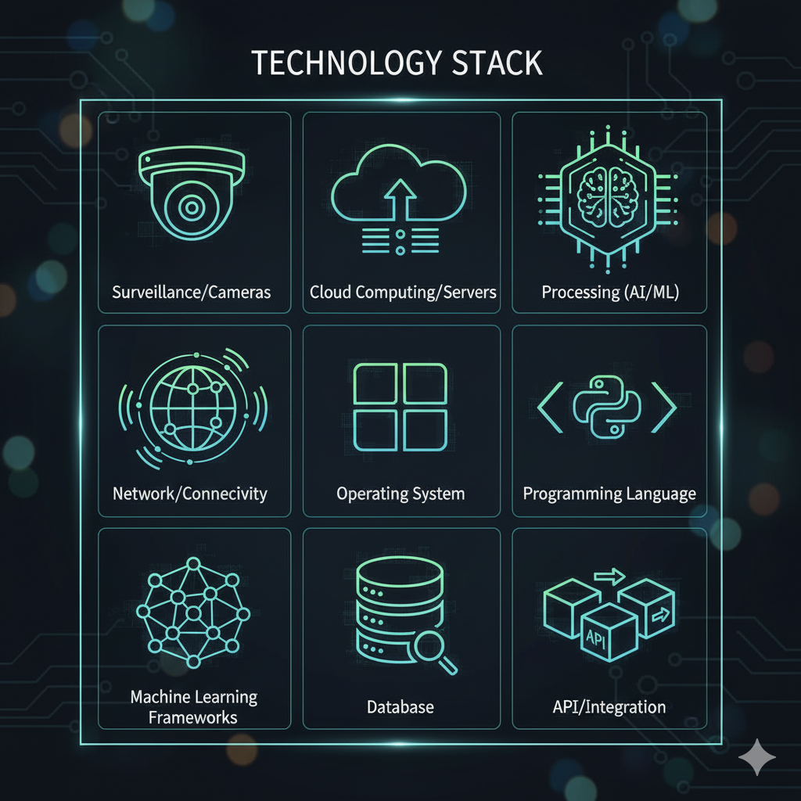
6. Theoretical Analysis
6.2 Hardware Requirements
High-Resolution Surveillance Cameras (IP Cameras).
A Central Server or Cloud Infrastructure for processing data.
High-Performance Processors (CPUs/GPUs) for running complex AI algorithms.
Secure Network Connectivity (Wired or Wireless).
Storage Devices for storing and analyzing data.

Slide 10
7. Applications
Public Spaces: Parks, bus stations, train stations, and shopping malls.
Educational Campuses: Universities and colleges to ensure student safety.
Corporate Offices: Monitoring parking lots and common areas.
Residential Communities: Gated communities and apartment complexes.
Smart City Initiatives: Integrating with city-wide surveillance networks for a comprehensive safety solution

Slide 11

Github Link
https://github.com/Saloni-Jain25/AegisAI

Slide 12
REFERENCES
Kalshetty, Y. R., et al. (2024). "Women Safety Analytics – Protecting Women from Safety Threats." International Journal of Innovative Research in Technology (IJIRT). This paper is highly relevant as it discusses a very similar project, validating your approach of using AI for gender classification and threat detection.
Raji, I., & Sholademi, D. B. (2023). "Predictive Policing: The Role of AI in Crime Prevention." International Journal of Computer Applications in Technology (IJCAT). This reference provides a strong academic foundation by focusing on the core concept of using AI and predictive analytics to anticipate and prevent criminal activity, which is the heart of your proposed solution.
Adams, A., & D' Silva, E. M. (2025). "Technology-Enabled Gender-Based Violence Solutions: The Story of Red Dot Foundation and Safecity." Routledge. This book provides essential real-world context, showing how technology is being used by reputable organizations to combat gender-based violence, giving your project a strong practical and social purpose.
Rigano, C. (2019). "Using Artificial Intelligence to Address Criminal Justice Needs." NIJ Journal 280, National Institute of Justice. This publication from a government agency lends institutional credibility to your project by discussing various applications of AI in law enforcement, from facial recognition to crime forecasting.

Slide 13
Thank You! Any Queries?

