Slide 1



Synopsis Presentation on
Guided By: Presented By:
Prof. Kapil Sahu Saloni Jain (0827IT221128)
Riddhi Pathak (0827IT221120)
Sakshi Pandya (0827IT221127)
Shivani Bafna (0827IT233D09)

Slide 2

Contents
Introduction
1.1 Overview
1.2 Purpose
Literature Review
Problem Statement
Proposed Solution
Objectives
Theoretical Analysis
6.1 Block Diagram
6.2 Hardware Requirements
6.3 Software Requirements
Applications
REFERENCES

Slide 3
1. Introduction
1.1 Overview
The SENECT is a web application designed to foster meaningful connections between alumni and students at a university. It aims to provide a centralized platform for university students to connect with their alumni and seek any sort of professional support, also allowing the alumni to create communities and host events, enhancing the overall student experience.
1.2 Purpose
To facilitate effective mentorship relationships between alumni and students.
To offer a comprehensive platform for academic and career resources.
To create a vibrant community where users can connect, collaborate, and learn from each other.
To enhance student engagement and overall university experience.

Slide 4
2. Literature Review
Sr. No. | Name of Solution/System | Features | Limitations/Drawback
1. | My Alumni Network | Stay updated about events and reunions and discuss and share updates with fellow alumni. | Proper alumni connecting facilities are not available like for one-to-one communication
2. | Alma Connect | Alumni networking app helping you connect with alumni | No feature of accessing the LinkedIn profile of alumni

Slide 5
Sr. No. | Name of Solution/System | Features | Limitations/Drawbacks
3. | Alma shines | Get connect with your batchmates and old students of your institutes. | You can’t able to get particularly connected to the alumni of your college only which creates a lot of confusion to select whom.
4. | Uni Connect | App for universities, offering key features such as Career Connect, Notice Board, AI assistant, Mentorship. | Not targeting the customers whose sole purpose is to get mentorship or guided by seniors.

Slide 6
3. Problem Statement
Limited Access to Mentorship: Many students struggle to find suitable mentors or have limited opportunities for personalized guidance.
Lack of Centralized Resources: Students often face difficulties in accessing academic help, career advice, and networking opportunities.
Isolation and Lack of Community: Students may feel disconnected from their peers and miss out on valuable social interactions.
Lack of personal peer support: Students feel disconnected seeking advice anywhere and everywhere.

Slide 7
4. Proposed Solution
Mentorship Programs: Numerous studies have demonstrated the positive impact of personal mentorship on student success, academic performance, and career development
Online Communities: Studies have highlighted the benefits of online platforms in fostering social connections, knowledge sharing, and community building
Career Development Tools: Research has explored the effectiveness of online tools in providing career guidance, job search assistance, and professional development.
Personal peer support: Our app connects students with their alumni who have been through the same phases in the same environment adding a personal touch to the conversation .

Slide 8
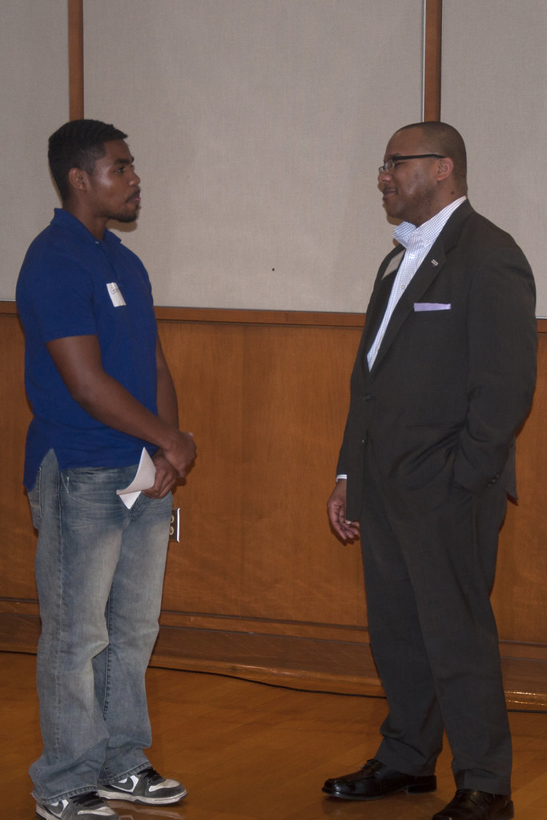
5. Objectives
To connect the existing alumnus with the students
To promote exchange of academic, cultural, social experience with the students.
To mentor and channelize the efforts of the students seeking better opportunities to learn and grow.
To promote a goodwill and sense of pride to both alumni and students.
To advice and conduct activities that shall motivate and upgrade student skill sets.
This Photo by Unknown Author is licensed under CC BY-SA-NC

Slide 9
6. Theoretical Analysis
Start
Login
Enter Credentials
E-mail
Password
Connect to Alumni
- Send request
- Receive request
- Accept/Decline request
Sign Up
As an Alumni
As a Student
E-mail
Password
Create Profile
Add Skills
Select Domain
Add bio
Contact Alumni
Chat
Video Call
Voice Call
Authentication
E-mail verification
Password Verification
Alumni Suggestions
Based on domain
Alumni Profiles
End
Authent-ication Success
No
Yes
Fig. Flowchart

Slide 10


6.2 Hardware Requirements
High-performance server for efficient data processing and handling.
Reliable internet connection for seamless user experience.
Sufficient storage capacity for data storage and backups.
6.3 Software Requirement
Front-end development: HTML, CSS & JavaScript.
Back-end development: Node.js with Express.js or a similar framework.
Database: Firebase for efficient data storage and retrieval.

Slide 11

7. Applications
The SENECT app can be applied to various university settings, including:
Undergraduate students: Providing mentorship, academic support, and career guidance.
Graduate students: Facilitating research collaborations and professional networking.
International students: Offering cultural exchange, language support, and academic adjustment assistance.

Slide 12

GitHub Link
https://github.com/Saloni-Jain25/senect

Slide 13

REFERENCES
LinkedIn
“The Impact of Mentorship on Student Success" by J. M. Jenkins and A. M. Johnson (Journal of Educational Research, 2017)
“Online Communities and Social Media" by A. M. O’Reilly and P. M. Leonardi (Stanford University Press, 2016)
Designing Effective Mentorship Programs" by J. M. Jenkins et al. (Proceedings of the ACM Conference on Human Factors in Computing Systems, 2019)

Slide 14

Thank You
Any Queries ?

