Slide 1


VOITHOS
Prepared by:
Yash Shiyani (18DCE125)
Guided by :
Asst Prof. Ronak Roy
Devang Patel Institute of Advance Technology and Research

Slide 2

OUTLINE
Abstract
Objective
Motivation
Problem Statement
Flow chart
Implementation video
Hardware and Software Requirements
Roles and Responsibility of every member
Expected Outcome
Reference

Slide 3

ABSTRACT
The microsoft uses the digital assistant named “cortana”it uses the internet facility.
But our Proposed System has capability to work without Internet Connectivity.
It is named as VOITHOS.
Voithos is a software which will make our work easy and works per our need and command.

Slide 4
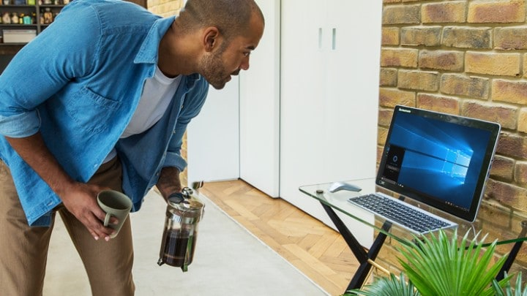
OBJECTIVE
Making personal assistant for accessing device by speaking.
It will translate text to speech.

Slide 5
MOTIVATION
Prioritize and manage diverse tasks, from opening apps .
Managing tasks (opening the Apps).
Works offline.

Slide 6
PROBLEM STATEMENT
Making an offline personal assistant for people to access computer and its application without performing actual process

Slide 7
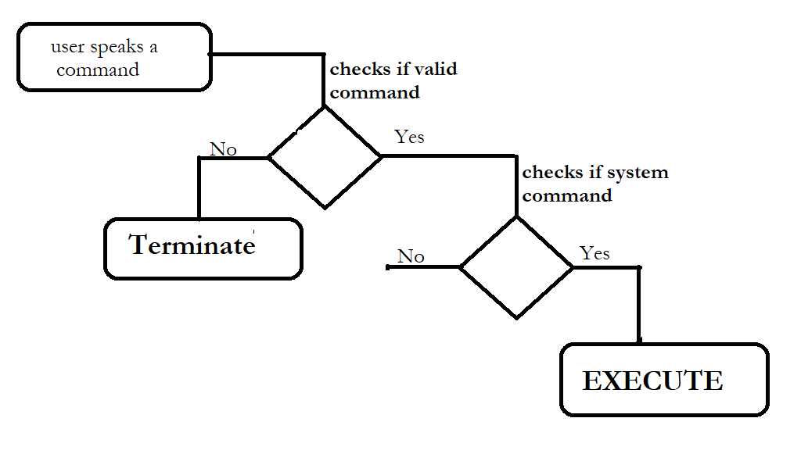
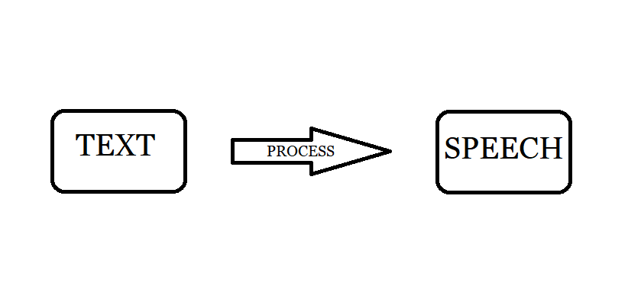
FLOWCHART
Module 1:
Module 2:

Slide 8

Implementation video
VOITHOS

Slide 9
REQUIREMENTS
Hardware:
PC(For compiling code)
Microphone (For voice recognisation)
Software:
Eclipse(JAVA language)
Windows
Sphinx4 library

Slide 10

ROLES AND RESPONSIBILITIES OF EVERY MEMBERS

Slide 11
EXPECTED OUTCOME
To open applications as per our command.
And also Text to speech converter.

Slide 12
REFERENCES
https://github.com/techiew/speech-to-text-itx
https://github.com/topics/speech-to-text?l=java&o=asc&s=forks
https://www.youtube.com
https://www.includehelp.com/recommended-posts-to-read.aspx
https://www.geeksforgeeks.org/converting-text-speech-java/

Slide 13
Thank You

