Slide 1
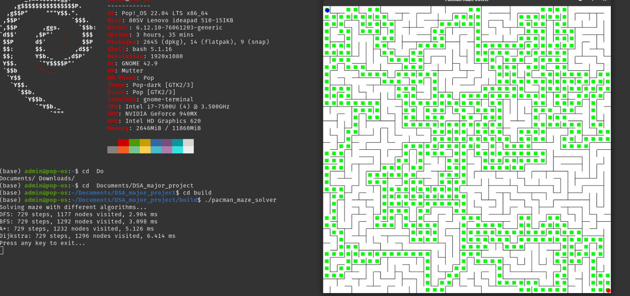
Pacman Maze Solver
Course Details:
CSL2020
Data Structures and Algorithms
Dr. Suchetana Chakraborty
Project Mentor : Satwik Bhushan
Team Members:
Yash Verma (B23MT1046)
Bhaskar Sharma (B23BB1012)
Daksh Sohni(B23MT1014)
Chirag Saxena (B23BB1013)
GitHub Repo :- https://github.com/YashVermaTS/DSA_MAJOR_PROJECT

Slide 2
INTRODUCTION
Maze solving is a classical problem that not only serves as a cornerstone in computer science education but also models real-world challenges faced in navigation, robotics, game design, and AI-based planning systems. This project addresses the problem of programmatically solving mazes using algorithmic methods and visualizing the process to provide insight into the decision-making path taken by the solver.
Domain and Use Case Mapping
Why It’s an Important/Relevant Problem
Why It’s a Challenging Problem
Why a Data-Driven Solution Looks Promising
Mazes abstract real-world scenarios where an agent must find an optimal path from a starting point to a goal. The solution developed in this project simulates such scenarios:
Maze generation and representation (maze.cpp)
Solver algorithms for pathfinding (MazeSolver.cpp)
Visual representation of both the maze and the solving process (MazeVisualizer.cpp)
Integration and user interface through the main control logic (main.cpp)
Combinatorial Explosion: The number of potential paths can grow exponentially with maze size.
Dead Ends and Loops: A naive approach may get stuck or repeatedly traverse unnecessary paths.
Multiple Objectives: Often, the shortest or safest path is required, not just any solution.
Visualization: Translating the solving process into an understandable visual form adds another layer of complexity.
Navigation is one of the most foundational tasks across many intelligent systems. Solving mazes is a simplified abstraction of:
Navigating drones through buildings
Automating warehouse logistics
Qubit Mapping in Quantum Computing
Algorithmic Efficiency: Using BFS, DFS, or A*, the maze can be solved in a predictable and optimal manner.
Adaptability: Solutions can adapt to changes in maze structure or constraints.
Scalability: Algorithms can scale to larger and more complex mazes.
Visualization and Analysis: Internal state can be recorded and visualized, providing rich feedback and learning potential.

Slide 3
CURRENT STATUS
Recent Developments in Data Structures and Algorithms
Limitations of Existing Approaches
Despite these advancements, several challenges persist in the application of data structures and algorithms to maze-solving and pathfinding:
Scalability: Traditional algorithms like BFS and DFS can become inefficient as the size and complexity of the maze increase. Their performance degrades in large-scale or high-dimensional spaces, necessitating more scalable solutions .​
Dynamic Environments: Many existing algorithms assume static environments. In real-world applications, environments can change dynamically, requiring algorithms that can adapt in real-time .​
Resource Constraints: Algorithms often face limitations related to memory and processing power, especially in embedded systems or mobile devices. Optimizing algorithms to function under such constraints remains a significant challenge .​
Visualization and Interpretability: While visualization tools exist, integrating them seamlessly with algorithms to provide real-time, interpretable insights is still an area needing improvement .​
The field of data structures and algorithms (DSA) has seen significant advancements in 2024, driven by the need to handle complex computational problems efficiently. Key trends include:
Hybrid Algorithms: The integration of Evolutionary Algorithms (EAs) and Reinforcement Learning (RL) has led to the development of Evolutionary Reinforcement Learning (ERL), which combines the exploration capabilities of EAs with the exploitation strengths of RL.
Sublinear Algorithms: Research at institutions like the Simons Institute has focused on sublinear algorithms, which aim to process data more efficiently by examining only a portion of the input. These algorithms are particularly useful in scenarios where data is massive, and full processing is computationally infeasible .​
Quantum Algorithms: The exploration of quantum algorithms has opened new avenues for solving problems that are intractable for classical computers. Quantum algorithms leverage the principles of quantum mechanics to perform computations more efficiently,

Slide 4
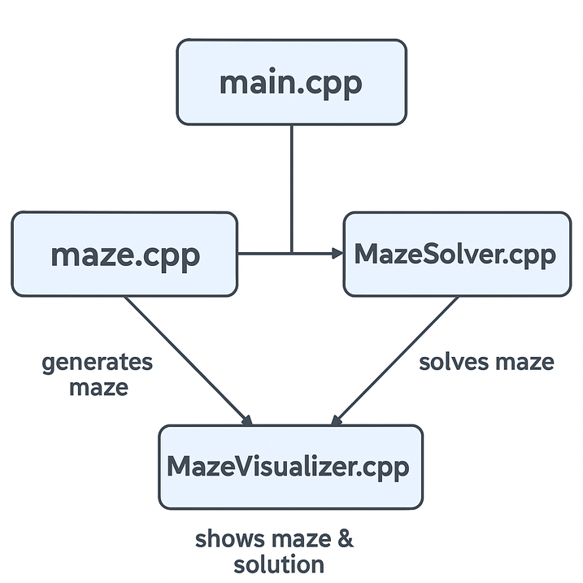
IDEA
Project Idea Overview
The core idea of this project is to build a complete system that can read, solve, and visualize mazes using classic graph traversal algorithms. The emphasis is not just on solving the maze but on demonstrating how the solution is created in real-time, making the internal algorithmic decisions transparent and educational.
This project leverages modular programming by dividing the solution into key components:
Maze Generator
Solver Engine (handling search algorithms)
Graphical Visualizer (to show final path)
GitHub Repo :- https://github.com/YashVermaTS/DSA_MAJOR_PROJECT
main.cpp
This is the entry point of the program. It offers two functionalities:
Comparison mode (compare): Runs all algorithms multiple times on random mazes and prints average stats.
Visualization mode (default): Solves one maze and visualizes the solution using A*(can be customized but from source code selection functionality is to be added).

Slide 5
maze.cpp – Maze Generation and Structure
This file implements the Maze class, which creates a 2D grid and uses a maze generation algorithm. Here's a summary of its responsibilities:
🔧 Core Responsibilities:
Create a maze grid with walls and paths.
Randomly generate a solvable maze using DFS backtracking and random paths are created by removing walls randomly to check algorithms optimal path finding capabilities.
Provide access to neighbors for pathfinding.
Allow checking and updating walls.
✨ Key Features:
Maze::Maze(int w, int h) – Constructor to generate a maze with width w and height h.
getNeighbors(pos) – Returns the valid next positions from the current cell.
isWall(pos) – Checks if a position is a wall or not.
getStart() and getEnd() – Provides entry and exit points for solving.

Slide 6
MazeSolver.cpp – Maze Solving Algorithms
This file contains the actual pathfinding algorithms:
🤖 Algorithms Implemented:
DFS (Depth-First Search) – Explores as deep as possible before backtracking.
BFS (Breadth-First Search) – Explores all neighbors level-by-level.
Dijkstra’s Algorithm – Expands the least-cost nodes first.
A* – Like Dijkstra’s, but adds a heuristic (usually distance to goal) for smarter expansion.
🧩 Key Concepts:
Each function:
Takes a Maze as input.
Tracks visited nodes.
Builds a path from start to goal.
Measures execution time.
Returns a SolveResult with:
.path (vector of points)
.visitedNodes
.executionTime

Slide 7
MazeVisualizer.cpp – Visual Interface
This file deals with rendering the maze and the solution.
🔧 Uses:
built on top of a graphics library like SFML .
Draws walls, paths, visited nodes.
Visually animates the A* solution.
✨ Key functions:
MazeVisualizer::draw(path) – Highlights the final solution path.
MazeVisualizer::run() – Starts a window and displays everything until user exits..

Slide 8
🧠 HOW DO THEY WORK TOGETHER:
main.cpp
│
├── maze.cpp (generates maze)
│
├── MazeSolver.cpp (solves maze)
│
└── MazeVisualizer.cpp (shows maze & solution)
main.cpp controls the flow.
maze.cpp builds the environment.
MazeSolver.cpp applies logic to solve it.
MazeVisualizer.cpp shows the results.

Slide 9
CONCLUSION
While maze-solving algorithms are well-studied, the integration of a visualizer that reflects internal algorithmic decisions in real-time adds an educational and intuitive dimension which was the main intention of this project. It bridges the gap between algorithm design and educational understanding.
Key Findings and Learnings
Scope for Future Extension
Through the development and implementation of this maze-solving and visualization system, several key insights were gained:
Algorithmic Understanding: We deepened our understanding of pathfinding algorithms like BFS and DFS, and how their performance and behavior differ in various maze configurations.
Modular Design: Separating the system into logical modules (solver, maze representation, visualization) significantly improved maintainability and clarity.
Visualization as a Learning Tool: Animating the solving process helped in intuitively grasping the internal logic of search algorithms, providing a bridge between theory and practice.
Debugging through Visual Feedback: Visualization also acted as a powerful debugging tool to verify algorithmic correctness and spot inefficiencies or bugs.
This project opens several promising avenues for future development:
Algorithm Expansion: Implementing other algorithms such as IDDFS to compare efficiency and performance.
Dynamic Mazes: Supporting moving goals, obstacles, or real-time changes to maze configuration.
User Interaction: Allowing users to design custom mazes and select algorithms dynamically.
Adding weighted paths: to better differentiate between performace of dijkstra’s algorithms.
Adding Adversaries: like ghosts which track ‘pacman’ and increase the complexity further can be helpful in understanding game theory. potential techniques can be minimax trees and MCTS

Slide 10
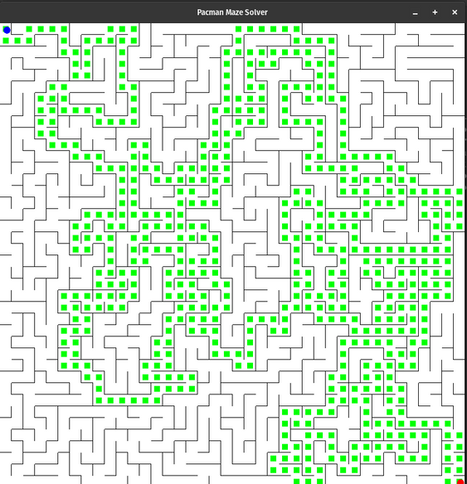
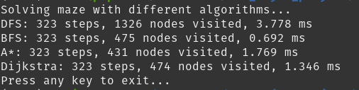
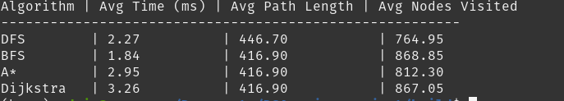
Individual Contribution
Graphs and data structures: Bhaskar Sharma, Daksh Sohni
Search Algorithms: Yash Verma , Chirag Saxena
Integration & Debugging: Yash Verma
Acknowledgement
We would like to sincerely thank:
The course instructor and teaching assistants for their guidance and support.
Open-source communities and contributors of graphics and algorithm libraries, where references were used in accordance with licensing terms.
Educational platforms like GeeksforGeeks, Stack Overflow, and Wikipedia for supplementary understanding of algorithms and concepts.
special mentions to https://ai.berkeley.edu/search.html for initial motive and ideation.
LLMs were used in some capacity to understand the SFML library better and how to use cmake files etc.

