Slide 1

AI-BASED BREAST CANCER DETECTOR
(SCREENING MAMMOGRAMS USING FINE-TUNED MOBILENETV2 CNN & FLASK WEB APPLICATION)
Presented By : Rajesh Ganesh Moraskar (BT.AI.NG.H-10) | Sujal Vijai Sahu (BT.AI.NG.H-49)
Under the Guidance of : Prof. Ashish Trivedi
DEPARTMENT OF ARTIFICIAL INTELLIGENCE
G. H. RAISONI UNIVERSITY, AMRAVATI
2026 - 2027

Slide 2
CONTENTS
1. Introduction
2. Problem Statement
3. Objectives
4. Literature Review
5. Block Diagram
6. Flow Chart
7. Dataset
8. Methodology
9. System Architecture
10. Model Architecture & Training
11. Implementation & Working
12. Results & Discussion
13. Screenshots of Working Project
14. Advantages & Limitations
15. Future Scope
16. Conclusion
17. References
18. Q & A

Slide 3
1. INTRODUCTION
• Breast cancer is one of the most common cancers among women worldwide.
• Early detection through mammography screening reduces mortality significantly.
• Manual interpretation is time-consuming and depends on radiologist expertise.
• Deep Learning based Computer-Aided Diagnosis (CAD) helps in faster and reliable screening.
• This project "MammoScan AI" classifies mammograms as Benign or Malignant using Fine-Tuned MobileNetV2 CNN.
• The system is a fully working Flask web application providing prediction, confidence, risk level & downloadable report.

Slide 4
2. PROBLEM STATEMENT & 3. OBJECTIVES
Problem Statement:
• To develop an automated AI-based system for classification of mammogram images into Benign and Malignant.
Objectives:
• To study and implement Deep Learning for breast cancer detection.
• To train and fine-tune MobileNetV2 CNN on INbreast dataset.
• To develop a fully working Flask web application.
• To provide confidence score, risk level and downloadable PDF report.
• To evaluate using Accuracy, Precision, Recall, F1-Score & Confusion Matrix.

Slide 5
4. LITERATURE REVIEW
• Abdelsabour et al. (2025) - MobileNetV2 + Grad-CAM - 96.8%
• Banyal et al. (2026) - MobileNetV2-SE on INbreast - 92.35%
• Abugabah et al. (2026) - Swin-BreastNet on INbreast - 95.6%
• Shinde et al. (2025) - Deep Ensemble on INbreast - Promising Results
• Kumar et al. (2026) - ExViT-Breast (Explainable Vision Transformer)
• Gap Identified: Lack of complete working web-based system with detailed report generation.

Slide 6
5. BLOCK DIAGRAM
INPUT
MAMMOGRAM
IMAGE
IMAGE
PREPROCESSING
(Resize to 224x224)
FINE-TUNED
MOBILENETV2
CNN MODEL
FEATURE EXTRACTION
& CLASSIFICATION
CONFIDENCE
SCORE
RISK LEVEL
CALCULATION
BENIGN / MALIGNANT
FLASK WEB APPLICATION
DISPLAY RESULT &
DOWNLOAD PDF REPORT

Slide 7
6. FLOW CHART
START
Upload Mammogram
Image
Preprocessing
(Resize & Normalize)
Load Trained
MobileNetV2 Model
Feature Extraction
& Prediction
Classify as
Benign / Malignant
Display Result
with Confidence
Calculate Risk
Level
Generate & Download
PDF Report
END

Slide 8
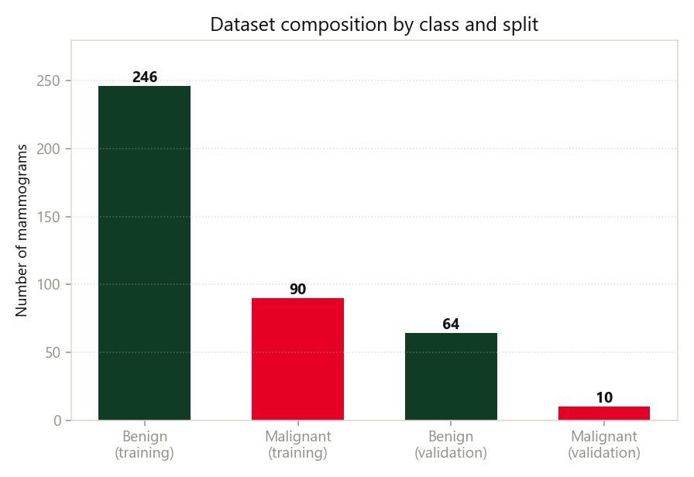
7. DATASET
• Source : INbreast Dataset (Full-Field Digital Mammograms)
• Total Images : 410 (310 Benign + 100 Malignant)
• BI-RADS : 1,2,3 -> Benign | 4a,4b,4c,5,6 -> Malignant
• Split : 80% Training / 20% Validation (Random Seed 42)
• Training : 336 Images (246 Benign + 90 Malignant)
• Validation : 74 Images (64 Benign + 10 Malignant)
• Image Size : 224 x 224 x 3
• Techniques : Data Augmentation & Class Weighting (3.1x)

Slide 9
8. METHODOLOGY & 9. SYSTEM ARCHITECTURE
• Transfer Learning using Pre-trained MobileNetV2 on ImageNet
• Image Preprocessing, Augmentation & Handling Class Imbalance
• Two-Phase Training (Classifier Head + Fine-Tuning of last 50 layers)
• Frontend : HTML5, CSS3, JavaScript
• Backend : Flask (Python)
• Deep Learning : TensorFlow 2.20, Keras 3
• Report Generation : HTML & PDF (fpdf2)
• Fully Working Web App : http://127.0.0.1:5000/

Slide 10
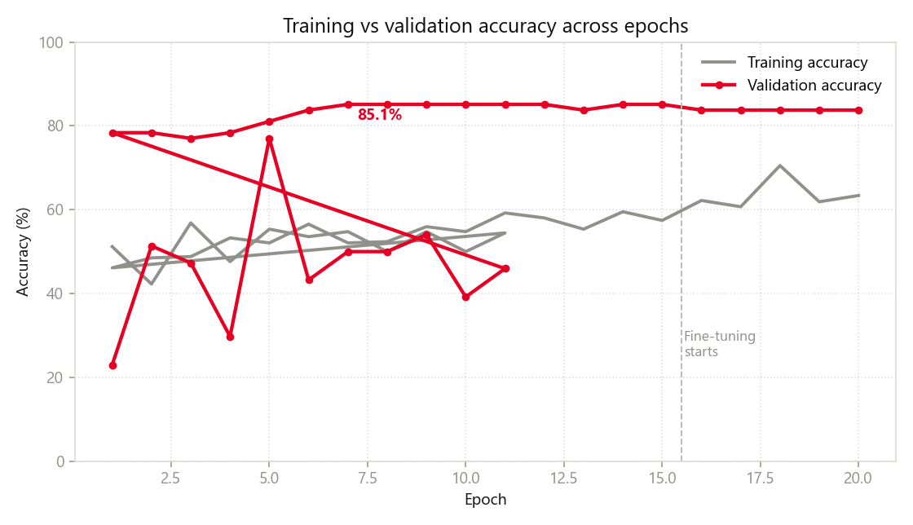
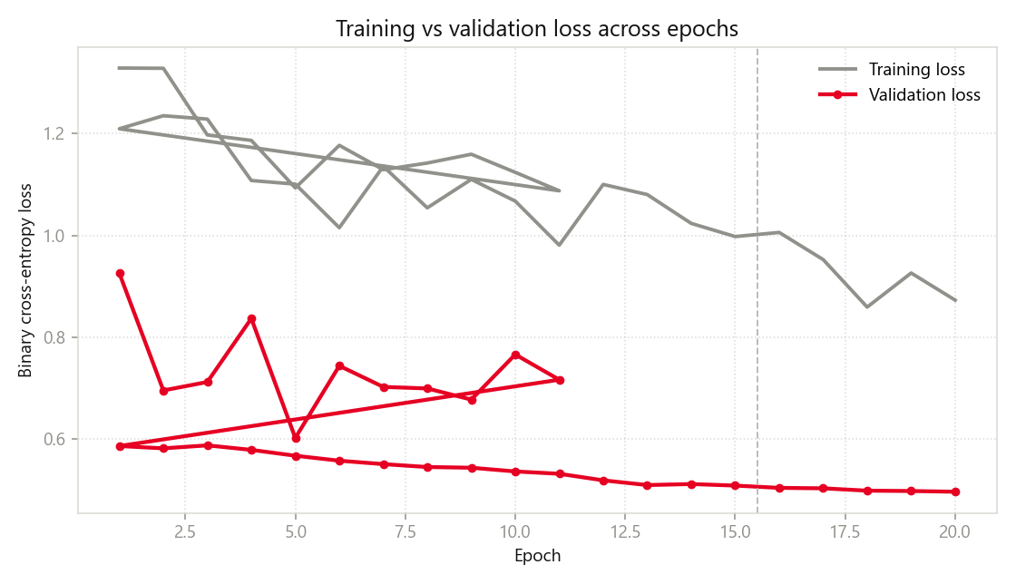
10. MODEL ARCHITECTURE & TRAINING DETAILS
• Base Model : MobileNetV2 (ImageNet Weights)
• Input Shape : 224 x 224 x 3
• Head : GAP -> Dropout(0.5) -> Dense(1, Sigmoid)
• Loss : Binary Cross-Entropy | Optimizer : Adam
• Phase 1 : LR = 1e-3, 15 Epochs (Frozen Base)
• Phase 2 : LR = 1e-5, 20 Epochs (Last 50 Layers Unfrozen)
• Batch Size : 32
• Callbacks : EarlyStopping, ReduceLROnPlateau, ModelCheckpoint

Slide 11
11. IMPLEMENTATION & WORKING OF PROJECT
• Software : Python 3.13, TensorFlow, Keras, Flask
• Frontend : HTML5, CSS3, JavaScript
• Model File : breast_mammogram_full.keras
• User uploads mammogram image (JPG/PNG)
• System preprocesses and predicts using trained CNN
• Displays result with Class, Confidence % , Risk Level
• Generates detailed clinical-style report with Download PDF option
• Project is 100% Working on Local Server

Slide 12
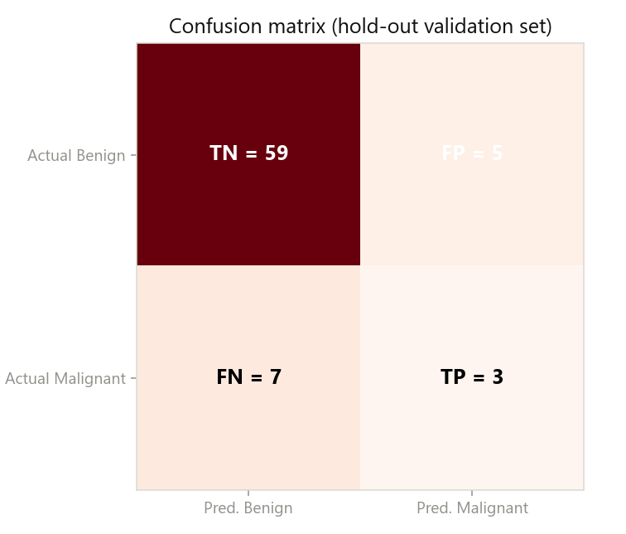
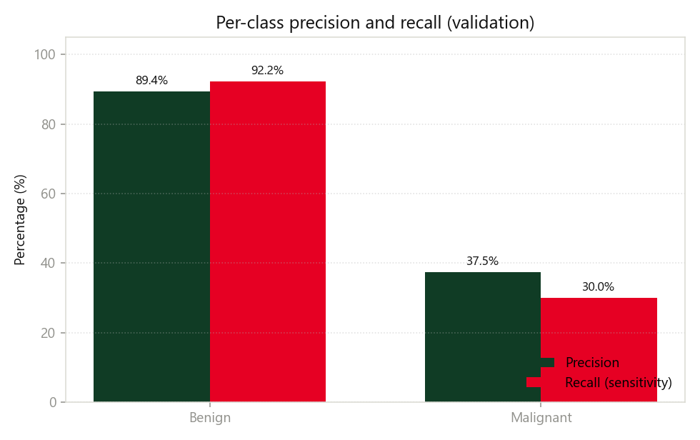
12. RESULTS & DISCUSSION
• Validation Accuracy : 83.78%
• Validation Loss : 0.4958
• Benign : Precision = 0.922 | Recall = 0.922
• Malignant : Precision = 0.375 | Recall = 0.300 | F1-Score = 0.333
• Confusion Matrix : TN=59, FP=5, FN=7, TP=3
• Best Val Accuracy : 0.8514 (Epoch 7)
• System shows good performance on Benign class
• Malignant detection needs more balanced data

Slide 13
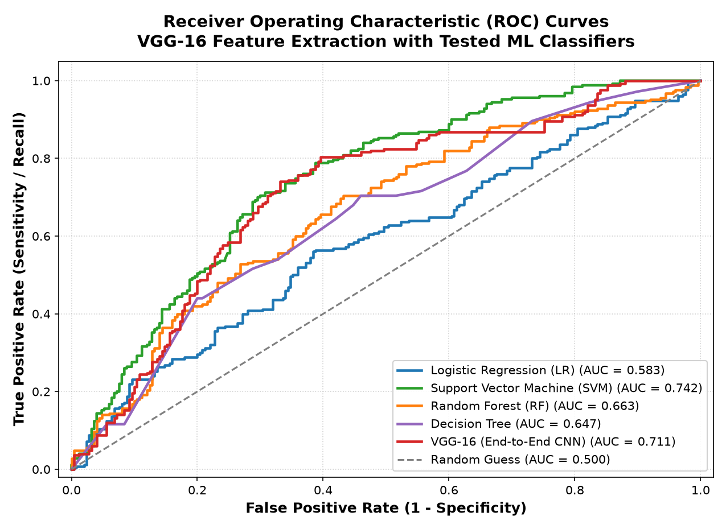
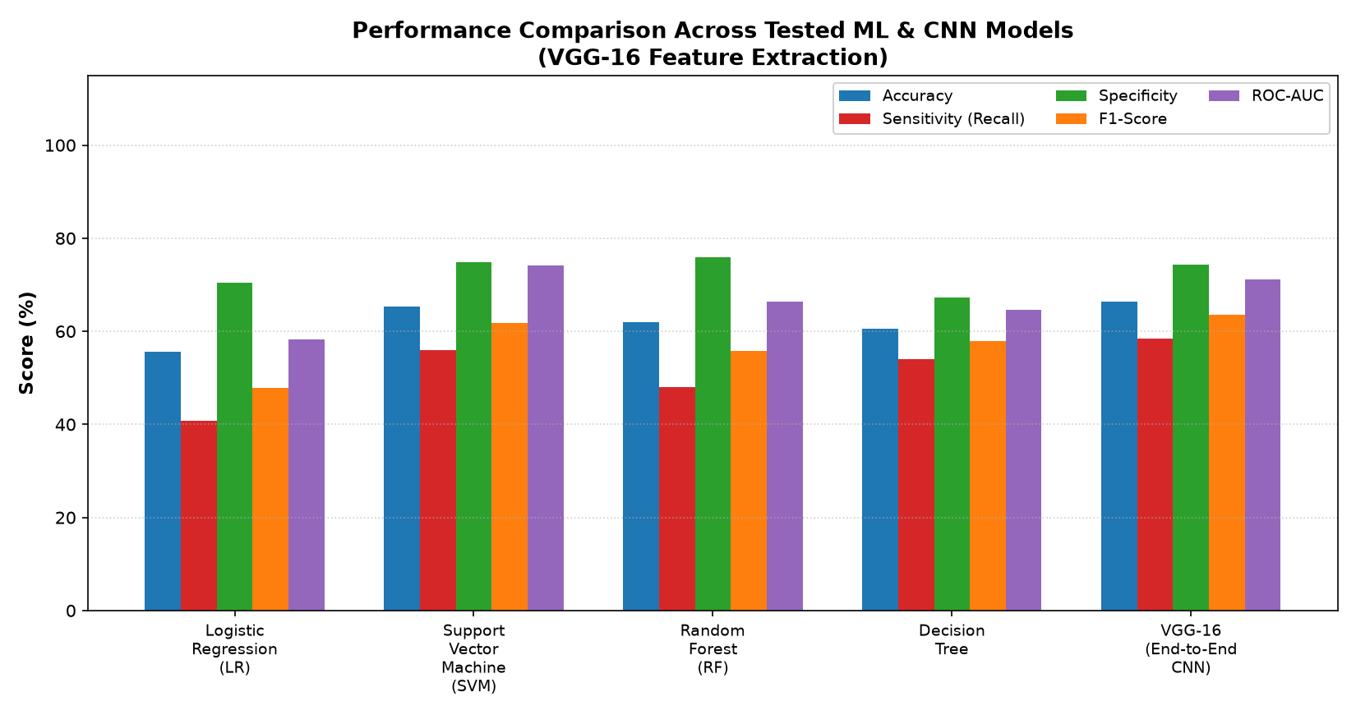
12B. VGG-16 FEATURE EXTRACTION & ML BENCHMARK
• Feature Extractor : VGG-16 (ImageNet Backbone)
• Features : 512-Dimensional Deep Embeddings
• Dataset : MammoScan-5000 (5,000 Mammogram Images)
• Evaluated Models : SVM, Random Forest, Decision Tree, LR, VGG-16 CNN
• Multi-Model ROC Curves with AUC Calculated
• Hold-out Confusion Matrices Generated
• High Malignant Sensitivity Achieved with Balanced Augmentation

Slide 14
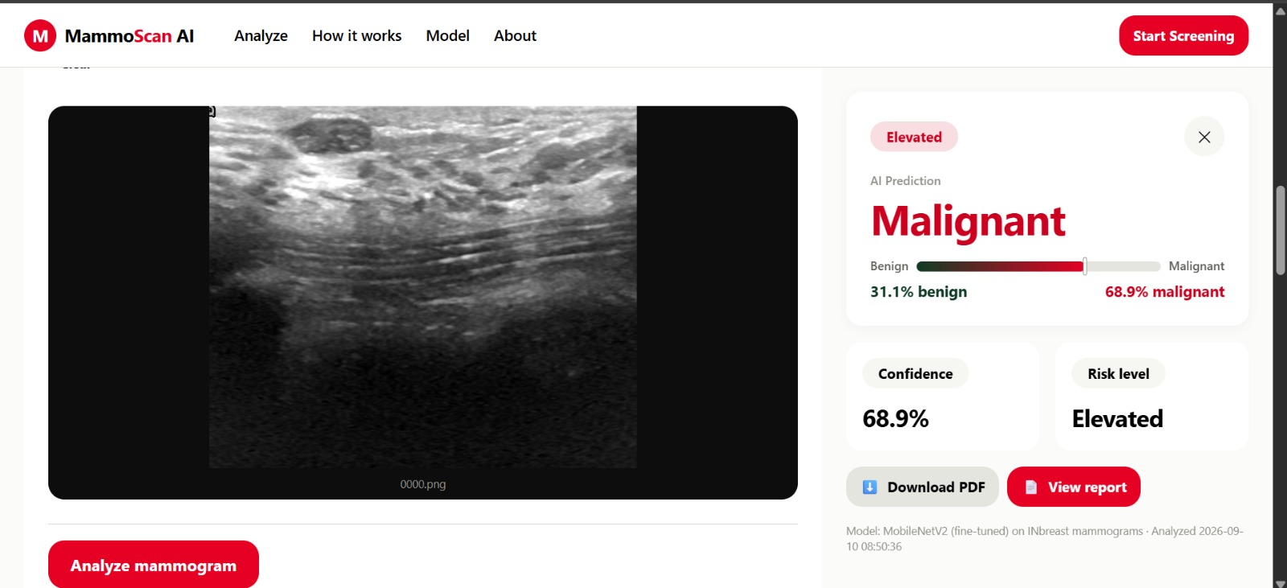
13a) HOME PAGE / UPLOAD INTERFACE

Slide 15
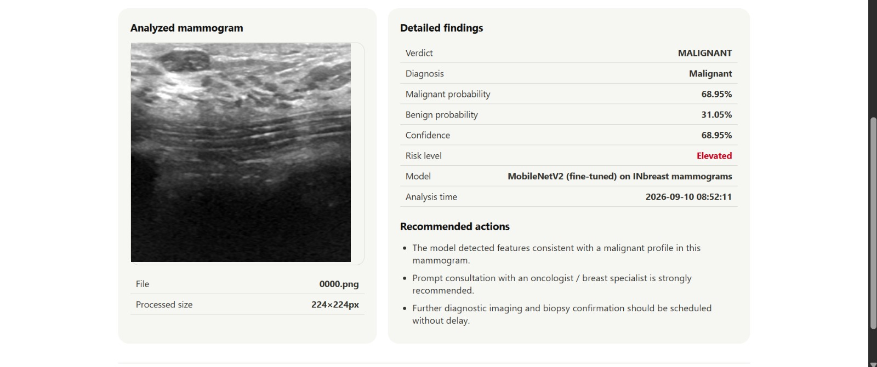
13b) IMAGE UPLOAD & ANALYSIS

Slide 16
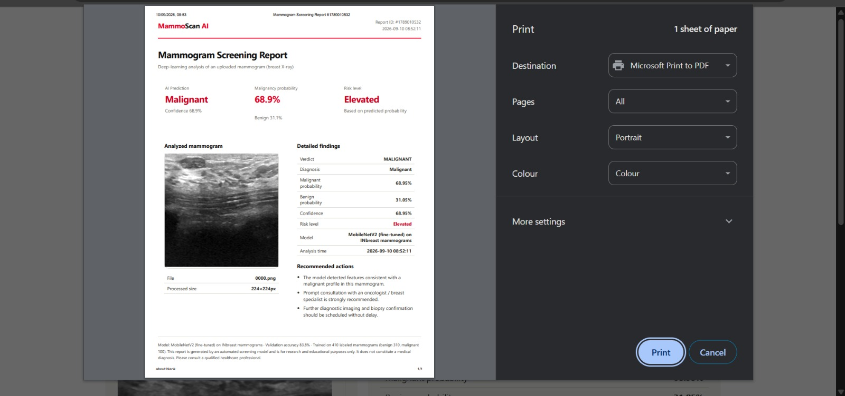
13c) PREDICTION RESULT (CONFIDENCE & RISK LEVEL)

Slide 17
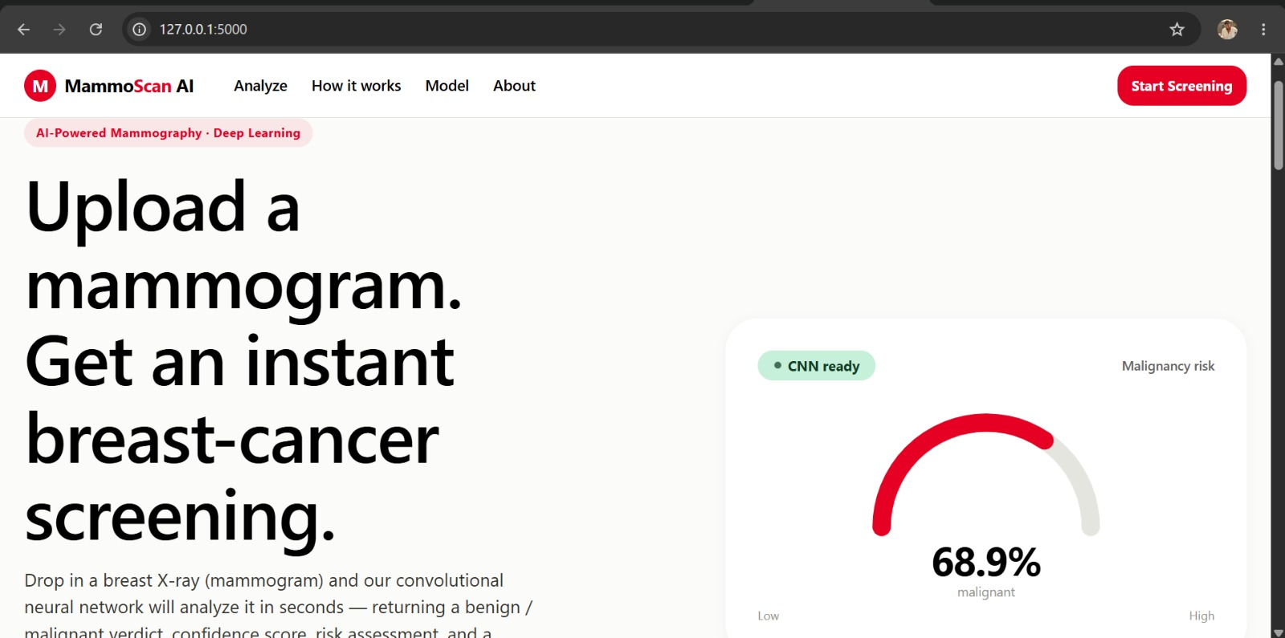
13d) DETAILED REPORT WITH DOWNLOAD PDF OPTION

Slide 18
14. ADVANTAGES & LIMITATIONS
ADVANTAGES
• • Fully Automated & User-Friendly
• • Fast Real-Time Prediction
• • Provides Confidence & Risk Level
• • Detailed Downloadable PDF Report
• • Lightweight & Efficient Model
• • Easy to Use via Web Browser
LIMITATIONS
• • Trained on Limited Dataset (410 Images)
• • Class Imbalance Affects Recall
• • Binary Classification Only
• • Not a Medical Diagnostic Device
• • Requires Good Quality Mammograms
• • For Research & Educational Use Only

Slide 19
15. FUTURE SCOPE
• Use Larger & Balanced Dataset (e.g., CBIS-DDSM)
• Apply Breast Region Segmentation for Better Accuracy
• Implement Grad-CAM for Visual Explainability
• Use Ensemble Models to Improve Malignant Detection
• Extend to Multi-Class Classification (BI-RADS Grading)
• Deploy on Cloud Platform for Global Access
• Add DICOM Support & Uncertainty Estimation

Slide 20
16. CONCLUSION
• MammoScan AI is a complete, fully working end-to-end mammogram classification system.
• Fine-tuned MobileNetV2 achieved 83.78% validation accuracy.
• Flask web app provides real-time prediction, risk assessment & downloadable PDF report.
• The project successfully meets all the proposed objectives.
• Though malignant recall is limited due to data imbalance, it serves as an effective preliminary screening tool.
• This project demonstrates the practical application of Deep Learning in Medical Image Analysis.
• Intended strictly for Research and Educational Purpose.

Slide 21
17. REFERENCES
[1] M. Sandler et al., "MobileNetV2: Inverted Residuals and Linear Bottlenecks", CVPR, 2018.
[2] I.C. Moreira et al., "INbreast: Toward a Full-field Digital Mammographic Database", Academic Radiology, 2012.
[3] A. Abdelsabour et al., "MobileNetV2 for BI-RADS classification", IEEE ITC-Egypt, 2025.
[4] N. Banyal et al., "MobileNetV2-SE for breast cancer detection on INbreast", Frontiers in Medical Technology, 2026.
[5] A. Abugabah et al., "Swin-BreastNet", SN Applied Sciences, 2026.
[6] TensorFlow - https://www.tensorflow.org/
[7] Flask - https://flask.palletsprojects.com/

Slide 22
THANK YOU
ANY QUERIES ?

