Slide 1
Chapter 5: Interfacing

Slide 2
Types of bus-based I/O: memory-mapped I/O and standard I/O
Processor talks to both memory and peripherals using same bus – two ways to talk to peripherals
  Memory-mapped I/O
    Peripheral registers occupy addresses in same address space as memory
    e.g., Bus has 16-bit address
      lower 32K addresses may correspond to memory
      upper 32k addresses may correspond to peripherals
  Standard I/O (I/O-mapped I/O)
    Additional pin (M/IO) on bus indicates whether a memory or peripheral access
    e.g., Bus has 16-bit address
      all 64K addresses correspond to memory when M/IO set to 0
      all 64K addresses correspond to peripherals when M/IO set to 1

Slide 3
Memory-mapped I/O vs. Standard I/O
Memory-mapped I/O
  Requires no special instructions
    Assembly instructions involving memory like MOV and ADD work with peripherals as well
    Standard I/O requires special instructions (e.g., IN, OUT) to move data between peripheral registers and memory
Standard I/O
  No loss of memory addresses to peripherals
  Simpler address decoding logic in peripherals possible
    When number of peripherals much smaller than address space then high-order address bits can be ignored
      smaller and/or faster comparators

Slide 4
Microprocessor interfacing: interrupts
Suppose a peripheral intermittently receives data, which must be serviced by the processor
  The processor can poll the peripheral regularly to see if data has arrived – wasteful
  The peripheral can interrupt the processor when it has data
Requires an extra pin or pins: Int
  If Int is 1, processor suspends current program, jumps to an Interrupt Service Routine, or ISR
  Known as interrupt-driven I/O
  Essentially, “polling” of the interrupt pin is built-into the hardware, so no extra time!

Slide 5
Microprocessor interfacing: interrupts
What is the address (interrupt address vector) of the ISR?
  Fixed interrupt
    Address built into microprocessor, cannot be changed
    Either ISR stored at address or a jump to actual ISR stored if not enough bytes available
  Vectored interrupt
    Peripheral must provide the address
    Common when microprocessor has multiple peripherals connected by a system bus
  Compromise: interrupt address table

Slide 6
Interrupt-driven I/O using fixed ISR location
Time
1(a): μP is executing its main program.
1(b): P1 receives input data in a register with address 0x8000.
2: P1 asserts Int to request servicing by the microprocessor.
3: After completing instruction at 100, μP sees Int asserted, saves the PC’s value of 100, and sets PC to the ISR fixed location of 16.
4(a): The ISR reads data from 0x8000, modifies the data, and writes the resulting data to 0x8001.
4(b): After being read, P1 de-asserts Int.
5: The ISR returns, thus restoring PC to 100+1=101, where μP resumes executing.

Slide 7
Interrupt-driven I/O using fixed ISR location
1(a): μP is executing its main program
1(b): P1 receives input data in a register with address 0x8000.
Program memory
μP
Data memory
ISR
16:
MOV R0, 0x8000
System bus
17:
# modifies R0
18:
MOV 0x8001, R0
19:
RETI # ISR return
...
Int
P1
P2
Main program
...
PC
0x8000
0x8001
100:
instruction
101:
instruction

Slide 8
Interrupt-driven I/O using fixed ISR location
2: P1 asserts Int to request servicing by the microprocessor
Program memory
μP
Data memory
ISR
16:
MOV R0, 0x8000
System bus
17:
# modifies R0
18:
MOV 0x8001, R0
19:
RETI # ISR return
...
Int
P1
P2
Int
Main program
1
...
PC
0x8000
0x8001
100:
instruction
101:
instruction

Slide 9
Interrupt-driven I/O using fixed ISR location
3: After completing instruction at 100, μP sees Int asserted, saves the PC’s value of 100, and sets PC to the ISR fixed location of 16.
Program memory
μP
Data memory
ISR
16:
MOV R0, 0x8000
System bus
17:
# modifies R0
18:
MOV 0x8001, R0
19:
RETI # ISR return
...
Int
P1
P2
Main program
...
PC
0x8000
0x8001
100:
instruction
100
101:
instruction
100

Slide 10
Interrupt-driven I/O using fixed ISR location
4(a): The ISR reads data from 0x8000, modifies the data, and writes the resulting data to 0x8001.
4(b): After being read, P1 deasserts Int.
Program memory
μP
Data memory
ISR
16:
MOV R0, 0x8000
System bus
17:
# modifies R0
System bus
18:
MOV 0x8001, R0
19:
RETI # ISR return
...
P1
P1
P1
P2
Int
P2
Int
Main program
0
...
PC
0x8000
0x8000
0x8001
100:
instruction
0x8001
101:
instruction
100

Slide 11
Interrupt-driven I/O using fixed ISR location
5: The ISR returns, thus restoring PC to 100+1=101, where μP resumes executing.
Program memory
μP
Data memory
ISR
ISR
16:
MOV R0, 0x8000
16:
MOV R0, 0x8000
System bus
17:
17:
# modifies R0
# modifies R0
18:
18:
MOV 0x8001, R0
MOV 0x8001, R0
19:
19:
RETI # ISR return
...
RETI # ISR return
...
Int
P1
P2
Main program
Main program
...
...
PC
0x8000
0x8001
100:
instruction
100:
instruction
+1
100
100
101:
instruction
100
101:
instruction

Slide 12
Interrupt-driven I/O using vectored interrupt
1(a): μP is executing its main program.
1(b): P1 receives input data in a register with address 0x8000.
Time
2: P1 asserts Int to request servicing by the microprocessor.
3: After completing instruction at 100, μP sees Int asserted, saves the PC’s value of 100, and asserts Inta.
4: P1 detects Inta and puts interrupt address vector 16 on the data bus.
5(a): μP jumps to the address on the bus (16). The ISR there reads data from 0x8000, modifies the data, and writes the resulting data to 0x8001.
5(b): After being read, P1 deasserts Int.
6: The ISR returns, thus restoring PC to 100+1=101, where μP resumes executing.

Slide 13
Interrupt-driven I/O using vectored interrupt
1(a): P is executing its main program
1(b): P1 receives input data in a register with address 0x8000.
Program memory
μP
Data memory
ISR
16:
MOV R0, 0x8000
System bus
17:
# modifies R0
18:
MOV 0x8001, R0
19:
RETI # ISR return
...
Inta
P1
P2
Main program
Int
...
PC
16
100:
instruction
0x8000
0x8001
101:
instruction
100

Slide 14
Interrupt-driven I/O using vectored interrupt
2: P1 asserts Int to request servicing by the microprocessor
Program memory
μP
Data memory
ISR
16:
MOV R0, 0x8000
System bus
17:
# modifies R0
18:
MOV 0x8001, R0
19:
RETI # ISR return
...
Inta
P1
P2
Int
Main program
Int
...
PC
1
16
100:
instruction
0x8000
0x8001
101:
instruction
100

Slide 15
Interrupt-driven I/O using vectored interrupt
3: After completing instruction at 100, μP sees Int asserted, saves the PC’s value of 100, and asserts Inta
Program memory
μP
Data memory
ISR
16:
MOV R0, 0x8000
System bus
17:
# modifies R0
18:
MOV 0x8001, R0
19:
RETI # ISR return
1
...
Inta
Inta
P1
P2
Main program
Int
...
PC
16
100:
instruction
0x8000
0x8001
100
101:
instruction
100

Slide 16
Interrupt-driven I/O using vectored interrupt
4: P1 detects Inta and puts interrupt address vector 16 on the data bus
Program memory
μP
Data memory
ISR
16:
MOV R0, 0x8000
System bus
17:
# modifies R0
16
System bus
18:
MOV 0x8001, R0
19:
RETI # ISR return
...
Inta
P1
P2
Main program
Int
16
...
PC
16
100:
instruction
0x8000
0x8001
101:
instruction
100

Slide 17
Interrupt-driven I/O using vectored interrupt
5(a): PC jumps to the address on the bus (16). The ISR there reads data from 0x8000, modifies the data, and writes the resulting data to 0x8001.
5(b): After being read, P1 deasserts Int.
Program memory
μP
Data memory
ISR
ISR
16:
MOV R0, 0x8000
16:
MOV R0, 0x8000
System bus
17:
# modifies R0
System bus
17:
# modifies R0
18:
18:
MOV 0x8001, R0
MOV 0x8001, R0
19:
19:
RETI # ISR return
...
RETI # ISR return
...
Inta
P1
P1
P2
Int
P2
Main program
Int
Main program
16
...
...
PC
0
100:
instruction
100:
instruction
0x8000
0x8000
0x8001
100
0x8001
101:
101:
instruction
instruction

Slide 18
Interrupt-driven I/O using vectored interrupt
6: The ISR returns, thus restoring the PC to 100+1=101, where the μP resumes
Program memory
μP
Data memory
ISR
ISR
16:
MOV R0, 0x8000
16:
MOV R0, 0x8000
System bus
17:
17:
# modifies R0
# modifies R0
18:
18:
MOV 0x8001, R0
MOV 0x8001, R0
19:
19:
RETI # ISR return
...
RETI # ISR return
...
Int
P1
P2
Main program
Main program
...
...
PC
0x8000
0x8001
100:
instruction
100:
instruction
+1
100
100
101:
instruction
100
101:
instruction

Slide 19
Interrupt address table
Compromise between fixed and vectored interrupts
  One interrupt pin
  Table in memory holding ISR addresses (maybe 256 words)
  Peripheral doesn’t provide ISR address, but rather index into table
    Fewer bits are sent by the peripheral
    Can move ISR location without changing peripheral

Slide 20
Additional interrupt issues
Maskable vs. non-maskable interrupts
  Maskable: programmer can set bit that causes processor to ignore interrupt
    Important when in the middle of time-critical code
  Non-maskable: a separate interrupt pin that can’t be masked
    Typically reserved for drastic situations, like power failure requiring immediate backup of data to non-volatile memory
Jump to ISR
  Some microprocessors treat jump same as call of any subroutine
    Complete state saved (PC, registers) – may take hundreds of cycles
  Others only save partial state, like PC only
    Thus, ISR must not modify registers, or else must save them first
    Assembly-language programmer must be aware of which registers stored

Slide 21
Direct memory access
Buffering
  Temporarily storing data in memory before processing
  Data accumulated in peripherals commonly buffered
Microprocessor could handle this with ISR
  Storing and restoring microprocessor state inefficient
  Regular program must wait
DMA controller more efficient
  Separate single-purpose processor
  Microprocessor relinquishes control of system bus to DMA controller
  Microprocessor can meanwhile execute its regular program
    No inefficient storing and restoring state due to ISR call
    Regular program need not wait unless it requires the system bus
      Harvard archictecture – processor can fetch and execute instructions as long as they don’t access data memory – if they do, processor stalls

Slide 22
Peripheral to memory transfer without DMA, using vectored interrupt
Time
1(a): μP is executing its main program.
1(b): P1 receives input data in a register with address 0x8000.
2: P1 asserts Int to request servicing by the microprocessor.
3: After completing instruction at 100, μP sees Int asserted, saves the PC’s value of 100, and asserts Inta.
4: P1 detects Inta and puts interrupt address vector 16 on the data bus.
5(a): μP jumps to the address on the bus (16). The ISR there reads data from 0x8000 and then writes it to 0x0001, which is in memory.
5(b): After being read, P1 deasserts Int.
6: The ISR returns, thus restoring PC to 100+1=101, where μP resumes executing.

Slide 23
Peripheral to memory transfer without DMA, using vectored interrupt
1(a): μP is executing its main program
1(b): P1 receives input data in a register with address 0x8000.
Program memory
μP
Data memory
ISR
0x0000
0x0001
16:
MOV R0, 0x8000
17:
# modifies R0
18:
MOV 0x0001, R0
System bus
19:
RETI # ISR return
...
Main program
Inta
P1
...
Int
100:
instruction
16
101:
instruction
PC
0x8000

Slide 24
Peripheral to memory transfer without DMA, using vectored interrupt
2: P1 asserts Int to request servicing by the microprocessor
Program memory
μP
Data memory
ISR
0x0000
0x0001
16:
MOV R0, 0x8000
17:
# modifies R0
18:
MOV 0x0001, R0
System bus
19:
RETI # ISR return
...
Main program
Inta
P1
...
Int
100:
instruction
Int
16
101:
instruction
PC
1
0x8000
100

Slide 25
Peripheral to memory transfer without DMA, using vectored interrupt
3: After completing instruction at 100, μP sees Int asserted, saves the PC’s value of 100, and asserts Inta.
Program memory
μP
Data memory
ISR
0x0000
0x0001
16:
MOV R0, 0x8000
17:
# modifies R0
18:
MOV 0x0001, R0
System bus
19:
RETI # ISR return
...
1
Inta
Main program
Inta
P1
...
Int
100:
instruction
16
101:
instruction
PC
0x8000
100
100

Slide 26
Peripheral to memory transfer without DMA, using vectored interrupt (cont’)
4: P1 detects Inta and puts interrupt address vector 16 on the data bus.
Program memory
μP
Data memory
ISR
0x0000
0x0001
16:
MOV R0, 0x8000
17:
# modifies R0
System bus
18:
MOV 0x0001, R0
16
System bus
19:
RETI # ISR return
...
Main program
Inta
P1
...
Int
16
100:
instruction
16
101:
instruction
PC
0x8000
100

Slide 27
Peripheral to memory transfer without DMA, using vectored interrupt (cont’)
5(a): μP jumps to the address on the bus (16). The ISR there reads data from 0x8000 and then writes it to 0x0001, which is in memory.
5(b): After being read, P1 de-asserts Int.
μP
Data memory
Program memory
Data memory
0x0000
0x0001
ISR
0x0001
ISR
ISR
16:
16:
16:
MOV R0, 0x8000
MOV R0, 0x8000
MOV R0, 0x8000
17:
17:
17:
# modifies R0
# modifies R0
# modifies R0
System bus
18:
System bus
18:
18:
MOV 0x8001, R0
MOV 0x8001, R0
MOV 0x0001, R0
19:
19:
19:
RETI # ISR return
RETI # ISR return
...
RETI # ISR return
...
...
Main program
Inta
Main program
Main program
P1
...
P1
...
...
Int
100:
Int
16
100:
100:
instruction
instruction
instruction
PC
0
101:
101:
101:
instruction
instruction
instruction
0x8000
0x8000
100

Slide 28
Peripheral to memory transfer without DMA, using vectored interrupt (cont’)
6: The ISR returns, thus restoring PC to 100+1=101, where μP resumes executing.
Program memory
μP
Data memory
ISR
0x0000
0x0001
ISR
16:
16:
MOV R0, 0x8000
MOV R0, 0x8000
17:
17:
# modifies R0
# modifies R0
18:
System bus
18:
MOV 0x8001, R0
MOV 0x0001, R0
19:
19:
RETI # ISR return
...
RETI # ISR return
...
Main program
Inta
Main program
P1
...
...
Int
100:
16
100:
instruction
instruction
PC
101:
101:
instruction
instruction
+1
0x8000
100
100

Slide 29
Peripheral to memory transfer with DMA
1(a): μP is executing its main program. It has already configured the DMA ctrl registers.
1(b): P1 receives input data in a register with address 0x8000.
Time
4: After executing instruction 100, μP sees Dreq asserted, releases the system bus, asserts Dack, and resumes execution. μP stalls only if it needs the system bus to continue executing.
3: DMA ctrl asserts Dreq to request control of system bus.
2: P1 asserts req to request servicing by DMA ctrl.
5: (a) DMA ctrl asserts ack (b) reads data from 0x8000 and (b) writes that data to 0x0001.
6:. DMA de-asserts Dreq and ack completing handshake with P1.
7(a): μP de-asserts Dack and resumes control of the bus.
7(b): P1 de-asserts req.

Slide 30
Peripheral to memory transfer with DMA (cont’)
1(a): μP is executing its main program. It has already configured the DMA ctrl registers
1(b): P1 receives input data in a register with address 0x8000.
Program memory
μP
Data memory
0x0000
0x0001
No ISR needed!
System bus
...
Dack
DMA ctrl
P1
Main program
Dreq
...
0x0001
ack
100:
instruction
PC
0x8000
req
101:
instruction
0x8000
100

Slide 31
Peripheral to memory transfer with DMA (cont’)
2: P1 asserts req to request servicing
by DMA ctrl.
3: DMA ctrl asserts Dreq to request control of system bus
Program memory
μP
Data memory
0x0000
0x0001
No ISR needed!
System bus
...
Dack
DMA ctrl
DMA ctrl
P1
P1
Main program
Dreq
P1
...
Dreq
0x0001
ack
100:
instruction
1
PC
req
101:
instruction
0x8000
req
0x8000
100
1

Slide 32
Peripheral to memory transfer with DMA (cont’)
4: After executing instruction 100, μP sees Dreq asserted, releases the system bus, asserts Dack, and resumes execution, μP stalls only if it needs the system bus to continue executing.
Program memory
μP
Data memory
0x0000
0x0001
No ISR needed!
System bus
...
Dack
1
Main program
Dack
DMA ctrl
P1
...
Dreq
0x0001
ack
100:
instruction
PC
0x8000
req
101:
instruction
0x8000
100

Slide 33
Peripheral to memory transfer with DMA (cont’)
5: DMA ctrl (a) asserts ack, (b) reads data from 0x8000, and (c) writes that data to 0x0001.
(Meanwhile, processor still executing if not stalled!)
μP
Data memory
Program memory
Data memory
0x0000
0x0001
0x0000
0x0001
No ISR needed!
System bus
System bus
...
Dack
DMA ctrl
P1
Main program
Dreq
DMA ctrl
1
P1
...
ack
ack
0x0001
ack
0x0001
100:
instruction
PC
req
0x8000
req
0x8000
0x8000
101:
instruction
0x8000
100

Slide 34
Peripheral to memory transfer with DMA (cont’)
6: DMA de-asserts Dreq and ack completing the handshake with P1.
Program memory
μP
Data memory
0x0000
0x0001
No ISR needed!
System bus
...
Dack
DMA ctrl
P1
Main program
Dreq
0
...
Dreq
ack
0
0x0001
ack
100:
instruction
PC
0x8000
req
101:
instruction
0x8000
100

Slide 35
ISA bus DMA cycles
Processor
Memory
ISA-Bus
R
A
R
DMA
A
I/O Device
DMA Memory-Write Bus Cycle
DMA Memory-Read Bus Cycle
CYCLE
CLOCK
D[7-0]
A[19-0]
ALE
/IOR
/MEMW
CHRDY
C1 C2 C3 C4 C5 C6 C7
CYCLE
CLOCK
D[7-0]
A[19-0]
ALE
/MEMR
/IOW
CHRDY
C1 C2 C3 C4 C5 C6 C7
DATA
DATA
ADDRESS
ADDRESS

Slide 36
Arbitration: Priority arbiter
Consider the situation where multiple peripherals request service from single resource (e.g., microprocessor, DMA controller) simultaneously - which gets serviced first?
Priority arbiter
  Single-purpose processor
  Peripherals make requests to arbiter, arbiter makes requests to resource
  Arbiter connected to system bus for configuration only
Micro-processor
System bus
7
Inta
5
Priority
arbiter
Peripheral1
Peripheral2
Int
3
Ireq1
2
2
Iack1
6
Ireq2
Iack2

Slide 37
Arbitration using a priority arbiter
Micro-processor
System bus
7
Inta
5
Priority
arbiter
Peripheral1
Peripheral2
Int
3
Ireq1
2
2
Iack1
6
Ireq2
Iack2
1. Microprocessor is executing its program.
2. Peripheral1 needs servicing so asserts Ireq1. Peripheral2 also needs servicing so asserts Ireq2.
3. Priority arbiter sees at least one Ireq input asserted, so asserts Int.
4. Microprocessor stops executing its program and stores its state.
5. Microprocessor asserts Inta.
6. Priority arbiter asserts Iack1 to acknowledge Peripheral1.
7. Peripheral1 puts its interrupt address vector on the system bus
8. Microprocessor jumps to the address of ISR read from data bus, ISR executes and returns
(and completes handshake with arbiter).
9. Microprocessor resumes executing its program.

Slide 38
Example: Vectored interrupt using an interrupt table
Processor
Fixed priority: i.e., Peripheral1 has highest priority
Keyword “_at_” followed by memory address forces compiler to place variables in specific memory locations
  e.g., memory-mapped registers in arbiter, peripherals
A peripheral’s index into interrupt table is sent to memory-mapped register in arbiter
Peripherals receive external data and raise interrupt
MASK
IDX0
IDX1
ENABLE
DATA
MEMORY
Priority Arbiter
Memory Bus
Peripheral 1
Peripheral 2
Jump Table
void Peripheral1_ISR(void) {
unsigned char data;
data = PERIPHERAL1_DATA_REG;
}
// do something with the data
unsigned char ARBITER_MASK_REG _at_ 0xfff0;
unsigned char ARBITER_CH0_INDEX_REG _at_ 0xfff1;
unsigned char ARBITER_CH1_INDEX_REG _at_ 0xfff2;
unsigned char ARBITER_ENABLE_REG _at_ 0xfff3;
unsigned char PERIPHERAL1_DATA_REG _at_ 0xffe0;
unsigned char PERIPHERAL2_DATA_REG _at_ 0xffe1;
unsigned void* INTERRUPT_LOOKUP_TABLE[256] _at_ 0x0100;
void Peripheral2_ISR(void) {
unsigned char data;
data = PERIPHERAL2_DATA_REG;
}
// do something with the data
void InitializePeripherals(void) {
ARBITER_MASK_REG = 0x03;
// enable both channels
ARBITER_CH0_INDEX_REG = 13;
ARBITER_CH1_INDEX_REG = 17;
void main() {
INTERRUPT_LOOKUP_TABLE[13] = (void*)Peripheral1_ISR;
InitializePeripherals();
INTERRUPT_LOOKUP_TABLE[17] = (void*)Peripheral2_ISR;
for(;;) {} // main program goes here
}
ARBITER_ENABLE_REG = 1;
}

Slide 39
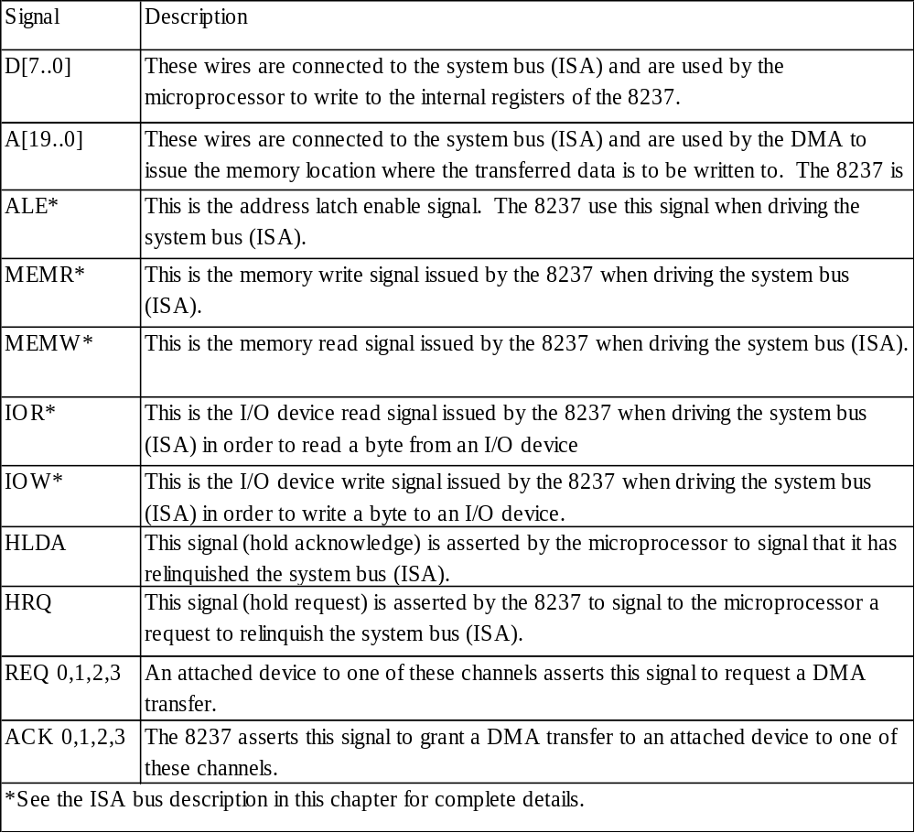
Intel 8237 DMA controller
D[7..0]
A[19..0]
ALE
MEMR
MEMW
IOR
IOW
HLDA
HRQ
Intel 8237
REQ 0
ACK 0
REQ 1
ACK 1
REQ 2
ACK 2
REQ 3
ACK 3

Slide 40
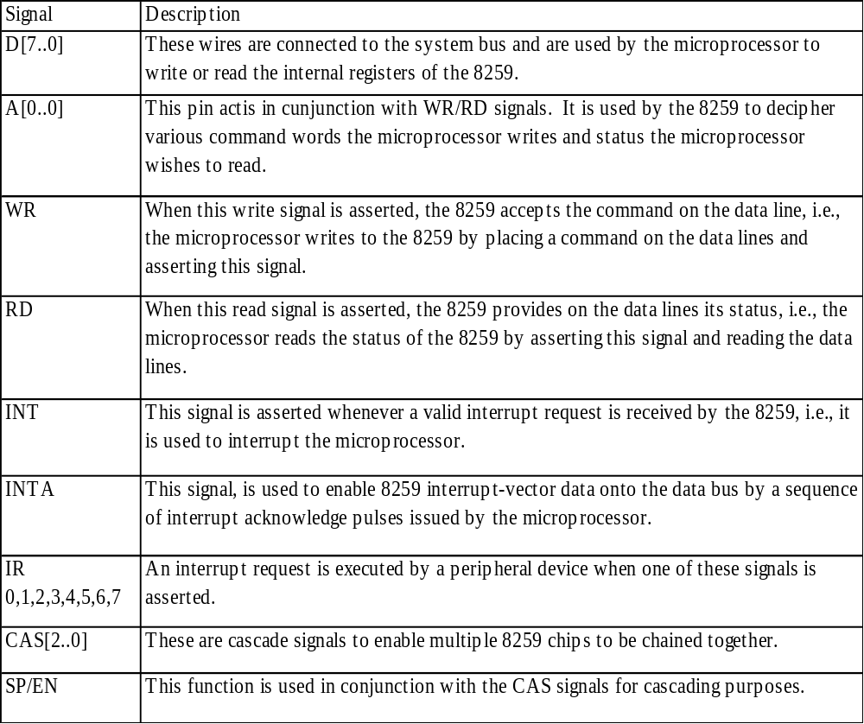
Intel 8259 programmable priority controller
D[7..0]
A[0..0]
RD
WR
INT
INTA
CAS[2..0]
SP/EN
Intel 8259
IR0
IR1
IR2
IR3
IR4
IR5
IR6
IR7

